Slide 1
Enhancing Mid-Career Excellence
Presentation by
The University Senates Conference
Academic Affairs and Research Committee
May 19, 2022

Slide 2
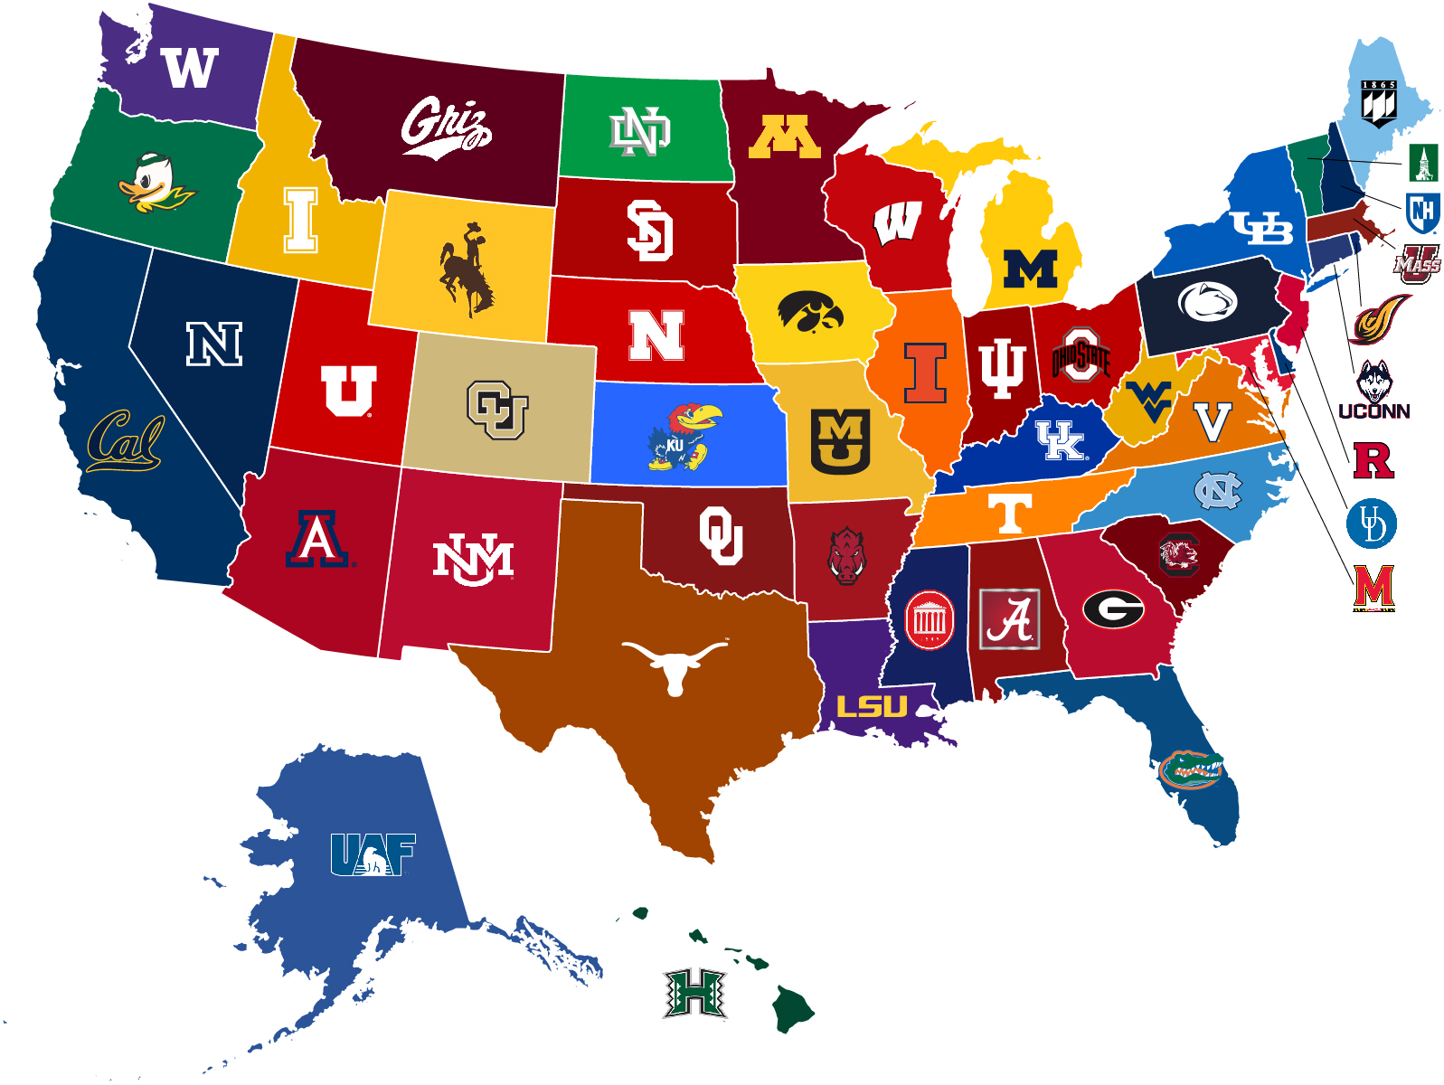
challenges
The challenges of mid-career professional development in higher education nationwide
Significant support system in place for junior faculty: research funds, mentoring, ongoing feedback and evaluations on performance
Limited corresponding support system in place for mid-career faculty
Joint AAUP Policy Committee & Provost Survey

Slide 3
Provost & OVCR Initiatives
Provost’s “Thriving as an Associate Professor” Series
Provost’s “Through the Faculty Ranks” Series
Provost Guidance & Initiatives for Academic Units
Provost Communication #9 “Public outreach & Service especially around DEI is to be considered for promotion & tenure decisions
OVCR Research and Development Project
But much is left to individual colleges and units

Slide 4
Leadership Fellowships
Provost’s Building Pathways for Emerging Leaders Fellowship
Big Ten Academic Alliance Academic Leadership Program

Slide 5
Faculty-Administrator Leadership Program (FALP) Highlight
Programs like these build upon support for leadership capacity at all colleges throughout the system

Slide 6
Mid-Career Leadership Training
Beginning 22/23, a temporary position was added- assistant to the provost for leadership training and development
UIS subscribes to several providers which offer on-going professional & leadership development

Slide 7
Reorganization & Development
Academic reorganization requires training of UEOS
Reinforce leadership development of current deans as well as two new deans

Slide 8
Establish Vision for Women in Leadership
Gender Inclusive Leadership Council
Recognition for Supporting Advancement
Provide Funding

Slide 9
Suggested Actions
Enhance resources system wide for mid-career faculty development
Annual reports from the universities to enhance accountability
Incentivize review of mentoring to units
Enhance leadership and training programs for managing people and budgets

Slide 10
Thank You

