Slide 1


University of Illinois
Alumni Association Update
September 17, 2026
David Bambrey, President (UIAA)
Notes:
1

Slide 2
Engagement Update
Notes:
1

Slide 3










Engagement Results
TOTAL ANNUAL ENGAGEMENT
32%
170,530
of Contactable Alumni Engaged
Experiential
Volunteer
Communication
Philanthropy
58,764
7,270
128,311
25,098
vs. 2024
vs. 2024
vs. 2024
vs. 2024
University of Illinois
Alumni Association

Slide 4
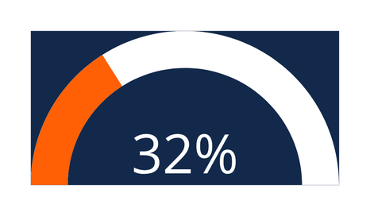

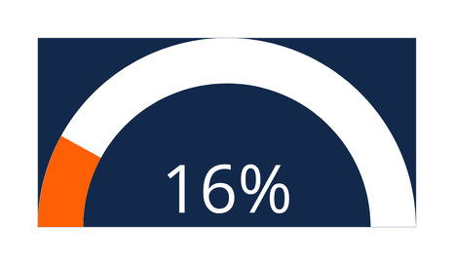
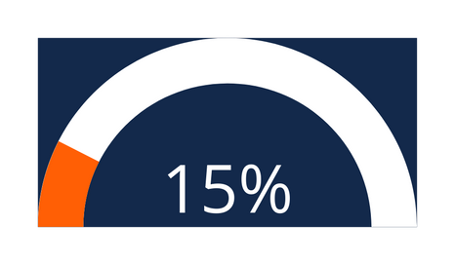
Benchmark Results
Illinois | Peers | US/Canada | All Respondents
+33% Higher Than Peers: Illinois outperforms direct peer institutions by 8 percentage points (32% vs. 24%).
2x National Average: Our engagement rate doubles the US/Canada higher education benchmark of 16%.
University of Illinois
Alumni Association

Slide 5
Spotlight Programs
Notes:
1

Slide 6

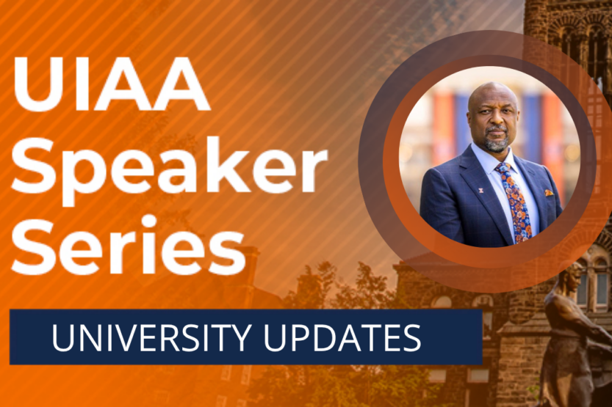
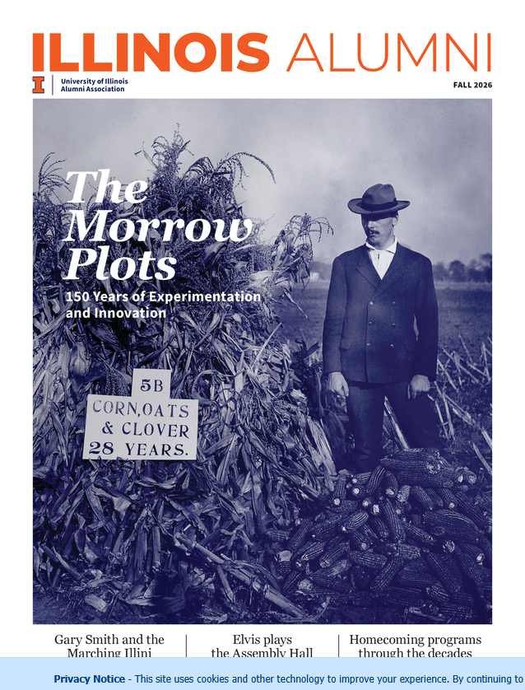
Virtual Engagement Programs
  IlliniLink:
    Online networking & mentorship platform
    17,000+ users (alumni, students and faculty/staff).
    Provides a way for alumni & students to interact at scale from wherever they are in the world!
  Speaker Series – Recent Sessions:
    A Closer Look at Undergraduate Admissions and Enrollment at Illinois featuring Sara MacKenzie
    A Conversation with Chancellor Isbell featuring Charles L. Isbell, Jr.
    Creating Breakthroughs: Harnessing Basic Science and Engineering to End Cancer featuring Rohit Bhargava
  Illinois Alumni (Digital Edition)
    Available for all alumni/constituents on the Alumni Association website.
      Physical copies are distributed quarterly to all Association members.
University of Illinois
Alumni Association
Notes:
15

Slide 7
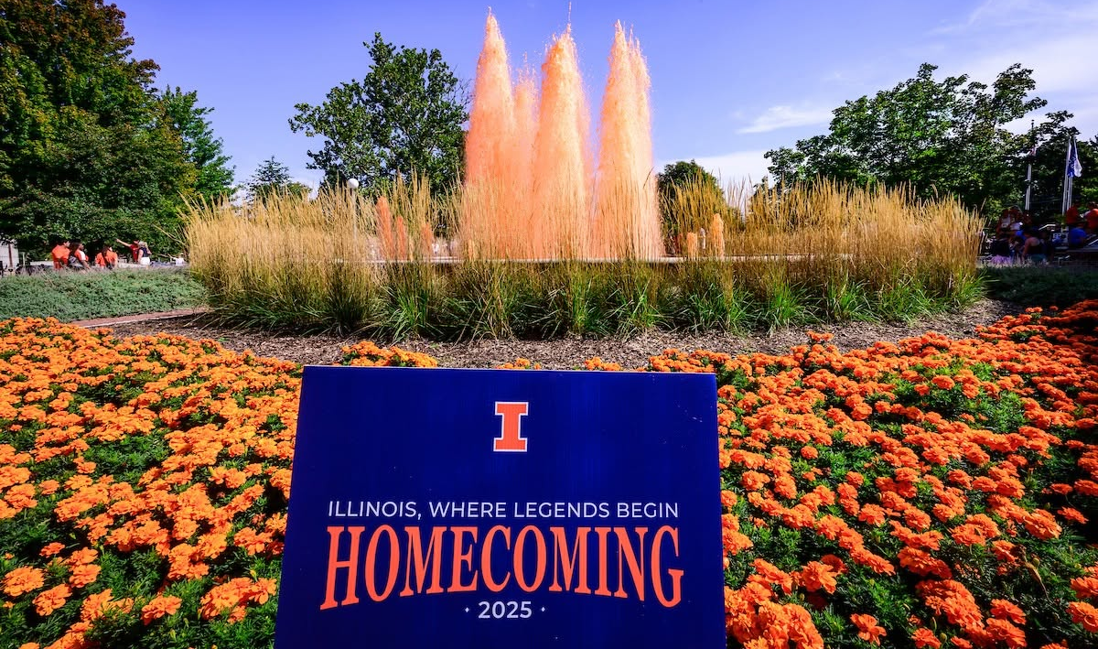
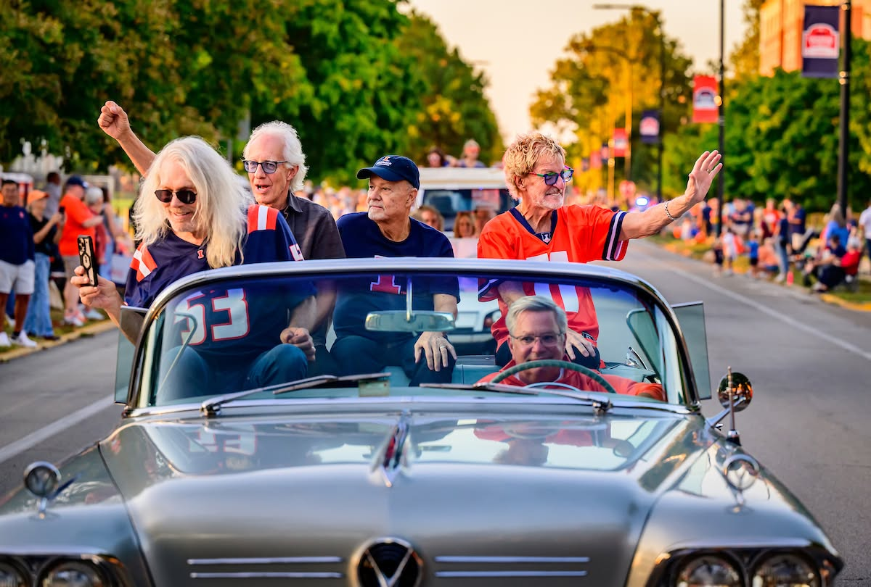
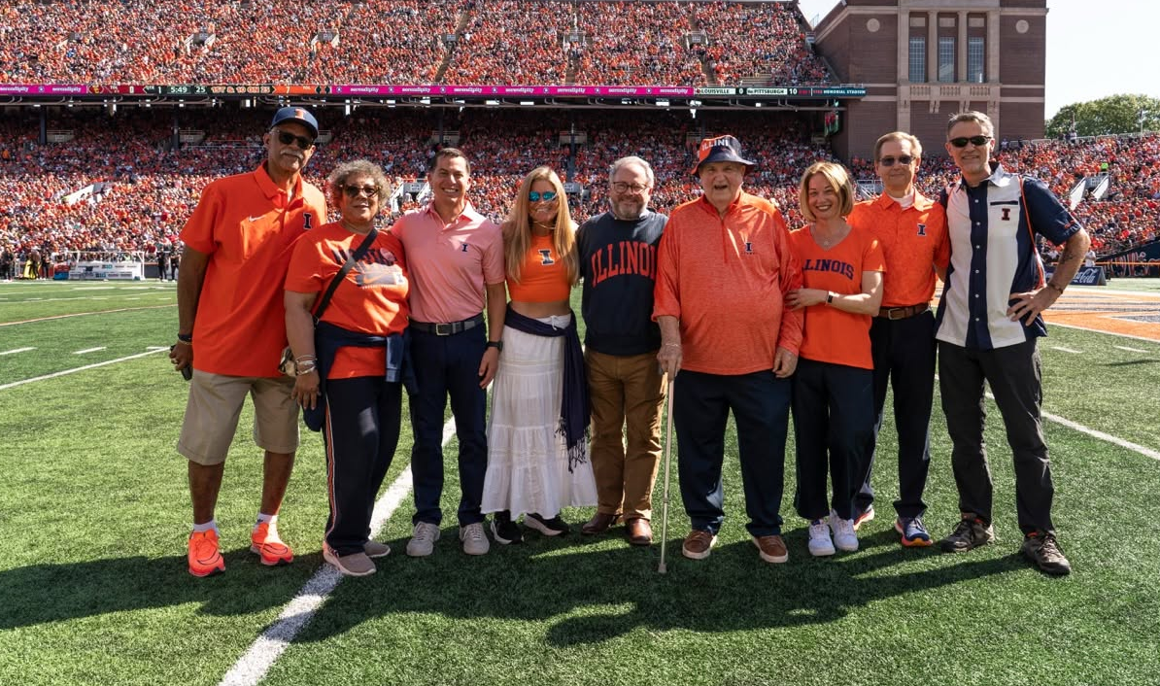
Homecoming: Sept 27- Oct 3
“Once an Illini, Always an Illini”
  Key Alumni Association Homecoming Events -
  September 27:
    Student Alumni Ambassadors Fun Run
    Fountain dyeing event
  October 1: Alumni awards gala
  October 2: Student leader luncheon & Homecoming parade
  October 3: Illinois vs. Purdue
  Visit homecoming.illinois.edu for more information and a full schedule of events.

Slide 8



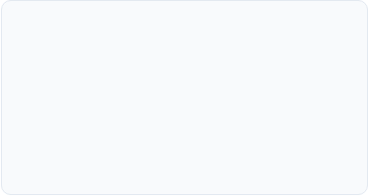
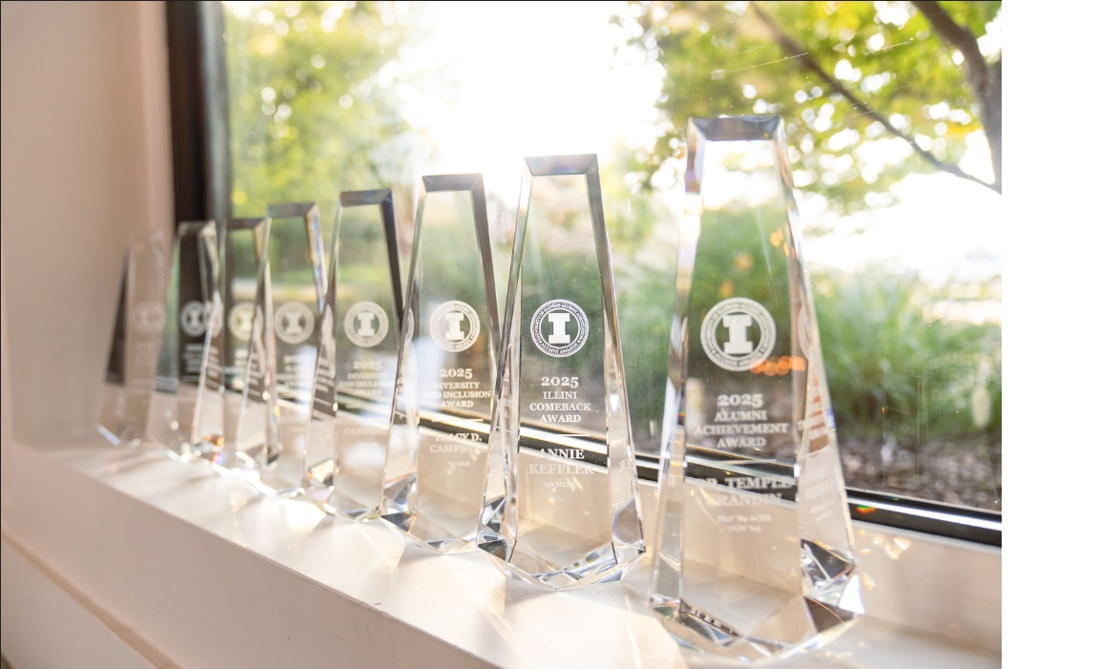



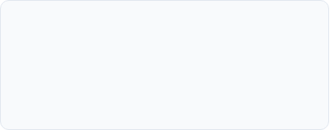


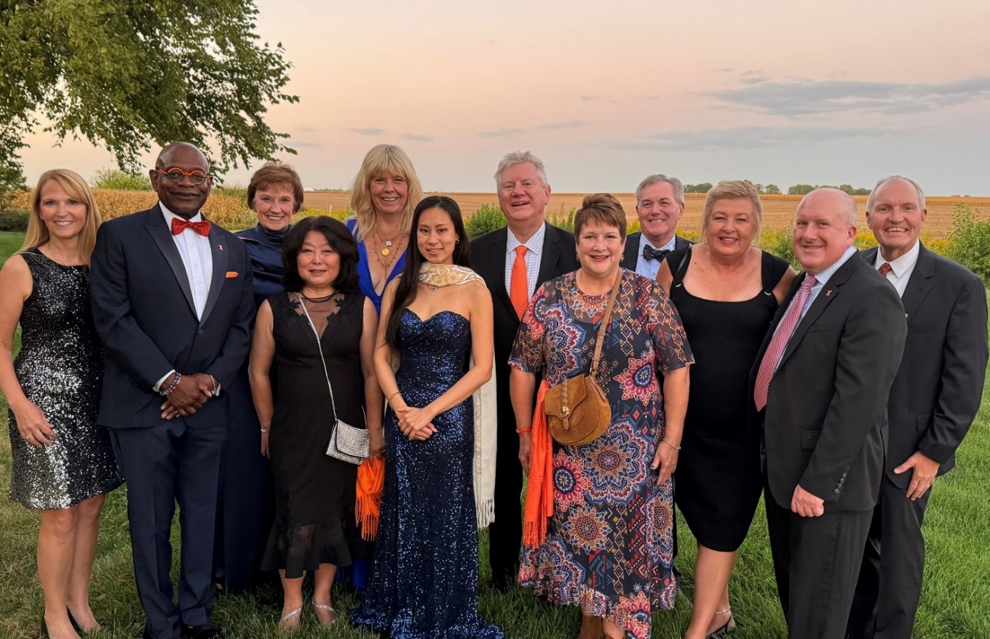




Homecoming: Alumni Awards
Honoring exceptional achievements, loyalty, and leadership across the Illini community
Alumni Achievement
Illini Comeback
Distinguished Service
Mike Hopkins
Chris Carpenter
Julia Whittington
Deb Neubek
Kate McMahon
University of Illinois
Alumni Association
Diversity & Inclusion
Young Alumni
Lou Liay Spirit
Fleda Mask Jackson
Kathryn M. Polkoff
Loren Tate
Honorary Alumni Award
Dan and Gina Hartleb
University of Illinois
Alumni Association

Slide 9
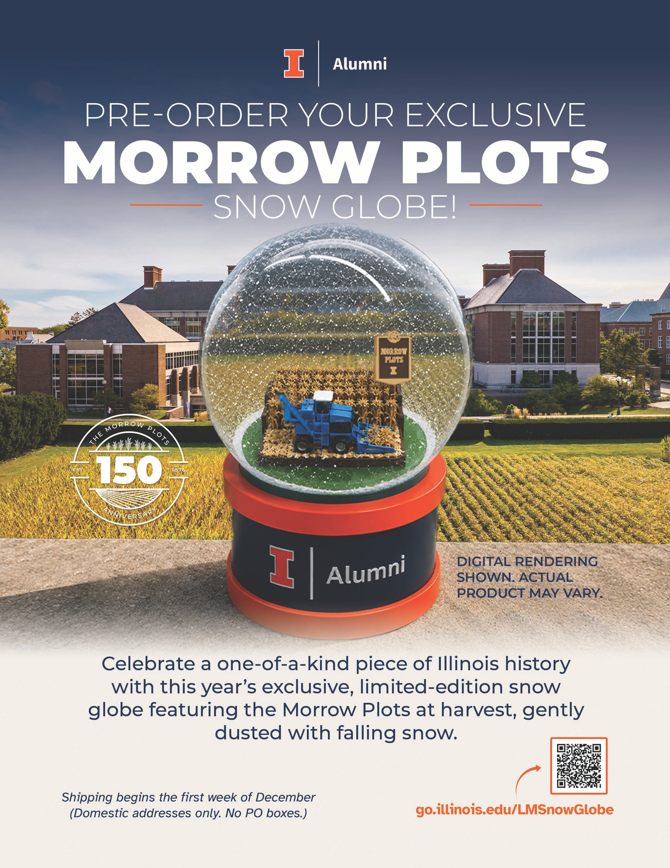
Snow Globe Program – Year 4
  Past Snow Globes Include: Alma Mater, Gies Memorial Stadium & Altgeld Hall
  Social Media “Influencers” Program: creating a network of alumni and friends to advocate on our behalf
  Stewardship and Philanthropy: working with the College of ACES to create unique stewardship and fundraising pieces for donors to the campaign.
University of Illinois
Alumni Association
Notes:
15

Slide 10
THANK YOU!
QUESTIONS
University of Illinois
Alumni Association

