Slide 1
UNIVERSITY SENATES
CONFERENCE
Presentation to the
Board of Trustees
Lynn Fisher, USC Chair
September 17, 2026

Slide 2
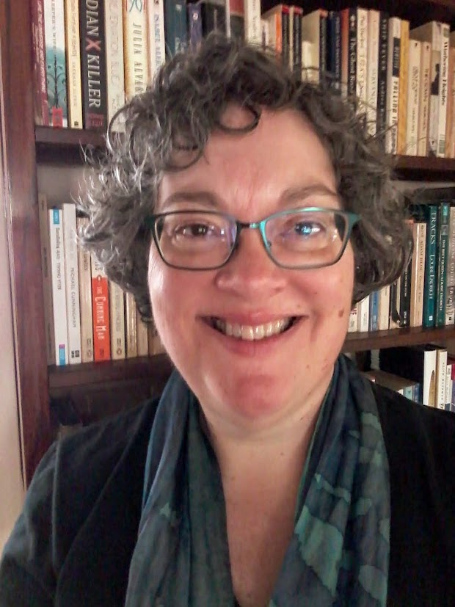
Lynn Fisher, USC Chair 26/27
Professor, Anthropology & Archaeology, UIS
Sociology/Anthropology Department
Ph.D., University of Michigan; B.A. Oberlin College
Teaching: archaeology, world prehistory, biological & general anthropology; emphasis: hands-on, research skills
Research: social change and technology in Neolithic farming societies, Germany; current focus: flint mines
Service: former chair of UIS Campus Senate, former department chair
About UIS: liberal arts focus, small class size, ability to pursue research interests

Slide 3
University Senates Conference (USC)
Provides a link between the senates of the three universities
  Review actions of senates
  Promote agreement among the senates in matters of university-wide relevance
Advises on revisions to the Statutes and General Rules
Acts as an advisory group to the President and the Board of Trustees (through the President)
Notes:
A statutory body; three primary functions as laid out in Statutes; USC reviews “all matters acted upon by each university senate” (Statutes II.2.b)

Slide 4

USC and the Senates
  USC members are elected representatives of their senates
  Senates exercise legislative functions in matters of educational policy
  Each senate has its own bylaws and committee structures (Executive Committee, Academic Freedom & Tenure, Library, Student Discipline, and more)
  Senates represent faculty, students, and staff

Slide 5
USC Membership 2026-2027
UIC | UIS | UIUC
Annette Carmichael | Kristi Barnwell | Kate Clancy
Larry Danziger | Lynn Fisher | Toni Gist
Sandra De Groote | Matt Geras | Holly Golecki
Danilo Erricolo |  | Linda Herrera
Kate Floros |  | Rob Kar
Steven Schwinn |  | William Maher
Donald Wink |  | Linda Moorhouse
 |  | Neil Pearson
 |  | Charles Roseman
 |  | Josie Rudolphi
Notes:
Committee of 20 members from our three universities; members elected for three-year terms by the individual senates; representation is proportional to size of faculty – 7 from Chicago, 3 from Springfield, 10 from Urbana-Champaign; leadership typically rotates among the three universities. Members are full-time faculty who work around their own campus teaching, research and service to serve on USC, often in a sustained way.

Slide 6
USC Committee Structure
Executive Committee 26/27
Lynn Fisher, Chair (UIS)
Linda Moorhouse, Vice Chair (UIUC)
Kristi Barnwell (UIS)
Sandra De Groote (UIC)
Kate Floros (UIC)
William Maher (UIUC)
Three Standing Committees
Academic Affairs and Research
Finance, Budget, and Benefits
Statutes and Governance

Slide 7

Ongoing Activities & AY 26/27 Priorities
Promoting agreement among senates on proposed revisions to the Statutes, ST-83, ST-91 and more
  2024-25: Three senates review and comment on ST-83 (Aug. 24 version)
  2025-26: Review senate comments, consult with EVP advisory group
  2026-27: Prepare suggested statutory revisions for senate review
Input on System policies shared by President’s office
Proposed symposia: Public Education for the Public Good
USC retreat, Oct. 19-20 – Strengthen shared governance, collaboration across universities to meet current challenges
Notes:
Retreat topics re current challenges: developing focus on developing and sharing resources on student mental health and AI in the classroom

Slide 8
To work for the greater good of the University of Illinois and all of its universities.
OUR MISSION
We invite Board members to share thoughts and priorities regarding shared governance and the relationship of the Board with USC.
Lynn Fisher
USC Chair
Email: lfish1@uis.edu
Phone: 217.206.7938
David Perryn
USC Administration
Email: dperryn@uillinois.edu
Phone: 217.300.7448
University Senates Conference

