Slide 1



Launch

Slide 2

Why Illinois Leads
This plan is about leading together, serving the public good, and being good ancestors.

Slide 3

How Illinois Leads
This plan helps us to match limited resources with a shared vision.

Slide 4

What Illinois Leads
Illinois will lead by influencing every important political, social, and technological decision in the world.

Slide 5

Developing the plan
Understanding the higher ed landscape
Bringing people together
Listening to those we serve
Shaping insights to lead
Lives within the larger Illinois public ecosystems

Slide 6

The Plan

Slide 7
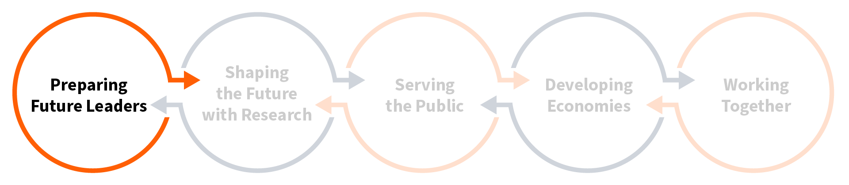
Goal 1
Illinois leads by preparing future leaders.

Slide 8
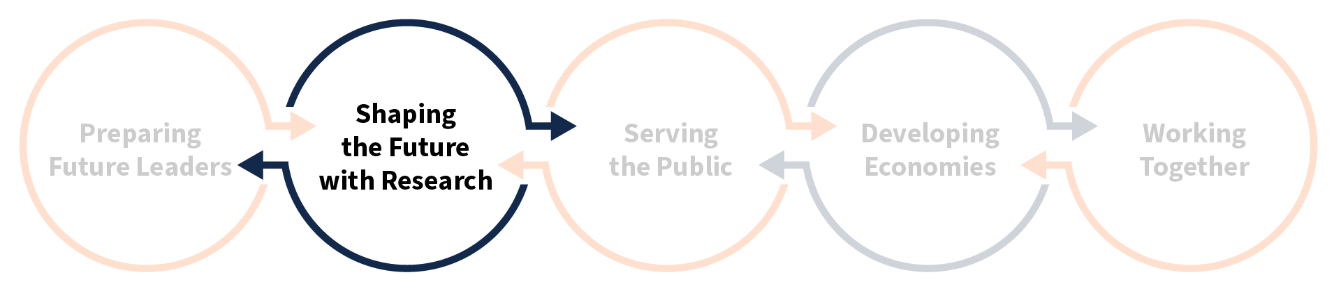
Goal 2
Illinois leads by shaping the future with research.

Slide 9
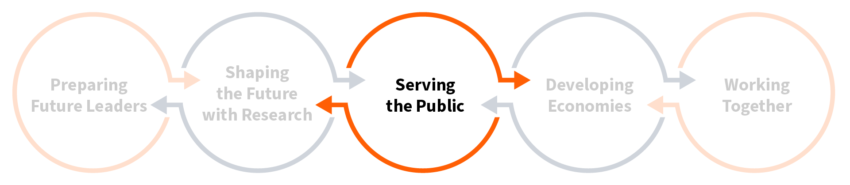
Goal 3
Illinois leads by serving the public.

Slide 10
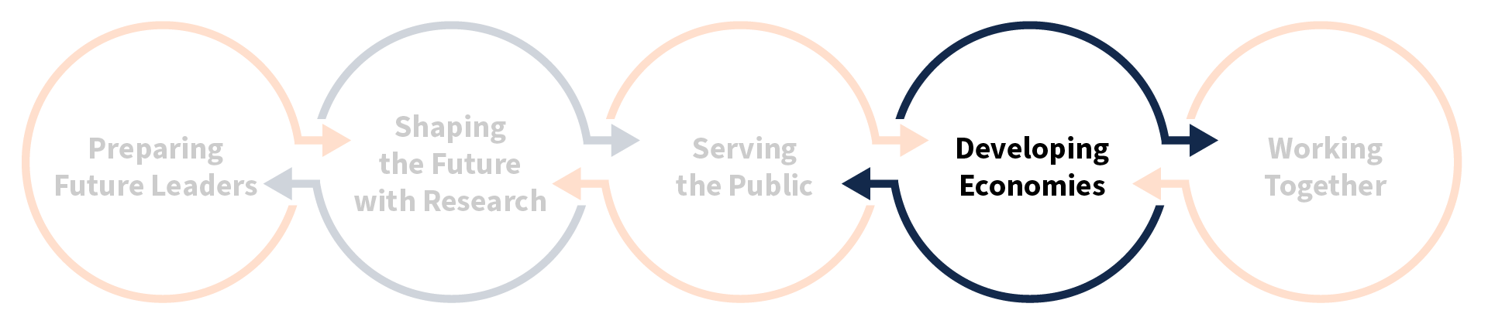
Goal 4
Illinois leads by developing economies.

Slide 11
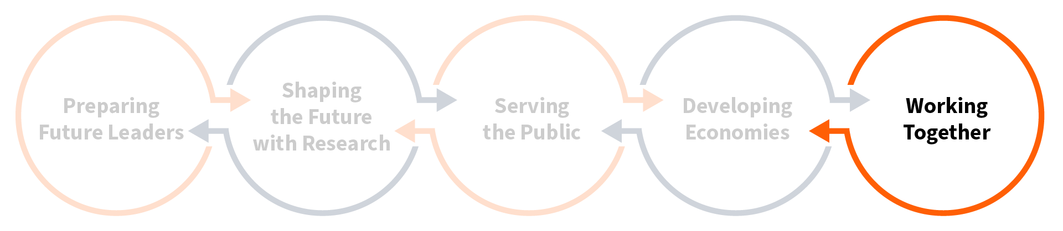
Goal 5
Illinois leads by working together.

Slide 12

Implementation

Slide 13





Implementation Framework
Layer 3
Measurement, Storytelling, and Thought Leadership
The evidence of progress and the account the university gives of it
Layer 2
People, Coordination, and Belonging:
The ownership and collaboration that advance the work
Layer 1
Goals, Strategies, Tactics:
The substance of the plan, from intent to action
Layer 0
Foundational Systems:
The infrastructure that supports the work
13

Slide 14

Steering groups
Inclusion, accountability, and responsiveness are central.

Slide 15

Unit guidance
We want every member of the university community to see themselves in the plan.

Slide 16

strategicplan.illinois.edu
Access the Plan

