Slide 1
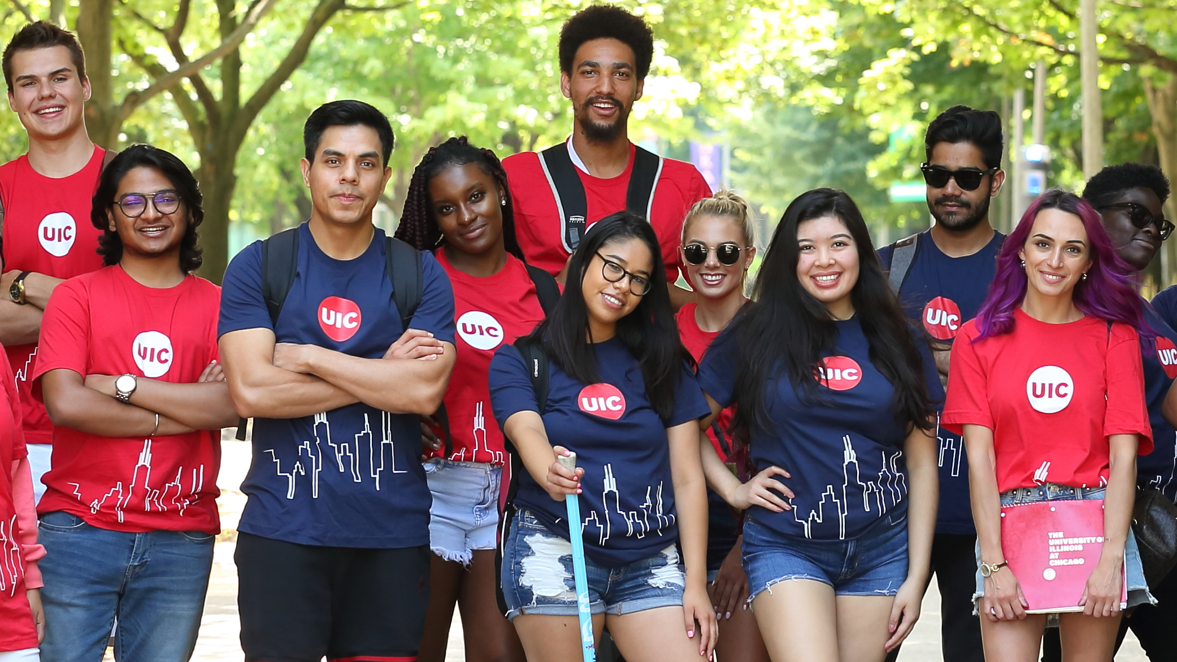
UIC Alumni Association Board of Trustees Meeting | January 15, 2026

Slide 2
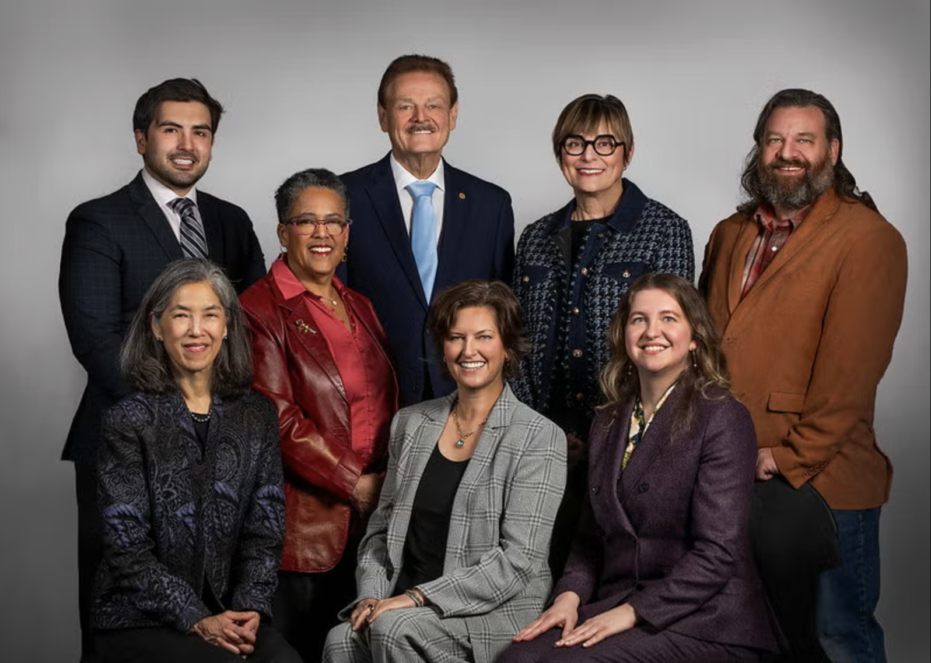

UIC’s mission is to provide the broadest access to the highest levels of educational, research and clinical excellence.
The UICAA’s initiatives and events are planned and built with this mission in mind, considering how we and our alumni can realize it at UIC and demonstrate it in our lives and work.

Slide 3

UIC at a Glance
TOP 50
2025 FALL ENROLLMENT
TOP 30
Social Mobility
35,869
Public University
Ethnically Diverse
#1
in Illinois​
U.S. News & World Report
LARGEST IN UIC HISTORY
U.S. News & World Report
Best bang for the buck Midwest
almost
16 TOP-RANKED
Also, ranked #9 nationally - leading in increasing access to higher education and creating pathways to economic success.
#1
colleges, including seven health sciences colleges and Chicago’s only public law school
13,000
full-time employees
Washington Monthly
The Wall Street Journal
Notes:
UIC’s mission is to provide the broadest access to the highest levels of educational, research, and clinical excellence. We are Chicago’s only public research university, with a powerful legacy of social justice that builds on the work of the legendary social reformer Jane Addams.
We are a minority-serving institution; over 50% of our students are Pell-eligible; roughly half are first generation; and our clinics and hospital focus on the most underserved communities in Chicago and across the state.
At the same, our faculty compete their ideas nationally and internationally and annually land half a billion dollars in research funding. We are all about ACCESS and EXCELLENCE and believe that both can be achieved simultaneously.

Slide 4
UIC Students
35,869 overall enrollment
24,260 undergraduate
7,341 graduate
4,268 professional
56% of our students are Pell-eligible
Roughly half are first generation college students
A federally designated Minority- Serving Institution
UIC has also been designated an ‘Opportunity University’ by the Carnegie Foundation, recognizing us as a national model for providing high access and higher earnings after graduation
#1 in Illinois and Top 10 nationally for Social Mobility
1 in 3 students speak a language other than English at home

Slide 5

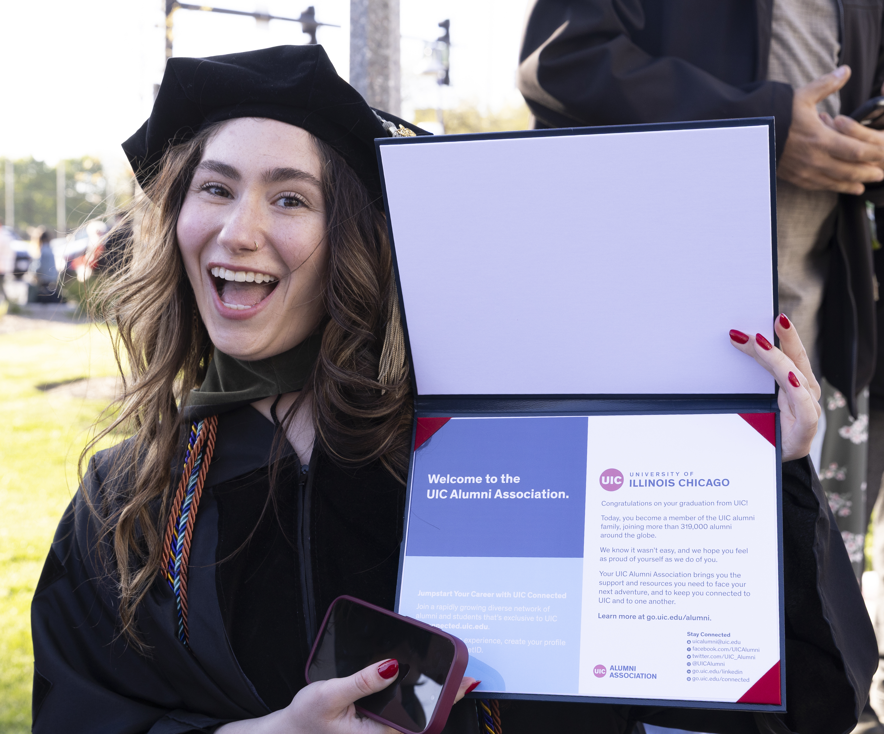
UIC Alumni
Of our 360,000 UIC alumni, more than 70% stay in Illinois
In the State of Illinois, UIC produces 1 out of 3 pharmacists and dentists
UIC is the state's principal educator of health professionals and a major health care provider to underserved communities
More than 8,000 nurses in Illinois attended UIC
1 in 5 Chicago Public Schools principals or assistant principals trained at UIC
1 in 7 Chicago Public Schools students engaged with a UIC-prepared teacher
Nearly 1 in 4 Illinois social workers are trained by the Jane Addams College of Social Work

Slide 6
UIC Alumni Association

Slide 7
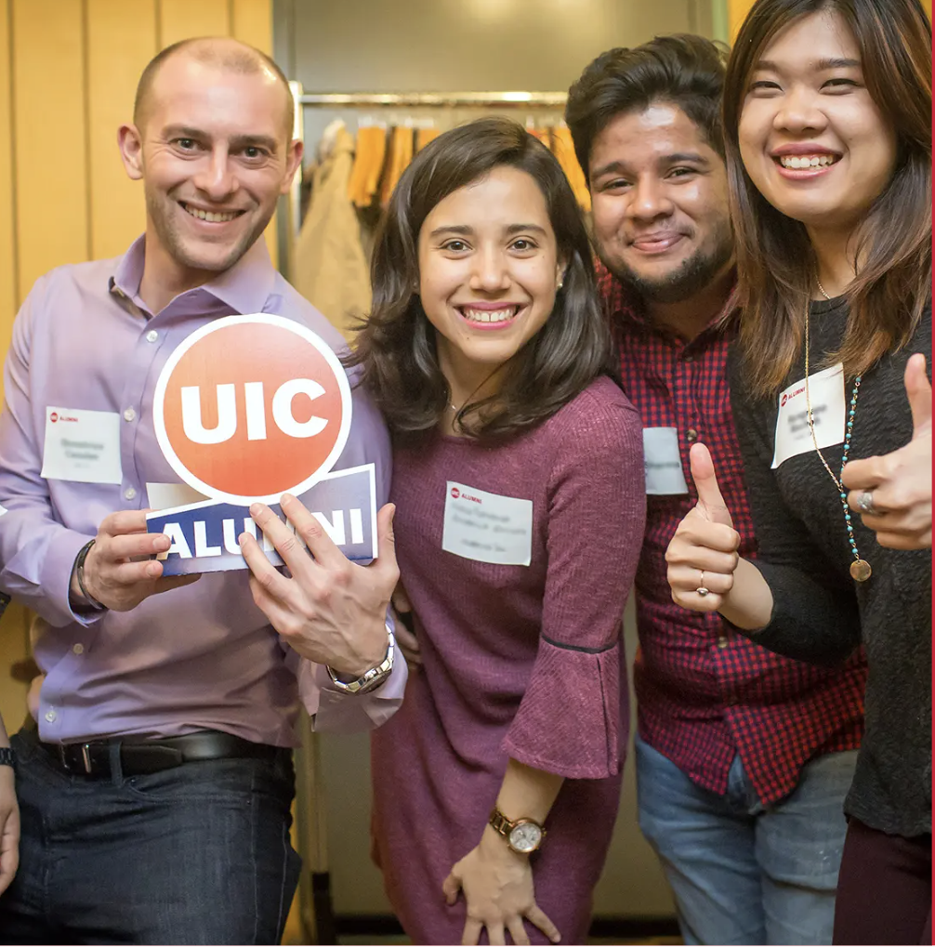
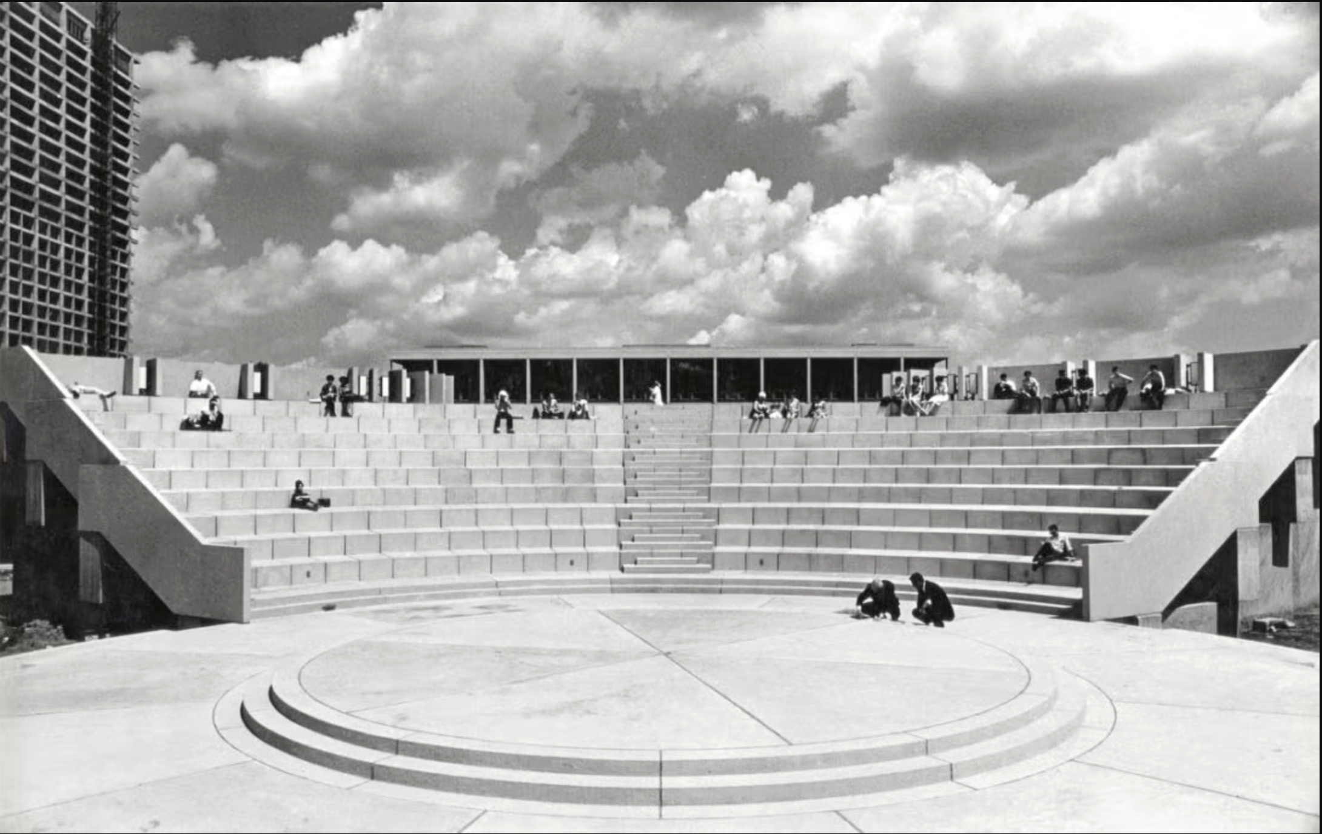
History of Alumni Relations at UIC
University of Illinois Alumni Association is founded UIAA
Westside Office of Alumni Relations opens in Chicago
Leadership change UIAA President/CEO
UIAA Chicago office opened
UIC Alumni Board founded
1965
1983
2015
2017
1873
1966
1998
2016
2020
UIC Circle campus opens
Consolidation of east/west campuses to create UIC
Organizational change and assessment of UIAA services
UIC-UIAA office closed
UIC Alumni Association launched

Slide 8
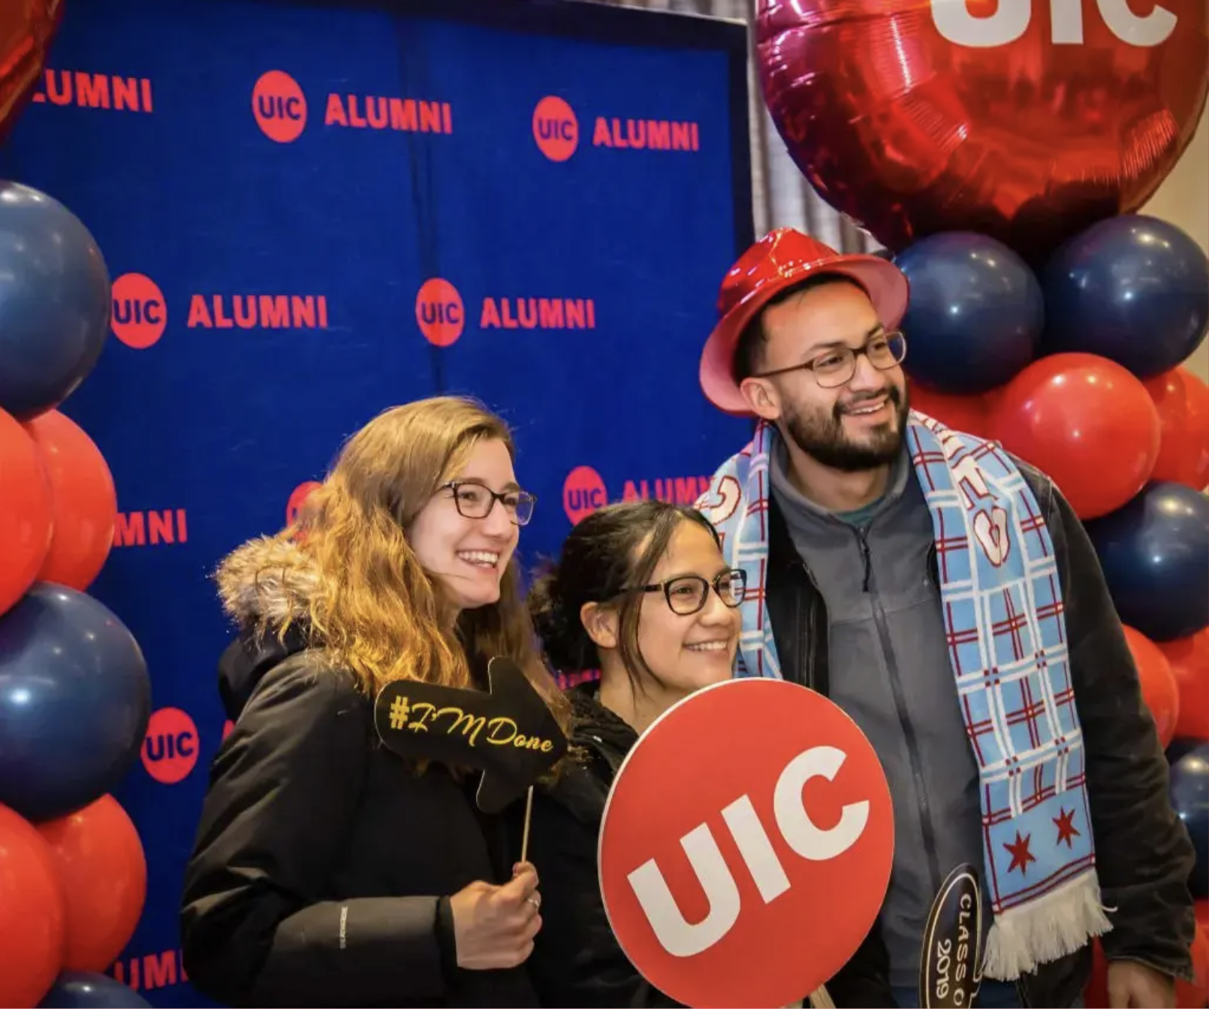
Alumni and Donor Engagement
The Alumni and Donor Engagement Team (ADE) in the Office of the Vice Chancellor for Advancement cultivates lifelong relationships with alumni and donors through meaningful engagement and volunteer opportunities. This builds a strong pipeline of support through annual gifts, which we steward consistently. These relationships lead to major- and principal-level gifts, and advance UIC’s mission.
Notes:
BIG 3 – Regional Program

Slide 9
Alumni and Donor Engagement Team
Office of the Vice Chancellor for Advancement
Alumni and Donor Engagement (ADE)
UIC Alumni Association
Inclusive Engagement
Special Events
Annual Giving
Stewardship and Donor Relations
UICAA Board
Notes:
BIG 3 – Regional Program

Slide 10
Alumni Board Structure
Leadership Committee
Advocacy
Awards and Nominations
Student and Recent Alumni
Alumni Loyalty and Outreach
Alumni Career Services

Slide 11
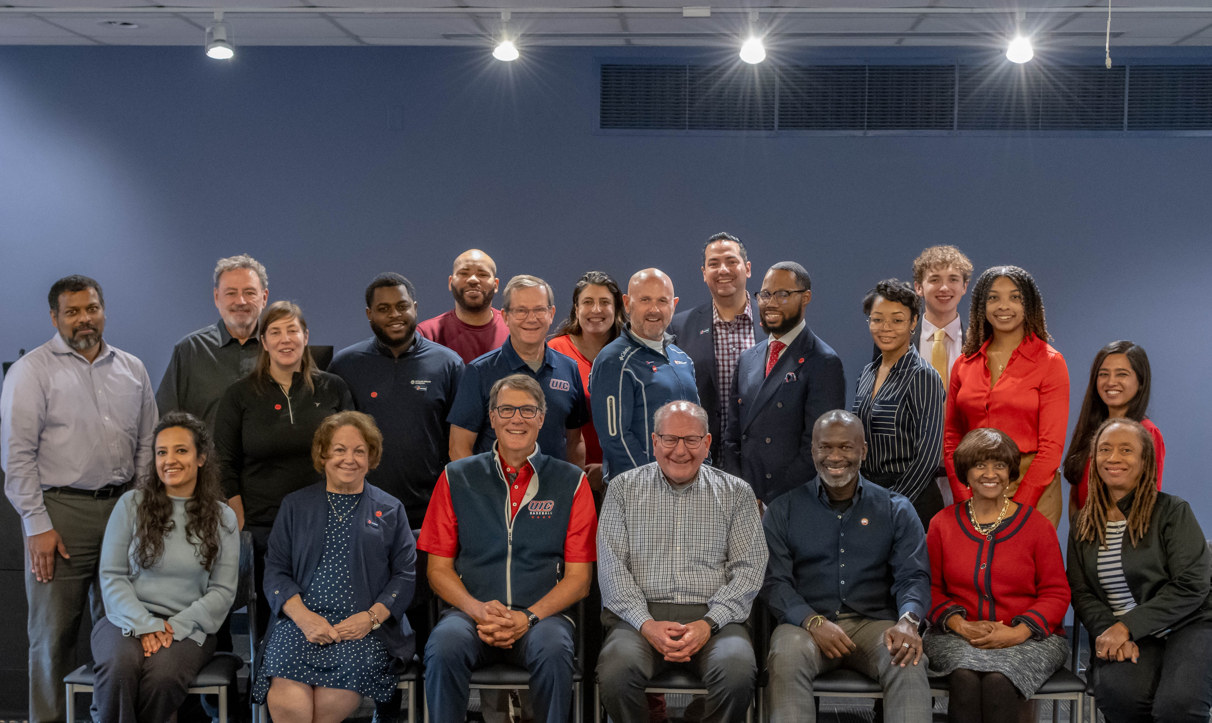
Alumni Board Mission
The University of Illinois Chicago Alumni Board is charged with advancing alumni relationships with the university to support student success, encourage connections among alumni and promote advocacy that drives UIC’s mission. The UIC Alumni Board advises on and supports meaningful alumni engagement that connects UIC alumni to one another and the university.
Notes:
BIG 3 – Regional Program

Slide 12
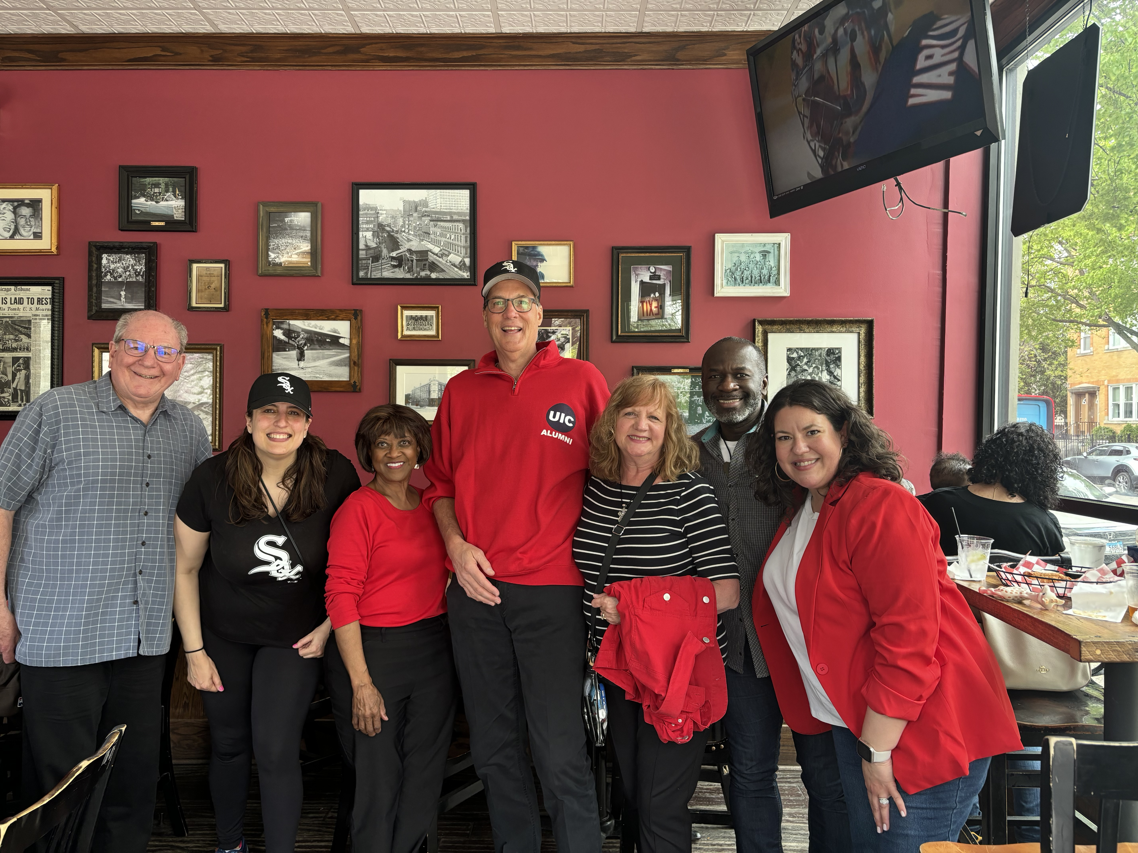
Alumni Board Demographics
39 TOTAL MEMBERS
Age
21–34 (23.08%)
35–44 (23.08%)
45–54 (30.77%)
55–64 (7.69%)
65+ (15.39%)
Gender
Women (53.85%)
Men (46.15%)
Race & Ethnicity
African Heritage/Black(30.77%)
Asian/Southeast Asian (12.82%)
Hispanic/Latino(20.51%)
White(35.9%)
As of 07/01/2025

Slide 13
UICAA Alumni Engagement
Volunteerism
Countless ways to give back and stay connected, including serving as class agents and on alumni panels, judging student research, affinity groups and the Volunteer Admissions Program.
Alumni Program and Events
Signature programs that create meaningful opportunities for alumni to connect with peers, students, donors and the university community.
Lifelong Alumni Career Connections
UIC Connected and Flames Connect put alumni and students together for guidance, career insights, and networking opportunities that strengthen lifelong connections.

Slide 14
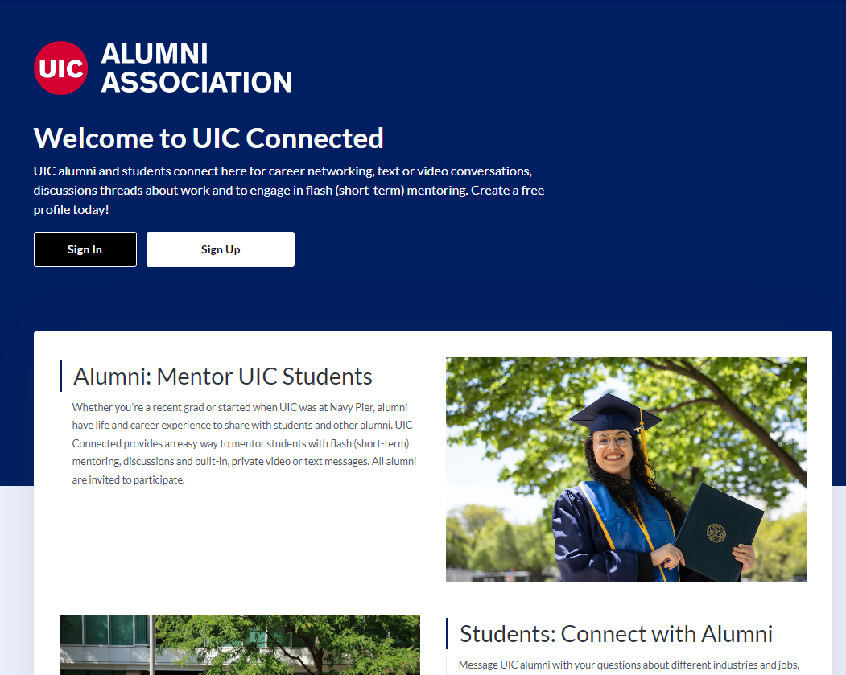
Lifelong Alumni Career Connections
UIC CONNECTED: NETWORK, MENTOR AND HIRE
UIC Connected is an exclusive virtual network where alumni can connect with fellow alumni and current students for mentorship, networking and career growth.

Slide 15
Lifelong Alumni Career Connections
PROGRAMS
Flames Connect
Mentoring initiative that invites alumni to connect with students, share their unique experiences and provide career guidance.
UIC Alumni Exchange
A virtual learning series that brings alumni and faculty experts together to share insights on politics, history, career development and more.
Alumni Coaching Network
Alumni help peers develop leadership skills and make career changes.

Slide 16
Unique Volunteerism
Affinity Groups
Alumni Affinity Networks bring together UIC graduates who share common identities, interests or experiences to foster community, connection and support.
Alumni Judges
Alumni judges assist in evaluating the quality of student presentations and identify those to be awarded.
Alumni Admissions
Connects UIC graduates with prospective students to share personal experiences and help inspire and inform future Flames, offering authentic insights that strengthen UIC’s commitment to access and student success.

Slide 17
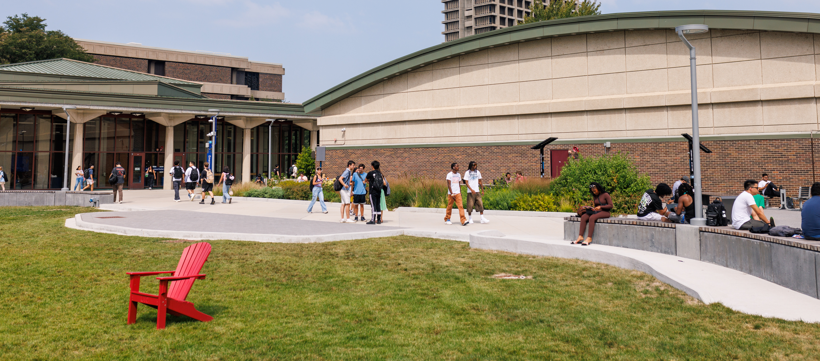
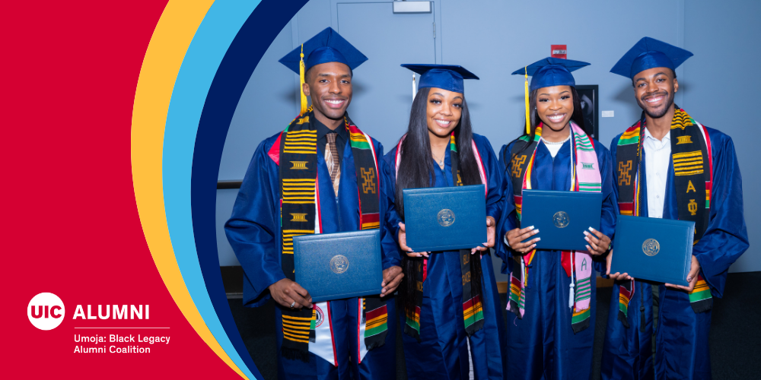
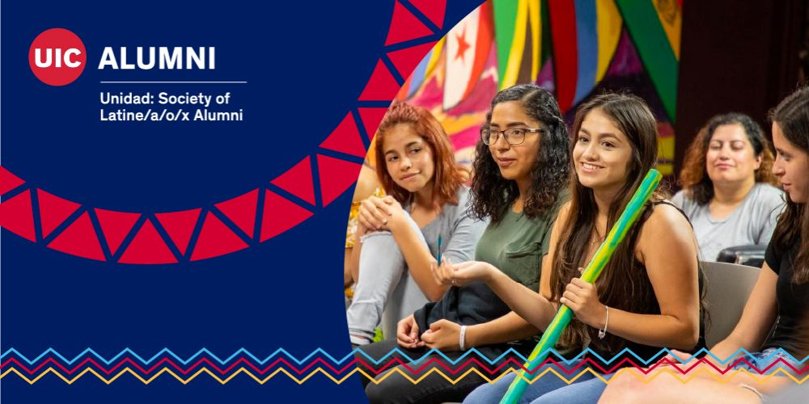

Alumni Affinity Networks
UMOJA: Black Legacy Alumni Coalition
UNIDAD: Society of Latine/a/o/x Alumni
Lavender Circle

Slide 18
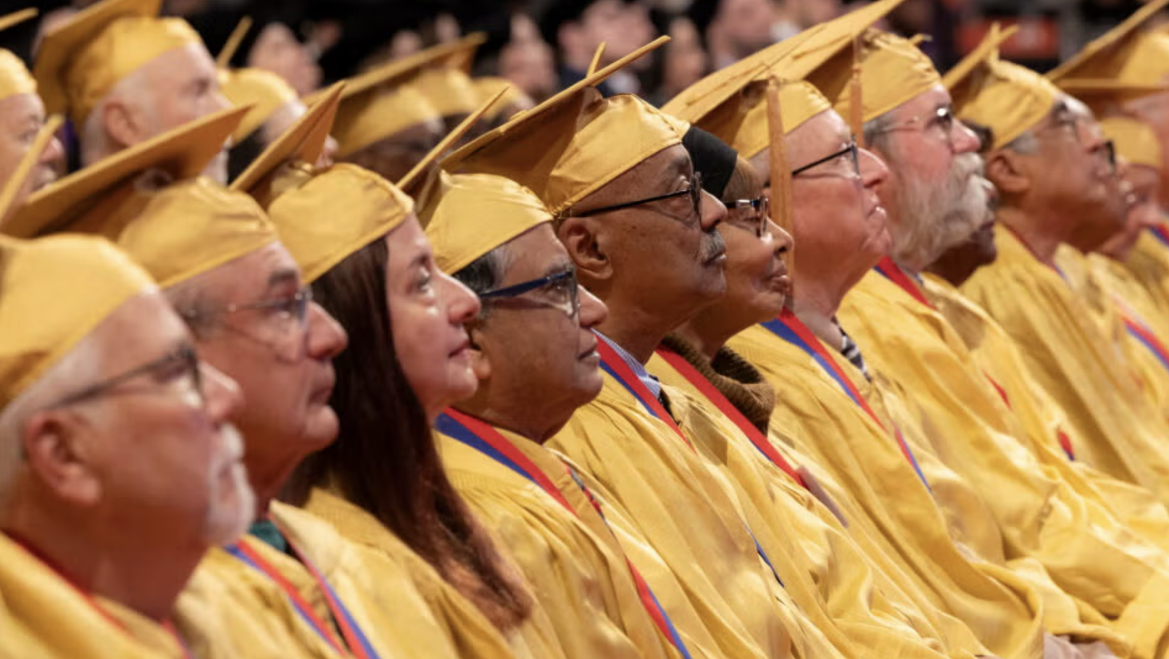

Golden Graduation Ceremony
SIGNATURE ALUMNI EVENT
Honored Class of 1975 at Commencement Ceremony
Golden Grads 50th Anniversary Medallions
Golden Grads Giving Campaign: $128,382

Slide 19
Preparing for the Next Campaign

Slide 20
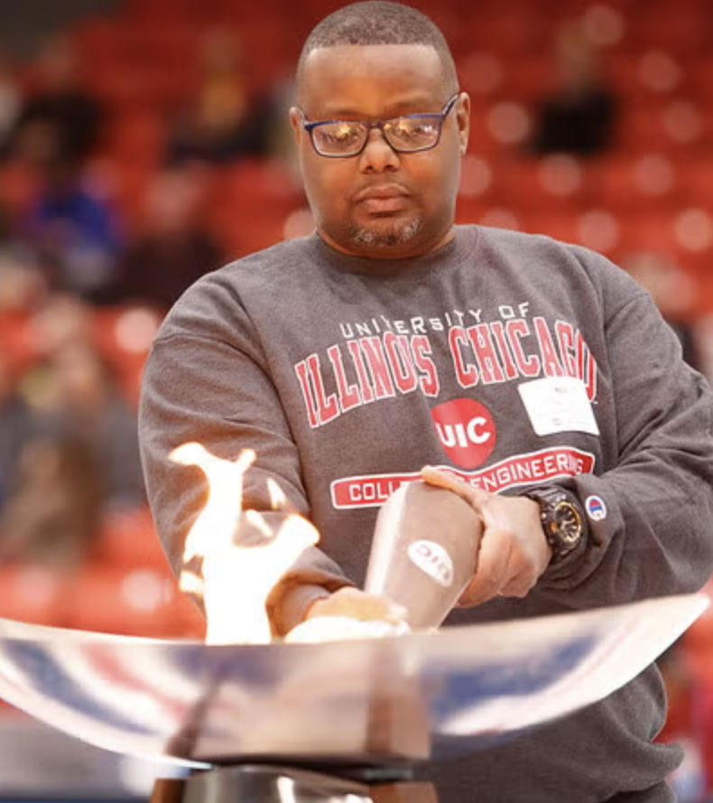
Alumni Engagement Metrics Framework
Philanthropic Giving and financial support
Volunteer Time and service contributions
(AEM)
Strengthen alumni relationships
Drive philanthropic outcomes
Inform strategic planning
Benchmark against peer institutions
FOUR MODES OF ENGAGEMENT
Experiential Event attendance and participation
Communication Interactions via email, social media
Notes:
Engagement is counted if alumni participate in at least one mode per year.

Slide 21
UIC Alumni Association
FY25 ENGAGEMENT METRICS
50,000+ TOTAL ALUMNI REACHED
42.78% E-NEWS OPEN RATE
~8,000 UIC CONNECTED USERS
~850 VOLUNTEER PARTICIPATION
~3,200 EVENT ATTENDANCE
Current snapshot of key metrics

Slide 22

Opportunities for Growth and Pipeline Building
Individual Alumni Engagement
Advocacy
1. Deepen personal connections and increase participation 2. Manage individual alumni engagement plans
Build a strong network of alumni advocates to promote university interests
Alumni-Student Mentoring
Enhance Alumni Communication
Grow more meaningful, career-focused relationships between alumni and students
Use digital channels and personalized content
Expand UIC Alumni Volunteer Opportunities
Philanthropic Growth
Target lapsed donors with segmented campaigns and impact storytelling
Build a more unified, visible and accessible alumni volunteer ecosystem across UIC

Slide 23
Thank you!
Damaris Tapia
Executive Director, UIC Alumni Association
dtapia@uic.edu

