Slide 1
Academic Freedom:
A Brief History
prepared for the
Board of Trustees
presented by: Carol Symes, Department of History, UIUC University Senates Conference January 18, 2024

Slide 2
Charting 150 years
of promise and progress
University of Illinois Press, 2017

Slide 3
What is academic freedom?
liberty to pursue knowledge
the protected freedoms of
rigorous inquiry and disciplined research
not only for academic faculty and students but for society at large
unlike freedom of speech, it is bounded by disciplinary training and expertise
Notes:
3

Slide 4
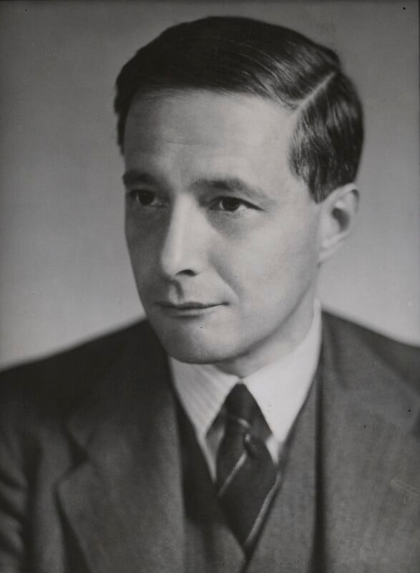
History of academic freedom
Wilhelm von Humboldt
(1767-1835)
Michael Polanyi
(1891-1976)

Slide 5
An Ancient Scientific Revolution:
Discoveries in Alexandria, 3rd c. BCE
Heliocentric universe
Earth’s circumference
Atomic theory
Law of specific gravity
Scientific anatomy
Circulation of blood

Slide 6
Measuring and Mapping
Euclid (c. 300 BCE)
Aristarchus of Samos (d. 230 BCE)
Eratosthenes of Alexandria (d.196 BCE)
Physiology and Physics
Herophilus of Chalcedon (d. 280 BCE)
Erasistratus (d. 250 BCE)
Archimedes of Syracuse (d. 212 BCE)

Slide 7
Measuring and Mapping
Euclid (c. 300 BCE)
Aristarchus of Samos (d. 230 BCE)
Eratosthenes of Alexandria (d.196 BCE)
Claudius Ptolomaeus (2nd c. CE)
Physiology and Physics
Herophilus of Chalcedon (d. 280 BCE)
Erasistratus (d. 250 BCE)
Archimedes of Syracuse (d. 212 BCE)
Aelius Galenus (2nd c. CE)

Slide 8
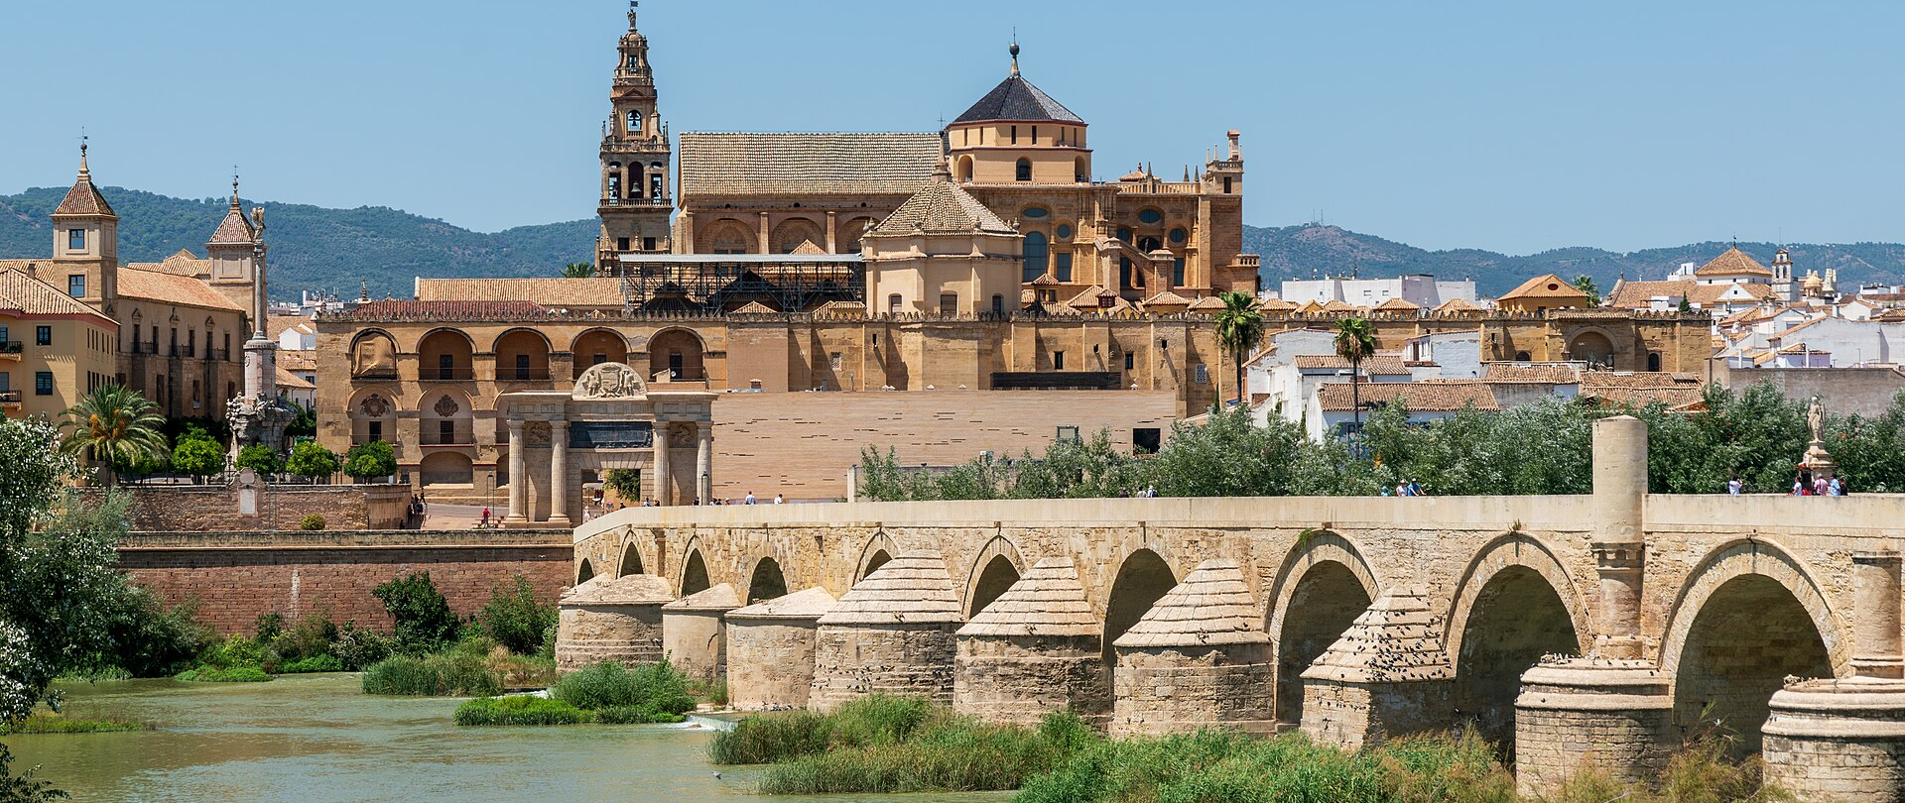
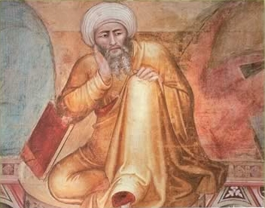
medieval Córdoba
(Muslim Spain)
Ibn Rushd, “Averroes”
(1126-1198)
mathematics, medicine,
astronomy, physics

Slide 9
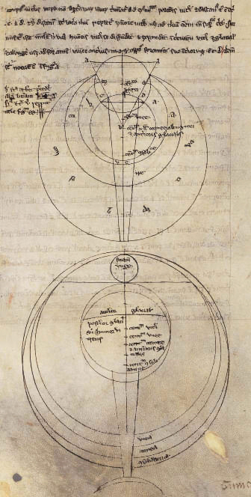
Studies in optics:
Opus Maius
of
Roger Bacon
(1219-1292)
Averroës depicted
in a 14th-century
Italian fresco
Ibn Rushd, “Averroës”
(1126-1198)
mathematics, medicine,
astronomy, physics

Slide 10
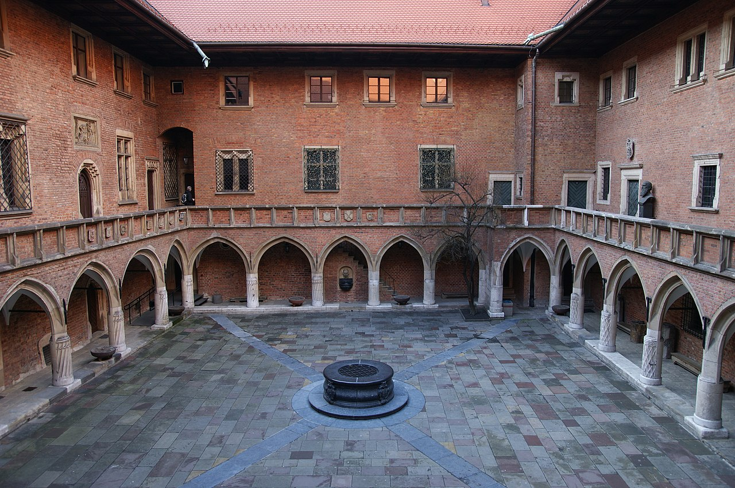
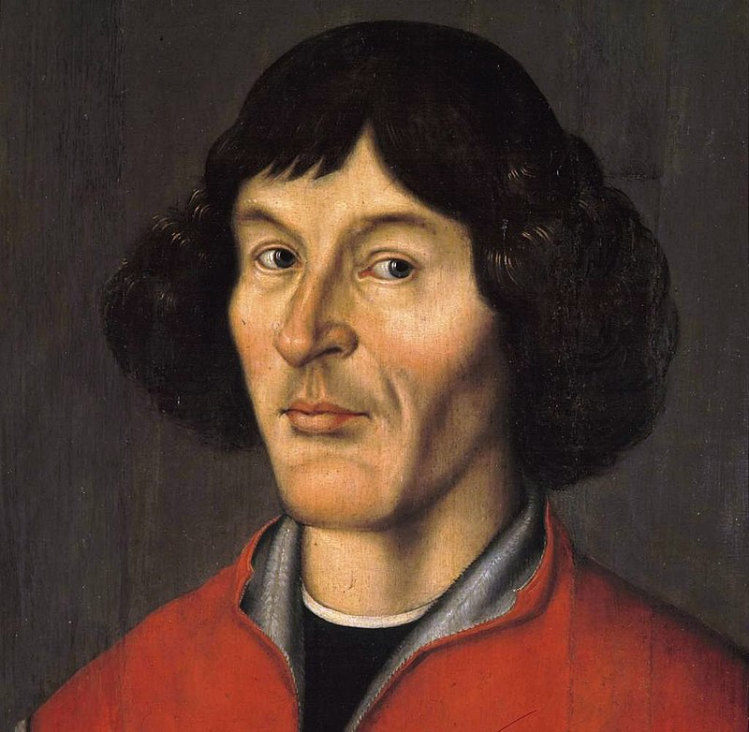
Nicolaus Copernicus
(1473-1553)
Collegium Maius
of the
Jagiellonian University,
Kraków
(founded 1364)

Slide 11
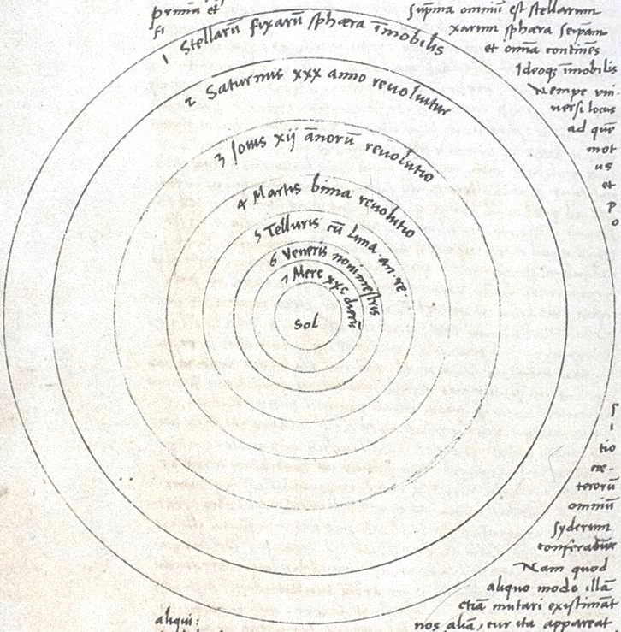
Heliocentric universe
Nicolaus Copernicus
(1473-1553)
Autograph manuscript
drawing of the
heliocentric universe

Slide 12
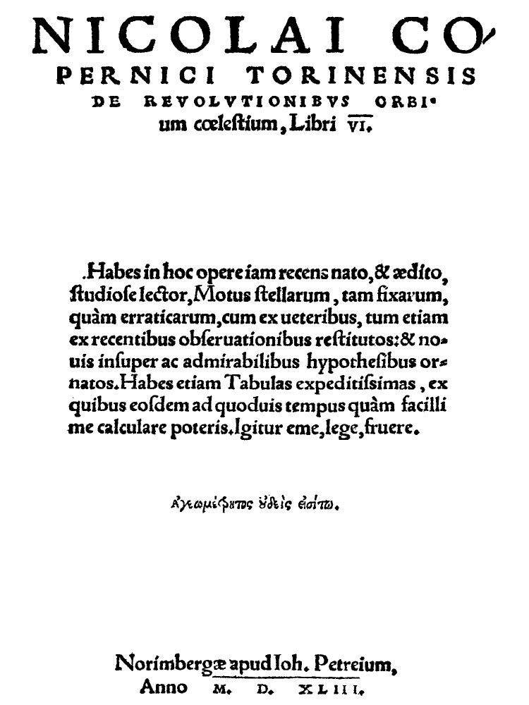
On the Revolutions of the Heavenly Spheres
(Nuremberg, 1543)
Autograph manuscript
drawing of the
heliocentric universe

Slide 13
Thank you!
Celest Weuve
USC Chair
Email: cweuv2@uis.edu
Phone: 217.206.8414
David Perryn
Administrative Aide
Email: dperryn@uillinois.edu
Phone: 217.300.7448
Carol Symes, Department of History, UIUC
Email: symes@illinois.edu

