Slide 1
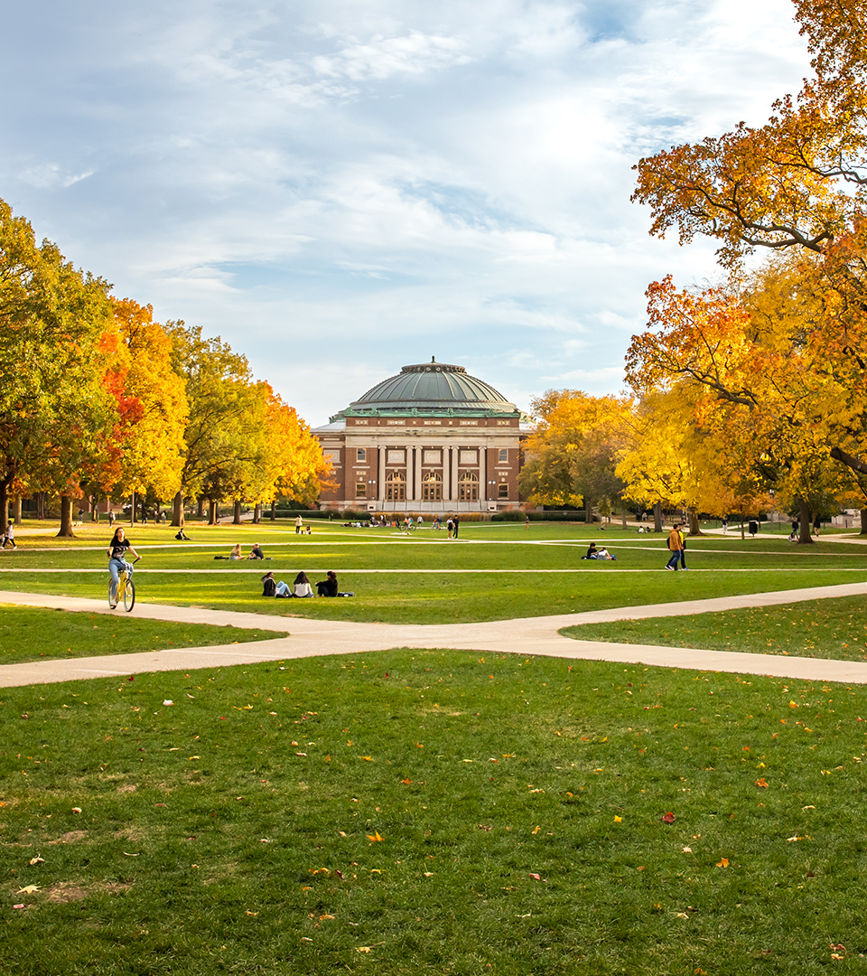
Welcome to Urbana

Slide 2
Our Newest Graduates

Slide 3
Another Record Year for Applications

Slide 4
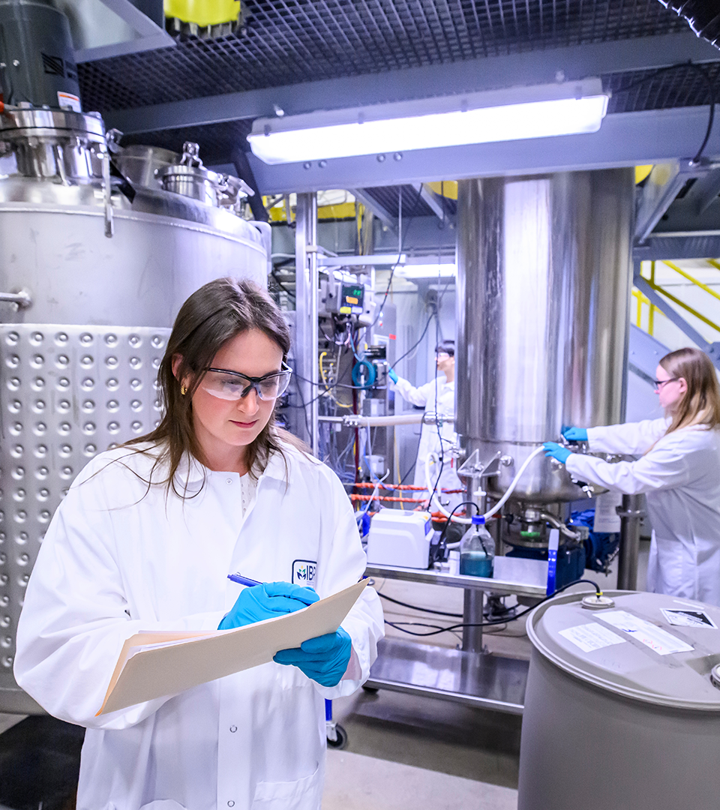
Boldly Driving Discovery and Innovation

Slide 5
Reconnecting International Partners
India

Slide 6
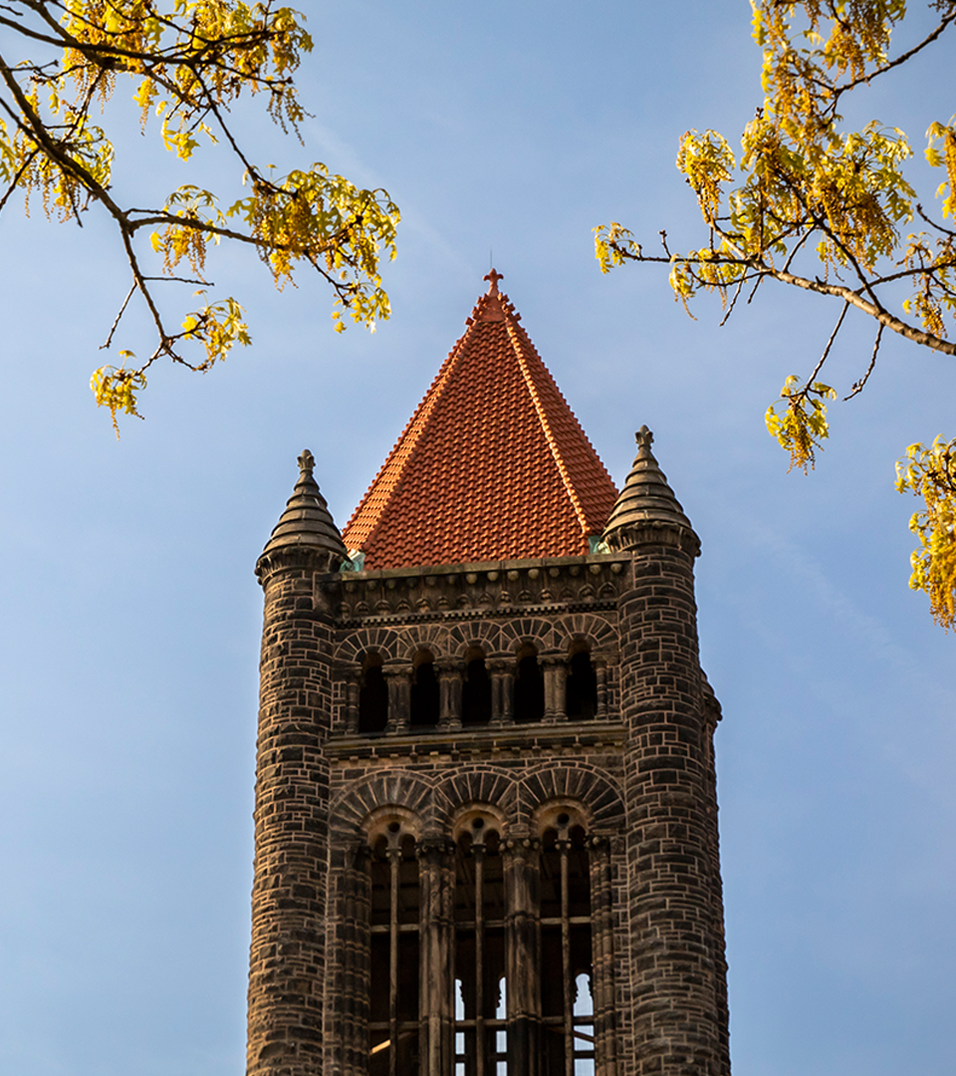
Welcome to Urbana

