Slide 1
Introduction
REMARKS TO THE BOARD OF TRUSTEES
President Tim Killeen
January 18, 2024
Notes:
Thank you, Chairman Edwards.
At this time, I would like to introduce our treasurer, LESTER H. MCKEEVER, JR., partner at Mitchell-Titus accounting firm in Chicago. He joins us via Zoom.
Also:
Chancellor and Vice President ROBERT JONES from Urbana.
Chancellor and Vice President MARIE LYNN MIRANDA from Chicago.
And the other university officers and staff:
Interim University Counsel SCOTT RICE.
Vice President/Chief Financial Officer and Comptroller PAUL ELLINGER.
Executive Vice President and Vice President for Academic Affairs NICHOLAS JONES.
Vice President for Economic Development and Innovation JAY WALSH.
Secretary of the Board of Trustees and the university JEFFREY STEIN.
Representing the Urbana Senate: JON HALE, associate professor, education policy, senate executive committee vice chair and associate professor of education policy, organization and leadership, associate professor of curriculum and instruction, and acting director for the Forum on Future of Public Education.
Representing the Chicago Senate, ASA ASAD, student senator, studying in the College of Liberal Arts and Sciences.
Representing the Springfield Senate, CELEST WEUVE, director of the School of Health Sciences and chair of the Springfield Senate Executive Committee and University Senates Conference.
Representing the academic professional staff, LISA MERRIFIELD, Illinois Extension community and economic development specialist, Urbana.
Also joining us via the livestream and representing the University Senates Conference, SANDRA De GROOTE, professor and head of Assessment and Scholarly Communications, and chair of the UIC Senate Executive Committee.
All three of our universities have now reopened for the spring. I say this often but, alongside the beginning of the fall semester and commencements, this renewal of classes and research creates an air of excitement and promise unlike anything else I know.
We begin again, though, amid violent conflict abroad that directly touches so many on our campuses.
I want to reaffirm that the well-being and safety of all of our students – from every background -- is our first priority.
Our faculty, staff and leadership work every day to live up to this responsibility, taking the measures we’ve talked about these preceding months while also constantly monitoring events to determine whether we need to add additional safeguards or otherwise change course.
At the same time, we maintain our commitment to free expression and open debate.
It has sometimes been suggested in these past few difficult months that in higher education we must choose between, on one hand, maintaining safe environments for learning and discovery and, on the other, offering a forum for the expression and debate of ideas.
We must do both.
When we go to work in higher education or enroll as students, we enter into a compact of sorts: that we will agree to listen to even unpopular or uncomfortable ideas and, if we disagree, to do so with respect. This does not extend, of course, to hate speech or any call for harm to anyone.
This compact has been tested at colleges and universities around the world over the past few months, and likely will continue to be.
So, while we hope for peace in all the world’s conflict zones, we are committed to these cornerstones of our mission as a public university – providing for the well-being and safety of our students while fostering the free flow of ideas and expression that drives education, research and discovery.
(TRANSITION INTO TUITION DISCUSSION)
As part of our service to the people of Illinois and our unwavering commitment to our land-grant mission, we work every day to improve affordability and access to our three universities.
The proposed tuition levels you will vote on later today would again freeze tuition for in-state undergraduates and are true to this ironclad commitment.
There are few things we can do that have a more positive impact on the working families of Illinois that seek out the life-changing opportunities a college education can provide than to promise them that we will hold down the cost of tuition.
Our ability to keep these costs in check is also another demonstration of our strong working partnership with the state’s elected leaders.
The governor and the members of the General Assembly have committed to healthy reinvestment in public higher education the past few years.
This helps us better control the cost of tuition, and to provide robust financial aid that makes a college education possible for more Illinoisans.
As I say regularly, there are few better investments the state can make on behalf of the people of Illinois.

Slide 2
START OF FALL VIDEO
Notes:
Our mission to serve the public good has also led us these past three years to annual tours of towns, cities, farms and other locations around the state where the University of Illinois System is making -- or can make -- a real difference in lives and communities.
In each of these multiday journeys we meet with community members, lawmakers, business and higher education leaders, alumni and others to learn more about how the U of I System can contribute to economic growth and societal well-being in ways that touch every Illinoisan.
Above all, we set out to listen, strengthen connections and learn.
I returned from the most recent tour in September and October sobered by the challenges so many people face … but also energized by seeing how we really are helping, and learning about some of the ways that we can do more.

Slide 3
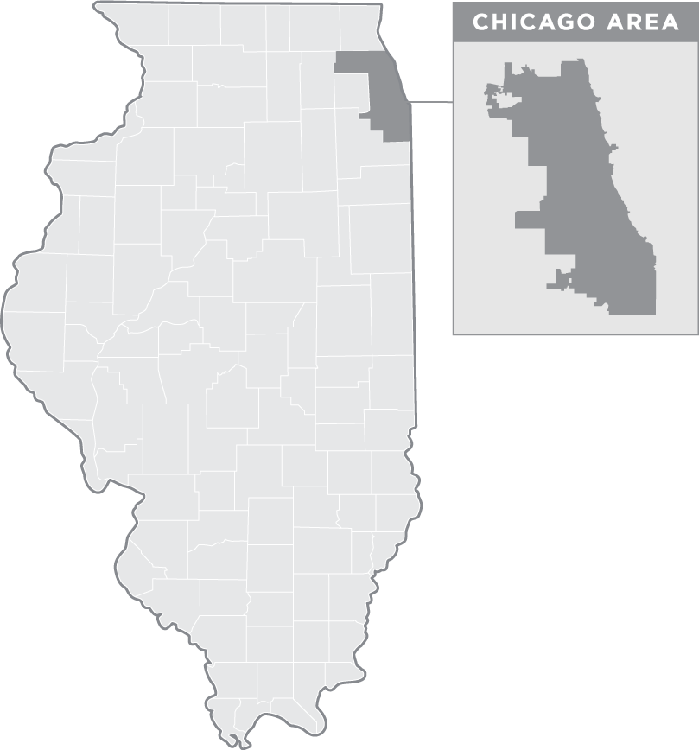










OUR roadmap
OUR 2023 ROADMAP
12
13
1. Makanda
11
2. Murphysboro
3. Belleville
14
4. Alton
5. Cuba
6. Havana
7. Peoria
8. Quad Cities
9. Dixon
10. Elgin
11. Maywood
12. Malcolm X College
13. Discovery Partners Institute
14. Chicago High School for Agricultural Sciences
Notes:
Chancellor Jones, Chancellor Miranda, Chancellor Gooch and I were joined by others from across the system in this third installment of the U of I System Leadership Tour.
I am extremely grateful to Trustee Milhouse for joining us in several locations, as well.
You can see on this map the many places we stopped over two legs last fall – we covered more than 1,300 road miles.

Slide 4
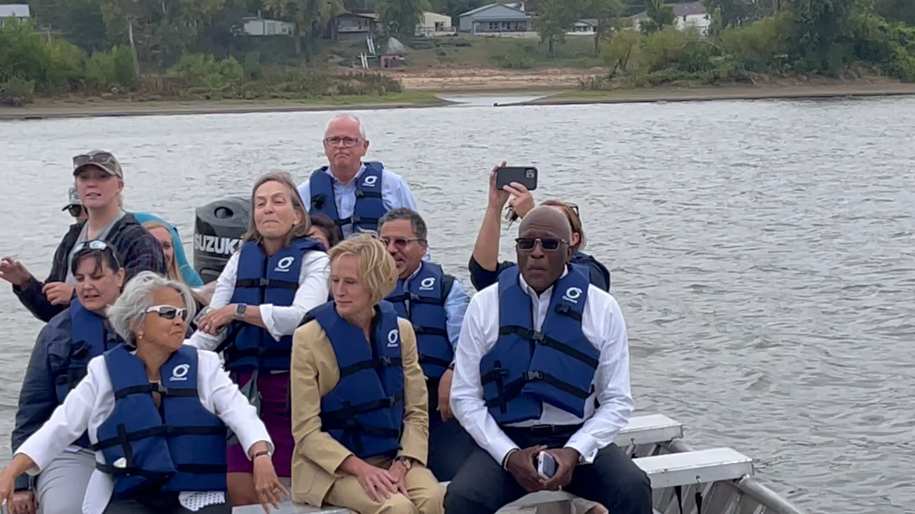
BOAT VIDEO
Notes:
The tour allowed the members of our leadership team to connect in new ways, strengthening our partnership and our friendships with each other.
All three of our chancellors, as you can see, are every bit as comfortable in the field and on the water as they are on our campuses.
And should an invasive carp ever launch itself into your boat while you learn more about the Illinois River from the Prairie Research Institute, call Chancellor Miranda.
It happened in her boat and she snapped into action, dispatching a fish that was neither cooperative nor small back into the river.
(To Chancellor Jones) About how big was that carp, Chancellor Jones?
(Wait for response)
Beyond our team and our fish stories – I promise that one’s entirely true, by the way -- let me tell you about a few things that really hit home for me …
And about some of the advances already in progress as a result of the tour.

Slide 5
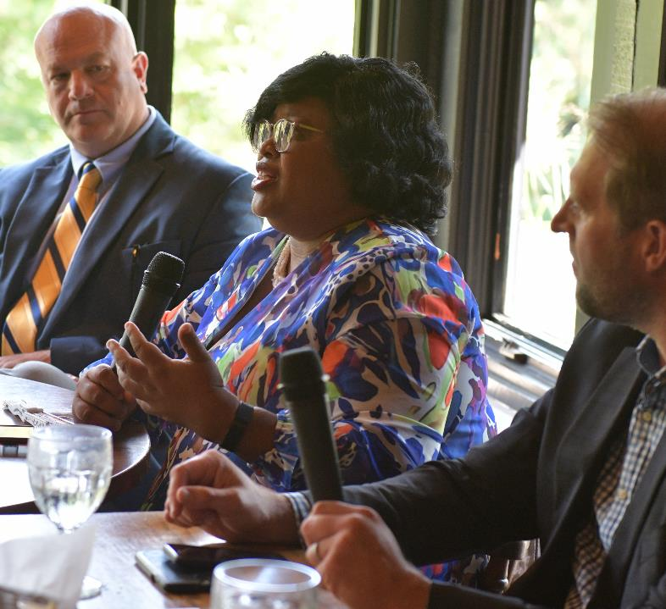
BRIDGING THE BROADBAND GAP
BRIDGING THE BROADBAND GAP
“It’s easy to get desensitized to the numbers that are part of this (equity) issue. We have to understand that these are human beings trying to enhance, survive and thrive.”
— Aneta Thomas Lee Visiting Assistant Director for Digital Equity, Inclusion, and Navigation at Illinois Broadband Lab
Notes:
Our tour stops made clear that the gaps in digital equity made so clear during the pandemic remain real barriers.
The Illinois Broadband Lab formally launched last year to help bridge these gaps, and at a stop in Makanda in far-southern Illinois we learned about how that is happening.
The lab links our Illinois Innovation Network and Illinois Extension with state-government partners and spent much of 2023 gathering information about broadband access across the state.
Now the lab is creating a statewide digital navigator to enroll households that struggle to pay for broadband in an affordability program.
Vital to this effort, as the lab’s Aneta Thomas Lee said, is remembering that this work is about people -- connecting them with opportunities that can change their lives, giving them the tools to succeed.

Slide 6
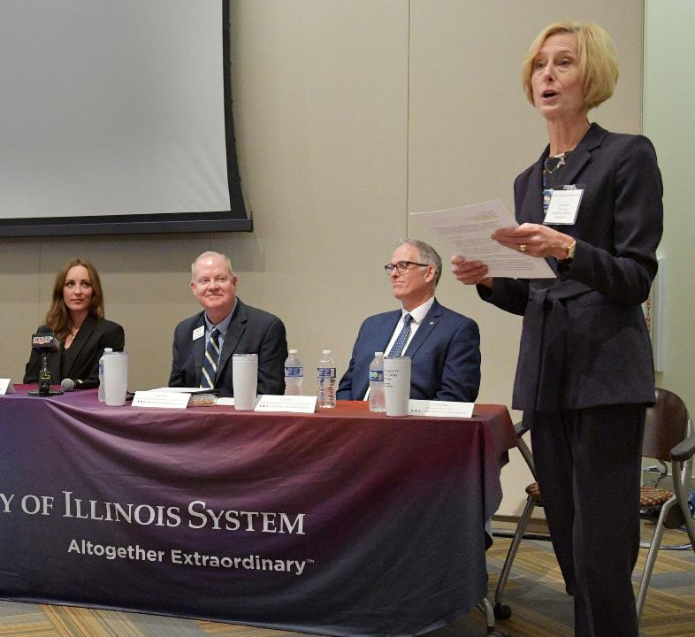
FUELING AN ECONOMIC ECOSYSTEM IN PEORIA
FUELING AN ECONOMIC ECOSYSTEM IN PEORIA
“When you’re part of a network that’s working together, not competing, you have peers you can reach out to for great ideas, and as entrepreneurs you don’t have to reinvent the wheel.”
—Robert Kerr Executive Director of Innovation & Opportunity at the new UIS Innovation Center
Notes:
Distillery Labs in Peoria and other Illinois Innovation Network hubs around the state are really driving forward.
At our stop in Peoria, it was clear that IIN is becoming a force in central Illinois for connections that create opportunities for entrepreneurs and provide vital support for startups.
Now, after our tour, plans are in the works to extend the IIN’s impact by partnering with Bradley University and Illinois Central College to boost business development in the region anchored by Peoria, Springfield and Decatur.
Most of you have heard me say this before, but a real superpower of the U of I System is our ability to connect people and whole institutions to meet challenges.

Slide 7
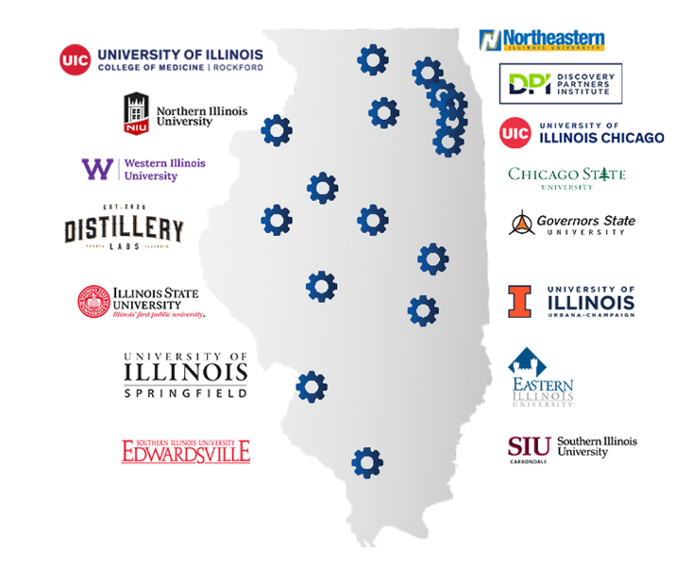
The Illinois Innovation Network
The Illinois Innovation Network drives inclusive and integrated research, innovation and economic development across Illinois.
Notes:
IIN, by the way, is such a fact of life around the U of I System now that it’s easy to forget that it’s only four years old.
But the work its 15 hubs are doing is making a difference.
IIN, for example, is one of the key partners working on the state project to transform the economy of the town of Cairo (KEHR-oh).
As part of this effort, IIN worked with the office of Lt. Gov. Stratton to open something last year that every thriving community needs but Cairo lacked: a grocery store, the Rise Community Market.
That project grew out of our first tour in 2021.

Slide 8
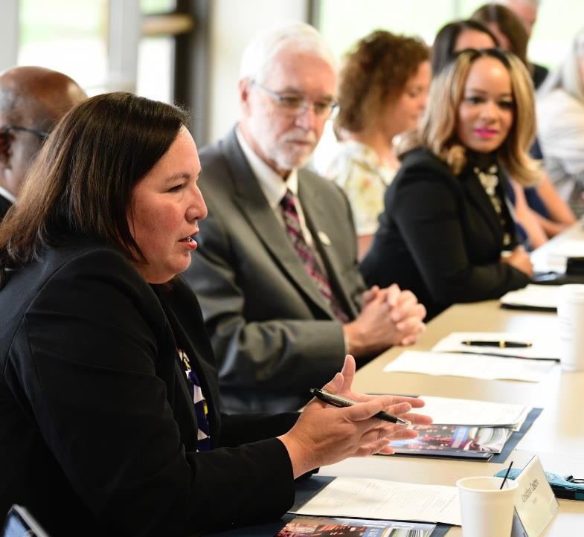
Smoothing the Transfer Path
SMOOTHING THE TRANSFER PATH
“So how do we help students seamlessly transfer into our state university programs? These two institutions are doing it incredibly well. We need to tout that across the state.”
—Illinois State Sen. Cristina Castro
Notes:
One of the most consistent priorities of all three tours has been visiting community colleges as we work to create a seamless path for students to transfer to four-year universities.
For many students who seek four-year degrees, community college is a great way to lower costs and limit debt.
And we know that transfer students perform very well at our universities.
Let me say first that we – the system and the state -- are getting a lot right in this area.
Illinois is among the top handful of states with the highest rates of bachelor’s degree completion among students who start at community colleges.
Further, at 87 percent, the U of I System is well ahead of the national average of 63 percent in the amount of transfer credit that is transferable and degree-applicable.
Continuing to smooth the transfer path, though, must be a priority. We talked about how that happens at stops at Elgin Community College in the western suburbs and at Malcolm X Community College in Chicago.
At Malcolm X we met with a group focused on success for students at community colleges, One Million Degrees.
We discussed collaborating to get more people enrolled in two-year schools and providing the right support systems.
And now conversations have begun between One Million Degrees and UIC’s Latin American Recruitment and Educational Services about next steps.
In Elgin, State Senator Cristina Castro joined us.
She said that the path is smoother now than it was when she was an Elgin student.
But she believes the state’s public universities can and should do more.
One way we’re working toward that goal is conducting transfer symposiums around the state for community colleges, so they know how best to help their students whose goals include four-year degrees.
Our next symposium is this spring at Shawnee Community College in Alexander County in far-southern Illinois.

Slide 9
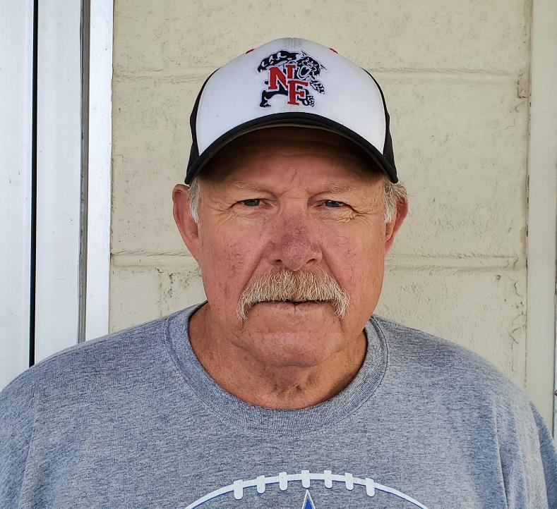
Health Care Where It’s Hardest to Provide
HEALTH CARE WHERE IT’S HARDEST TO PROVIDE
“Rural health care, we live it out here.
…It’s rough, it’s really rough.”
—Cuba Mayor Doug Schmidt
Notes:
I want to talk now about a tour stop that illustrates a vital area of need where the U of I System can make life better for many, many people.
(REFER TO THE SLIDE) This is Doug Schmidt, the mayor of Cuba, a small town about 35 miles southwest of Peoria.
Cuba has about 1,100 residents and – like people in small towns all over Illinois -- if they need specialty medical care, there is essentially no place near home to get it.
Mayor Schmidt told us at our tour stop in Cuba about how this gap in the health care system touched his family.
The mayor’s grandson was born in a hospital out of town because the area lacks obstetricians, and he was born with a number of medical issues.
So the mayor’s infant grandson spent 15 days in a children’s hospital far from home to get essential treatment.
The mayor teared up as he told us about his anguish, knowing his grandson – and so many like him -- simply couldn’t get that care anywhere near the comforts of home and family.
Mark Rosenblatt, the executive dean of the University of Illinois College of Medicine, was at this tour stop.
He said the U of I System can help by using technology – AI and machine learning -- to improve the delivery of health care in rural Illinois and bridge some of these gaps.
We will be working to make that happen, and Mayor Schmidt is eager for Cuba to serve as test bed of sorts for Dean Rosenblatt’s ideas.
Much of what we’re talking about also applies to underserved areas of our cities – a lack of access to care that technology could help address.

Slide 10
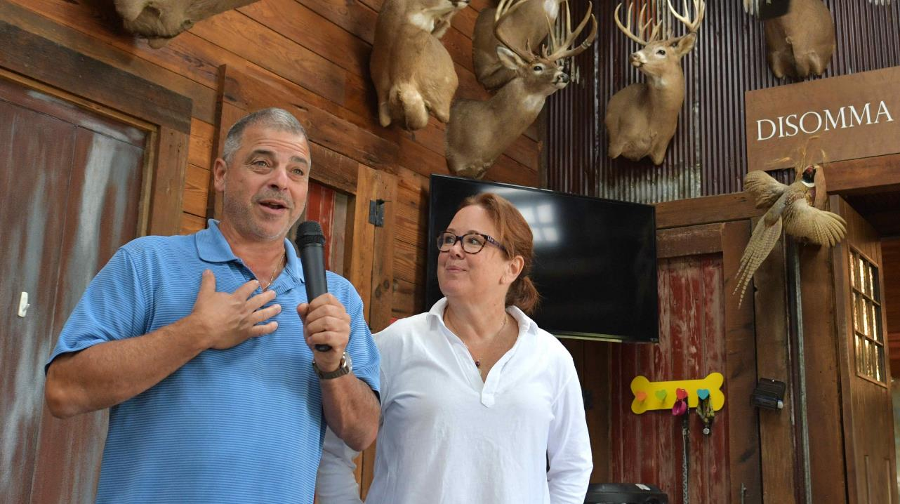
Connecting with our alumni
Notes:
In Cuba, our hosts were Urbana-Champaign alumnus Bill Disomma and his wife, Mary Disomma.
Bill is a founding partner of Jump Trading.
They offered us their wonderful lodge and were warm and incredibly generous hosts.
One of the major benefits of each tour is the opportunity to engage with alumni up and down the length of our state.
A few, like the Disommas in Cuba and UIUC alumna Angie Eckert and her family near Belleville, even host large crowds.
These interactions drive home just how much our alumni care about what we are doing and are real ambassadors for us.

Slide 11
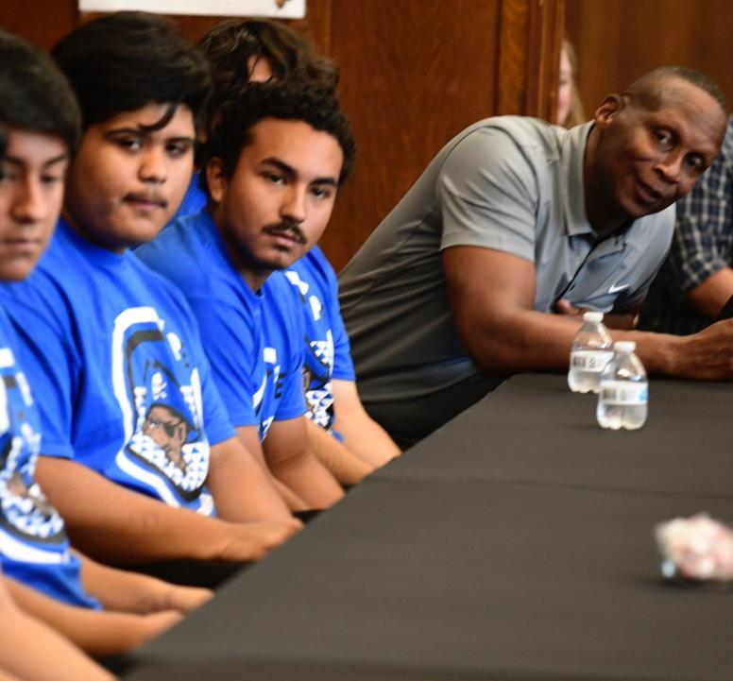
THE IMPORTANCE OF BEING THERE
THE IMPORTANCE OF BEING THERE
“Provide them information and give them access and the opportunity to visit the campus, to get exposed to some of the majors and the programs.”
—Proviso East High School Principal Rodney Hull
On what his students need.
Notes:
During each of our three state tours, people we’ve met appreciate that we’re coming to them, that we’re listening, and then acting.
We heard this at Proviso East High School in Maywood, about 10 miles west of downtown Chicago.
That fact is, very few Proviso East students enroll at our universities.
Principal Rodney Hull talked powerfully and passionately about his students and what they need from the U of I System.
First, they need to see us. Many of these students don’t believe that college is for them. We need to convince them it can be.
They also need to know that financial aid is available, that more than a third of our in-state undergraduates – students like them -- pay no tuition or fees at all.
Then they need to see our universities so they know that, yes, there is a place somewhere across the U of I System for so many of them.
I’m proud to say that, as a result of our talk with Principal Hull and his students, UIC this week is hosting more than 100 Proviso East students on campus.
That’s 100-plus smart, ambitious young students getting a glimpse of how the bright future we offer could be theirs.

Slide 12

Thank you
Thank you
Notes:
As you can see, we learn a great deal from these tours, and then we act on it with a long and growing roster of partners to make a difference.
All of this is driven by our modern land-grant mission – to serve the people of our state and improve the quality of life for all who live here through education, research, workforce development and so much more.
Thank you all for the opportunity to share a few highlights and talk about what our work means for communities all across our great state.

