Slide 1
Sharing the Burden
Presentation to the Board of Trustees
Presented by Nicholas C. Burbules, University Senates Conference
January 20, 2022

Slide 2
Faculty Responses to the COVID Crisis

Slide 3
Proud of our state-of-the-art testing system
System-wide researchers and public health experts made this happen, led by system and campus leaders. The University of Illinois system is a national model of how to do this right.
Here, another dimension: we want to present an overview of how individual faculty have responded to and been affected by the COVID crisis, their accomplishments and sacrifices, and their lingering concerns.

Slide 4
Faculty have adapted their teaching to new modalities
It's not just a matter of using Zoom instead of lecturing in class. Effective remote teaching requires redesigning the curriculum to promote new ways of interacting and learning.
Done under time constraints: faculty weren’t choosing to redesign their courses, they had to do so, often with little or no experience in online teaching, within a very short period of time.
IT professionals across the system aided instructors, and on very short notice, to move their courses to an entirely online format, and delivered crucial training for instructors. University libraries found creative ways to continue to provide lending services to faculty and students during COVID.
Faculty discovered new possibilities through remote teaching. Some skeptics became converts: different, often better, kinds of student-to-student interaction; differing modes of response (chat, polls, and emoticons), making class interactions more accessible to a wider variety of learning styles. Many students say they prefer to have at least some of their classes online.

Slide 5
Adjusting to remote work more generally
Between teaching and committee meetings, faculty often spend several hours a day in Zoom sessions.
Attendance and participation (for example, at senate meetings) has increased. Zoom has a “levelling effect.” People uncomfortable standing or speaking in front of a group often participate more through audio, video, or in the text chat.
Zoom can be somewhat anonymous and impersonal. On the other hand, not being so aware of other's physical appearance may decrease awareness of social class and cultural differences
“Zoom fatigue” – how long can you sustain attention after hours of staring at a screen? Switching off the video and doing side work during meetings. People are starting to crave live, real interaction again with others.
As we move past campus shutdowns, we are starting to ask longer-term questions about remote work or hybrid arrangements that take advantage of some of these benefits, and what kinds of work can be done as well or even better at a distance.

Slide 6
Effects on faculty mental health; stress
For faculty, as for citizens generally, the extended length of COVID accommodation, with new variations and no end in sight, has been a serious challenge; for some, isolation has been very stressful.
For all the potential benefits of online interaction, people miss personal interactions in teaching, advising, and collaboration; relationships and group morale have suffered.
On a personal front, people have to make daily decisions about balancing the risk of infection, and all the work to mitigate that risk takes a toll on creativity and productivity.
The continuing waves of the virus mean that there are fewer opportunities for the professional networking and recharging that happen with travel to conferences.

Slide 7
Disproportionate effects on certain groups
As we consider these challenges and sacrifices, it is also important to keep in mind the different ways in which they affect different groups. Faculty working from home with childcare responsibilities, for example – typically women – have faced added stressors, especially when their children are preschool age or are not able to attend school.
Looking at metrics like scholarly productivity, as well as more subjective factors like mental health and stress, we need to keep in mind that some faculty are more susceptible to these difficulties.

Slide 8
Dealing with student challenges: mental health, disruptions to work and study
While we are focusing on faculty here, all the same considerations also bear upon the student experience, for both undergraduates and graduates. Social isolation, disruption to work and progress toward completion, and coping with the complex logistics of staying safe and keeping others safe can be even bigger challenges for students with fewer personal support systems available to them.
For faculty, dealing with student stress and mental health issues, or referring them to university resources who can help them, has taken on an even bigger role during this period than in usual teaching and advising relationships. Students are often reluctant to admit they need help until it is quite late.

Slide 9
Effects on conducting research and research productivity (and P&T consequences)
Different kinds of research face different kinds of barriers: for work that must be done in a lab environment, often working in close quarters with others, masking and distancing requirements provide some but not absolute protection; for work that involves field studies, observations, or interviews with others, COVID restrictions make that more difficult and sometimes impossible. Access to and research archives is often limited.
For research that is funded by grants, with definite deadlines for completion, these factors have been especially disruptive.
For faculty facing promotion and tenure decisions, the direct and indirect effects of COVID (ranging from having it, to caring for others who do, to changing teaching and research activities under duress, to a lack of travel and conference attending, etc), have often had a devastating effect on faculty performance.
Campus policies allow for rollbacks and other accommodations, but these can extend the already-stressful period of waiting to pass this hurdle. Review processes, from the department all the way up to the Board of Trustees, have to balance fair accommodation for faculty with maintaining the highest expectations of excellence. (And, as noted above, these constraints have affected some groups of faculty even more heavily than others.)

Slide 10
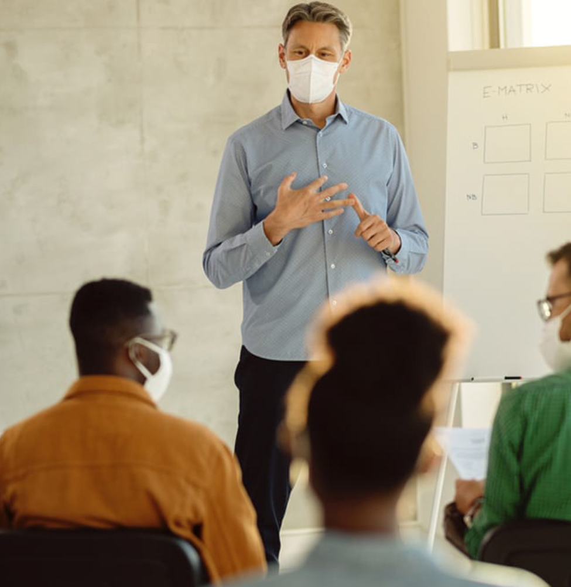
Concerns and risks in returning to FTF teaching
As we return to more on-campus and hybrid teaching, which is a welcome change for many faculty members as well as students, this too comes with some challenges. Although the number of student infectious cases is small, the classroom can include a large concentration of people. Some faculty, especially those in higher risk categories, are anxious about possible exposure.
Finally, what is the “new normal” we are creating? How will online and blended courses become a permanent part of the curriculum for on-campus students? What new models of working from a distance will become accepted for certain job activities? How do we balance the invaluable on-campus experience for faculty and students with the reality that COVID, in some form, will be with us for a very long time to come?

Slide 11
Thank You

