Slide 1
REMARKS TO THE
BOARD OF TRUSTEES
President Tim Killeen
January 20, 2022
Notes:
Thank you all for being here.
Before I begin, let me say a few words about my friend, Chancellor Michael Amiridis.
As chancellor you have elevated the University of Illinois Chicago, growing the enrollment, beginning a major transformation of the campus, and cementing its status as Chicago’s university.
This has, of course, helped lift all of us across the U of I System.
I will miss your partnership in the quest that all of us share, to serve the state and its people.
Under your leadership UIC established new records in enrollment, fundraising and research funding--$440 million in sponsored research awards last year.

Slide 2
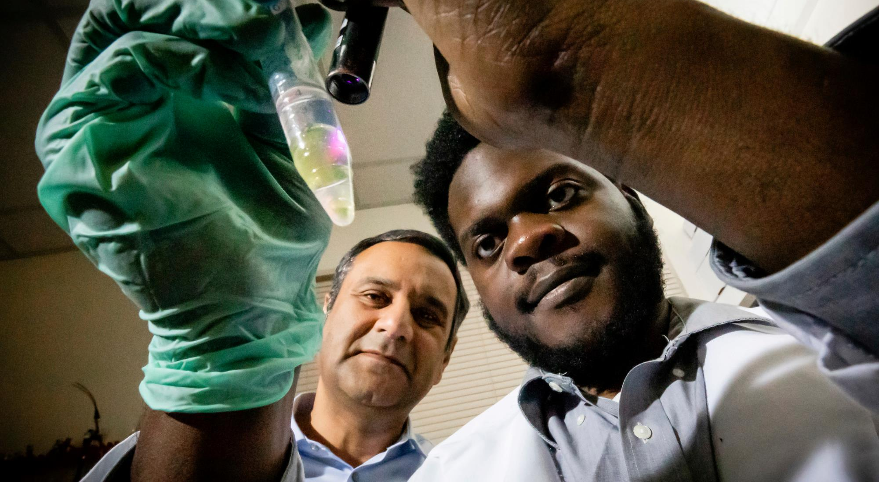
RESEARCH WITH GLOBAL IMPACT
Notes:
Alongside the world-class education we provide, research is one of the major pillars of our mission.

Slide 3
OUR RESEARCH PROWESS IS SYSTEMWIDE:
WITH IMPACT ACROSS THE STATE & BEYOND
Notes:
Through research, faculty at all three of our universities create new knowledge and solve some of society’s most pressing and challenging problems.
With our faculty as the engine, our three universities are collectively a research powerhouse, driving change and progress for our state and the world beyond.

Slide 4
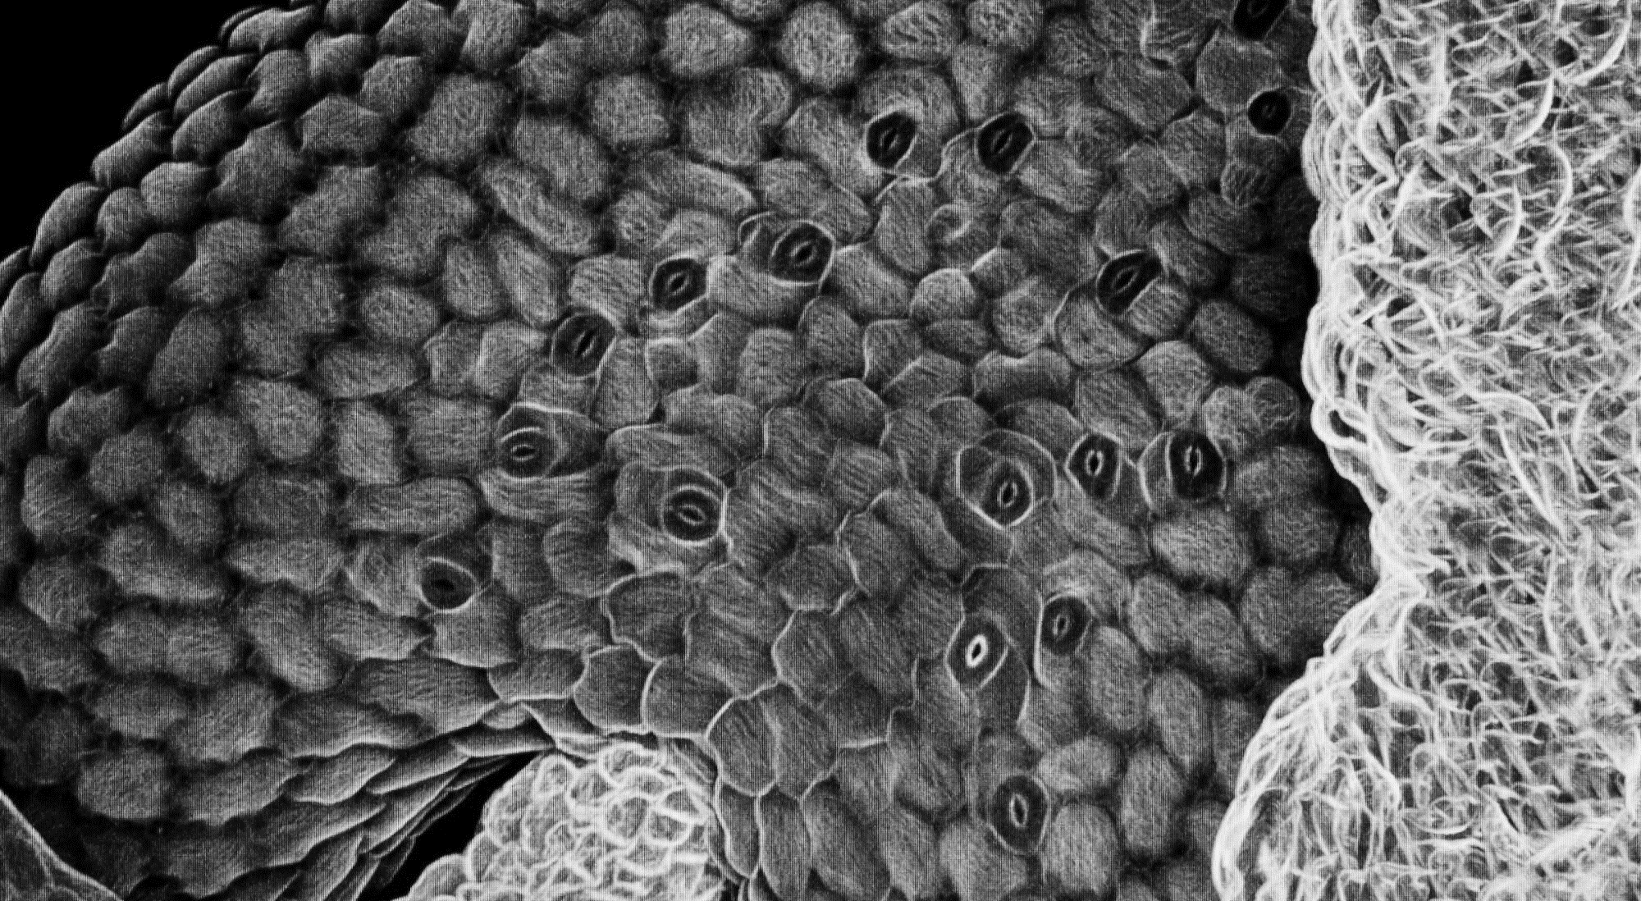
The U of I System: A research powerhouse
$1.1B
FY2020 TOTAL SYSTEM-WIDE RESEARCH EXPENDITURE
$611.9M
FY2020 FEDERAL RESEARCH AWARDS
Notes:
You can measure the power of this engine in financial terms. … Total system-wide research expenditures are well over a billion dollars a year. And the system is, every year, among the absolute largest recipients of federal research investment. … In 2021, the National Science Foundation awarded U of I System universities $134 million.
Another measure of this power is innovation and its impact.
In 2021, faculty innovations resulted in 103 U.S. patents and 106 licenses and options to commercialize technologies.
Right now, 117 startups are licensing intellectual property from system universities. And that number is growing.
You can also measure the impact of our research in terms of trust. When decision-makers, public and private, are looking for solutions and answers, they often count on us.

Slide 5
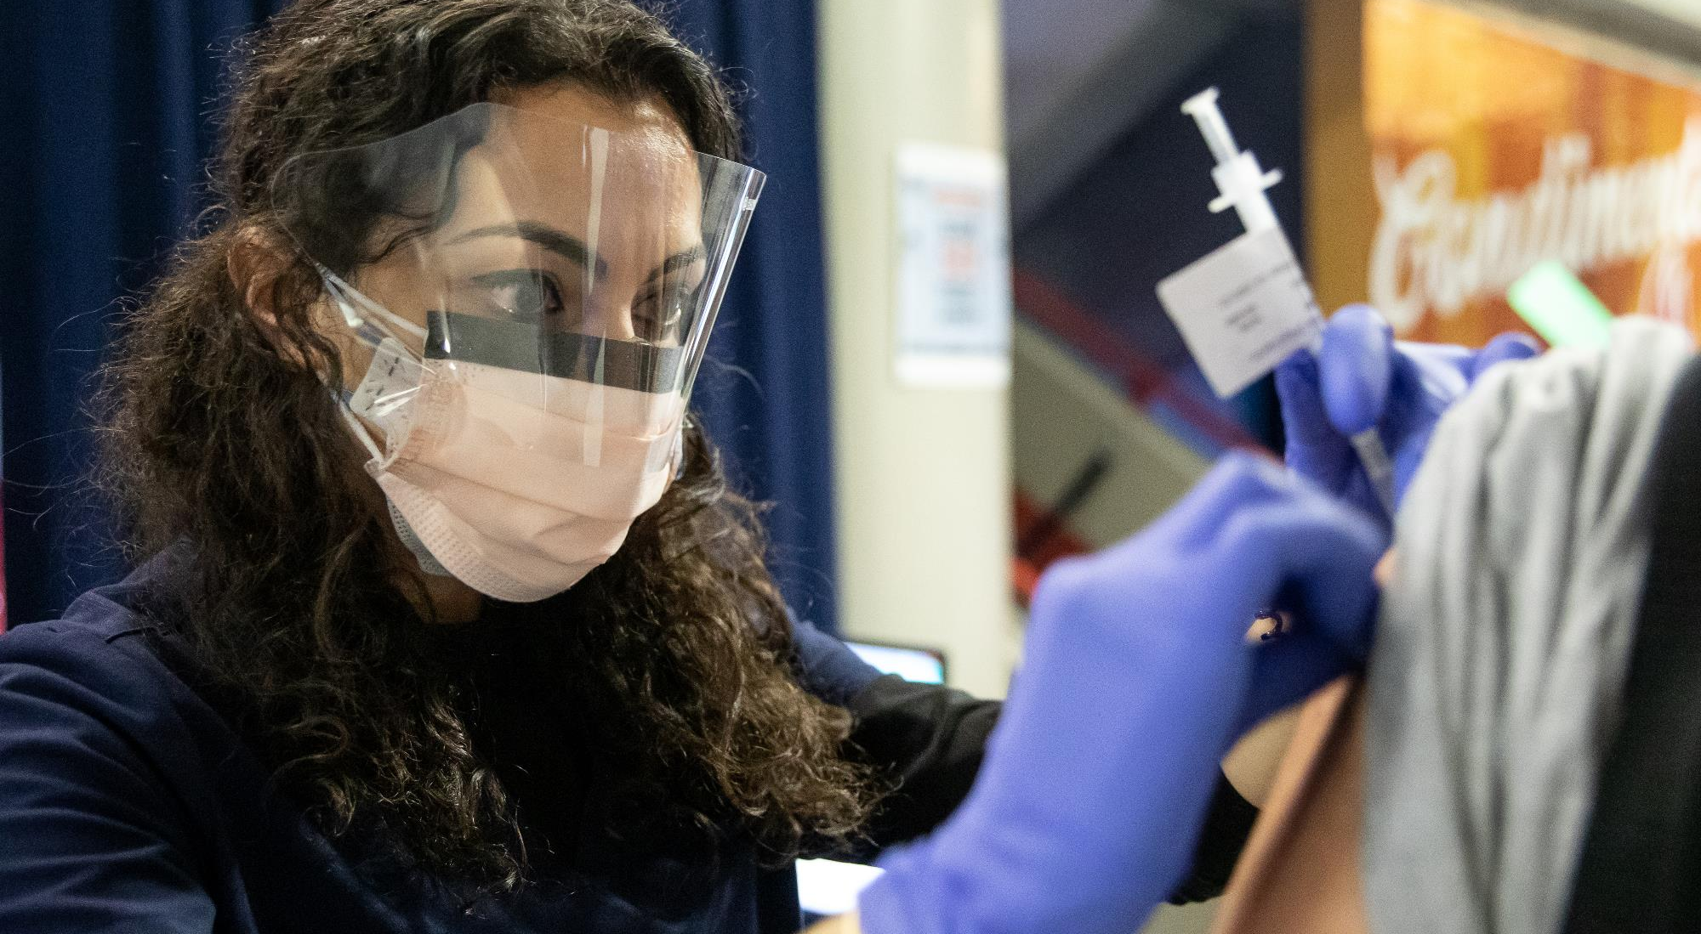
COVID-19 PANDEMIC RESPONSE
Notes:
There is, of course, no better, more immediate example than the response of the U of I System to the COVID-19 pandemic and the value our research has provided not just to our students, faculty and staff, but to the citizens of Illinois and people around the country.
When the pandemic began, we needed to get back to campus, and schools and business across Illinois and beyond needed to safely return to class and to work.
The SHIELD program, the saliva-based COVID-19 test created at Urbana-Champaign, was developed rapidly and enabled the successful return to our campuses in the fall of 2020 … Now SHIELD is protecting almost a million people at 1,700 K-12 schools around Illinois, as well as at countless business, courthouses, the public schools in Baltimore and Washington, D.C., and on and on.
You may have seen just last week that the 200,000 SHIELD tests we made available to the Chicago Public Schools in a deal brokered by Gov. J.B. Pritzker helped return students to school.
SHIELD is built on our research. Sustained federal investment drove the innovation that made the quick development of SHIELD possible.

Slide 6
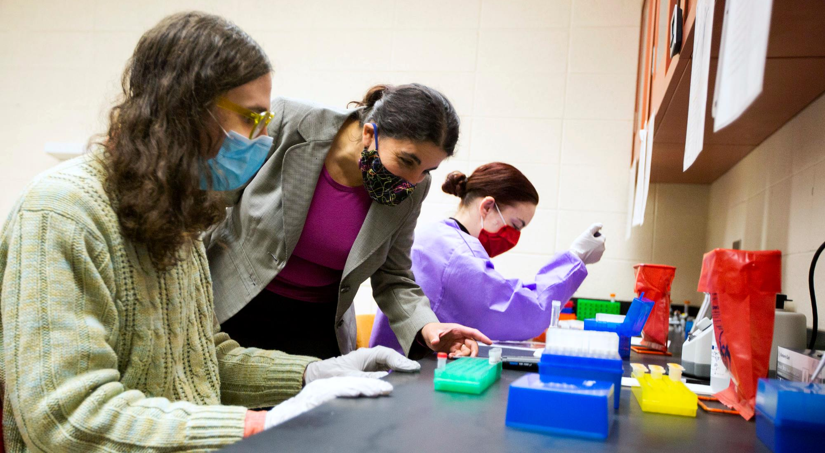
COVID-19: BEYOND TESTING & VACCINES
Notes:
Through the pandemic, the governor and the Illinois Department of Health also needed data to help make decisions to protect people and, at the same time, steer the economy to minimize negative impacts. … Again, our experts provided key data, driven by our research and experience.
The system’s Institute for Government and Public Affairs has also played an important role here through a series of ongoing policy reports.
The push to create vaccines against the virus began very early, and the need for large-scale trials was almost immediate.
UIC hosted trials for both the Moderna and Johnson & Johnson vaccines. … UIC vaccine research also now includes testing the effects of boosters and studying vaccinations in high-risk populations like transplant recipients and pregnant women.
In all, UIC researchers have been awarded more than $60 million in funding for COVID-19 research.
COVID pneumonia is among the more serious effects of the virus, and differentiating between it and non-COVID pneumonia is vital to treatment decisions. … At Springfield, computer scientists are using deep learning to improve and speed up computer-aided diagnosis.

Slide 7
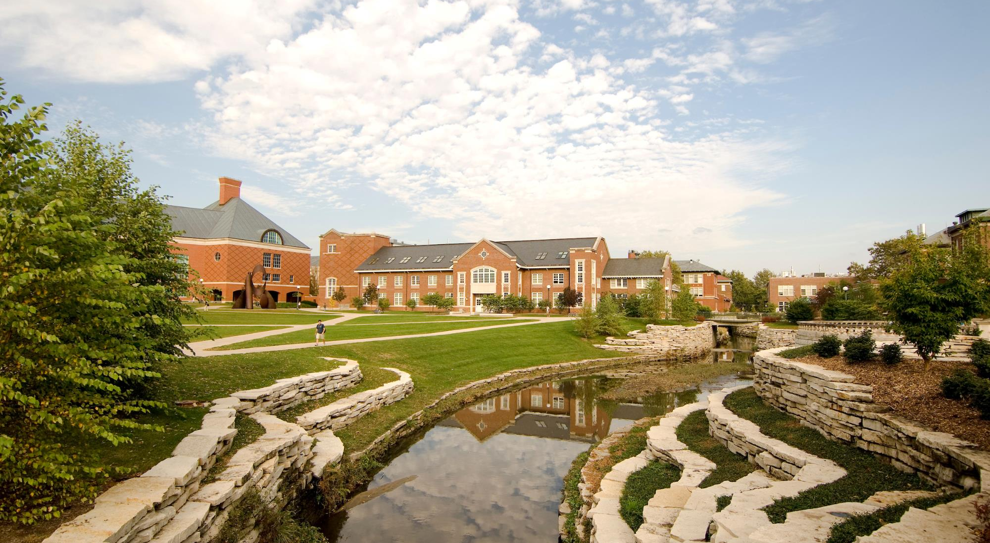
ACCELERATING DISCOVERY
Notes:
Public partnership drives so much of our research, but private partners are extremely important catalysts for innovation at our universities.
Some of the most promising opportunities on the horizon lie in emerging technologies – quantum computing, AI and hybrid cloud computing environments.
A new $200 million IBM-Illinois Discovery Accelerator Institute at Urbana-Champaign’s Grainger College of Engineering was created last year to position Illinois as an international industry leader.
This 10-year agreement presents significant opportunity to advance our research efforts and will have profound impact.

Slide 8
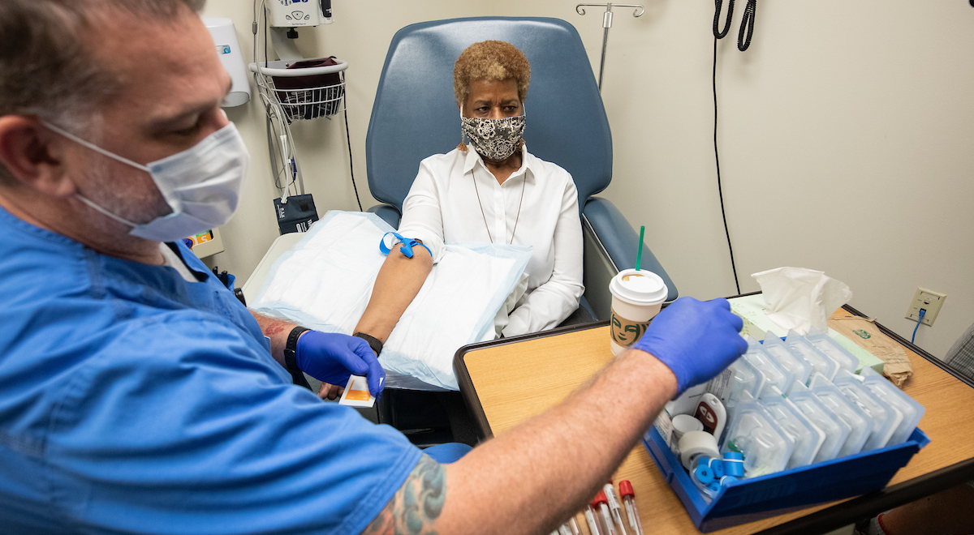
OUR RESEARCH IS ENSURING A HEALTHIER FUTURE
Notes:
I touched on some of our healthcare-related research earlier, but this vital area is a real U of I System strength.
UIC is a hub of medical innovation with a proven track record in the discovery and development of drugs that address important t health issues and improve quality of life. This includes the bladder-cancer therapeutic Tice BCG, the Shingrix vaccine against the shingles virus; Phexxi, which is a hormone-free birth control gel; and Presizta, an anti-HIV treatment.

Slide 9
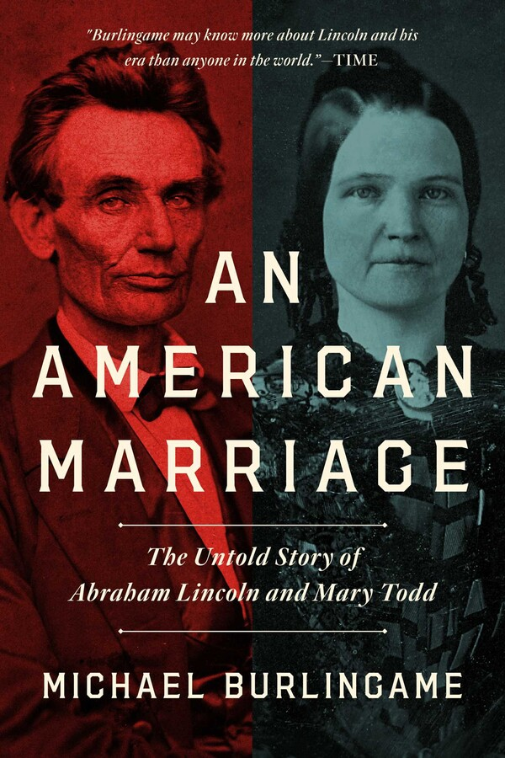
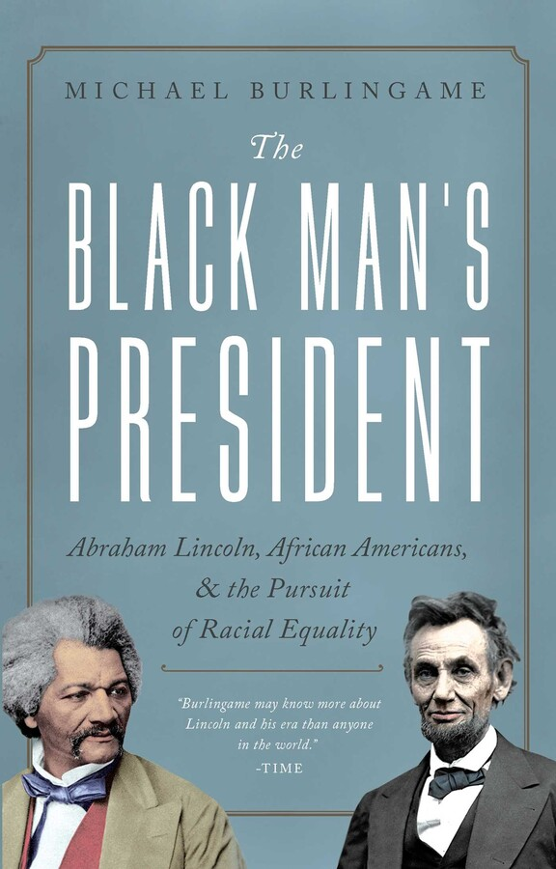
THE ARTS & HUMANITIES
Notes:
At UIS, computer science researchers are using AI to accelerate the engineering of enzymes known as MMPs which have great potential for the treatment of cancer, cardiovascular disease and other ailments.
STEM-driven research is, of course, crucial. But arts and humanities research helps us better understand ourselves and our society.
Abraham Lincoln’s presidency shapes so much in American life, even today.
We have grown to better understand his life and its ongoing impact through a pair of books published last year by UIS Professor Michael Burlingame. “An American Marriage: The Untold Story of Abraham Lincoln and Mary Todd,” and “The Black Man's President,” provide deep insight into both the public and private Lincoln.
At the Humanities Research Institute in Urbana, clusters of faculty fellows are working across a range of important subjects, among them the uncertain present and future of the news business and its ability to inform Americans and help them make good decisions.
Urbana journalism Professor Nikki Usher, a recent fellow, last year authored a new book, “News for the Rich, White, and Blue: How Place and Power Distort American Journalism.” In it she draws on more than a decade of field research to explain how journalists decide what becomes news and how news organizations strategize for that future.

Slide 10
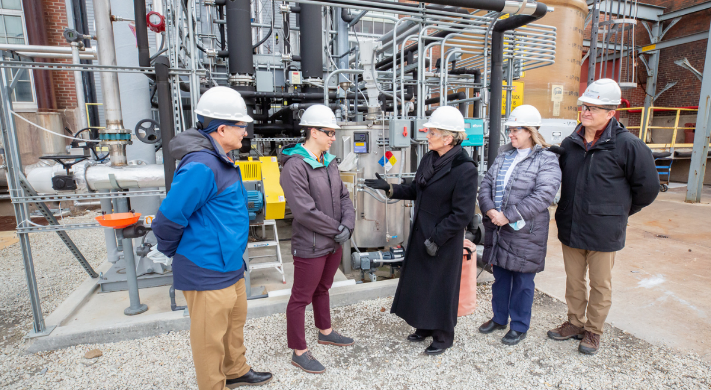
THE FIGHT AGAINST CLIMATE CHANGE: CAPTURING GREENHOUSE GASES
Notes:
Among the most difficult problems facing us all is climate change, and you can find work directly aimed at this challenge all across the U of I System.
Just one example is the large-scale pilot testing of CO2 capture technology being led by the Prairie Research Institute.
When the system being built at City Water, Light & Power in Springfield is complete, it will capture more than 90 percent of the CO2 emissions produced by the plant and potentially provide a building block toward wider adoption of carbon-capture technology.
I could spend hours – days, really -- describing all of the vital research going on at our universities. The depth and breadth are astounding.
But the research I have just touched on all has one thing in common: public impact … It lives up to that fundamental ideal of the land-grant institution: to advance society through education and knowledge and contribute to the public good.

Slide 11
Research means opportunity, jobs and a better quality of life… It gives us understanding of why things happen, how they happen and what might happen as we make our way forward.
Notes:
Research means opportunity, jobs and a better quality of life … It gives us understanding of why things happen, how they happen and what might happen as we make our way forward.

Slide 12
“Nothing in life is to be feared, it is only to be understood. Now is the time to understand more, so that we may fear less.”
-Marie Curie
Notes:
The brilliant scientist Marie Curie once said, “Nothing in life is to be feared, it is only to be understood. Now is the time to understand more, so that we may fear less.”
Our research is a billion dollar-plus machine driving change and opportunity for the better.

Slide 13
THANK YOU

