Slide 1
UNIVERSITY OF ILLINOIS SYSTEM
Third Quarter 2021 Investment Update
UNIVERSITY OF ILLINOIS SYSTEM
Third Quarter 2021 Investment Update
Prepared for the Board of Trustees
Reported to the Board of Trustees
January 20, 2022
November 2021

Slide 2
Table of contents
Section Page Number
Market Overview and System Assets 3
Endowment Fund Update: September 30, 2021 6
Operating Pool Update: September 30, 2021 10
Appendix:
Market Environment 13
Disclosures 19

Slide 3
MARKET OVERVIEW AND SYSTEM ASSETS
MARKET OVERVIEW AND SYSTEM ASSETS

Slide 4
Market returns
MAJOR ASSET CLASS RETURNS
Data sources: Lipper and Hedge Fund Research, data as of 5th business day following quarter-end

Slide 5
university Operating and endowment funds: September 30, 2021
The University Operating and Endowment Funds were valued at $4.3 billion as of September 30, 2021.
The Operating Pool (ex-Permanent Core) was valued at $3.2 billion. The permanent core investment (gray bar) is a long-term investment of operating cash in the Endowment Pool to enhance distributions to invested units.
The combined Endowment Pool is valued at $992.4 million (green and gray right bar) and is discussed further on the following slides.
The Pure Endowment (excluding Operating) is valued at $546.8 million.

Slide 6
ENDOWMENT FUND UPDATE:
September 30, 2021
ENDOWMENT FUND UPDATE:
September 30, 2021

Slide 7
Market value and asset allocation: endowment pool
Over/Under Allocation to Long-Term Policy Targets

Slide 8
Total endowment pool performance (September 30, 2021)
Over the one-year period, the endowment returned 22.5%. All asset classes contributed to performance, most notably U.S. equity (+36.8%) and private equity (+44.6%).
Over the ten-year period, the endowment posted an 9.8% return, supported by solid returns from U.S. equity (+16.2%), private equity (+14.5%), and real assets (+7.9%).
Endowment Pool | Quarter Ending
Market Value Change | September-2021
Beginning Market Value | $1,004.4 M
Net Contributions | ($8.7 M)
Gain/Loss | ($3.2 M)
Ending Market Value | $992.4 M
Note: The beginning market value + net contributions + net investment gains referenced in the table may not equal the ending market value due to rounding.

Slide 9
Asset class performance: endowment pool (September 30, 2021)
 | Current Allocation (%) | Policy Allocation (%) | Quarter ending Sep-2021 | 1 Year | 3 Years | 5 Years | 10 Years | Since Inception | Inception Date
Endowment Pool |  |  | -0.3 | 22.5 | 9.8 | 9.6 | 9.8 | 8.4 | Sep-87
Performance Benchmark |  |  | -0.1 | 20.9 | 10.7 | 10.2 | 10.5 | 8.6
GLOBAL EQUITY | 61.4 | 56.0 | -1.1 | 33.3 | 13.9 | 14.2 | 13.1 | 8.6 | Sep-87
Total U.S. Equity |  |  | -0.2 | 36.8 | 15.7 | 16.4 | 16.2 | 10.0 | Sep-87
U.S. Equity Benchmark |  |  | -0.1 | 31.9 | 15.9 | 16.8 | 16.5 | 10.3
Total Non-U.S. Equity |  |  | -2.6 | 25.1 | 8.3 | 9.2 | 8.0 | 5.8 | Sep-93
Non-U.S. Equity Benchmark |  |  | -2.6 | 25.2 | 8.3 | 9.1 | 7.7 | 5.9
Total Private Equity |  |  | 0.0 | 44.5 | 25.3 | 21.9 | 14.5 | 7.0 | Jan-04
Private Equity Benchmark |  |  | 0.0 | 44.8 | 19.0 | 19.9 | 19.7 | 13.7
GLOBAL FIXED INCOME ¹ | 18.4 | 20.0 | 0.0 | 0.1 | 5.6 | 3.4 | 3.9 | 6.7 | Sep-87
Total Public Fixed Income |  |  | 0.0 | -0.7 | 5.3 | 3.2 | 3.8 | 6.7 | Sep-87
Bloomberg Barclays U.S. Aggregate |  |  | 0.1 | -0.9 | 5.4 | 2.9 | 3.0 | 6.2
REAL ASSETS ¹ | 12.9 | 14.0 | 2.2 | 18.9 | 8.1 | 6.1 | 7.9 | 10.0 | Dec-06
Total Real Estate |  |  | 3.5 | 22.4 | 7.4 | 6.9 | - | 9.9 | Aug-13
Real Estate Benchmark |  |  | 6.4 | 13.9 | 6.2 | 6.2 | - | 9.5
Total Farmland² |  |  | 0.0 | 13.5 | 9.3 | 5.3 | 5.6 | 8.4 | Dec-06
NCREIF Cornbelt Index |  |  | 0.0 | 9.0 | 5.0 | 3.4 | 6.9 | 8.6
DIVERSIFYING STRATEGIES¹ | 7.0 | 10.0 | 1.1 | 12.2 | -9.5 | -5.3 |  | -1.8 | May-13
Total Hedge Funds |  |  | 1.3 | 11.9 | -10.6 | -6.1 | - | -2.3 | May-13
HFRI Fund Weighted Composite Index |  |  | -0.4 | 21.6 | 8.4 | 7.2 | - | 5.5
CASH | 0.4 | 0.0 | 0.0 | 0.0 | 1.0 | 1.0 | - | 0.8
¹Global Fixed Income, Real Assets and Diversifying Strategies include allocations and performance of private investments.
²Farmland directly owned by the Endowment is valued annually on June 30.

Slide 10
OPERATING POOL UPDATE:
September 30, 2021
OPERATING POOL UPDATE:
September 30, 2021

Slide 11
Liquidity layers: Operating pool (September 30, 2021)
OPERATING POOL LIQUIDITY LAYERS
AS OF SEPTEMBER 30, 2021
The asset allocation strategy for the Operating Pool consists of investing funds across four liquidity layers. Board- approved ranges are depicted by the bars, while the diamonds represent the actual allocation.
Funds expected to be used within one year are invested in the primary liquidity layer.
Longer-time horizon investments, including core and permanent core, are expected to provide higher rates of return and will experience some variation in market value as capital market conditions change.
The System’s permanent core operating funds are invested in the System’s Endowment Pool investment program.
Total sum of allocation may not equal 100% due to rounding.

Slide 12
TOTAL OPERATING POOL PERFORMANCE (September 30, 2021)
Over the trailing one-year period ending September 30, 2021, the Operating Pool returned 0.3%, outperforming the benchmark return.
  Managers in the Operating Pool outperformed their respective benchmarks over the period.
Over the five-, ten-year, and since inception periods, the Operating Pool has outperformed the benchmark.
  The majority of the Operating Pool’s managers have each met or outperformed their respective benchmarks.
Operating Pool | Quarter Ending
Market Value Change | September-2021
Beginning Market Value | $2,815.8 M
Net Contributions | $381.2 M
Gain/Loss | $1.4 M
Ending Market Value | $3,198.4 M
Note: The Total Pool’s beginning and ending market values include bank balances in which the System earns credit to offset bank fees. The beginning market value + net contributions + net investment gains referenced in the table may not equal the ending market value due to rounding.

Slide 13
APPENDIX: MARKET ENVIRONMENT
APPENDIX: MARKET ENVIRONMENT

Slide 14
Market environment
2012-2021 Annual Returns of Key Indices
 |  |  |  |  |  |  |  |  |  |  |  | 5-year | 10-year
2012 | 2013 | 2014 | 2015 | 2016 | 2017 | 2018 | 2019 | 2020 | 2021 |  |  | annual | annual
Global REIT 27.7% | Small Cap 38.8% | Global REIT 15.0% | Large Cap 1.4% | Small Cap 21.3% | Emerging Markets 37.3% | Bonds 0.0% | Large Cap 31.5% | Small Cap 20.0% | MLPs 39.4% |  |  | Large Cap 16.9% | Large Cap 16.6%
Emerging Markets 18.2% | Large Cap 32.4% | Large Cap 13.7% | Bonds 0.5% | MLPs 18.3% | Int'l 25.0% | High Yield -2.1% | Small Cap 25.5% | Large Cap 18.4% | Large Cap 15.9% |  |  | Small Cap 13.5% | Small Cap 14.6%
Int'l 17.3% | MLPs 27.6% | Bonds 6.0% | Hedge Funds -0.3% | High Yield 17.1% | Large Cap 21.8% | Hedge Funds -4.0% | Int'l 22.0% | Emerging Markets 18.3% | Global REIT 14.6% |  |  | Emerging Markets 9.2% | Global REIT 8.7%
Small Cap 16.3% | Int'l 22.8% | Small Cap 4.9% | Global REIT -0.8% | Large Cap 11.9% | Small Cap 14.6% | Large Cap -4.4% | Global REIT 21.9% | Hedge Funds 10.9% | Small Cap 12.4% |  |  | Int'l 8.8% | Int’l 8.1%
Large Cap 16.0% | Hedge Funds 9.0% | MLPs 4.8% | Int'l -0.8% | Emerging Markets 11.2% | Global REIT 10.4% | Global REIT -5.6% | Emerging Markets 18.4% | Int'l 7.8% | Int'l 8.3% |  |  | High Yield 6.5% | High Yield 7.4%
High Yield 15.8% | High Yield 7.4% | Hedge Funds 3.4% | Small Cap -4.4% | Global REIT 4.1% | Hedge Funds 7.8% | Small Cap -11.0% | High Yield 14.3% | Bonds 7.5% | Hedge Funds 5.8% |  |  | Hedge Funds 5.8% | Emerging Markets 6.1%
MLPs 4.8% | Global REIT 3.7% | High Yield 2.5% | High Yield -4.5% | Bonds 2.6% | High Yield 7.5% | MLPs -12.4% | Bonds 8.7% | High Yield 7.1% | High yield 4.5% |  |  | Global REIT 5.1% | Hedge Funds 4.5%
Hedge Funds 4.8% | Bonds -2.0% | Emerging Markets -2.2% | Emerging Markets -14.9% | Int'l 1.0% | Bonds 3.5% | Int'l -13.8% | Hedge Funds 8.4% | Global REIT -9.0% | Emerging Markets -1.2% |  |  | Bonds 2.9% | Bonds 3.0%
Bonds 4.2% | Emerging Markets -2.6% | Int'l -4.9% | MLPs -32.6% | Hedge Funds 0.5% | MLPs -6.5% | Emerging Markets -14.6% | MLPs 6.6% | MLPs -28.7% | Bonds -1.6% |  |  | MLPs -2.4% | MLPs 1.2%

Slide 15
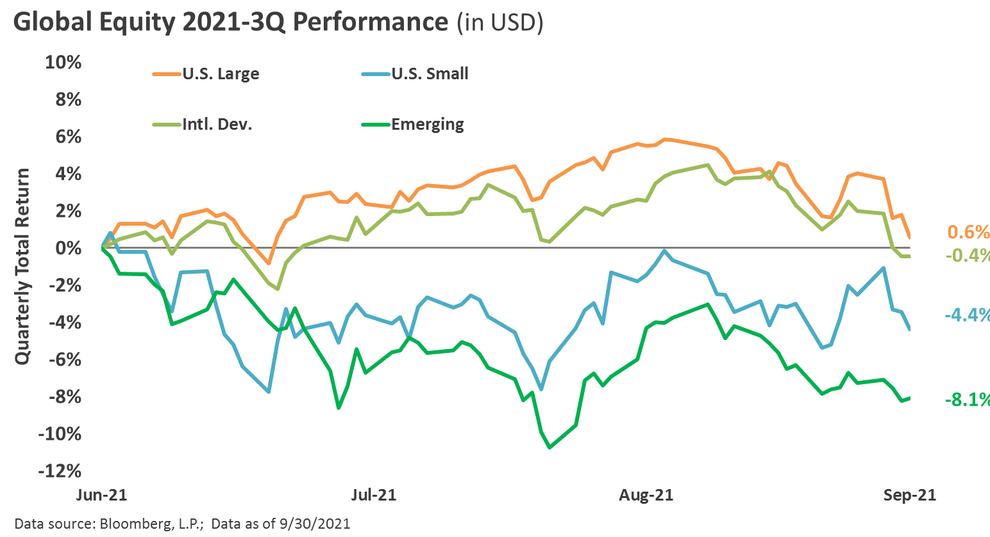
Global equity
Global equity performance in the third quarter was generally negative, particularly in emerging markets, where a continuing regulatory crackdown on certain industries by the Chinese government helped drive volatility higher and returns lower. Consequently, many relative valuation measures evolved to reflect a significantly cheaper emerging markets backdrop versus the multi-decade high valuation environment in the U.S..
Domestically, large cap outperformed small cap, as market participants digested both moderating economic activity and the looming tapering of quantitative easing by the Federal Reserve (Fed).
Domestic large cap growth outperformed value for the quarter, although this dynamic reversed in September as the rise in interest rates, a steepening of the Treasury yield curve, and strong performance from the energy sector supported value’s relative performance throughout the month.

Slide 16
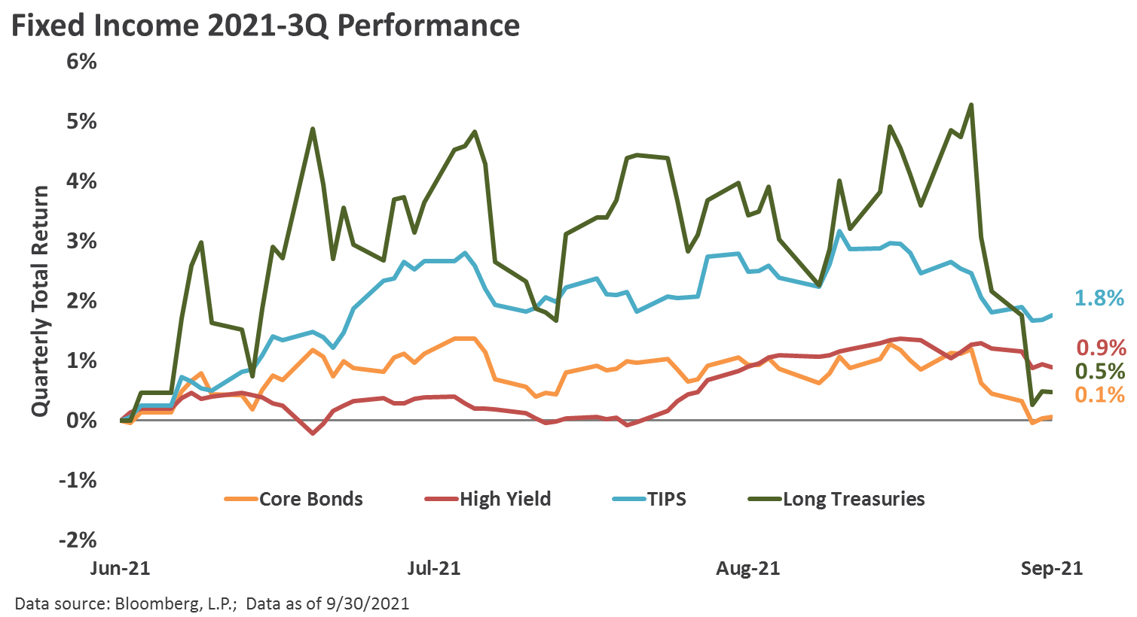
Fixed income
Bond returns in the third quarter were flat-to-modestly positive, as a late quarter rise in Treasury yields pressured the longer duration and rate-sensitive corners of the bond market. Treasury Inflation-Protected Securities (“TIPS”) were a strong performer, as inflationary worries remained at the forefront of the macro backdrop.
As the Fed prepares to taper their pace of asset purchases, with latest guidance suggesting the process will begin in November, nominal interest rates have risen more than 30 basis points from their localized lows in early-August to the highest level since early-June, with the 10-Year Treasury Note concluding the quarter with a 1.49% yield.
Below investment-grade corners of the market, such as high yield bonds, continued to generate positive returns. Although credit spreads widened slightly quarter-over-quarter, they remained well-below historical average levels.

Slide 17
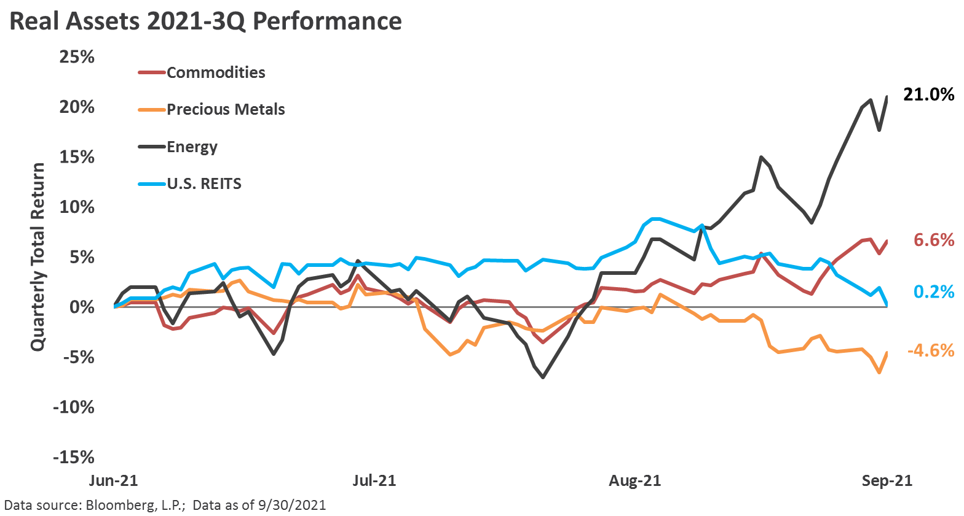
Real assets
Energy spot prices, particularly natural gas, witnessed strong upward pressure, fueled by ongoing elevated inflation sentiment and hurricane-related production disruptions. Despite a supportive commodity price backdrop, energy infrastructure performance moderated after stellar performance in the preceding three quarters.
Real estate investment trust (REIT) performance was essentially flat, with late-quarter performance headwinds from a general risk-off environment, rising interest rates, and renewed growth concerns pressuring investor sentiment.
Precious metal spot prices faced forceful headwinds, as global market participants braced for the incremental tapering of Fed monetary accommodation and competing alternative currencies, such as cryptocurrencies, rose sharply.

Slide 18
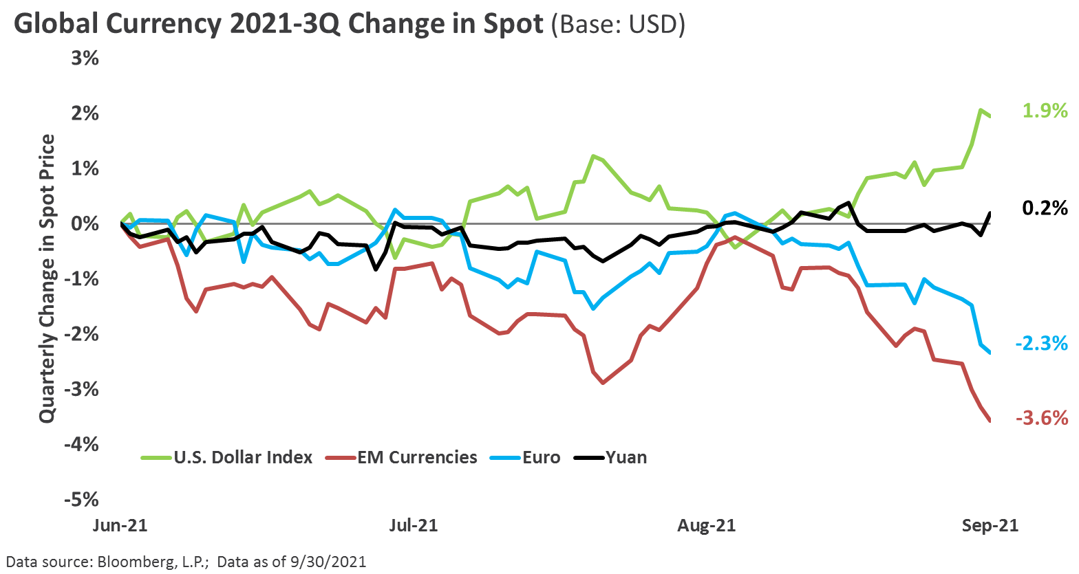
currencies
A continued relatively stronger U.S. economic recovery, paired with the imminent reigning-in of policy accommodation by the Fed, helped drive the global exchange rate value of the U.S. dollar (USD) higher in the third quarter, particularly versus liquid emerging market currencies.
Persistent investor worries of runaway inflation and a disorderly decline in the USD took a back seat during the quarter, in spite of a further widening in the federal budget deficit and the looming passage of the multi-trillion-dollar infrastructure package.

Slide 19
disclosures
disclosures

Slide 20
disclosures
This presentation was prepared by Fund Evaluation Group, LLC (FEG), a federally registered investment adviser under the Investment Advisers Act of 1940, as amended, providing non-discretionary and discretionary investment advice to its clients on an individual basis. Registration as an investment adviser does not imply a certain level of skill or training. The oral and written communications of an adviser provide you with information about which you determine to hire or retain an adviser. Fund Evaluation Group, LLC, Form ADV Part 2A & 2B can be obtained by written request directed to: Fund Evaluation Group, LLC, 201 East Fifth Street, Suite 1600, Cincinnati, OH 45202 Attention: Compliance Department.
The information herein was obtained from various sources. FEG does not guarantee the accuracy or completeness of such information provided by third parties. The information in this report is given as of the date indicated and believed to be reliable. FEG assumes no obligation to update this information, or to advise on further developments relating to it.
FEG, its affiliates, directors, officers, employees, employee benefit programs and client accounts may have a long position in any securities of issuers discussed in this report.
Index performance results do not represent any managed portfolio returns. An investor cannot invest directly in a presented index, as an investment vehicle replicating an index would be required. An index does not charge management fees or brokerage expenses, and no such fees or expenses were deducted from the performance shown.
Neither the information nor any opinion expressed in this report constitutes an offer, or an invitation to make an offer, to buy or sell any securities.
Any return expectations provided are not intended as, and must not be regarded as, a representation, warranty or predication that the investment will achieve any particular rate of return over any particular time period or that investors will not incur losses.
Past performance is not indicative of future results.
This report is prepared for informational purposes only. It does not address specific investment objectives, or the financial situation and the particular needs of any person who may receive this report.

Slide 21
disclosures
Large Cap is represented by the S&P 500 Index which measures the performance of large capitalization U.S. stocks. The S&P 500 is a market-weighted index of 500 stocks that are traded on the NYSE, AMEX, and NASDAQ. www.standardandpoors.com
Mid Cap is represented by the Russell Mid Cap Index which measures performance of U.S. mid capitalization stocks. The Russell Mid Cap Index is a capitalization-weighted index of the 800 smallest companies in the Russell 1000 Index. The stocks are traded on the NYSE, AMEX, and NASDAQ. www.russell.com
Small Cap is represented by the Russell 2000 Index which measures the performance of U.S. small capitalization stocks. The Russell 2000 is a capitalization-weighted index of the 2,000 smallest stocks in the broad U.S. equity market, as defined by the Russell 3000 Index. These stocks are traded on the NYSE, AMEX, and NASDAQ. www.russell.com
International is represented by the MSCI EAFE Index which is a Morgan Stanley Capital International index that is designed to measure the performance of the developed stock markets of Europe, Australasia, and the Far East. www.mscibarra.com
Emerging Markets are represented by the MSCI Emerging Markets Index which is a Morgan Stanley Capital International index that is designed to measure the performance of emerging market stock markets. www.mscibarra.com
Hedged Equity is represented by the Hedge Fund Research, Inc. Fund Weighted Composite Index, an equal weighted index that includes over 2,000 constituent funds, both domestic and offshore with no Fund of Funds included in the index. www.hfri.com
Bonds are represented by the Barclays U.S. Aggregate Bond Index which includes U.S. government, corporate, and mortgage-backed securities with maturities up to 30 years. www.barclays.com
High Yield is represented by the Barclays U.S. Corporate High Yield Index. www.barclays.com
Global REIT is represented by the FTSE EPRA/NAREIT Developed Index which is designed to track the performance of listed real estate companies and REITS worldwide. www.ftse.com
MLPs are represented by the Alerian MLP Index. www.alerian.com
Hedge Funds are represented by the Hedge Fund Research, Inc. Fund of Funds Composite Index. www.hfri.com

Slide 22
THANK YOU

