Slide 1
AI and Other Tools: An Investment in Classroom Innovation
Keia Hobbs, MD
AARC Presentation – University Senates Conference
January 23, 2025

Slide 2
The Future Classroom is Now Across the UI System: Artificial Intelligence
Open-source generative AI is used across the UI System to innovate learning but can present ethical implications explored on our universities through research, courses, and collaborative discourse.
Al algorithms can be utilized to generate models for writing the next great American novel or Shakespearean play, predict changing climates and weather patterns or next variant of the COVID-19 virus to assist scientists in developing a more effective vaccine.

Slide 3
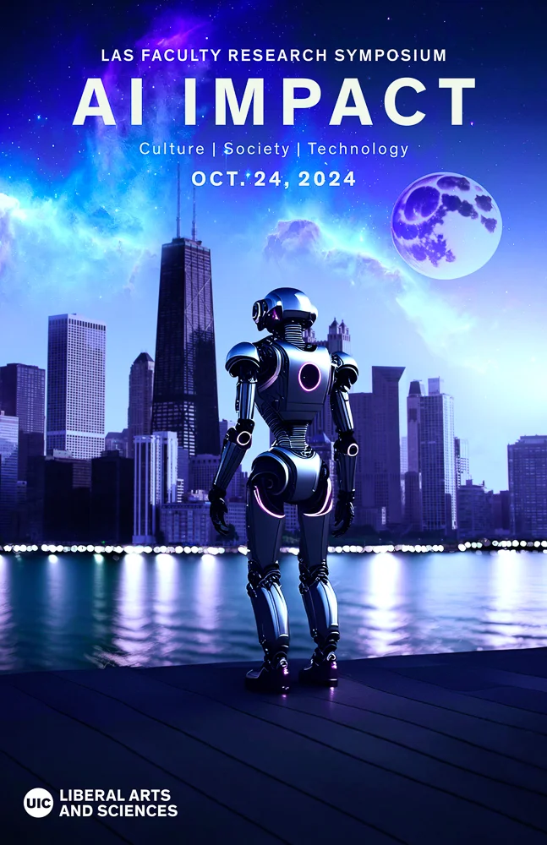
AI@UIC
Emerging technologies have allowed educators to offer immersive and creative experiences.
UIC LAS hosted a research symposium on AI IMPACT in October 2024, to look at Artificial Intelligence, including current and future applications.
AI and other innovative tools present an opportunity to change the way we teach.

Slide 4
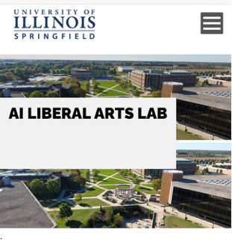
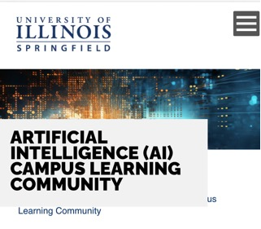
AI@UIS
UIS is pioneering an educational framework that prepares a new generation for the complexities of an AI-driven world and places the institution at the heart of shaping the future and ethical direction of AI.
Faculty and staff are working on the development of a prototype of an AI Lab with a focus on liberal arts skills, such as critical thinking skills, problem-solving, natural language processing, and various forms of writing and historical perspectives.
In 2023, UIS opened the Orion Lab, which allows students to take a hands-on approach to learning and encourages innovation and discovery. The possibilities are limitless.

Slide 5
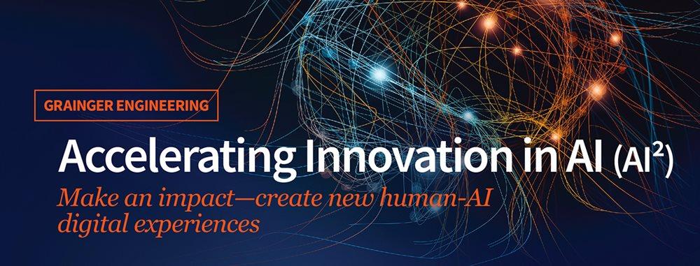
AI@UIUC
UIUC has led the charge by creating AI@UIUC and offering courses and certificates in AI Application and Innovation.
Since 2019, the university has conducted over $270 million of AI-related research projects, spurring advancements in agriculture, biotechnology, education, and other fields while equipping the next generation of inclusive experts with hands-on experience.

Slide 6
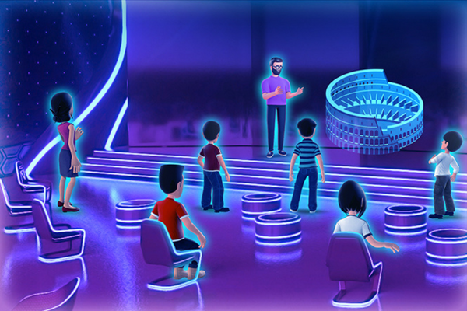
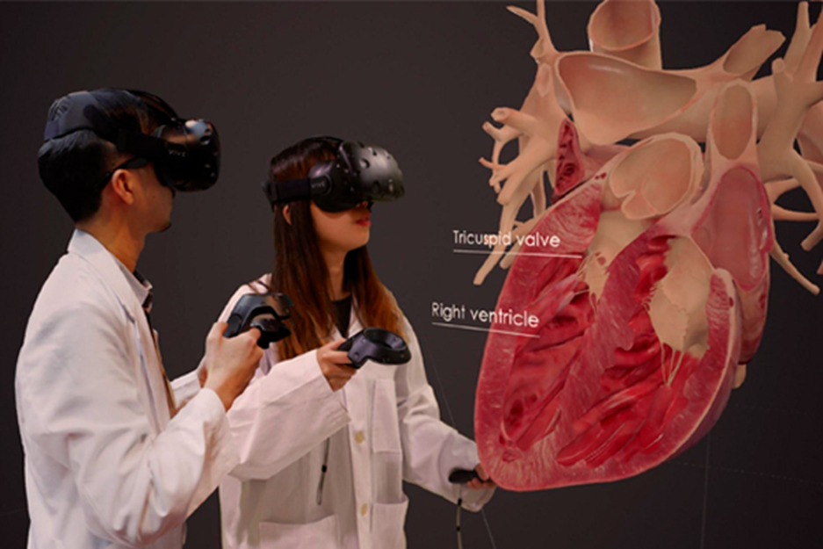
Augmented and Virtual Reality Applications
Investing in these technologies will enhance the growth of the UI System and allow us to be at the forefront of AI/AR/VR Technology.
Bridge learning across the classroom, schools, and universities using meta-classrooms.
Imagine working on an architecture project with classmates or using an immersive experience to dissect the human body with peers in another county or country.

Slide 7
Future Applications
Investing in the future of learning has long-reaching implications that will allow the U of I System to be a leader in education.
Ensure oversight and governance practices provide the necessary checks and balances.
These technology tools complement the new aims of the universities to expand into quantum computing and provide a foundation to build new ideas and collaborations across the globe.

Slide 8
Thank You
Questions?
Keia Hobbs, MD
Email: khobbs@uic.edu
Phone: 312-996-9117
Jeffrey Eric Jenkins
USC Chair
Email: jej@Illinois.edu
Phone: 217-333-1819

