Slide 1
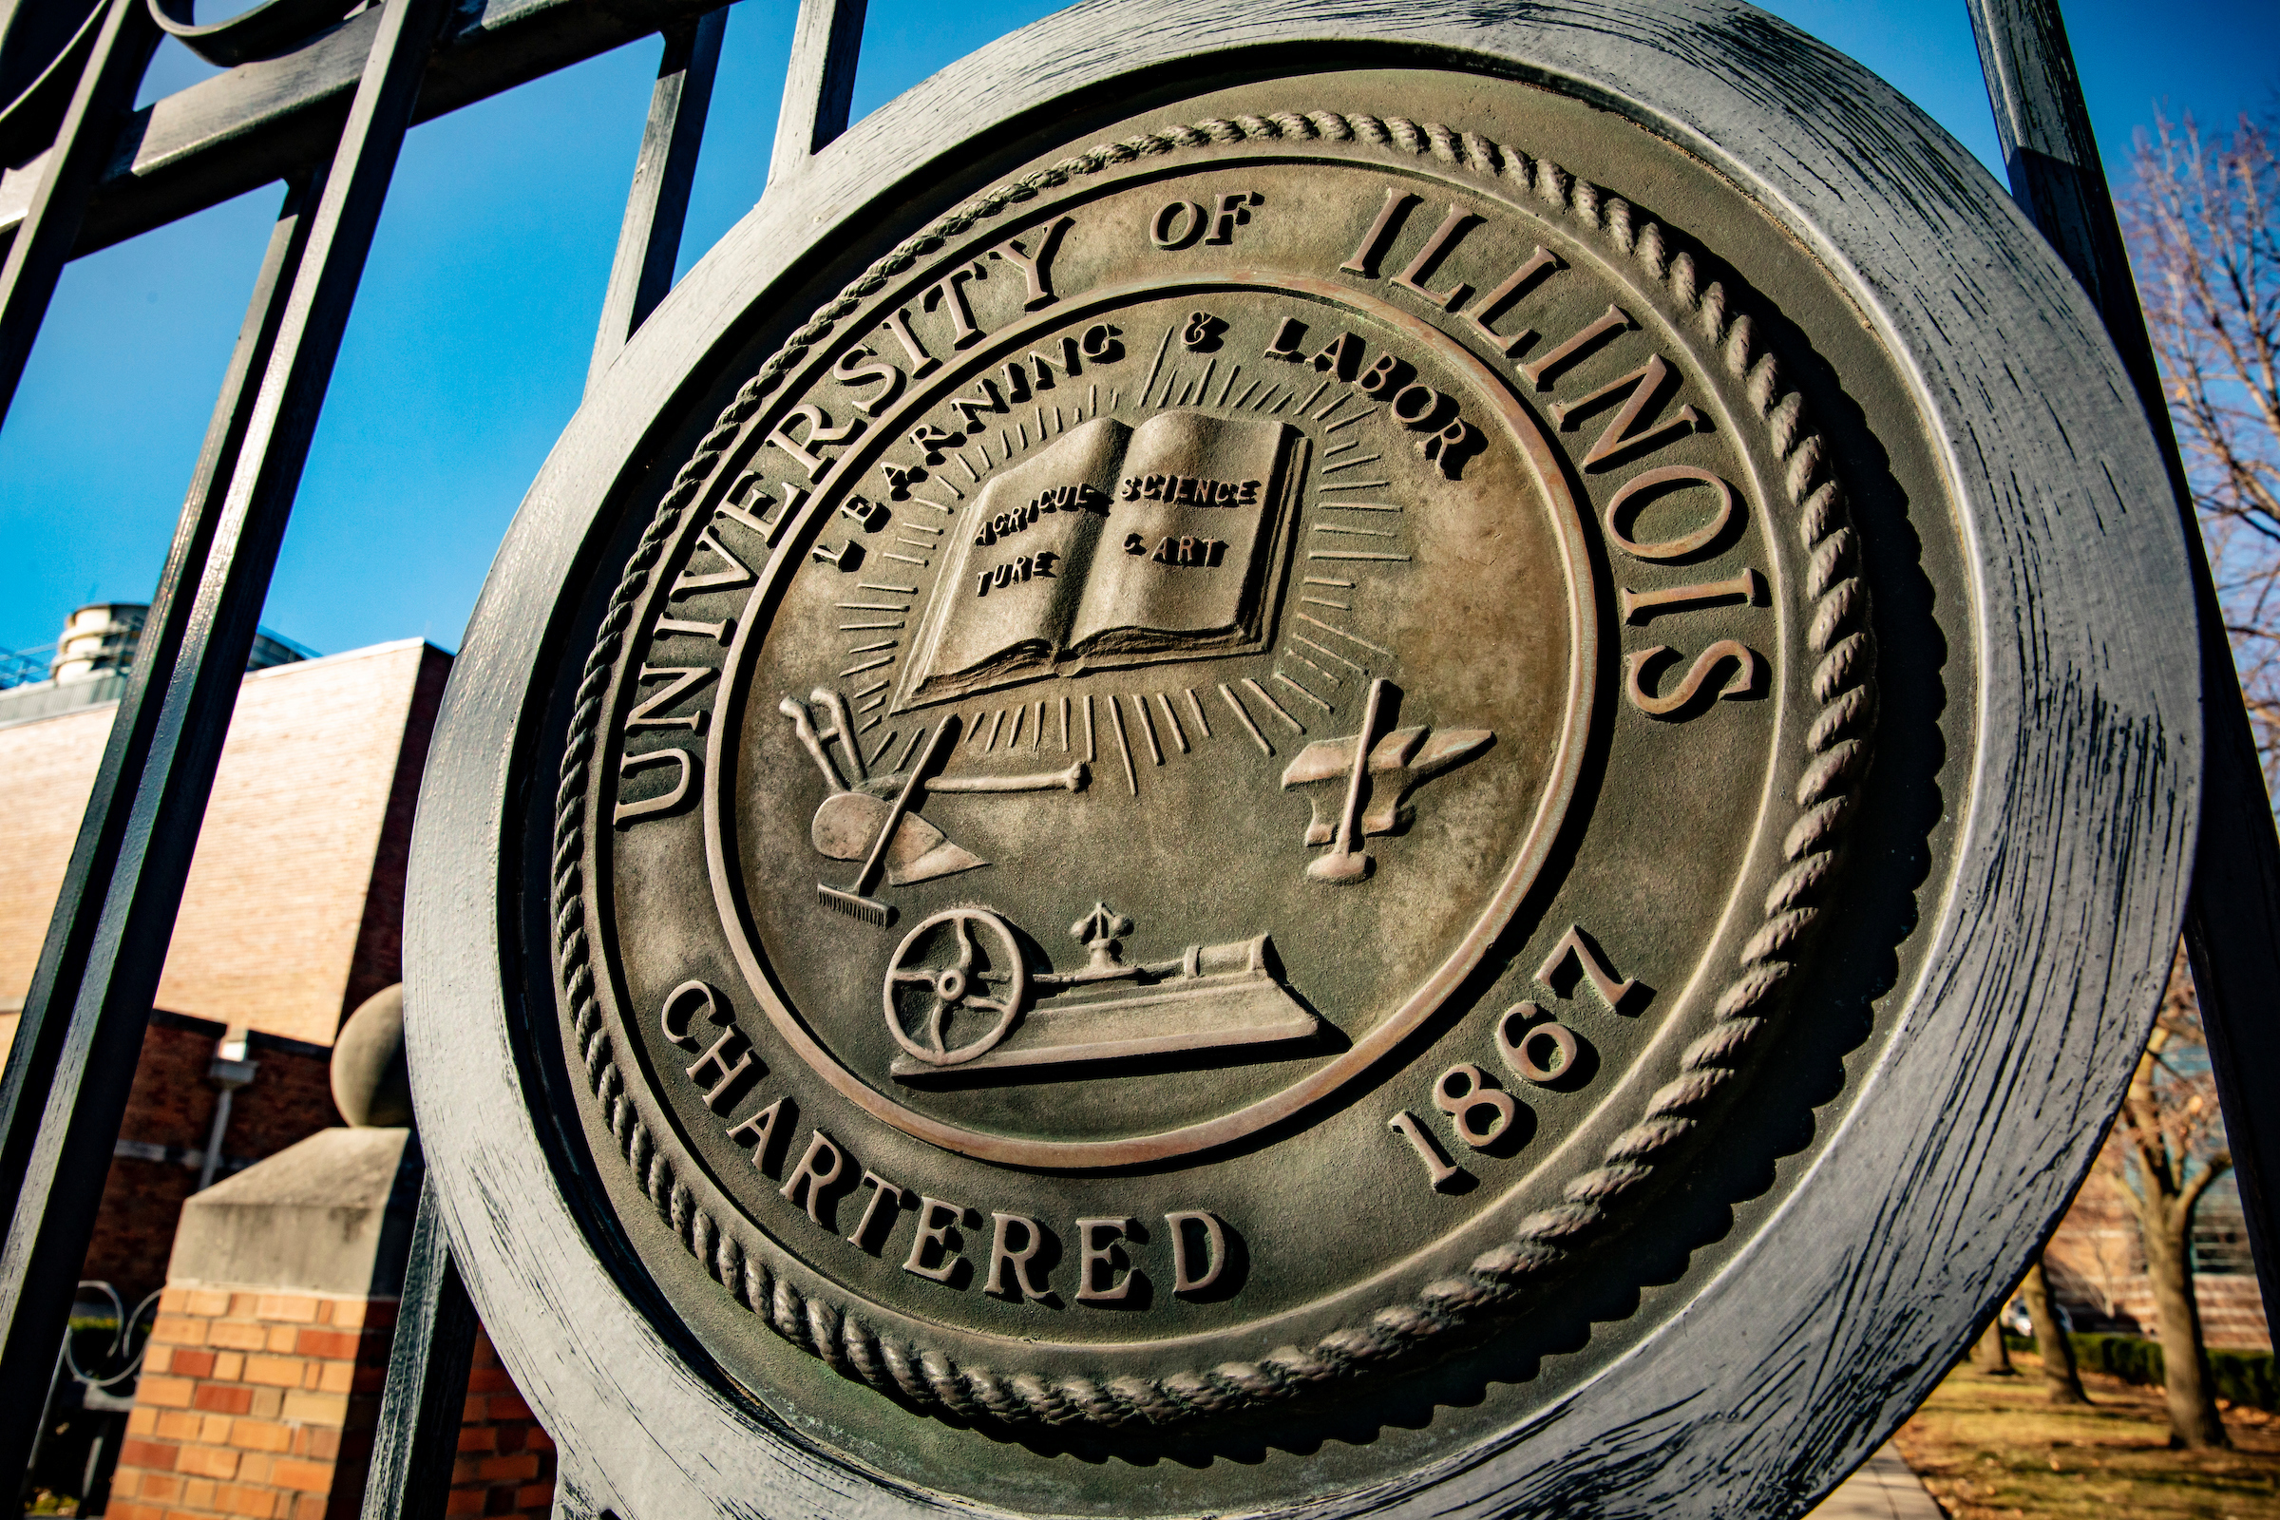
REMARKS TO THE BOARD OF TRUSTEES
January, 23rd, 2025
Tim Killeen, President
Notes:
Thank you, Chairman Ruiz, and congratulations on your election to this new role.
Your fellow trustees have certainly made an excellent decision in electing you to this leadership role.
I have enjoyed the many opportunities to work closely with you these past few years – both in your role as deputy governor and as a trustee – as we ensure that the U of I System is doing all it can to serve the people of this state.
And congratulations to Trustee Gutman on your reappointment.
I look forward to working with you both in the year ahead.

Slide 2
“Stand Firm”
Notes:
Abraham Lincoln is among the most-quoted leaders in American history, and there is one expression that appears to have been a favorite.
Again and again, President Lincoln advised the country, colleagues, friends and others to stand firm.
That idea, of standing firm, is consistent in Lincoln’s speeches, correspondence and, from what we can tell, his thinking.
Hold fast to your core values, he tells us, and know that they will see you through.
Lincoln’s certainty in those values also offers us a bedrock sense of optimism, rooted in knowing who you are, what’s most important, and what you’re meant to be.

Slide 3
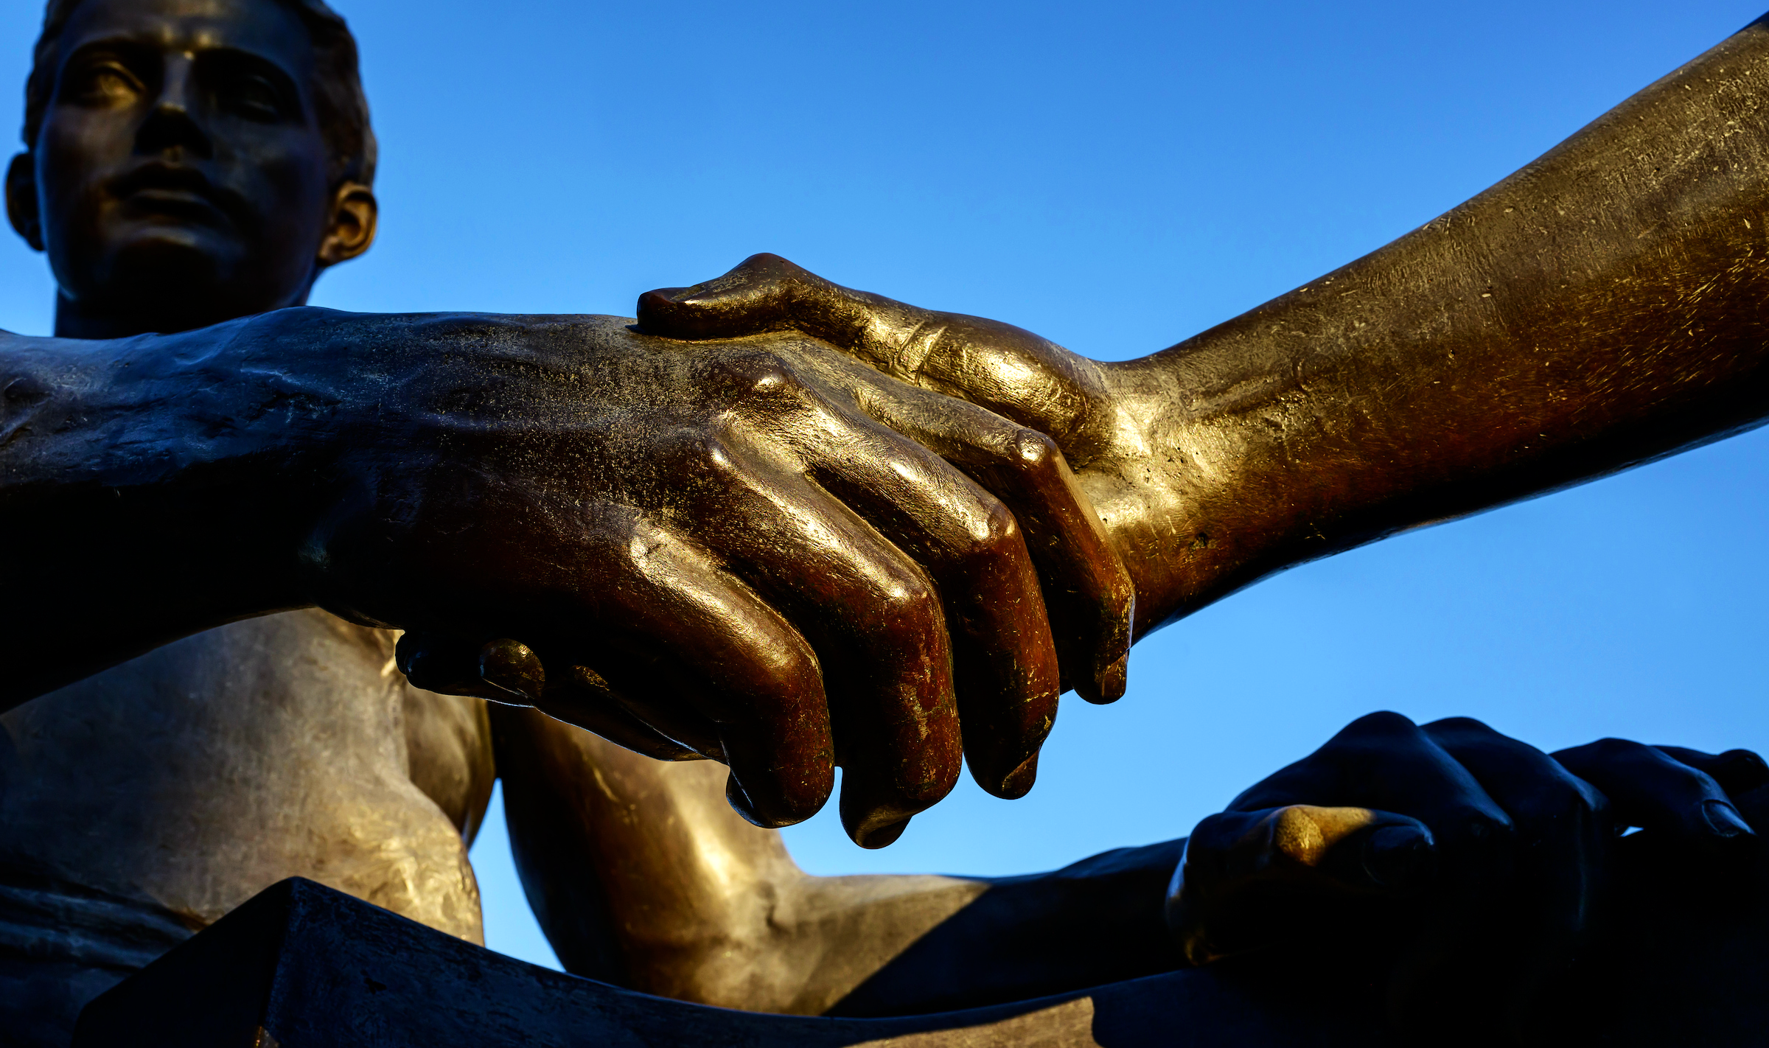
Rooted in Our Origins - Guided by Our Values
Notes:
Our origins date to the Morrill Act of 1862 and the land-grant university system it created.
The creation of the land-grant system was an expression of optimism and ambition during a difficult time – and a recognition of a need that higher education could meet and meet well.
What is now the University of Illinois System was meant to, bottom line, serve a growing public through education, research and innovation.
You can see this even now in our Strategic Framework and its four pillars. They state plainly who we are:
An Institution of and for our students …
Dedicated to research and scholarship with global impact …
Working to foster a healthy future for Illinois and the Midwest ….
All while building tomorrow's university today.
And we do all of this, again, to serve the people of this state: our students, their families … and every citizen of Illinois.
The values that guide us now are rooted in what you might think of as Lincoln’s pragmatic optimism.
And that’s where I find myself today, as we begin a new year.
Those of you who know me know that I am, fundamentally, an optimist.
But my optimism is rooted in a deep pragmatism based on the strengths – not just a few, but many of them – of the University of Illinois System.

Slide 4
Our Universities
Notes:
I want to talk about just a few of the ways we deliver for the people of our state beyond our campuses – they represent an important part of the power of being a system.
But I need to start with the fundamentals, our core missions and the way they reflect our values.
First, the students at our universities and the research and discovery happening there.

Slide 5
Growing Enrollment-Systemwide
Notes:
We enroll more than ever, 97,772 as of the fall. And we graduate more than ever – more than 27,041 in 2024.
Those graduations include a 51 percent increase in the number of Black graduates and a 117 percent increase in Hispanic graduates over the past decade.
We have work to do, to be sure, but that’s real progress.
Each one of those degrees represents a life changed – the research backs me up here, but it’s a fact that college graduates will earn more, $1.2 million more over a lifetime than someone who has only a high school diploma, according to the Association of Public and Land-grant Universities.
The experience of being a student — of being challenged to explore the world, interact with others from every background, and test your own ideas against lived experience — also provides every one of those 97,000-plus people enrolled on our campuses with the tools to be engaged citizens, active members of the communities they’ll live in.
Those benefits, economic and social, also reach those around our graduates: their families, their neighbors, their friends.
And we provide this growing access with affordability in mind. Families count on this.
Right now, we provide $298 million in financial aid a year. That’s an increase of about $104 million over the past decade.
When you combine our aid commitment with state and federal aid, more than a third of system undergraduates pay no tuition or fees.
And more than half of all instate undergraduate students enrolled across the system pay less than $3,000 a semester.
As a result, our students graduate with less debt than national averages.
And we do this with our state in mind: In-state students make up almost 80 percent of all undergraduate enrollment.
So, we’re changing the lives of students from Illinois, giving them the keys that will open so many doors in their lives, and doing it without requiring them to take on crippling debt.

Slide 6
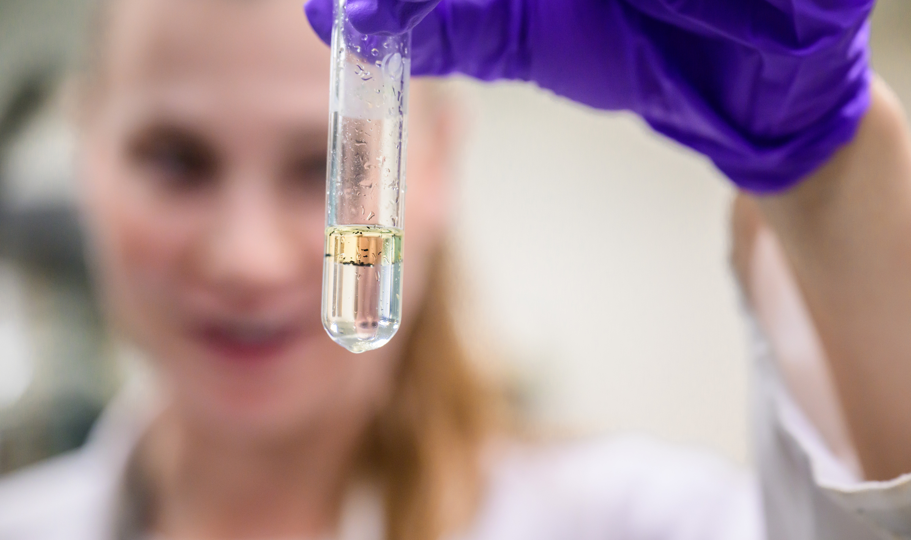
A Research Powerhouse
Notes:
We continue to be a research powerhouse, delivering on the investment that people of our state and the country make in our work, applying the results to help people here in Illinois and far beyond thrive economically and socially.
Let me give you a few quick examples of our research impact making news, just from these past few weeks:
At the University of Illinois Chicago, the Learning to Lead in Math project led by professor Alison Castro Superfine is using a U.S. Department of Education grant to work with principals and teachers across Cook County to improve K-8 math instruction.
At Urbana-Champaign, research led by Prairie Research Institute scientist Hong Lu has found a possible new way to decrease the reliance of commercial aircraft on fossil fuels, using a fuel additive made from polystyrene that might otherwise be destined for a landfill.
And at UIS, assistant professor Kyle Blount has just begun NSF-funded research on how irrigation of lawns and parks affects water movement and mitigates extreme heat.
In just those three quick examples, you can see the U of I System at work on some of the great challenges and needs before us: improving primary education, searching for ways to make air travel more sustainable, and digging into one potential source of heat mitigation as we confront climate change.
Now let me talk in a bit more detail about just a couple of other ways the U of I System is at work in the life of our state.

Slide 7
UI Health: At work for Chicago and the State
Notes:
It would be difficult to overstate the importance of the roles the University of Illinois Chicago and UI Health play in the health and well-being of this city and our state.
You can see for yourself.
Campuses in Chicago, Peoria, the Quad Cities, Rockford, Springfield, and Urbana, and seven health science colleges: Applied Health Sciences; Dentistry, Medicine, Nursing; Pharmacy; the School of Public Health; and the Jane Addams College of Social Work.
And this is what they give Illinois:
One in every three dentists in Illinois trained at UIC.
One in every eight physicians in our state completed their MD at UIC, and one in every three physicians has trained here in some way.
More than 8,000 nurses working in our state trained here, too.
That’s also true of one in every four social workers in Illinois. And one in every three pharmacists.
In all, UIC added almost 2,400 new – and badly needed, I might add -- healthcare professionals to our state’s workforce in 2024.
But UIC and UI Health are also frontline caregivers for so many here in the city and beyond.
That’s through the University of Illinois Hospital, and through the Mile Square Health Center network. In all, they had more than 1,4 million patients visits in FY 2024.
Let’s talk in particular about what I consider a real gem, Mile Square.
Mile Square Health Center opened in the late 1960s on Chicago’s near West Side, the creation of a group of determined community activists trying to find some way to provide quality healthcare for their neighborhood.
It became a part of the U of I System in 1999 and today, Mile Square’s 11 clinics – 10 in Chicagoland and one in Rockford – exist to provide high-quality, holistic health care for tens of thousands of patients who live in underserved areas.
In FY ’24, Mile Square conducted more than 158,000 patient visits.
Most patients are from historically disenfranchised racial and ethnic minority communities and many live in poverty, either lacking insurance entirely or with only the most basic coverage.
They look to Mile Square — and they are, one and all, treated regardless of their ability to pay.

Slide 8
Surgeon General Julius B. Richmond
Notes:
By the way, the foundations of the national movement for Federally Qualified Health Centers – Mile Square is now one of them – were laid here in the U of I System by U.S. Surgeon General Julius B. Richmond.
After graduating from Urbana-Champaign, he completed his medical degree at the College of Medicine, later was a faculty member, and is widely known as the “grandfather of FQHCs.
A pediatrician, he also was co-founder and the first director of Head Start.

Slide 9
Heather Pendergrast Associate Dean for clinical affairs at UIC
Notes:
Now I want to take a moment to tell you more about another UI Health initiative, the 55th and Pulaski Health Collaborative.
This innovative partnership provides comprehensive health services to Chicago's Gage Park and West Elsdon communities.
The list of what’s available is as long as your arm, but it includes specialty care in cardiology, dermatology, endocrinology, neurology, ophthalmology, sports medicine and on and on.
I was fortunate to be there last October as part of our annual State Leadership Tour to learn more.
The video you’re about to see is from the tour. It’s from Heather Prendergast, the associate dean for clinical affairs at UIC, telling us a little about origins of the 55th and Pulaski Health Collaborative.
(VIDEO PLAYS HERE)
Absolutely unprecedented access, and meeting needs that otherwise that likely would not be met.

Slide 10
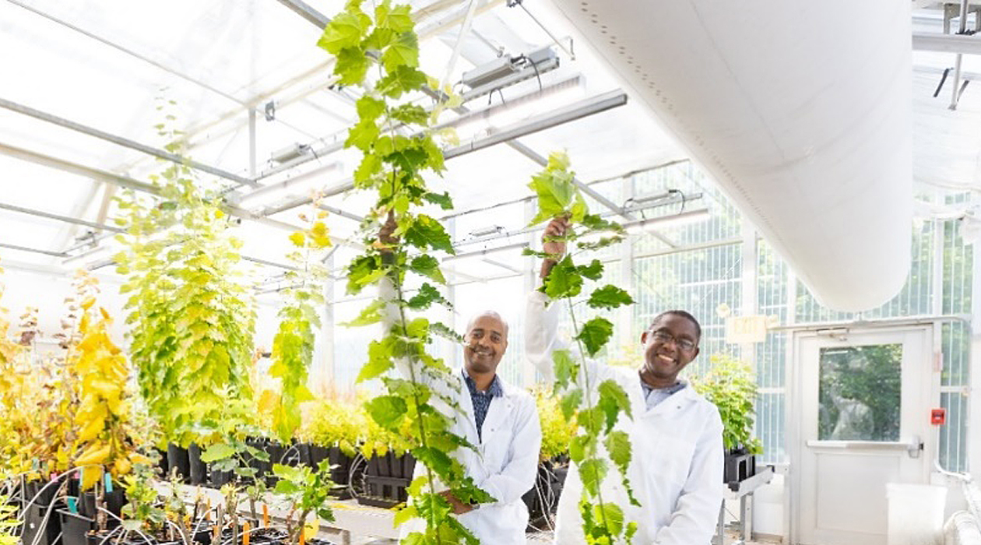
Bigger Crop Yields to Meet Growing Demands
Notes:
The growing world population and changing climate make our efforts to boost agricultural production absolutely vital.
I want to dig into just one example of how our researchers are succeeding.
A team of scientists from the Center for Advanced Bioenergy and Bioproducts Innovation at Urbana-Champaign has identified a gene that enhances photosynthesis and can boost the plant height.
Researchers at CABBI and their collaborators at Oak Ridge National Laboratory call the gene BOOSTER and have found that it helps drive fast growth and increased height in poplar trees.
You can see in the photo, on the left, a tree with elevated levels of the BOOSTER gene, while the tree on the right is the same age but smaller due to lower expression of the gene.
It’s a first step toward possible application on a large scale in food and bioenergy crops to give farmers another tool to boost production.

Slide 11
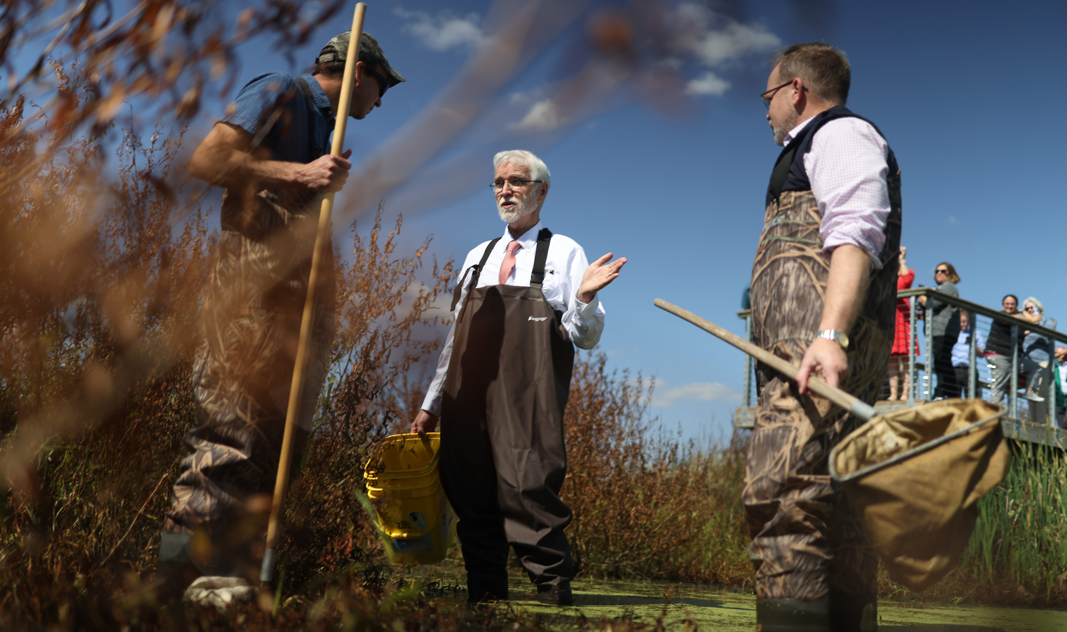
Connecting with the People of Illinois
Notes:
Just a few minutes ago I mentioned our State Tour.
Every year we spend six days cris-crossing the state, listening, learning and connecting with people.
You can see here our stop last October at the Therkildsen Field Station that UIS operates at the Emiquon Preserve near Havana.
(SPEAK OFF THE CUFF ABOUT THE PHOTO AND WHAT’S HAPPENING IF APPROPRIATE)
These face-to-face engagements every fall lead to new collaborations – we are working more closely now with community colleges to foster transfer success in large part because of our meetings through the tour, for instance.
We also strengthen longstanding partnerships.
The Illinois Farm Bureau hosted us in Bloomington, and provided a tremendous reminder for us just how vital the U of I System is and long has been to Illinois agriculture – that connection truly does go all the way back to our founding.
After the tour, IFB President Brian Duncan, who is an Ogle County livestock and grain farmer, wrote to express his thanks.
He also noted some of the many areas in which we share interests, including the federal Farm Bill and our longstanding collaborations on ag research and other areas in Urbana-Champaign.
Brian also noted recent talks with UIC and expressed interest in exploring the possibility of working even more with UIS, as well.

Slide 12
Madison Harris Homewood-Flossmoor Community High School, Flossmoor, Illinois
Notes:
My favorite numbers from tour are these:
3 – the number of high schools we visited last October – and 26. That’s how many students we had the chance to speak with face to face in the way you really only can in small groups.
We learned on an earlier tour just how much it means for the U of I System and its universities to show up in high schools, to tell them about who we are and how they might find a place on one of our campuses.
As we’ve heard from administrators again and again, some of the students we meet don’t consider us a possibility until they actually see us and talk with us.
And they’re incredibly grateful for the chance to talk with us and learn more about what is possible.
It plants a seed that can grow into something much bigger.
I’ll let one of those students tell you more.
This is Madison Harris, a student at Homewood-Flossmoor Community High School in Flossmoor with big plans for her future.
(VIDEO PLAYS HERE)

Slide 13
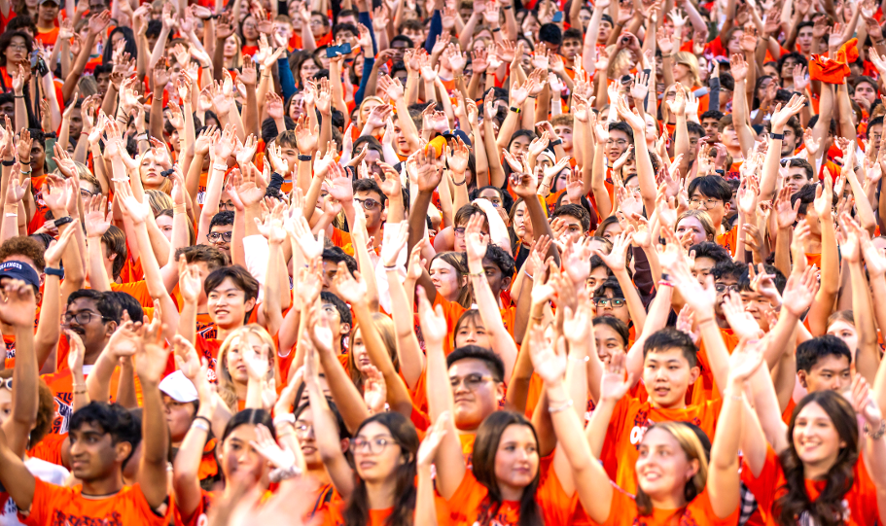
Delivering for the Public Good at an Unmatched Scale
Notes:
These are some of the ways the U of I System is driving deep impact, impact for the better, on the lives of the people of Illinois and many more beyond our state borders.
I’d wager that almost every person in this room could tell us many more.
The common thread through them all is those core values I talked of in the beginning, detailed in the Strategic Framework and lived every day at our three universities and across the rest of the system.
Because of our enrollment – which is more than half of the state’s public higher education students – and our broad reach here in Illinois and around the world, we do all of this at a scale no other institution in this state can match.
Working for the public good, and delivering, at an unmatched scale.
The foundation beneath all of this is built on our values and, like Lincoln, our feet are planted and we’re standing firm.

Slide 14
Thank You
Notes:
Thank you all.

