Slide 1
REMARKS TO THE BOARD OF TRUSTEES
REMARKS TO THE BOARD OF TRUSTEES
President Tim Killeen
January 26, 2023
Notes:
Thank you, Chair Edwards, and all our University of Illinois System trustees -- it’s great to see all of you again. I appreciate your ongoing dedication and service as we continue to plot a course into the future.
Welcome to a new year and, at our three universities, our more than 94,000 students have begun a new spring semester of learning and doing on their way to degrees that will give them the chance at bigger and better tomorrows.
The through line in all that we do – education, research, public service and outreach – is innovation, the act of doing something differently and better.

Slide 2
Innovation: collaboration, ideation, implementation, and value creation
innovation
COLLABORATION, IDEATION, IMPLEMENTATION AND VALUE CREATION
Notes:
There are what seems to be an endless number of ways to define and describe innovation in the contexts of education, business, government, agriculture and on and on. Google will point you to more of them than you likely care to read.
But a woman named Faith Weekly who is a community development advisor at the St. Louis Federal Reserve took an approach in a paper she authored that I quite appreciate, breaking innovation down into component parts.
Innovation requires collaboration, ideation, implementation and value creation. Almost like a recipe … one that, taken at face value, really requires just these four simple ingredients.

Slide 3
An innovative history
AN INNOVATIVE HISTORY
“IF YOU LOOK AT HISTORY, INNOVATION DOESN’T COME JUST FROM GIVING PEOPLE INCENTIVES; IT COMES FROM CREATING ENVIRONMENTS WHERE THEIR IDEAS CAN CONNECT.“
- Steven Johnson, science author
Notes:
“If you look at history, innovation doesn’t come just from giving people incentives; it comes from creating environments where their ideas can connect.” - Steven Johnson, science author
I would add a fifth ingredient: environment. A place for innovation to happen.
The science author Steven Johnson laid it out well, as you can see here (ON SLIDE): Innovation comes from creating environments where ideas can connect and incubate.
Put simply, that’s us.
You find a whole ecosystem of individual, overlapping environments across the University of Illinois System.
That began with our founding and the land-grant mission itself. The idea behind the land-grant university was pure innovation.
They were the product of the Morrill Act of 1862 – signed into law by Illinois’ own Abraham Lincoln – which gave every state and territory land to create a university whose primary mission was higher education for the masses.
The University of Illinois sprang from that spark of genius in 1867.
It is probably impossible to catalogue every innovation that has followed, in our classrooms and outside of them, but it’s safe to say that they have collectively changed human life and society, made life better.
The majority of these changes for the better have long legs that reach into the future, even those whose time seems to have passed.
On them are built new ideas and new ways of thinking that reach up and up to where we are today and will continue to do so well into the future, beyond us all.

Slide 4
Abraham Lincoln
ABRAHAM LINCOLN
UNDERSTANDING OUR PAST TO HELP GUIDE US IN THE FUTURE
- Professor Michael Burlingame, UIS
Author “Abraham Lincoln: A Life” & “The Inner World of Abraham Lincoln”
Notes:
Technology often springs to mind when we think about innovation, and it’s crucially important in our world.
But innovation isn’t the exclusive province of technology. Innovation can drive our understanding of our past, as well.
Professor Michael Burlingame, the Chancellor Naomi B. Lynn Distinguished Chair in Lincoln Studies at UIS, is a leading expert on Lincoln and has for decades enriched our understanding of the man whose hand helped shape the country as we know it today and the pivotal times in which he lived.
Burlingame’s “ABRAHAM LINCOLN: A LIFE” won the 2010 Lincoln Prize, honoring the book as one of the finest scholarly works on Lincoln. It is one of Burlingame’s 12 books on Lincoln and his life.

Slide 5
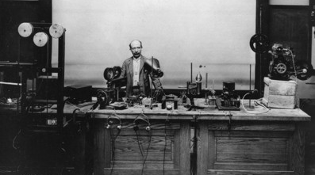
First sound on film
FIRST SOUND ON FILM
PROFESSOR JOSEPH TYKOCHINSKI-TYKOCINER – THE FIRST “TALKIE,” 1922
Notes:
For breadth of innovation and impact, it would be hard to surpass PLATO, the distributed computer learning system built in the early 1960s at Urbana-Champaign.
PLATO was the first of its kind and, at its peak, included several thousand terminals around the world. The women pictured at these terminals on campus and those involved in PLATO were true pioneers.
PLATO was the forerunner of, and this is quite a list:
Computer-based learning – think for a moment about just how critical this has been the past few years.
Also, online networking.
Plasma flat-panel displays – can imagine a world without them?
PLATO also gave us interactive touch screens.
A whole range of software innovations were driven by PLATO and its users.
And … this might be the really big one … PLATO was a precursor to today’s entire online world
It was a thriving online community that predated social media by decades.

Slide 6
Jane Addams and hull house
JANE ADDAMS & HULL HOUSE
PIONEER OF AMERICAN SOCIAL WORK, NOBEL PEACE PRIZE RECIPIENT
Notes:
Jane Addams was a true pioneer of another sort, working on the frontiers of peace activism – she was a Nobel Prize winner – she was the mother of social work as a profession in this country.
UIC’s Jane Addams School of Social Work bears her name and carries on her mission.
A native of the little village of Cedarville, Illinois, up near the Wisconsin state line, she and a friend established Hull House in what was then a neighborhood of working-class immigrants on Chicago’s near-west side.
Hull House was a settlement house, where educated women lived and maintained a sort of community center where the newly immigrated who lived nearby could pick up the skills they needed to plant their own American roots.
This is now part of the campus here at UIC. Two of the Hull House buildings are now the Hull House Museum.
Hull House and other settlement houses were forerunners of centers like the recently opened UIC Neighborhood Center and Auburn Gresham Healthy Lifestyle Hub.

Slide 7
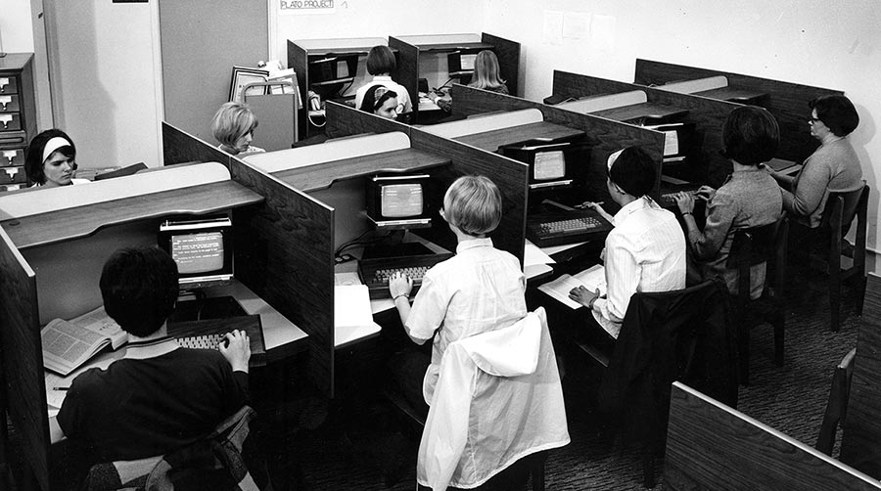
plato
PLATO
THE FIRST COMPUTER-ASSISTED INSTRUCTION SYSTEM AND FORERUNNER OF TODAY’S ONLINE WORLD.
Notes:
For breadth of innovation and impact, it would be hard to surpass PLATO, the distributed computer learning system built in the early 1960s at Urbana-Champaign.
PLATO was the first of its kind and, at its peak, included several thousand terminals around the world.
It was the forerunner of, and this is quite a list:
Computer-based learning – think for a moment about just how critical this has been the past few years.
Also, online networking.
Plasma flat-panel displays – can imagine a world without them?
PLATO also gave us interactive touch screens.
A whole range of software innovations were driven by PLATO and its users.
And … this might be the really big one … PLATO was a precursor to today’s entire online world
It was a thriving online community that predated social media by decades.

Slide 8
Innovation right now
“INNOVATION IS THE ABILITY TO SEE CHANGE AS AN OPPORTUNITY – NOT A THREAT.”
- Steve Jobs
innovation
RIGHT NOW
Notes:
“Innovation is the ability to see change as an opportunity – not a threat.” - Steve Jobs
Innovation so often has that enduring impact, to reach into our classrooms and laboratories—and our lives – and propel what happens next, to answer questions being asked by the changes happening around us right now.
Or as Steve Jobs put it, to see change as an opportunity.

Slide 9
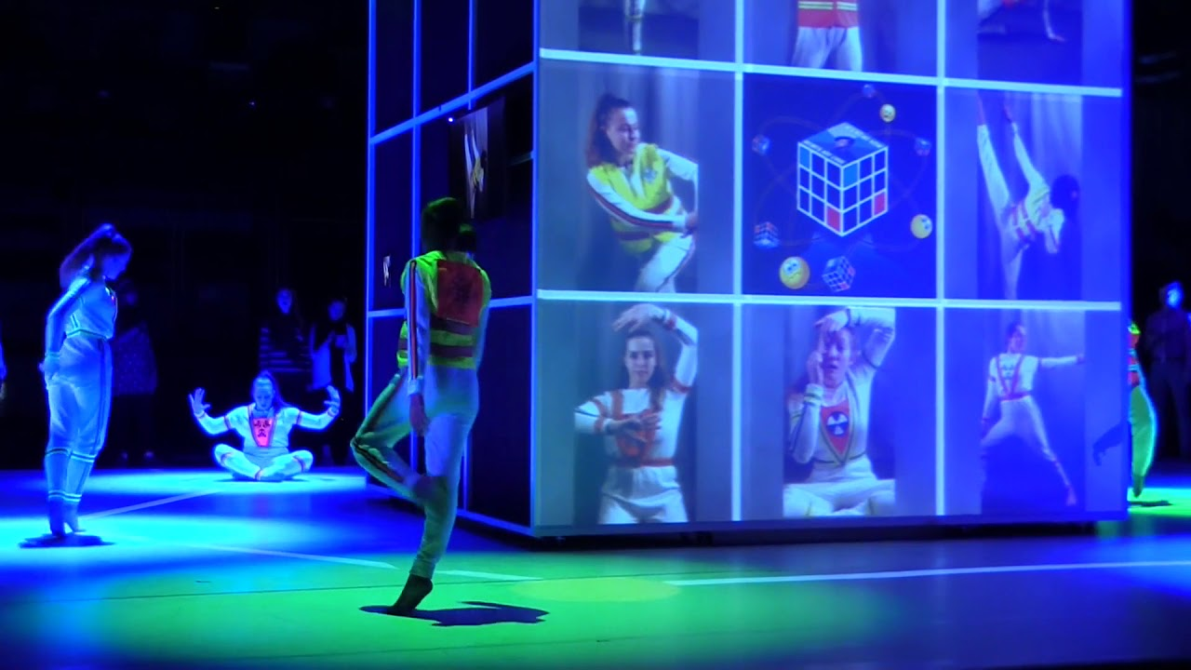
When art and technology meet
WHEN ART AND TECHNOLOGY MEET
INTEGRATING TECHNOLOGY AND THE AUDIENCE INTO PERFORMANCES
Notes:
You don’t have to look hard to see PLATO’s influence in the work of Urbana-Champaign Professor John Toenjes, using technology to weave together audience and performers in theater and dance.
Toenjes is the director of the university’s Department of Dance but also a fellow at the National Center for Supercomputing Applications, where he launched the Laboratory for Audience Interactive Technologies.
The lab generated an app called Mosho that has been used in a variety of performance settings to allow an audience to interact with performers and play a role themselves.

Slide 10
Treatments for devastating illnesses
TREATMENTS FOR DEVASTATING ILLNESSES
Notes:
The University of Illinois College of Medicine and UIC’s UIHealth combine to give us a medical powerhouse where research is concerned, one that provides the power to save lives but also change lives for the better.
Shingles is a painful condition that almost a third of Americans will unfortunately experience.
Shingrix is a vaccine for shingles developed at the at College of Medicine at Rockford. It was the first shingles vaccine that could be used on people who are immunocompromised.
The successful HIV/AIDS treatment Prezista was developed by a former UIC professor and, in addition to saving lives, its royalties also support several endowed chairs at UIC.
Crucially, we worked with the United Nations to make Prezista available at little cost to people living with HIV in Sub-Saharan Africa and other areas that are among the least-developed places in the world.

Slide 11
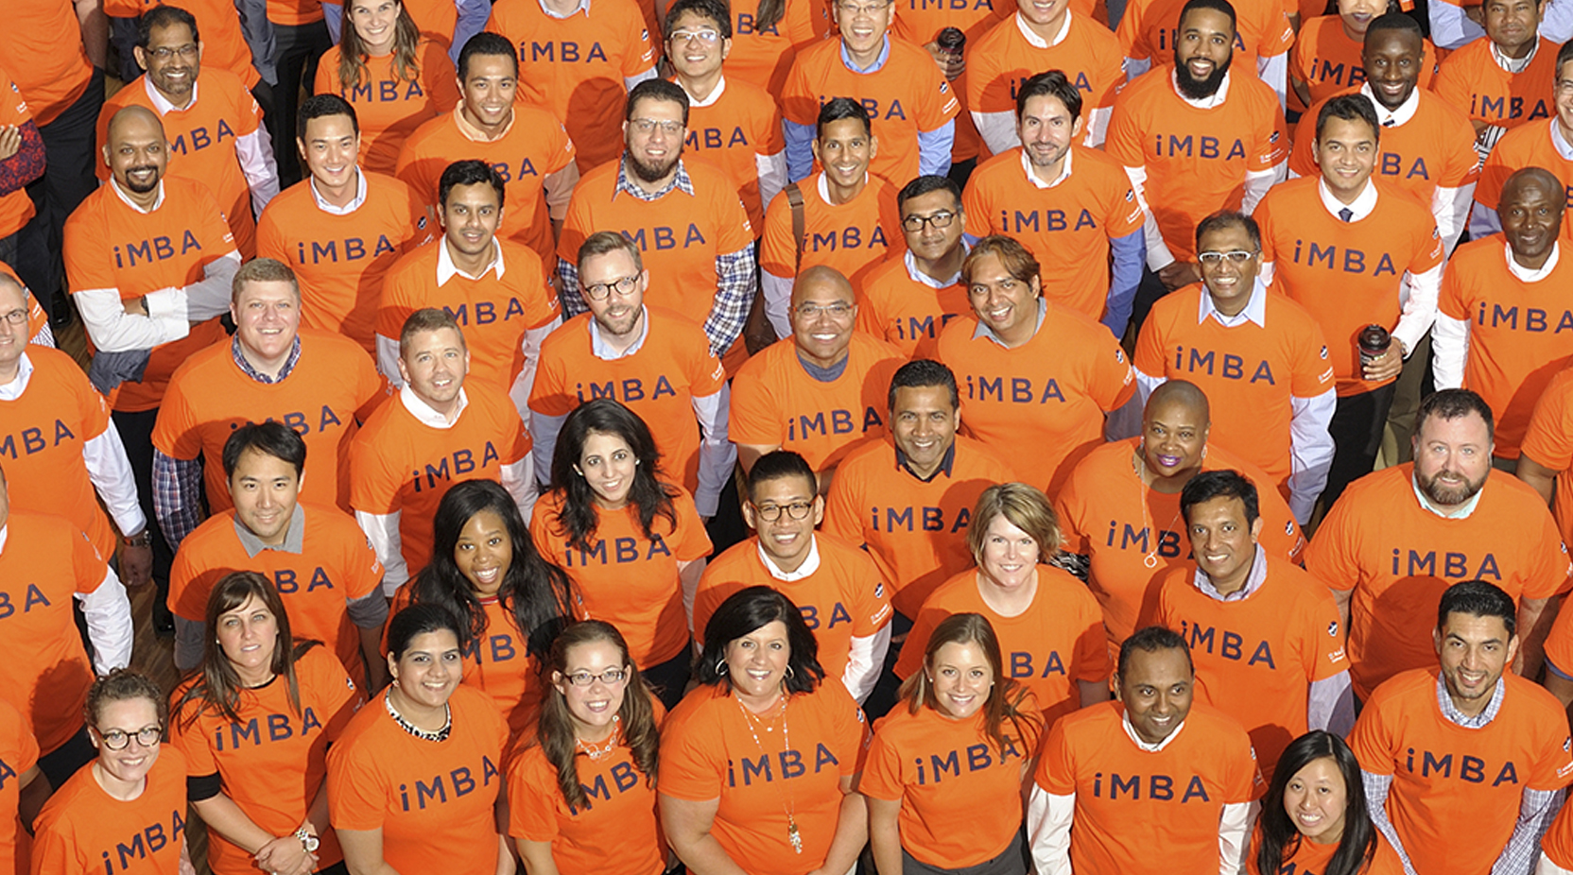
Cutting edge education
CUTTING EDGE EDUCATION
IMBA AT GIES COLLEGE OF BUSINESS
Notes:
Innovation also provides improvements right here on our campuses.
One among many examples is the iMBA program at the Gies College of Business in Urbana. Last year Poets & Quants named it the U.S. MBA Program of the Year and it now has about 4,000 students worldwide.
The degree is fully online so it’s extremely accessible. It costs a fraction of what many MBAs cost. And it takes a stackable approach that allows students to apply credit from the department’s Master of Science in Management, Master of Science in Accountancy or several certificate programs to their MBA.

Slide 12
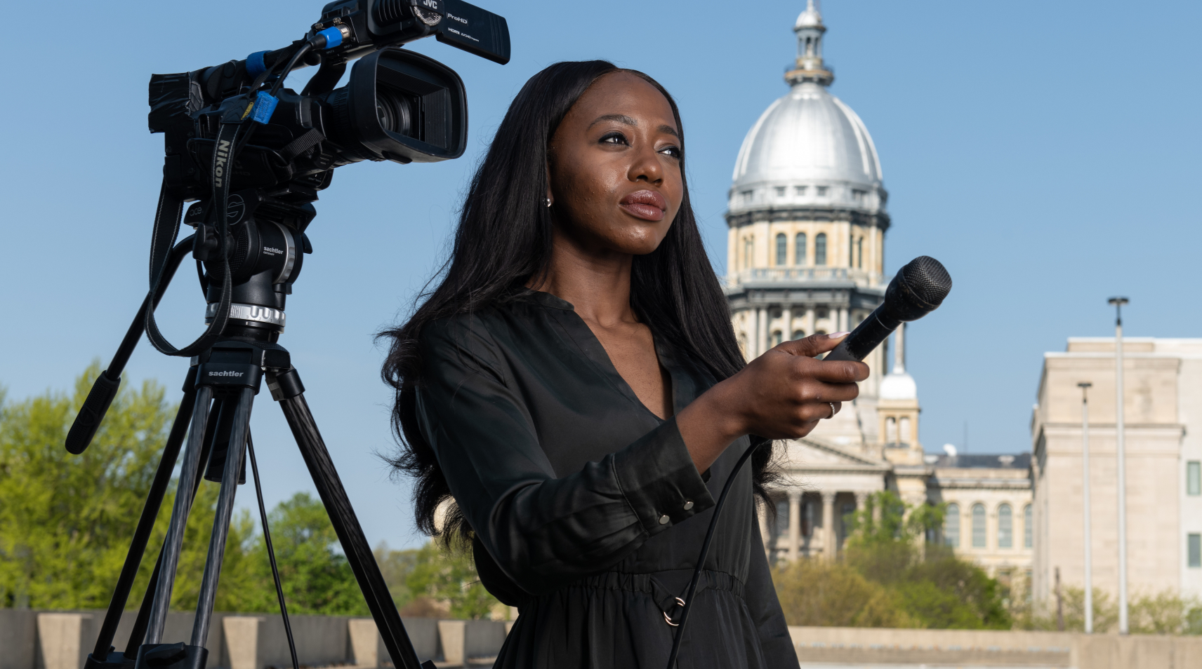
Training journalists for turbulent times
TRAINING JOURNALISTS FOR TURBULENT TIMES
PUBLIC AFFAIRS REPORTING PROGRAM
Notes:
In this era of conspiracy theories, “alternative facts” and rampant misinformation, the Public Affairs Reporting Program at UIS is training students to provide an antidote: fact-based reporting on government and politics that can offer clarity to news consumers.
PAR alumni are at work in Springfield, Chicago and across the country, including the nation’s capital.
Just one measure of PAR’s impact: Three alums are Pulitzer Prize winners.

Slide 13
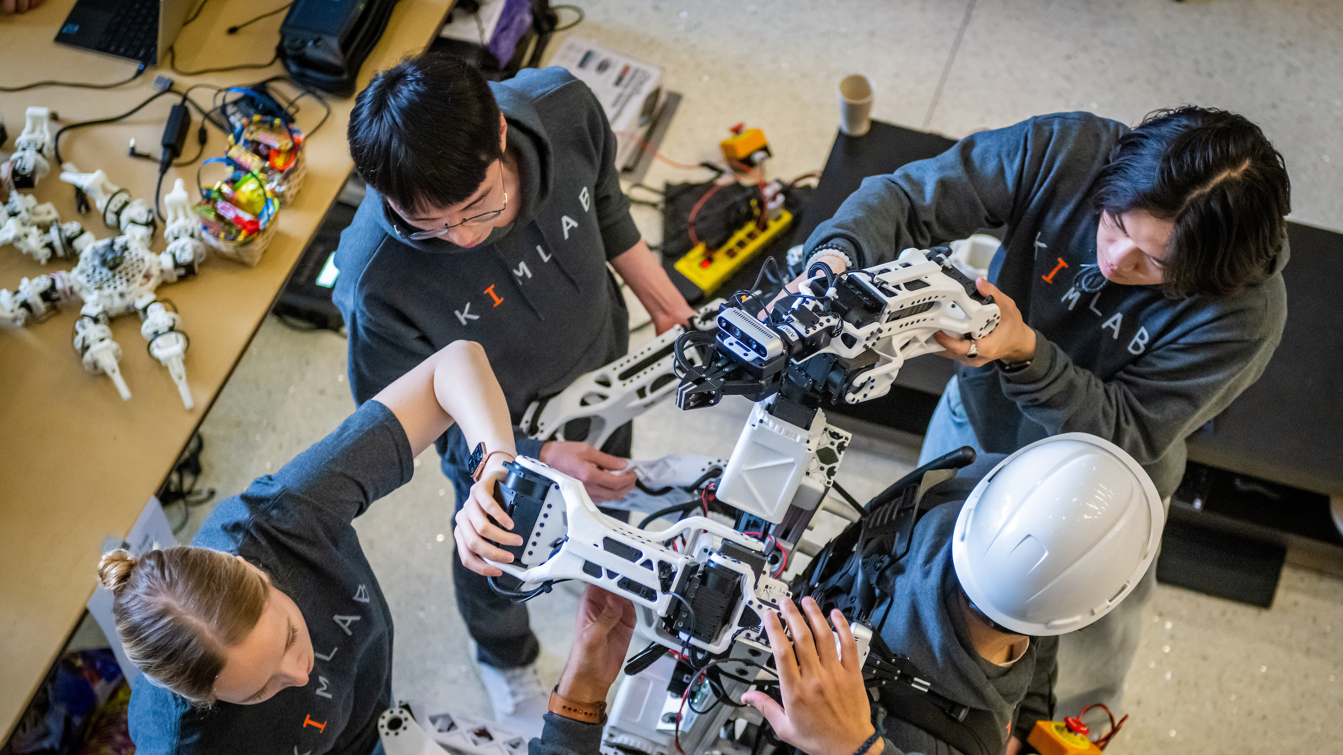
Innovation for tomorrow
Innovation FOR
“The best way to predict the future is to create it.”
- Alan Kay, computer scientist and Turing Award laureate
TOMORROW
Notes:
The innovation happening on our campuses over the past few years and even now – the research and advances I’m talking about today and so many more -- will have a strong hand in defining the future we live in.
As the quote from computer scientist Alan Kay suggests, it is the best way to build the world that we want to live in, and the one we want to leave for our children and grandchildren.
It is also the best way to work toward a world that provides opportunity for all, starting with making sure basic needs and looming challenges are met.

Slide 14
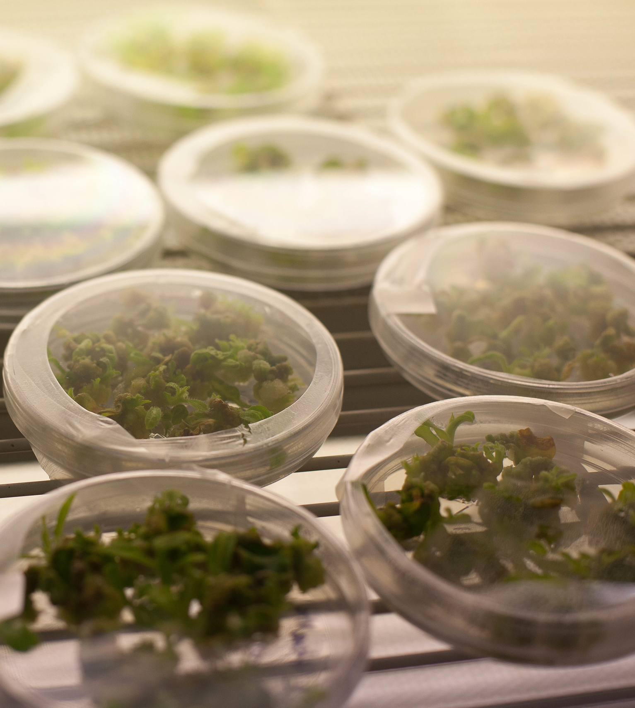
Our challenge: to feed the world
OUR CHALLENGE: TO THE FEED THE WORLD
RIPE and Perennial rice
Notes:
Research aimed squarely at feeding a growing world population amid a changing climate is a mainstay at the University of Illinois and no doubt will be well into the future.
Urbana-Champaign is, as we know, an agricultural dynamo. Just a couple of examples that will pay dividends for years to come:
Realizing Increased Photosynthetic Efﬁciency, or RIPE, has no small mission: It was created to end hunger worldwide by improving the photosynthesis to increase crop production.
And its work, now a decade old, is showing tremendous promise. The Bill and Melinda Gates Foundation just provided $34 million to extend RIPE’s work to increase production of cowpeas, a staple of small African farms, and soybeans.
RIPE researchers also have modified plants with a protein found in algae to improve their photosynthesis and increase growth while using less water.
The increasing adoption of perennial rice developed by crop scientists at Urbana-Champaign, meanwhile, means farmers can reap up to eight harvests from plants rather than replanting each growing season.

Slide 15
Better computing for the years ahead
BETTER COMPUTING FOR THE YEARS AHEAD
Notes:
Advances in computing have radically altered our way of life over the past few decades, and the need for further advances – the need to quickly process growing amounts of data that are increasingly touching every aspect of life while using as little energy as possible -- will only continue.
The ACE Center for Evolvable Computing in Urbana’s Grainger College of Engineering, opened just this month, was created to develop distributed computing technology to help meet those twin demands, processing speed and energy efficiency.

Slide 16
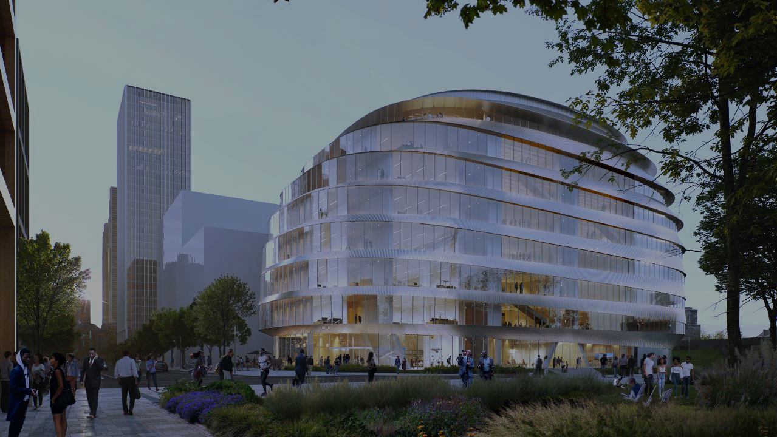
Reaching a state and its people
REACHING A STATE AND ITS PEOPLE
ILLINOIS INNOVATION NETWORK AND DISCOVERY PARTNERS INSTITUTE
Notes:
Innovation also comes in creating new environments for the innovators.
The University of Illinois System has partnered with the state of Illinois, the other public universities in the state and a range of other public and private entities to create a network of such environments through the Illinois Innovation Network and its Discovery Partners Institute in Chicago.
State funding has helped make the 15 IIN hubs, including DPI, a reality.
And now researchers from across IIN are working on projects aimed at an array of regional needs related to the economy, health and social well-being.
Just this month, teams were awarded grants for projects that will introduce K-12 students to artificial intelligence as a key component of autonomous vehicle technology, use machine learning and optimization tools to more efficiently maintain Illinois’ roads, and develop short courses to support the Illinois livestock industry.
DPI is, of course, at work training the next-generation workforce for Chicagoland and is a pioneer in wastewater testing now deployed at our universities and across the state to monitor for the spread of COVID-19 and the flu virus.
And its new headquarters, now in the planning stage, will anchor an innovation district in Chicago South Loop that will help shape the economy of the city and region for decades to come.

Slide 17
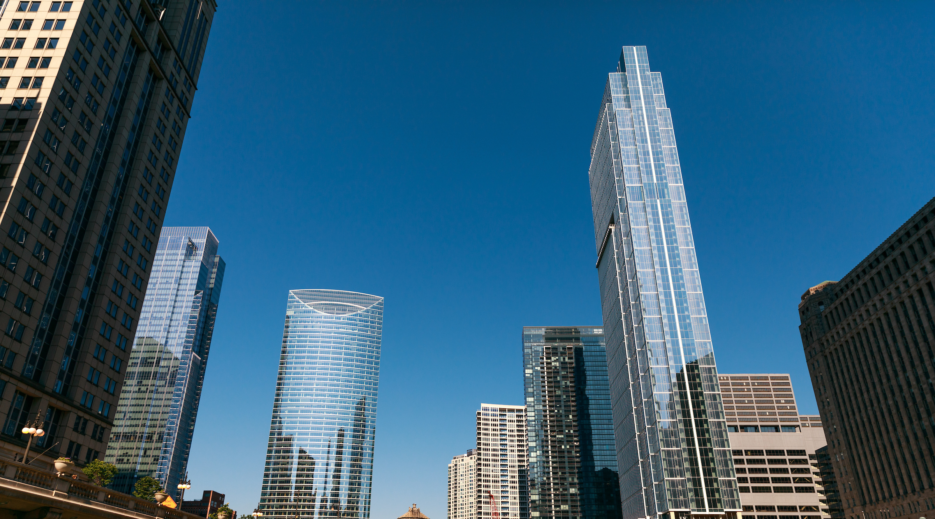
Define innovation
“APPROACHING EVERY SITUATION SAYING, ‘HOW CAN WE MAKE THIS BETTER?’”
– Karin Hurt, Author and Former Verizon Wireless executive
DEFINE
INNOVATION
Notes:
“Approaching every situation saying, ‘How can we make this better?’” – Karin Hurt, author and former Verizon Wireless executive
Innovation in its simplest form might be this: Approaching every situation with an eye toward making it better.
Across our universities and among our tens of thousands of faculty and staff, that’s our charge, distilled to its essence – in all that we do, strive to make things better.
Supporting innovation, this engine for improvement, requires a degree of belief from all of us, a bold vision backed up by investment.
We need the best in classrooms and labs. We need the ability to seek out partners – elsewhere in higher ed, but also in government and the private sector, here at home and across the country and globe.
Our culture of innovation also comes with a responsibility to the public that created us to help establish the kind of equity that for so much of society has been lacking – to create opportunities and give people the resources they need to take advantage of them.
With all of us working together, the U of I System can remain the engine for innovation that it has been for more than 150 years.
And it can be even better, delivering for a world that truly needs us at our best.

Slide 18
Thank you
Thank you

