Slide 1
Introduction
REMARKS TO THE BOARD OF TRUSTEES
President Tim Killeen
July 11, 2024
Notes:
• Thank you, Chairman Edwards.
• At this time, I would like to introduce our Treasurer: LESTER H. MCKEEVER JR., partner at Mitchell-Titus accounting firm in Chicago.
• Also:
o Chancellor and Vice President ROBERT JONES from Urbana;
o Chancellor and Vice President MARIE LYNN MIRANDA from Chicago;
o And Chancellor and Vice President JANET GOOCH from Springfield.
• And the other university officers and staff:
o University Counsel SCOTT RICE;
o Vice President/Chief Financial Officer and Comptroller PAUL ELLINGER;
o Executive Vice President and Vice President for Academic Affairs NICHOLAS JONES;
o Vice President of External Relations and Communications ADRIENNE NAZON;
o Vice President for Economic Development and Innovation JAY WALSH ;
o And Secretary of the Board of Trustees and the University JEFFREY STEIN.
• Representing the University Senates Conference, SANDRA De GROOTE, professor and head of assessment and scholarly communications, and chair of the UIC Senate Executive Committee.
• Representing the Urbana Senate: CHAYA SANDLER, experiential learning coordinator and academic advisor, Department of Agricultural and Consumer Economics.
• Representing the Chicago Senate, ASA ASAD, student senator, studying in the College of Liberal Arts and Sciences.
• And representing the academic professional staff: MINT SIMAGRAI [SIM-a-grEYE].

Slide 2
An engine for impact at scale
AN ENGINE FOR IMPACT AT SCALE
Notes:
As we begin to look ahead to the next academic year, planning with great anticipation for all of the possibility, promise and challenges it holds, I want to take a moment to think about the year we’ve just wrapped up.
There are literally hundreds of thousands – maybe millions – of milestones that I could list, if we had the time and all of you granted me your indulgence, to measure the success of the year just completed and our progress.
More than 24,000 new degree holders, taking their places in the world and helping power our economy and strengthen society.
More than 13,230 brand-new freshmen – a record high – embarking on their own journeys toward degrees.
And application and admission numbers that show our trajectory clearly pointed up.
If we needed a reminder of the excellence of our faculty and what they provide to our students, the fact that we continue to see more and more applicants and add students is one of our best measures.
Our systemwide research enterprise is a constant source for breakthroughs, and this year was a tremendous example:
The development of a promising new antibiotic that reduced or eliminated drug-resistant bacterial infections;
A new trial launched for a possible prostate-cancer treatment;
The creation of a new antifungal molecule that kills fungi without toxicity in human cells;
The design of a new method to make hydrogen gas – one of our most promising sources of clean energy -- using only solar power and agricultural waste, cutting the energy needed to extract hydrogen from water by 600 percent;
And a number of important new studies revealing areas where Americans are susceptible to belief in conspiracy theories and other types of mid- and disinformation.
Our Illinois Innovation Network is building momentum across the state, from our ongoing work building up rural and urban broadband access to the children and adults enrolled right now in tech programs at the Discovery Partners Institute in Chicago, developing their talents and building strong futures.
I would also add that our alignment with elected leaders here in Illinois has never been stronger.
This is reflected in another increase this year in state spending on higher education and the indicators -- like our work in helping create the state’s next economic plan – that our elected leaders value what we have offer.
Our voice and experience are also valued in Washington, D.C. Just one example: I was part of a U of I System delegation that met with State Department leaders and Sen. Tammy Duckworth this year to talk about our efforts in international engagement.
Taken as a whole, the U of I System is a wondrous, hyper-efficient machine for solving problems and seizing on opportunities – sort of a supercharged Swiss Army knife operating at a massive scale, allowing us to positively impact lives all over Illinois and beyond.

Slide 3
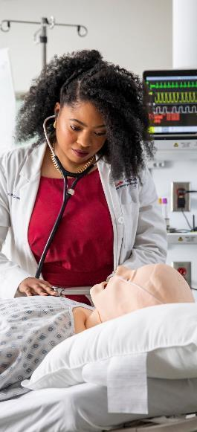
Recent commencements
THE CHALLENGES WE FACE
Notes:
Our state, our country and the world face a long list of challenges – and in each, opportunities.
Climate change.
The need to build a sustainable economy and prepare people for productive roles in it.
The challenges we face around misinformation and disinformation.
Future health crises and the absolute necessity that we give people better access to health care and the tools to foster well-being.
The potential and the uncertainties embodied in AI.
And many more.
Taken together, it can sound like a lot, and it is -- a series of often-stubborn challenges, many of them intertwined with real opportunities -- all of which have to be met head on.
If you were writing a script, it would make for one heck of a story.
This is where we come in … “we” meaning higher education and, of course, the outstanding public university system we are all part of.

Slide 4
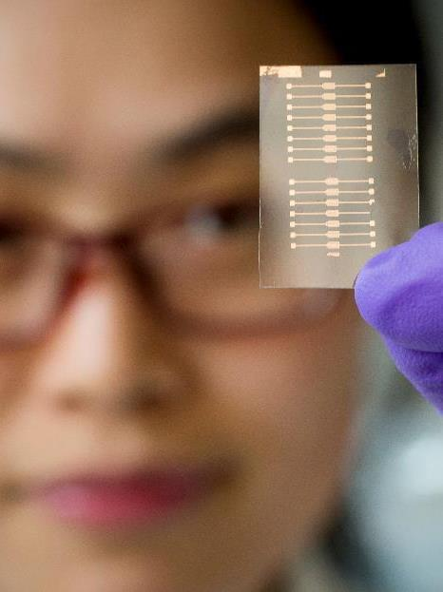
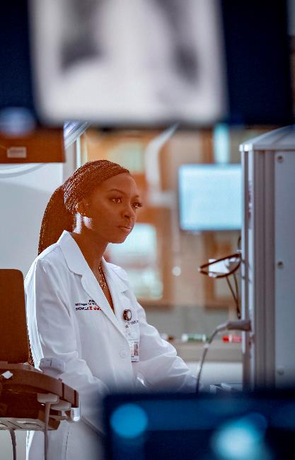
SKILLS FOR A CIVIC LIFE
OUR ROLE — LEADERSHIP
Notes:
A common element in many of the best, most positive stories is the character who emerges to show the way, to drive the narrative and all involved toward resolution.
That driving character is a leader, in so many senses of that word:
A supporter, an advocate, a champion, a guide -- a problem solver hard at work on solutions – serving -- who drives the arc toward resolution.
In our story, higher education and the U of I System have what it takes to be the problem solver and guide that this moment demands.
We have – and I believe this in the core of my being – a vision and a dedication to service that the world needs right now.

Slide 5
System update
Education as an
ANTIDOTE
Notes:
Our core mission always has been and always will be education – the absolutely world-class education we provide at our three universities.
It is the best job training available, a key component of sustainable economic development, and of course much more.
This is true for the more than 97,000 students enrolled in Urbana-Champaign, Chicago and Springfield, but also the rapidly increasing numbers we’re reaching through our growing roster of programs at the Discovery Partners Institute and around the state through the Illinois Innovation Network.
Education and the rigors our students face are also, I believe, the best medicine for learning to live and work together in a pluralistic society – to finding common ground, compromise and, in the plainest language, getting things done in the name of the public good.

Slide 6
research
RESEARCH:
THE PROBLEM SOLVER
Notes:
Sitting right alongside education is our powerhouse research enterprise.
This is where we find answers.
Stronger, more resilient crops to feed a growing population in a changing global climate.
Solutions for the imperative that we have clean air and water for all.
Better health care and greater access to it – preventative care and treatments for those who do become ill.
Technologies that will create new jobs and entire new industries.
Think about what works in the world around us and how much of it is derived from our research. So much of the tech industry that helps drive our economy today, as just one example, grew out of our research and that conducted by our peers across higher education.
Our research muscle also makes us a magnet for innovation engines like the $51 million Illinois Fermentation and Agriculture Biomanufacturing Tech Hub announced last week by the U.S. Department of Commerce’s Economic Development Administration.
iFAB, as it’s known, will leverage expertise from the University of Illinois and industry partners to position central Illinois as a top hub for biomanufacturing.
I share Chancellor Jones’ excitement about this new initiative – this will be big.

Slide 7
System update-DPI AND IIN
BEYOND OUR CAMPUSES
Notes:
I mentioned DPI and IIN, and they’re two of the primary ways we reach and extend what we have to offer beyond our enrollment.
You can look right now at DPI and the roster of summer programs I mentioned, all taking off within the past few weeks:
The sixth cohort of the Pritzker Tech Talent Lab’s Tech Apprenticeship Program with 26 adult students.
The 33 K-9th-grade students who are part of the Discover Computer Ignite Generative AI program.
And the new Swift 2-week Intensive Teacher Training program and its 18 high school teachers, learning invaluable computer science instruction skills.
And that’s just a small sample – in all DPI has 425 learners in its programs right now and is working with 40 organizations to deliver these programs.
We are also focused on building partnerships around the globe dedicated to creating opportunities for students and solving many of these challenges that we all share in human health, climate change and the need for economic opportunity.
We now have strong partners in Taiwan, Singapore, Brazil, Mexico, Canada, The U.K., Germany and India -- and are working to build new links in the Middle East and Africa.
One year from now, as you know, we’re also bringing the 2025 Sustainability Research and Innovation Congress to Chicago.
A group of us just returned from SRI24 in Helsinki and our work has already begun to get ready for SRI25.
The Congress is a partnership with Future Earth and the Belmont Forum, and it will be big:
We expect up to 2,000 people from around the world -- educators, scientists, practitioners, leaders from governments and local communities -- all of them focused on solutions that will mitigate climate impact and ensure that we are working toward resilient communities.

Slide 8
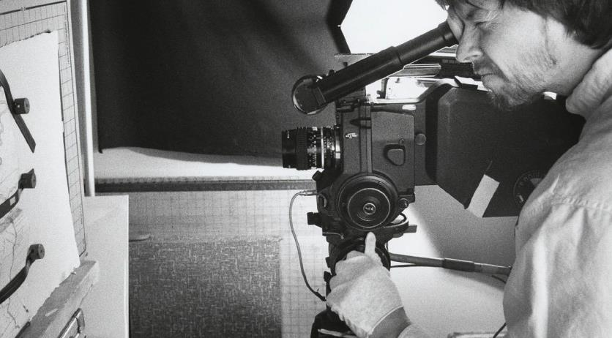
SKILLS FOR A CIVIC LIFE
“Do not lose your enthusiasm…”
Notes:
Before leaving for SRI24, I was fortunate enough to listen to a great variety of commencement speakers in May at our three universities, and – in this challenging moment for us all -- to read and watch video of so many more inspiring, thought-provoking commencement addresses from around the country.
There was, in many, a common thread that really stuck with me: An emphasis on hope and resilience, and the need for both.
At Brandeis University, documentary filmmaker Ken Burns urged those in his audience and in particular those new graduates, “Do not lose your enthusiasm.”
Simple, and powerful.
The education, the research and everything else we offer are an open door to an optimism that comes from knowing that there are solutions and answers and that we have in the capacity to find them.

Slide 9
Thank you
Thank you
Notes:
Through all of these things and too many more to name here today, we can give the world in some cases answers … and in others the tools to find those we don’t provide ourselves.
We must, and we absolutely can.

