Slide 1
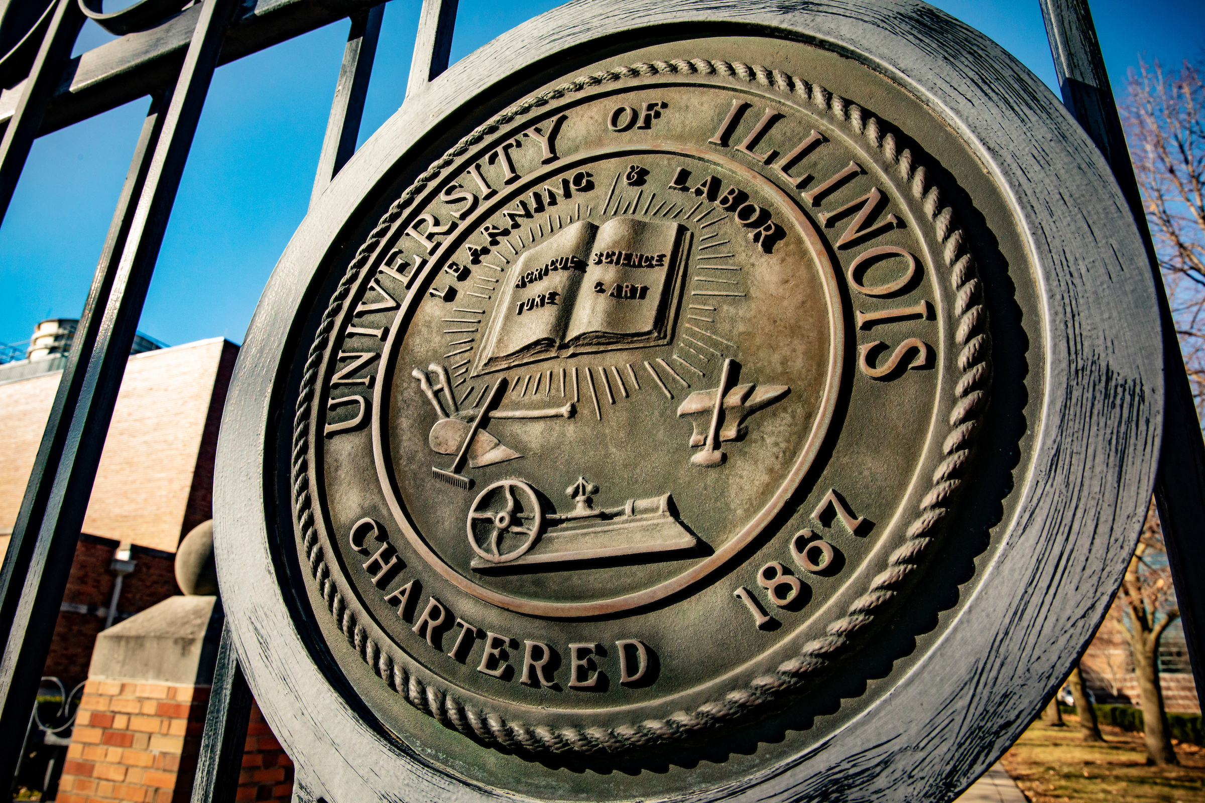

REMARKS TO
THE BOARD OF TRUSTEES
July 16, 2026
Tim Killeen, President
Notes:
Thank you, Chairman Ruiz.
At this time, I would like to introduce our Treasurer: HOWARD ENGLE.
Also:
Chancellor and Vice President CHARLES ISBELL JR. from Urbana
Chancellor and Vice President MARIE LYNN MIRANDA from Chicago
Chancellor and Vice President JANET GOOCH from Springfield
And the Other University Officers and Staff:
University Counsel, SCOTT RICE
Vice President/Chief Financial Officer and Comptroller, PAUL ELLINGER
Executive Vice President and Vice President for Academic Affairs, NICHOLAS JONES
Vice President for Economic Development and Innovation, JAY WALSH
Vice President of External Relations and Communications, ADRIENNE NAZON
Secretary of the Board of Trustees and the University, JEFFREY STEIN
Representing the Urbana-Champaign Senate, ANGELA LYONS, professor, Department of Agricultural and Consumer Economics, Urbana, and chair, UIUC Senate Executive Committee
Representing the Academic Professional Staff: ERIC KURT, media communications coordinator, University Library, Urbana
Representing the University Senates Conference, LINDA MOORHOUSE, professor, School of Music, College of Find and Applied Arts
Representing the Chicago Senate, SANDRA DE GROOTE, professor and head, assessment and scholarly communications, University Library, Chicago, and chair of the UIC Senate Executive Committee.
And joining us via the livestream:
Representing the Springfield Senate, MATTHEW GERAS, associate professor and director of Graduate Students for the School of Politics and International Affairs, and chair of the UIS Senate

Slide 2
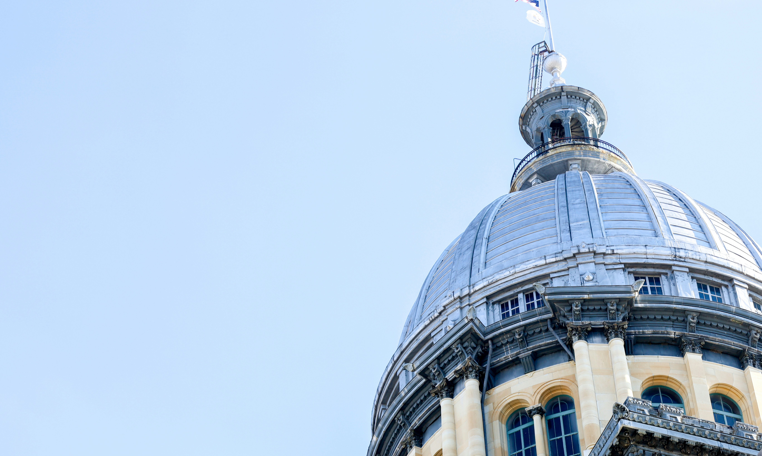
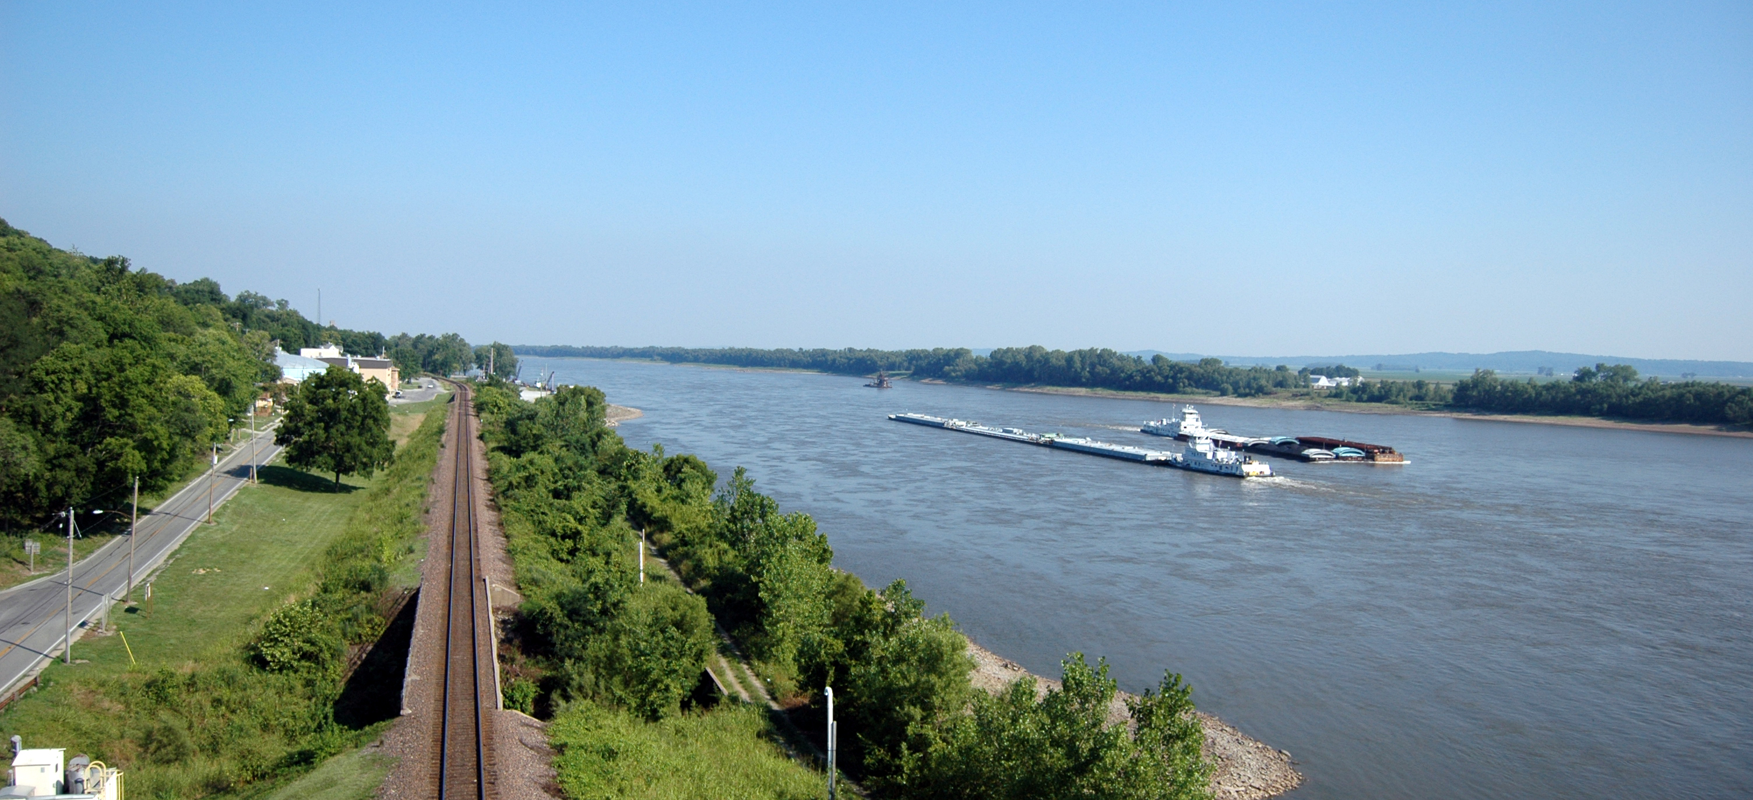
Beyond Our Campuses
Notes:
When we talk about the power of the University of Illinois System, most people picture our three universities, including our academic health enterprise.
That's understandable. They are extraordinary places.
But that misses the impact that ripples out far beyond the university campuses in Urbana-Champaign, Chicago and Springfield and into every corner of Illinois, across the nation and around the world.
Over the past few board meetings, I've talked about how we deliver on our fundamental mission through the incredible work of our faculty and staff and through the differences our alumni make once they leave us.
Today I want to put those puzzle pieces together, add a few new ones, and tell you a story.
Not a story limited to our three world-class universities. It is a story of the U of I System’s collective enterprise and the state to which it belongs, and how thoroughly the former is woven into the latter.

Slide 3

A Defining Moment
Notes:
The timing of this story is not an accident.
We are living through a watershed period, a time that will yield lasting changes across society.
Technology is transforming how we work, learn and discover at a pace that is both exhilarating and unsettling. That transformation is creating demand for a new kind of economy, one that is sustainable and brings everyone along.
This economy must support people who need better access to health care, to preventative care, to the basics of a healthy life.
It must hold up under changes in weather that are testing our infrastructure and our communities and will for decades to come.
And it must give young people something we cannot measure on any dashboard: sincere hope and real, driving purpose.
Higher education is positioned like nothing else to lead in this moment. We are in the business of knowledge and of ideas that solve real problems and set us up for a promising future.
I have a word for that work and for what it produces: thrivability. Creating the conditions that allow people to thrive — economically, socially, environmentally and culturally.
Public higher education is perfectly positioned to deliver it. And by that standard, here in Illinois, the University of Illinois System is already leading.

Slide 4
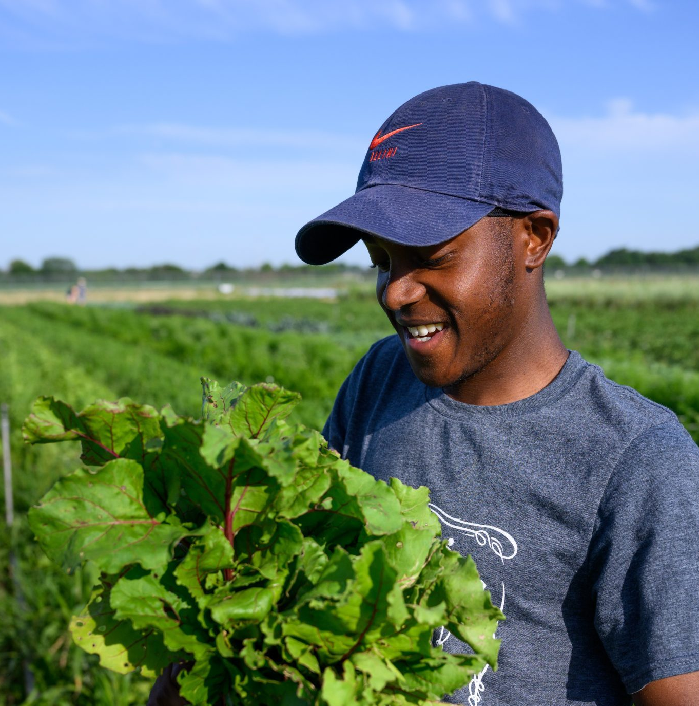
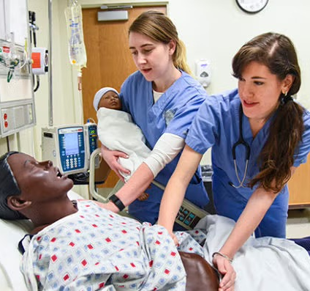
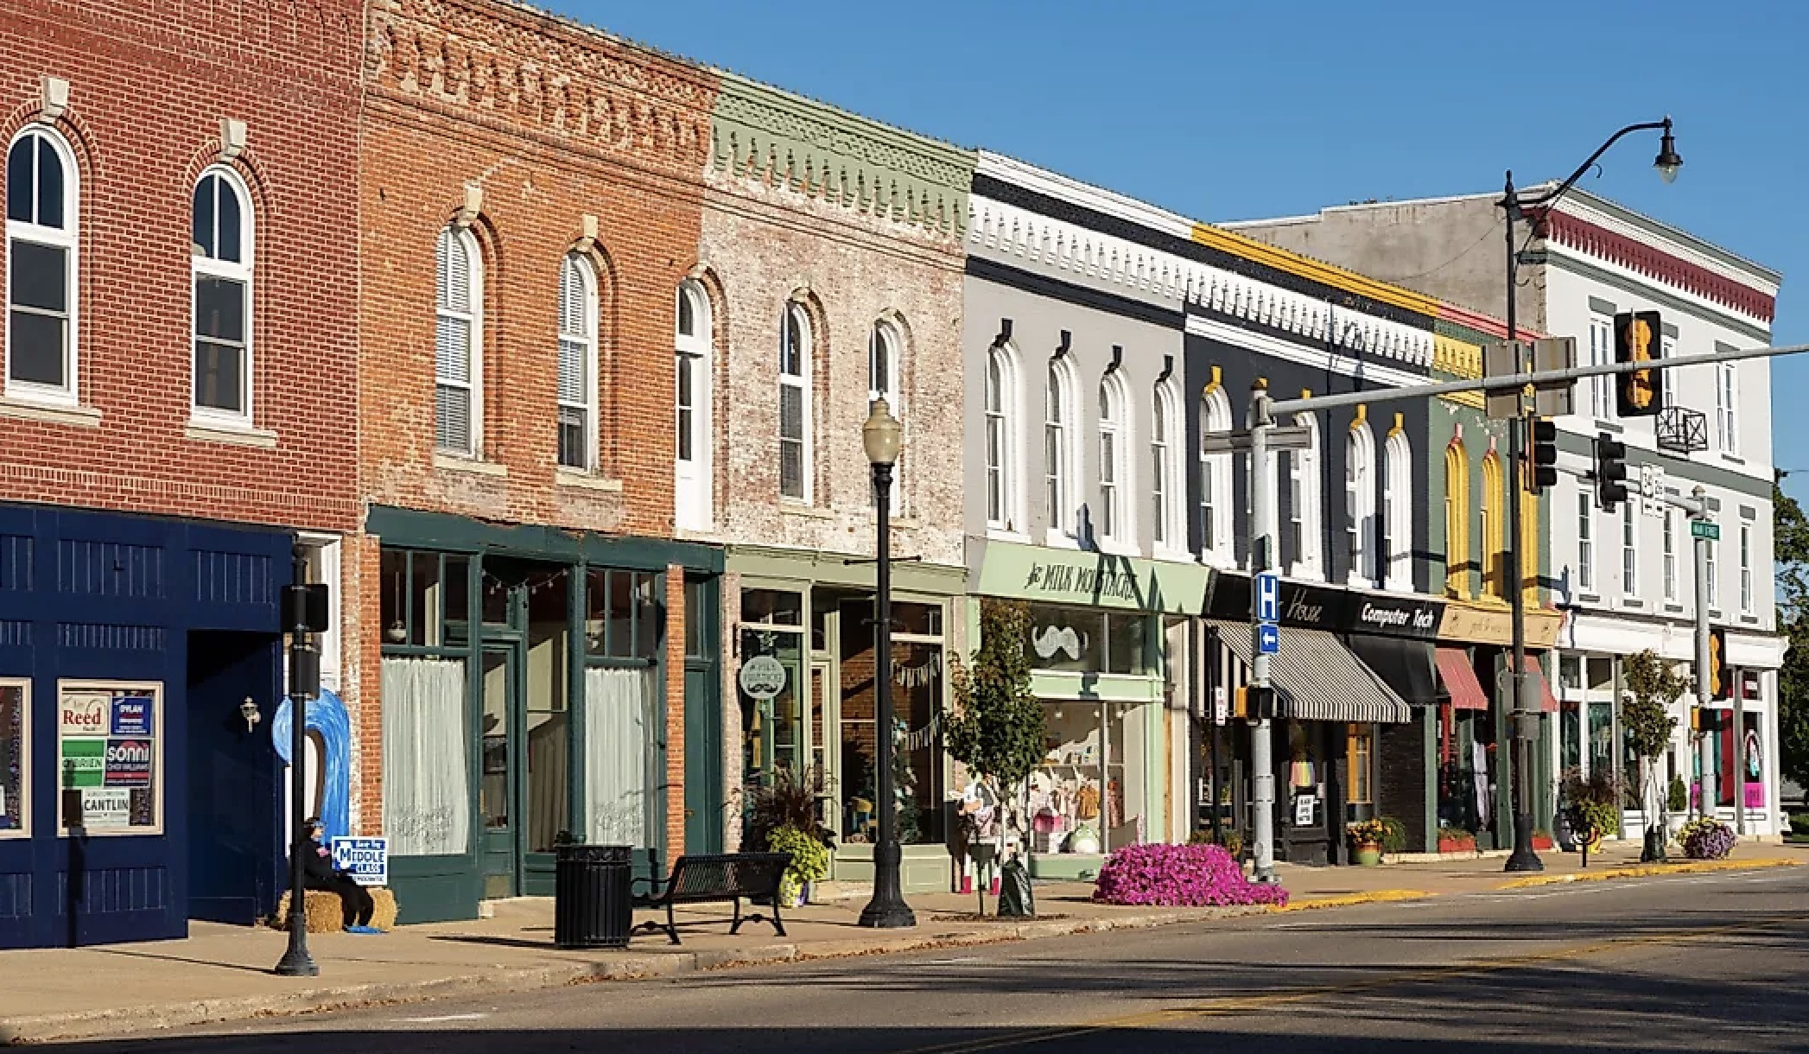
Pick a County
Notes:
So let’s begin our story. Pick a county. Any one of Illinois' 102.
In that county this morning, a high school student logged into a course her own school couldn't offer but our Illinois Virtual Schools and Academy pilot, known as IVSA, can and does.
A farmer checked planting guidance and market conditions that trace back to our research, in fields and in labs.
A nurse we trained started her shift at the local hospital.
The water flowing from the tap was drawn from a supply our scientists monitor and protect.
A small business owner who came through one of our programs, perhaps the Diverse Supplier Development Program, opened her doors and got to work.
And sometime today, somewhere in that county, a family will watch a performance, or a ballgame, or attend a summer program that exists because of this system.
You cannot spend a day in Illinois without touching something the U of I System helped create or make better and stronger.
And the ripples don't stop at the county line. So, let’s keep moving.

Slide 5
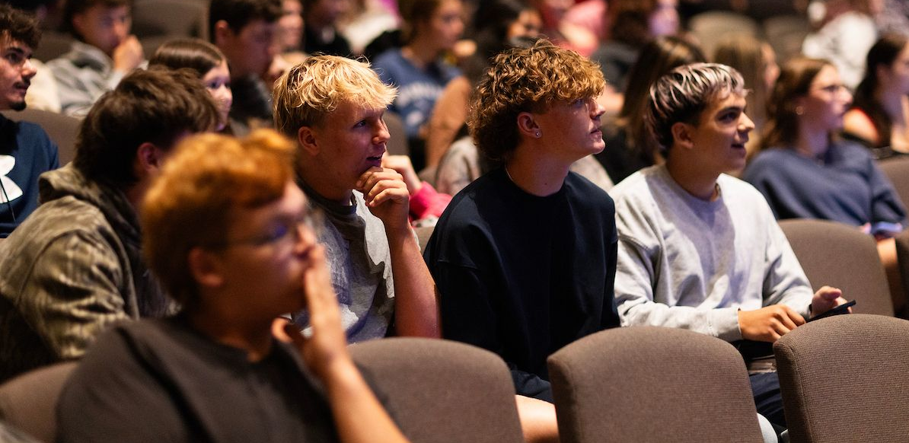
Learning at Every Stage of Life
Notes:
Start with education, because our reach begins long before a student ever applies to one of our universities, and it continues long after graduation.
We are in Illinois high schools through programs that open doors early, including IVSA ensuring students have access to high-quality instruction in language arts, science and world languages.
And through our direct relationships with high schools throughout the state, we are making sure more students know that our doors are open wider than they ever imagined. A student who never pictured herself on a University of Illinois System campus should know that she belongs here.
We partner with community colleges across the state, creating pathways for students who choose to start college closer to home.
The new Bachelor of Applied Science in Engineering Technology at UIS was designed in direct response to employers who need skilled technologists, and it is built for the working adult as much as the traditional student.
And we serve the learner at every stage after that: the career changer, the returning veteran, the professional who needs new skills for a changing economy. Lifelong learning is part of our mission.

Slide 6
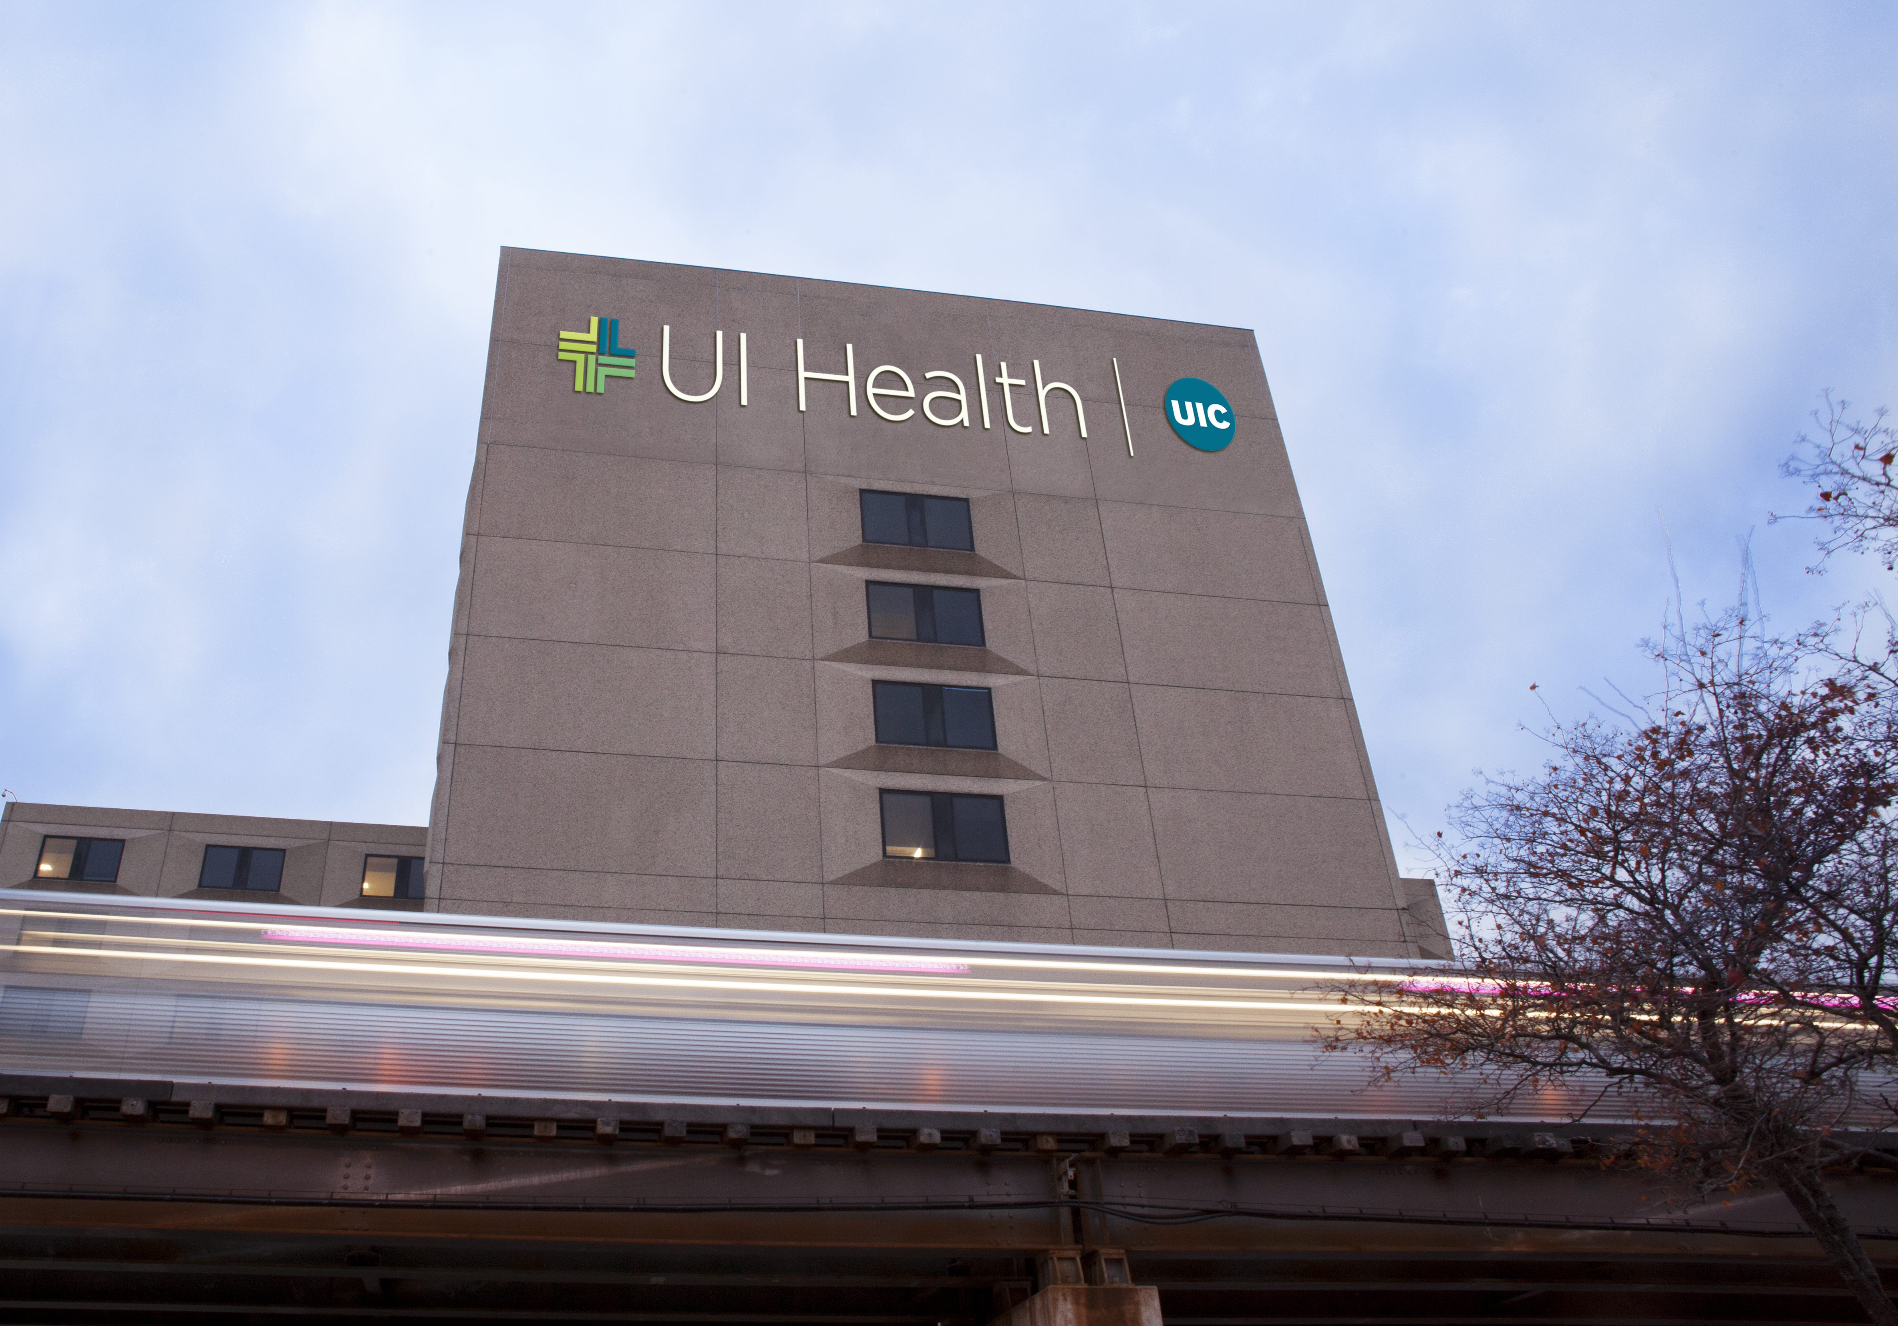
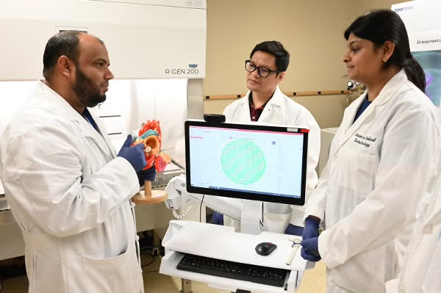
A Healthier Illinois
Notes:
Nothing impacts people more than their health and well-being, and we are dedicated to access and being a rising tide that raises every boats all over Illinois.
At UIC, UI Health sees more than 1.5 million patient visits a year. The Mile Square Health Centers add more than 162,000 visits. UIC's dental clinics, more than 154,000.
Those aren't just big numbers. They are people. Illinoisans, many in the communities where care is hardest to find.
Our medical enterprise trains the state's next generations of doctors, nurses, dentists, pharmacists and social workers at campuses in Chicago and beyond.
When a rural hospital hires a physician, the odds are good we trained her.
We are also have a longstanding and growing relationship with the Illinois Department of Public Health, built up in particular since the pandemic. It now spans more than 20 projects and includes one of the most sobering challenges in front of us: reversing the decline in life expectancy that has hit some Illinois communities hardest.
And because health today depends on connection, our work through the Illinois Innovation Network to expand broadband access promotes better health, too. Telemedicine cannot reach a home the internet doesn't.
And at the frontier of health care, at UIC and the Carle Illinois College of Medicine, our researchers are pioneering engineering-based medicine, new treatments and new answers for a growing world.

Slide 7
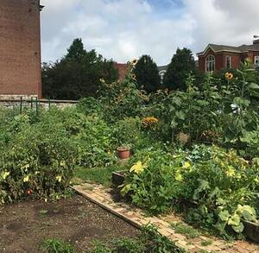
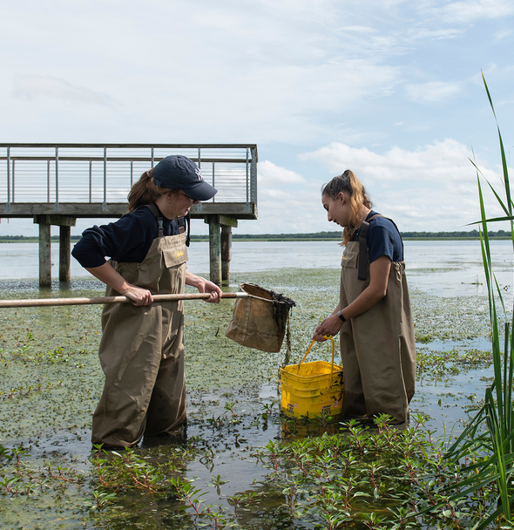
Well-Being, From the Gound Up
Notes:
Health doesn't stop at the clinic door. The air we breathe, the water we drink and the food we grow are, of course, critical components.
Our impact here is every bit as concrete as the treatment a good healthcare professional can provide.
The Morrow Plots in Urbana represent 150 years of continuous discovery in service of Illinois’ farmers and through them, the entire state.
Today that lineage runs through RIPE, where we lead an international effort to improve photosynthesis itself, work whose harvest will be felt on every continent.
And all of our knowledge moves directly to the people who feed us, through field days and other outreach efforts, as well as Illinois Extension, on the ground in every one of those 102 counties.
You would be hard-pressed to find one of Illinois' more than 71,000 farms that has not benefited from the U of I System.
We are here also at work in our cities, where we have a hand in urban gardens, community food projects and nutrition programs.
At UIC, the College of Urban Planning and Public Affairs and the Great Cities Institute work to transform cities into sustainable urban environments through policy and through the science that helps mitigate changes in weather and build for a better future.
UIS runs the Therkildsen Field Station at the Emequon Preserve, devoted to floodplain restoration and connecting students and researchers in this important work.
The Prairie Research Institute protects our water supplies, maps the land we live on, and gives city planners and businesses deep understanding of the land and water they cannot get anywhere else.
And through CLEETS, our global research center on clean energy and transportation, we are working with international partners so that discoveries made anywhere in the world benefit people right here in Illinois.

Slide 8
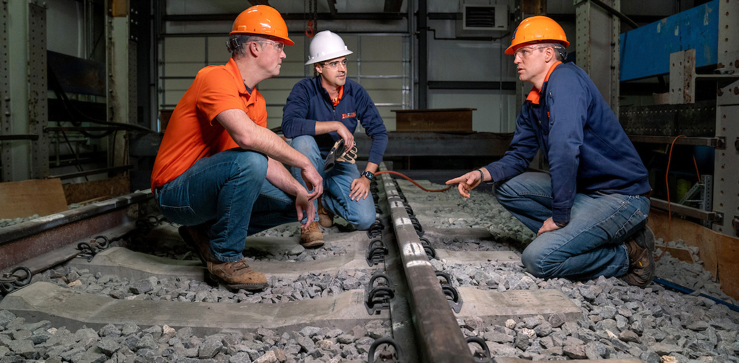
An Economy Built to Last
Notes:
Everything I’ve talked about so far helps write Illinois’ economic story, but our contributions go so much further.
We help entrepreneurs start companies and small businesses grow. Our Diverse Supplier Development Program, which I mentioned earlier, has now graduated 117 small, minority-owned firms better equipped to compete for U of I System and other public contracts with us and beyond.
Through the Illinois Innovation Network, the Quad Cities Manufacturing Institute just launched a new workforce initiative with advanced manufacturing partners.
And we tend the infrastructure of commerce itself. RAILTEC in Urbana makes the nation's rail system, coast to coast, safer and more efficient. Our transportation researchers also work closely with the Illinois Department of Transportation on the roads and transit Illinoisans use every day.
You have heard me talk about IQMP at length, so I won't retell that incredible story today.
But what IQMP and Discovery Partners Institute both signal are important: When the state of Illinois makes two of its boldest economic bets of a generation, it entrusted the U of I System to lead them.

Slide 9
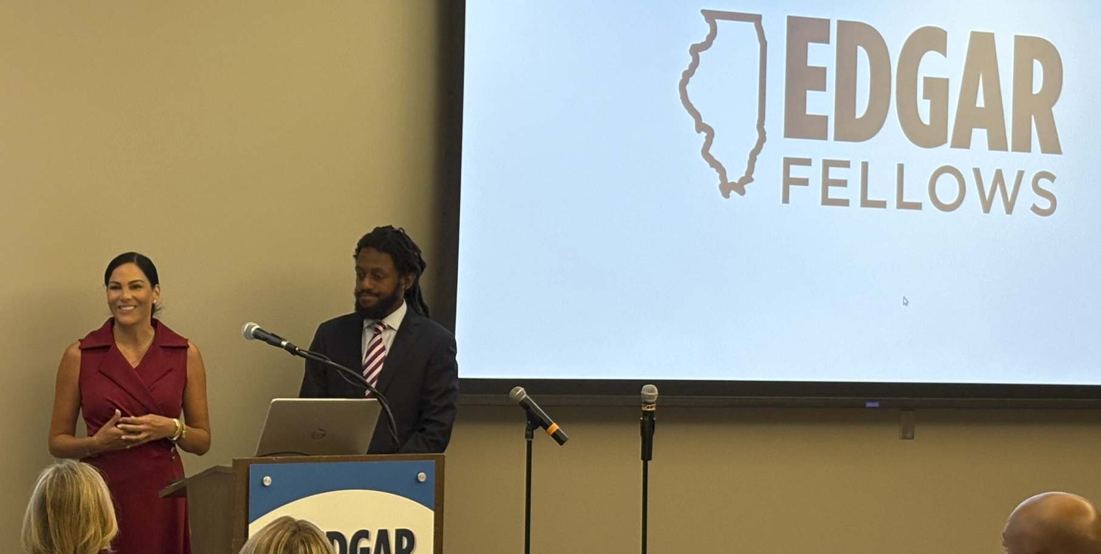
Informing Policy That
Shapes Illinois and the Nation
Notes:
Good policy needs good information, and the U of I System provides a vast, trusted network of expertise that helps inform policy work at the state and even national levels.
Our faculty share their expertise every day, through the news media, public lectures and testimony before legislative bodies.
And our Institute of Government and Public Affairs specializes in training leaders through the efforts such as its Edgar Fellows program and to give lawmakers reliable analysis on the questions being debated in Springfield: state spending, mass transit, healthcare policy for family caregivers, air pollution trends and much more.
Through IWERC, the Illinois Workforce and Education Research Collaborative, we also give the state's education and workforce leaders reliable, actionable research across the entire cradle-to-career pipeline, working with state agencies, school districts, early childhood programs, colleges and workforce initiatives to solve the issues they bring to us.

Slide 10
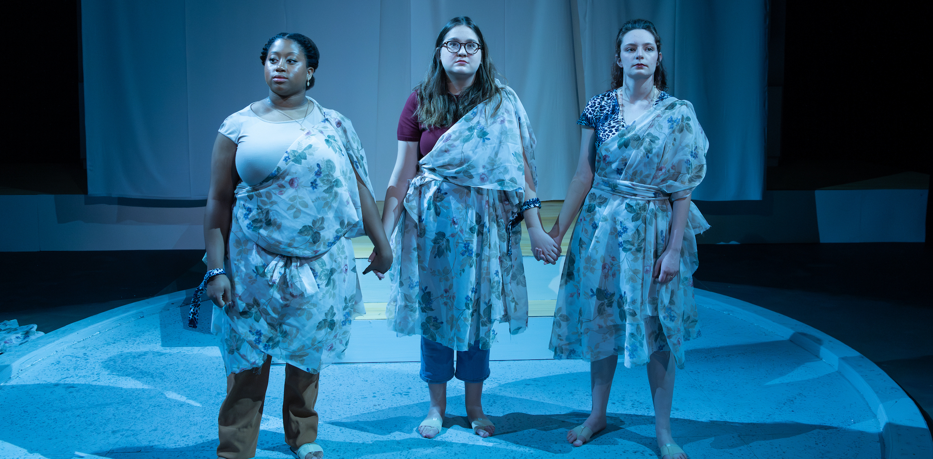
Woven Into Community Life
Notes:
And then there is the impact that may not be apparent in economic reports but is critical in the life of a community.
We partner with arts organizations across the state, and the artists, musicians, writers and performers who sharpen their crafts with us go on to enrich our communities, connecting us through shared joy, triumphs, aspirations and struggles.
They affirm what we share through our humanity.
We also open our campuses to enrich the lives of those who live around them.
At the UIS Performing Arts Center, the recently renovated Sangamon Auditorium is reopening with a series of Broadway productions this fall.
And at all of our universities, summer athletic and academic programs and camps bring families onto our campuses.

Slide 11

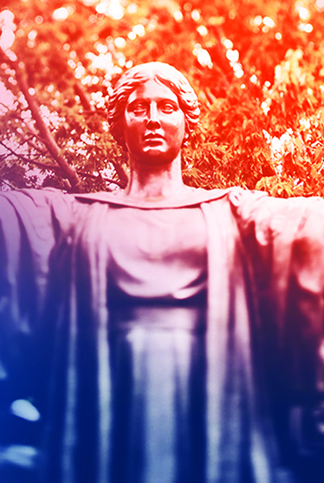
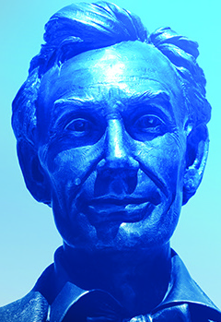
A Universe of Impact
Notes:
So let's return to that county you thought about earlier.
Education from high school through a lifetime. Health care where it's hardest to find. Food, water, land and air. Jobs created, businesses kept, infrastructure strengthened. Policy informed. Community life enriched. Economically, socially, environmentally, the University of Illinois System is present, and not as a visitor. As a neighbor. As a partner. On the ground.
And notice how far the ripples travel. Research that begins in Urbana-Champaign improves harvests on other continents.
Partnerships forged through CLEETS are shaping how the world builds clean transportation.
I-MMAS is building educational and cultural bridges between Illinois and Mexico.
CARLI serves students at colleges and universities all over Illinois, and an alumni base growing by more than 28,000 people a year carries this System's impact everywhere they go.
And we, the people in this room, show up all over Illinois – we’ll be heading out again this fall on our Leadership State Tour.
What we build does not just stay here. Our work and our people speak for our state and the U of I System — around the nation and around the world, and they bring real value back home.
There is a deep well of expertise here for virtually any challenge Illinois faces. And where there isn't, we have the capacity, and the partners, to build it.
This is thrivability made real — the right conditions, engendered by an enterprise designed for them, this incredible, one-of-a-kind university system.

Slide 12

Thank You
Notes:
Thank you, Chair Ruiz and trustees.

