Slide 1
UNIVERSITY SENATES CONFERENCE
Looking Back, Moving Forward
Jeffrey Eric Jenkins, Chair
July 17, 2025

Slide 2
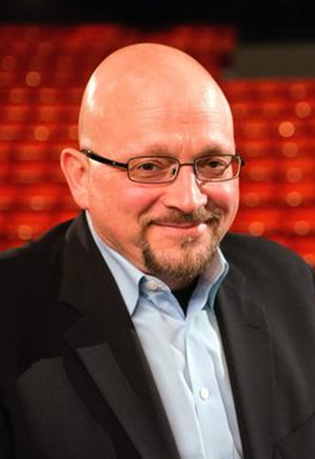

USC chair
JEFFREY ERIC JENKINS
USC Chair (2024-25)
Professor and Chair of Theatre Studies
Director of Graduate Studies in Theatre
Ph.D., University of East Anglia (UK)
MFA, Carnegie Mellon University
B.A., San Francisco State University
Former surgical technician, U.S. Army
Alumnus, President’s Executive Leadership Program (PELP)
Two terms as chair of Urbana-Champaign Senate Executive Committee
Inaugural Executive Committee, Discovery Partners Institute
Former department head and producer of Illinois Theatre
Author and editor of nine history and reference books
Advocate for international free expression and democratic process
President of the International Association of Theatre Critics

Slide 3
UNIVERSITY SENATES CONFERENCE
Senate representatives from the three universities are working with the system administration to achieve our common institutional goals
Thirty-three citations in Statutes
Reviews “matters acted upon by each university senate” (Statutes II.2.b)

Slide 4
Breakdown of USC Committee members
University Senates Conference
Committee of 20 members from our three universities
Seven (7) from Chicago
Three (3) from Springfield
Ten (10) from Urbana-Champaign
Leadership rotates among the three universities
Executive Committee: Two (2) elected members from
each university

Slide 5
THE PAST YEAR
ST-83: Statutes initiative returned to the senates for additional consideration and potential revisions, which continues
DPI 2.0: Shift in focus of Discovery Partners Institute engaged USC for review and response
Presentations to the Board of Trustees
Background:
Challenges surrounding
concerns related to academic
freedom, a contentious election cycle, and outcomes related to the federal environment

Slide 6

PRESENTATIONS
IGPA: The Institute of Government and Public Affairs (Professor Schwinn)
AI and Other Tools: Investment in Classroom Innovation
(Professor Hobbs)
The Rising Arc of Arts Research (Professor Moorhouse)
Shared Governance
(Professor Tolliver)

Slide 7
IGPA: WHAT IS IT?
  The People’s Policy Think Tank
  IGPA includes scholars across disciplines, and across the three universities
  IGPA scholars provide objective, non-partisan, and evidence-based research and analysis of public policy issues
  IGPA connects our research with public policy and public-policy makers

Slide 8

THE AI Future
Far-reaching implications that will help the U of I System to lead in education
Provide oversight and governance practices provide the necessary ethical checks and balances
These tools complement aims to expand into quantum and provide foundations for new ideas and collaborations across the globe

Slide 9

What is ARTS RESEARCH?
Systematic study and exploration of artistic practice, process, and impact on society, culture, and various disciplines
Combines creative expression
with critical inquiry
Analytical and creative, fostering new ways of understanding and engaging with the human experience

Slide 10

Shared governance
Interdependence, not
separate “lanes”
Consultation process
Communication and respect
Service and the institution

Slide 11
MOVING FORWARD
ST-83: Senates and USC working through reconciliation process
DPI 2.0: Continuing engagement and consultation
Focus of shared governance:
  Institutional good
  Open communications
Lifting our eyes to see the horizon, as we take careful steps

Slide 12
Comments and Questions?
Jeffrey Eric Jenkins
USC Chair
Email: jej@Illinois.edu
Phone: 217.333.1819
David Perryn
Administrative Aide
Email: dperryn@uillinois.edu
Phone: 217.300.7448

