Slide 1
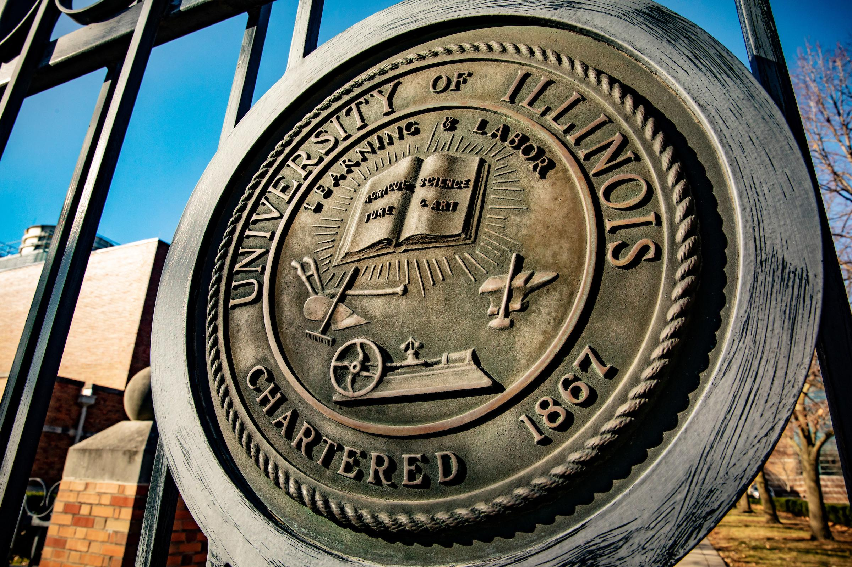

REMARKS TO
THE BOARD OF TRUSTEES
July 17, 2025
Tim Killeen, President
Notes:
Thank you, Chairman Ruiz.
At this time, I would like to introduce our treasurer, LESTER H. MCKEEVER JR., partner at Mitchell-Titus accounting firm in Chicago.
Also:
Chancellor and Vice President Designate CHARLES ISBELL from Urbana;
Chancellor and Vice President MARIE LYNN MIRANDA from Chicago;
And Chancellor and Vice President JANET GOOCH from Springfield
And the other university officers and staff:
University Counsel SCOTT RICE;
Vice President/Chief Financial Officer and Comptroller PAUL ELLINGER;
Executive Vice President and Vice President for Academic Affairs NICHOLAS JONES;
Vice President of External Relations and Communications ADRIENNE NAZON;
Vice President for Economic Development and Innovation JAY WALSH;
And Secretary of the Board of Trustees and the university JEFFREY STEIN.
Representing the University Senates Conference and the Chicago Senate, SANDRA De GROOTE, professor and head of assessment and scholarly communications.
Representing the Urbana Senate, JEFFREY ERIC JENKINS, professor and chair, theatre studies, and University Senates Conference chair.
And representing the academic professional staff, BARBARA GOTTESMAN, director of Strategic Initiatives and Projects, UIC School of Law.
Before I continue, I also want to congratulate all of our student trustees on their installation and thank them for serving in these important roles.
To Trustee Mizan and Trustee Bizan, welcome back! Serving a second year is just further demonstration of your deep commitment to the U of I System. Thank you both.
I am also excited to welcome Trustee Humphrey.
I look forward to working with you and all of our trustees in the year ahead.

Slide 2


A beacon and a safe harbor
Notes:
As we meet here today, we are wrapping up what has undeniably been an incredible year for the University of Illinois System — but also a year in which we have operated and continue to operate in what some might euphemistically call interesting times.
The U of I System and all of American higher education have come under pressure to respond to questions among some about the importance of the education we offer; legitimate concerns about the cost of four-year degrees; and the same declining public trust and confidence affecting so many institutions in our country.
Now, added to this landscape, we face challenges that are on another level.
Changes in federal policies and priorities continue to come at us rapidly, and there is no doubt that they will mean deep cuts in federal funding for research and education.
I know you all understand the uncertainty we face.
And yet, amid all of this, we again have record enrollment, we have more than 27,000 new graduates and we are delivering for the state of Illinois and its citizens in myriad ways far beyond our campuses.
We do this because all of it is part of our commitment to the public good.
That mission is many-faceted, but infused in all of it is our responsibility to be a steadying force, a beacon that lights the way and a safe harbor for the innovative thinking and transformative ideas that will continue to shape the future.

Slide 3
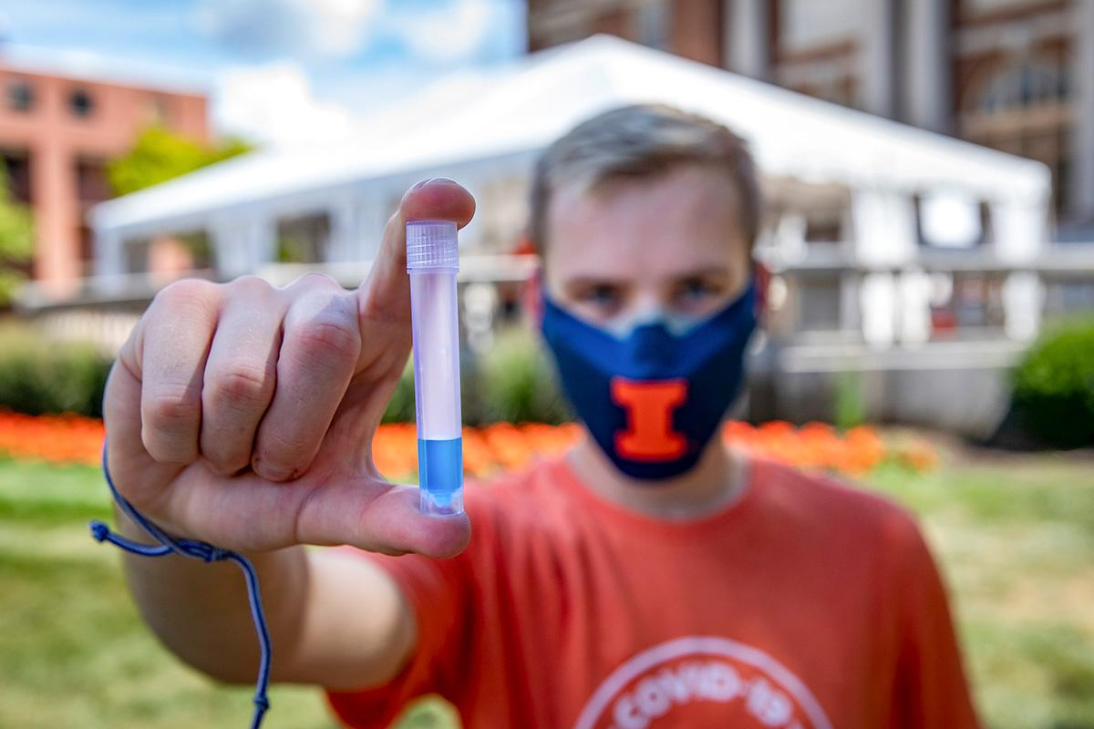

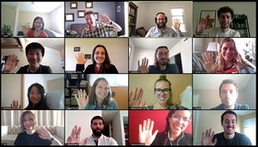
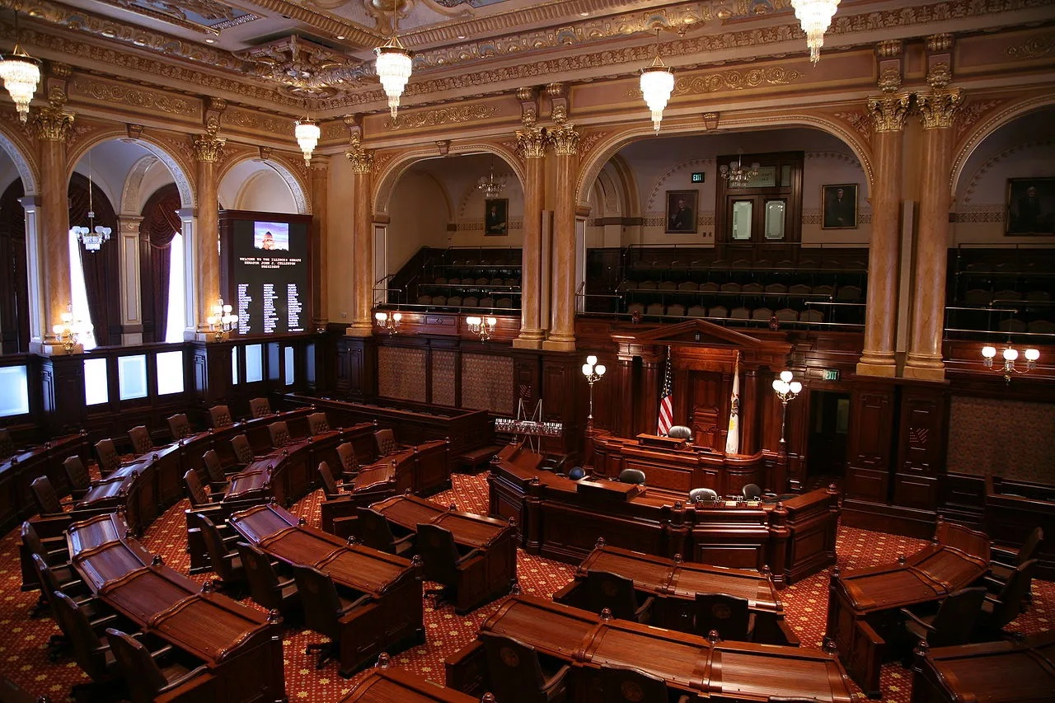
There for the people of Illinois
Notes:
As I said, we have been tested before. Many times.
Just in the past decade, the state budget impasse and the pandemic spring immediately to mind.
Both presented major challenges.
And in both cases, I believe that we learned just how resilient – when we are needed most – we really are.
We’re built for it.
During the pandemic in particular – our students and their families, our faculty and our staff needed the U of I System. The state as a whole and people all across Illinois needed us, too.
And we were there.
Our SHIELD test-and-trace system allowed our universities to safely go back to in-person instruction and research in just a few months.
That same technology helped K-12 schools across our state do the same – get back in the classroom and get there safely.
We also shared SHIELD with businesses, government agencies and with the public – all of it helping Illinois to stay open for business and allowing our society to move forward.
Think, too, about how important the ability to connect virtually was to the entire world during the pandemic — can you imagine how we’d have gotten by without Zoom and Teams?
The origins for that kind of connectivity lie here, in the U of I System. We developed one of the very first, if not the first, chat rooms. Talkomatic was created in 1973 using PLATO.
When Illinois needs us most, we’re there. Our track record is the proof.

Slide 4
97,772
Increased by 9.5% from 2019-20
Systemwide enrollment
27,041
Increased by 19.2% from 2019-20
Degrees awarded
20,001
Increased by 11.2% from 2019-20
Under-represented students enrolled
$283M
Increased by 18.4% from 2019-20
Financial aid commitment
$24.9B
Increased by 11.8% from 2018
Total economic impact
Notes:
And through it all we continue to build our record of performance. Just consider a few top-line measures.
Systemwide enrollment is near 98,000, up almost 10 percent over the past five years.
We now award more than 27,000 degrees a year – that’s almost 20 percent more than five years ago.
Our enrollment of students from underrepresented backgrounds is up, too – more than 11 percent.
We are making all of those things more possible by investing more in financial aid than ever -- $283 million of our own funding now a year.
Our total economic impact on Illinois, by the way, is increasing, too. It’s now $24.9 billion a year, up substantially, as you can see.

Slide 5
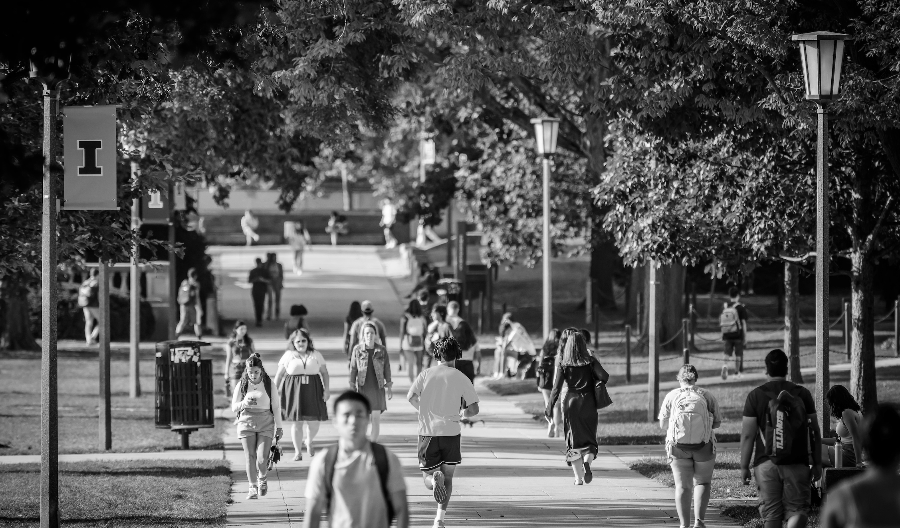
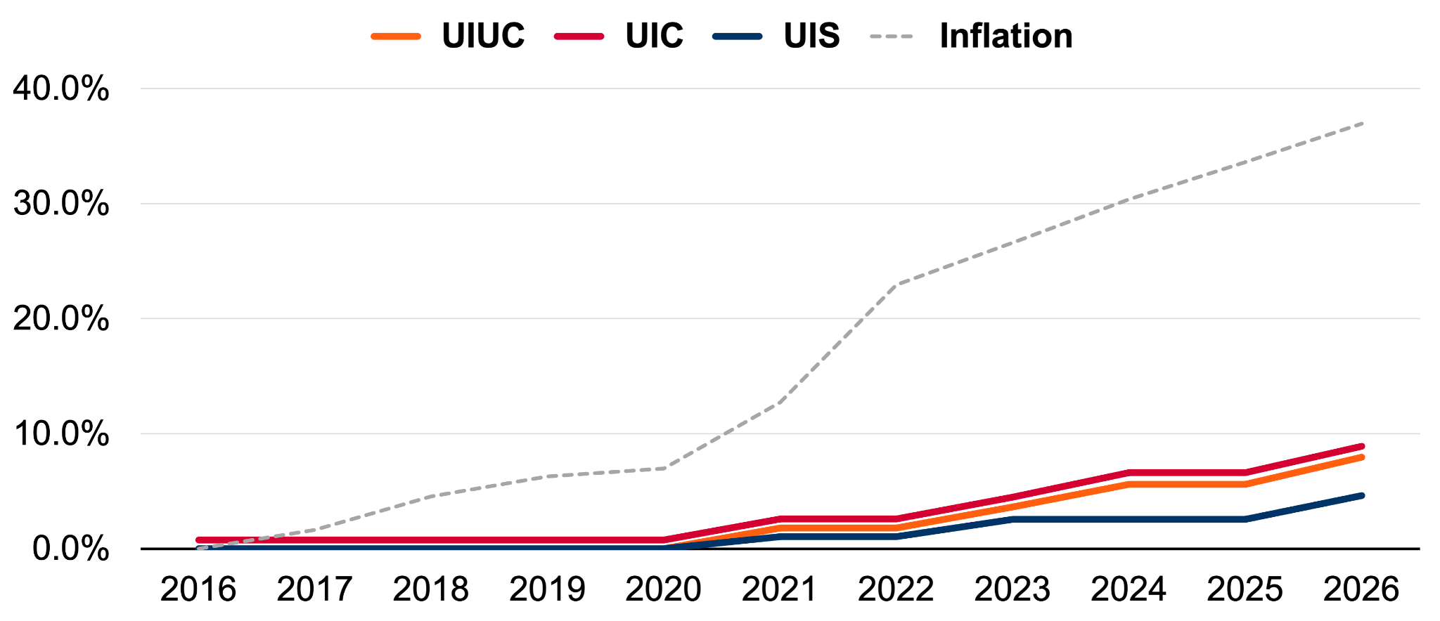
Keeping Tuition Costs Down
Tuition vs. Inflation, cumulative change by year
37.0%
7.9%
7.9%
4.6%
Notes:
All of those arrows are pointing up, but I’d like to highlight one area where you might say we are not keeping pace, and happily so: Tuition.
As you can see, over the past decade, tuition at our three outstanding universities has increased only modestly, and far, far below the rate of inflation.
That’s all thanks to you, our trustees, working with us to keep costs down — and the students and families of Illinois are the beneficiaries.

Slide 6

The Power of Partnership
Notes:
The University of Illinois System is a powerful force for progress, working at a scale that has incredible impact all over our state.
The real key to unlocking that power, the catalyst that makes us even greater than the substantial sum of all of these vital parts, is partnership
.
I talk a lot about partnership and its importance, its power, and often those partners are external.
Government leaders in Springfield and in Washington, industry, our vendors who help us keep this great machine running, and other universities at home and abroad.
But the generous collaborations and key partnerships we rely on are internal, too.
Our faculty are our greatest asset, the reason students flock to us in ever-increasing numbers and drivers of research that really does change the world.
They are our partners in shared governance.
The University of Illinois Foundation, our donors and the devoted and growing network of alumni, many of whom serve as our vocal champions when we need them. We rely on all of them now more than ever.
The partners in this equation also include the U of I System leadership team, including Chancellor Miranda, Chancellor Gooch and Chancellor Isbell — who we welcome today — and myself. And our talented staff, at work all across the university system.
And, importantly, all of you, our trustees.
You bring accomplishment, a deep variety of expertise, devotion to the university system and, above all, an understanding and appreciation of the power of the education we offer.
We all have key parts to play, and when we work together in these roles, the UI of I System is, frankly, relentless and unstoppable.

Slide 7
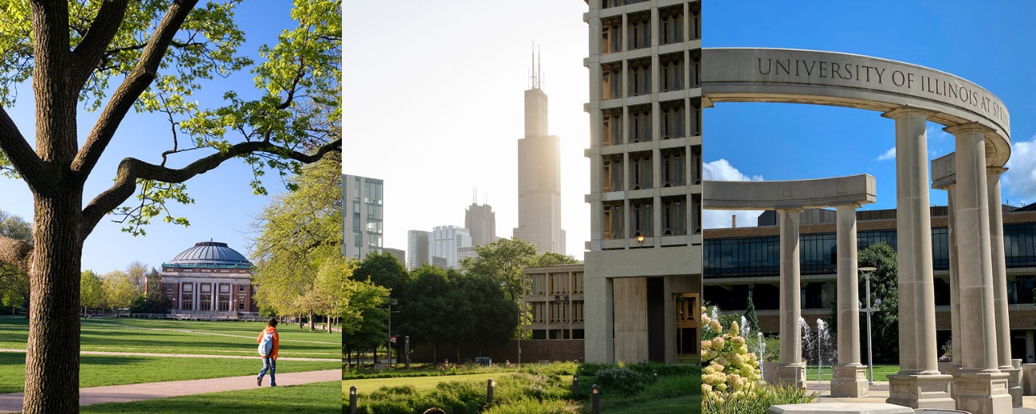
Shared Vision
Notes:
All of those who make up these partnerships have a vision for what the U of I System can and should be, of what we can achieve.
These visions might vary a little depending on perspective, of course, but they’re a bit like concentric circles with a great shared center … where our expectations and ideas meet.
This shared vision has driven our momentum for a number of years now.
It isn’t that all of us agree on everything at all times or always have the same ideas for how we get where we need to go.
Diversity of thought and the questions that arise from the differing perspectives we bring are real strengths.
But our collaborative efforts are all built on that shared vision, including a kindred sense of what makes the U of I System so important to our state and a belief that we have a responsibility to serve Illinois and its people.
This sense of service and mission has never been more important than it is right now, and that will only be more true in the months and years ahead.

Slide 8

What We Can Do Together
Notes:
So, what can we accomplish together? Or, more accurately, what must we accomplish together?
Let’s start with that core mission: Offering a world-class education.
We were created, first and foremost, to provide an excellent higher education to the citizens of our state.
We enrolled 97,772 students last fall, and we expect even more in the semester that begins next month.
They’re counting on us, and so many more will continue to in the years ahead.

Slide 9
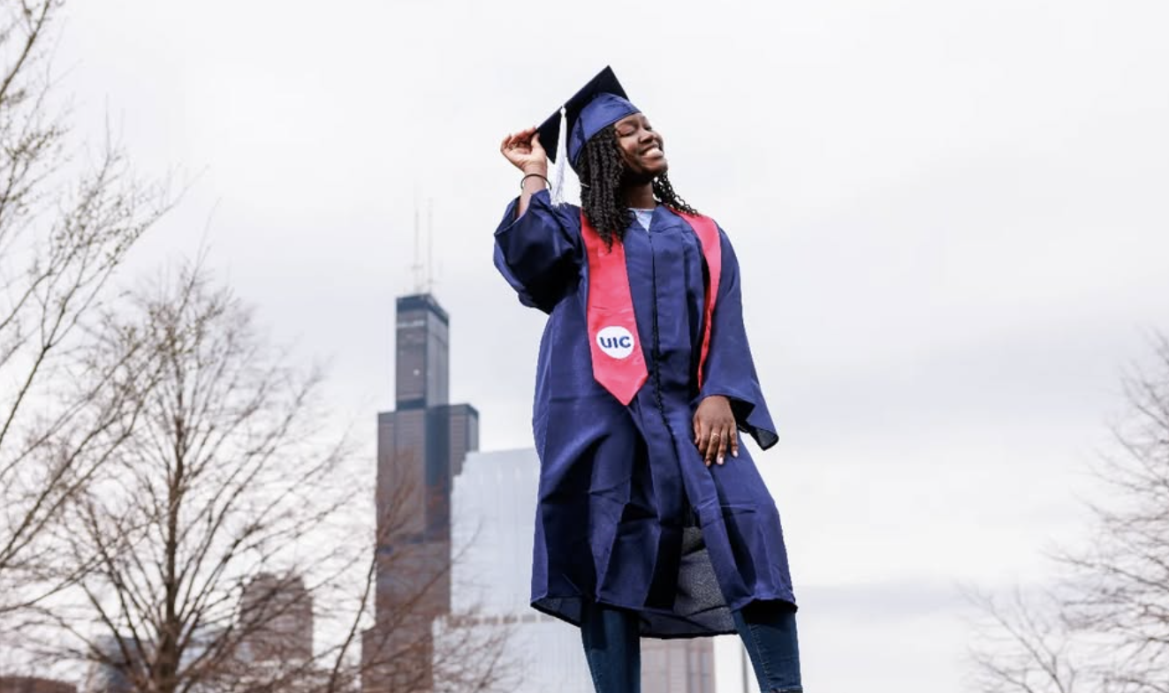
What We Can Do Together
Notes:
Together, we must continue to build a resilient, sustainable economy and society for Chicago and all of Illinois.
Three-quarters of students who graduate with a U of I System degree stay right here to power our state.
We also, increasingly, provide workforce development through training for people trying to advance their careers who aren’t U of I System students.
This tech training and workforce development happen to a great degree at the Discovery Partners Institute and through the Illinois Innovation Network’s Workforce and Education Exchange, or WEX.
DPI is training more than 2,400 people a year – K-12 students, adult learners and teachers.
WEX, meanwhile, is connecting industry partners with the state’s 12 public universities, 48 community colleges, more than 640 high schools and 26 local workforce training boards to hire trained workers.

Slide 10
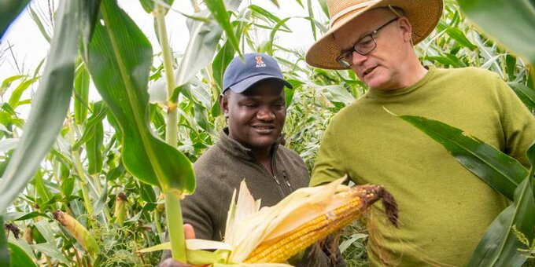
What We Can Do Together
Notes:
Together, we can find the answers to the major questions we face:
“How do we feed a growing population and keep it healthy?”
“How do we address climate change?”
“How do we cultivate the kind of resilient, civically engaged society that will serve as a key ingredient in the future we must build for future generations to thrive?”
These questions are among the biggest challenges of our time.
But the U of I System has the tools to provide answers.
We have one of the country’s great agricultural schools in Urbana-Champaign and a robust medical enterprise here in Chicago, both of which reach all across our state and beyond.
We have world-class researchers at all three universities focused on climate science, and statewide organizations such as IIN and Illinois Extension to make certain that this important work both connects with researchers outside our system and reaches people all over Illinois.
We are also rich in expertise across the full range of the arts, humanities and social sciences. They offer us the understanding of history and cultures that we must have if we are going to build that thriving, sustainable society that is the foundation of our future.
The best way to build the future you want is to design it. We can do that.

Slide 11
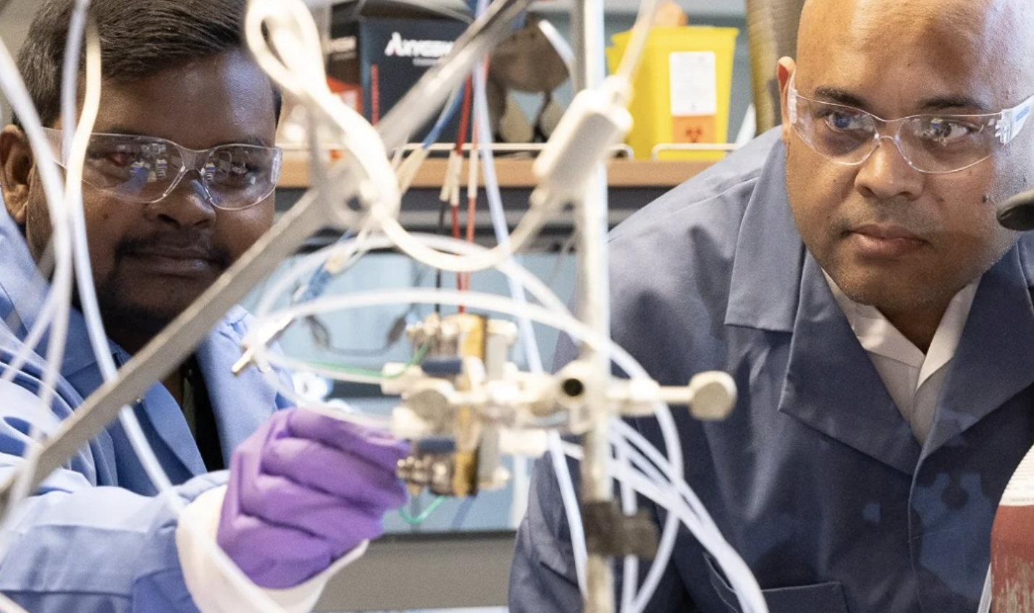
What We Can Do Together
Notes:
As a system, we also remain a research powerhouse, and together we can work to nurture this one-of-a-kind asset and see that it keeps firing on all cylinders and provides solutions to the challenges we face and helps us meet the opportunities ahead.
That includes our powerful engineering and tech research; our researchers focused on the arts, humanities and social sciences; and our medical enterprise; all of which have literally changed the world for the better.
We also can continue to serve Illinois through our power as a convenor: We bring people and ideas together from across the state and around the world, all for the benefit of the people who live here.

Slide 12

Let’s Build for the Future — Together
Notes:
We can do all of this and more together. The collaborative spirit that we rely on to navigate challenges and take advantage of opportunities has been our superpower.
The seas around us, as we know, are choppy right now.
We can and must be that safe harbor the people of Illinois have counted on since our founding while also leading the way to a brighter future.
We’re here for them and we will be here in the years ahead. It’s a responsibility we share.

Slide 13
Thank You
Notes:
Thank you, and I’m looking forward to working together in the new academic year we’ll begin very soon.

