Slide 1
Board of trustees presentation welcome
BOARD OF TRUSTEES PRESENTATION
President Tim Killeen
July 20, 2023
Notes:
Thank you, (Chair Edwards/Trustee Cepeda)
And thank you to Chancellor Miranda and UIC for hosting us today. I also want to say welcome to Chancellor Miranda – I am absolutely delighted that you are now here.
At this time, I would like to introduce our treasurer, LESTER H. MCKEEVER, JR., partner at Mitchell-Titus accounting firm in Chicago.
Also:
Chancellor and Vice President ROBERT JONES from Urbana;
Chancellor and Vice President MARIE LYNN MIRANDA from Chicago;
Chancellor and Vice President JANET GOOCH from Springfield.
And the other university officers and staff:
University Counsel THOMAS BEARROWS;
Vice President, Chief Financial Officer and Comptroller PAUL ELLINGER;
Executive Vice President and Vice President for Academic Affairs NICHOLAS JONES;
Vice President of External Relations and Communications, ADRIENNE NAZON;
Vice President for Economic Development and Innovation JAY WALSH;
Secretary of the Board of Trustees and the University JEFFREY STEIN;
Representing the University Senates Conference, Keia Hobbs, assistant professor, clinical family medicine, University of Illinois Chicago.
representing the Springfield Senate, Amy Dunning, assistant professor in the School of Education and vice chair of the senateq.
Representing the Urbana Senate, Chaya Sandler, assistant director of the business minor and cohort course administration, Gies College of Business.
Representing the Chicago Senate, Cynthia Fritschi, associate professor of biobehavioral nursing science.
Representing the academic professional staff, Michael Wesbecher (wes becker), director, communications and events, UIC Office of the Vice Chancellor for Health Affairs.
Also joining us is DONALD WINK, professor of chemistry and chair of the Chicago Senate Executive Committee.

Slide 2
A year of accomplishment
Notes:
We have just completed another academic year, one punctuated across the University of Illinois System by so many truly meaningful points of pride.
Record enrollment … a wide range of new initiatives in which we are serving the people of this state from Chicago and Rockford to Springfield and Cairo and all points in between … a growing roster of partners around the globe with whom we will collaborate to impact all of society … a strong and sustainable financial position.
If we plotted the year that’s just ended on a fever chart, the University of Illinois System arrow would be climbing steadily upward.
Let me tell you about just a few of the high points.

Slide 3
Sound financial footing
$697.8M BUDGET
7% INCREASE IN OPERATIONAL FUNDING
$100M INCREASE IN THE MONETARY AWARD PROGRAM
A 16.6% INCREASE
Notes:
I will begin with some of the very best news we received over the past year – a new state budget that supports public higher education in a way that makes clear our state’s leaders, including Gov. J.B. Pritzker, understand what we do for Illinois.
Just over a month ago the governor signed a budget that provides $697.8 million -- a 7 percent increase in operational funding.
This is the kind of healthy reinvestment in public higher education we have talked about for so long.
The new budget also increases funding for the Monetary Award Program by $100 million, a 16.6% increase.
MAP provides financial aid to more than 22,800 students across our three universities.
We can now safely refer to this much-appreciated support, for us and for all of public higher ed, as a trend.
This makes five straight years of either increased support or – in 2020 and ‘21, at the height of the pandemic – unchanged financial support.
We have strong partners in Gov. Pritzker and the General Assembly who understand that we are one of Illinois’ greatest assets … and I am deeply grateful.
Our government relations and advocacy team deserves real credit for their work in building these strong relationships.
We can’t take that support for granted, of course.
It is a reflection of what we can and must continue to deliver.

Slide 4
Excellence at scale
94,800 OUR RECORD ENROLLMENT
Notes:
At our universities, we delivered access to an excellent education like never before – our enrollment topped a record 94,800.
Some of you have previously heard me talk about this, but it bears repeating.
In 2013 our three universities enrolled just over 78,000 students.
Since then, our enrollment has grown by more than 16,700 – that means that over the past decade we’ve added what amounts to a brand-new, midsize university to public higher education in Illinois.
That’s more than 16,000 additional lives changed through the excellent education we offer.
Every year, including the one we’ve just concluded, we graduate more than 24,000 students – the equivalent of a midsize town every 12 months, with every resident equipped with an education that is among the best available anywhere.
Beyond the importance of our overall scale, two-thirds of our students are from Illinois, and almost 80 percent of our undergraduates.
At a time when we hear a great deal about students choosing to leave the state, three-quarters of our graduates choose to stay here.
Our record enrollment also includes almost 25,000 students from underrepresented minorities. Here at UIC, that includes almost 40 percent of the 33,700 students.
Systemwide, we are now more diverse than ever before.
These are levels of minority enrollment I am proud of – each one represents a life changed through earned opportunity.

Slide 5
Our commitment
“
The University of Illinois System will continue to open its doors wide to all deserving students – including those for whom opportunities may have been unfairly limited.
Notes:
In the wake of the recent Supreme Court decision on affirmative action, we know we also have much more work to do.
We are undeterred by this decision in our commitment to equity and access. Our doors remain open wide to all deserving students – including those for whom opportunities may have been unfairly limited.
That extends to all of our current students, as well. If you are enrolled at one of our universities, you earned your place here and you belong here. There is no doubt.

Slide 6
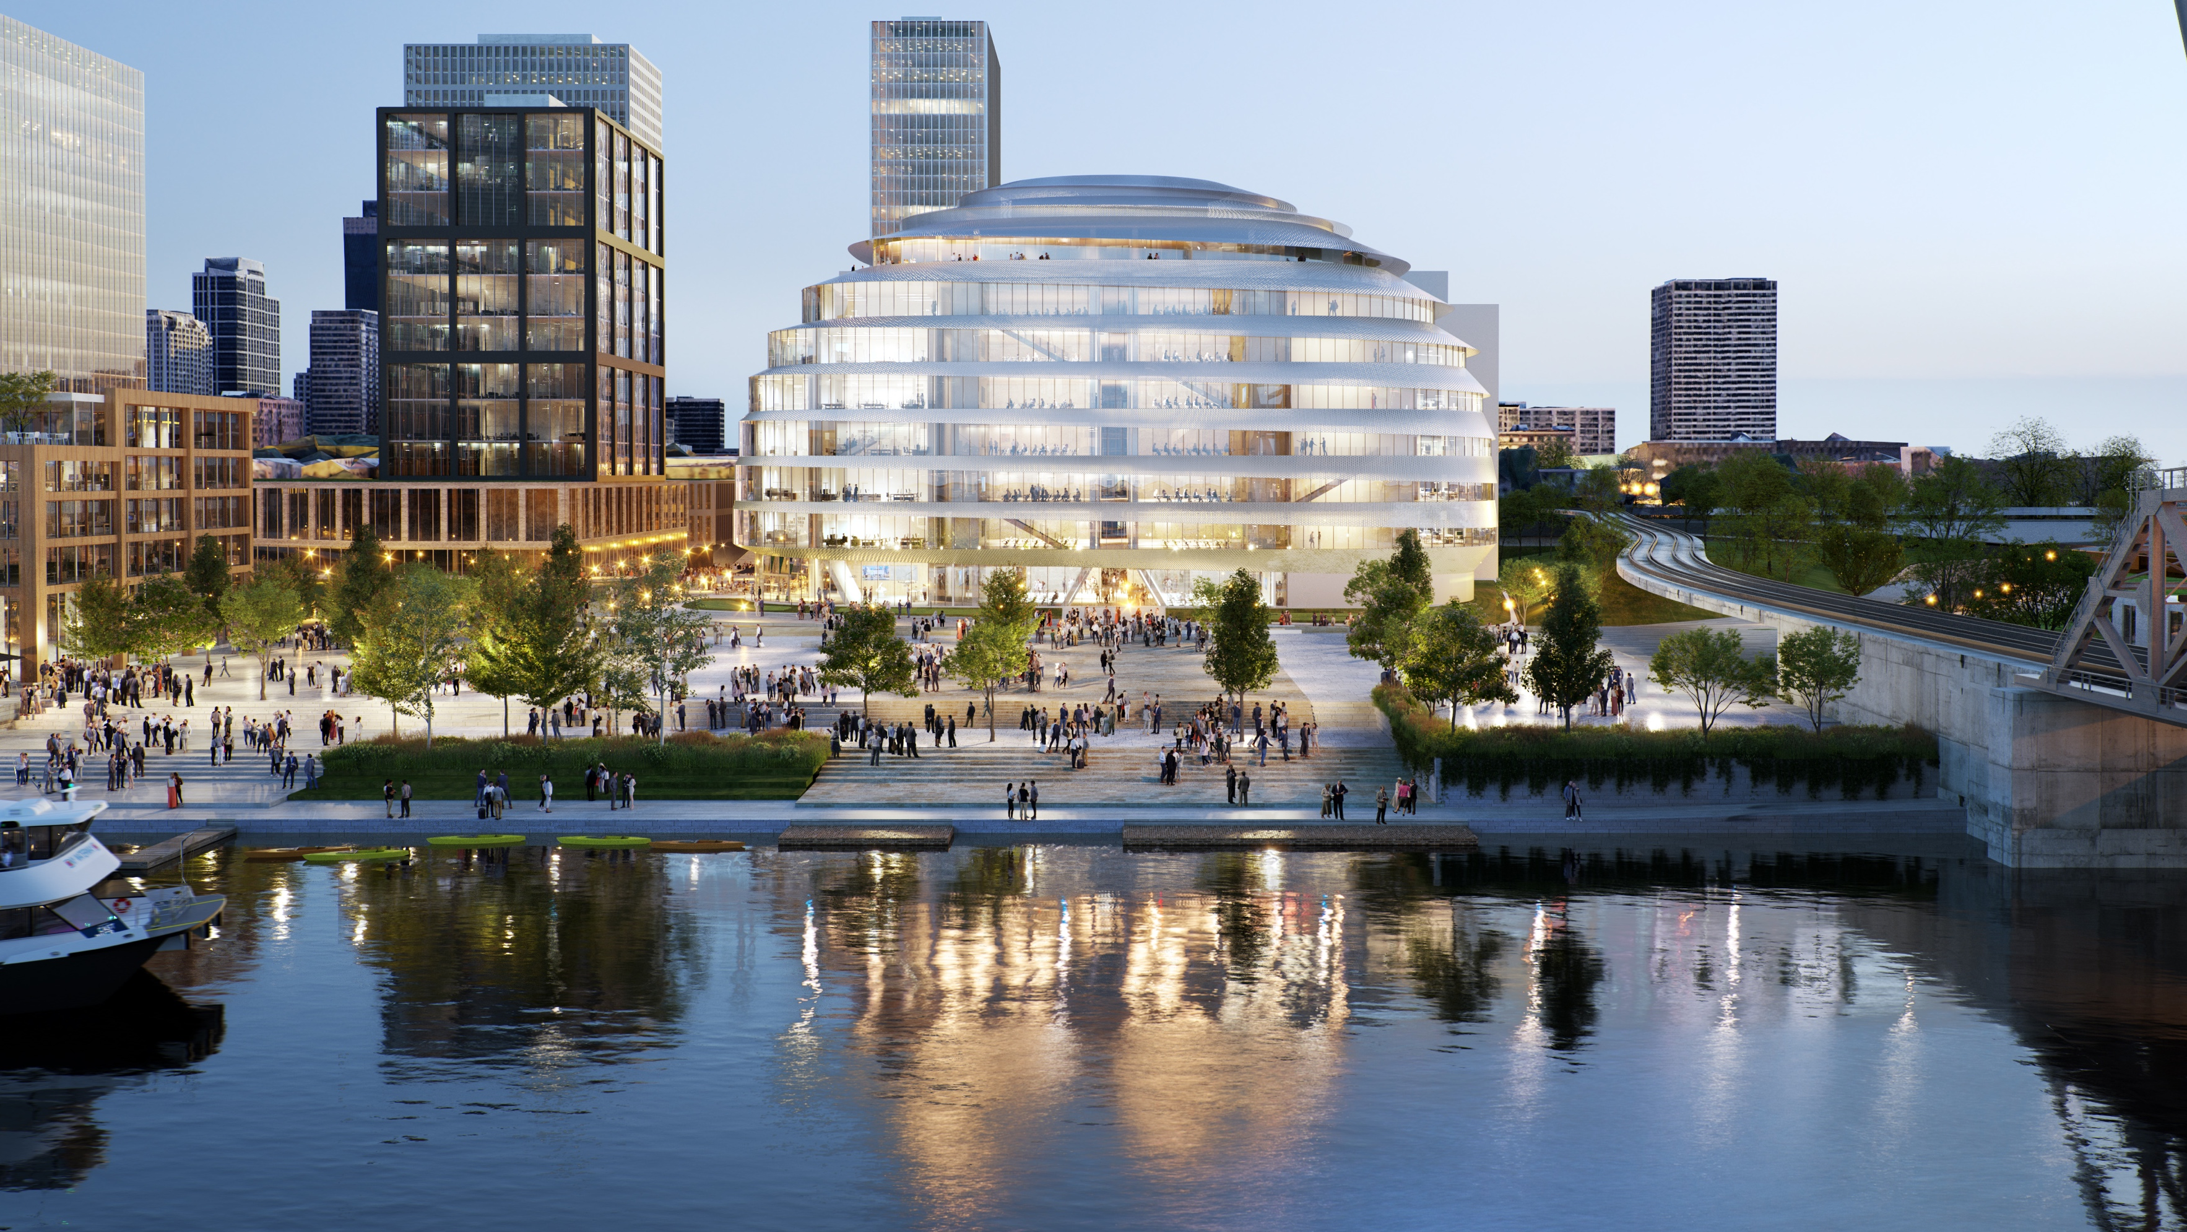
Building an equitable future
BUILDING AN EQUITABLE TECH TALENT PIPELINE
Notes:
Staying here in Chicago, the Discovery Partners Institute continues to grow into its vital role as a magnet for and developer of tech talent for the city and region.
Over the just-completed year, DPI’s Community Education Unit, part of the Pritzker Tech Talent Labs, worked with about 550 students. Almost three-quarters of those students are Black or Latinx.
DPI’s Workforce Education Unit trained 67 adults in software development and placed almost 50 more in apprenticeships at Cognizant, SAP and John Deere.
So almost 700 people, in all, took steps toward new lives as tech professionals, and this impact will only grow.
This summer, for instance, a record 115 students will be part of the Digital Scholars program.

Slide 7
Growing partnerships
GROWING PARTNERSHIPS
Notes:
Partnerships are at the center of our mission to serve the people of this city, our state and all of society.
And in the past year we have forged bonds with a number of new partners around the world, adding to those we have been working with for years now.
We combine our strengths to address global challenges, in the process providing collaborative opportunities for our faculty and students and opening doors for entrepreneurs and researchers from outside the United States to bring their innovation and ideas to Chicago and Illinois.
Since last fall, the U of I System has opened its first Latin American office, at UNAM in Mexico City. This opens a door to all of Latin America for student recruitment, the exchange of researchers and the chance to work on challenges we share around health and wellbeing, agriculture, sustainability and more.
We also have a new partnership created just in the past weeks with National Tsing Hua University in Taiwan, and another with Taiwan’s Industrial Technology Research Institute to explore cooperation in, among other areas, biomedical research, semiconductors, AI, and talent development.
DPI has launched a new partnership with the German lab DESY that will send researchers in both directions but also give startups in Hamburg a base in Chicago.
And just last month, the system signed a new MOU with Cardiff University, allowing students and researchers to collaborate in engineering, healthcare, environmental science and many more areas.
These partnerships are the means by which we multiply our impact at home and abroad and operate as a truly global university system.

Slide 8
Sustainable research
SUSTAINABLE RESEARCH
Notes:
Systemwide, our research portfolio has grown to more than $1.2 billion a year, funding that is financing discovery at all three universities -- and helping rev up the state’s economy and strengthen our society through the life-changing innovation we talk about so much.
It is difficult to limit myself when looking around for examples of the research happening around the system – the volume and impact are astounding.
But, given the urgency around sustainability, let me talk about two projects focused there.
Here in Chicago, UIC is partnering with Argonne National Laboratory and a range of others on the Community Research on Climate and Urban Science, a collaborative laboratory created to study urban climate change and its effects at local and regional scales.
The Department of Energy last fall awarded CROCUS $25 million to dig deep into the climate disruption already happening in Chicago.
Researchers will explore how trees, open spaces, buildings, expressways and Lake Michigan are shaping the city’s climate, as well as how the Chicago area influences climate regionally.
Co-PIs from UIC are Max Berkelhammer, Miquel Gonzalez-Meler and Ralph Cintron and, while their work is focused on the city, what CROCUS learns will be useful in creating models for other urban environments.
In Urbana-Champaign, DOE this spring committed to five additional years of the critical bioenergy work happening at CABBI, the Center for Advanced Bioenergy and Bioproducts Innovation.
Like CROCUS, CABBI is built on partnerships … a collaboration between the university’s Institute for Sustainability, Energy, and Environment, the Carl R. Woese Institute for Genomic Biology, 11 academic departments across the Urbana campus, and 20 other institutions around the country.
Andrew Leakey is the director of CABBI and, as he said last spring, the new DOE grant is a massive investment in CABBI’s mission to reduce our dependence on fossil fuels.
With the additional funding, DOE will have invested a total of $262.5 million by 2027.

Slide 9
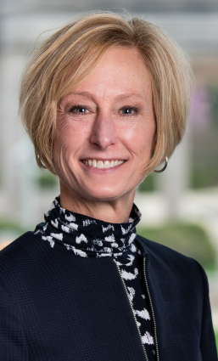
University leadership
OUR LEADERSHIP
Notes:
Finally, I want to talk about our people, in particular our leadership.
Urbana continues to operate as an innovative powerhouse under the stewardship of Chancellor Jones.
In Springfield, Chancellor Gooch will soon enter her second full year at the helm, and UIS is already benefitting from her vision of the university as a powerful engine for prosperity.
I consider myself fortunate to count both Chancellor Gooch and Chancellor Jones as partners and friends, and the system enjoys their strong leadership.
And now we welcome Chancellor Miranda here in Chicago.
UIC is a real jewel in the U of I System – an urban research university that serves one of the world’s great cities, designated as a Hispanic-serving institution, home of a healthcare enterprise that provides a major percentage of our state’s doctors, nurses and other healthcare professionals.
Chicago and our whole state are better for the innovation and brilliant minds at work on this campus – and the scale at which it serves as an agent for progress and change.
Now Chancellor Miranda brings a new vision, a new spirit and a full appreciation for the importance of this university and the possibilities of its role here in this incredible city.
If you were willing to listen to me go on, I could talk for hours about all of the good that happened across our system over the past year … and hours more about the opportunities ahead.
But in short, this has been a very good year.

Slide 10
What’s next
WHAT’S NEXT?
Notes:
Now, you might say, what’s next?
For starters, we’re anticipating another jump in enrollment – we won’t have the final numbers, of course, for some time. But I’m very excited about what we see so far and can’t wait to share the details when we have them.
I also look forward to beginning a conversation about the next year -- and next years -- when we meet again in September, but you can be sure we will not be standing still.
As Helen Keller once wrote, “He who is content with what has been done is an obstacle in the path of progress.”
We are poised to continue delivering for the people of Illinois.

