Slide 1
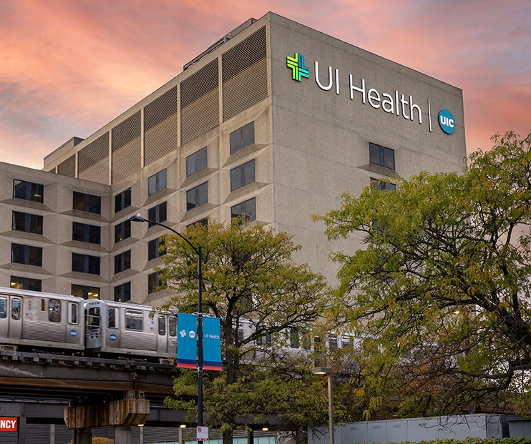
THE FUTURE: Addressing the health & well-being of our community
Robert barish, md, mba
Vice chancellor for health affairs
July 2022

Slide 2
We are UI Health
7 health sciences colleges
Applied Health Sciences
Dentistry
Medicine
Nursing
Pharmacy
Public Health
Social Work
40+ care locations
Delivery quality care throughout Illinois
UI Cancer Center
Urban Health Program

Slide 3
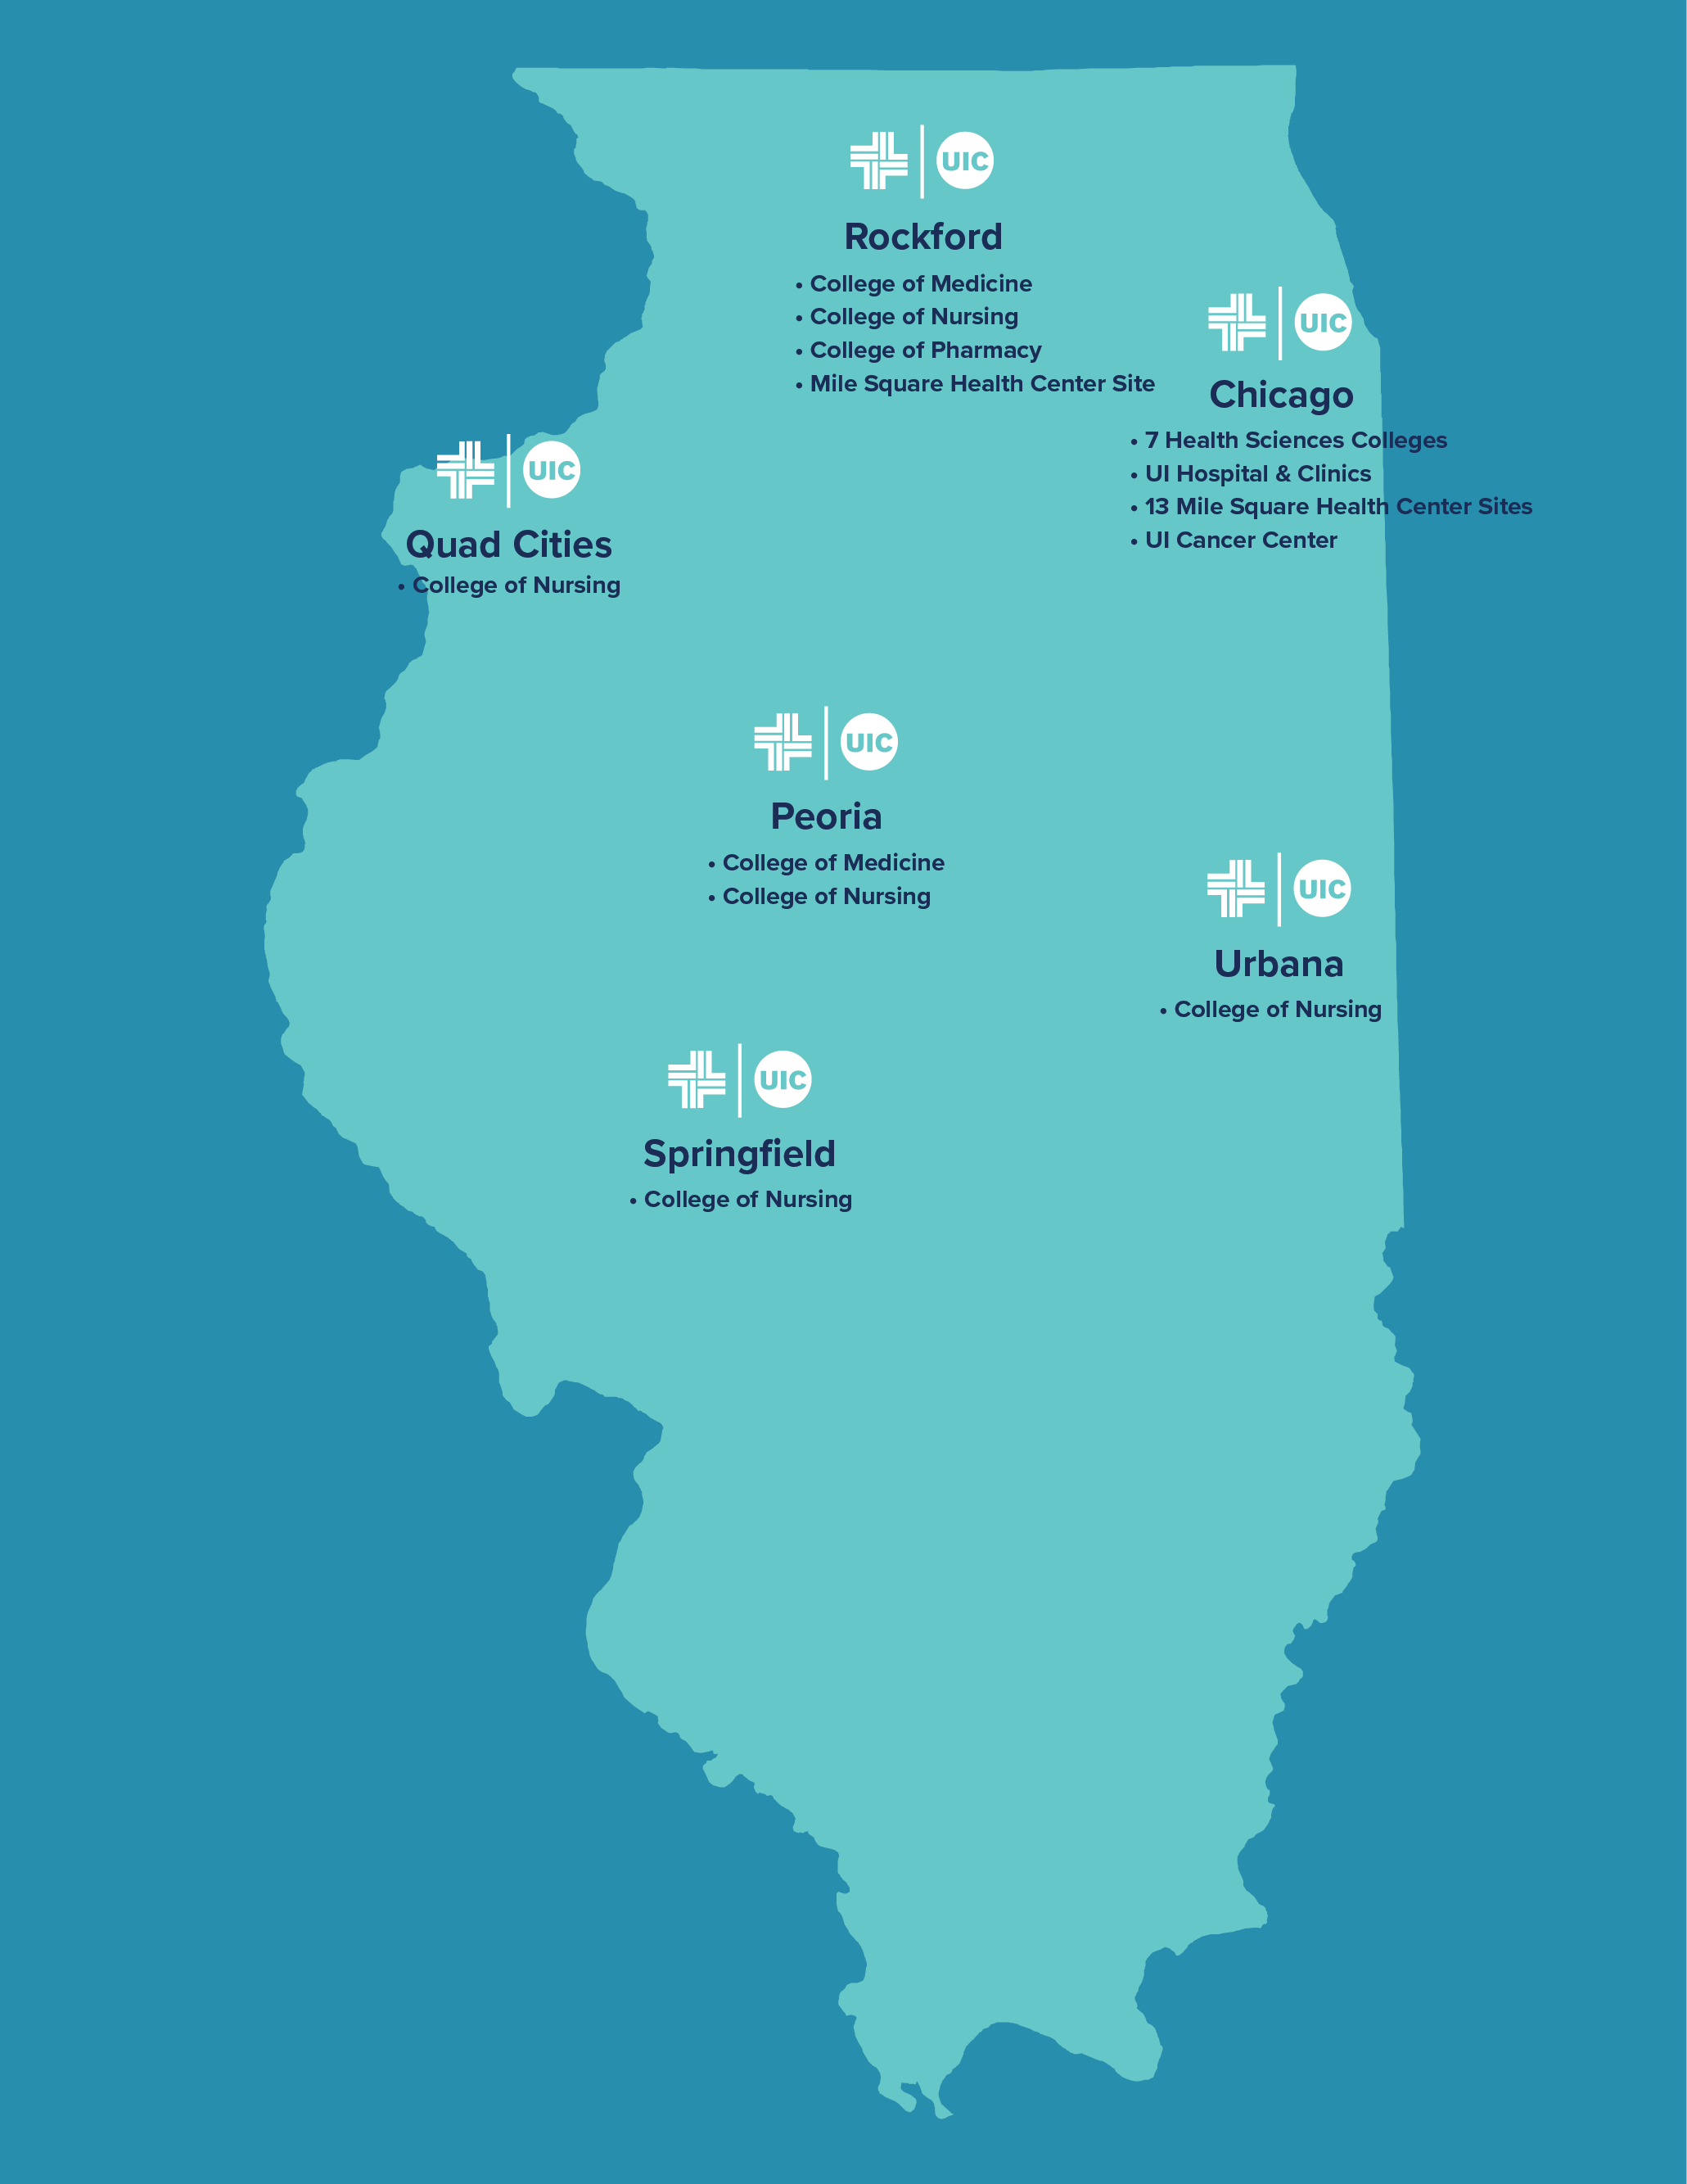
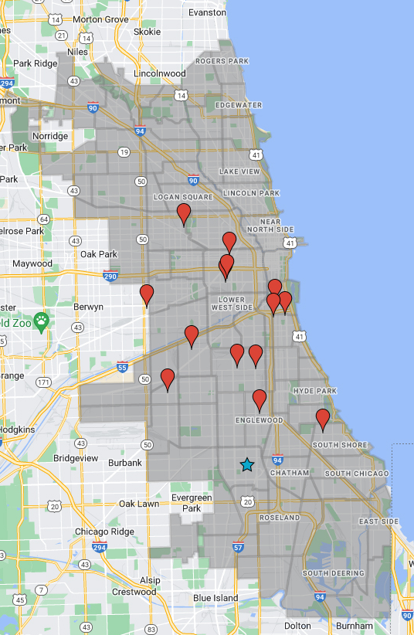
Reaching out
Reaching Out:
Health & Wellness in the Community

Slide 4
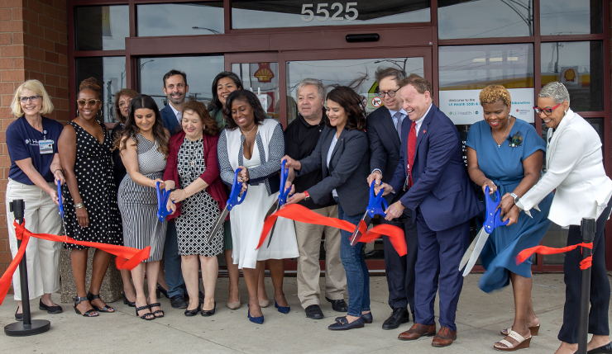
Reaching Out 2
Reaching Out:
Health & Wellness in the Community
The new 55th & Pulaski Health Collaborative was inaugurated with a ribbon cutting on May 20, 2022.
The collaborative is a partnership between six clinical service providers.
The new facility will promote health equity by providing comprehensive specialty healthcare services.

Slide 5
THE FUTURE: Human Centered Design

Slide 6
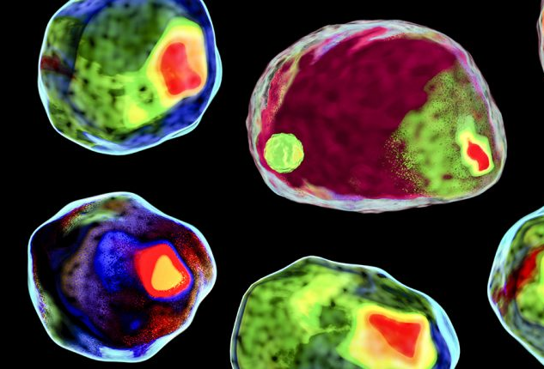
The Future
THE FUTURE: Cellular Therapy
The University of Illinois Cancer Center is the only public university-based cancer center in Chicago dedicated to the pursuit of health equity and study of cancer disparities.

Slide 7
THE FUTURE: Surgical Innovation

Slide 8
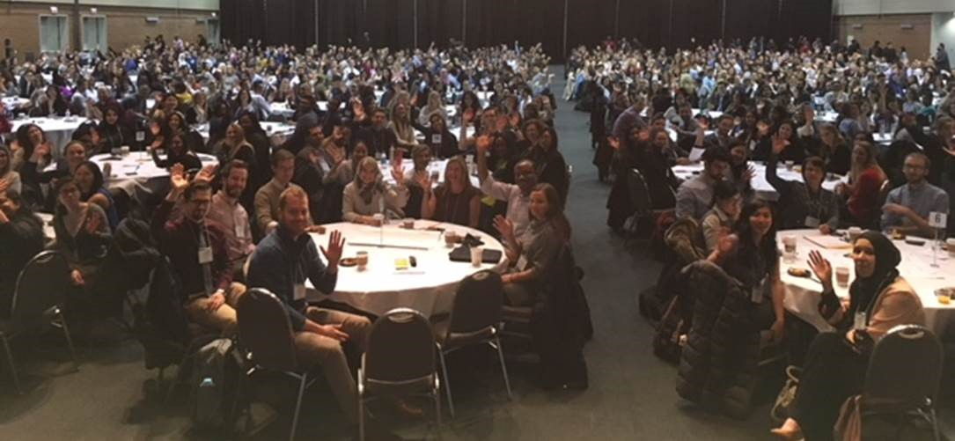
The Future 2
THE FUTURE:
Interprofessional Education & Collaborative Practice
Center for the Advancement of Inter Professional Practice, Education and Research (CAIPPER)

Slide 9
We are altogether extraordinary
We are altogether extraordinary

