Slide 1
CAPITAL UPDATES
CAPITAL UPDATES
Board of Trustee Meeting
July 21, 2022

Slide 2
Capital Spend and Trends Board Oversight of Capital Projects Capital Plan FY23 and Beyond
Capital Spend and Trends
Board Oversight of Capital Projects
Capital Plan FY23 and Beyond

Slide 3
CAPITAL SPEND & TRENDS
CAPITAL SPEND & TRENDS

Slide 4
Historical Context
2018
Less than $25 million appropriated from State of Illinois
10-year capital plan presented to the Board of Trustees: 510 projects $6 Billion
Expanded financing with Public Private Partnership (P3) Model
2019
$1.4 Billion State appropriation supporting $2 billion projects
Completed 87 projects: $346 million Initiated 120 projects: $434 million
2020-2021
Completed 300 projects: $602 million Initiated 216 projects: $382 million
2022
Completed 127 projects: $313 million Initiated 257 projects: $602 million Requested 5-year updated capital plan
Notes:
Initiated projects for 2022 figures include DPI ($250M), DKC Illinois Extension Center ($40M)

Slide 5
CAPITAL SPEND BY YEAR
5 year average 2017 – 2021:
$259 million
2022 projected spend:
$390 million

Slide 6
$1.6 BILLION IN ACTIVE CAPITAL PROJECTS
$819 Million in Planning and Design
$766 Million In or Near Construction
Notes:
Planning & Design = Planning, AE Select, Design
Examples: DPI ($250M), Altgeld/Illini ($192M), Drug Discovery ($165M), Undergrad Library ($50M), All other: $172M
In or Near Construction = Bid/Award, Construction
Examples: UIC Specialty Care Building P3 ($196M), CDRLC ($118M), Ubben ($40M), Parking Decks ($21M), All other: $390M, 130+ Projects

Slide 7
CAPITAL FUNDING 2018 VS. 2022
Capital Fund Sources for Projects with Budgets Greater Than $5 million
$885 Million
$1.711 Billion

Slide 8
ACTIVE STATE INVESTMENT IN CAPITAL
2018: Less than $25 million
2019: Now: $1.4 billion appropriated supporting $2 billion in projects
2022: $615 million in active state-funded projects

Slide 9
$1.1 BILLION IN ACTIVE NEW CONSTRUCTION PROJECTS
Notes:
Examples:
UI Health Specialty Care Building $196M
CDRLC $118M
DPI $250M
Drug Discover $165M
Library Commons $35M

Slide 10
ACTIVE PROJECTS
$326 Million in Remodeling and Additions
$187 Million in Site Work, Utilities and Infrastructure and Deferred Maintenance
Notes:
Deferred Maintenance, Site Work: EPC Project ($34M), Replace Mechanical Equipment at BRL (UIC) ($17M), All others under $7M
Remodel/Additions: Undergrad Library ($50M), Ubben ($40M), Welcome Atrium UI Hospital $18M

Slide 11
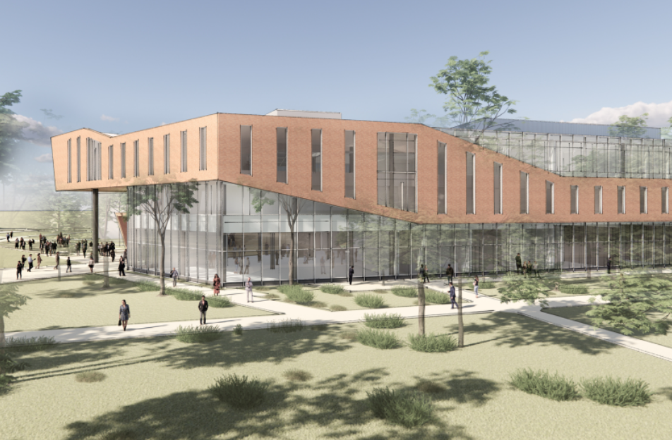
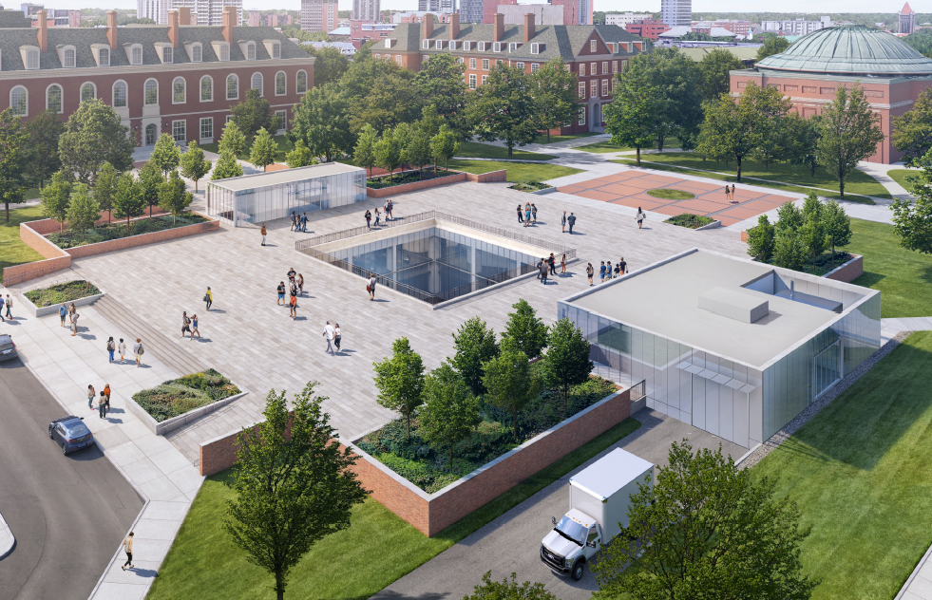
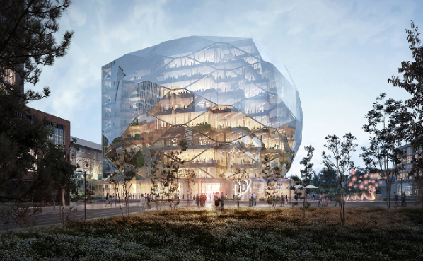
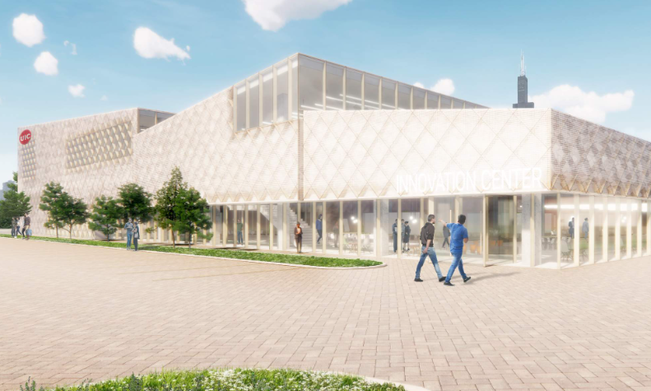
EXAMPLE PROJECTS IN DESIGN
Library Commons
New Construction
$35M Budget
In Design
State-Funded
Undergrad Library Redevelopment
Remodel
$50M Budget
In Design
University Funded
Discovery Partners Institute
New Construction
$250M Budget
In Design
State + University Funded
Innovation Center Expansion
Addition
$10M Budget
In Design
State + University Funded
Notes:
Altgeld/Illini Hall
Undergrad Library Redevelopment
DKC Illinois Extension Center
Ubben
Swine Research Center?
Library Commons
Capitol Innovation Center
CDRLC
OSC
Welcome Atrium
ADA Patient Rooms

Slide 12
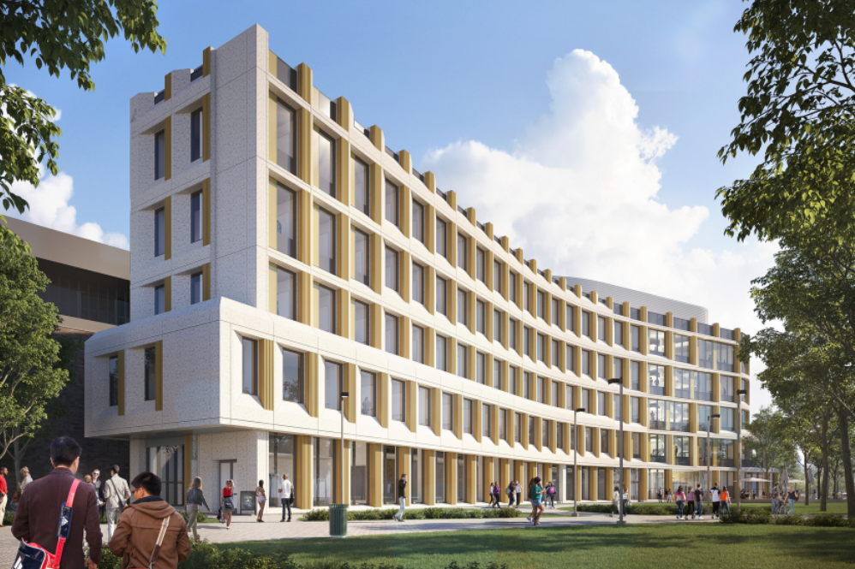
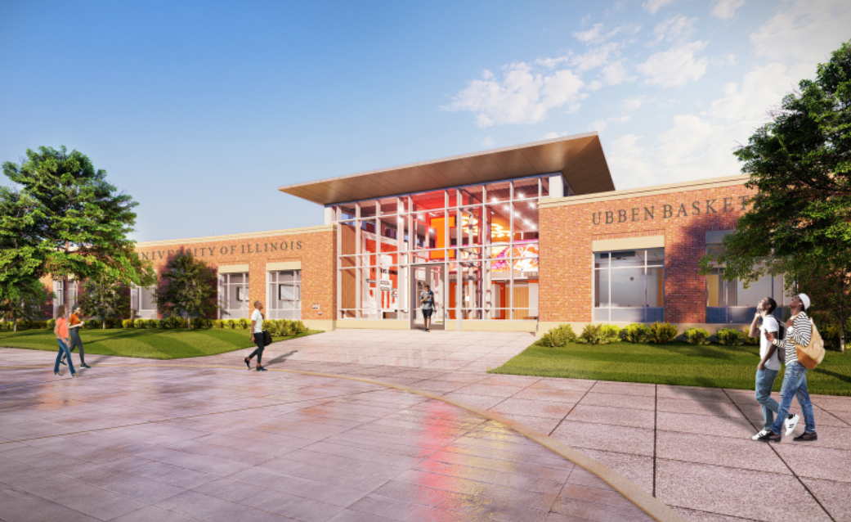
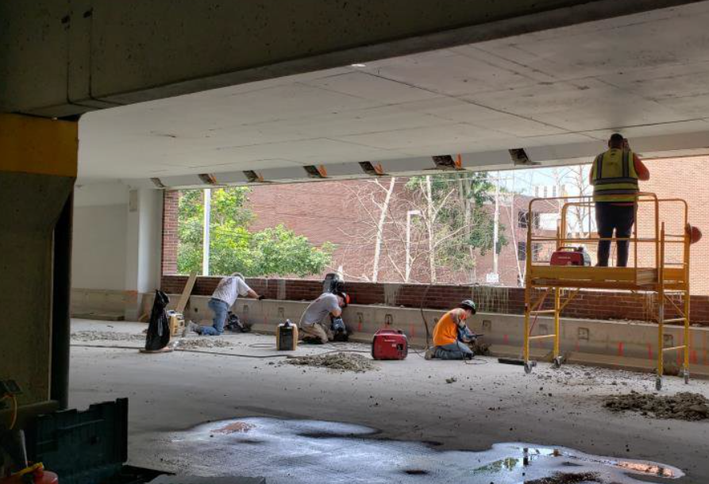
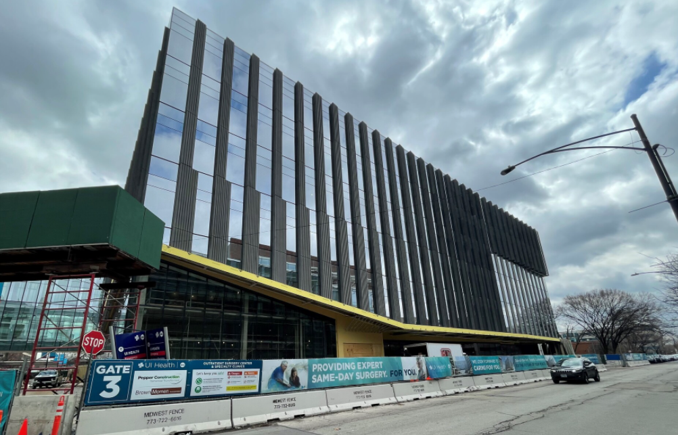
EXAMPLE PROJECTS IN CONSTRUCTION
Computer Design Research and Learning Center
New Construction
$117.8M Budget
State + University Funded
Ubben Basketball Complex
Remodel/Addition
$39.8M Budget
Donor-Funded
UIUC Parking Structures
Renovation
$21.3M Budget
Bond Funded
UI Health Specialty Care Building
New Construction
$195M Budget
P3
Notes:
Altgeld/Illini Hall
Undergrad Library Redevelopment
DKC Illinois Extension Center
Ubben
Swine Research Center?
Library Commons
Capitol Innovation Center
CDRLC
OSC
Welcome Atrium
ADA Patient Rooms
CQE
Clinical Decision Unit

Slide 13
DIVERSE BUSINESS SPEND
% Diverse Spend
The University of Illinois System continues to support and promote the use of Business Enterprise Program (BEP) and Veterans Business Program (VBP) certified vendors on all capital projects.
Beginning August 2021, capital professional service and construction service BEP certified vendor participation goals increased to 30% as well as the addition of a VBP certified vendor participation goal of 3% to construction services.

Slide 14
BOARD OVERSIGHT OF CAPITAL PROJECTS
BOARD OVERSIGHT OF CAPITAL PROJECTS

Slide 15
CAPITAL DELIVERY PROCESS OVERVIEW INTERNALLY FUNDED PROJECTS
Need Identified
Project Initiated
Conceptualization
Professional Services Consultant Selection
Legend
Project Phases
Project Approval for Projects with Budgets > $5 million
Design Contract Approval for Contracts > $1 million
Board of Trustees Touchpoints
Design
Bid & Award
Construction
Post-Construction
Design Approval for New Buildings or Significant Renovations
Construction Contract Approvals for Contracts > $2.5 million

Slide 16
CAPITAL DELIVERY PROCESS OVERVIEW STATE-FUNDED/CDB-MANAGED PROJECTS
[
Project Funds Appropriated by Legislature
Legend
Need Identified
Project Initiated
Conceptualization
Project Phases
CDB Obtains Project Statement and Assumes Project Management Responsibilities
Governor’s Office of Management and Budget (GOMB) Decision to Release Project Funds
Approve Capital Request to IBHE for Projects Seeking State Funding
Project Approval for Projects with Budgets > $5 million
Board of Trustees Touchpoints
Professional Services Consultant Selection
Design
Bid and Award
Construction
Post-Construction
Actions Taken by State Agencies
Employ Architect/ Engineer
Design Approval for New Buildings or Significant Renovations

Slide 17
BOARD OF TRUSTEE TOUCHPOINTS
BOARD OF TRUSTEE TOUCHPOINTS
Professional Services Consultant Contract Amendment
Amendment causes contract to exceed $1 million
Amendment requires associated budget increase
Project Budget Increase
Any increase to budget must first be approved by the Board
Change Orders
Report provided outlining all change orders that exceed 5% of originally approved contract value

Slide 18
FY23 & BEYOND
FY23 & BEYOND

Slide 19
CAPITAL PROCESS RECOMMENDATIONS
Ernst & Young Consulting Engagement
Implement contractor evaluations
Architect evaluations forthcoming
Streamline approval processes
Increased university delegated authority for change order approvals
Increase staffing to meet project demands
Increase utilization of retainer work orders

Slide 20
CAPITAL PROCESS RECOMMENDATIONS
Ernst & Young Engagement, continued
Implement Capital Project Audits
Engaged with FTI Consultants
Observations include:
Multiple project management systems lead to errors, duplication of efforts
System scheduling capabilities need to be enhanced
Standardize file retention policies

Slide 21
CAPITAL INITIATIVES
Facility Condition Assessment
Develop a comprehensive approach to deferred maintenance
Capital Project Management Software
Effort to replace 10-15 year old systems
Crowe: Small Construction Project Processes Assessment
Legislative: Changes to procurement and construction services
Design Build and Single Prime
Capital Project Audits
Evaluation of current processes and delivery ongoing
Updated 5 year Capital Plan

Slide 22
5-YEAR CAPITAL PLAN
$2.85 Billion in Identified Need
Millions
74% Identified for Academic, Research, and UI Health

Slide 23
PROPOSED FUNDING SOURCES
Planned Use of State Funds
$1.4 Billion
23% Existing appropriation
24% Requested appropriation
53% Future request
Notes:
Of the $1.43B in planned use of state funds, $333M (23%) has already been appropriated, the majority of this is R&R funds that have been appropriated but not yet released

Slide 24
DISCUSSION Projects Coming Soon
DISCUSSION Projects Coming Soon

