Slide 1
Creating Tomorrow’s University Today
BOT Retreat
July 21, 2022

Slide 2
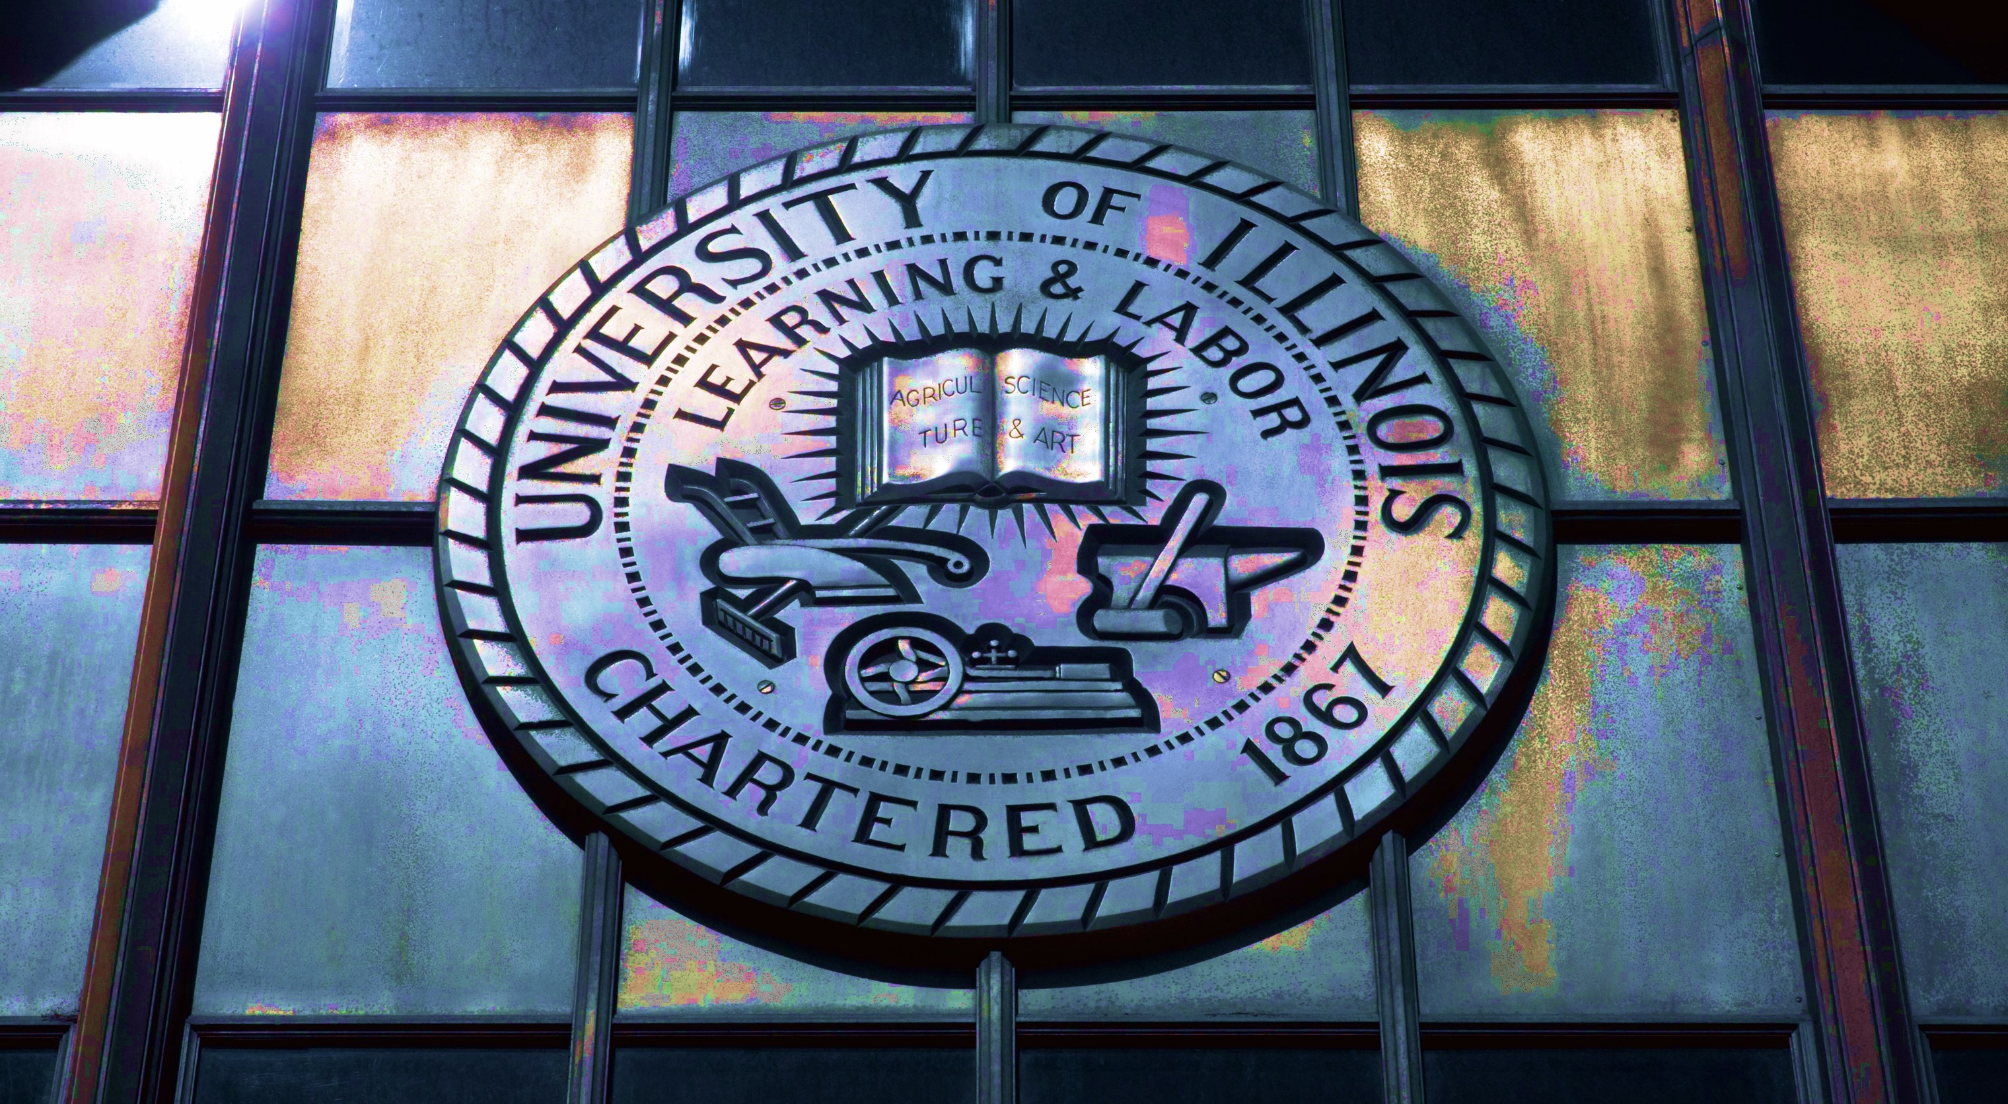
Creating Tomorrow’s University Today
Programmatic Transformations

Slide 3
A Legacy of Impact Benefiting Society
Ever since the first student walked onto the campus in 1868,
the University of Illinois has been a priceless resource
for the State of Illinois and the nation.
It has provided opportunities for education to citizens and helped create a thriving economy for the State.
It has played created generations of innovators, entrepreneurs, leaders, and thinkers and advanced the frontiers of knowledge to benefit society.

Slide 4
Extending the Historical Legacy
Technology driven transformation of industry requires
diverse talented workforce to create growth and prosperity

Slide 5
Two Pathways to Greater Impact
Improve and Extend Current Model of Education Delivery
Create Innovative, New Models of Delivery to Reach Broader Audiences

Slide 6
Nearly 100,000 students
25,000 annual graduates

Slide 7
Enhancing Inclusivity
Access 2030 Program

Slide 8
New Innovative Models of Program Delivery
Degree Programs will Continue
But
We need to Consider Additional Forms of Education Delivery

Slide 9
New Innovative Models of Program Delivery
Alternative Credentials
New Audiences
Life-Long Learners
Leveraging New Educational Technologies

Slide 10
Enhance our impact
To enhance our impact,
we must challenge tradition,
be inclusive as well as expansive,
create new partnerships
and embrace change

Slide 11
Thank You

