Slide 1
Innovation and Economic Development at the
University of Illinois System
Jay Walsh
Vice President for Economic Development and Innovation
University of Illinois System

Slide 2
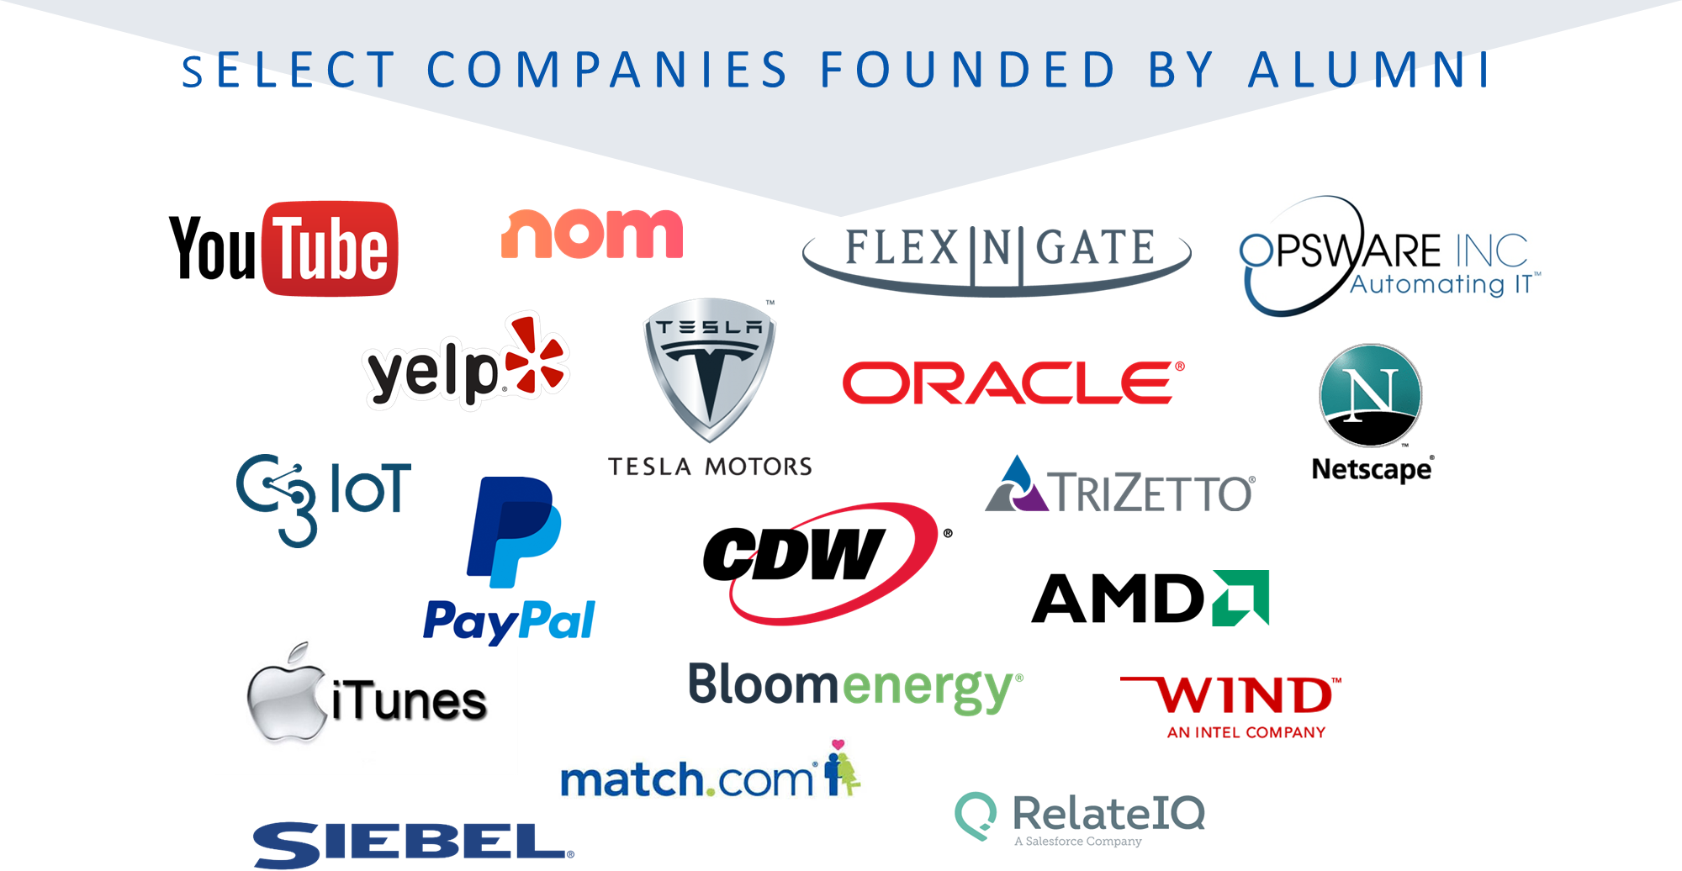
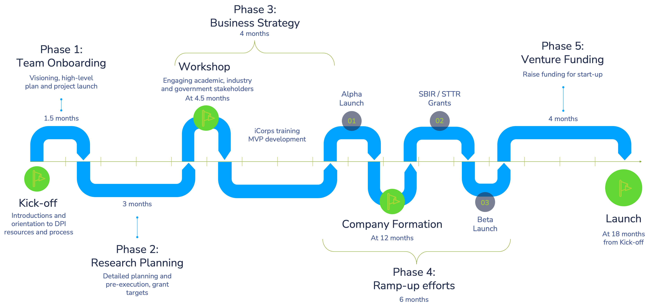
Innovation
DPI: Applied Research focusing on Innovation / Business Development

Slide 3
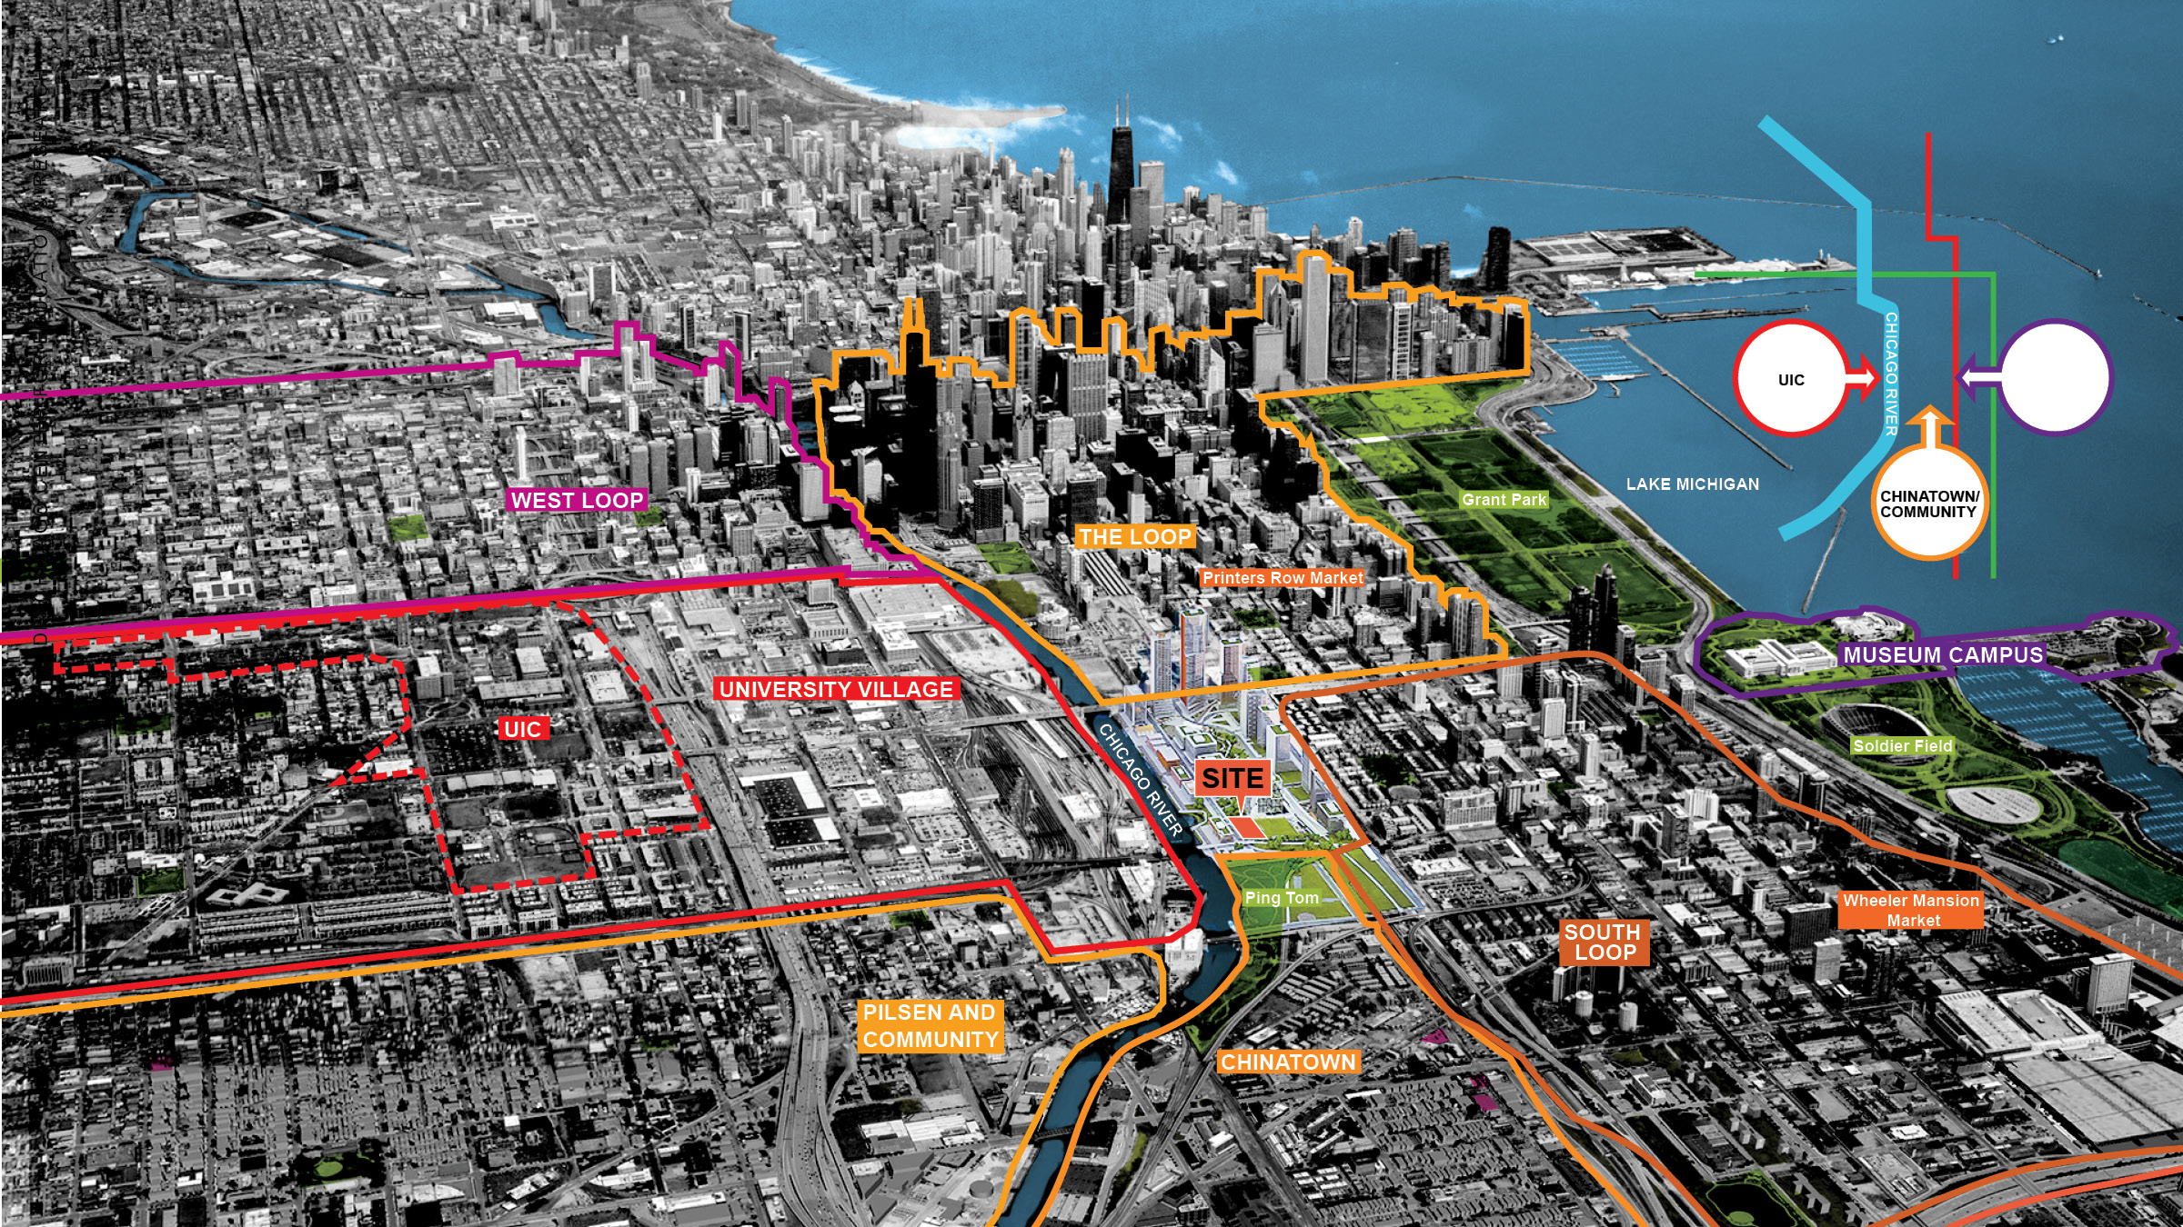
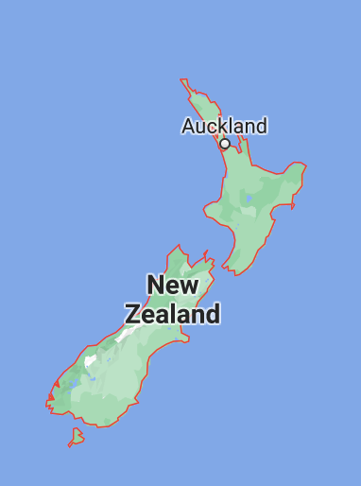

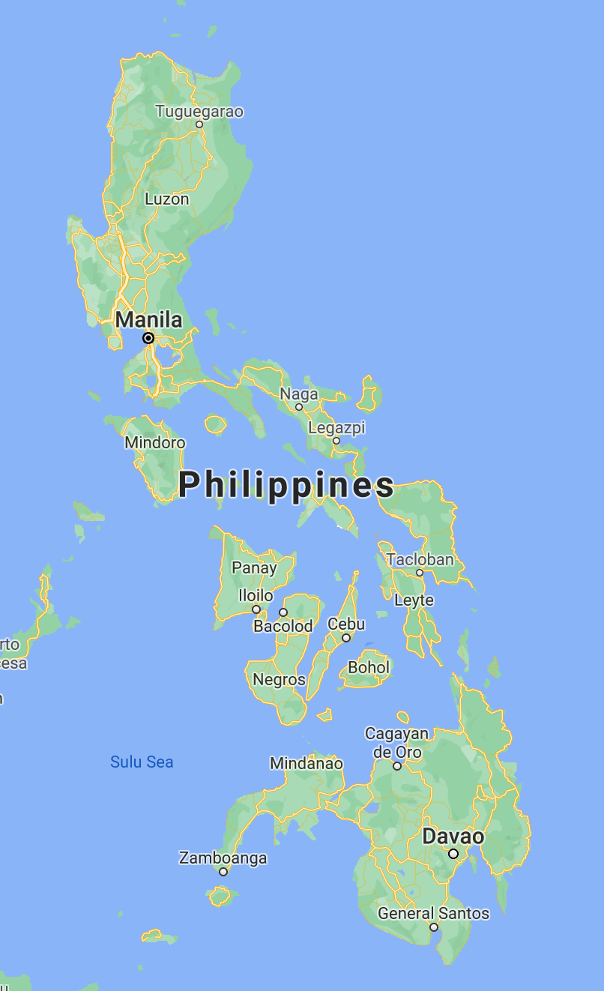

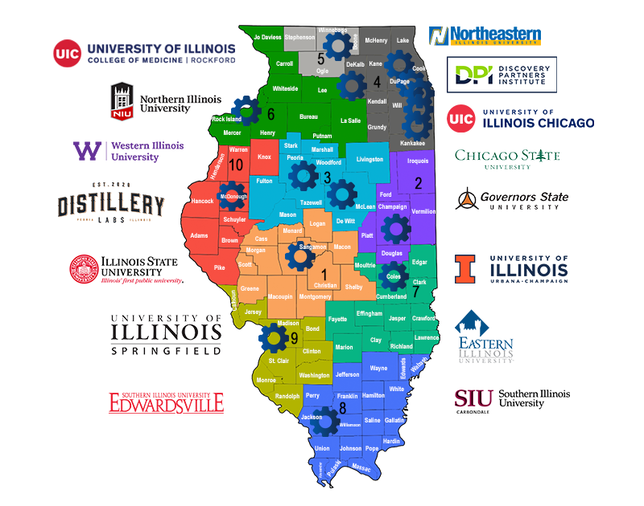
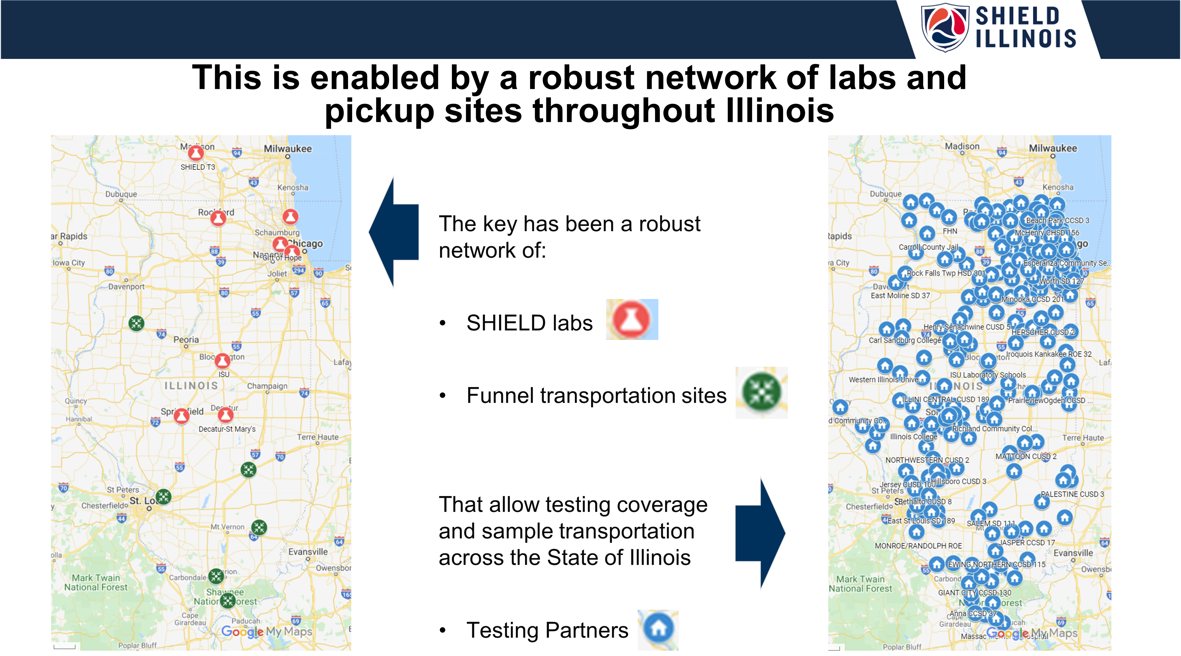
At Scale
DPI: Community scaling
Shield: Global scaling
GLHEC: Regional scaling
IIN: State-wide scaling
Shield Illinois: operational scaling

Slide 4

With the Community
DPI: Neighboring Communities
IIN: A Network of Networks
Diverse
Tech Talent Development

Slide 5
For Impact
IMPACTS CREATED BY THE U OF I SYSTEM IN FY 21
Operations spending impact: $5.0 billion
Research spending impact: $1.3 billion
Hospital spending impact: $1.6 billion
Construction spending impact: $193.4 million
Start-up & spin-off company impact: $838.0 million
Visitor spending impact: $3.6 million
Student spending impact: $387.2 million
Alumni impact: $9.5 billion
TOTAL ECONOMIC IMPACT:
$18.9 billion
164,154 Jobs supported
UIUC Research Park:
  >50 Start-up companies, 43k ft² incubator
  ADM, Abbott Laboratories, AbbVie, AGCO, Ameren, Bayer, BP, Brunswick, Cargill, Capital One, Caterpillar, CME Group, Corteva AgriSciences, Deere & Company, Forcepoint, Graybar, Littelfuse, Motorola Solutions, Nutrien, NVIDIA, P&G, Riverbed, State Farm, Synchrony, and Verizon Media Group/Yahoo.
UIC Innovation Center:
  Corporate sponsored classes, labs, and programs; students from 20 disciplines
  OSF HealthCare, Verizon, Baxter, BMW, Cigna, Dunkin Donuts, Phonak, Herman Miller, Caterpiller, Intuive, Wilson, USG, Kia, Morning Star, Cricket, Redbox, Motorola
Innovate Springfield:
  >70 companies
  To occupy a new space shortly

Slide 6
Illinois Innovation Network
Illinois Innovation Network
A Structured Collaborative driving inclusive economic development via innovation
Advisory Council
IIN Working Committees
Education & workforce Development
IIN Council
Representatives from fifteen hubs
Corporate Engagement
Entrepreneurship
Advocacy & Policy
Research & Collaboration
Admin Agent OVPEDI U of I System
IIN Executive Committee

Slide 7
Strategic Alignment of the IIN Hubs
Strategic Alignment of the IIN Hubs
  Hub focus areas align with following themes
      Computing and data
      Food and agriculture
      Environment and water
      Health and wellness
  Entrepreneurship & Inclusive and integrated Economic Development
Maximizing potential to implement national capital project and program priorities, quickly and equitably
Aligning with regional and local industry and philanthropic sustainability and innovation priorities

