Slide 1
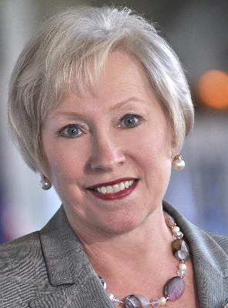
THE POWER OF SYSTEMS
NANCY ZIMPHER
Senior Fellow, National Association of System Heads
Chancellor Emeritus, State University of New York (SUNY)
President Emeritus, University of Cincinnati
Chancellor, University of Wisconsin-Milwaukee
Executive Dean, Professional Colleges; Dean, College of Education, The Ohio State University

