Slide 1
UNIVERSITY OF ILLINOIS
ENDOWMENT FARMS
ANNUAL REPORT
2021
JANUARY THROUGH DECEMBER 2021
Reported to the Board of Trustees
July 21, 2022

Slide 2
CY2021 ANNUAL REPORT
Office of the Vice President, Chief Financial Officer and Comptroller
349 Henry Administration Building, 506 South Wright Street • Urbana, Illinois 61801
July 2, 2022
Board of Trustees University of Illinois
The 2021 University of Illinois System Endowment Farm report is attached herein. The report contains background information on the endowment farm portfolio, including a map and an overview of crop growing conditions, prices, and land values. Specific summary reports for each farm follow the background information. The acreage, year of endowment, value estimate, income and return are provided for each farm. These reports are prepared on an accrual basis in accordance with generally accepted accounting principles.
The endowment farms are gifts of farmlands and buildings provided by donors to support the University of Illinois System. Each endowed farm is managed in accordance with the donor’s goals, objectives, and interests. Earnings generated by the endowment farms support research and student fellowships, scholarships, and a student loan fund. In addition, other activities supported by the endowment farms include promotion of 4-H activities and operation of Allerton Park, House, and Retreat Center. In 2021, the level of support for these programs provided by the endowment farms totaled almost $3.1 million.
The first farmland gift, received in 1923, was the Carter-Pennell farm. Management was assigned to the College of Agriculture, Department of Agricultural Economics. Currently, management is in the Office of Treasury Operations and conducted by Agricultural Property Services.
The System’s top priority in managing endowed agricultural land is to steward the farm in accordance with the donors’ goals and objectives. Good stewardship is accomplished by focusing on achieving optimal net income while pursuing improvement of the farm through management of soil conservation, drainage, and fertility. Endowment farms are also managed to achieve other benefits of the gifts, such as gaining positive local public relations, building relationships with Illinois farm operators, and furthering the education, outreach, and research mission of the System. We continually examine ways in which to optimize all elements encompassed within these priorities.
Sincerely,
Paul N. Ellinger
Interim Vice President, Chief Financial Officer and Comptroller
Cc: President Killeen Secretary Knott
1

Slide 3
CY2021 ANNUAL REPORT
CONTENTS
LOCATION AND LISTING OF ENDOWMENT FARMS
3, 4
5
6
7
8
COMMODITY PRICES
ENDOWMENT FARM INCOME DISTRIBUTIONS
2021 FARMLAND VALUES IN ILLINOIS
ENDOWMENT FARM RETURNS AND ASSET VALUES
INDIVIDUAL FARM REPORTS
9
10
11
12
13
14
15
16
17
18
19
20
21
22
23
24
25
26
27
ADDINGTON FARMS
ALLERTON FARMS
CAMPBELL FARM
CARMAN FARM
CARTER-PENNELL FARM
CURL FARMS
DEHART FARM
GROHNE FARM
HACKETT FARM
HERBOLSHEIMER FARMS
HUBBELL FARM
HUNTER RESEARCH FARM
HUNTER SCHOLARSHIP FARMS
O’CONNELL-PHILLIPS FARM
SPILLMAN FARMS
VOIGT-FREEMAN FARM
WAFFLE FARM
WARREN FARM
WEBER FARM
2

Slide 4
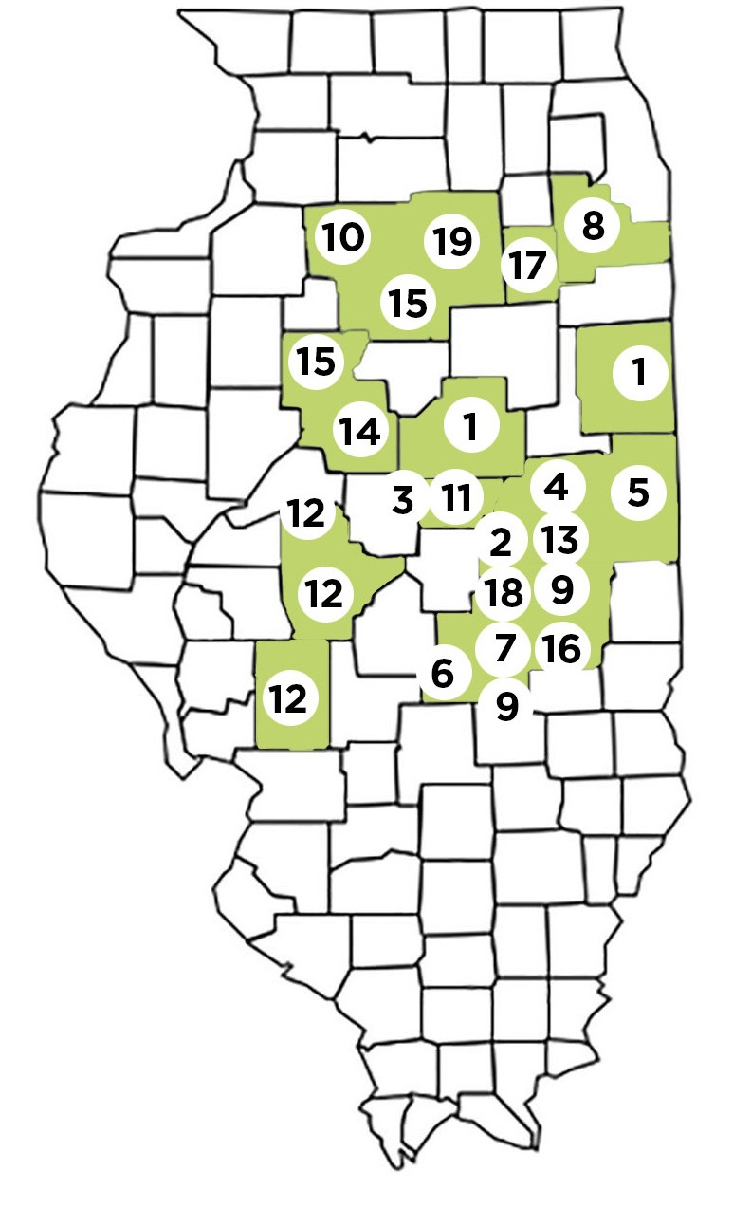
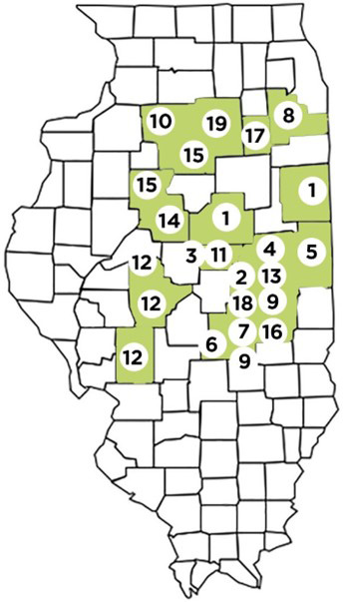
LOCATION OF ENDOWMENT FARMS
CY2021 ANNUAL REPORT
Addington Farms
Iroquois and McLean Counties
Allerton Farms
Piatt County
Campbell Farm
DeWitt County
Carman Farm
Champaign County
Carter-Pennell Farm
Vermillion County
Curl Farm
Shelby County
DeHart Farm
Moultrie County
Grohne Farm
Will County
Hackett Farm
Douglas and Moultrie Counties
Herbolsheimer Farms
Bureau County
Hubbell Farm
DeWitt County
Hunter Agricultural Research Farm
Champaign County
Hunter Agricultural Scholarship Farms
Macoupin, Menard, & Sangamon Counties
O’Connell-Phillips Farms
Tazewell County
Spillman Farms
Marshall & Peoria Counties
Voigt-Freeman Farm
Coles County
Waffle Farm
Grundy County
Warren Farm
Piatt County
Weber Farms
LaSalle County
3

Slide 5
CY2021 ANNUAL REPORT
Name of Endowment | Donor(s) | Total Acres | Year of Gift | Purpose of Gift (How Income is Used)
Addington | Francoise A. Addington | 1,909 | 1991 | Agriculatral Research Grants
Allerton | Robert H. Allerton | 3,632 | 1946 | Maintenance of Conference Center and Allerton Park
Campbell | Grace V. Campbell | 86 | 1976 | Scholarships for Illinois farm men and women
Carman | Cecelia B. Carman | 72 | 1993 | Scholarships - College of ACES - Dept. of Natural Resources and Environmental Sciences
Carter-Pennell | Joseph Carter & Jane Pennell-Carter | 346 | 1929 | Student Loan Fund
 |  | 40 | 1999
Curl | Grace Curl |  |  | Agricultural Research and/or Scholarships
 |  | 110 | 2011
DeHart | Carl A. DeHart | 120 | 1975 | Scholarships to students
Grohne | David F. Grohne | 259 | 2019 | College of ACES - Dept. of Natural Resources and Environmental Sciences
Hackett | Jessie E. Hackett | 414 | 1950 | Graduate scholarships & fellowships
Herbolsheimer | Bertrand V. Herbolsheimer | 168 | 2013 | Improvement of Agriculture
Hubbell | Alta E. Teter | 190 | 1972 | General educational purposes
Hunter | Ralph O. & Mabel F. Hunter | 1,251 | 1975 | Scholarships - College of Agricultural, Consumer & Environmental Sciences
Hunter #6 | Ralph O. & Mabel F. Hunter | 280 | 1975 | Agricultural Research
O’Connell/ Phillips | Frances P. O’Connell and John D. Phillips | 188 | 2017 | College of Liberal Arts, College of Agricultural, Consumer & Environmental Sciences
Spillman | Robert E. Spillman | 477 | 2013 | Agricultural Education and Scholarships
Voigt-Freeman | Nellie Voigt-Freeman | 218 | 1996 | Agricultural Research
Waffle | Dorothy Foersterling Waffle | 120 | 1994 | Student Scholarships - College of Agricultural, Consumer & Environmental Sciences
 |  | 48 | 1995 | Promotion of 4-H activities and for youth of Illinois
Warren | Elizabeth H. Warren
 |  | 80 | 1996
Weber | Laura M. Weber | 796 | 1955 | Benefit or use of College of Agricultural, Consumer & Environmental Sciences
4

Slide 6
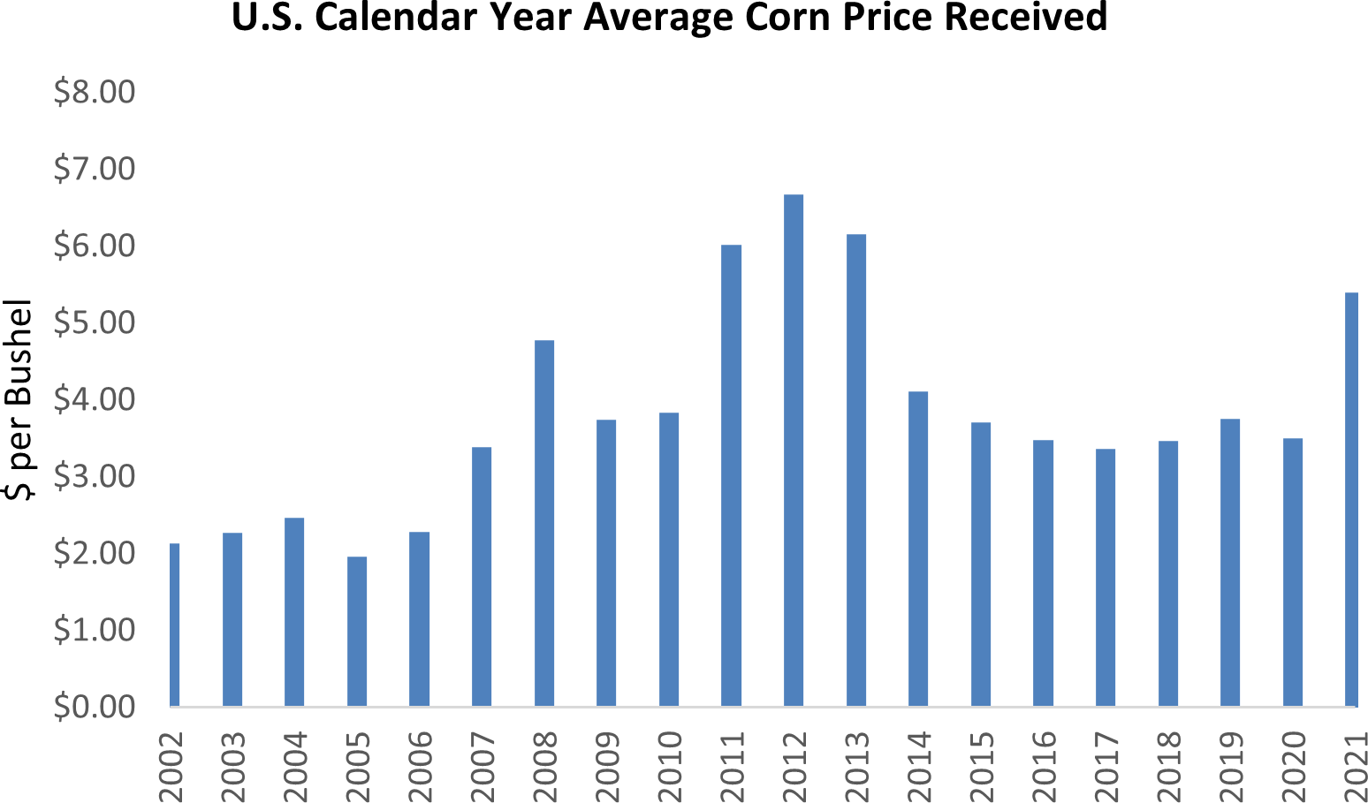
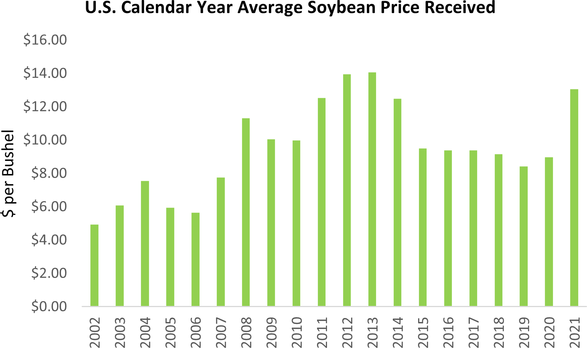
COMMODITY PRICES
CY2021 ANNUAL REPORT
Corn and Soybeans
During the 2021 crop year, corn prices averaged $5.40 per bushel. The average prices
in 2020 and 2019 were $3.50 and $3.75, respectively.
During the 2021 crop year, soybean prices averaged $ 13.05 per bushel. The average
prices in 2020 and 2019 were $8.98 and $8.43, per bushel respectively.
Commodity prices directly impact revenue on five of the University’s farm units with crop share agreements. Marketing of crops grown on the five farms is through local grain elevators or seed production contracts. The revenue on twenty-nine University farms with cash rent agreements is directly impacted by commodity prices and indirectly impacted through land valuations.
Uncertainty for the global markets, due to war and other external factors like import and export availability, along with domestic inflation being astronomically higher than normal, led to an uptick in input prices and to a significant increase in market prices for the 2021 crop.
Source: Farmdoc - US Average Farm Price Received Database
5

Slide 7
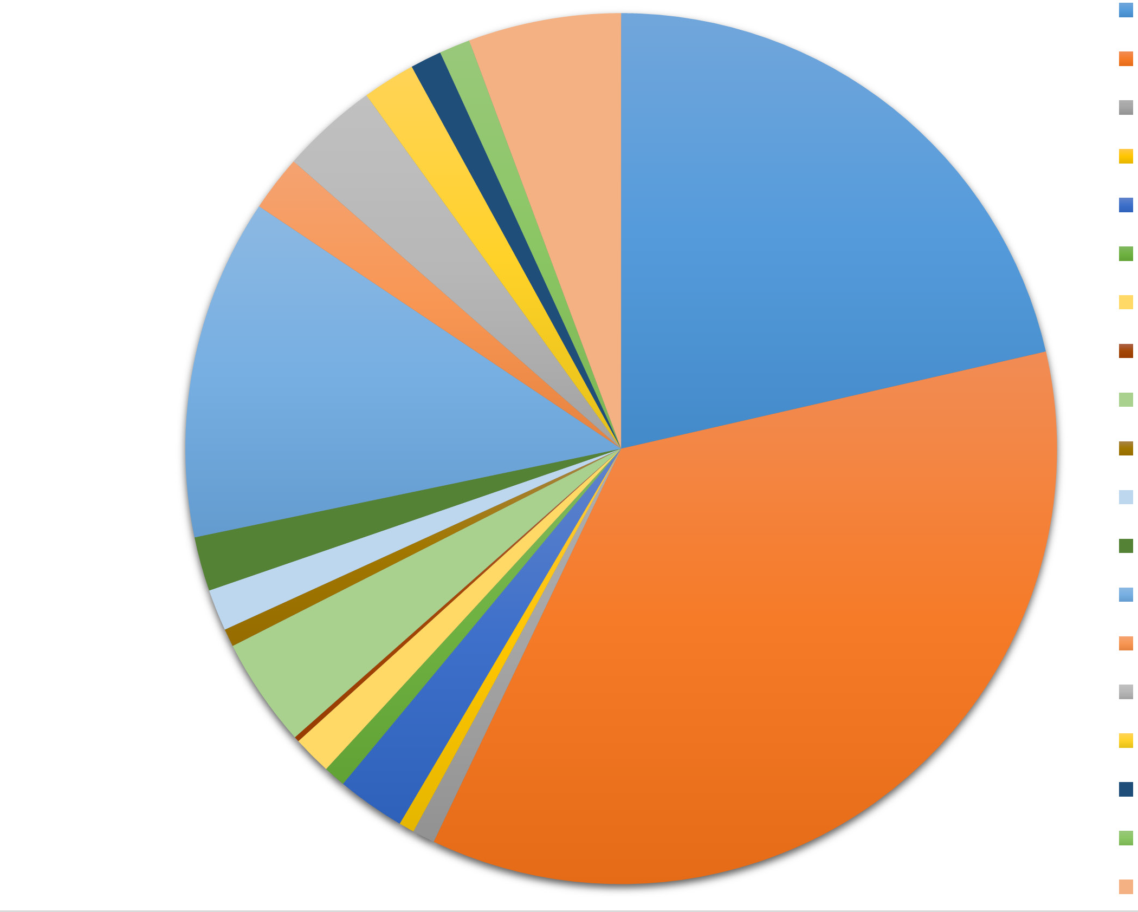
ENDOWMENT FARMS BY THE NUMBERS:
CY2021 ANNUAL REPORT
The University of Illinois System has 34 endowment farm units in its care. Ag Property Services Staff manage the farms and serve as fiduciary for the endowed farms’ beneficiaries. Management includes focusing on optimal net income and improving farm properties while pursuing environmental stewardship, positive local community relations, and supporting the educational and research missions of the system’s three universities.
BY THE NUMBERS
20 COUNTIES WITH ENDOWMENT FARMS
19 ENDOWMENT FARMS
34 FARM UNITS
Monitoring soil fertility and conservation practices optimize returns while ensuring long-term productivity. As fiduciaries for these farms, we encourage profitability while limiting risk as much as possible. By utilizing a flexible cash rent lease, the University stays current with agricultural market prices.
$115.8M JUNE 30, 2021 VALUE
$15.9M ORIGINAL VALUE
Earnings from endowment farms support University research, student fellowships, scholarships, and student loans. These returns also support 4-H activities and operation of the Allerton Park and Retreat Center. Our presence in each farming community builds positive public relations and furthers the University’s mission and vision for research, public service, and economic development.
13.5% 2021 RETURN
$3.2M NET INCOME CY 2021
$3.1M 2021 DISTRIBUTION
Farm Distributions:
Addington | $670,409
Allerton | $1,115,979
Campbell | $25,995
Carman | $18,014
Carter-Pennell | $79,344
Curl | $25,665
DeHart | $45,016
Grohne | $5,919
Hackett | $126,753
Herbolsheimer | $20,716
Hubbell | $48,201
Hunter Research | $63,008
Hunter Scholarship | $396,215
O’Connell-Phillips | $64,830
Spillman | $112,599
Voigt-Freeman | $61,391
Waffle | $36,388
Warren | $35,824
Weber | $177,460
Addington 19%
Allerton 38%
Campbell 1%
Carman 0%
Carter-Pennell 3%
Curl 1%
DeHart 2%
Grohne 0%
Hackett 5%
Herbolsheimer 0%
Hubbell 2%
Hunter Research 3%
Hunter Scholarship 12%
O’Connell-Phillips 1%
Spillman 3%
Voigt-Freeman 3%
Waffle 1%
Warren 1%
Weber 5%
6

Slide 8
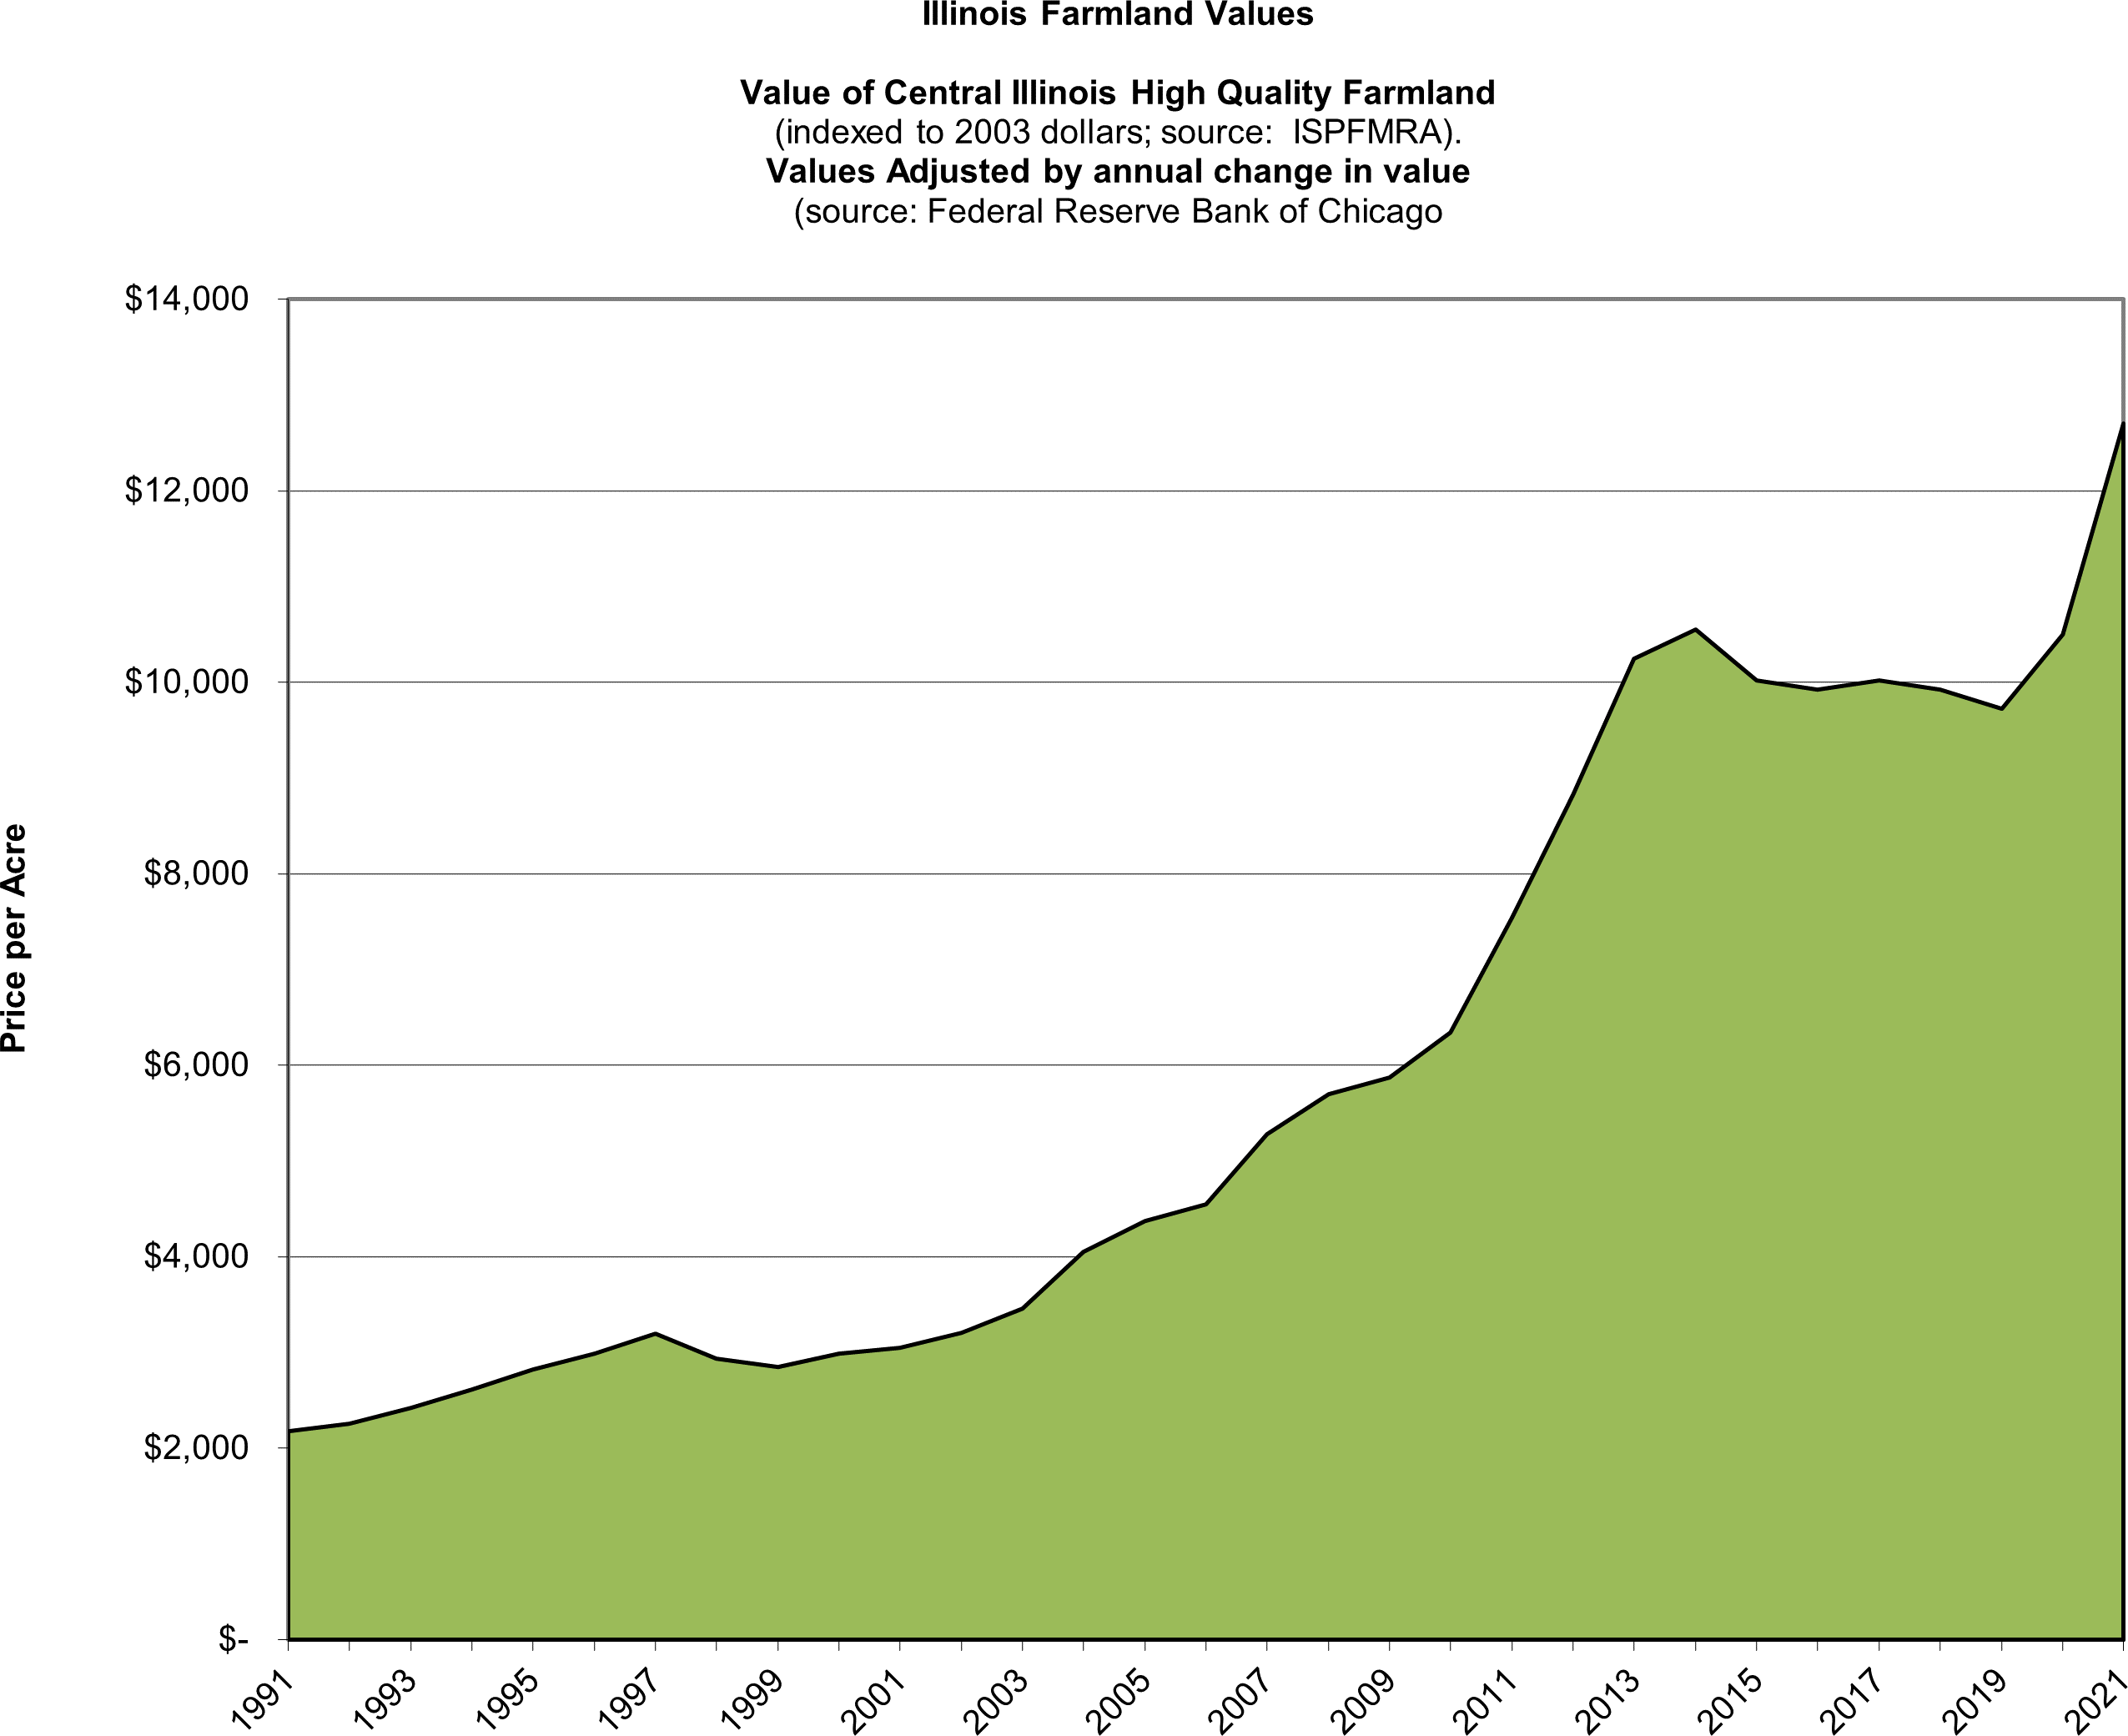
2021 FARMLAND VALUES IN ILLINOIS
During calendar year 2021, the value of high quality agricultural land in the State of Illinois increased by 18 percent while Central Illinois agricultural land increased by approximately 21 percent according to the Federal Reserve Bank of Chicago’s survey of agricultural bankers in the Seventh District. 56% of the bankers polled anticipate agricultural land values to increase while the remaining 44% anticipate values to remain stable during the first quarter of 2022. A historical index of farmland values using the Illinois Society of Professional Farm Managers and Rural Appraisers and Federal Reserve figures is shown below.
CY2021 ANNUAL REPORT
7

Slide 9
EXPLANATION FOR 2021 ASSET VALUES
CY2021 ANNUAL REPORT
In 2008, 2014, and 2019, the University of Illinois Endowment Farms were appraised by an independent agency in order to ensure compliance with Governmental Accounting Standards Board (GASB) rules. Statement No. 52 of GASB “requires endowments to report land and other real estate investments at fair value”.
In the years between full appraisals (2009-2013, 2015-2018, and 2020-2021), the same independent agency provided an estimate of market value which was derived by an annual updating of prior appraised values. The June 30, 2021 market value for each specific farm is shown in the Summary Reports of Individual Endowment Farms.
As with most real estate assets, financial performance is estimated with appraisal-based returns. Professional appraisal methods are used for beginning and ending values of the farms. On occasion, annual appraisal-based returns may actually reflect multi-year changes or idiosyncratic, local land market conditions. Appraisal-based financial returns are often described as having some inertia relative to actual market changes.
8

Slide 10
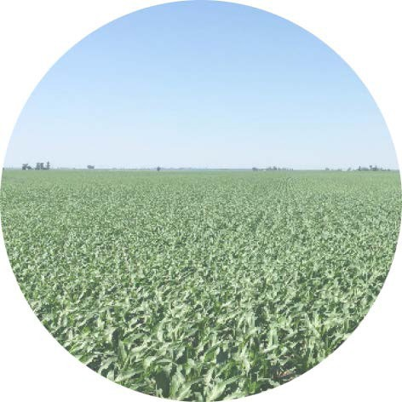
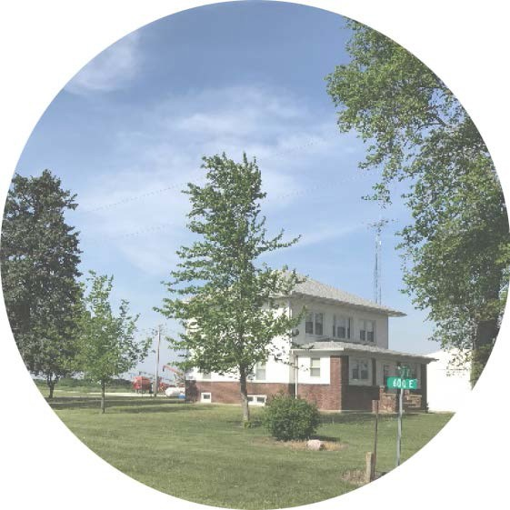
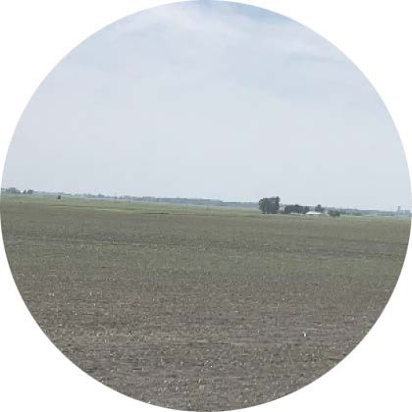
ADDINGTON FARMS
CY2021 ANNUAL REPORT
The Board of Trustees of the University of Illinois gratefully accepted the gift of farmland from the Estate of Francois Williams Addington in 1991.
The farmland is located in two Illinois counties: Iroquois and McLean. One farm includes research plots, seed corn production, and commercial production. The other three farms are primarily in row crop production. Four farm operators independently operate the farmland as four individual farms. The net income distribution
is made annually to the College of ACES for agricultural research grants.
BY THE NUMBERS
1,909.0 TOTAL ACRES
1,815.1 ACRES IN PRODUCTION
133.8 | SOIL PRODUCTIVITY INDEX
$73,412 | PAID LIEU OF REAL ESTATE TAX
$3,604,472 | ORIGINAL VALUE
$18,429,051 | VALUE JUNE 30, 2021
$670,919 | NET INCOME CY 2021
15.2% | TOTAL RETURN
$670,409 | NET INCOME DISTRIBUTION
9

Slide 11
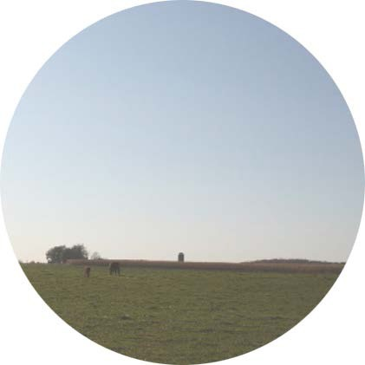
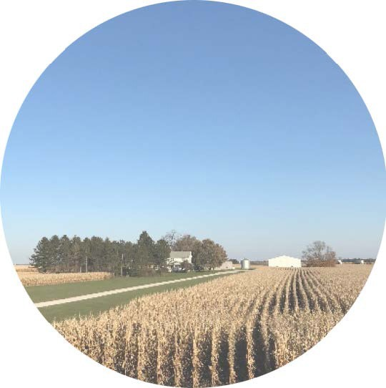
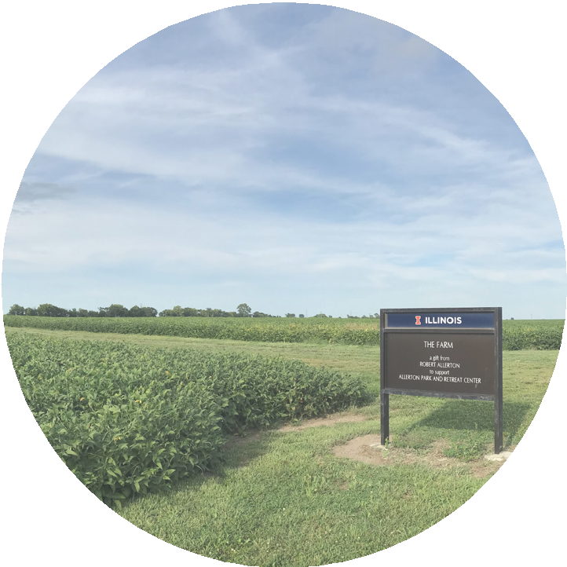
ALLERTON FARMS
CY2021 ANNUAL REPORT
In 1946, Robert Allerton generously donated farmland, woods and his Piatt County Estate to the Board of Trustees of the University of Illinois. The farmland is located in Piatt County.
Three farm operators independently operate the farmland as four individual farms. The four farms are primarily in row crop production. Annual net income disbursement is used to help maintain the Allerton Park and Conference Center.
BY THE NUMBERS
3,632.0 TOTAL ACRES
3,379.5 ACRES IN PRODUCTION
139.6 SOIL PRODUCTIVITY INDEX
$154,304 | PAID LIEU OF REAL ESTATE TAX
$609,621 | ORIGINAL VALUE
$41,501,884 | VALUE JUNE 30, 2021
$1,106,221 | NET INCOME CY 2021
14.5% | TOTAL RETURN
$1,115,979 | NET INCOME DISTRIBUTION
10

Slide 12
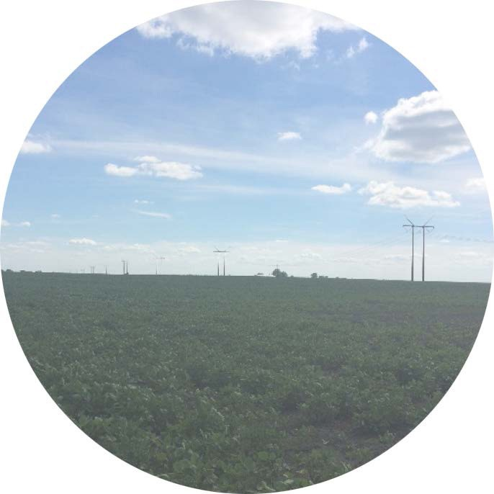
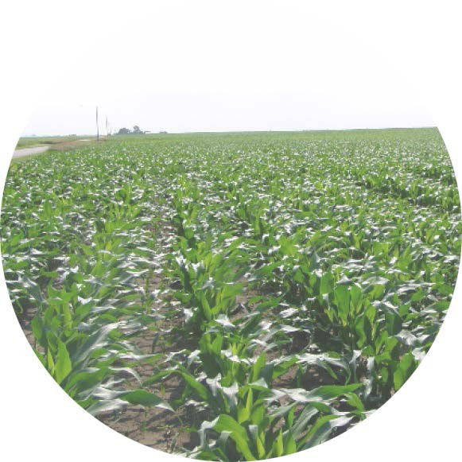
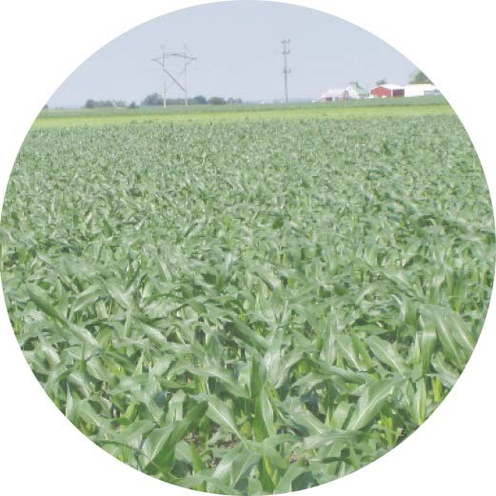
CAMPBELL FARM
CY2021 ANNUAL REPORT
Grace V. Campbell endowed her farmland to the University of Illinois in 1976 to support scholarships for Illinois farm men and women.
The Campbell Farm is located in DeWitt County, Illinois. The farm is in row crop production with a natural wetland located on the farm.
BY THE NUMBERS
86.0 TOTAL ACRES
85.2 ACRES IN PRODUCTION
137.5 SOIL PRODUCTIVITY INDEX
$2,803 PAID LIEU OF REAL ESTATE TAX
$220,000 ORIGINAL VALUE
$920,229 VALUE JUNE 30, 2021
$25,467 NET INCOME CY 2021 16.1% TOTAL RETURN
$25,995 NET INCOME DISTRIBUTION
11

Slide 13
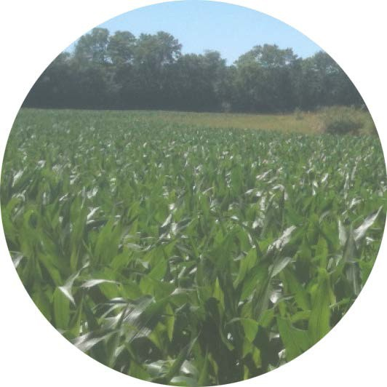
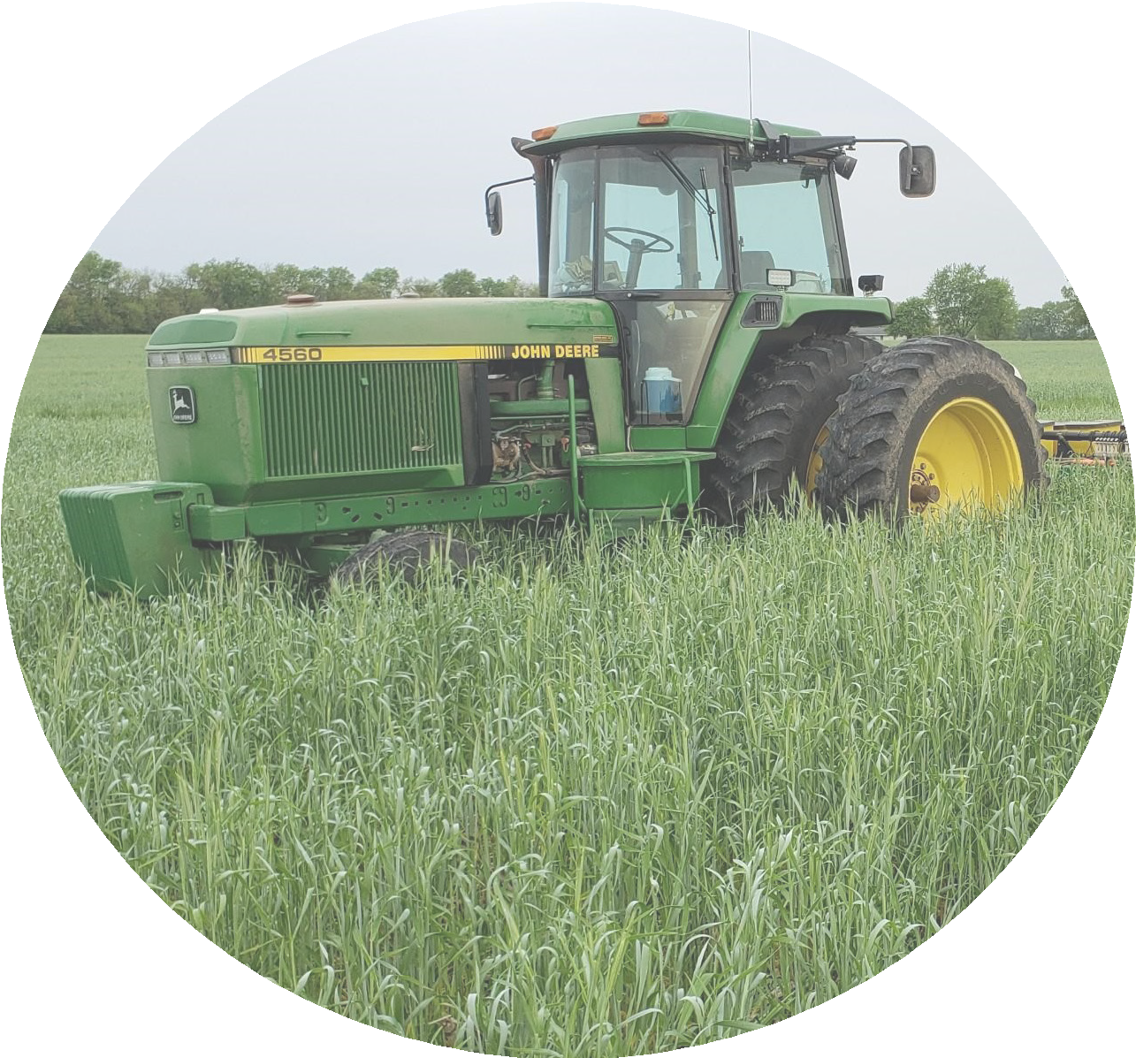
CARMAN FARM
CY2021 ANNUAL REPORT
Cecelia B. Carman donated farmland located in Champaign County, Illinois to the Board of Trustees of the University of Illinois in 1993.
Annual net income distribution is to the College of ACES for scholarships.
BY THE NUMBERS
72.0 TOTAL ACRES
71.2 ACRES IN PRODUCTION
126.5 | SOIL PRODUCTIVITY INDEX
$2,133 | PAID LIEU OF REAL ESTATE TAX
$126,900 | ORIGINAL VALUE
$695,778 | VALUE JUNE 30, 2021
$15,351 NET INCOME CY 2021
15.5% TOTAL RETURN
$18,014 NET INCOME DISTRIBUTION
12

Slide 14
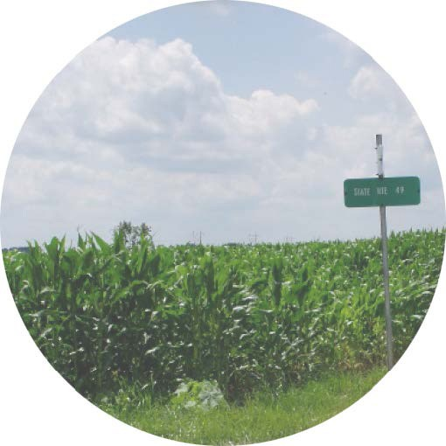
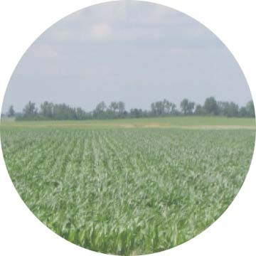
CARTER-PENNEL FARM
CY2021 ANNUAL REPORT
The first endowment of farmland to the University of Illinois was in 1929. The gift was the result of a Trust created by Joseph and Jane Pennell-Carter. The farmland is located in Vermilion County, Illinois. The farm is in row crop production. Annual net income disbursement supports the student loan fund.
BY THE NUMBERS
346.0 TOTAL ACRES
319.3 ACRES IN PRODUCTION
113.6 SOIL PRODUCTIVITY INDEX
$6,755 PAID LIEU OF REAL ESTATE TAX
$50,974 ORIGINAL VALUE
$2,254,030 VALUE JUNE 30, 2021
$77,100 | NET INCOME CY 2021
11.1% | TOTAL RETURN
$79,344 | NET INCOME DISTRIBUTION
13

Slide 15
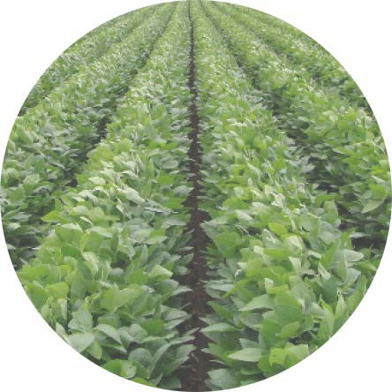
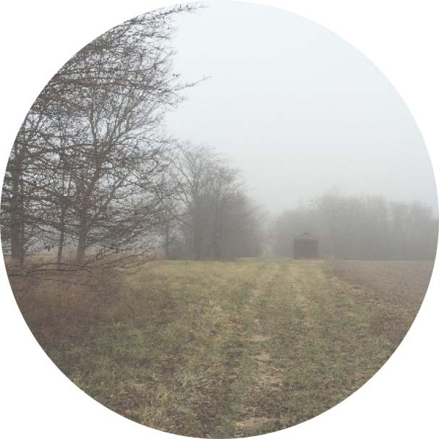
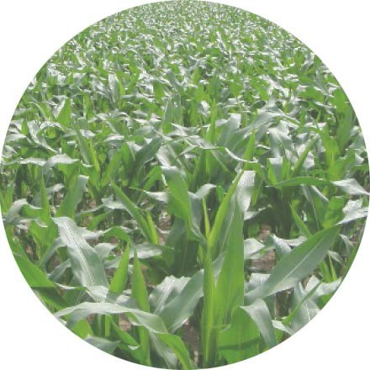
CURL FARMS
CY2021 ANNUAL REPORT
The Board of Trustees of the University of Illinois accepted a gift of 40 acres of farmland from Grace V. Curl in 1999. In 2011 an additional 110 acres came to the University after the closing
of Mrs. Curl’s Life Estate. Two farm operators independently operate the Shelby County, Illinois farmland as two farms. Both farms are in row crop production. The net income distribution
is made annually to the College of ACES for research and scholarships.
BY THE NUMBERS
150.0 TOTAL ACRES
133.1 ACRES IN PRODUCTION
123.8 SOIL PRODUCTIVITY INDEX
$3,006 PAID LIEU OF REAL
$799,230 | ESTATE TAX ORIGINAL VALUE
$1,322,464 | VALUE JUNE 30, 2021
$42,501 | NET INCOME CY 2021
13.6% | TOTAL RETURN
$25,665 | NET INCOME DISTRIBUTION
14

Slide 16
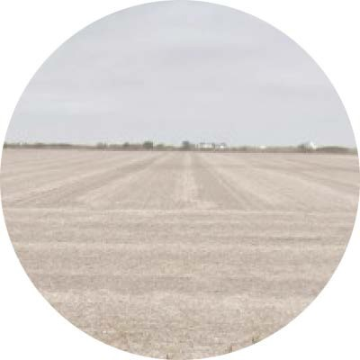
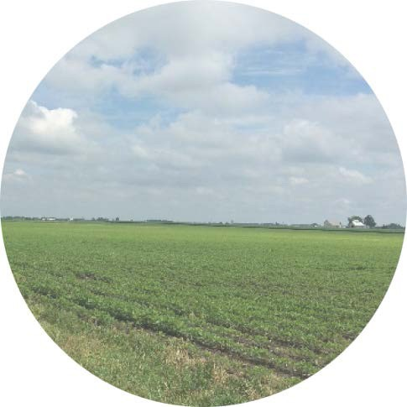
DEHART FARM
CY2021 ANNUAL REPORT
Carl A. DeHart donated farmland located in Moultrie County, Illinois to The Board of
Trustees of the University of Illinois in 1975. The farmland is operated as a row crop farm. Annual distribution of net income is received by the College of ACES for scholarships.
BY THE NUMBERS
120.0 TOTAL ACRES
116.2 | ACRES IN PRODUCTION
138.0 | SOIL PRODUCTIVITY INDEX
$4,562 | PAID LIEU OF REAL ESTATE TAX
$234,000 | ORIGINAL VALUE
$1,380,343 | VALUE JUNE 30, 2021
$39,624 | NET INCOME CY 2021
16.2% | TOTAL RETURN
$45,016 | NET INCOME DISTRIBUTION
15

Slide 17
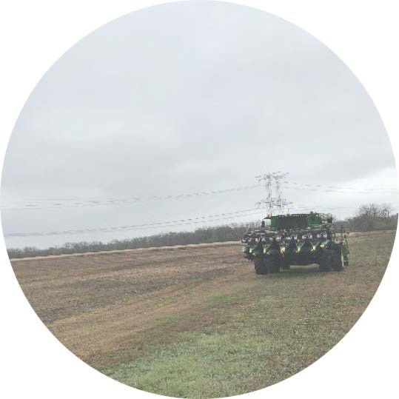
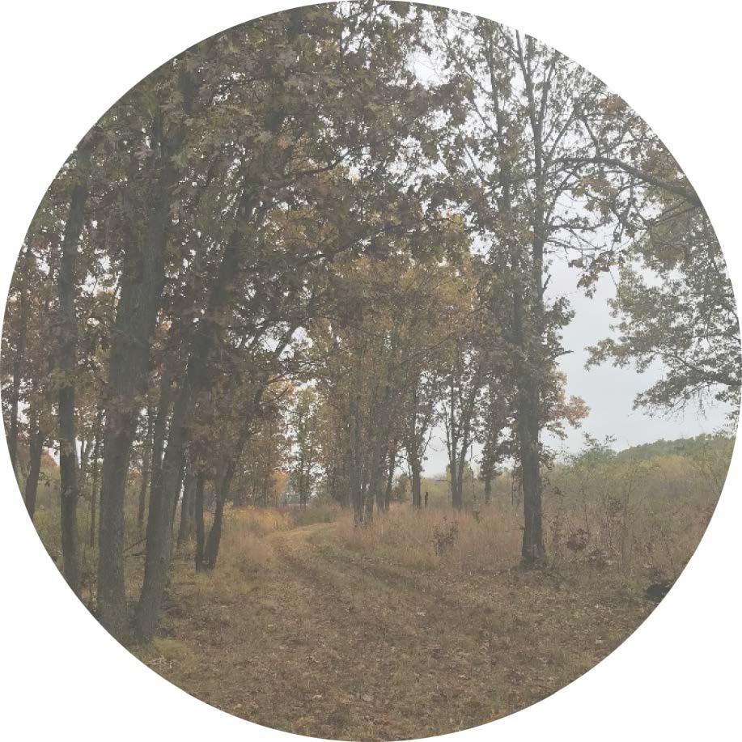
GROHNE FARM
CY2021 ANNUAL REPORT
In late 2019, the University received a Will County, Illinois farm through the generosity of David F. Grohne. The farm contains both
tillable and woodland acres. Annual net income distribution is the College of Agricultural, Consumer, and Environmental Science to support the faculty and staff in Natural Resources and Environmental Sciences.
BY THE NUMBERS
149.0 TOTAL ACRES
93.0 ACRES IN PRODUCTION
149.0 SOIL PRODUCTIVITY INDEX
$2,714 | PAID LIEU OF REAL ESTATE TAX
$1,477,000 | ORIGINAL VALUE
$1,477,000 | VALUE JUNE 30, 2021
$6,919 | NET INCOME CY 2021
0.5% | TOTAL RETURN
$5,919 | NET INCOME DISTRIBUTION
16

Slide 18
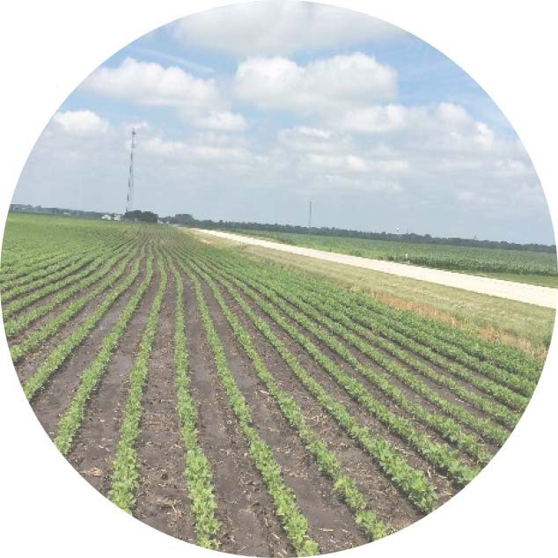
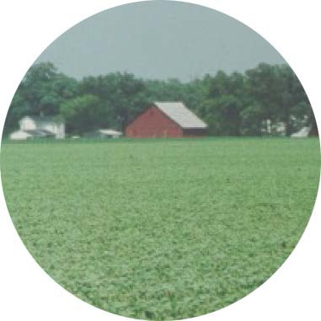
HACKETT FARM
CY2021 ANNUAL REPORT
Jessie E. Hackett donated Illinois farmland located in Douglas and Moultrie Counties to The Board of Trustees of the University of Illinois in 1950. One farm operator leases the farmland.
The farm is in row crop production. Annual net income distribution supports graduate fellowships and scholarships.
BY THE NUMBERS
414.0 TOTAL ACRES
362.6 | ACRES IN PRODUCTION
135.0 | SOIL PRODUCTIVITY INDEX
$13,422 | PAID LIEU OF REAL ESTATE TAX
$158,785 | ORIGINAL VALUE
$4,305,207 VALUE JUNE 30, 2021
$125,477 NET INCOME CY 2021 16.3% TOTAL RETURN
$126,753 NET INCOME DISTRIBUTION
17

Slide 19
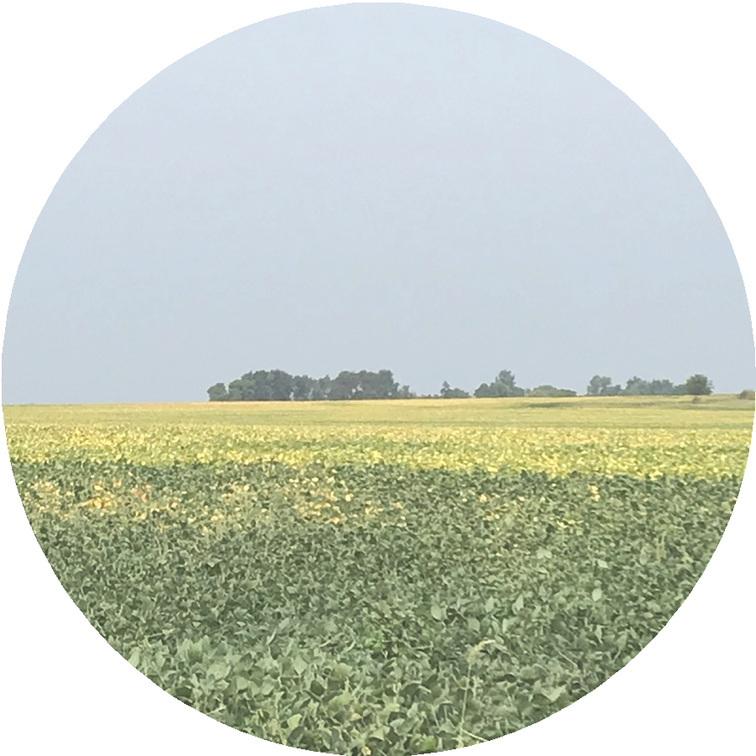
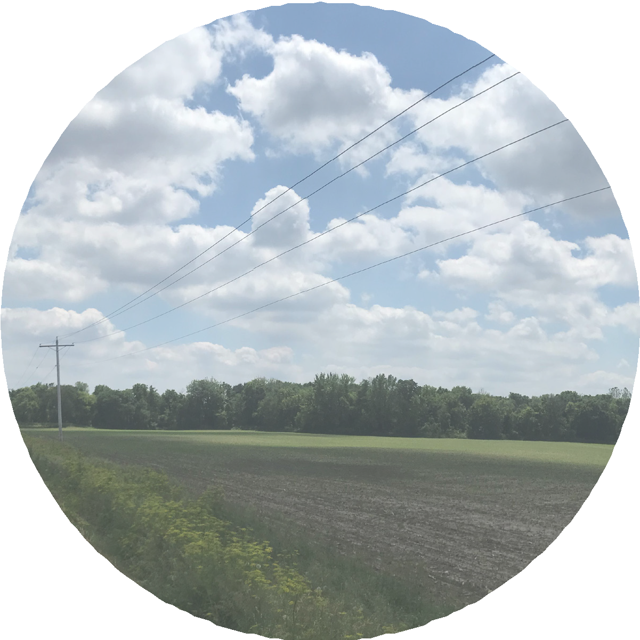
HERBOLSHEIMER FARMS
CY2021 ANNUAL REPORT
Bertrand V. Herbolsheimer gave a gift of Bureau County, Illinois farmland to The Board of Trustees of the University of Illinois in 2013. Three farm operators operate this gift as three individual farms. The farms are in row crop production. Annual net income distribution is to
the College of ACES supporting improvement of agriculture through research.
BY THE NUMBERS
168.2 TOTAL ACRES
127.2 | ACRES IN PRODUCTION
130.8 | SOIL PRODUCTIVITY INDEX
$5,278 | PAID LIEU OF REAL ESTATE TAX
$1,232,500 | ORIGINAL VALUE
$1,418,419 | VALUE JUNE 30, 2021
$19,616 | NET INCOME CY 2021
16.9% | TOTAL RETURN
$20,716 | NET INCOME DISTRIBUTION
18

Slide 20
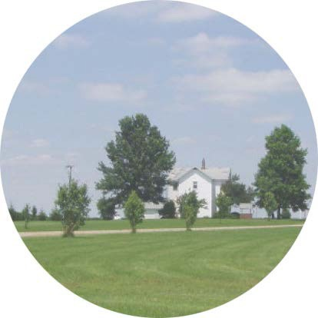
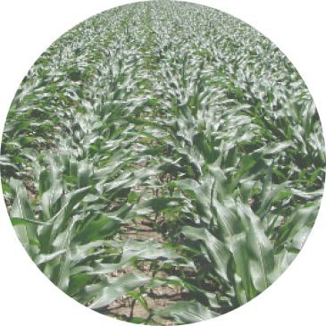
HUBBELL FARM
CY2021 ANNUAL REPORT
In 1972, a gift of farmland located in DeWitt County, Illinois was given from Alta E. Teter to the Board of Trustees of the University of
Illinois. The farm is in row crop production and includes a farmstead with a dwelling and out buildings. Annual net income distribution is for general education purposes.
BY THE NUMBERS
160.0 TOTAL ACRES
157.2 ACRES IN PRODUCTION
125.6 SOIL PRODUCTIVITY INDEX
$7,573 | PAID LIEU OF REAL ESTATE TAX
$129,600 | ORIGINAL VALUE
$2,030,400 | VALUE JUNE 30, 2021
$47,448 | NET INCOME CY 2021
23.3% | TOTAL RETURN
$48,201 | NET INCOME DISTRIBUTION
19

Slide 21
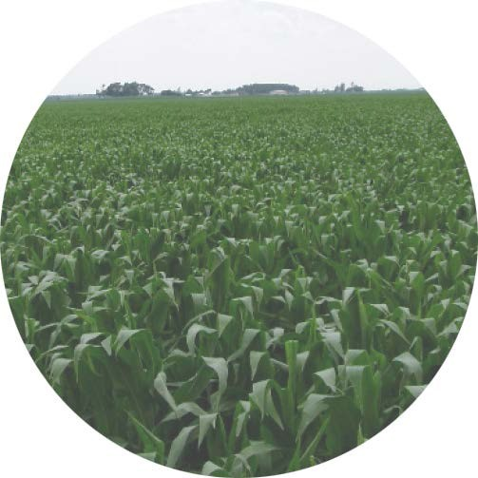
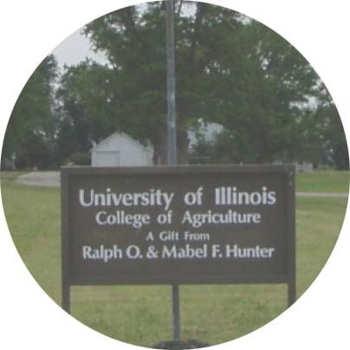
HUNTER RESEARCH FARM
CY2021 ANNUAL REPORT
In 1975, the Board of Trustees of the University of Illinois received Champaign County farmland from Ralph O. and Mabel F. Hunter.
The farm is in row crop production. Annual net income distribution is to the College of ACES, supporting research. Included with the farm is a farmstead with grain bins and outbuildings.
BY THE NUMBERS
280.0 TOTAL ACRES
243.9 | ACRES IN PRODUCTION
142.3 | SOIL PRODUCTIVITY INDEX
$9,082 | PAID LIEU OF REAL ESTATE TAX
$655,746 ORIGINAL VALUE
$3,254,400 VALUE JUNE 30, 2021
$59,805 | NET INCOME CY 2021
15.1% | TOTAL RETURN
$63,008 | NET INCOME DISTRIBUTION
20

Slide 22
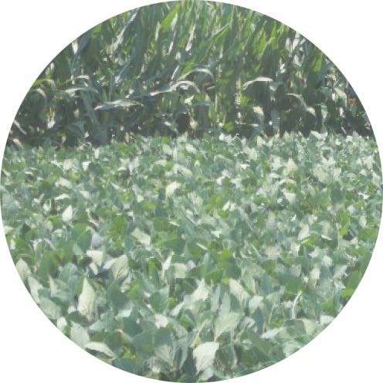
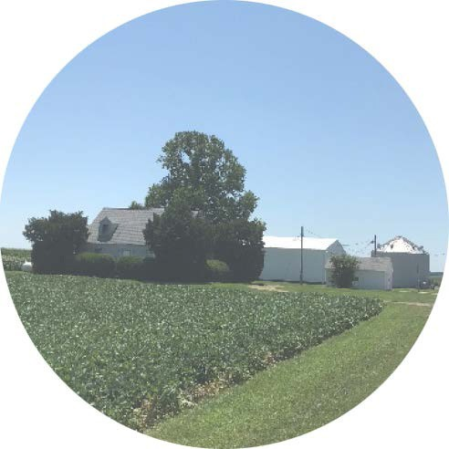
HUNTER SCHOLARSHIP FARMS
CY2021 ANNUAL REPORT
In 1975, the Board of Trustees of the University of Illinois received Menard and Sangamon County, Illinois farmland from Ralph O. and Mabel F. Hunter. Three farms are in row crop production while one is in research, seed corn and row crop production. There are three farm operators farming the gift as four individual farms. The net income distribution is to the College of ACES, supporting scholarships.
Included with two of the farms are farmsteads with dwellings, grain bins and out buildings.
BY THE NUMBERS
1,251.1 TOTAL ACRES
1,215.5 | ACRES IN PRODUCTION
138.5 | SOIL PRODUCTIVITY INDEX
$56,549 | PAID LIEU OF REAL ESTATE TAX
$2,352,519 | ORIGINAL VALUE
$16,223,307 | VALUE JUNE 30, 2021
$451,301 | NET INCOME CY 2021
9.9% | TOTAL RETURN
$396,215 | NET INCOME DISTRIBUTION
21

Slide 23
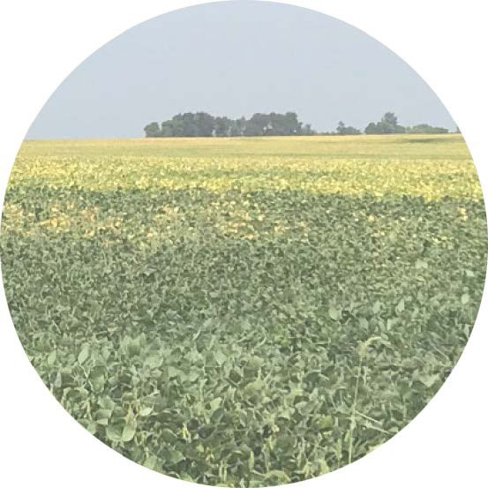
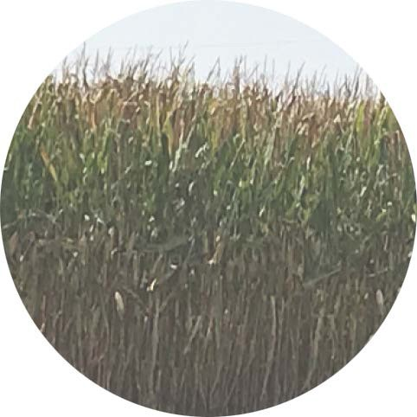
O’CONNELL-PHILLIPS FARM
CY2021 ANNUAL REPORT
The Board of Trustees of the University of Illinois received a gift of farmland located in Tazewell County, Illinois from siblings, Frances P. O’Connell and John D. Phillips, in 2017. The farm is in row crop production. Annual net income distribution is allocated equally between the College of Liberal Arts and the College of ACES.
BY THE NUMBERS
188.4 TOTAL ACRES
182.2 | ACRES IN PRODUCTION
137.0 | SOIL PRODUCTIVITY INDEX
$7,270 | PAID LIEU OF REAL ESTATE TAX
$2,086,000 | ORIGINAL VALUE
$2,256,410 | VALUE JUNE 30, 2021
$64,350 | NET INCOME CY 2021
5.5% | TOTAL RETURN
$64,830 | NET INCOME DISTRIBUTION
22

Slide 24
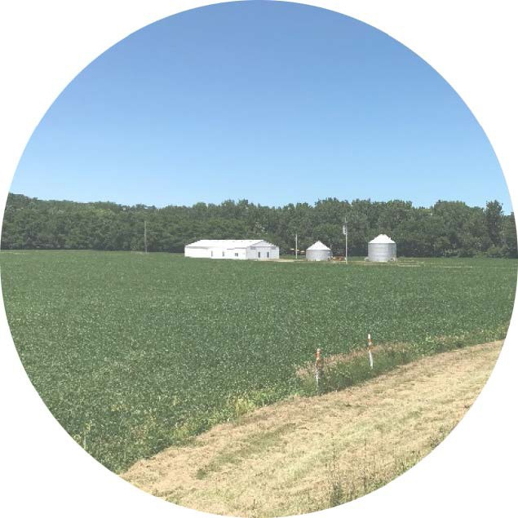
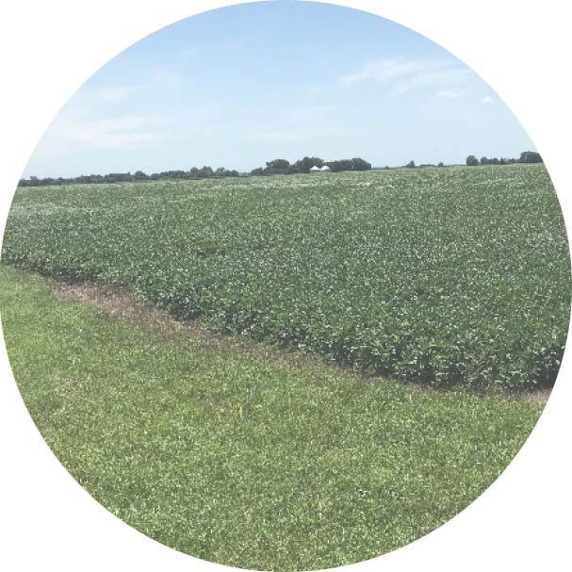
SPILLMAN FARMS
CY2021 ANNUAL REPORT
In 2003, Robert E. Spillman generously donated his Marshall and Peoria County farmland to the Board of Trustees of the University of Illinois.
The farm is in row crop production. There are two farm operators operating the farm as two individual farms. Annual net income distribution is to the College of ACES for agricultural education and scholarships.
BY THE NUMBERS
477.0 TOTAL ACRES
412.0 | ACRES IN PRODUCTION
129.6 | SOIL PRODUCTIVITY INDEX
$16,902 | PAID LIEU OF REAL ESTATE TAX
$1,528,830 ORIGINAL VALUE
$4,941,461 VALUE JUNE 30, 2021
$128,046 | NET INCOME CY 2021
11.2% | TOTAL RETURN
$112,599 | NET INCOME DISTRIBUTION
23

Slide 25
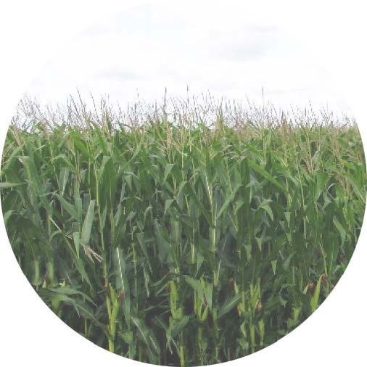
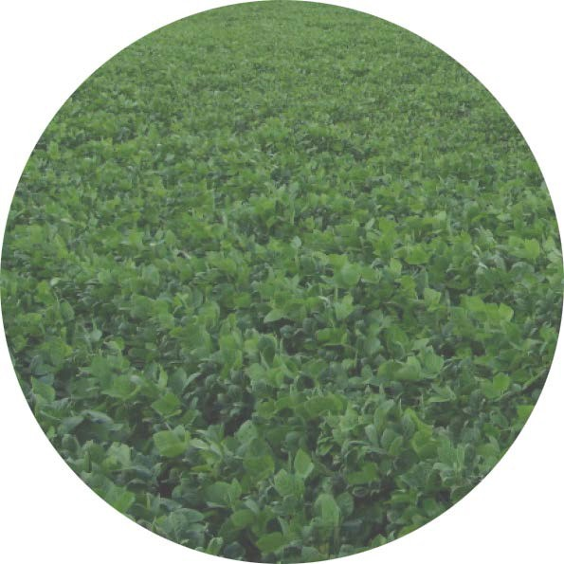
VOIGT-FREEMAN FARM
CY2021 ANNUAL REPORT
A gift of Coles County, Illinois farmland from Nellie Voigt-Freeman came to the Board of Trustees of the University of Illinois in 1996.
The farm is in row crop production. Annual net income distribution is to the College of ACES for agricultural research.
BY THE NUMBERS
218.0 TOTAL ACRES
216.6 ACRES IN PRODUCTION
137.2 | SOIL PRODUCTIVITY INDEX
$10,576 | PAID LIEU OF REAL ESTATE TAX
$661,850 | ORIGINAL VALUE
$2,407,022 | VALUE JUNE 30, 2021
$61,136 | NET INCOME CY 2021
7.8% | TOTAL RETURN
$61,391 | NET INCOME DISTRIBUTION
24

Slide 26
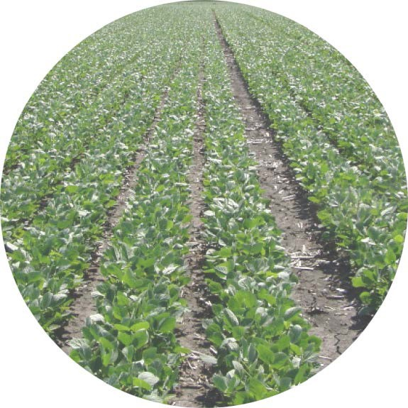
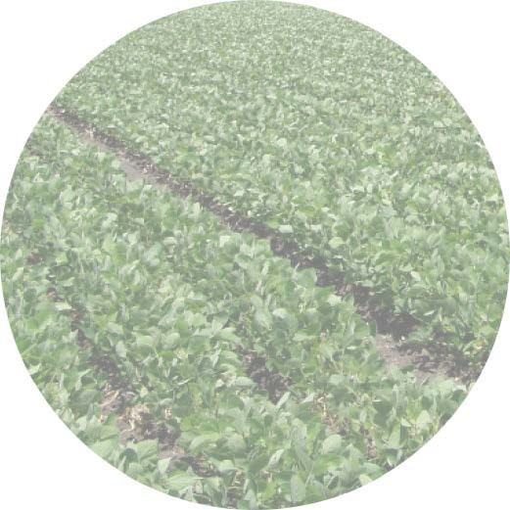
WAFFLE FARM
CY2021 ANNUAL REPORT
In 1994, the Board of Trustees of the University of Illinois received a gift of Grundy County, Illinois farmland from Dorothy Foersterling Waffle. The farm is in row crop production.
Annual net income distribution is to the College of ACES for student scholarships.
BY THE NUMBERS
120.3 TOTAL ACRES
118.8 | ACRES IN PRODUCTION
126.2 | SOIL PRODUCTIVITY INDEX
$3,246 | PAID LIEU OF REAL ESTATE TAX
$258,000 | ORIGINAL VALUE
$1,244,880 | VALUE JUNE 30, 2021
$34,511 | NET INCOME CY 2021
17.2% TOTAL RETURN
$36,388 NET INCOME DISTRIBUTION
25

Slide 27
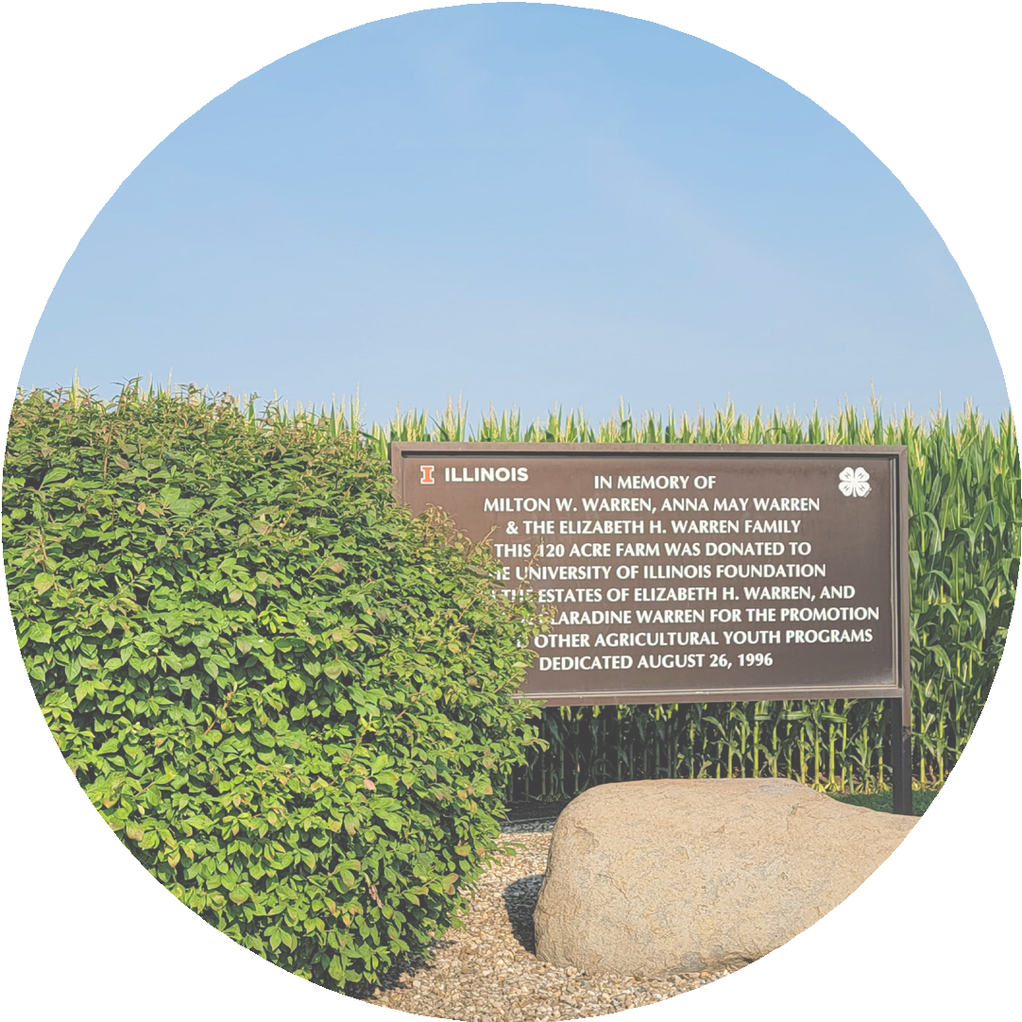
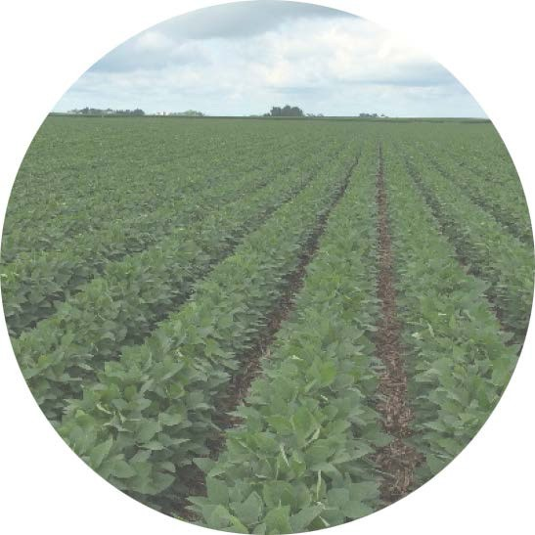
WARREN FARM
CY2021 ANNUAL REPORT
In 1955, Elizabeth H. Warren gave a 40 acre gift of farmland located in Piatt County, Illinois to the Board of Trustees of the University of Illinois. In 1996 an additional 80 acre gift from Mrs.
Warren’s estate came to the University. The farm is in row crop production. Annual net income distribution is to the College of ACES to support 4-H activities and the youth of Illinois.
BY THE NUMBERS
120.0 TOTAL ACRES
119.0 | ACRES IN PRODUCTION
140.6 | SOIL PRODUCTIVITY INDEX
$6,331 | PAID LIEU OF REAL ESTATE TAX
$269,000 | ORIGINAL VALUE
$1,477,943 | VALUE JUNE 30, 2021
$55,450 | NET INCOME CY 2021
17.2% | TOTAL RETURN
$35,824 | NET INCOME DISTRIBUTION
26

Slide 28
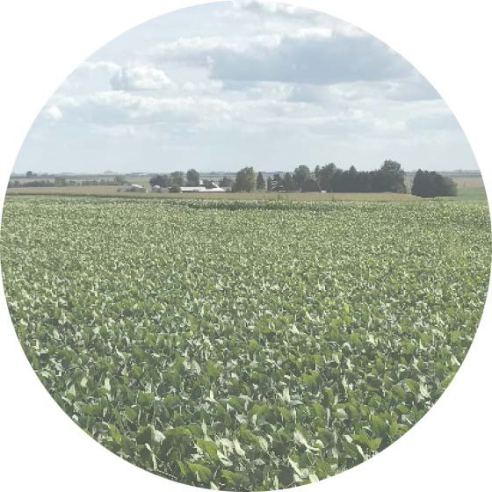
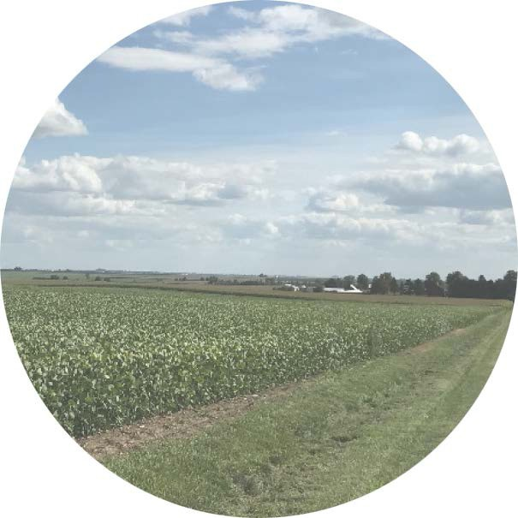
WEBER FARMS
CY2021 ANNUAL REPORT
Laura M. Weber gave LaSalle County, Illinois farmland to the Board of Trustees of the University of Illinois in 1955. The farm is in row crop production. There are two farm operators operating the farm as two individual farms. One farm includes a dwelling, bins, and outbuildings. Annual net income distribution is to the College of ACES.
BY THE NUMBERS
795.6 TOTAL ACRES
774.1 ACRES IN PRODUCTION
139.8 SOIL PRODUCTIVITY INDEX
$47,204 PAID LIEU OF REAL
ESTATE TAX
$271,200 | ORIGINAL VALUE
$8,305,033 | VALUE JUNE 30, 2021
$180,120 | NET INCOME CY 2021
13.3% | TOTAL RETURN
$177,460 | NET INCOME DISTRIBUTION
27

Slide 29
TREASURY OPERATIONS
506 South Wright Street, Room 214 Henry Administration Building Urbana, IL 61801 (MC-339)
www.treasury.uillinois.edu
(217) 244-8359
treasuryoperations@uillinois.edu

