Slide 1
Reported to the Board of Trustees
July 21, 2022
UNIVERSITY OF ILLINOIS SYSTEM
First Quarter 2022 Investment Update Prepared for the Board of Trustees
May 2022

Slide 2
Table of contents
Section Page Number
Market Overview and System Assets 3
Endowment Fund Update: March 31, 2022 6
Operating Pool Update: March 31, 2022 10
Appendix:
Market Environment 13
Disclosures 19

Slide 3
MARKET OVERVIEW AND SYSTEM ASSETS

Slide 4
Market returns

Slide 5
university Operating and endowment funds: March 31, 2022
The University Operating and Endowment Funds were valued at $4.40 billion as of March 31, 2022.
The Operating Pool (ex-Permanent Core) was valued at $3.32 billion. The permanent core investment (gray bar) is a long-term investment of operating cash in the Endowment Pool to enhance distributions to invested units.
The combined Endowment Pool is valued at $994.2 million (green and gray right bar) and is discussed further on the following slides.
The Pure Endowment (ex-Permanent Core) is valued at $553.8 million.

Slide 6
ENDOWMENT FUND UPDATE:
March 31, 2022

Slide 7
Market value and asset allocation: endowment pool
Over/Under Allocation to Long-Term Policy Targets

Slide 8
Total endowment pool performance (March 31, 2022)
Over the one-year period, the endowment returned 8.1%, supported by solid returns in U.S. equity (+11.2%), private equity (+30.3%), and real assets (+19.6%).
Over the ten-year period, the endowment posted an 8.4% return, supported by solid returns from U.S. equity (+13.7%), private equity (+16.4%), and real assets (+8.6%).
Endowment Pool | Quarter Ending
Market Value Change | March-2022
Beginning Market Value | $1,039.2 M
Net Contributions | ($8.0 M)
Gain/Loss | ($37.0 M)
Ending Market Value | $994.2 M
Note: The beginning market value + net contributions + net investment gains referenced in the table may not equal the ending market value due to rounding.

Slide 9
Asset class performance: endowment pool (March 31, 2022)
 | Current Allocation (%) | Policy Allocation (%) | Quarter ending Mar-2022 | 1 Year | 3 Years | 5 Years | 10 Years | Since Inception | Inception Date
Endowment Pool |  |  | -3.6 | 8.1 | 10.6 | 8.9 | 8.4 | 8.3 | Sep-87
Performance Benchmark |  |  | -3.2 | 7.1 | 11.1 | 9.3 | 8.9 | 8.5
GLOBAL EQUITY | 60.3 | 58.0 | -4.6 | 9.2 | 15.6 | 12.9 | 11.2 | 8.5 | Sep-87
Total U.S. Equity |  |  | -5.5 | 11.2 | 17.9 | 14.6 | 13.7 | 10.0 | Sep-87
U.S. Equity Benchmark |  |  | -5.3 | 11.9 | 18.2 | 15.3 | 14.2 | 10.3
Total Non-U.S. Equity |  |  | -5.7 | -1.4 | 7.8 | 6.9 | 6.0 | 5.5 | Sep-93
Non-U.S. Equity Benchmark |  |  | -5.6 | -1.3 | 7.9 | 6.9 | 5.7 | 5.7
Total Private Equity |  |  | 0.0 | 30.3 | 30.4 | 24.2 | 16.4 | 7.8 | Jan-04
Private Equity Benchmark |  |  | 0.0 | 24.4 | 23.5 | 19.8 | 18.1 | 14.0
GLOBAL FIXED INCOME ¹ | 18.0 | 20.0 | -4.6 | -2.2 | 2.9 | 3.0 | 3.0 | 6.5 | Sep-87
Total Public Fixed Income |  |  | -4.9 | -3.3 | 2.2 | 2.5 | 2.7 | 6.4 | Sep-87
Bloomberg U.S. Aggregate |  |  | -5.9 | -4.2 | 1.7 | 2.1 | 2.2 | 5.9
Total Private Fixed Income |  |  | 0.0 | 24.4 | 21.5 | - | - | 19.7 | Jan-18
Bloomberg U.S. Corporate HY Index |  |  | -4.8 | -0.7 | 4.6 | - | - | 4.3
REAL ASSETS ¹ | 13.3 | 14.0 | 0.1 | 19.6 | 9.8 | 7.3 | 8.6 | 10.1 | Dec-06
Total Real Estate |  |  | 0.2 | 23.1 | 9.9 | 8.6 | - | 10.6 | Aug-13
Real Estate Benchmark |  |  | 7.1 | 27.6 | 10.4 | 8.7 | - | 10.7
Total Farmland² |  |  | 0.0 | 13.5 | 9.4 | 5.4 | 5.6 | 8.1 | Dec-06
NCREIF Cornbelt Index |  |  | 0.0 | 9.0 | 5.0 | 3.4 | 6.9 | 8.3
DIVERSIFYING STRATEGIES¹ | 7.5 | 8.0 | 1.2 | 6.3 | -8.2 | -5.6 |  | -1.4 | May-13
Total Hedge Funds |  |  | 1.3 | 5.8 | -9.4 | -6.4 | - | -1.9 | May-13
Hedge Fund Index |  |  | 0.1 | 4.6 | 9.0 | 6.6 | - | 5.3
CASH | 0.9 | 0.0 | 0.0 | 0.0 | 0.6 | 0.9 | - | 0.7
¹Global Fixed Income, Real Assets and Diversifying Strategies include allocations and performance of private investments.
²Farmland directly owned by the Endowment is valued annually on June 30.

Slide 10
OPERATING POOL UPDATE:
March 31, 2022

Slide 11
Liquidity layers: Operating pool (March 31, 2022)
OPERATING POOL LIQUIDITY LAYERS
AS OF March 31, 2022
The asset allocation strategy for the Operating Pool consists of investing funds across four liquidity layers. Board- approved ranges are depicted by the bars, while the diamonds represent the actual allocation.
Funds expected to be used within one year are invested in the primary liquidity layer.
Longer-time horizon investments, including core and permanent core, are expected to provide higher rates of return and will experience some variation in market value as capital market conditions change.
The System’s permanent core operating funds are invested in the System’s Endowment Pool investment program.
Total sum of allocation may not equal 100% due to rounding.

Slide 12
TOTAL OPERATING POOL PERFORMANCE (March 31, 2022)
Over the trailing one-year period ending March 31, 2022, the Operating Pool returned -1.2%, outperforming the benchmark return.
Most managers in the Operating Pool matched or outperformed their respective benchmarks over the period.
Over the five-, ten-year, and since inception periods, the Operating Pool has outperformed the benchmark.
The majority of the Operating Pool’s managers have either met or outperformed their respective benchmarks.
Operating Pool | Quarter Ending
Market Value Change | March-2022
Beginning Market Value | $3,155.6 M
Net Contributions | $210.2 M
Gain/Loss | ($41.2 M)
Ending Market Value | $3,324.5 M
Note: The Total Pool’s beginning and ending market values include bank balances in which the System earns credit to offset bank fees. The beginning market value + net contributions + net investment gains referenced in the table may not equal the ending market value due to rounding.

Slide 13
APPENDIX: MARKET ENVIRONMENT

Slide 14
Market environment
2013-2022 Annual Returns of Key Indices
 |  |  |  |  |  |  |  |  |  |  |  | 5-year | 10-year
2013 | 2014 | 2015 | 2016 | 2017 | 2018 | 2019 | 2020 | 2021 | 2022 |  |  | annual | annual
Small Cap 38.8% | Global REIT 15.0% | Large Cap 1.4% | Small Cap 21.3% | Emerging Markets 37.3% | Bonds 0.0% | Large Cap 31.5% | Small Cap 20.0% | MLPs 40.2% | MLPs 18.8% |  |  | Large Cap 16.0% | Large Cap 14.6%
Large Cap 32.4% | Large Cap 13.7% | Bonds 0.5% | MLPs 18.3% | Int'l 25.0% | High Yield -2.1% | Small Cap 25.5% | Large Cap 18.4% | Large Cap 28.7% | Hedge Funds -2.6% |  |  | Small Cap 9.7% | Small Cap 11.0%
MLPs 27.6% | Bonds 6.0% | Hedge Funds -0.3% | High Yield 17.1% | Large Cap 21.8% | Hedge Funds -4.0% | Int'l 22.0% | Emerging Markets 18.3% | Global REIT 25.7% | Global REIT -4.0% |  |  | Int’l 6.7% | Global REIT 7.3%
Int'l 22.8% | Small Cap 4.9% | Global REIT -0.8% | Large Cap 11.9% | Small Cap 14.6% | Large Cap -4.4% | Global REIT 21.9% | Hedge Funds 10.9% | Small Cap 14.8% | Large Cap -4.6% |  |  | Global REIT 6.7% | Int’l 6.3%
Hedge Funds 9.0% | MLPs 4.8% | Int'l -0.8% | Emerging Markets 11.2% | Global REIT 10.4% | Global REIT -5.6% | Emerging Markets 18.4% | Int'l 7.8% | Int'l 11.3% | High Yield -4.8% |  |  | Emerging Markets 6.0% | High Yield 5.7%
High Yield 7.4% | Hedge Funds 3.4% | Small Cap -4.4% | Global REIT 4.1% | Hedge Funds 7.8% | Small Cap -11.0% | High Yield 14.3% | Bonds 7.5% | Hedge Funds 6.0% | Int’l -5.9% |  |  | High Yield 4.7% | Hedge Funds 3.9%
Global REIT 3.7% | High Yield 2.5% | High Yield -4.5% | Bonds 2.6% | High Yield 7.5% | MLPs -12.4% | Bonds 8.7% | High Yield 7.1% | High yield 5.3% | Bonds -5.9% |  |  | Hedge Funds 4.6% | Emerging Markets 3.4%
Bonds -2.0% | Emerging Markets -2.2% | Emerging Markets -14.9% | Int'l 1.0% | Bonds 3.5% | Int'l -13.8% | Hedge Funds 8.4% | Global REIT -9.0% | Bonds -1.5% | Emerging Markets -7.0% |  |  | Bonds 2.1% | Bonds 2.2%
Emerging Markets -2.6% | Int'l -4.9% | MLPs -32.6% | Hedge Funds 0.5% | MLPs -6.5% | Emerging Markets -14.6% | MLPs 6.6% | MLPs -28.7% | Emerging Markets -2.5% | Small Cap -7.5% |  |  | MLPs -0.1% | MLPs 1.3%

Slide 15
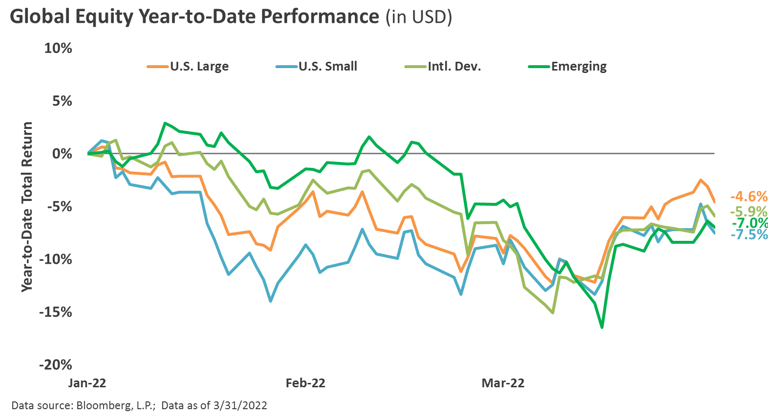
Global equity
Global equities posted broad-based losses in the first quarter, as volatility increased significantly amid Russia’s invasion of Ukraine, soaring energy prices, multi-decade high inflation, and the initiation of a Fed tightening cycle.
Immense upward pressure on nominal interest rates and energy costs helped drive a notable divergence in performance between growth and value equities, with this ongoing dynamic leading many market participants to believe we are in the midst of a “regime change.”
Continuing the trends that characterized much of the 2021 market environment, the first quarter was marked by large cap outperforming small cap and domestic equities outperforming international equities. International equities, particularly emerging markets, faced headwinds from Russia’s invasion of Ukraine, as well as rising COVID-19 cases and related containment measures across China.
GLOBAL EQUITY PERFORMANCE
For the Quarter Ended 3/31/2022, in USD
Data source: Bloomberg, L.P. Data as of 3/31/2022.

Slide 16
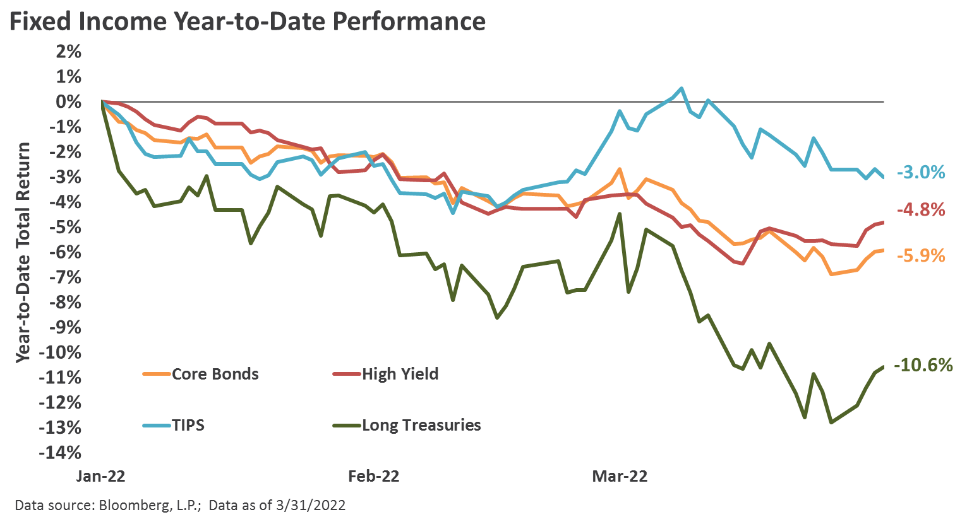
Fixed income
Similar to global equities, bond sectors posted broadly negative returns, as substantial upward pressure on interest rates drove steep declines across rate-sensitive corners of the market, such as core bonds. The Bloomberg U.S. Aggregate Bond Index declined by 5.9% during the quarter, representing the worst quarterly performance since third quarter 1980 and the third worst quarterly total return in the nearly 50-year history of the index.
Speculative grade credit risk premiums increased modestly, but ended the quarter below historical averages, while the ultra short duration and floating rate structure of bank loans led to relatively strong performance.
The Federal Reserve initiated the policy rate “liftoff” process in March and provided forward guidance pointing to at least 6 additional hikes throughout 2022, as well as the expectation to begin allowing their nearly $9 trillion balance sheet to runoff at an initial pace of $95 billion per month in the coming months.

Slide 17
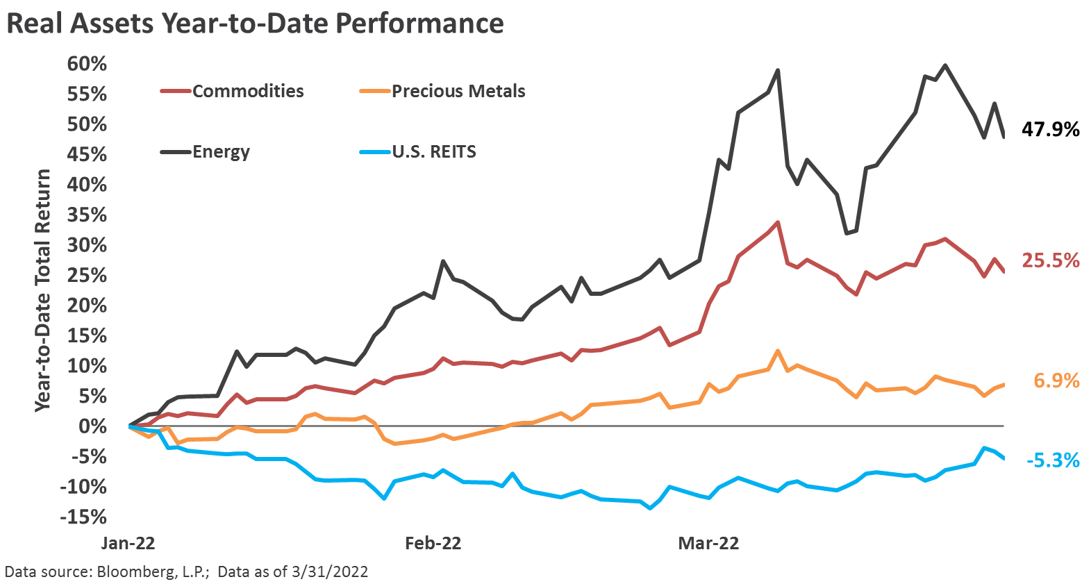
Real assets
Strong calendar year 2021 performance across real assets persisted into the first quarter. Commodities, and energy in particularly, benefitted from tailwinds from a continued robust inflationary backdrop.
Following one of the strongest calendar year performances on record, Real Estate Investment Trusts (REITs) lagged the broader real assets complex, as sharply rising interest rates and economic slowdown concerns weighed on investor sentiment.
Precious metal spot prices gradually increased throughout the quarter, with gold’s safe-haven status aiding in sending spot prices to near the highest on record (at more than $2,000 per ounce) amid a significant increase in geopolitical tensions.

Slide 18
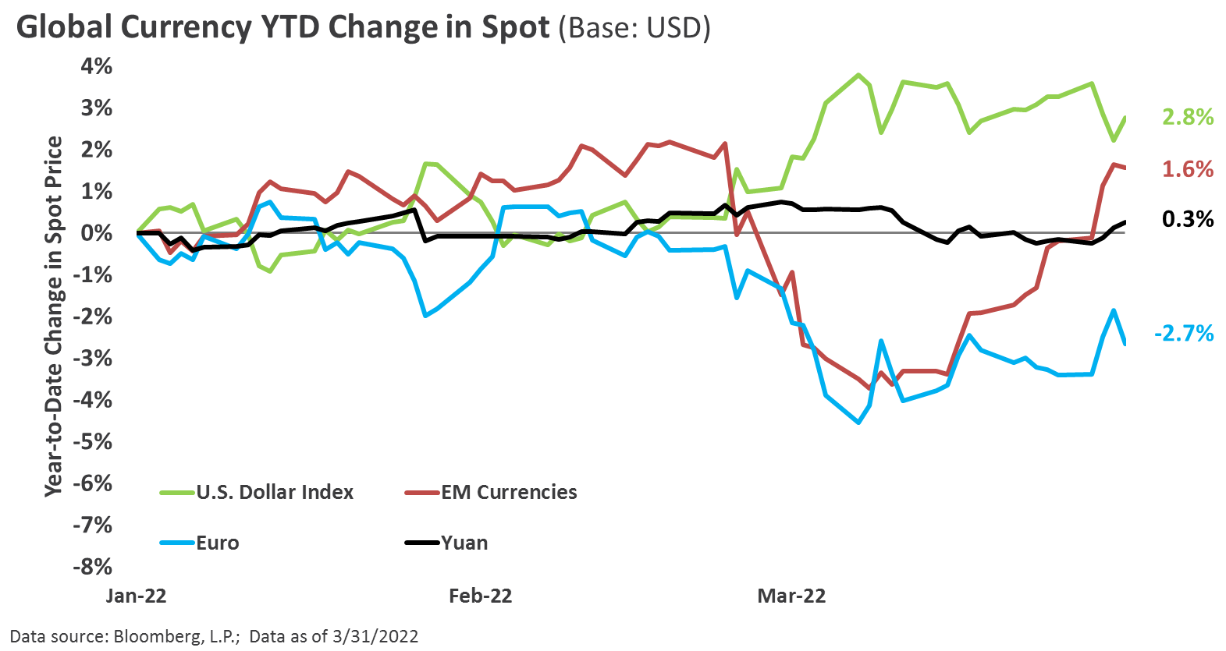
currencies
The U.S. dollar (USD) appreciated throughout the first quarter, particularly versus the Japanese yen. The USD was supported by relatively stronger economic fundamentals, safe-haven flows following Russia’s invasion of Ukraine, and the formal commencement of the Fed’s tightening campaign in March through an increase to the federal funds rate and hawkish forward guidance.
Despite suffering a brief Russian-related decline versus the USD in the latter half of the quarter, emerging market currencies staged a rebound in late March, likely buoyed by robust price pressures among many key commodity sectors.

Slide 19
disclosures

Slide 20
disclosures
This presentation was prepared by Fund Evaluation Group, LLC (FEG), a federally registered investment adviser under the Investment Advisers Act of 1940, as amended, providing non-discretionary and discretionary investment advice to its clients on an individual basis. Registration as an investment adviser does not imply a certain level of skill or training. The oral and written communications of an adviser provide you with information about which you determine to hire or retain an adviser. Fund Evaluation Group, LLC, Form ADV Part 2A & 2B can be obtained by written request directed to: Fund Evaluation Group, LLC, 201 East Fifth Street, Suite 1600, Cincinnati, OH 45202 Attention: Compliance Department.
The information herein was obtained from various sources. FEG does not guarantee the accuracy or completeness of such information provided by third parties. The information in this report is given as of the date indicated and believed to be reliable. FEG assumes no obligation to update this information, or to advise on further developments relating to it.
FEG, its affiliates, directors, officers, employees, employee benefit programs and client accounts may have a long position in any securities of issuers discussed in this report.
Index performance results do not represent any managed portfolio returns. An investor cannot invest directly in a presented index, as an investment vehicle replicating an index would be required. An index does not charge management fees or brokerage expenses, and no such fees or expenses were deducted from the performance shown.
Neither the information nor any opinion expressed in this report constitutes an offer, or an invitation to make an offer, to buy or sell any securities.
Any return expectations provided are not intended as, and must not be regarded as, a representation, warranty or predication that the investment will achieve any particular rate of return over any particular time period or that investors will not incur losses.
Past performance is not indicative of future results.
This report is prepared for informational purposes only. It does not address specific investment objectives, or the financial situation and the particular needs of any person who may receive this report.

Slide 21
disclosures
Large Cap is represented by the S&P 500 Index which measures the performance of large capitalization U.S. stocks. The S&P 500 is a market-weighted index of 500 stocks that are traded on the NYSE, AMEX, and NASDAQ. www.standardandpoors.com
Mid Cap is represented by the Russell Mid Cap Index which measures performance of U.S. mid capitalization stocks. The Russell Mid Cap Index is a capitalization-weighted index of the 800 smallest companies in the Russell 1000 Index. The stocks are traded on the NYSE, AMEX, and NASDAQ. www.russell.com
Small Cap is represented by the Russell 2000 Index which measures the performance of U.S. small capitalization stocks. The Russell 2000 is a capitalization-weighted index of the 2,000 smallest stocks in the broad U.S. equity market, as defined by the Russell 3000 Index. These stocks are traded on the NYSE, AMEX, and NASDAQ. www.russell.com
International is represented by the MSCI EAFE Index which is a Morgan Stanley Capital International index that is designed to measure the performance of the developed stock markets of Europe, Australasia, and the Far East. www.mscibarra.com
Emerging Markets are represented by the MSCI Emerging Markets Index which is a Morgan Stanley Capital International index that is designed to measure the performance of emerging market stock markets. www.mscibarra.com
Hedged Equity is represented by the Hedge Fund Research, Inc. Fund Weighted Composite Index, an equal weighted index that includes over 2,000 constituent funds, both domestic and offshore with no Fund of Funds included in the index. www.hfri.com
Bonds are represented by the Barclays U.S. Aggregate Bond Index which includes U.S. government, corporate, and mortgage-backed securities with maturities up to 30 years. www.barclays.com
High Yield is represented by the Barclays U.S. Corporate High Yield Index. www.barclays.com
Global REIT is represented by the FTSE EPRA/NAREIT Developed Index which is designed to track the performance of listed real estate companies and REITS worldwide. www.ftse.com
MLPs are represented by the Alerian MLP Index. www.alerian.com
Hedge Funds are represented by the Hedge Fund Research, Inc. Fund of Funds Composite Index. www.hfri.com

