Slide 1
BOARD OF TRUSTEES
BOARD OF TRUSTEES
March 17, 2022
Tim Killeen, President University of Illinois System
Notes:
Thank you all for being here.
This is only the second time in two years that we’ve met in person, and I have to say I am incredibly grateful that we are again able to safely meet in a live setting. We know that the virus remains a very real concern, but I am buoyed by the progress we have made.

Slide 2
Closing Equity Gaps
CLOSING
EQUITY GAPS
Notes:
As we look ahead as a university system, a top priority continues to be closing equity gaps among the citizens across Illinois, within our urban and rural communities, and beyond.
These gaps can be seen across numerous facets of society, where all share the common thread of persistently disproportionate opportunities to prepare for and access education, employment, civic and cultural engagement, health care and other critical dimensions of well-being …
… and all undermine the ability for each and every citizen to thrive and contribute, in turn lifting themselves, their families, their communities, our state and, dare I say, our country and our world.
During the state listening tour that chancellors and I conducted last year, we heard the clarion call echo loudly in major cities and small towns alike -- from Rockford to Peoria, Chicago to Carbondale, and all across the state. And while the fundamental needs that will drive greater economic vitality vary greatly across zip codes, it is clear that closing equity gaps among our citizens remains crucial to achieving this essential part of our mission.

Slide 3
Public universities’ role uofi system leading the way
Public Universities’ Role
U OF I SYSTEM LEADING THE WAY
Notes:
The University of Illinois System recognizes and embraces the imperative to eliminate the disparities that are barriers to success.
We are listening intently, watching with eyes wide open. We know that we can and must do more.
We remain keenly focused on strategies that further improve access to higher education for more underrepresented low-income and rural students; ensure their success once they’ve enrolled, and all the way through graduation; build partnerships that drive inclusive innovation; and expand access to high-quality health care in underserved and underinsured communities.
We look to develop greater cultural competency across our universities; and continue to grow our leadership representation to better reflect the diversity of our campuses and communities at large, building on initiatives like UIC’s successful Bridge to the Faculty (B2F) recruitment program, designed to attract underrepresented postdoctoral scholars with the goal of a direct transition to a tenure-track junior faculty position after two years.
As we consider our unique role, we have embarked on several initiatives that we are confident will further increase our impact, transform lives and continue to propel our state forward through our noble pursuit as a public institution.
During the last decade, in particular, we have learned a great deal about both the opportunities and barriers to closing equity gaps in access to higher education. This understanding informed an exciting new initiative that is even more comprehensive than our previous efforts to strengthen programming and services to support success, and we were delighted to announce it during our appropriations hearings the last two weeks.

Slide 4
Increase Urm graduates by 50% access 2030
Increase URM graduates by 50%
ACCESS 2030
Notes:
Access 2030 is being created to increase the number of graduates from underrepresented groups by 50 percent by the end of the decade. This will include students from disadvantaged backgrounds — ethnic and racial, rural and urban.
This initiative will strengthen our bedrock commitment to the public good, ensuring that, as we work to improve life in our state, we are not leaving communities behind. It will build on our ongoing efforts to create more opportunities for Illinoisans of all backgrounds.
Each university is developing its own plans tailored to its campus, but Access 2030 will focus on readiness, retention and, importantly, graduation. It will support student success through mentoring, bridge programs and other efforts aimed at dismantling barriers that we know many students face.
The initiative is being tooled to close equity gaps throughout the pipeline, working from K-12 through college, including our community colleges.
Our three universities have made great strides over the past decade, increasing enrollment of underrepresented racial and ethnic groups by more than 68 percent. Currently, about a third of our enrolled undergraduate students are from such groups, almost 20,000 in all.
And, systemwide retention rates for these students are near or, in most cases, exceed national averages.

Slide 5
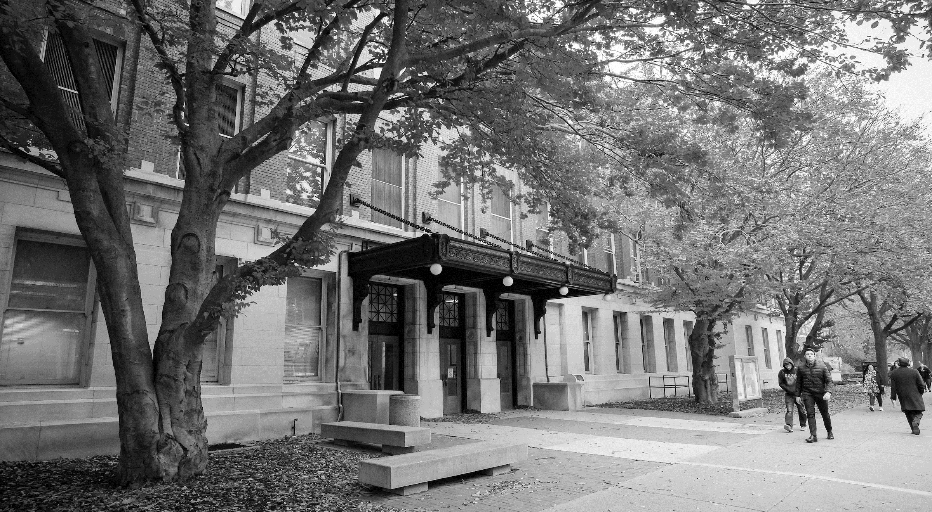
Ensuring a welcoming and inclusive student environment
Ensuring a welcoming and inclusive student environment
Notes:
Once on our campuses, students from all backgrounds, cultures and ethnicities need to feel respected, share a sense of belonging and have access to services that support their needs.
We have begun conversations about creative ways to reinforce our commitment to student centricity and inclusiveness by aggregating critical student-facing services that are core to the undergraduate experience.

Slide 6
DISTANCE AND ONLINE OFFERINGS
DISTANCE AND ONLINE OFFERINGS
Notes:
We’re also looking to reach more traditional and non-traditional students – in both urban and rural communities – through our growth in innovative online and distance education. The most recent set of US News & World Report rankings, out in just the last couple of months, reflect our strength in online education.
According to U.S. News & World Report, the University of Illinois Chicago is ranked No. 3 in online bachelor’s programs, the University of Illinois Urbana-Champaign is ranked in the top 10 nationwide for online master’s programs in education and engineering, and the University of Illinois Springfield’s online bachelor programs also ranked in the top 10 percent, rising to No. 29.
Behind these rankings are critical implications for closing equity gaps that keep many from pursuing and realizing their academic and professional dreams. Improving access to online and distance learning offers real opportunities for students who might not otherwise be able to complete an education.
It also offers opportunities for upskilling and reskilling to meet the demands of tomorrow’s workforces.

Slide 7
A catalyst for inclusive innovation
A Catalyst for
INCLUSIVE INNOVATION
Notes:
However, we know that the ability to benefit fully from online and distance education in turn requires closing equity gaps in broadband and digital access, which is sorely lacking in disadvantaged pockets throughout the state.
We’re looking to remove these and other barriers through inclusive innovation and are working on initiatives that would create real transformation in education and beyond.
As you know, the Illinois Innovation Network, a network of networks, is connecting the brightest minds and game-changing ideas to turn innovation into opportunity for the entire state and the region beyond.
Each of IIN’s 15 hubs is dedicated to accelerating innovation, job creation and economic growth … and doing so in an equitable, inclusive and sustainable way.

Slide 8
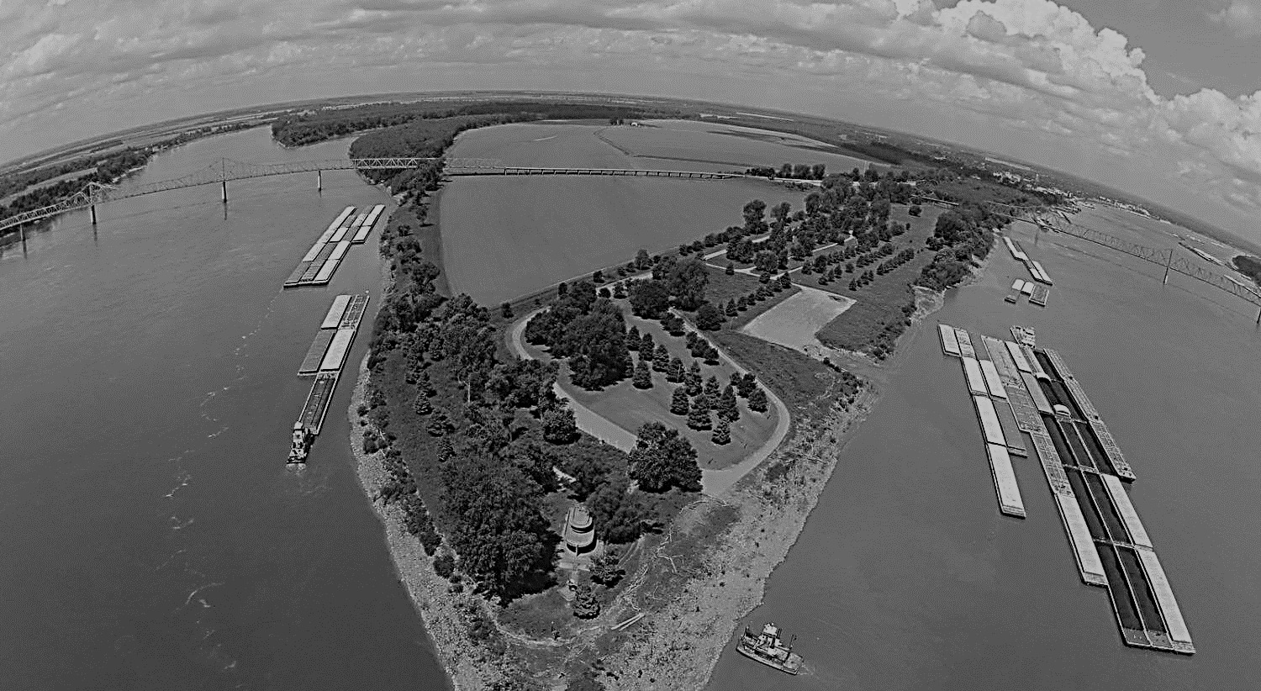
Cairo Opportunities
CAIRO OPPORTUNITIES
Notes:
The Port of Cairo in the southern tip of the state, which offers tremendous economic development potential but suffers from multiple deserts that pose significant barriers to equity, is the focus of several efforts.
IIN member Southern Illinois University Carbondale is helping lead the digital ecosystem in Cairo. A key goal of the project is achieving much-needed digital equity in the region.
Additionally, IIN is chairing the Illinois Broadband Advisory Council’s Digital Equity Committee, which will consider what it means for a community to be a “connected community.” We will examine Cairo as an example of an undeveloped community, Rockford as an underserved community, and Chicago as a more highly connected community but nonetheless having areas in need of better access.
Other activities to close equity gaps in Cairo include the opening of a new food co-op/grocery store where none whatsoever currently exists. Illinois Institute for Rural Affairs, based at IIN member Western Illinois University, is helping to make this happen.
Finally, SIUC is part of the Clean Tech Energy Coalition proposal that includes workforce training for clean tech energy industry jobs in southern Illinois, including the supply chain that goes through Cairo.

Slide 9
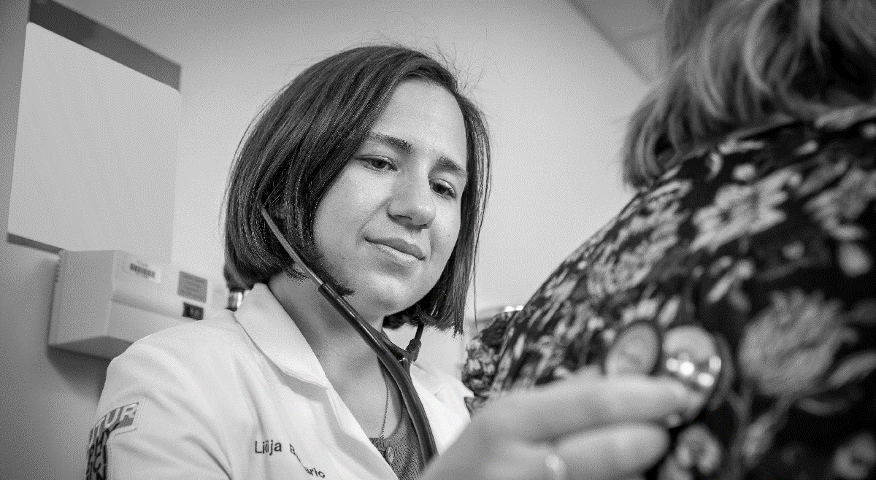
Investing in achieving health equity
Investing in
ACHIEVING HEALTH EQUITY
Notes:
At the same time, the lack of access to high-quality health care disproportionately affects many across our state.
To address disparities on Chicago’s Southwest Side, UI Chicago and UI Health are leading a collaborative to bring more health care services to neighborhoods in Gage Park and West Elsdon.
We know that zip code more than any other factor is a predictor of health and life expectancy. We heard about this during our last board meeting.
With U of I’s recent purchase, renovation and expansion of the of the previously closed clinical building, located where the two neighborhoods meet and not far from Midway International Airport, this new facility will provide access to specialty care and advanced diagnostics, mental health and women’s wellness services …
… and help meet the broader health care needs of these communities, where residents experience disproportionately high rates of diabetes, heart disease, obesity, cancer and pregnancy risk factors.

Slide 10
Our mission-aligned investing strategy
Our Mission-Aligned
INVESTING STRATEGY
Notes:
I’m delighted to end my remarks highlighting yet another example of the impact of our commitment to equity. You’ll recall in 2020, we announced U of I System’s Empowering Excellence: Financial Stewardship through Responsible Investing.
This program offers the opportunity for mission-aligned investing that reflects important diversity, equity and inclusion priorities in the investment process. Our results show that institutions can both invest responsibly and achieve significant returns. It also builds on our longer-standing commitment to increase allocations to diverse-owned and -led investment management firms.
According to a new study by the Intentional Endowments Network (IEN), the U of I System is a leader in exemplifying how sustainable endowment investments can outperform traditional ones. The study details how two years after establishing our program to incorporate environmental, social and governance factors – or ESG -- into investment decisions, our initial $160 million allocation has risen to $252 million, returning 47 percent on an annualized basis and outperforming benchmarks by 1.2 percent.
This is an investing strategy that not only is the right thing to do for our people and planet, but also makes good financial sense. I’m extremely proud of our move in this direction.

Slide 11
THANK YOU
THANK YOU
Notes:
As a system, we will continue to build on existing strategies to close equity gaps, working to better understand the needs of our students and all of our constituents throughout the state, identifying innovative programs and partnerships that further generate impact at scale to advance the public good.
I thank our trustees for your ongoing strategic vision and guidance and for your commitment to help grow the U of I System’s increasingly significant leadership role in the future.

