Slide 1

UIS Alumni Association
Update

Slide 2

Alumni Summary
    45,621 living graduates
    More than 28,000 reside in-state
    Top 5 Counties: Sangamon, Cook, Peoria, Macon & Tazewell
    Top 5 States: Illinois, Florida, Texas, Missouri & Arizona
    5-time Pulitzer Prize recognition
    53,721 total alumni

Slide 3
Organizational Structure
  Led by the Division of Advancement
    Alumni Engagement
    Fundraising
    Communications
    Data Management
  Four Pillars of Alumni Engagement
    Philanthropic
    Volunteer
    Experiential
    Communication

Slide 4
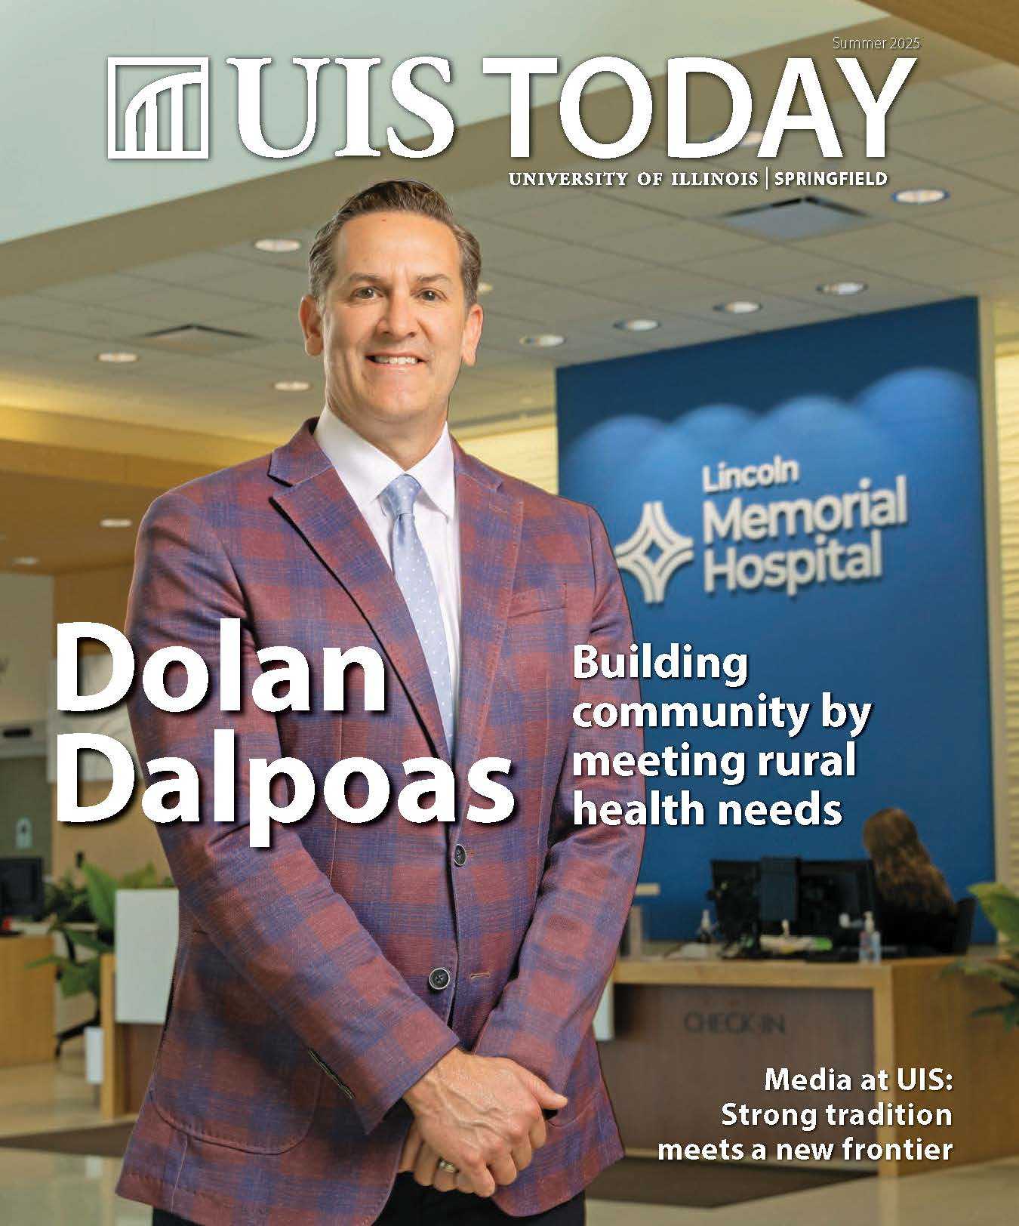





Print & Digital

Slide 5

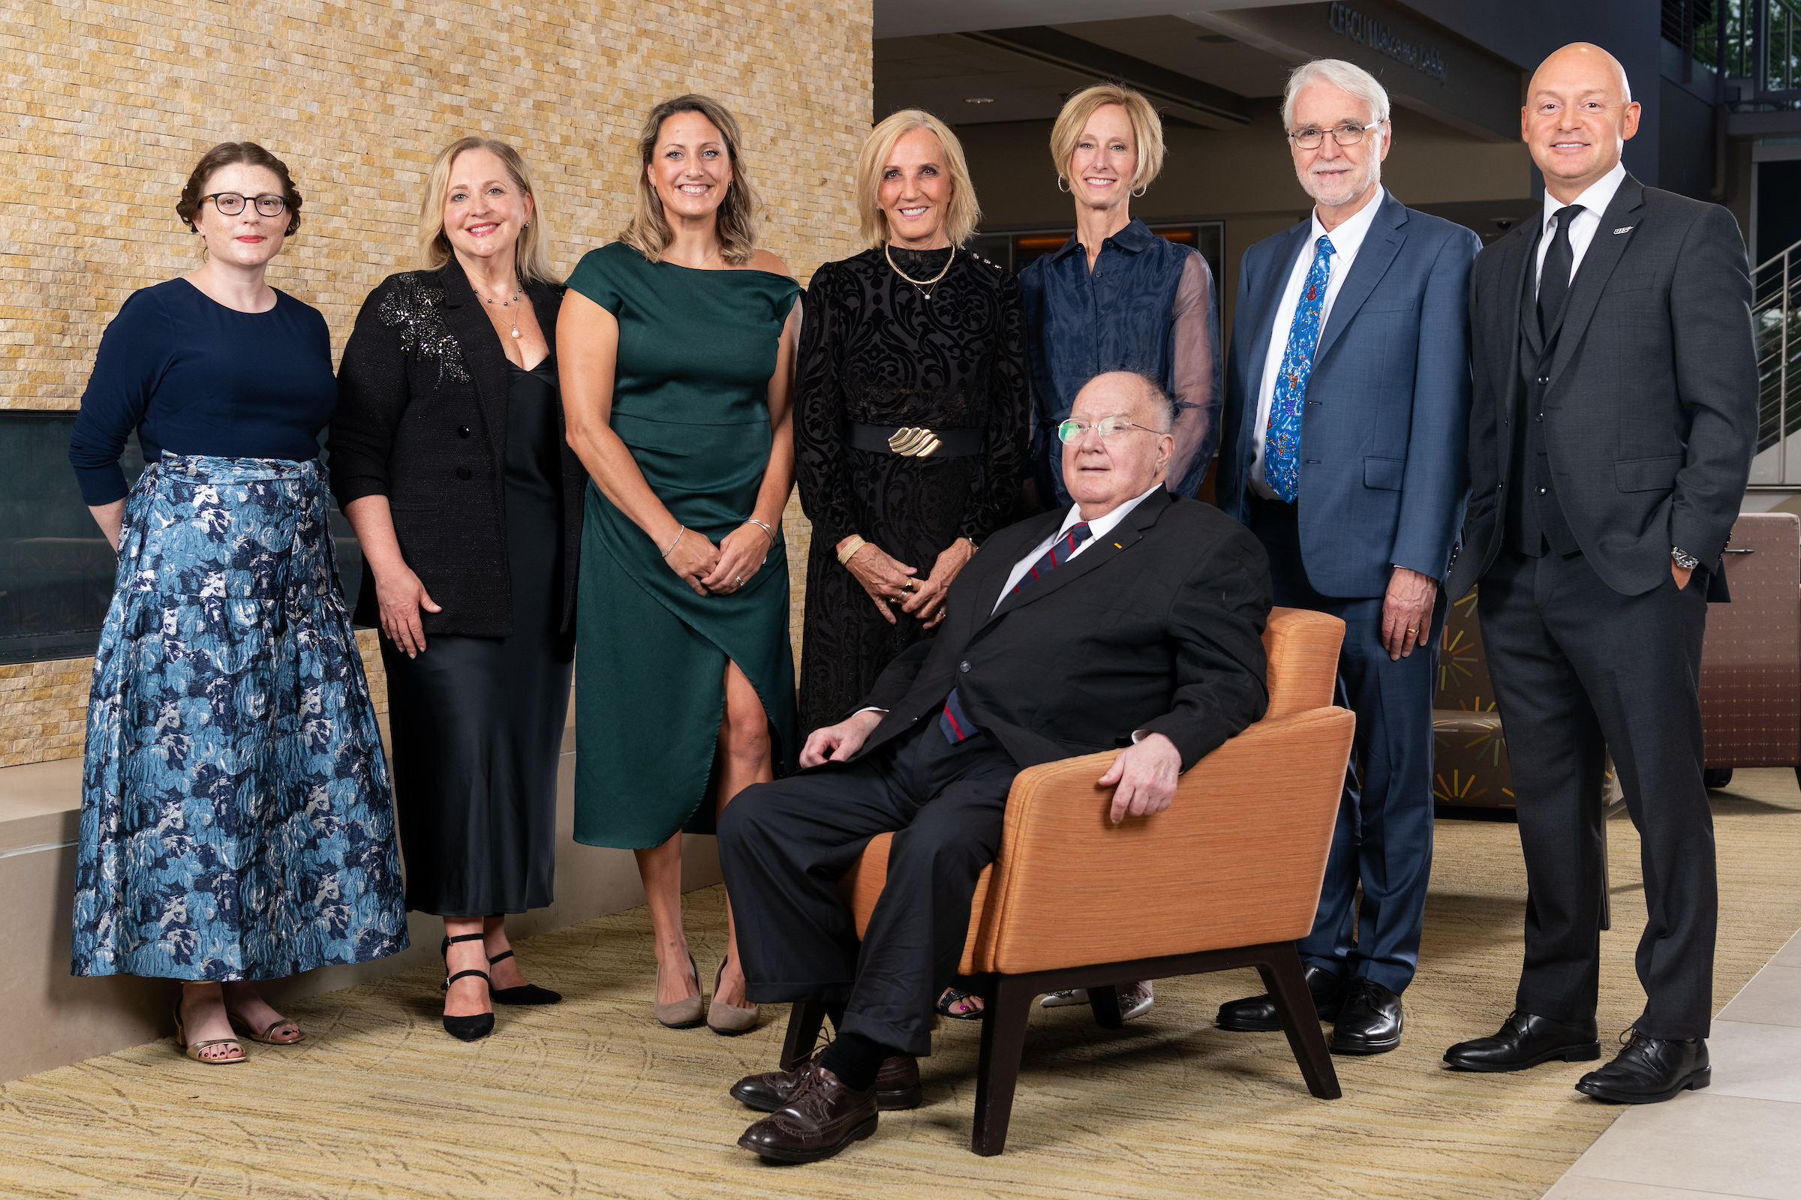
Events & Activities
Alumni GALA
ALUMNI SAGE SOCIETY

Slide 6
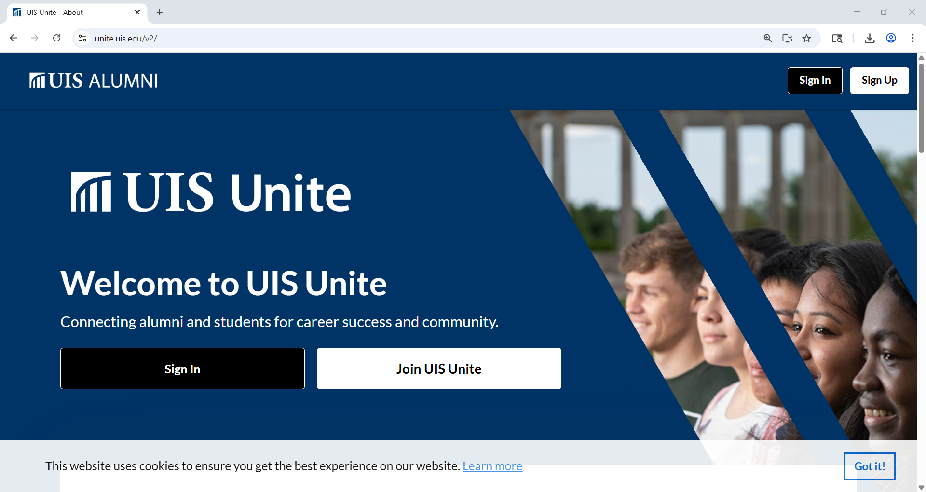
UIS Unite Digital Community

Slide 7

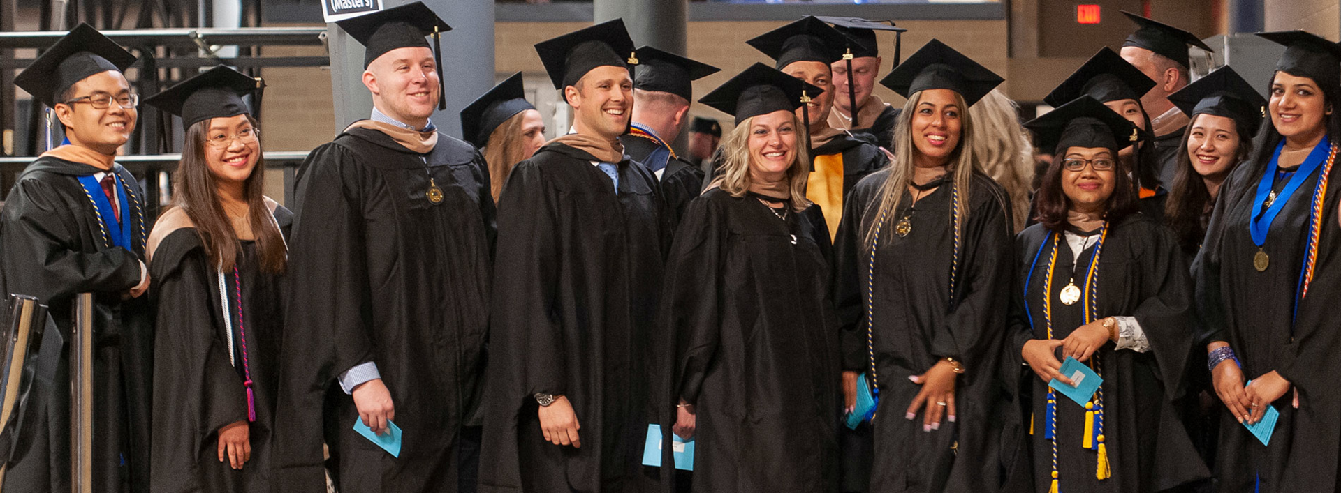
Recent Graduate Engagement
Unique Innovation,
Leadership & Creativity
RISING STAR AWARD

Slide 8

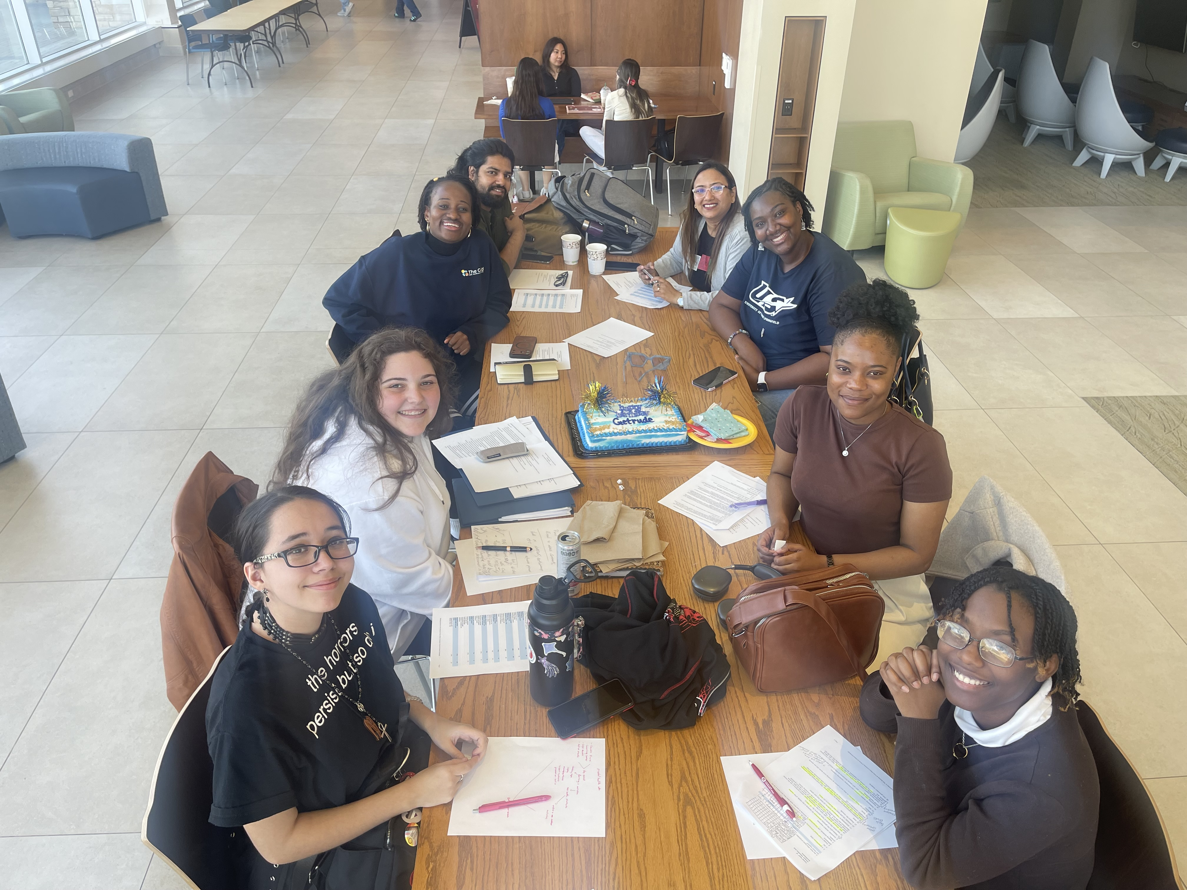
Student Philanthropy Program

Slide 9

Oral History Project
  All living graduates invited to share their story
    5,009 Respondents | 3,772 Stories | 24,998 data points (new and verified data)
  Sample Reflections
“Reflecting on my time at UIS, the breadth of opportunities stands out. I was involved in the computer science club, cross country team, and chamber orchestra - a level of engagement that can be hard to achieve at larger institutions.”
“The Capital Scholars Honors curriculum provided a unique, tight-knit experience. My cohort took specialized courses together, bonding over the shared challenges. Those relationships have endured, with one friend even becoming a roommate after college when we both landed at State Farm.”

Slide 10
Value & Giving Back
Display your diploma with pride: Education is to be celebrated! Let your friends, your family and your co-workers know of your University of Illinois and System UIS connection. Celebrate your educational journey.
Recruit a new student: Strengthen your legacy and increase the value of our degree by recruiting intelligent, hardworking students to walk through the doors of our Alma Mater.
Join UIS Unite (unite.uis.edu): Connect with fellow alumni and students, fostering a community of shared professional success and personal growth.
Make a gift (www.uis.edu/give): Honor those who have supported and championed your journey, paying it forward for future generations.
Join the Illinois Connection Advocacy Network (www.uillinois.edu/erc/advocacy): Make meaningful impact and amplify the voice of our alumni community through legislative advocacy.

Slide 11
YTD Fiscal Year Performance
Total Alumni Engaged |  | Percentage of Alumni Engaged
8,296 YTD 14,967 Goal 11,575 FY25 |  | 15.4% YTD 29% Goal 21.80% FY25

Slide 12
Alumni Board
Board Engagement Pillars
  The board focuses on experiential involvement, philanthropy, communications, advocacy, and service leadership to support institutional priorities.
Alumni Board Scorecard
  Defines participation including events, financial contributions, communications, advocacy, and volunteer leadership.
Community Ambassadors
  Board members promote UIS initiatives, mentor students, and elevate university visibility in professional networks.
Governance and Stewardship
  The board ensures alignment with university goals, fostering alumni participation and philanthropic growth statewide and nationally.

Slide 13
Emerging Discussions
  Participation Capture
    Identifying all points of contact and interaction
  Scalability = Local to global engagement
    Record-setting: Achieve 30% alumni participation in at least one pillar
    How do we elevate UIS Alumni profile? Digital badging? Alumni benefits program?
  Build culture of philanthropy
    Financial giving becomes the norm & record-setting fundraising outcomes
  How do we use AI as a tool for engagement?
  How do we build and support professional capacities & competencies for success?

Slide 14
Thank you!

