Slide 1

Challenges and Opportunities
University Senates Conference (USC) Presentation by Linda Herrera
Board of Trustees Meeting
March 19, 2026

Slide 2
Questions to Ponder
What does it mean to be a global university?
How can the University of Illinois model the world we desire and need?
2

Slide 3
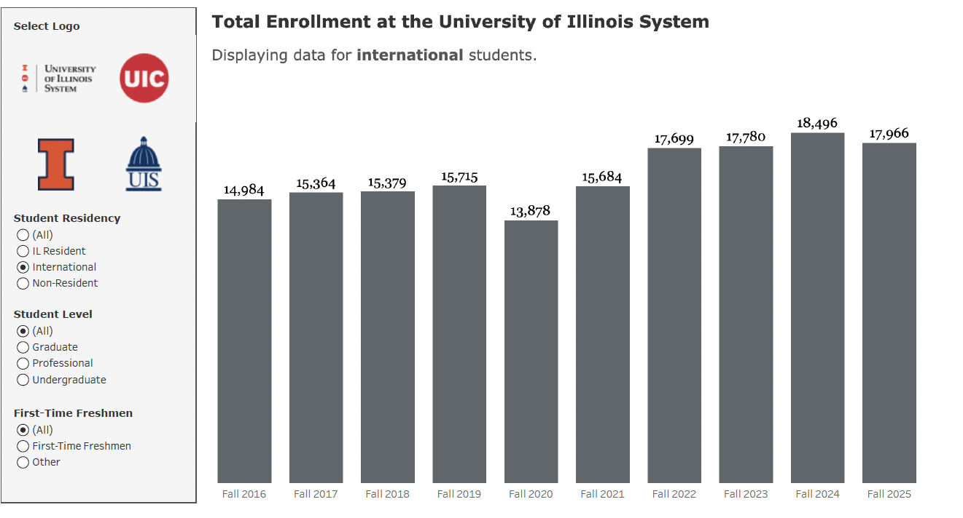
International Student Enrollments
2016-2025
https://www.uillinois.edu/data/enrollment
3

Slide 4
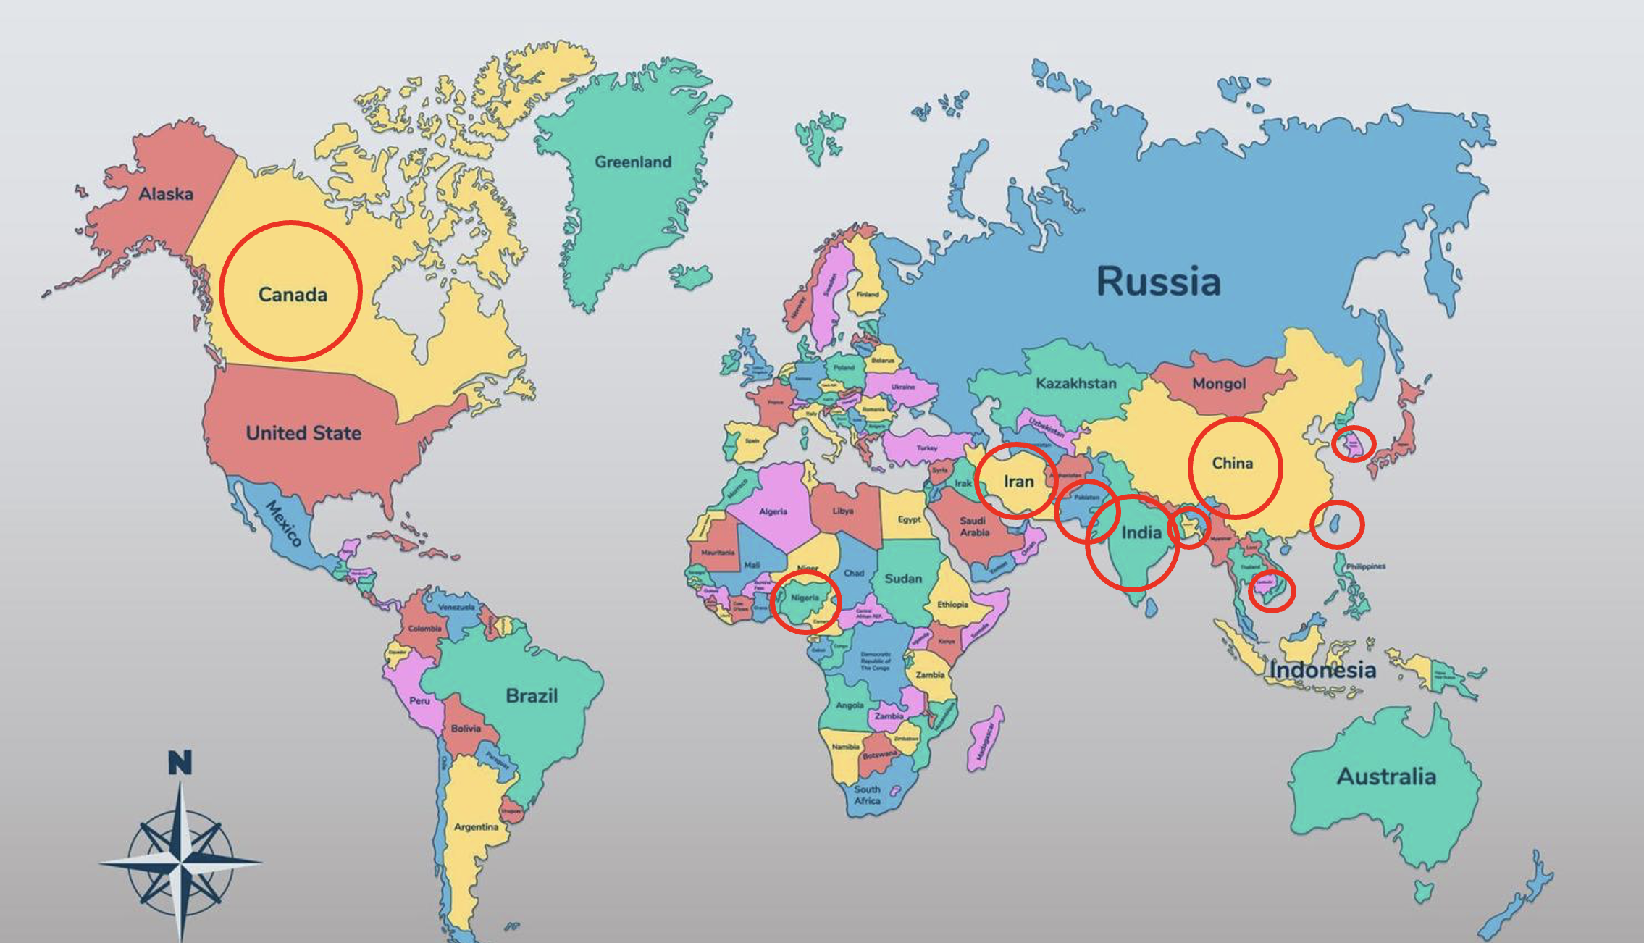
Top 10 Countries Represented by International Student Enrollments (2025)
Data from Office of Planning and Budgeting, UI System
4

Slide 5
Non-Resident Faculty and Alumni
Headcount and Percentage of Full-time International Faculty
1995-2025
 | 1995 | 2005 | 2015 | 2025
Total | 4,063 | 4,377 | 4,751 | 5,631
Total Non-Resident (NR) | 71 | 313 | 246 | 432
Percent NR | 1.7% | 7.4% | 5.2% | 7.7%
Source: Office of Planning and Budgeting, HR, University of Illinois System
University of Illinois System alumni are represented in 164 countries around the world!
https://www.uillinois.edu/alumni
5

Slide 6

Global University in a Fraught World
In times of fractured and strained democratic systems globally, education leads us to reflect collectively, engage deeply, and model a community based on rigorous ethical inquiry, deliberation, and principles of justice and fairness.
How do we do this?
6

Slide 7

Renew Commitment to International Programs, Social Sciences and Humanities
In the current climate, Title VI centers for the study of languages, world regions, and global studies, are under threat.
U of I System needs to find creative ways to continue support for this meaningful work as it reaffirms commitments to the social sciences and humanities.
7

Slide 8
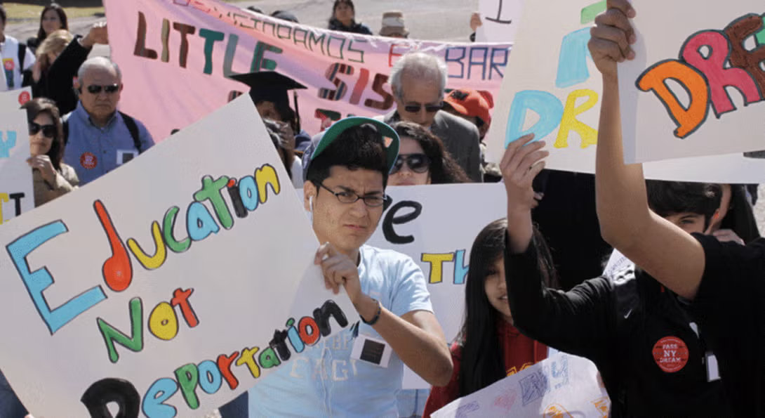
Protect and Support the Most Vulnerable Members of our Community
Learn About The Rigo Padilla Pérez Undocumented Student Resource Center
https://dream.uic.edu/about-us/
8

Slide 9
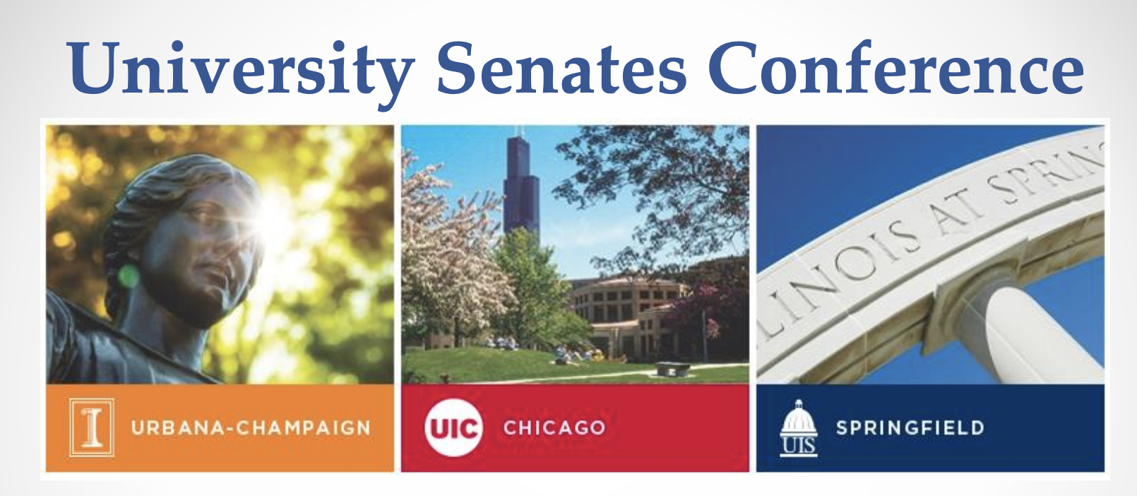
Guard Shared Governance
USC STATEMENT ON UNIVERSITY DEBATES
OT-388 University Senates Conference,
May 16, 2024
“…we share with many others concerns about the university debates over hostilities between Israel and Palestinian …. We support extremely broad principles of academic freedom and free speech, but these are not without limit….”
  respect the values of truth and accuracy
  we are always teachers who our students look to as examples of serious thought and responsible moral leadership
https://www.usc.uillinois.edu/sites/usc.uillinois.edu/files/images/OT-388%20USC%20Statement%20on%20University%20Debates_0.pdf
9

Slide 10
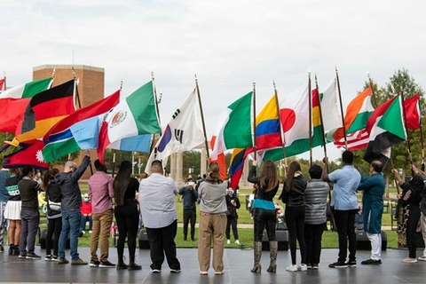
Being a Global University
…creates boundless opportunities.
Yet cultivating a university community that preserves the best traditions of learning and inquiry and fosters the global good is becoming increasingly more complex and challenging.
And it is more necessary than ever.
Students at UIS
10

Slide 11
Comments and Questions
Linda Herrera
USC Member
Email: lherrera@illinois.edu
Phone: 217-333-0960
Sandra De Groote
USC Chair
Email: sgroote@uic.edu
Phone: 312-413-9494
David Perryn
USC Administration
Email: dperryn@uillinois.edu
Phone: 217-300-7448
11

