Slide 1
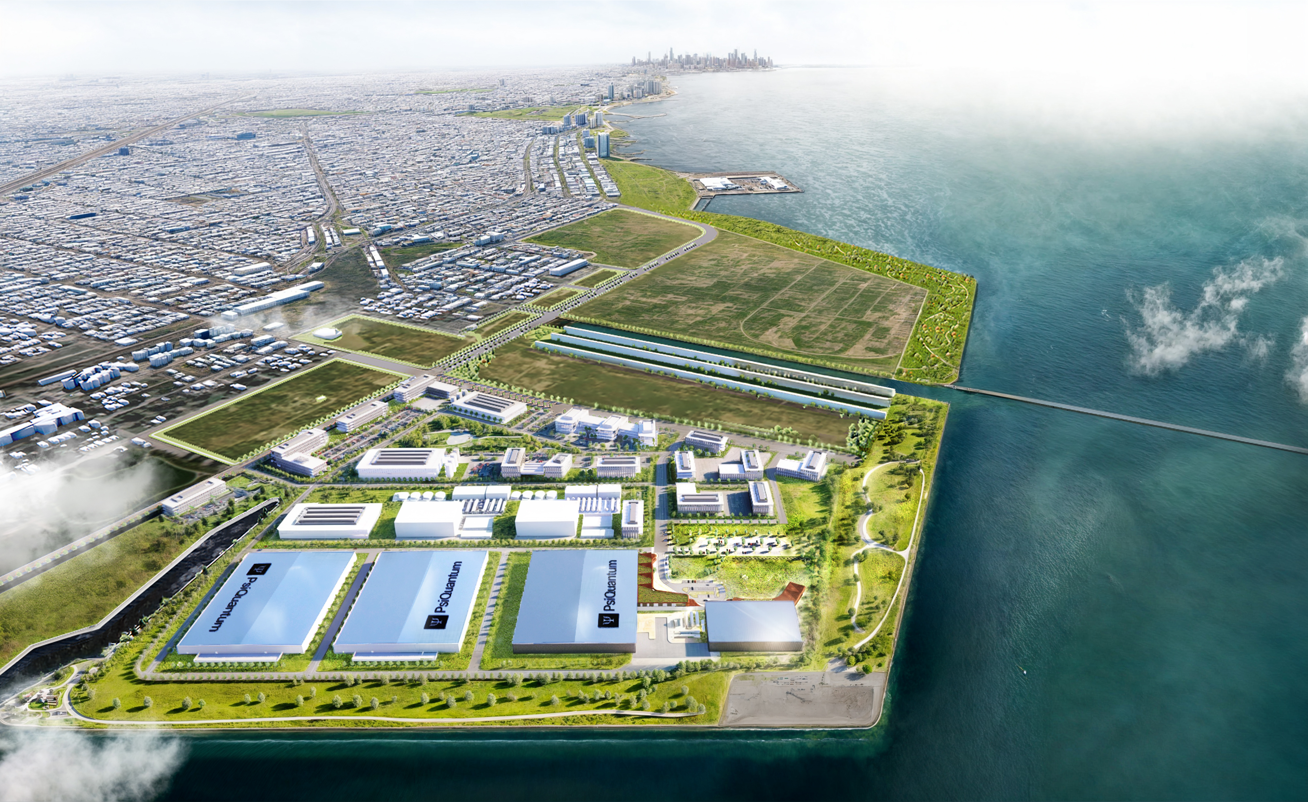
March 20, 2025
Illinois
Quantum and Microelectronics Park (IQMP)
UI Board of Trustees Meeting
Harley T. Johnson, UIUC Grainger College of Engineering
Director & CEO, IQMP

Slide 2
WHAT IS IQMP?
A first-of-its-kind campus to support quantum computing scale-up and related quantum and advanced microelectronics research and development

Slide 3
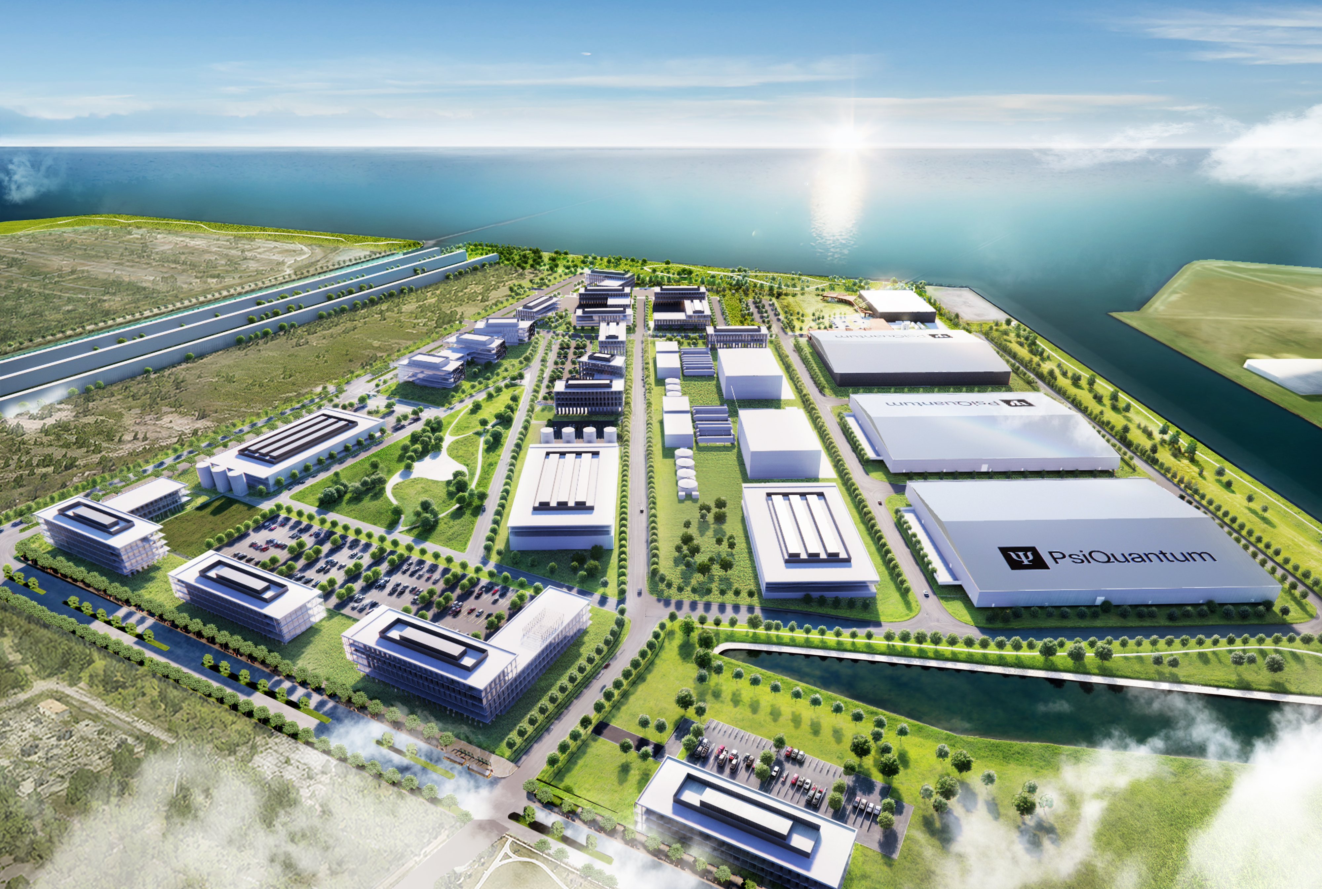


















ILLINOIS ECOSYSTEM PARTNERS

Slide 4
WHY QUANTUM?
Quantum computing has the potential to tackle many of the biggest challenges across many industries:
health care
transportation
agriculture
energy
financial services
national security
...but it must be proven…and to be proven it must be scaled up.

Slide 5
WHO WILL BE THERE?
PsiQuantum, who aim to build first utility-scale fault-tolerant quantum computer
IBM, who’ll locate their state-of-the-art quantum computer at the park, and who’ll be a lead partner in the National Quantum Algorithm Center
DARPA performers, in $280M DARPA-Illinois Quantum Proving Ground program
Other tenants/users, who’ll work to facilitate the development and commercialization of quantum technologies: from startups to Fortune 100 companies, across all sectors of quantum and microelectronics that support quantum – currently in advanced conversations with more than 20 companies

Slide 6
HOW WILL IT WORK?
Building on a historic $500M FY25 investment by the State in quantum and microelectronics
Managed and operated by the IQMP, LLC, which is owned by the Board of Trustees of the University of Illinois, and governed by a statewide group of stakeholders (universities, national labs, non-profits)
An R&D park & user facility for companies, universities, national labs, including
National Quantum Facility: a shared experimental facility with industrial scale cryo-plant, to provide cooling for quantum computing prototypes
National Quantum Algorithm Center: an algorithm and software R&D center to develop quantum computing capabilities for and with end users

Slide 7

IQMP coordinates the park development through 15 workstreams
Role of IMQP, LLC
URO: Provides coordination and oversight across workstreams, makes decisions affecting IQMP
IQMP, LLC oversight and coordination
Workstreams: Develops recommendations, identifies and solves challenges within scope, proactively escalates issues as necessary
Construction workstreams
Business development and funding workstreams
Community
workstreams
Site planning, development, infra.
Business development
Community Engagement
ComEd Power
DARPA-Illinois Proving Ground
Communications
Cryoplant
Federal Funding Pursuit
Workforce Development
National Quantum
Facility
IQMP Governance & Operations
National Quantum Algorithm
Center
PsiQuantum Facilities
Security
DPI integration

Slide 8


Business Development
We have 50+ qualified companies in our BD pipeline
Most of the pipeline generated from inbound inquiries from interested companies
Prospect
Exploratory
Negotiations
Deals Closed
Companies new to business development pipeline that have expressed interest in the IQMP
Exploratory discussions to understand IQMP capabilities, company needs
Negotiation and related to lease terms, funding, incentives applications, and other contractual items
Committed to IQMP
Pipeline stage
PsiQuantum has entered Stage C of DARPA’s QBI program!
28
17
7
Companies*

Slide 9
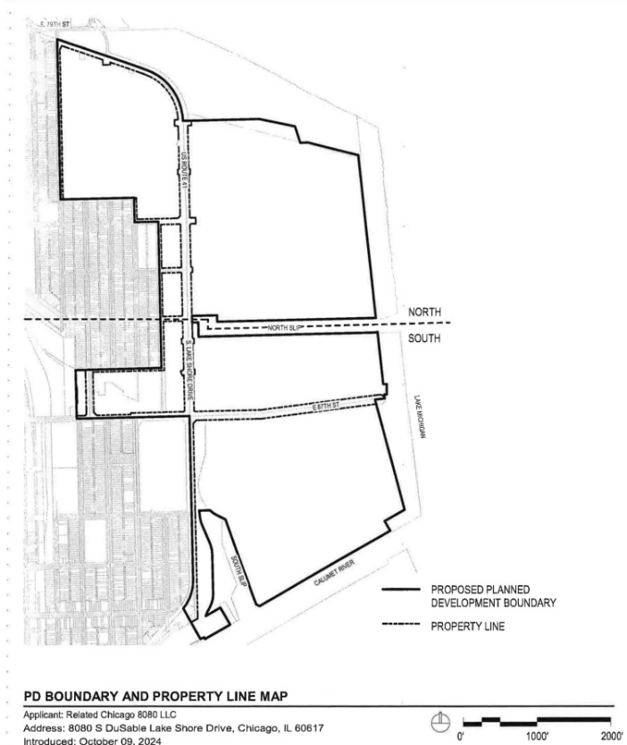
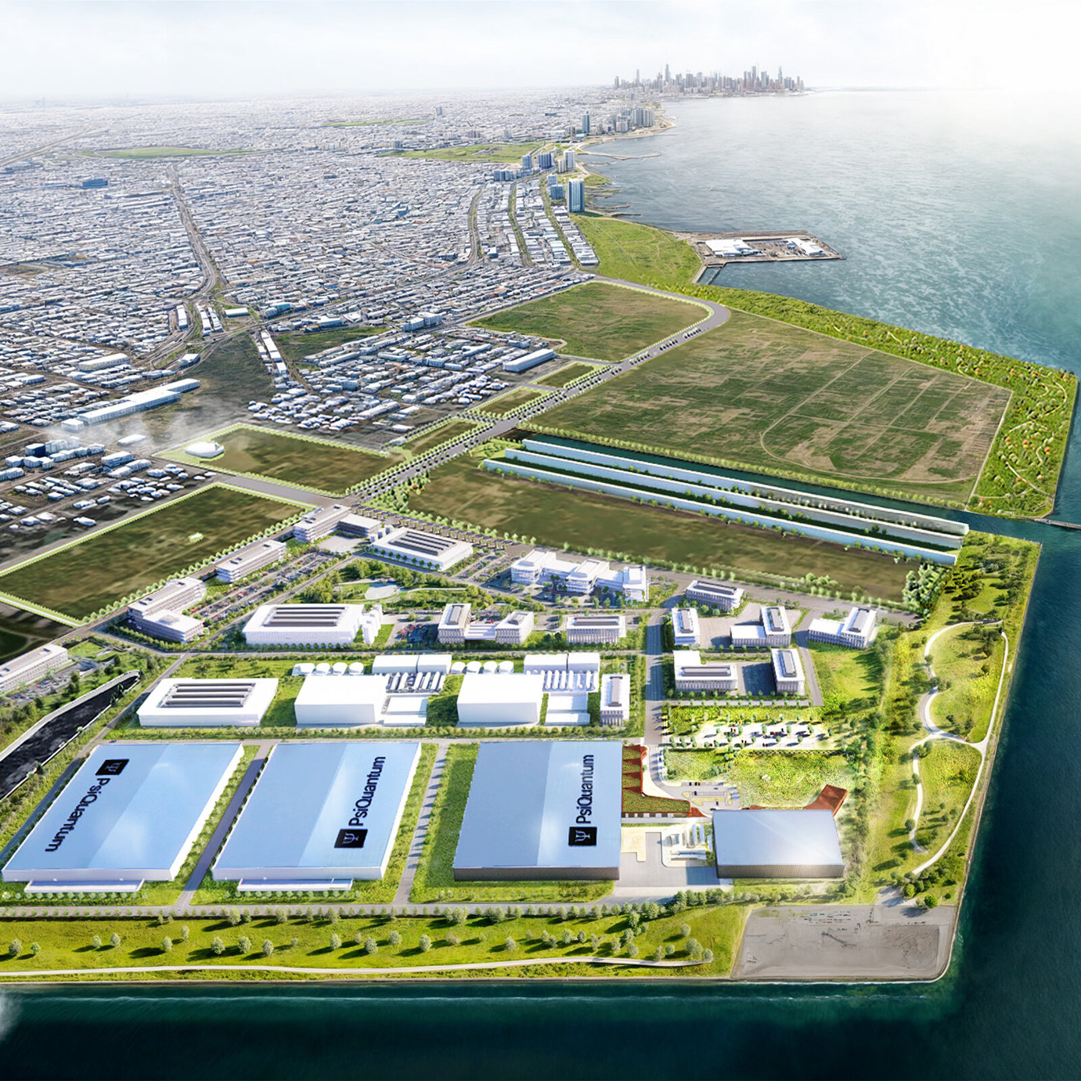
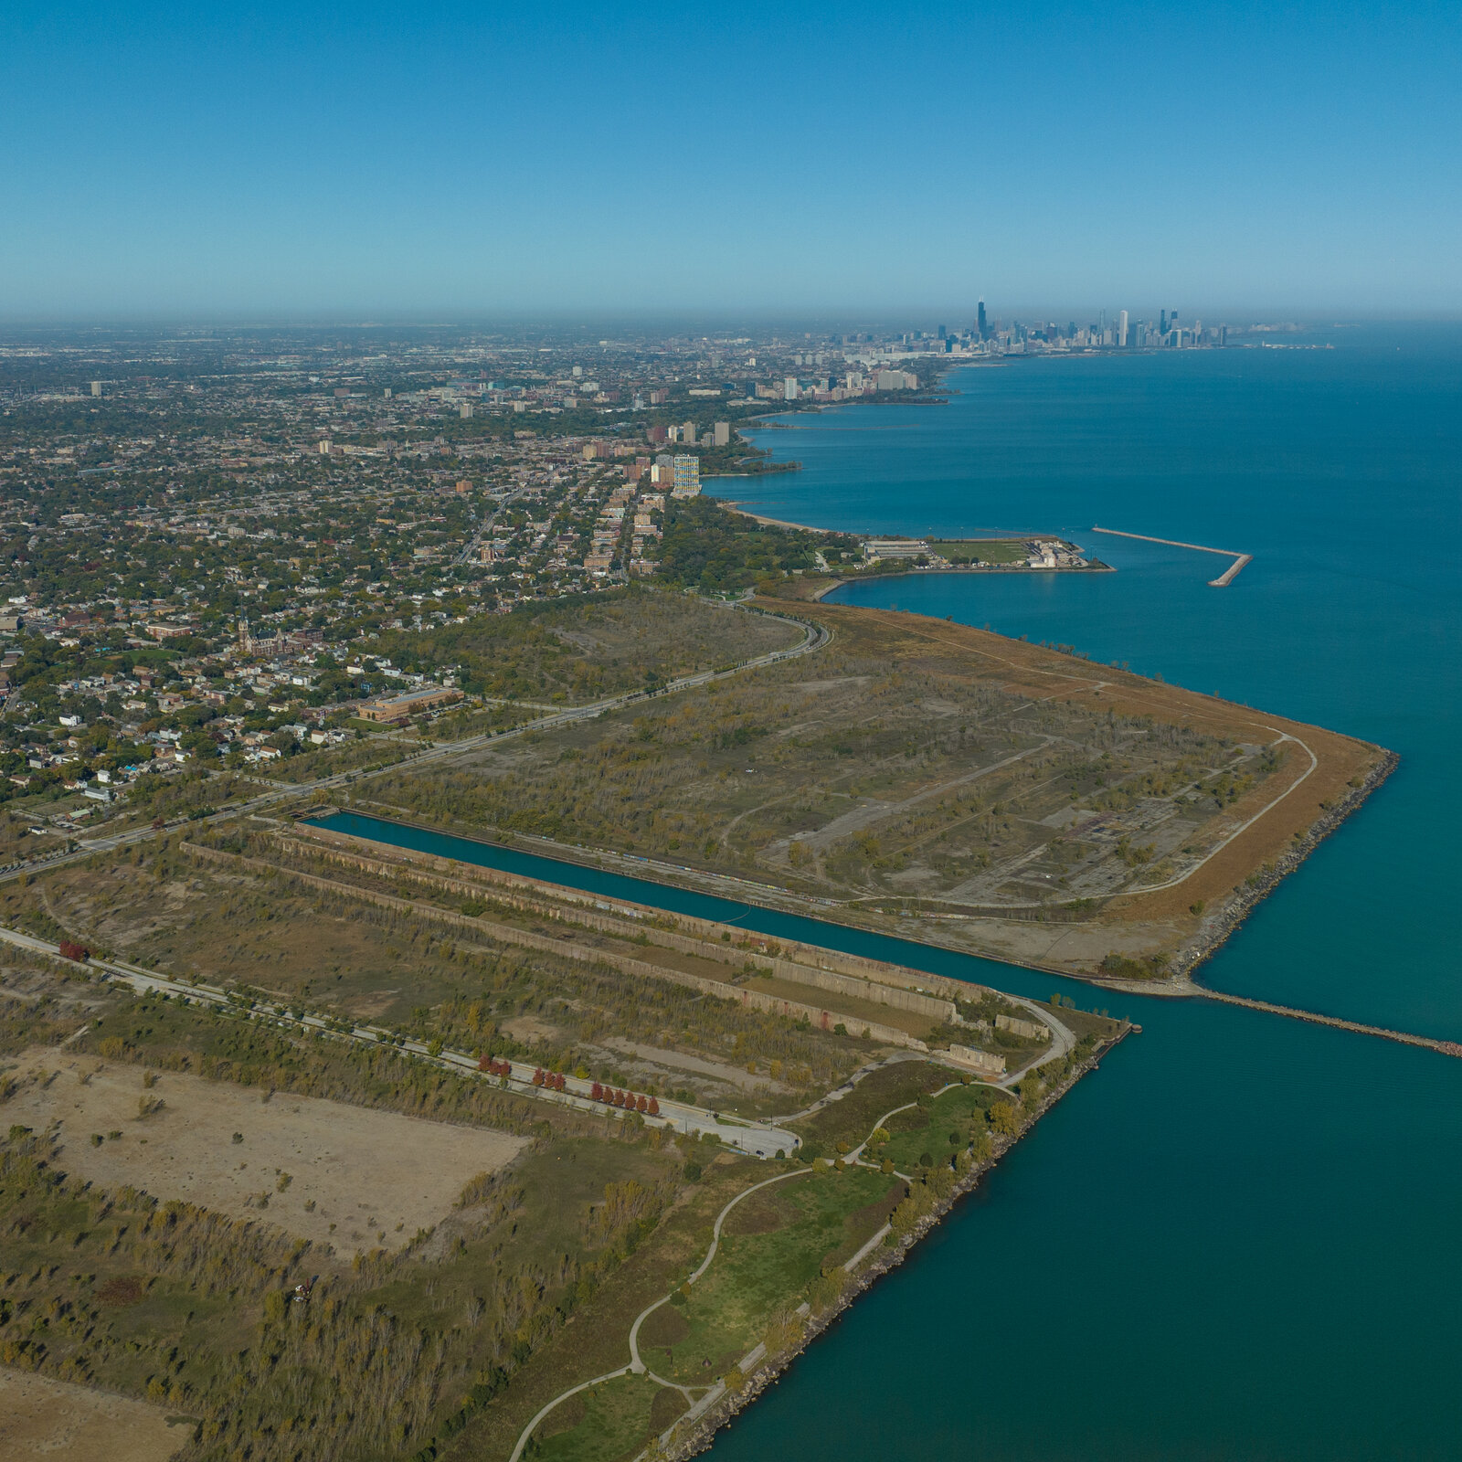
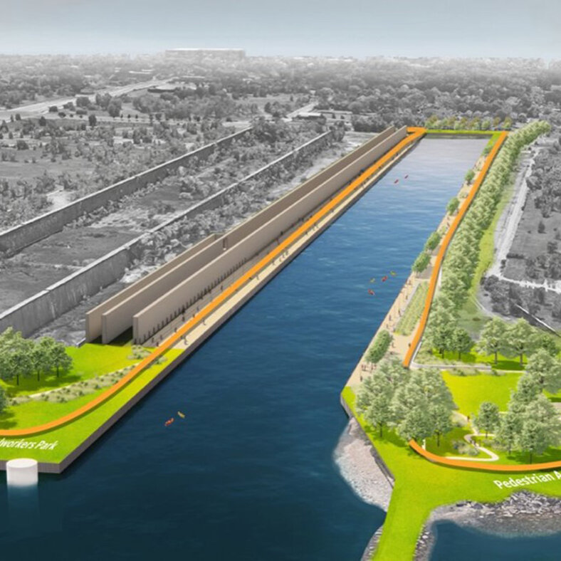
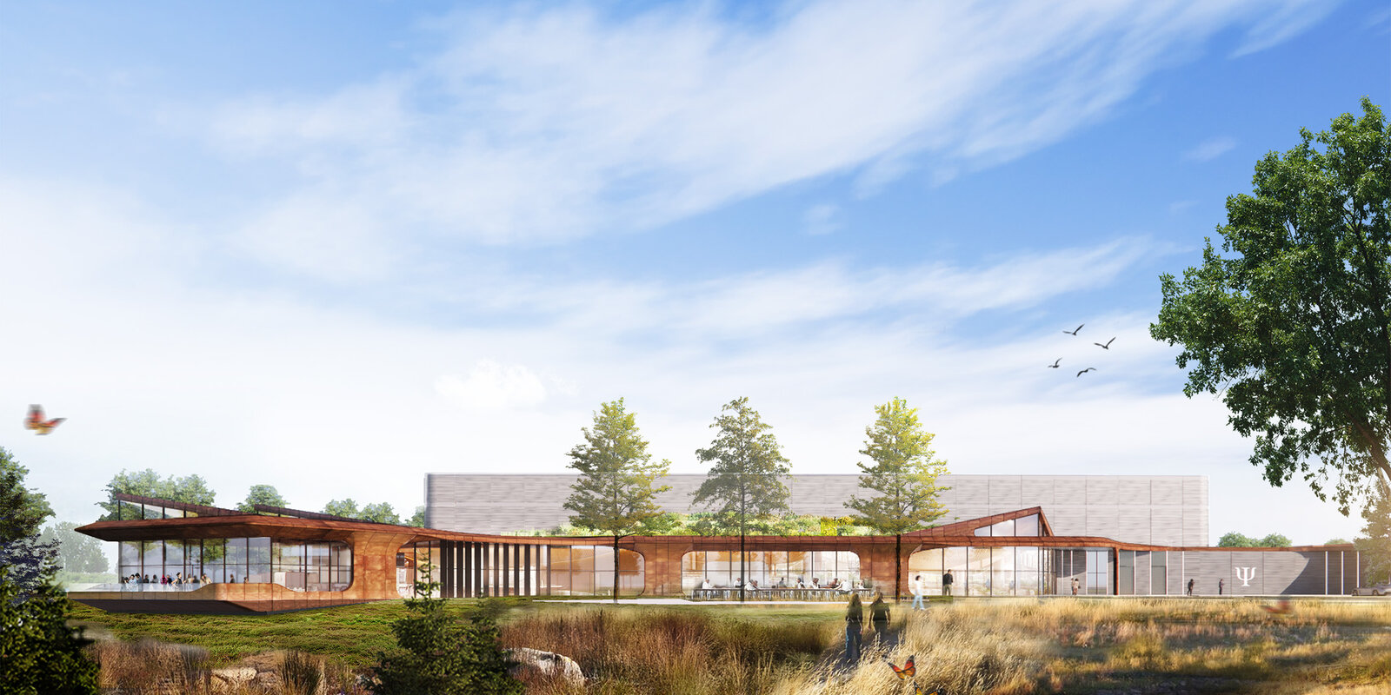
Site Development

Slide 10













Community Engagement
State and City coordinating a broad group of organizations
Highlights
Local residents in 7th and 10th Wards
Five community engagement meetings attended by 250+ residents and viewed by thousands more online¹
Leadership
Policymakers
  Members of the congressional delegation
  DoS, DoD, DoE
  State Rep. Tarver and State Sen. Peters
  Commissioner Moore
  Alderman Chico and Alderman Mitchell
Organizations
Environmental groups
Regular sessions between multiple environmental groups and IEPA and City Department of Environment
Cook County
Government
Education leaders
Ongoing collaboration with CPS, local principals, universities, community colleges and non-profits
1. Including 1 dedicated to Bush residents

Slide 11
DISCUSSION

