Slide 1
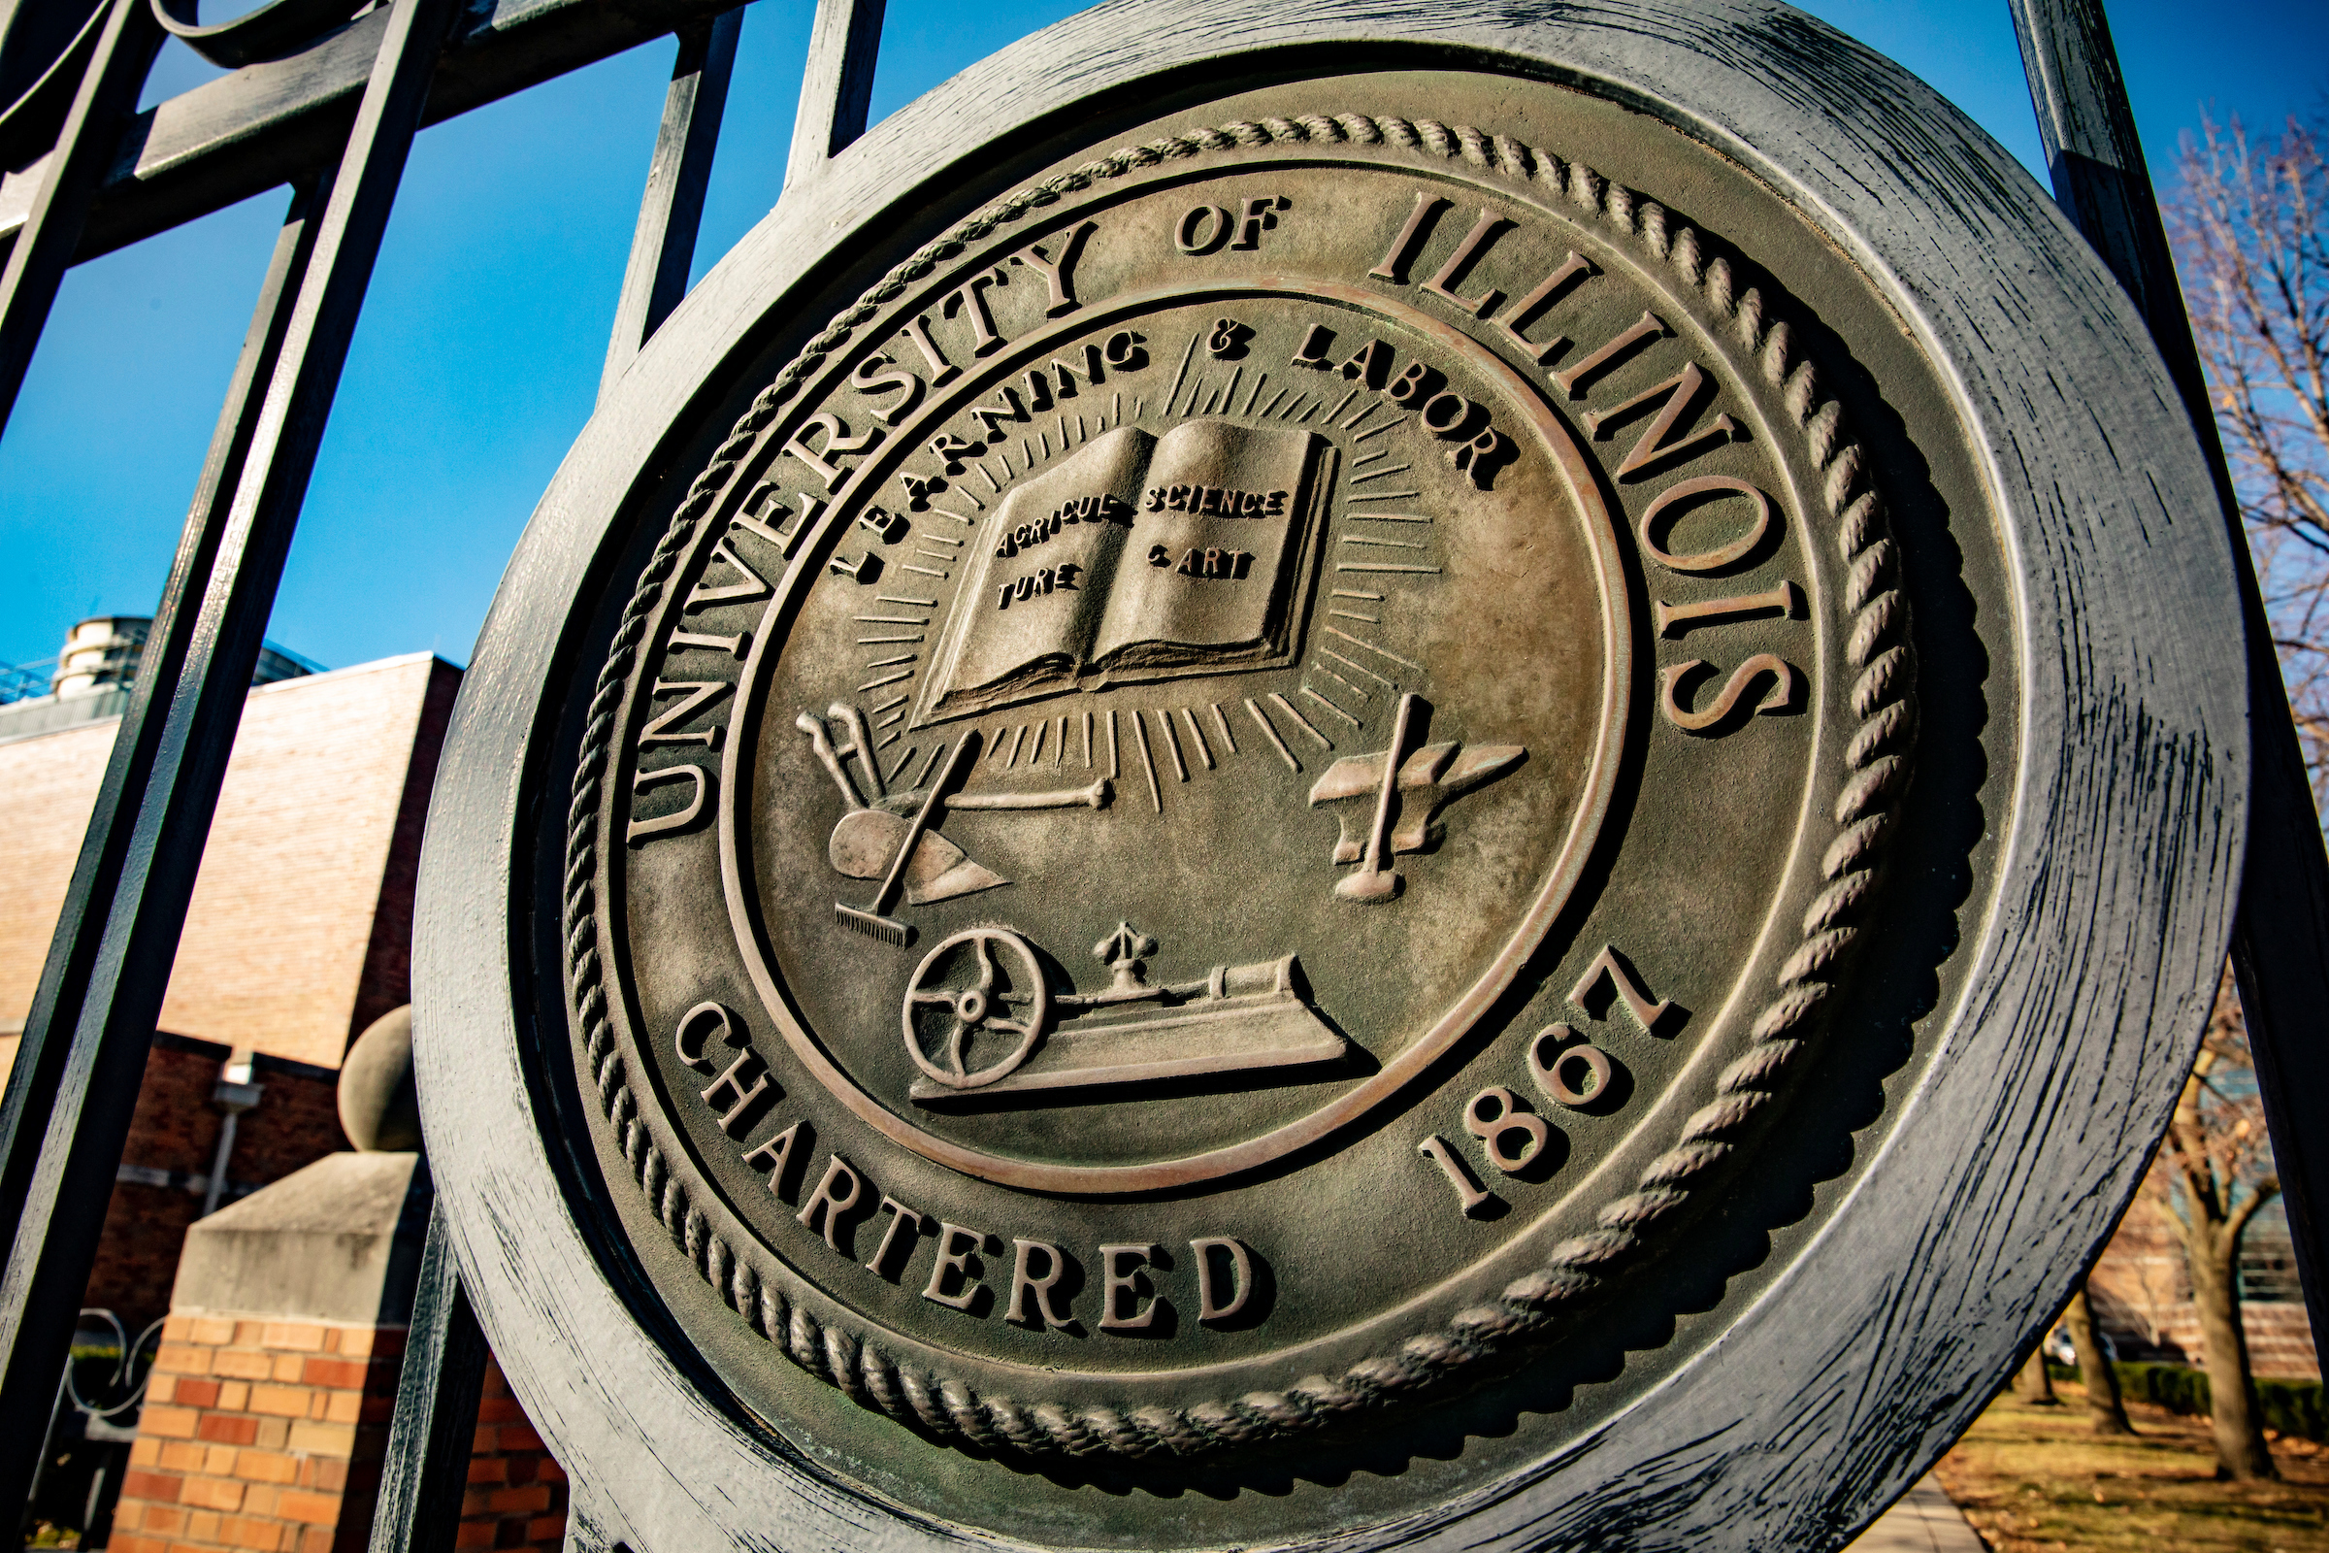

REMARKS TO
THE BOARD OF TRUSTEES
March, 20th, 2025
Tim Killeen, President
Notes:
Thank you, Chairman Ruiz.
At this time, I would like to introduce our treasurer, LESTER H. MCKEEVER JR., partner at Mitchell-Titus accounting firm in Chicago, joining us remotely.
Also:
Chancellor and Vice President ROBERT JONES from Urbana-Champaign;
Chancellor and Vice President MARIE LYNN MIRANDA from Chicago;
And Chancellor and Vice President JANET GOOCH from Springfield.
And the other university officers and staff:
University Counsel SCOTT RICE;
Vice President/Chief Financial Officer and Comptroller PAUL ELLINGER;
Executive Vice President and Vice President for Academic Affairs NICHOLAS JONES;
Vice President of External Relations and Communications ADRIENNE NAZON;
Vice President for Economic Development and Innovation JAY WALSH;
And Secretary of the Board of Trustees and the University JEFFREY STEIN.
Representing the Urbana-Champaign Senate, ERIC KURT, media commons coordinator, University of Illinois Library, Urbana.
Representing the Springfield Senate, NEETU SINGH, associate professor of management information system, secretary of the UIS Senate and member of the Senate Executive Committee.
Representing the academic professional staff: SARAH GIBSON, associate online advisor, Springfield.
Also joining us via the livestream:
Representing the University Senates Conference, AMY DUNNING, Assistant Professor of Mathematics, University of Illinois Springfield;
Representing the Chicago Senate, ASA ASAD, undergraduate student senator;
And SANDRA DEGROOTE, chair of the UIC Senate Executive Committee.
Allow me, before I begin, to welcome Trustee McKinney.
Congratulations on your appointment and I look forward to working with you in the years ahead.
We are obviously in the midst of a challenging period for all of higher education, particularly institutions like the University of Illinois System charged with the responsibility to provide an excellent education but also to pursue a deep portfolio of research that creates innovation and economic opportunity, enhances and even saves lives, and enriches life and our society — and so much of it financed by federal funding.
This is the model that has driven innovation in our country for many decades, and it is, frankly, the envy of the world.
That is not a platitude. It’s the truth.
The changes happening now are moving at a rapid pace. We do not yet have answers to all of the questions they raise. There is much uncertainty and I know that can be unsettling.
Please know that I and many other people across the U of I System are at work every day to try to get those answers, to make certain we comply with the law, and to advocate for the critical work that happens at our universities and across the system.
We will continue to make decisions based on the facts and work to protect funding critical to our institutions.
I’ve said often lately that, while we may have a panic button, we’ve set it aside.
We don’t have time to panic because we have to continue to meet our responsibilities, to live up to the promise we’ve made to work every day for our state.
Every student, all of our faculty and staff, and the people of Illinois are counting on us.

Slide 2

Students are our core mission
Notes:
When we last met in January, I talked about the idea of standing firm in the values that define you, borrowing from a theme that Illinois’ own Abraham Lincoln spoke of and apparently thought about through much of his life.
One of our core values, perhaps the most important one, is made clear in the first pillar of our Strategic Framework: We are and will be, first and foremost, an institution of and for our students.
Today I want to look closer at that first pillar, that dedication to serving our students – all of them.
In January during a brief trip to California for the University of Illinois Foundation meetings, Roberta and I found some time to take our son-in-law up on an invitation to speak to his middle-school class.
We talked about our own experiences as students and as educators and researchers, and about what higher education can mean in the lives of students and their families.
They were engaged and incredibly polite. None of them wondered -- out loud, anyway -- why the white-haired Welshman couldn’t talk a little less so they could hear more from the insightful scientist he accompanied.

Slide 3
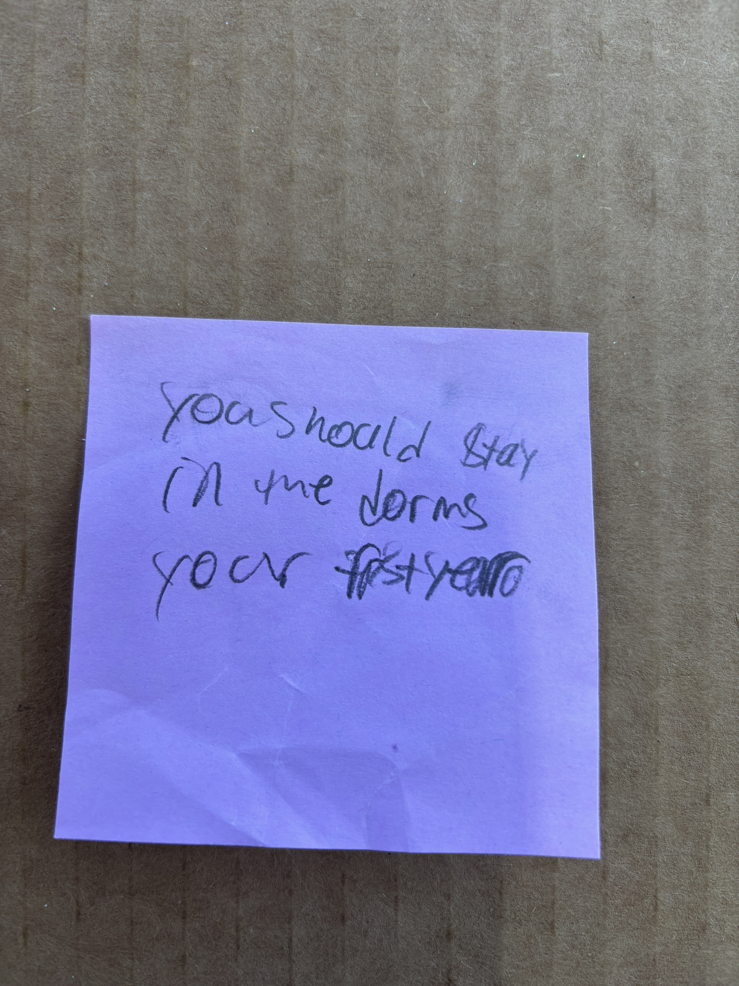
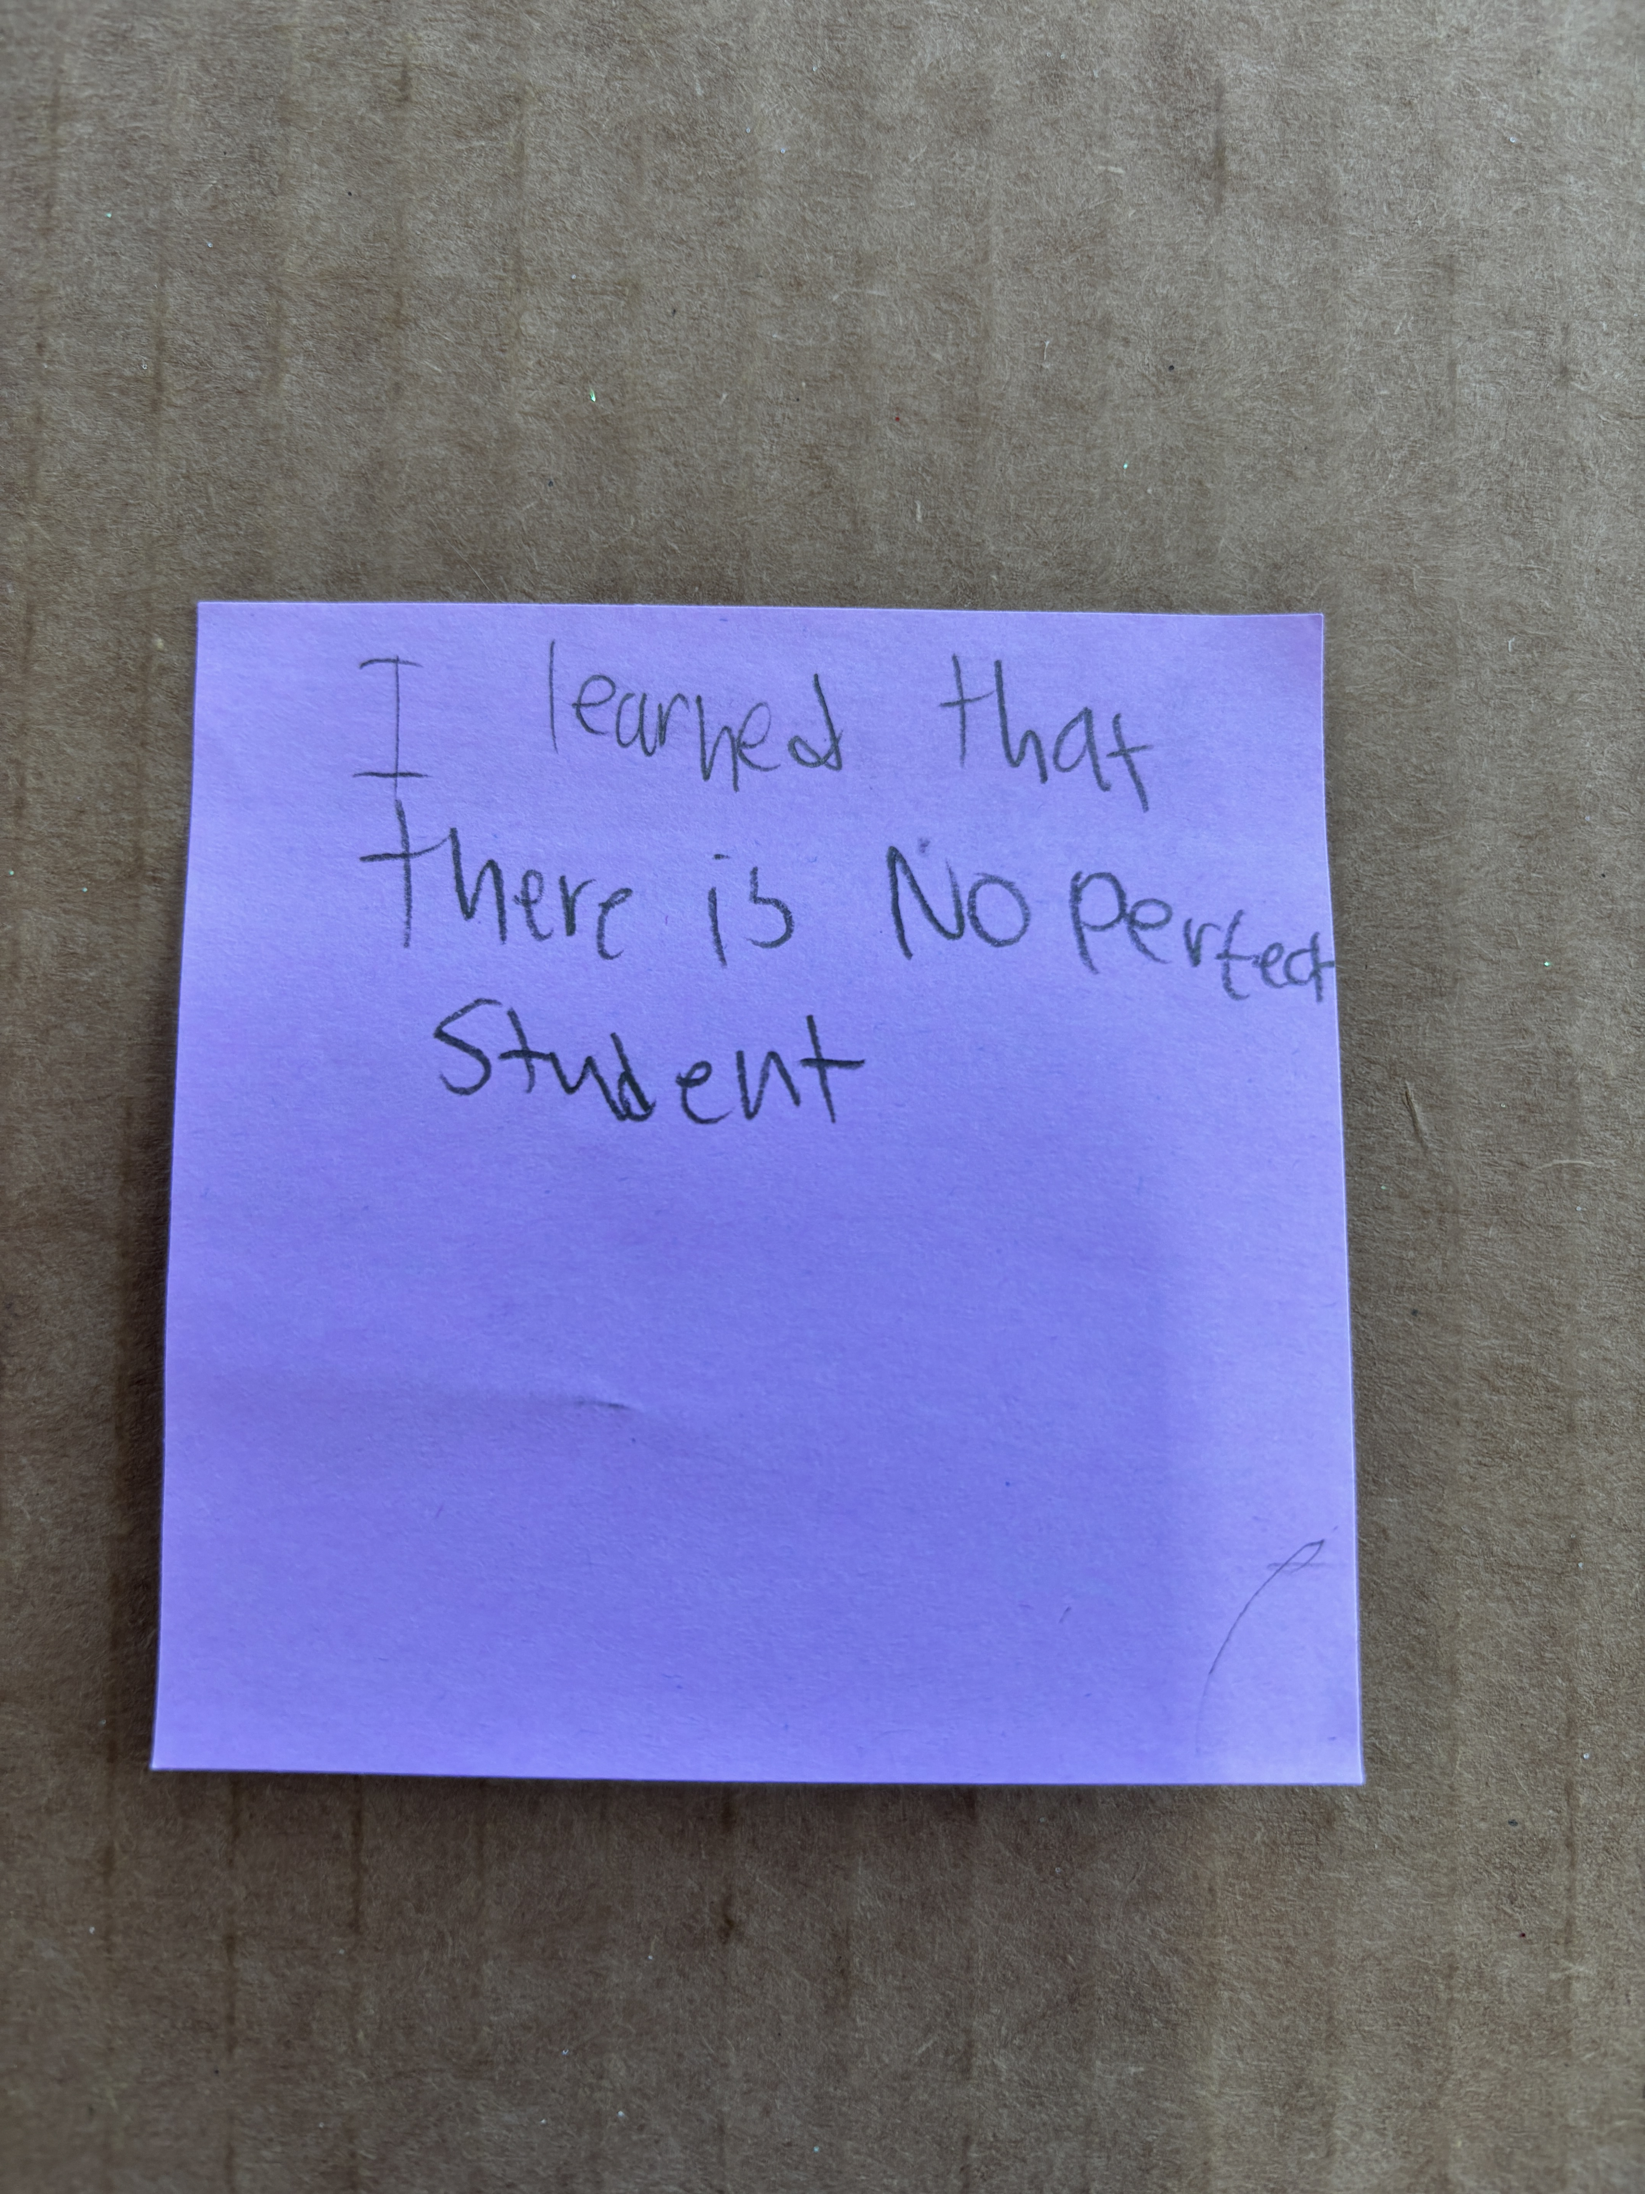
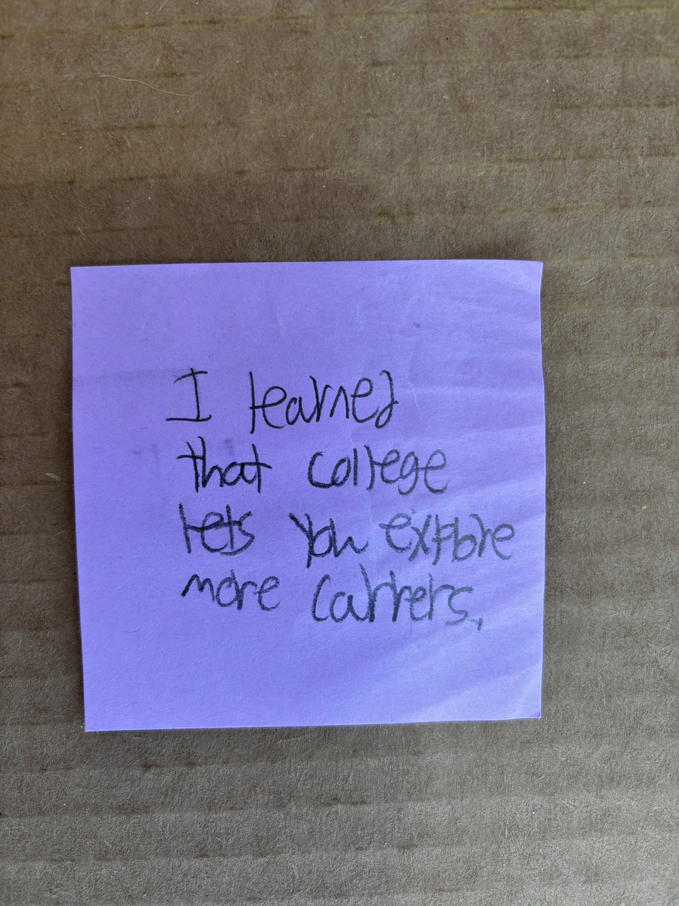
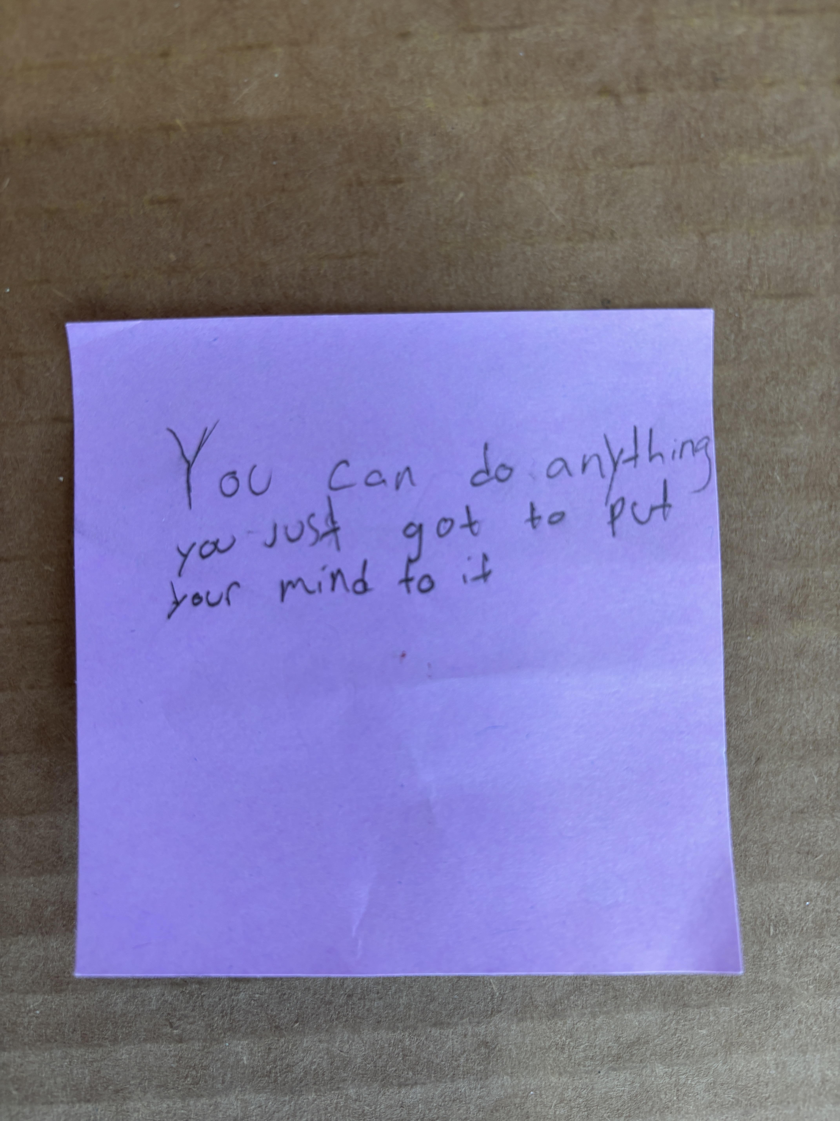
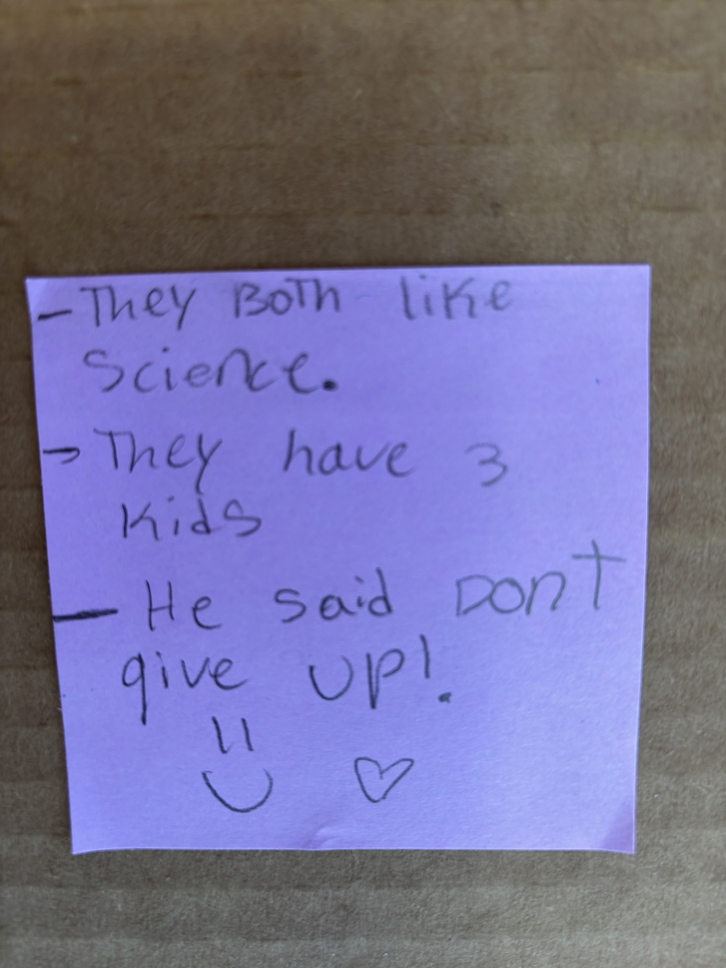
Each student is an individual
Notes:
Just a few days later, we were delighted to receive a beautiful thank-you card from the class and these incredible Post-it notes from each of the students, telling us a bit about what they took away from the hour or so we all spent together.
You can see a few of them there on this slide.
“College lets you explore more careers.”
“You can do anything, just put your mind to it.”
“Don’t give up!”
And perhaps my favorite, “I learned there is no perfect student.”
Thumbing through those purple Post-its, two things really struck me.
First, the young students’ kindness and the way they really listened touched us both.
If you doubt the younger generation, as we adults tend to do and no doubt have for millenia, talking to a few of them will change your mind.
Second, each of those students was part of the same discussion. But each came away with something entirely different and unique to them.
“There is no perfect student,” as the Post-it says -- no one kind of student who goes to college.
Each comes with a personal story, a different lived experience and lens on the world, and we need to meet each of them — and the richness each brings to our university system — where they are.

Slide 4

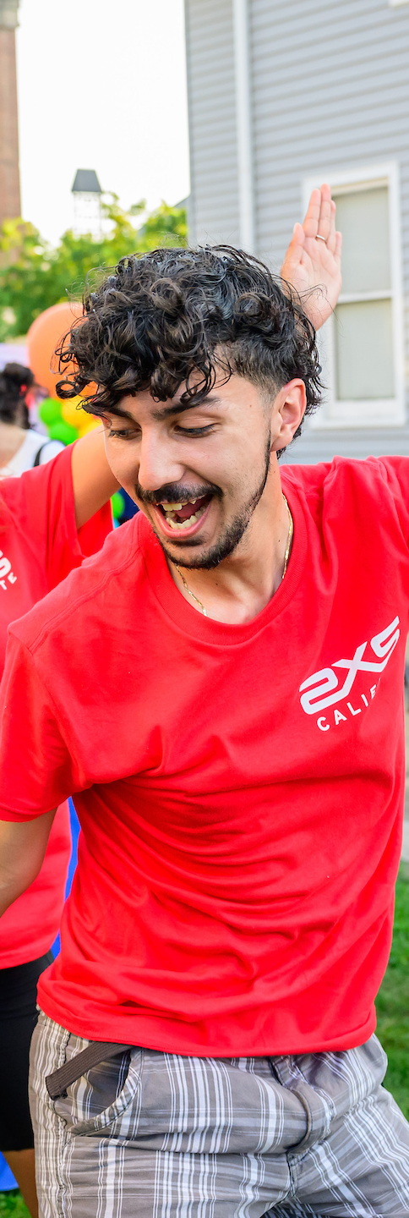
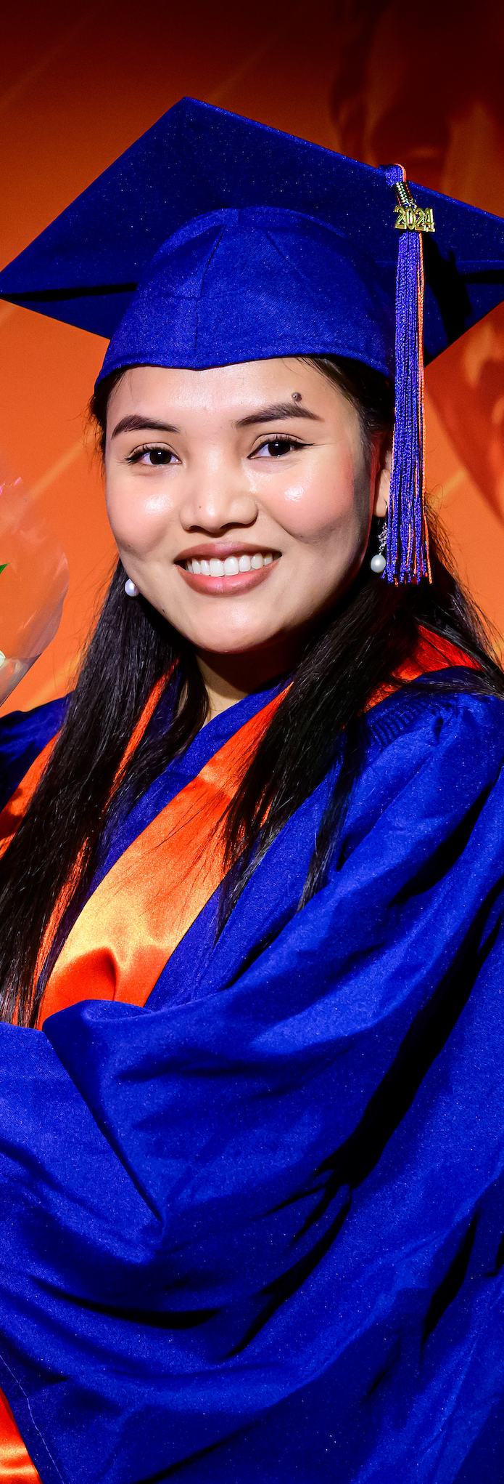
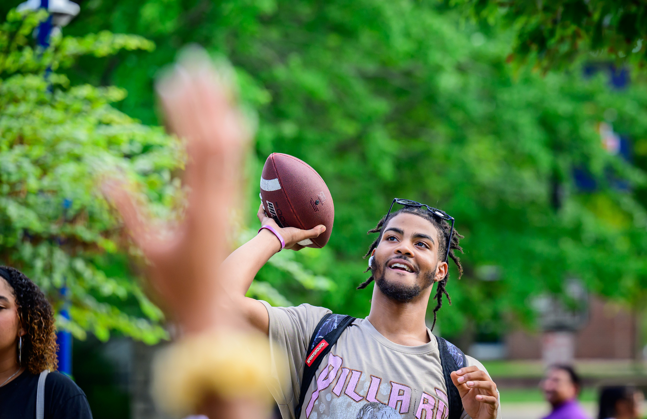
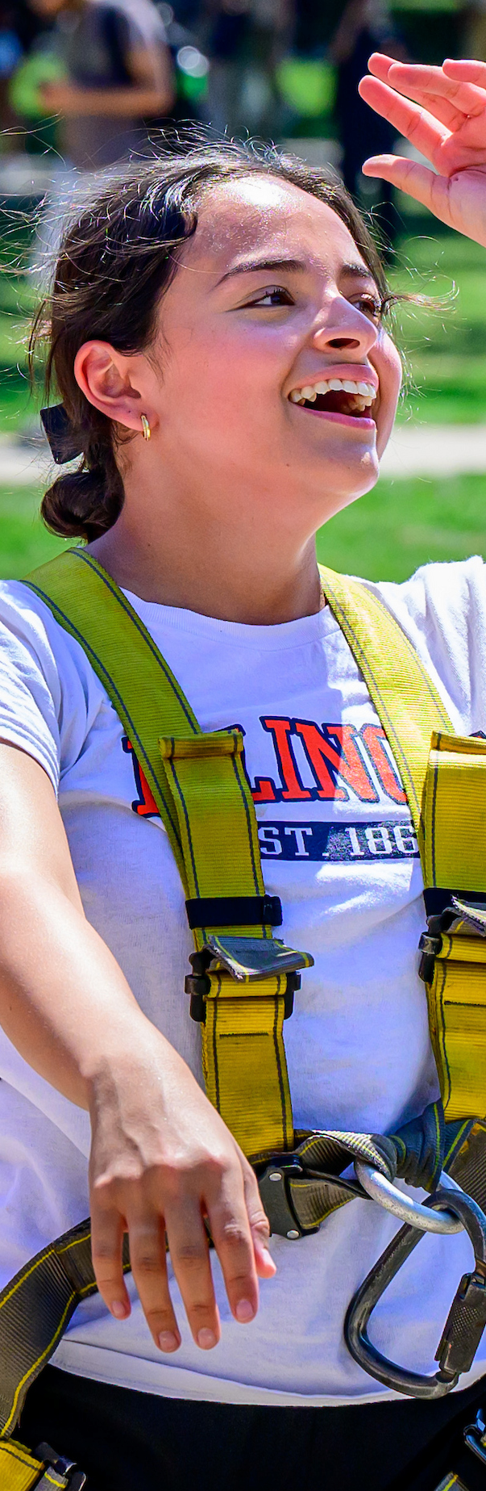
Meet every student where they are
Notes:
This leads me back to the more than 97,700 at students at our universities and all those who will follow them … and our mission to serve them and serve our state — all of it.
I have said this is virtually every room I’ve been in for some time now, but as a public university, operating in part with the investment of the public, we must reflect the people of our state.
Illinois is very urban – Chicago is one of the world’s great cities – and very rural -- Cairo and the county that surrounds it are home to fewer than 5,000 people.
Illinois is home to people of every race and nationality, almost certainly every religious background, a great quilt of cultures that come from every corner of the globe.
Illinoisans are wealthy, middle class and, in some cases, live below the poverty line. They are liberal, conservative and every plot point on the ideological spectrum in between.
Our students come from all these places, all these backgrounds, all these experiences.
That includes prosperous suburban school districts where an array of AP classes is the norm and a degree is the expectation.
But hardworking, ambitious students also come from schools, urban and rural, where students do not enjoy the same access to curriculums that will maximize their talents and prepare them for success.
Every one of our students is a bit different than all the rest, coming to us with their own background, their own set of skills and tools for success.
Our jobs are to ensure we are ensuring that each has what they individually need for success.

Slide 5
Support on our campuses and resources before they reach us
Notes:
So how do we make sure that happens?
Well, if you look around the U of I System, you can see what we ARE doing to give students the tools to succeed and to make sure they know that this is where they belong.
This means providing academic coaching for students who need it in one area or another – math may not be everyone’s strong suit, to name just one possibility.
It means health and wellness services – from mental health programs we’ve really beefed up over the past few years to on-campus health centers to sports and fitness opportunities that help keep mind and body sharp.
It means registered student organizations that we’ve long helped fund and support, some oriented toward future careers and others just for enrichment and fun.
It means the very successful bridge programs we’ve invested in substantially in recent years that provide a wide range of educational, personal, social, and cultural opportunities.
It means living-learning communities based on a wide range of interests and backgrounds.
And don’t forget – supporting our students means providing robust financial aid to make the education we offer accessible to people from every income background.
We also work to reach K-12 students, through tech-based teacher training that happens at the Discovery Partners Institute and our new partnership with the Illinois Virtual Schools & Academy.
Through IVSA, students can be part of an active learning environment that provides daily, real-time support; live instruction; and applied learning options.
It also means a great deal to young students whose day-to-day lives may not point them toward college to be exposed to the possibilities that are open to them.
Through our annual state tour and regular events aimed at meeting students in their high schools, the U of I System is opening those doors on a larger scale here at home.

Slide 6
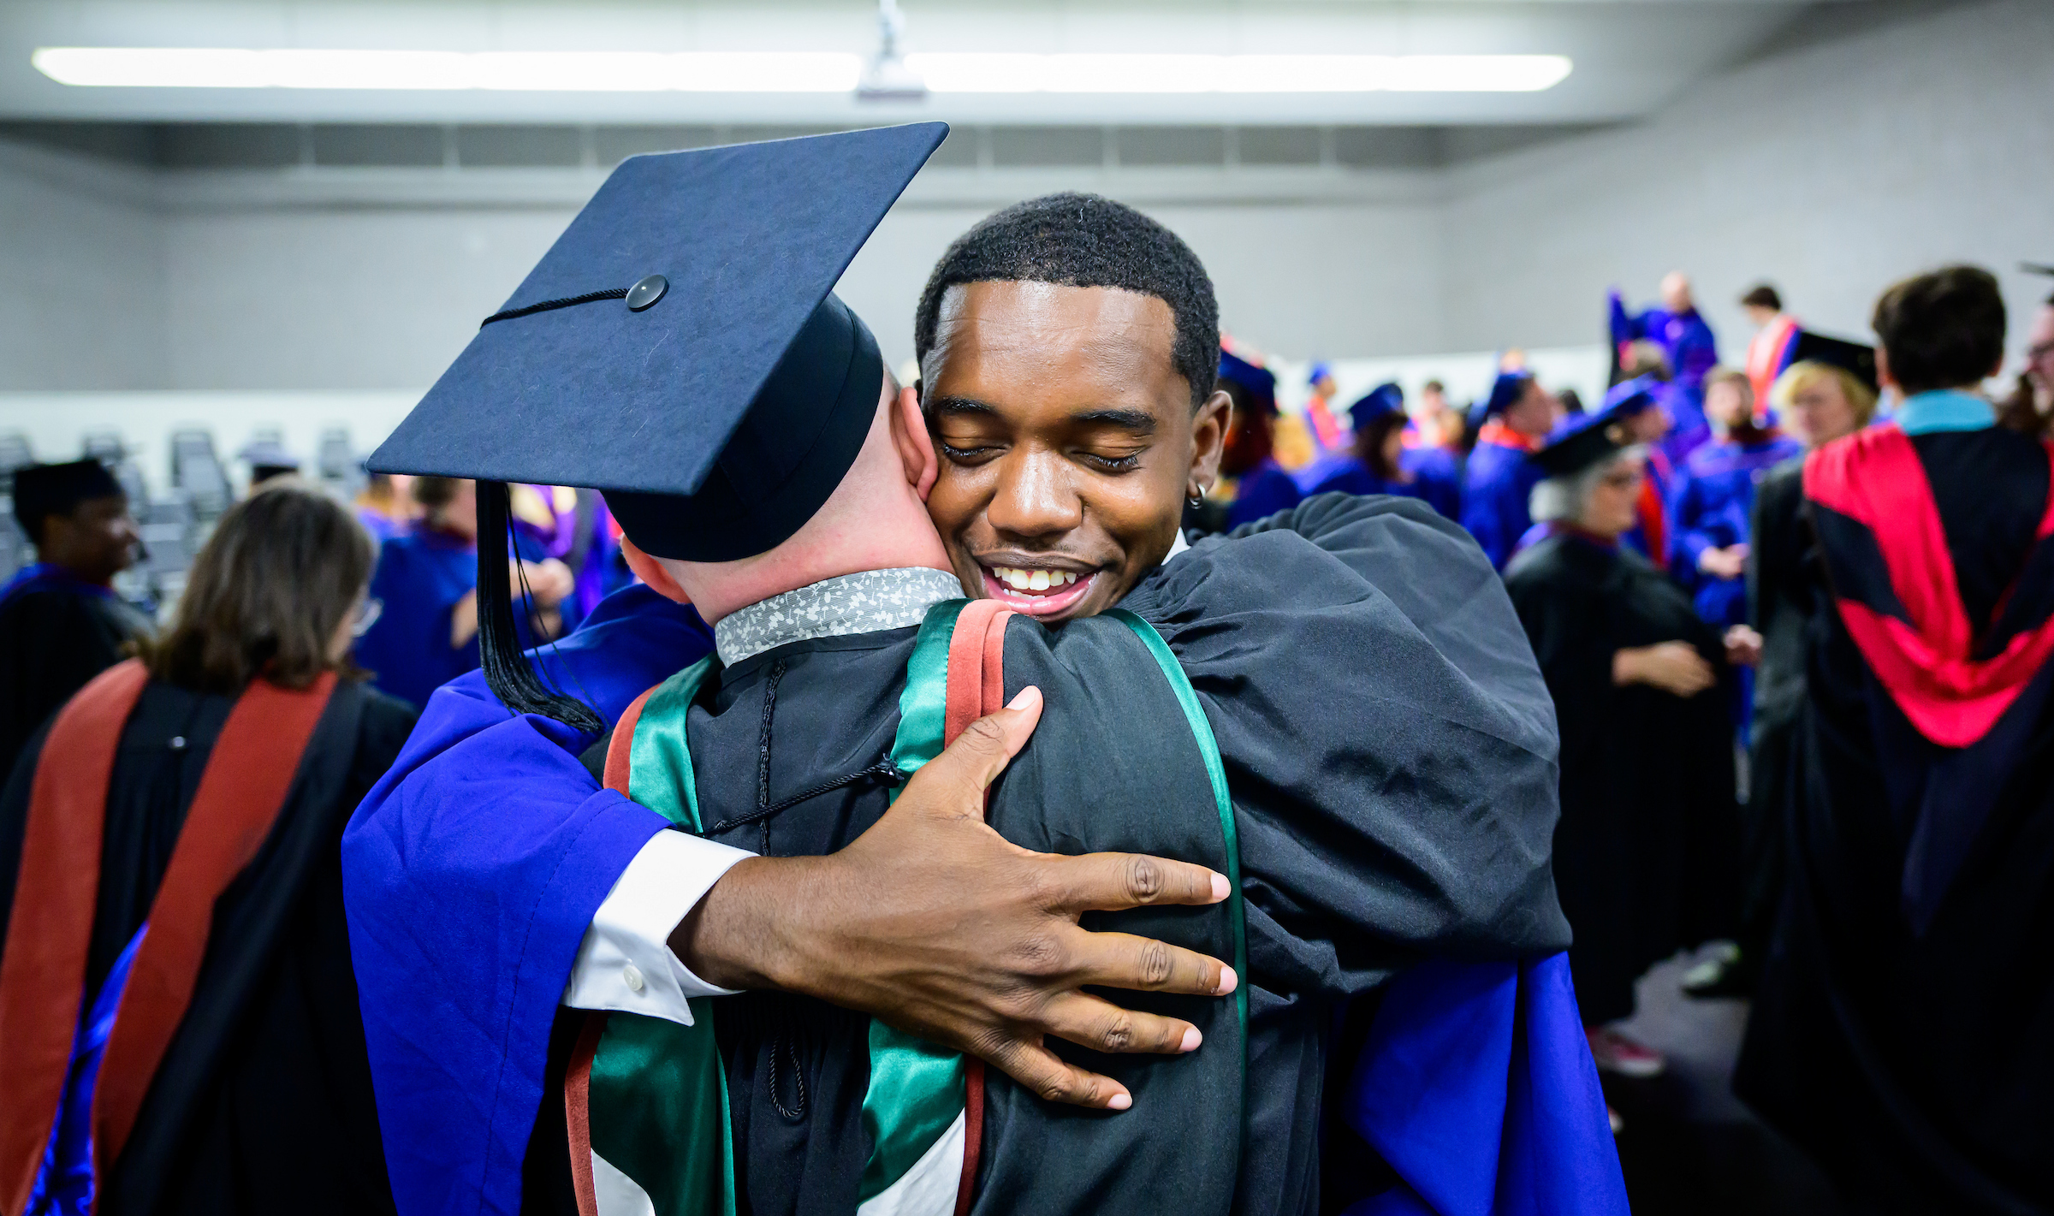
What success looks like
Notes:
And we know these efforts work.
Students who are part of bridge and other academic-support programs stay in college and graduate at higher rates, across the board, than students from similar backgrounds who don’t participate.
Outcomes are the holy grail, and this is how we achieve the best possible outcomes.

Slide 7
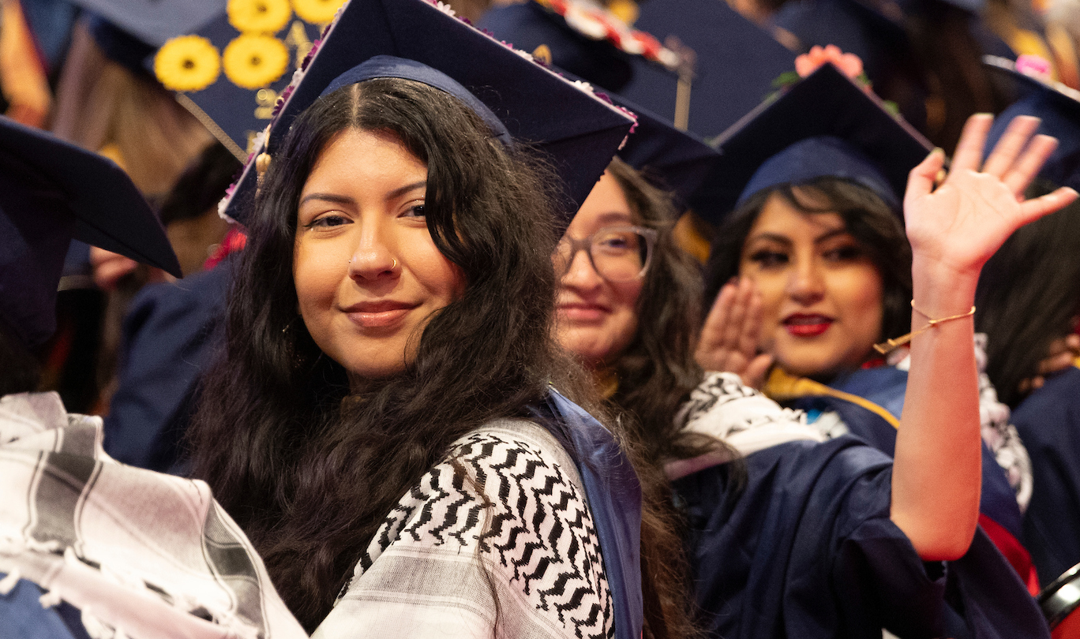
The tools to DO!
Notes:
Just a few days after we met in January, I spoke to an audience at the City Club of Chicago and was fortunate enough to be introduced by Lt. Gov. Juliana Stratton, an Urbana alum and a real U of I System ally.
She said something that stuck with me.
“It’s great to see dreamers that DO.”
Our students all dream, each and every one of them -- and they dream big.
What we provide is fuel for those dreams to drive them forward … and the tools for each of our students, whatever their background, to DO.

Slide 8
Thank You
Notes:
Thank you.

