Slide 1
USC Presentation – Public Engagement in the University of Illinois System: Teaching, Research, and Service
Donald Wink University Senates Conference Member
March 28, 2024

Slide 2
University of Illinois Guiding Principles
“It’s our responsibility, as the Public’s University, to improve quality of life by eliminating barriers to full participation, addressing problems systemically, and finding new avenues for relevance.”
“Just as our faculty and staff bridge spaces between disciplines to produce scholarship with societal value, we aim to produce graduates with the skills, values, and experiences to be truly engaged in their communities.”

Slide 3
Value of Research
“As the humanities center in a major land grant university, HRI is committed to developing and cultivating relationships and partnerships in the local community.”
—UIUC Humanities Research Institute
The Odyssey Project: free University of Illinois Urbana-Champaign courses in the humanities for low-income adults in East Central Illinois.

Slide 4
Value of TEACHING
The ultimate goal of our program is to provide programming, resources, and support for pre-health and health professional students, dedicated to addressing persistent health disparities in minority populations and improving the quality and availability of healthcare in underserved urban areas.
—UIC Urban Health Program
Urban Health Early Outreach Program – a pre-college academic and career awareness pathway program that supports students from populations that are under-represented in the health professions

Slide 5
Value of SERVICE
It is our goal to make service a part of the experience for every UIS community member and by doing so, to develop a commitment to civic and social responsibilities within individual students, faculty and staff as well as UIS as a whole.
—UIS Volunteer and Civic Engagement
The Leadership for Life Service Program: a service and leadership community within Lincoln Residence Hall to provide a positive environment through which students can take the first steps toward a lifelong commitment to community involvement.

Slide 6
EXTENSION AND HEALTH CARE

Slide 7
Engagement ACROSS THE UNIVERSITIES
Meaningful teaching
Support of community knowledge and social progress
Public health; Law and criminal justice; professional development
Translation of knowledge into public settings (innovation, economic development, and civic well-being)
Arts and humanities; Social sciences; Engineering; Health care settings

Slide 8
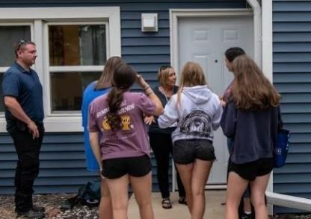
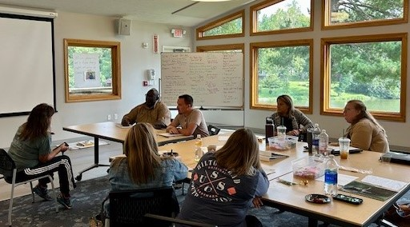
Enriching the classroom
UIS Alliance for Experiential Problem-Based Learning
Child Advocacy Studies (CAST) residential simulation lab
Child Network Child Advocacy Center team in MDT class

Slide 9
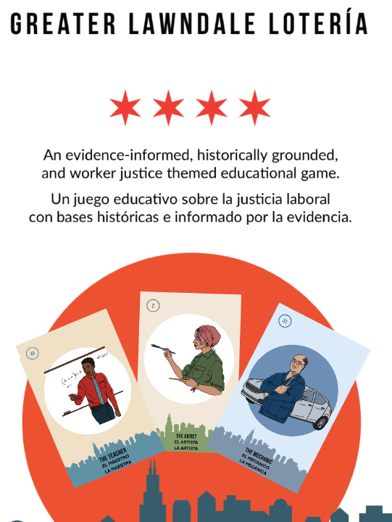
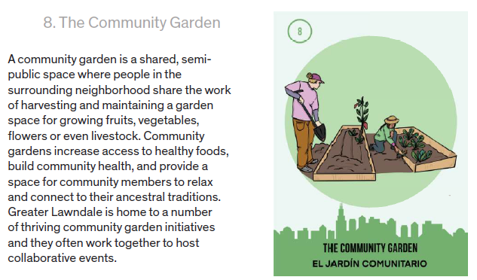
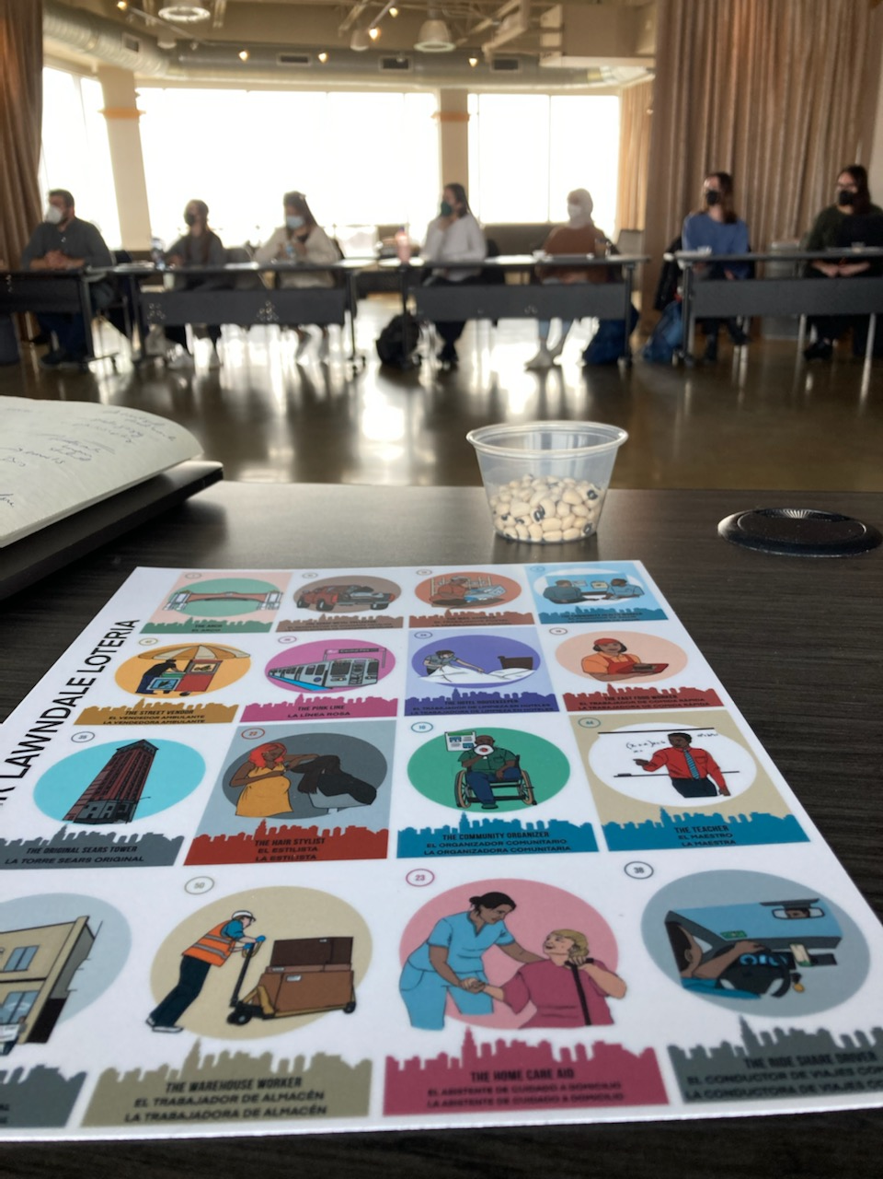
MEETING community needs
UIC Greater Lawndale Healthy Work Project (CDC / NIOSH)

Slide 10
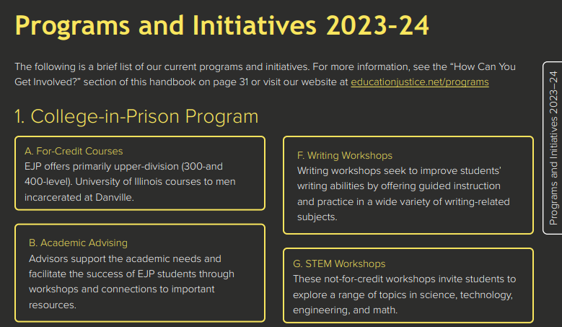
From campus to society
UIUC Education Justice Program

Slide 11
Questions?
Donald Wink
USC Member
Email: dwink@uic.edu
Phone: 312.413.7383
Celest Weuve
USC Chair
Email: cweuv2@uis.edu
Phone: 217.206.8414
David Perryn
Administrative Aide
Email: dperryn@uillinois.edu
Phone: 217.300.7448

