Slide 1
Introduction
REMARKS TO THE BOARD OF TRUSTEES
President Tim Killeen
March 28, 2024
Notes:
Traditional opening slide
Thank you, Chairman Edwards.
At this time, I would like to introduce our treasurer, LESTER H. MCKEEVER, JR., partner at Mitchell-Titus accounting firm in Chicago. He joins us via Zoom.
Also with us:
Chancellor and Vice President ROBERT JONES from Urbana
Chancellor and Vice President MARIE LYNN MIRANDA from Chicago
Chancellor and Vice President JANET GOOCH from Springfield
And the other university officers and staff:
University Counsel SCOTT RICE.
Vice President/Chief Financial Officer and Comptroller, PAUL ELLINGER.
Executive Vice President and Vice President for Academic Affairs NICHOLAS JONES.
Vice President of External Relations and Communications ADRIENNE NAZON.
Vice President for Economic Development and Innovation JAY WALSH.
Secretary of the Board of Trustees and the University JEFFREY STEIN.
Representing the Springfield Senate and the University Senates Conference, CELEST WEUVE, director of the School of Health Sciences; and chair of the Springfield Senate Executive Committee and University Senates Conference.
Representing the academic professional staff, ROBIN VANSACIK (van-SASS-sik), senior academic advisor, Office of Engaged Learning, Springfield.
And, joining us via the livestream and representing the Chicago Senate, SANDRA De GROOTE, professor and head of assessment and scholarly communications and chair of the UIC Senate Executive Committee.

Slide 2

INTERNATIONAL LEADERSHIP:
A PLATFORM FOR LEARNING AND INNOVATION
INTERNATIONAL LEADERSHIP:
A PLATFORM FOR LEARNING AND INNOVATION
Notes:
Developing partners around the globe is one of the University of Illinois System’s key strategic imperatives as we work to serve our students, enhance the excellence and impact of our faculty and, ultimately, drive economic opportunity across Illinois and create conditions in which people -- the citizens our state – can thrive.
At the outset, I want to acknowledge Vice President Jay Walsh’s role in developing the concepts and approaches that I want to discuss in my brief opening.
The world is increasingly interconnected, and increasingly competitive, and the global higher education landscape reflects this.
Our Strategic Framework speaks to this growing global connection and our unique ability to thrive in this environment – the second pillar of the framework calls for us to pursue research and scholarship with global impact.
We also have a long, long history of international impact -- dating back well over a century.
Eugene Davenport, the first dean of the College of Agriculture in Urbana, in the 1890s had a hand in the creation of Brazil’s first school of agriculture.
It’s still there: Escola Superior de Agricultura Luiz de Queiroz, part of the University of São Paulo.
Across the U of I System, we have many modern-day Davenports, innovators whose ideas spur positive change.
Now we are developing a unique international network through which they and their ideas move freely, where exchanges that drive innovation happen every day, and where we can combine our strengths with those of our partners to make the promising a reality.
Working across borders – meeting the world head on -- fosters entrepreneurship, enhances the quality and relevance of education and research, attracts top talent, and increases funding opportunities.
At the University of Illinois System – we MUST serve our state and community by being a global leader – driving an appropriate, essential and generous “intellectual globalization” to serve all of humanity – as well as our country and ourselves!

Slide 3

DPI: A CATALYST
DPI: A CATALYST
Notes:
The Discovery Partners Institute plays a central role in this strategy, a powerful hub that draws people and ideas and connects them to our universities, to Chicago and to Illinois.
DPI is a catalyst.
Many of the partnerships we have developed and continue to work on are based on the power and promise of DPI to connect and to lead on challenging issues that face us here in Illinois.
We share many of these challenges, of course, with those beyond our state – across our country and in other nations.
Climate change; the vital need to foster health and wellness through good nutrition, preventative care and medical advances; the demand for clean and abundant water; and so many more.
All of those challenges are universal and cross borders. Their solutions will be found by working across those borders.
I should add that DPI is powering toward a key milestone: Construction on its new headquarters in Chicago just went out for bid – incredibly exciting news in itself, and something which I’ll say a bit more about later in this meeting.

Slide 4

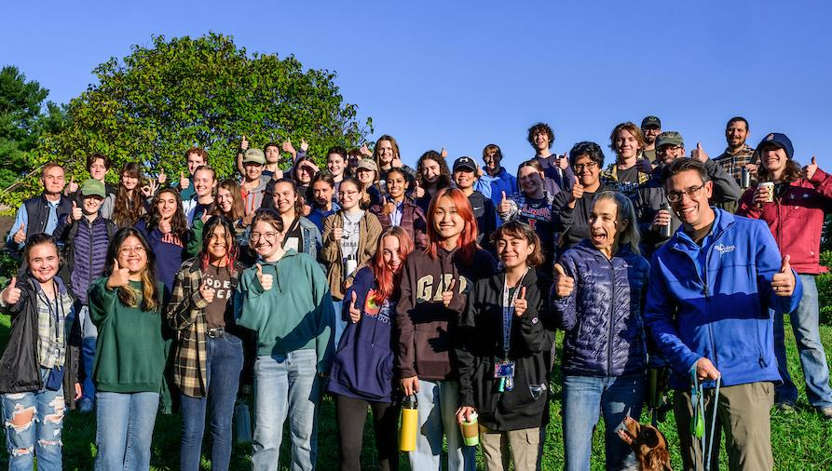

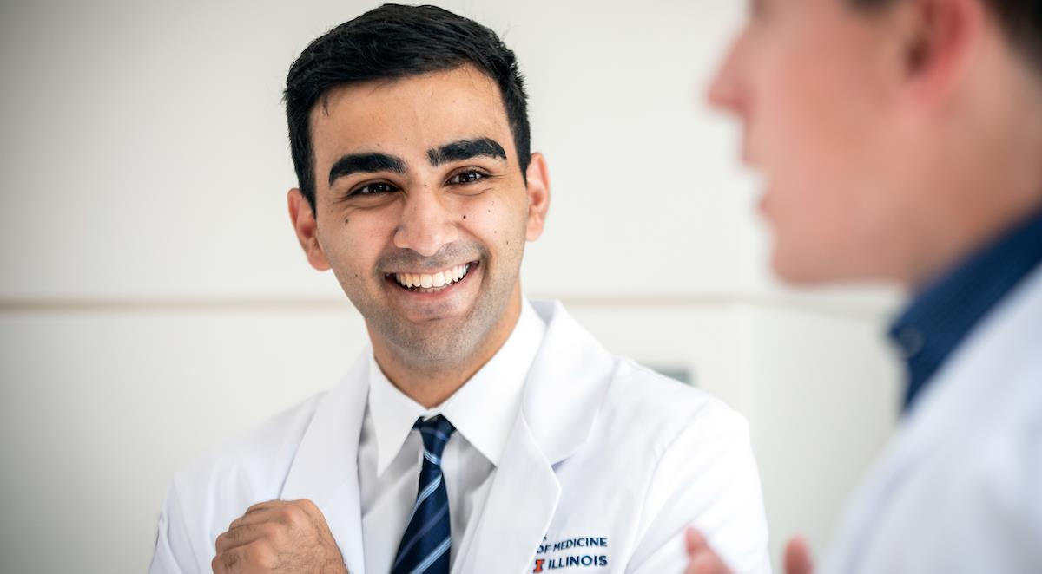

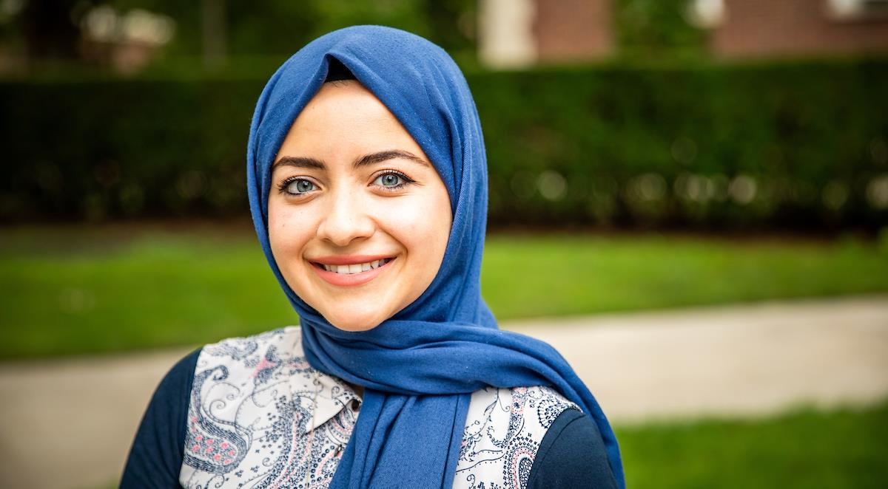


ALL ABOUT PEOPLE
ALL ABOUT PEOPLE
Notes:
We are building this international network with one constituency in mind over all others.
This work must be human-centered, conducted with people and their benefit squarely at the top of our agenda.
That includes our students, our faculty and the people of our state.
It also means relying on the human-centered disciplines -- in the arts, humanities and social sciences -- to shape our perspective on all of the challenges we work to address, but also on the opportunities we create.
The needs of people are and must be at the heart of this.

Slide 5
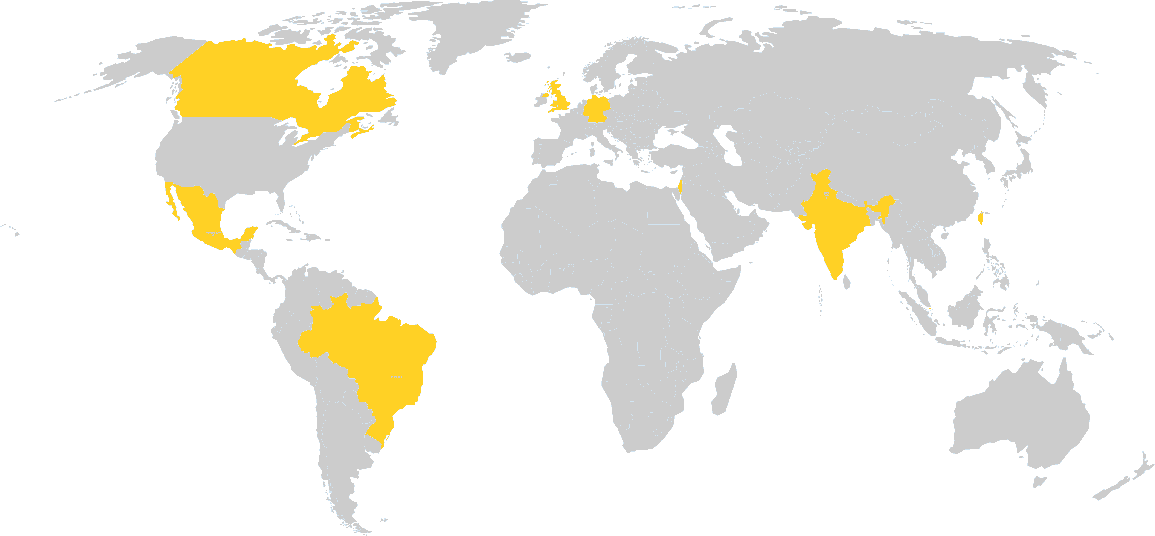
CULTIVATING PARTNERS, OPENING DOORS
CULTIVATING PARTNERS, OPENING DOORS
GERMANY
CANADA
UK
ISRAEL
JORDAN
MEXICO
TAIWAN
INDIA
BRAZIL
SINGAPORE
Notes:
You can see on this map that, from our long-ago efforts in countries such as Brazil and India, we as a university system are building this broad-based system for engagement that links us with institutions around the world -- capable partners and powerhouses in their own right with whom we work to create opportunities for students, faculty and our state … and face the serious challenges I mentioned a moment ago, along with many others.
This includes world-class partners in Canada, Taiwan, Singapore, The U.K., Germany and Mexico, as well as the beginning of our exciting Brasillinois initiative with new partners in South America’s largest and most economically powerful nation.
We are already exploring the potential for even more partnerships in other countries, as well … including locations in East Africa and the Middle East.

Slide 6






KEY AREAS OF EMPHASIS
KEY AREAS OF EMPHASIS
STUDENTS
FACULTY
RESEARCH
RECRUITING EXCELLENCE
ECONOMIC DEVELOPMENT
AMBASSADOR FOR ILLINOIS
Notes:
We’re building our approach around several key areas of emphasis that ground our international strategy in the core missions of the U of I System and reflect many of the priorities laid out by trustees in both the Guiding Principles and Strategic Framework.
These pillars also align with the modern land-grant mission, and ensure we can serve as a portal between Illinois and the world.

Slide 7


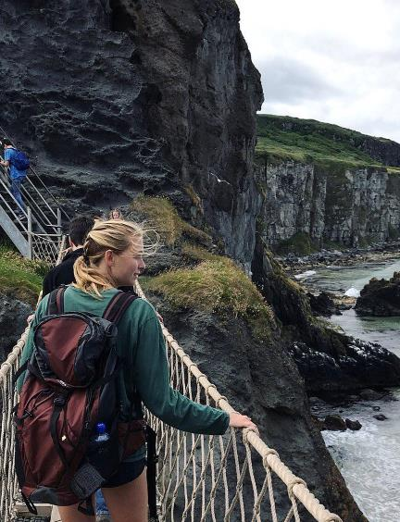
OUR STUDENTS:
GLOBAL OPPORTUNITIES
OUR STUDENTS:
GLOBAL OPPORTUNITIES
Notes:
First, in all of our partnerships we seek opportunities and advantages for our students.
International engagement provides those opportunities in a wide variety of ways.
As will soon happen with some of our newest partnerships in Mexico and Brazil, our students have more opportunities to study abroad.
They will learn more about the wider world firsthand and bring back both ideas and a deeper understanding of how to work together across national and cultural lines – invaluable skills to use in the workforce and in their lives as citizens.
And, of course, students come in the other direction, as well, broadening their own experience while adding to the cultural landscape and experience our students in Urbana-Champaign, Chicago and here in Springfield experience.
Through Brasillinois, for instance, the Brazilian Ministry of Education will send more than 100 Brazilian undergraduates and doctoral students to our three universities over the next few years.

Slide 8
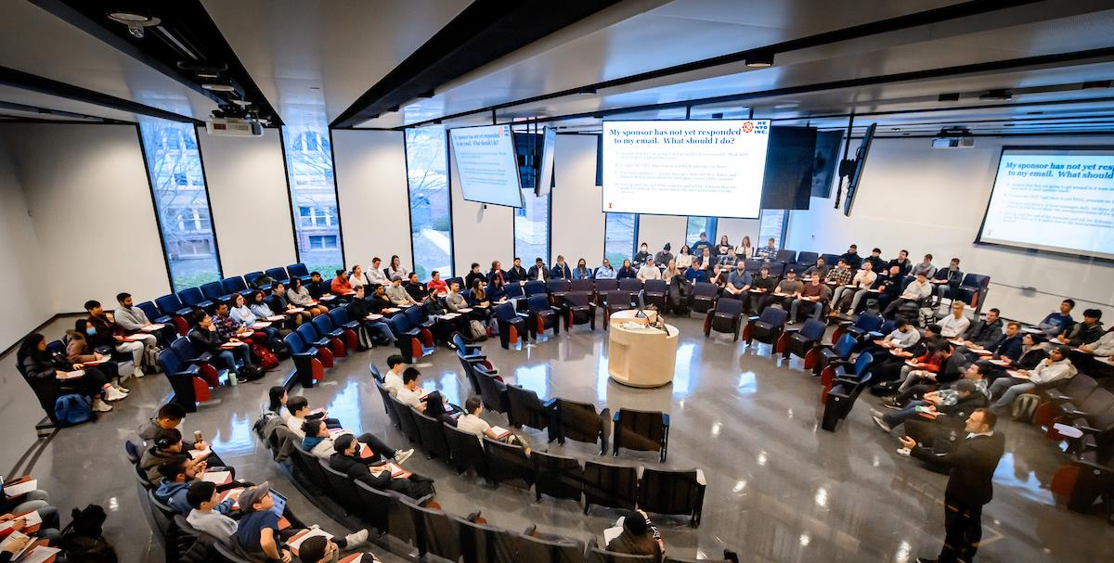
OUR FACULTY: EXCHANGE AND INNOVATION
OUR FACULTY:
EXCHANGE AND INNOVATION
Notes:
When we meet with potential partners from abroad, our faculty – the lifeblood of our universities – are right up there with our students as a top priority.
Faculty exchange and the opportunity to collaborate with colleagues abroad are primary features of virtually every partnership we create.
Our faculty are an incredible asset -- a spring of innovative expertise like very few other institutions in the country can offer, operating at a scale so few can match.
Paired with peers from around the world, their impact is multiplied.
Just last month, we awarded the first grants in a joint program for both travel and research launched last fall, a five-year commitment from the U of I System and Cardiff University.
Those first grants focus on a wide range of projects, many of them focused on health, transportation and sustainability.
They include a holistic mental health-assessment app and a study of resilient informal urban economies.

Slide 9

BREAKTHROUGH RESEARCH BUILDING ON A HISTORY OF INNOVATION
BREAKTHROUGH RESEARCH
BUILDING ON A HISTORY OF INNOVATION
Notes:
Our research, like that being funded with Cardiff and so much more, is a major calling card for us around the world. The U of I System is known as a leader in research discovery in engineering, technology, agriculture, and the humanities.
When your research has given the world the LED, the web browser, the successful HIV/AIDS treatment Prezista, home air conditioning and so much more, people know … and they want to work with you.
Teaming up with partners beyond our borders provides opportunities to address the challenges alluded to earlier that aren’t confined to any single state or country.
Two of our collaborations that are front and center right now illustrate this opportunity.
One, which I mentioned earlier, is the new Brasillinois initiative. We’ll formally kick this off in early April with a research networking event with the São Paulo Research Foundation, knows as FAPESP, at DPI.
Brasillinois will bring together researchers in health and medicine, sustainable cities, smart agriculture, climate, bioenergy, and the consolidation of democratic institutions to work on multidisciplinary research.
Another example is the Global Center for Clean Energy and Equitable Transportation Solutions, or CLEETS.
Using funding from our National Science Foundation, DPI is working with the University of Birmingham to power multidisciplinary research focused on reducing carbon emissions in road transportation.
CLEETS was announced last fall and the first research has just been published, identifying cybersecurity shortcomings connected to consumer EV charging stations.

Slide 10
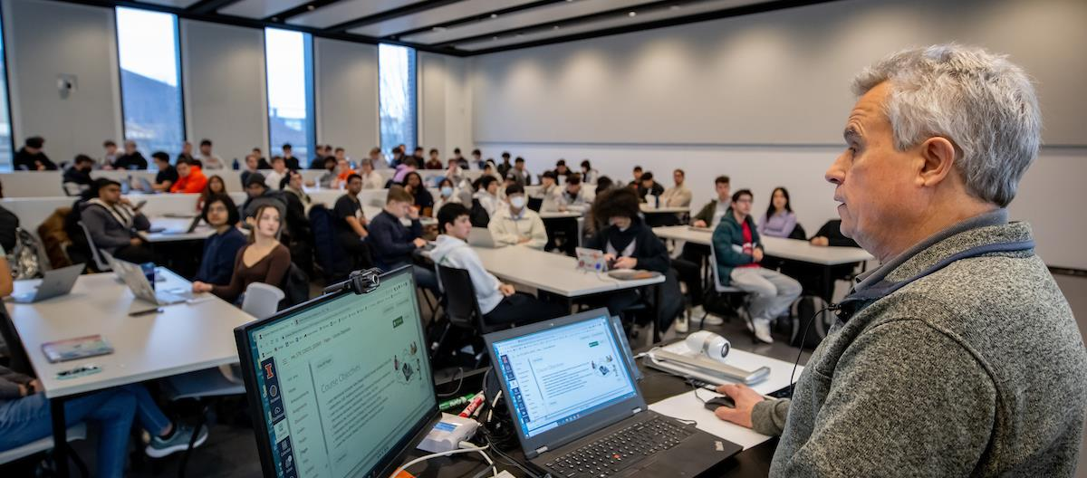
ATTRACTING TALENT
ATTRACTING TALENT
Notes:
International engagement includes bringing the best and brightest to Illinois – admitting brilliant students from abroad, many of whom will choose to make Illinois their home.
Right now, 17,780 international students are enrolled at our universities, almost 11,000 of whom are graduate students.
As I’ve noted before, 80 percent of our undergraduates come from Illinois, and these students from abroad enrich their experiences by bringing along pieces of their own culture, languages and perspectives.

Slide 11

ECONOMIC DEVELOPMENT
AN ASSET FOR ILLINOIS
ECONOMIC DEVELOPMENT
AN ASSET FOR ILLINOIS
Notes:
The U of I System is a key driver of Illinois’ economy, something we have talked more about with state leaders and the public in recent years.
We are a real asset for Illinois … and want to make sure people are aware of just how important that is.
Our international partnerships are built with sustainable economic development in mind.
Our trip last year to Taiwan led to fruitful talks with Taiwanese semiconductor manufacturers that are still ongoing, including more discussions this month about workforce development and microelectronics.
And last June, after a trip to Singapore, National University of Singapore and DPI announced a partnership that will bring two NUS programs to Chicago.
One is an NUS global entrepreneurship program that has seen its students launch almost 1,000 startups.
NUS also plans to establish a startup incubator, BLOCK71, in Chicago, its second U.S. location after San Francisco.

Slide 12

AN AMBASSADOR FOR ILLINOIS
AN AMBASSADOR FOR ILLINOIS
Notes:
When we seek to connect with universities and other partners around the world, we also go as ambassadors for our state and the people who live here.
Our reputation for excellence is widely known, and our research and our ability to educate are appreciated around the world.
Through our ability to provide ideas and expertise to those who might want to do business both with and in Illinois, we serve as an asset to the state’s efforts to attract businesses and export goods and services.
I was honored last summer to be a part of a trade mission to the United Kingdom led by Gov. Pritzker, including a meeting with the head of a collective of 140 U.K. universities regarding increased mobility for researchers and students.
In every exchange we have overseas, we highlight the economic advantages we have here in Illinois:
A world-class university system, for starters.
Add in a great city that is a destination for the world, a commercial transportation hub and the economic capital of a vibrant region.

Slide 13

INDIA: EXPLORING OPPORTUNITIES
INDIA:
EXPLORING OPPORTUNITIES
Notes:
Now, after an energizing trip in February, we are exploring potential partnerships with Indian peers.
A U of I System delegation traveled to Bombay, Delhi and Bangalore, meeting with colleagues from a number of Indian universities, as well as Indian alumni.
Chairman Edwards and Anne Edwards joined us for what was an eight-day whirlwind, and I want to thank them both for being part of our delegation.
Our longstanding relationship with India has seen more than 50,000 Indian students enroll in our universities just since 2000 -- and many of the country’s most innovative thinkers have become key members of our faculty.
We also have our system office now in New Delhi.
The trip was a beginning – a chance to see where our interests might align.
I’m happy to report that the Indian Institute of Technology Bombay already wants to become a new DPI partner.
IIT Bombay is one of India’s leading research universities, and
We’ll talk more about this exciting new connection in the months ahead.

Slide 14
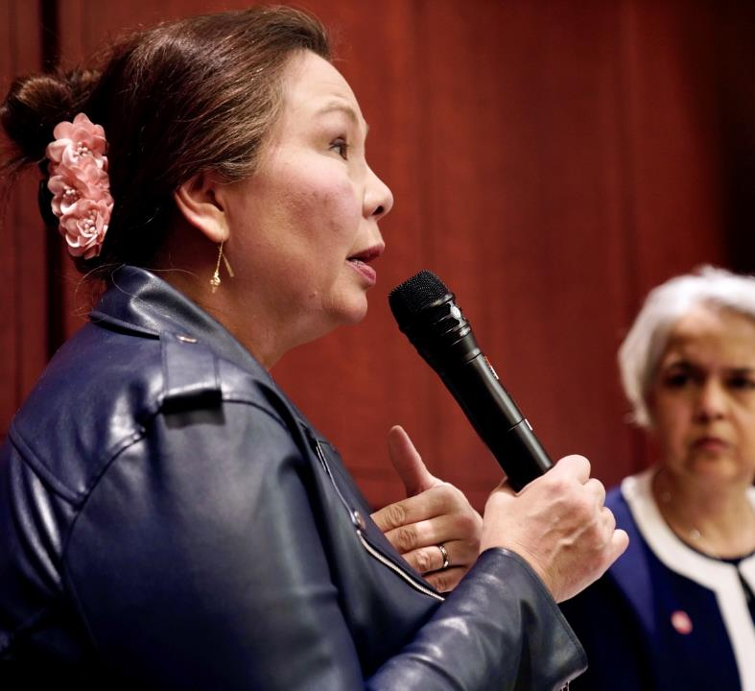
SEN. DUCKWORTH
“Higher education is a hidden strength of American economic power. Their efforts to engage internationally help develop strong affinity for the U.S. and grow our global competitiveness, both of which have economic returns.”
— Senator Tammy Duckworth
Notes:
Last week a number of system leaders were in Washington, D.C., where we met with members of the state Department and Sen. Tammy Duckworth.
When we discussed our international strategy, their responses were absolutely music to my ears.
According to Sen. Duckworth, “Higher education is a hidden strength of American economic power. Their efforts to engage internationally help develop strong affinity for the U.S. and grow our global competitiveness, both of which have economic returns.”

Slide 15
State Department
“The themes and geographies that are part of your
strategy match up well with our priorities.”
— Dr. Seth Center
Deputy Envoy for Critical
and Emerging Technology
U.S. Department of State
Notes:
Seth Center is the State Department’s deputy envoy for critical and emerging technology.
You can see his quote in the presentation, as well – in fact, I think he actually even said our themes align perfectly with his agency’s priorities.
This was a stronger endorsement of our strategy and its benefits than I would have even hoped for.

Slide 16

Thank you
Thank you
Notes:
I referred earlier to the Strategic Framework, and I’ll close by quoting our Guiding Principles and the compass they provide.
“We embrace our role as educators who promote the value of global encounter and exchange – not just for the sake of the academic enterprise, but for the future of our local and regional communities as well.”
Chairman Edwards, trustees: Thank you.

