Slide 1
USC Statement on Campus Debates: Challenging Conversations in Challenging Times
Nicholas C. Burbules University Senates Conference
May 16, 2024

Slide 2
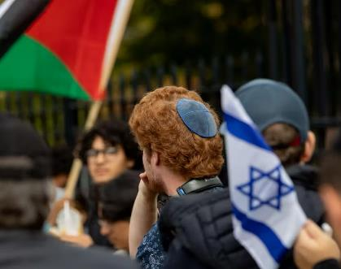
The Growing Conflict on Campus
The rising tensions of campus debates
Balancing academic freedom and free speech with a commitment to inclusion
How code words and phrases interfere with communication

Slide 3
Some principles
Free speech is not unlimited
Respect and concern for all in the community
Our mission as an educational and knowledge-producing institution
The special responsibilities of faculty

Slide 4
Questions?
Nicholas C. Burbules
USC Executive Committee
Email: burbules@illinois.edu
Phone: 217.244.0919
Celest Weuve
USC Chair
Email: cweuv2@uis.edu
Phone: 217.206.8414
David Perryn
Administrative Aide
Email: dperryn@uillinois.edu
Phone: 217.300.7448

