Slide 1
Introduction
REMARKS TO THE BOARD OF TRUSTEES
President Tim Killeen
May 16, 2024
Notes:
Thank you, Chairman Edwards.
At this time, I would like to introduce our chancellors:
From Urbana, Chancellor and Vice President ROBERT JONES;
From Chicago, Chancellor and Vice President MARIE LYNN MIRANDA from Chicago;
And from Springfield, Chancellor and Vice President JANET GOOCH from Springfield.
And the Other University Officers and Staff:
University Counsel SCOTT RICE;
Vice President/Chief Financial Officer and Comptroller PAUL ELLINGER;
Executive Vice President and Vice President for Academic Affairs NICHOLAS JONES;
Vice President for Economic Development and Innovation JAY WALSH;
Secretary of the Board of Trustees and the University JEFFREY STEIN.
Representing the University Senates Conference, JOYCE TOLLIVER, director, Program in Translation and Interpretation Studies, and associate professor in Spanish, Urbana.
Representing the University of Illinois Urbana-Champaign Senate, JAMES QUISENBERRY (KWIZ-in-behr-ee), executive director of Student Affairs Technology.
Representing the University of Illinois Chicago Senate, CATALIN BUHIMSCHI (bu-HIM-ski), head, Department of OBGYN, UIC College of Medicine, and professor of obstetrics and gynecology.
Also with us is SANDRA De GROOTE, professor and head of assessment and scholarly communications, and chair of the UIC Senate Executive Committee.
Also joining us via the livestream:
Representing the University of Illinois Springfield Senate, LYNN FISHER, chair, Department of Sociology and Anthropology, professor of anthropology, and newly elected chair of the UIS Senate.
And representing the academic professional staff: LISA MERRIFIELD, Illinois Extension community and economic development specialist, Urbana.

Slide 2
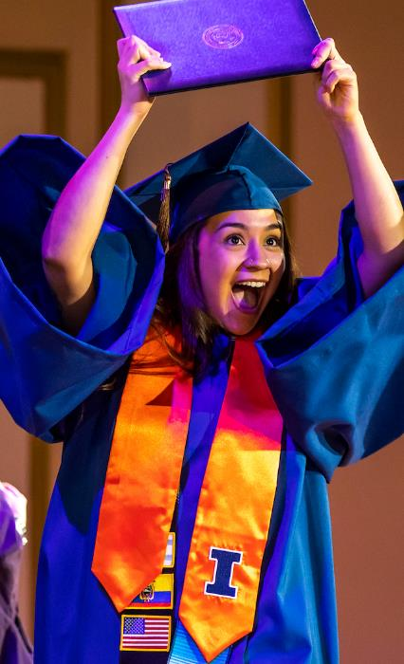
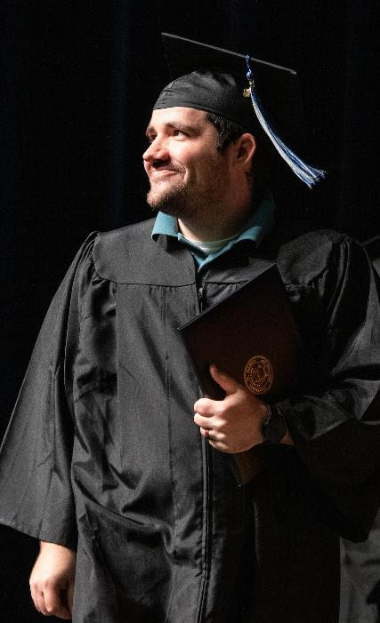
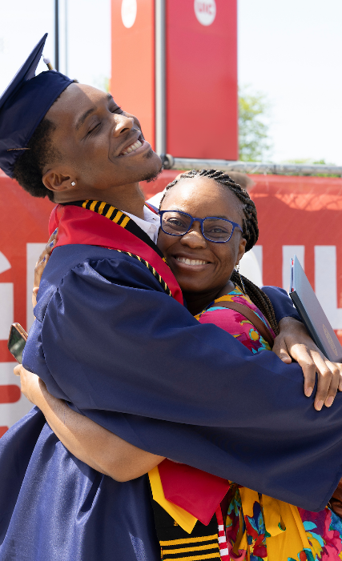
Recent commencements
Notes:
I would encourage everyone here in the room to watch this presentation on the large screens around us for maximum impact – our impact as a world-class university system.
If you know me, you know that commencement is a season of joy like no other.
Even during a period, like the one we’re living in, of real tension on campuses around the country when so many of our students, their families, our alumni, faculty and staff are understandably anxious or hurting, commencement remains a cause for celebration.
The smiles, the sense of accomplishment, the pride – and the relief. It’s all just incredible, as so many of us experienced over the past few weeks.
But it’s important to consider what happened on the way to that big day, and how it impacts what happens next.
This season and its happy outcomes – more than 22,000 of them this spring at our three universities -- are among the best arguments for the value of public higher education.
As you likely have heard, read, or been told recently, American faith in higher education is not what it used to be.
You do not have to go far to find a headline telling you just that. Google “value of college education” and you can quickly see for yourself.
We know the value is real and abundant – and that’s particularly true across the U of I System.
Students and families vote with their feet and our applications every year and our growing enrollment show us that they continue to choose us, and for good reason.
But it is up to us and all of higher ed to make our case.
Those arguments often begin with the economic fact that, whatever doubts some may have, people with college degrees generally earn more throughout their lives.
The news site Axios last month, under what the writer smartly called a “Reality Check,” used Federal Reserve data to make that point: Recent college graduates’ median annual earnings were $60,000 a year while someone at the same stage in life with only a high school diploma could expect to earn $36,000.
And a sizable gap remains over the course of a lifetime. That’s indisputable, and a fact worth pointing out.
But jobs and better earnings are hardly the only outcome worth celebrating.
I’ll return to that, but first I’ll let three recent U of I System graduates tell you in their own words.
If you’re a Cubs fan, you may already know Jeremiah Paprocki’s voice. He’s the public address announcer at Wrigley Field.
He debuted at 21 – yes, 21 years old – as the Cubs’ first Black PA announcer and he is a proud graduate of UIC, with a BA in communications. He used his experience as an announcer at UIC and host of a student talk show to get where he is today.
Cherish Recera graduated from Urbana-Champaign with bachelor’s degrees in both English and community health and now works for Abbott as a social media community manager.
And Miguel Valente is a two-time graduate of UIS – he has both a bachelor’s degree in political science and master’s in public policy.
He now works as a fiscal officer for the City of Springfield’s Office of Budget & Management. He’s also a member of the Illinois National Guard.

Slide 3
Video featuring recent graduates
Notes:
VIDEO PLAYS HERE
(IF YOUTUBE SCREEN IS VISIBLE AT THE END OF THE VIDEO:) Reminders of our value and impact are all around us, by the way – that video is playing from YouTube, co-founded, of course, by Urbana alumnus Jawed Karim.

Slide 4
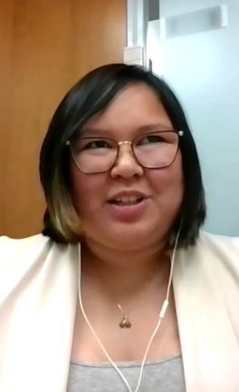
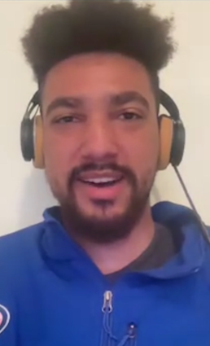
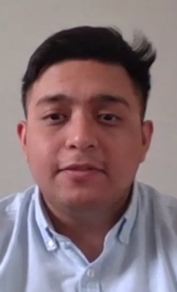
Featured graduates cont’d.
Notes:
It fills me with immense pride to hear what this education means in their own lives and beyond -- – and what these young graduates learned.
Cherish, as you heard, is a first-generation American and first-generation college graduate. It may be a cliché, but I can’t imagine a better example of living your best life.
Jeremiah is literally the voice of the North Side, but he also has a job with the Chicago Bulls and recently kicked off his own YouTube talk show along the lines of the one he started with the help of a staff member at UIC.
And Miguel had no sense that he might start and build a life somewhere other than his native Chicago – until a tour of UIS helped opened a door he didn’t realize was there.

Slide 5
GRADUATE OUTCOMES:
How many students have jobs or graduate-school destinations 6 months after graduating?
GRADUATE OUTCOMES:
How many students have jobs or graduate-school destinations 6 months after graduating?
91%
98%
83%
69% STAY IN ILLINOIS
84% STAY IN ILLINOIS
64% STAY IN ILLINOIS
Notes:
Before I go on, let me say that, without doubt, the education that students receive at U of I System universities is well worth it in economic terms.
You can see it on this slide – six months after graduation virtually all of our graduates have either a job they worked toward or a graduate-school destination.

Slide 6
GRADUATE EARNINGS:
What is the average starting salary for new graduates?
GRADUATE EARNINGS:
What is the average starting salary for new graduates?
$75,847
$69,485
$58,790
Notes:
And the average starting salaries for our graduates are very strong as well, as indicated here.
A career and what it provides financially is, without a doubt, important.
Work is the thing we all may well spend more of our adult lives on than anything else.
The foundation of a prosperous, healthy society is people with stable financial lives – a roof over their heads, the financial wherewithal to feed and care for themselves and their families, money to save and invest.

Slide 7
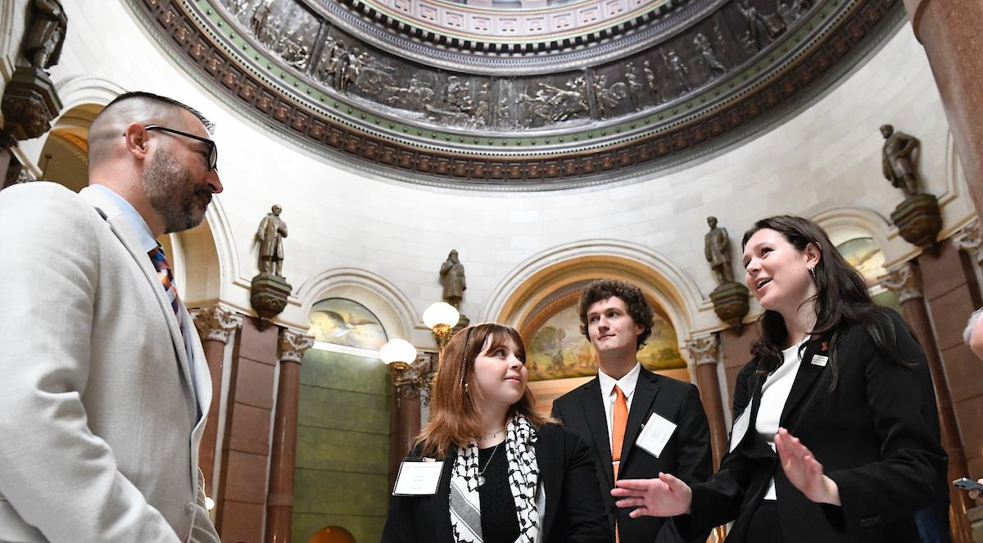
MORE THAN A PASSPORT TO A JOB
MORE THAN A PASSPORT TO A JOB
Notes:
But here I’m going to borrow on a theme I spoke about at commencement ceremonies in Chicago, Urbana and Springfield.
If we in higher education do our jobs – and across the U of I System I believe we do -- a college education is much more than a passport to economic opportunity.
This world-class education carries with it a duty, I believe, to serve as a force for good in their communities and beyond.
How do our graduates do that?
By taking all that they know – and by that I mean the full spectrum of their education, what they learn everywhere from classrooms and the quad to their dorm rooms, student groups, and the people around them at all times from every ethnic, social, religious and regional background – and use it to lead strong CIVIC lives.
Let’s face it: Just by being here, we all have an impact. The trick is choosing what kind of impact you have, and that’s a choice a college education helps prepare you to make.

Slide 8
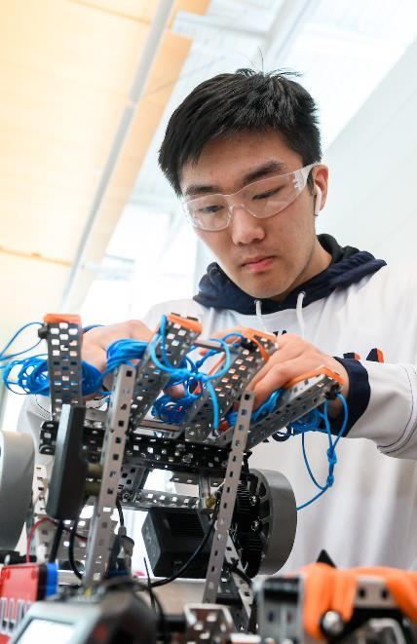
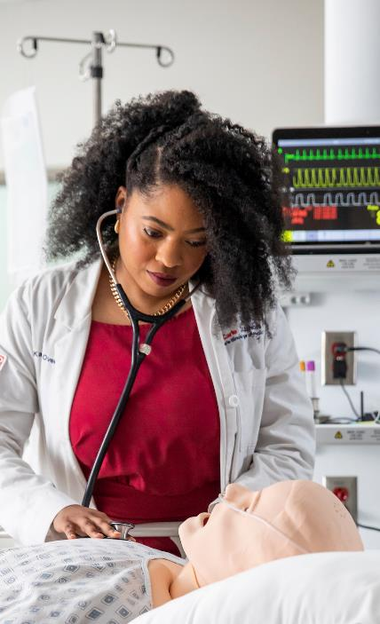
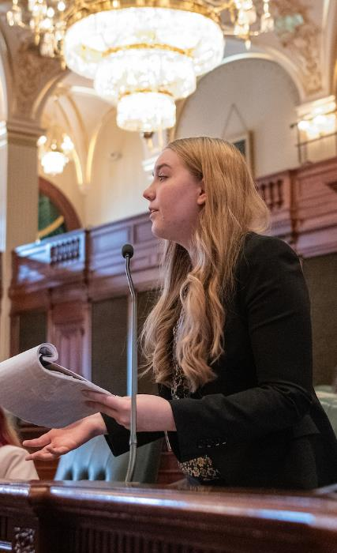
PROBLEM SOLVERS
PROBLEM SOLVERS
Notes:
The spirit of higher education done right is so much more than fact-based rote learning, as we know.
It’s grappling with ideas, learning to speak your mind while allowing others to do so, too – and to really hear them, whether you agree or not.
Wrapped up in this spirit is a sense of purpose, to take on the challenges we all face, to live up to what is really an obligation to be problem solvers, to seek solutions.
We need this connected spirit to take on the challenges we share – how to feed the world amid a changing climate; the human right to breathe clean air and drink clean water; the need to bridge the divide in public life to live as a society; the need for economic opportunity that leaves no one behind.
Each of us with the ability – and a responsibility -- to make a positive impact far beyond what we can physically reach.

Slide 9
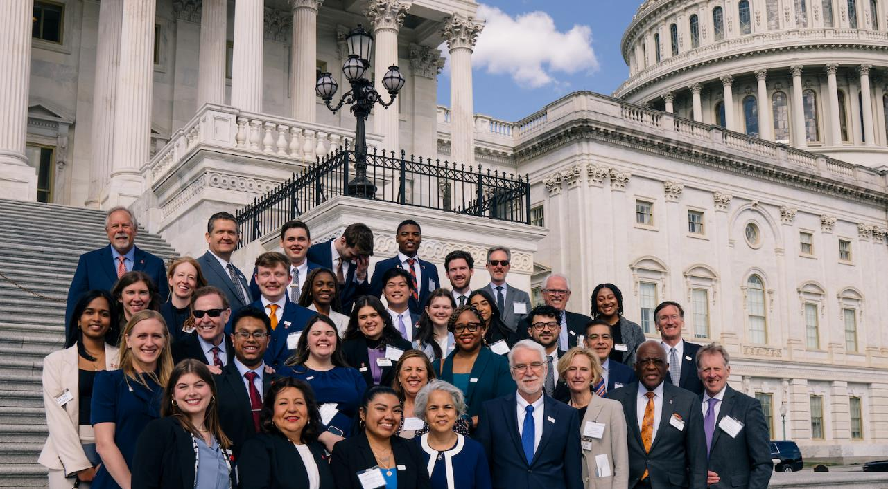
SKILLS FOR A CIVIC LIFE
SKILLS FOR A CIVIC LIFE
Notes:
Living a strong civic life also means being an active, informed participant in the public arena.
It means informing ourselves in ways learned through this education – sifting through the vast amounts of information that flow our way every day and deciding what matters and ultimately what’s accurate, what is true.
To be engaged, to cast a vote that has the positive impact you desire – and just to live your life well – you need to be well-informed in a wide range of ways.
A good education develops a degree of media literacy and societal literacy that serves that need.

Slide 10
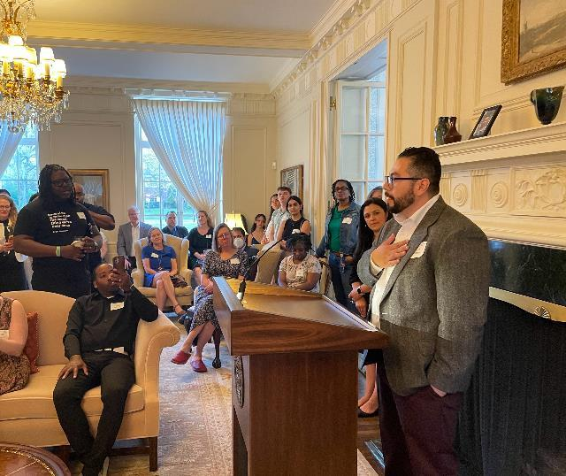
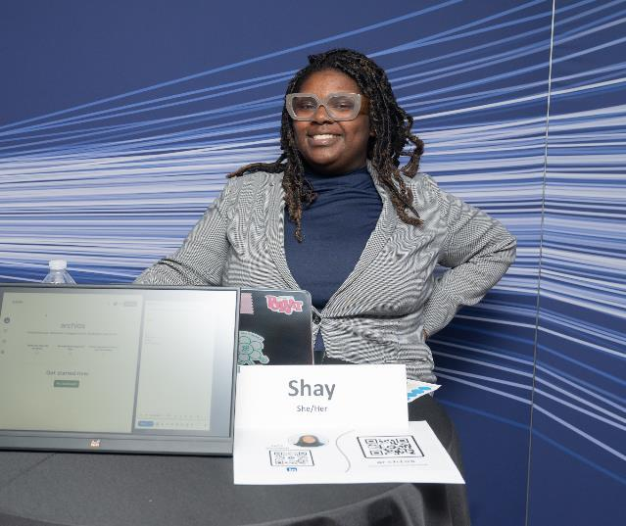
ACCESS: FAR BEYOND OUR CAMPUSES
ACCESS:
FAR BEYOND OUR CAMPUSES
Notes:
There are other pathways to life-changing credentials and in this season we celebrate those, too.
At the Discovery Partners Institute in Chicago, the FIFTH cohort of DPI’s software development apprenticeship program graduated in April.
This fifth group to work their way through the program is 28-strong, half of them women all from a wide variety of professional backgrounds.
Over the life of the programs DPI has now given teachers, musicians, photographers, restaurateurs and so many others the ability to write and deploy web-based applications, and soft skills they’ll use to build new careers.
In April we also marked the 15th anniversary of Urbana-Champaign’s Education Justice Project – EJP is a college-in-prison program led by the UIUC College of Education.
In any given semester, EJP has about 70 incarcerated students.
Angel Pantoja, who you can see here at the anniversary celebration at the President’s House, is an alumnus.
Without the EJP, he said, “I never would have had that creative spark to think that I could be more than what I was.”
Today he is Illinois Lt. Governor Juliana Stratton’s reentry policy coordinator, working to write more success stories – like his.

Slide 11
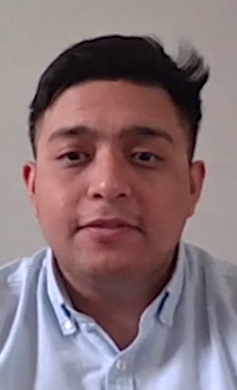
Featured graduates wrap-up
Notes:
I’d like to come back to our three recent U of I System graduates – with a reminder of just some of the ways the education of each is impacting lives beyond their own.
Cherish told us she shared her experience and her love for UIUC with her younger brother, who is now a student at Urbana-Champaign.
Jeremiah – Cubs and Bulls and a Chicago talk show – he’s touching an entire city, and I’d wager you’ll be hearing more from him.
And Miguel. UIS nurtured what I suspect was already in him -- a deep, heartfelt desire to serve. His education opened that door to a life in a new town where he’s doing just that, making a difference.

Slide 12
The scale of our graduation
Notes:
So how do we measure the value of a college education? Simple math provides one answer.
Multiply the kind of difference it’s making for people like Jeremiah, Cherish and Miguel and those around them by the 22,000-plus graduates who leave our universities every year -- and then add the countless others who journey with us to embrace new paths and opportunities.
That is the true value of higher education.

Slide 13
Thank you
Thank you
Notes:
Thank you.

