Slide 1
A Day in the life is a week in the Life
University Senates Conference Academic Affairs and Research Sub-Committee
“A Day in the Life is a Week in the Life” -Balancing the multi-faceted responsibilities of faculty
Presentation to the Board of Trustees May 18, 2023

Slide 2
Faculty: Job Responsibilities
WEAVING ELEMENTS
Community outreach/extension
DEI work
Entrepreneurship/tech transfer
Garnering funding/grantsmanship
Network development and maintenance
Time Commitments are Different for Each Function across the Three Universities
2
Notes:
explaining what "service" is. it actually includes such widely-ranging contributions as developing courses, approving curricula, making admissions decisions, etc. on the departmental level; and working closely with administrative leaders to help develop university policy in the shared governance arena.

Slide 3
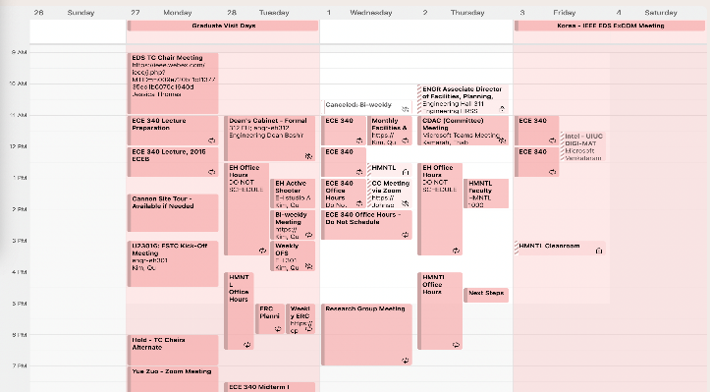
How Do We Organize Our Calendar: Time Management
3
Notes:
Key takeaway-need more faculty to balance the increased numbers of students. quiet time needed for individual research is often done on weekends and in the summer; travel to present research and how we handle teaching, mentoring, and administrative responsibilities while we are traveling. this particular week doesn't even include much shared governance work, which would be in addition to everything else.

Slide 4
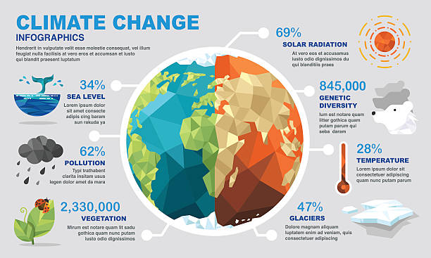
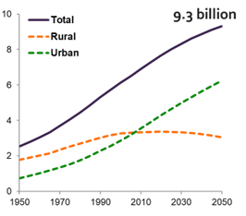
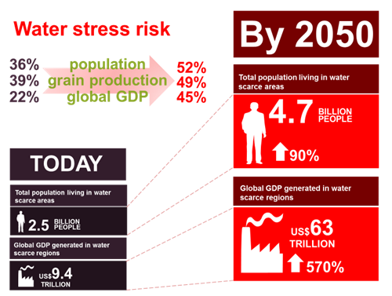
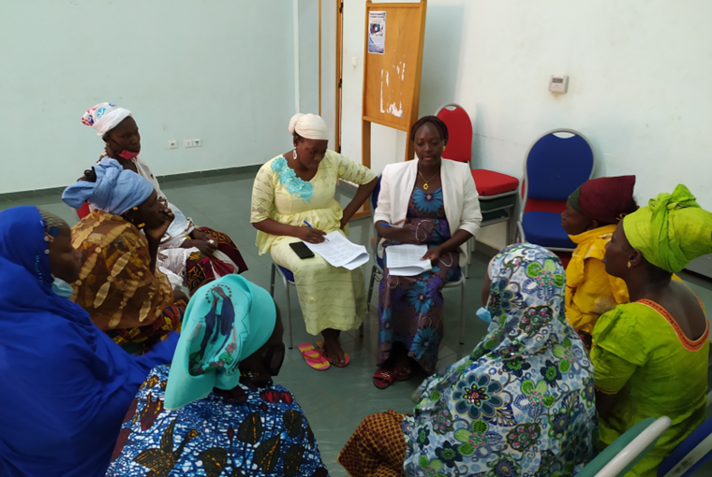
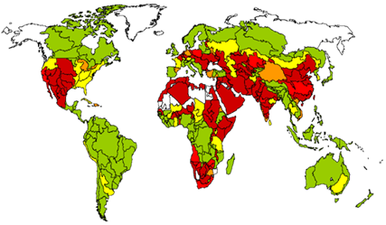
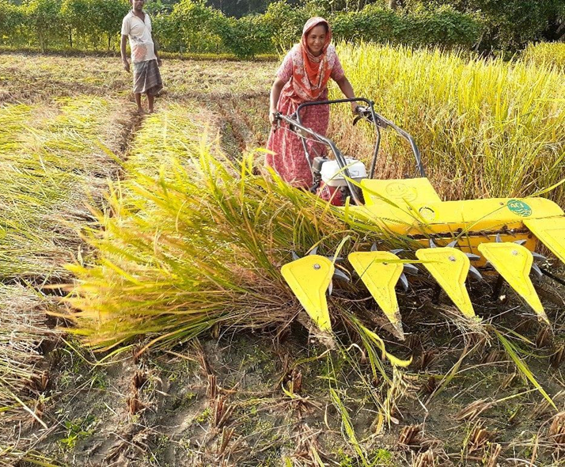
Growing Global Challenges
4

Slide 5
Why Do Faculty Matter and Why Are We In This Profession?
Different across individuals, disciplines, campuses
Joys of helping learning to take place, mentoring
Passion for Research, Teaching, Service - excellence in research supports excellence in teaching, service
Commitment towards the mission, vision, and goals of public universities
Joys of innovation
Empowering human resources
Deepening understanding of the human experience
Solving societal grand challenges
5

Slide 6
How do we sustain faculty motivation?
Important to value our faculty and recognize their contributions
Retention of quality faculty members is critical for our universities to be competitive and continue to have world class research and teaching- important to collaborate
Specifically important, given we have two top private universities in the state of Illinois to compete with: Northwestern and the University of Chicago
Time commitment for research: need to increase research time for faculty members. Concentration on one aspect of job responsibilities leads to the reduction in time for other aspects.
Valuing and honoring “Shared Governance”– it takes a lot of time and expertise and is usually done in addition to department/college committee works.
6

Slide 7
Thank you
Prasanta K. Kalita, Ph.D. Professor of Soil & Water Resources Engineering Department of Agricultural & Biological Engineering University of Illinois, Urbana-Champaign
Email: pkalita@illinois.edu

