Slide 1
Board of Trustees
BOARD OF TRUSTEES
President Tim Killeen
May 19, 2022
Notes:
Good morning and thank you all for being here.
This May meeting is always special as it comes on the heels of all our wonderful commencement ceremonies -- one of the most special and celebratory seasons at U of I and really on any college campus.

Slide 2
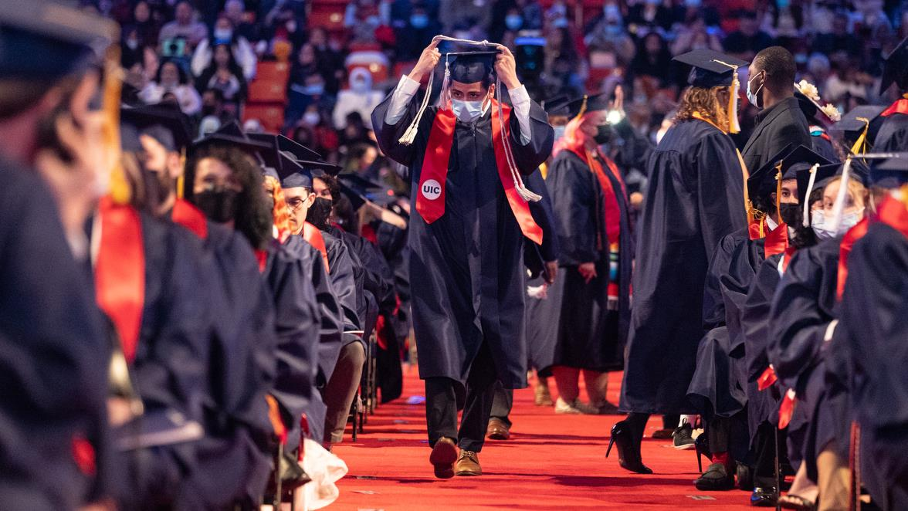
Graduation ceremony 1
Notes:
I am still incredibly energized from witnessing so many students walk across the stage this past week and a half, students who are all about to leap forward with that next big step. I’m proud to say that our number of graduates this year totals a whopping 25,000, another all-time high for the University of Illinois System and a proud reminder of why we’re here … of the impact we seek to make that is rooted in the bedrock mission we have carried since our founding.
It’s about opening our doors wide to every deserving student, not just the privileged few … providing an education that transforms lives, one by one … and collectively sending out new waves of talent, year after year, to create prosperity for our state, the nation and the world.

Slide 3
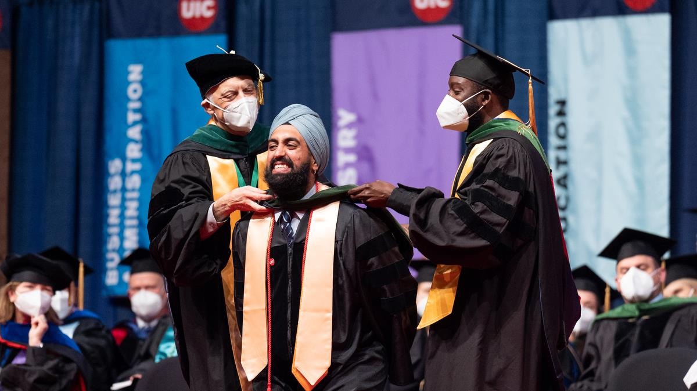
Graduation ceremony 2
Notes:
Celebratory recap - commencement

Slide 4
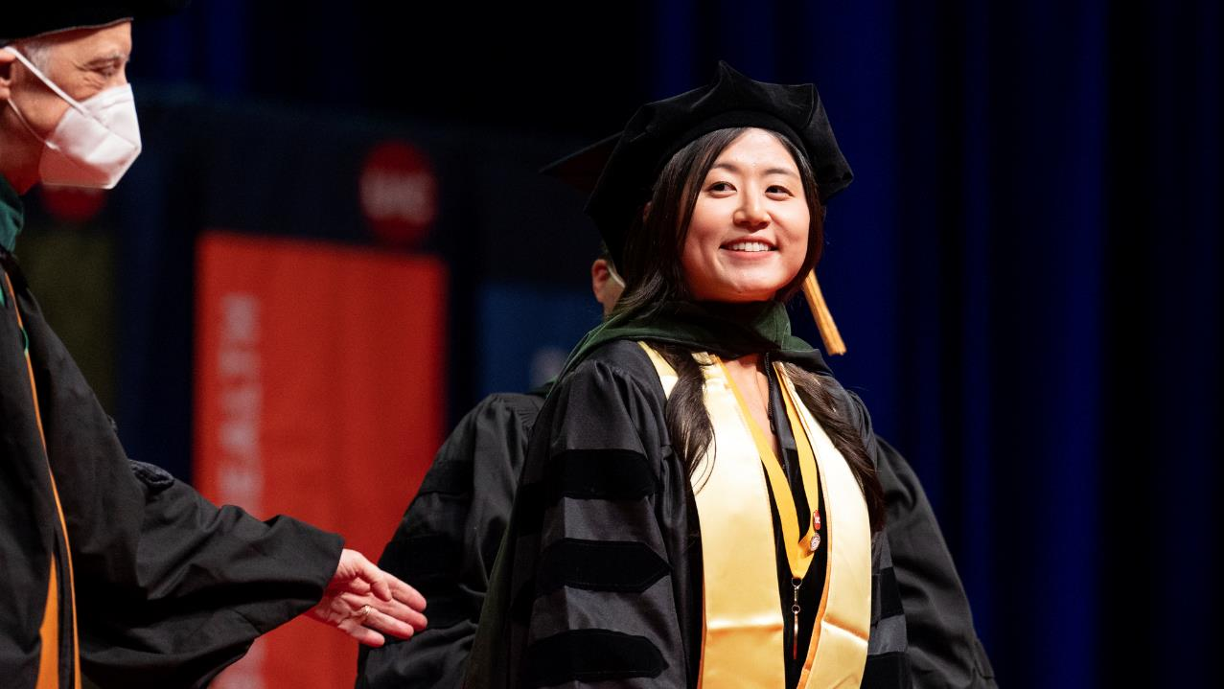
Graduation ceremony 3
Notes:
Celebratory recap - commencement

Slide 5
Graduation ceremony 4
Notes:
Celebratory recap - commencement

Slide 6
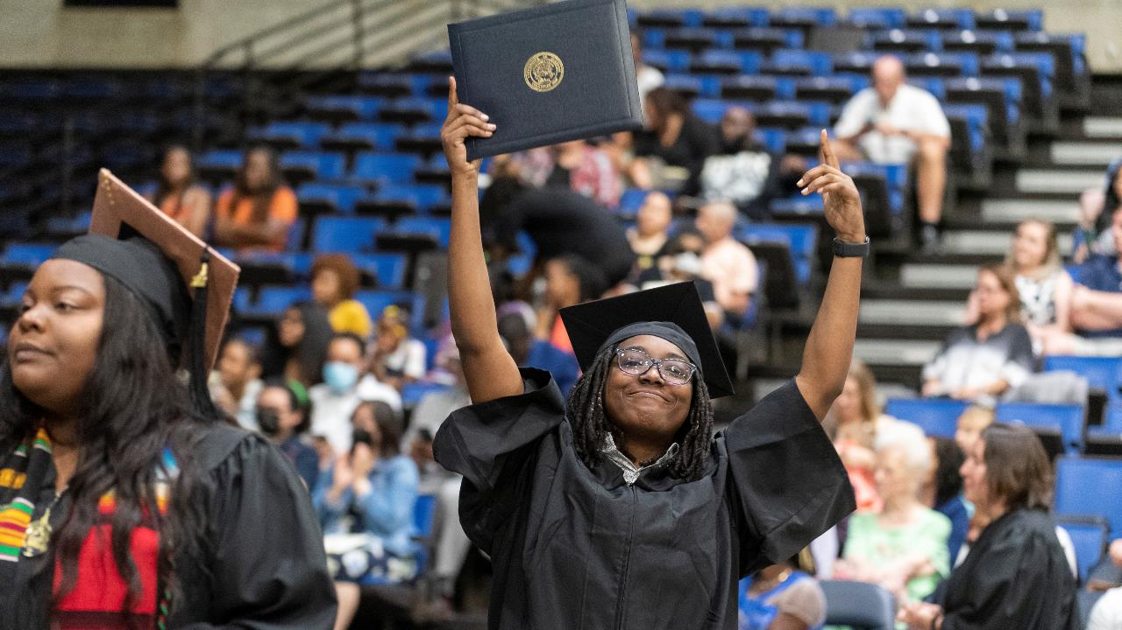
Graduation ceremony 5
Notes:
Celebratory recap - commencement

Slide 7
Graduation ceremony 6
Notes:
Celebratory recap - commencement

Slide 8
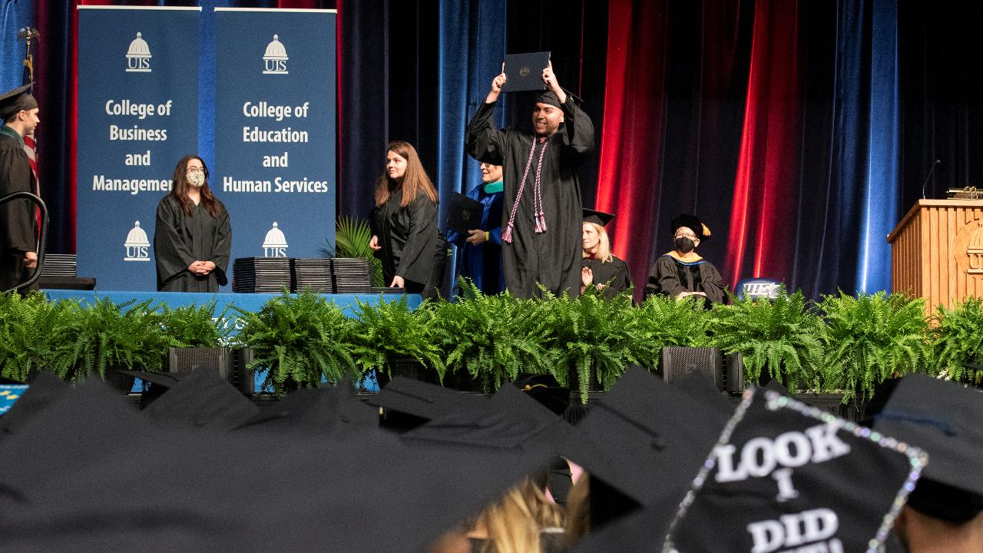
Graduation ceremony 7
Notes:
Celebratory recap - commencement

Slide 9
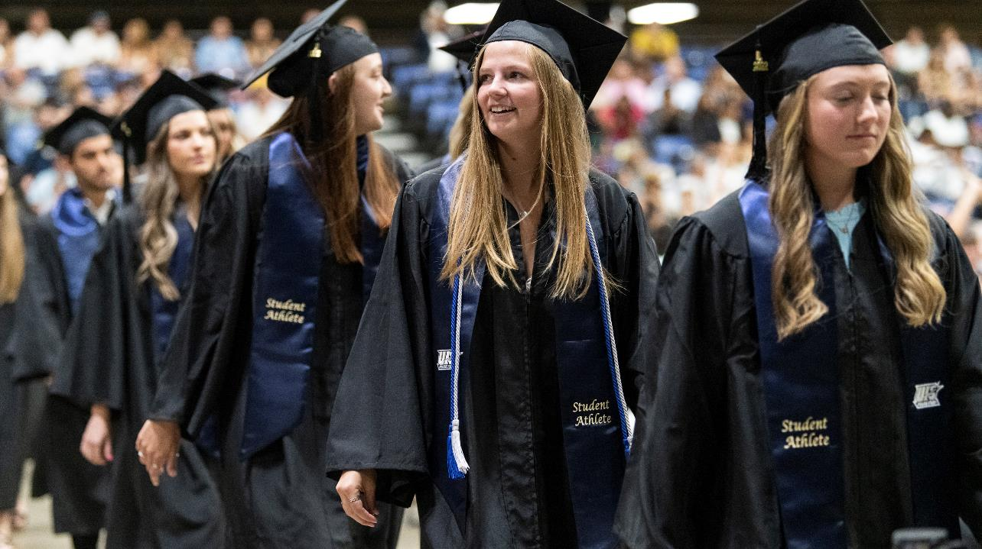
Graduation ceremony 8
Notes:
Celebratory recap - commencement

Slide 10
Graduation ceremony 9
Notes:
Celebratory recap - commencement

Slide 11
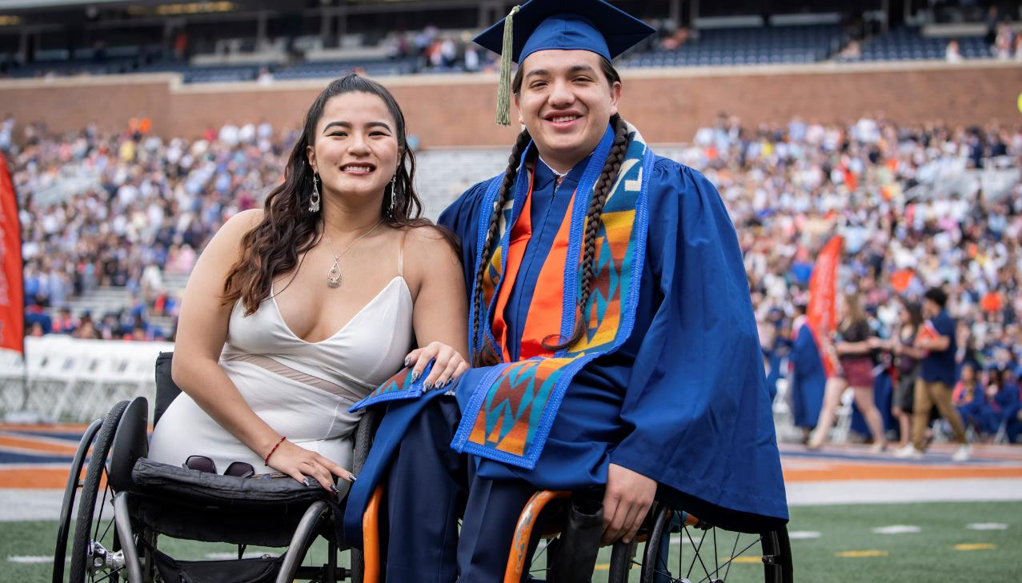
Graduation ceremony 10
Notes:
Celebratory recap - commencement

Slide 12
Graduation ceremony 11
Notes:
Celebratory recap - commencement

Slide 13
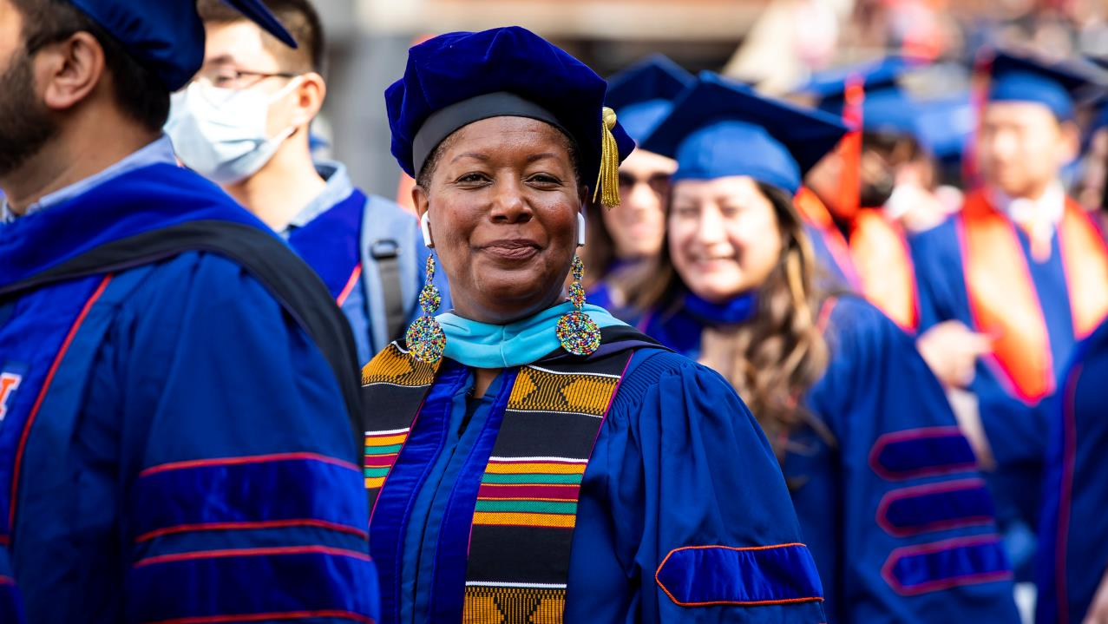
Graduation ceremony 12
Notes:
Celebratory recap - commencement

Slide 14
Graduation ceremony 13
Notes:
Celebratory recap - commencement

Slide 15
Economic impact
Our ECONOMIC
IMPACT
Notes:
In fact, our success in achieving these foundational goals is reflected in the results of our recently completed FY 21 economic impact study, and I am gratified to receive this important validation of our continued progress.
The data show that four years following our last economic impact study in 2017, the economic value of the U of I System continues to grow. We’re seeing increases across virtually every metric in the study.

Slide 16
Growing impact 1
Growing Our Impact:
$19B
TOTAL INCOME TO THE ILLINOIS ECONOMY
Notes:
The big, topline number I want to share is that in FY 21, the U of I System added $19 billion in income to the state’s economy -- $19 billion! That’s up from $17.5 billion in FY 17, an increase of 8.6 percent. This represents a value approximately equal to 2.1 percent of Illinois’ gross state product (GSP).

Slide 17
Growing impact 2
Growing Our Impact:
75%
SYSTEM GRADUATES REMAIN IN ILLINOIS
Notes:
As to that record number of graduates I mentioned earlier, the data show that a growing number of them are remaining in Illinois – 75 percent, up from 64.5 percent in FY 17, boosting their overall ability to impact the state and our economy.
Further, for the 75 percent of U of I System students who remain within Illinois, each U of I bachelor's degree graduate will see approximately $67,300 per year or approximately $31,200 more than someone with a high school diploma.

Slide 18
Growing impact 3
Growing Our Impact:
$12.8B
IN STUDENTS’ CUMULATIVE HIGHER EARNINGS, 15.7% ANNUAL INTERNAL RATE OF ROI
Notes:
This translates to a present value of $12.8 billion in cumulative higher future earnings and an internal rate of return of 15.7 percent, which is impressive when compared to the U.S. stock market’s 30-year average rate of return of 10.5 percent.

Slide 19
Growing impact 4
Growing Our Impact:
JOBS SUPPORTED (OR 1 IN 46 JOBS)
^{164,154}
Notes:
Adding to the strength of our impact are the growing number of partnerships here at home and along with them growing trust in the U of I System’s ability to cultivate diverse talent, create jobs and spur economic development.
Data from the new study validate our impact in this area, too. The U of I System’s impact can also be expressed in terms of jobs supported. That $19 billion in total economic impact also supported 164,154 jobs. Put another way, one out of every 46 jobs in Illinois are supported by the activities of the University of Illinois System.

Slide 20
Growing impact 5
Growing Our Impact:
Notes:
We also see this impact reflected and growing in our ongoing work with Discovery Partners Institute and the Illinois Innovation Network.
Announced in April of this year, DPI will be the location for one of the Department of Defense’s military technology accelerators, also known as a Defense Innovation Unit. This effort is part of the DoD’s long-term commitment to develop a stronger tech pipeline in Chicago and in alignment with our own U of I System goals.
Another exciting piece of news for DPI is its induction into the OneTen employer partner network. Over the next decade, this coalition of leading CEOs and their companies aims to reach out to a million Black people across the country who lack four-year degrees to upskill them, hire them and help them advance their careers and lives.
As a OneTen talent developer, DPI will provide resources to recruit and train Black talent in Illinois for high-demand tech jobs, further growing Chicago’s tech community.
Moving out of Chicago and across and down the state, the Illinois Innovation Network was awarded $120,000 in seed grants to four research teams in its fourth round of funding earlier this year.
The funding is part of IIN’s Sustaining Illinois program, designed to increase collaborative research among the state’s public universities. Their efforts will focus on the economy, health and well-being, while addressing issues of diversity, equity and inclusion.
Selected projects include a new approach to improving community resilience against floods, growing the computational thinking and coding workforce in southeast Illinois, investigating the viability of geopolymer concrete as a sustainable construction material, and examining how Illinois can develop a sustainable and inclusive supply chain for the electric vehicle industry.

Slide 21
Growing impact 6
Growing Our Impact:
$1.6B
IN HOSPITAL SPENDING INCOME TO ILLINOIS, EQUAL TO 13,367 JOBS SUPPORTED
Notes:
UI Health is an equally formidable enterprise known for leading-edge impact in health sciences education, health care delivery and research.
Although broader health-related impacts are outside the scope of the study’s analysis, it does look at the hospital’s impact to the state’s economy, and it is significant.
In FY 21, the U of I System’s hospital operations generated a net impact of $1.6 billion in added income to the state. This is equivalent to supporting 13,367 jobs.
The U of I System is leading the way and growing our impact in so many areas, and you can feel the momentum building – a critical mass of innovation and activity in motion that propels our state and the citizens of Illinois forward.

Slide 22
Performance
Our Platform for
PERFORMANCE
Notes:
All of this progress -- the extent of our impact -- has brought the U of I System to a critical jumping off point.
I think it’s fair to say, now more than ever, we are on solid footing and in a very strong position to capitalize on new opportunities and perform at even higher levels …
… identifying pressing problems in need of solutions and answering the call for action to generate the kinds of impact at scale that will allow us to further lead transformational change.
You may have heard me refer to this current favorable state as our “platform for performance,” the notion of having untapped capacity, standing poised to take off, to realize an ambitious vision for what’s next.
As we look at opportunities to pursue new initiatives and programs, we remain mindful of industry trends and market forces that are a part of the current landscape in higher education. These will continue to influence our strategic priorities and ultimately our success in growing our impact.
Changing demographics, the need for funding diversification, shifting learning modalities and internationalization, to name a few.
These trends and forces are evolving the way higher education is being designed and delivered, and the U of I System is evolving with them.
Another critical part of this equation, of course, is our strong financial position.
As you’ll see in our March year-to-date finance committee report, we’re currently enjoying solid fiscal performance, including public confidence buoyed by current favorable bond ratings. Our outlook for the future looks equally promising, too.
It goes without saying that another big part of what will continue to fuel all of this – education, research, innovation and opportunity -- comes from investment in public higher education … from the state’s recognition of the value the U of I System offers to the citizens of Illinois.
We were pleased to see the governor and our partners in the General Assembly demonstrate their belief in what the system provides to the state.
The new budget signed by the governor provides $655.2 million in general operating funds for the fiscal year that begins in July. That’s a 5 percent increase.
At the same time, the extraordinary success of our fundraising efforts across the system will continue to support the kinds of meaningful impact we seek.
Our three universities’ comprehensive campaigns, which officially wrap up on June 30, have each surpassed their goals – all combined that’s $3.1 billion -- and we still have six weeks to go.

Slide 23
Future Impact
FUTURE
IMPACT
Notes:
As we look to the future and our ability to springboard from our platform, we’ll aspire to capitalize on the intersections where we can make the most profound differences.
Whether continuing to move the needle on access and affordability through programs like Access 2030, which will increase the number of graduates from underrepresented groups by 50 percent by the end of the decade …
… building additional on-ramps for non-traditional students through our new transfer guarantee program, which allows Illinois high school graduates to have a home at one of our universities if they have completed at least 36 transferable hours at one of the state’s outstanding community colleges and maintained a 3.0 GPA …
… or with our growing number of online degree programs that help students, who have the desire to learn but need greater flexibility and convenience, to complete their degrees …
… UIS deserves a real nod of recognition here. Their number of online degree programs has now skyrocketed to 43, garnering U.S. News & World Report’s ranking among the top 10 percent of online undergraduate programs in the country ...
… or by continuing to be a hub of innovation and a magnet for federal research dollars. A recent $40 million from the National Science Foundation to UIUC will advance research in neuron-based computing systems and expand access and capabilities for the nation’s supercomputing infrastructure. UIC’s recent $22 million award from the National Institutes of Health will fund long-COVID research.

Slide 24
Growing impact 7
Growing Our Impact:
$1.3B
IN RESEARCH SPENDING INCOME TO ILLINOIS
Notes:
It’s worth mentioning here that data from the study show that U of I System research spending generated $1.3 billion in added income for the Illinois economy in FY 21.

Slide 25
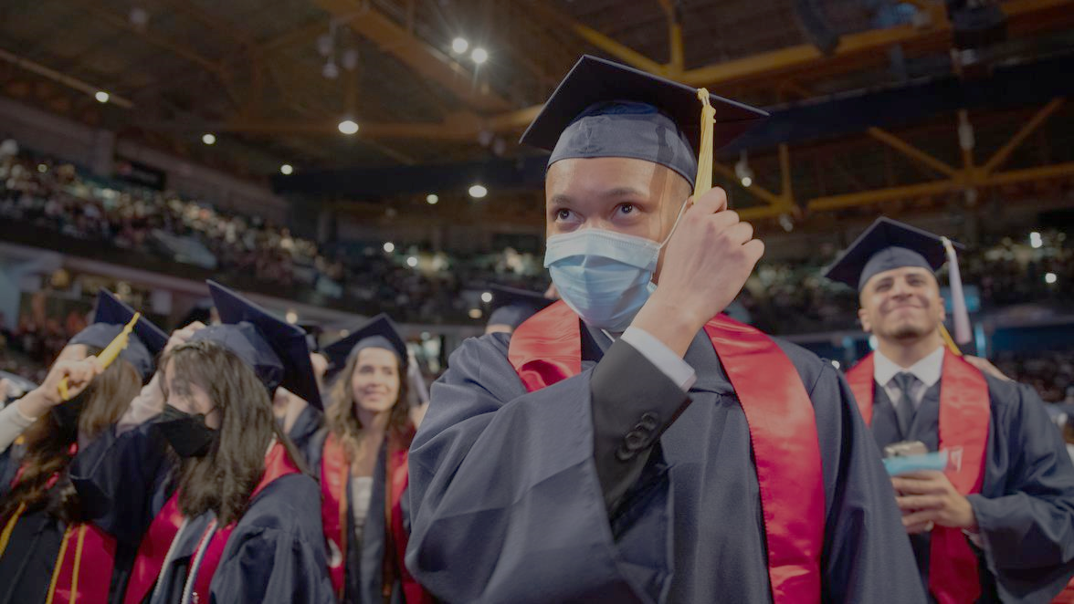
Force for Good
A Powerful Force
FOR GOOD
Notes:
There’s no doubt, the U of I System will continue to drive impact to be a powerful force for good.
I hope the highlights from the study give you a sense of the continuing economic value the U of I System provides, reinforcing our positive momentum and bright outlook for the future.

Slide 26
Thank You
THANK YOU
Notes:
The full 2021 report will be available in the next couple of months, and we look forward to sharing that with you as soon as possible.
Thank you.

