Slide 1
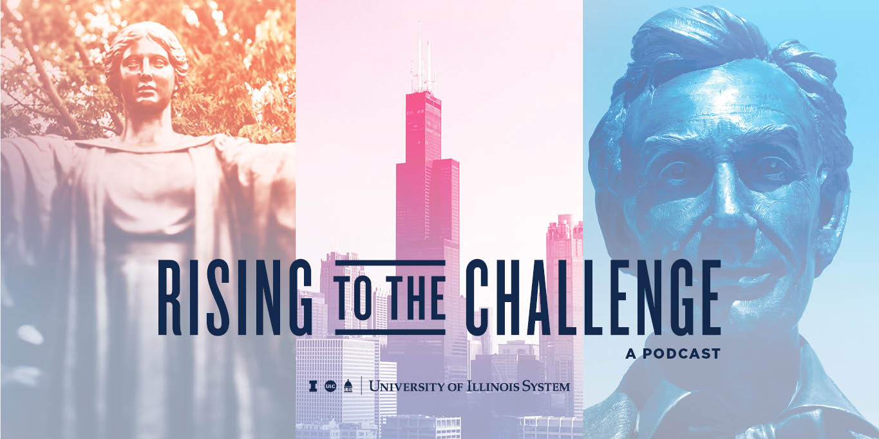
Enhancing Academic Excellence during a Double Pandemic
Presentation by
The University Senates Conference
Academic Affairs and Research Committee
Notes:
This presentation aims to identify a number of innovative or important developments that enhance teaching across the system for the public good.

Slide 2
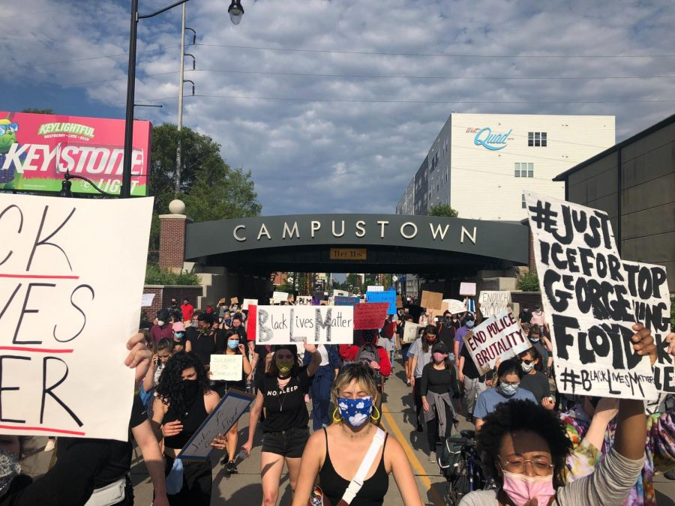
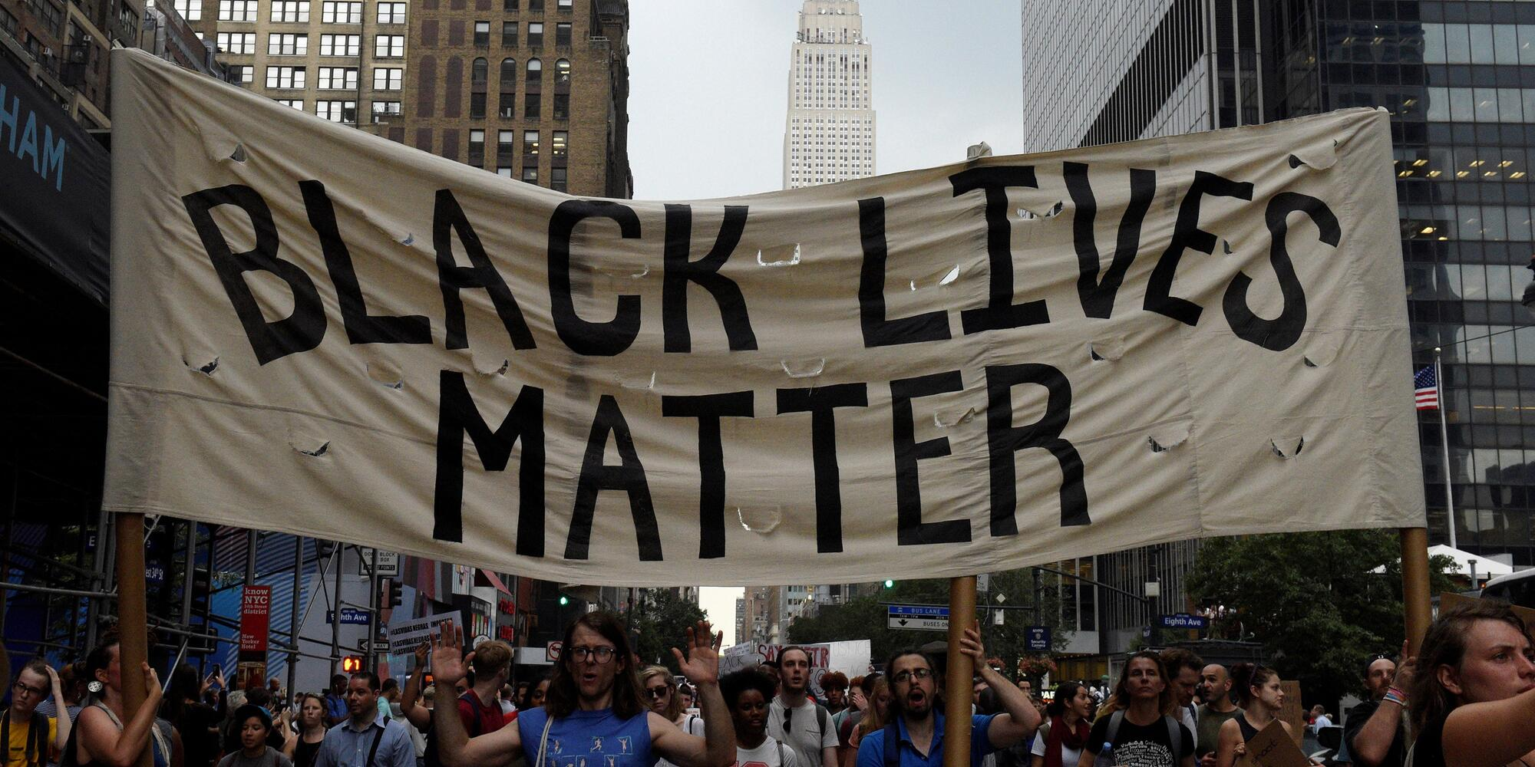
Call to Action to Address Systemic Racism
Steering Committee (led by Sean Garrick, Vice Chancellor of Diversity, Equity
and Inclusion)
Four Working Groups to Develop Recommendations
1. Teaching and Scholarship
2. Diversity and a Culture of Inclusion
3. Public Safety, Policing, and the Justice System
4. Community Action and Public Engagement
Commitment of $2 million annual funds for competitive research grants on
projects addressing systemic racism.
Notes:
As as system of comprehensive research universities, teaching is one of the core products that we offer—along with research and service.
Excellence in teaching is thus a bedrock value, and all three universities engage in numerous efforts to enhance and support teaching excellence.
UIUC is one of a handful of universities with a center Innovation in Teaching and Learning.
Among the key services that it offers are to: (1)-(5).
[NOTE TO PRESENTER/DON”T READ] UIUC is one of the few universities—along with UC Berkeley, University of Maryland, University of Michigan, University of Alabama-Birmingham, Vanderbilt University, Rutgers University, Northwestern--that have created a University Teaching and Learning Center dedicated to enhancing teaching and learning in higher education.

Slide 3
Let’s Look Closer at One Working Group
Working Group on Public Safety, Policing, and the Justice System
Co-Chaired by:
Margareth Etienne, Associate Dean for International Programs at the College of Law, and
Michael Schlosser, Director of the Police Training Institute.
Constructive but Difficult Conversations
Reflect the Array of Views in Society Today.
Hoping to Leverage the Police Training Institute (the only one of its kind at a major research university) and Develop Training Programs that could be Exported to Other Parts of the Country.
Notes:
As as system of comprehensive research universities, teaching is one of the core products that we offer—along with research and service.
Excellence in teaching is thus a bedrock value, and all three universities engage in numerous efforts to enhance and support teaching excellence.
UIUC is one of a handful of universities with a center Innovation in Teaching and Learning.
Among the key services that it offers are to: (1)-(5).
[NOTE TO PRESENTER/DON”T READ] UIUC is one of the few universities—along with UC Berkeley, University of Maryland, University of Michigan, University of Alabama-Birmingham, Vanderbilt University, Rutgers University, Northwestern--that have created a University Teaching and Learning Center dedicated to enhancing teaching and learning in higher education.

Slide 4
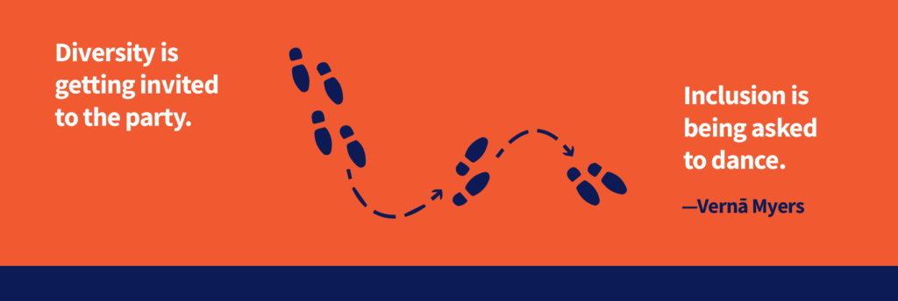
Let’s Look Closer at Another Working Group
Working Group on Diversity and a Culture of Inclusion
Co-Chaired by:
Kevin Hamilton, Dean, Professor Fine and Applied Arts, FAA
Antoinette Burton, Director, Humanities Research Institute, OVCRI; Professor, History, LAS
Have developed recommendations to ensure diverse groups can show up as their authentic selves in various settings
Obtain support to flourish-–thus aiding with retention and development.
Notes:
As as system of comprehensive research universities, teaching is one of the core products that we offer—along with research and service.
Excellence in teaching is thus a bedrock value, and all three universities engage in numerous efforts to enhance and support teaching excellence.
UIUC is one of a handful of universities with a center Innovation in Teaching and Learning.
Among the key services that it offers are to: (1)-(5).
[NOTE TO PRESENTER/DON”T READ] UIUC is one of the few universities—along with UC Berkeley, University of Maryland, University of Michigan, University of Alabama-Birmingham, Vanderbilt University, Rutgers University, Northwestern--that have created a University Teaching and Learning Center dedicated to enhancing teaching and learning in higher education.

Slide 5
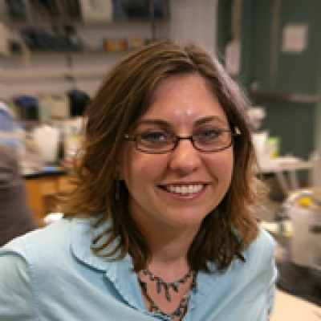
Center for Teaching Excellence
Inaugural Executive Director :
Dr. Erin Sanders O’Leary
Centers Like These Build Upon Support for Teaching Excellence
at all Colleges throughout the System
Notes:
More recently, UIC has joined these ranks by creating a New Center for Teaching Excellence.
Dr. Erin Sanders O’Leary will be the Inaugural Executive Director, pending approval by the Board of Trustees. She will start on July 1, 2020.
Dr. O’Leary currently serves as the Director of UCLA’s Center for Education Innovation & Learning in the Sciences. In the last decade, she has been awarded millions of dollars in federal and foundation grants to support educational initiatives and she is a published author and a recognized research scholar in science education. She was recently awarded a Diversity, Equity, and Inclusion Award by UCLA’s Academic Senate for her extraordinary leadership and commitment to diversity initiatives in education.
Centers like these build upon a rich tradition of programs that support excellence in teaching throughout the colleges and throughout the system. They help coordinate efforts and provide enriched services to the many forms of support offered within each college and unit. [NOTE TO PRESENTERS: Here are some examples: workshops, peer mentoring, teaching workshops, brown bags, etc.]
College of Education
Mentoring for all junior faculty
A Makers Space for faculty, students, and staff
Mentoring Associate to Full
Brown bags on different aspects of teaching and learning
Support for developing online and hybrid learning
College of Medicine
using curriculum focused on more active, team-based learning models and early integration into clinical studies
employing curricular components focused on student wellness, specifically to prevent student/physician burn-out/fatigue
College of Nursing
expanded experiential learning and simulation laboratory
Two faculty members are Team-Based Learning Trainer Consultants who conduct workshops for faculty
Faculty present new teaching modalities to fellow faculty
Structured mentoring, shadow teaching, pay for continuing education for teaching conferences and provide access tour CON series of online teaching courses
College of Urban Planning and Public Affairs
Peer review of teaching for junior faculty

Slide 6
Total Amount of Grants Submitted $7.9 Million
U.S. Department of Education ($2.6M), “Collaborative Research: Advancing Educational Access & Institutional Resilience at UIC”
NSF IUSE ($2M), “Institutional Transformation through a Curriculum and Faculty Development to Serve the Modern Chemistry Student”
NSF IUSE ($300K), “Public Knowledge Construction for Engaging Students in STEM Learning and Developing Science Literacy”
NSF HSI ($3M), “Institutional Transformation Through a Large-Scale Implementation of Departmental Action Teams”
Notes:
To quickly follow up, here is a list of the grants I’ve applied for on behalf of the Center since starting in July (all are submitted and currently pending; I’m either Co-PI or senior personnel as my formal role). Total amount pending to date: $7.9M
U.S. Department of Education ($2.6M), “Collaborative Research: Advancing Educational Access & institutional Resilience at UIC”
Proposal to introduce Summer Institute on Online Teaching for UIC faculty and increase dual enrollment courses to broaden access by CPS high school students
PI: Nikos Varelas (Academic Affairs)
NSF IUSE ($2M), “Institutional Transformation through a Curriculum and Faculty Development to Serve the Modern Chemistry Student”
Cohort of Chemistry faculty working together to reform the Chemistry curriculum; accompanied by professional development in both action research and inclusive/culturally-responsive teaching
PI: Don Wink (Chemistry)
NSF IUSE ($300K), “Public Knowledge Construction for Engaging Students in STEM Learning and Developing Science Literacy”
Involves integration of Wikipedia writing exercises into large enrollment biology courses
PI: Zach McDowell (Communication)
NSF HSI ($3M), “Institutional Transformation Through a Large-Scale Implementation of Departmental Action Teams”
Proposal involves department heads from all 11 STEM units in Engineering and LAS recruiting faculty groups (called Departmental Action Teams) to engage in action research to foster curricular and cultural change in teaching practices within respective departments; accompanied by professional development in inclusive/culturally-responsive teaching (specifically, participation in the Inclusive Education Scholars certificate program discussed today, which involves a collaboration between the Center and the Office of Diversity)
PI: Mike Stieff (LSRI)
I am also working with Jeremiah Abiade in Engineering on the HHMI Driving Change initiative, which is currently at the institutional self-study stage in which we’re gathering data to support application for a $5M grant that would fund implementation of a large-scale recruitment and retention program for Black students. I share this because UIC was among 37 institutions selected to proceed with the self-study stage, which is required to be eligible to apply for the larger grant. Although the Center was not involved in the initial application, I am now an active member of the leadership team moving forward with the self-study and efforts to secure funding, whether through HHMI or another agency or foundation, to support this work in the next year.
Anyway, this sort of effort that I’m engaging in at UIC is consistent with my previous track record at UCLA where I helped to raise more than $15M in extramural funds from federal agencies and private foundations to support educational development efforts, in that case primarily in the sciences. Almost all of these proposals were done in collaboration with research-focused faculty, supporting their engagement in the scholarship of teaching and learning (aka publishing) in addition to the curriculum and faculty development efforts specifically funded by these awards.

Slide 7
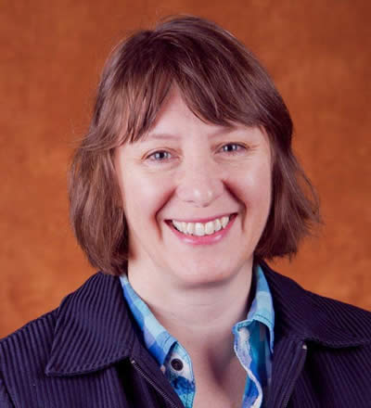
Responsive Teaching:
Intercession Courses
Culture, Health, & Power
Intercession Courses
Associate Professor of Sociology/Anthropology, Jennifer Manthei, was one faculty member who offered a winter intercession course over winter break.
Dr. Manthei’s course, “Culture, Health & Power” explores the ideas about health, illness and treatment across cultures and how to communicate effectively with people from other cultures (and one's own!).
By offering intercession courses,
both new and existing UIS students were provided an opportunity to catch up or get ahead in their plans for graduating during the pandemic during a period of time that is not usually utilized for instruction at UIS.
Notes:
UIS faculty are committed to active, student-centered pedagogies, community engagement, and interdisciplinary connections. Here we highlight just a few examples of teaching projects that engage students in research, create innovative learning spaces, and connect UIS with broader communities.
Teaching Excellence
Associate Professor of Sociology/Anthropology, Jennifer Manthei, was one faculty member who offered a winter intercession course over winter break.
By offering intercession courses, both new and existing UIS students were provided an opportunity to catch up or get ahead in their plans for graduating during the pandemic during a period of time that is not usually utilized for instruction at UIS.
Dr. Manthei’s course, “Culture, Health & Power” explores the ideas about health, illness and treatment across cultures and how to communicate effectively with people from other cultures (and one's own!).
She had great success, with not a single student failing in either of the two sessions she offered, thanks to a mix of innovative teaching techniques and empathy for students who were juggling illness or ill household members during the course.
Dr. Manthei provided a steady stream of small assignments to prevent students from becoming overwhelmed; calibrated the course to allow students to work ahead if they wished, making workloads manageable; provided optional Zoom meetings at key moments to support students in grasping challenging concepts and graded swiftly so that students had the feedback they needed to prepare them for the next assignment.
__________________________
Dr. Stephanie Hedge (English) and colleagues constructed the UNI 101, First Year Seminar Pilot (during the pandemic!): Group projects are incorporated that teach project management, digital literacy, and information presentation. Students create digital artifacts in a team. Piloting First Year Seminar remotely has demonstrated the creativity and commitment to excellent teaching by Dr. Hedge.

Slide 8
Presented to UIS Campus Senate-Spring 2021
Anti-Racism and Social Justice Taskforce
Guiding Questions
How can I make anti-racism central to the division/unit/program/class that I oversee?
How can I be an agent in dismantling systemic racism and oppression within UIS?
When making decisions that will impact the campus, how can I apply an anti-racist lens to ensure that this decision is equitable and contributes to the institutional commitment to becoming an anti-racist organization?
Notes:
Anti-Racism and Social Justice Taskforce
Presented to UIS Campus Senate-Spring 2021
– How can I make anti-racism central to the division/unit/program that I oversee? – How can I be an agent in dismantling systemic racism & oppression within UIS? – When making decisions that will impact the campus, how can I apply an anti-racist lens to ensure that this decision is equitable and contributes to the institutional commitment to becoming an anti-racist organization?

Slide 9
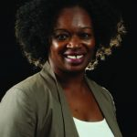
Teaching Excellence and Systemic Racism
Co-Chair of the Anti-Racism and Social Justice Taskforce and Sociology Instructor, Tiffani Saunders, works diligently across the Springfield community and campus to encourage anti-racist practices. In her courses she utilizes several techniques to assist students in understanding bias and racism. One of those examples is the use of ice breakers on the first day of class that address differences.
Dr. Saunders is the recipient of the 2021 UIS College of Liberal Arts and Sciences Faculty Excellence Award in Service. During the past year in particular, Professor Saunders has stepped up to offer truly outstanding and generous contributions of her time and effort as the university and surrounding communities responded to the pandemic and to pressing social justice concerns, exemplifying public sociology.
Notes:
Excellence in Teaching around topics of Systemic Racism
1.Jennifer Martin – In her teacher preparation courses, she incorporates readings to help her students deal with their own biases and discusses how to overcome those in their own classrooms. She also has addressed these topics in her eduCATE podcast.
2. Co-Chair of the Anti-Racism and Social Justice Taskforce and Sociology Instructor, Tiffani Saunders, works diligently across campus to encourage anti-racist practices. In her courses she utilizes several techniques to assist students in understanding bias and racism. One of those examples is the use of ice breakers on the first day of class that address differences. This is a very powerful strategy that assists students in thinking about racism at the very beginning of their course.
Tiffani Saunders, recipient of the 2021 UIS College of Liberal Arts and Sciences Faculty Excellence Award in Service! Prof. Saunders was recognized for her stellar record of university and community leadership. Her work exemplifies public sociology, which works for the public good through community engagement. During the past year in particular, Professor Saunders has stepped up to offer truly outstanding and generous contributions of her time and effort as the university and surrounding communities responded to the pandemic and to pressing social justice concerns.

Slide 10
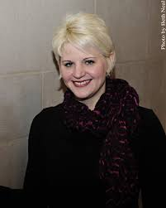
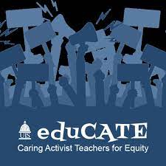
Teaching Excellence and Systemic Racism
Jennifer Martin – In her teacher preparation courses, she incorporates readings to help her students deal with their own biases and discusses how to overcome those in their own classrooms. She also has addressed these topics in her eduCATE podcast.
Notes:
Excellence in Teaching around topics of Systemic Racism
1.Jennifer Martin – In her teacher preparation courses, she incorporates readings to help her students deal with their own biases and discusses how to overcome those in their own classrooms. She also has addressed these topics in her eduCATE podcast.
2. Sociology Instructor, Tiffani Saunders, works diligently across campus to encourage anti-racist practices. In her courses she utilizes several techniques to assist students in understanding bias and racism. One of those examples is the use of ice breakers on the first day of class that address differences. This is a very powerful strategy that assists students in thinking about racism at the very beginning of their course.

Slide 11
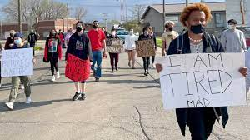
Excellence
Responsive Teaching
Better Serving the State
Better Serving the World
Innovation
Public Engagement
Notes:
These are only some examples of the efforts being made throughout the system to ensure we are offering the best educational products possible.
And these efforts should be viewed holistically. Through a combination of excellence, innovation, and outreach, we are creating programs that help us steward a comprehensive set of offerings. A rising tide lifts all boats and allows us to meet the changing challenges of higher education so as to serve the public good, both within Illinois and beyond.

Slide 12
Thank You

