Slide 1
Financial Update
Presentation to the Board of Trustees May 2021

Slide 2
Agenda
COVID-19 Financial Impact
Federal Funding
YTD (March 31) Revenue and Expenses

Slide 3
Response to COVID has been systematic and comprehensive

Slide 4
Advising the State
Advising the State

Slide 5
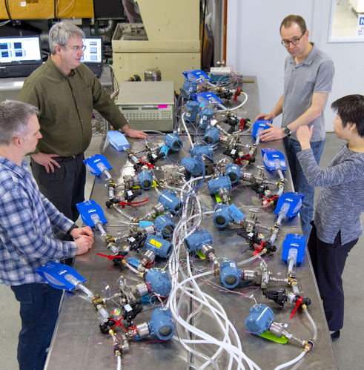
LEADING THE FIGHT ON ALL FRONTS
Innovating Ventilators

Slide 6
HELPING REMOTE LEARNING

Slide 7
Ui health clinical Response
3,000
COVID-19 Patients Treated
120,000
COVID-19 Vaccines Administered

Slide 8
Dealing With Uncertainty
Spring 2020:
Remote Classes, Remote Work
Fall 2021:
Sustaining Enrollment, Implementing Hybrid Model
Curbing Infections & Keeping Campuses Open

Slide 9
Our Enrollments Grew
System-wide enrollment

Slide 10
…And So Did Tuition Revenue
Tuition Revenue in $ Million

Slide 11
Intensive Testing Using Shield Protocol

Slide 12
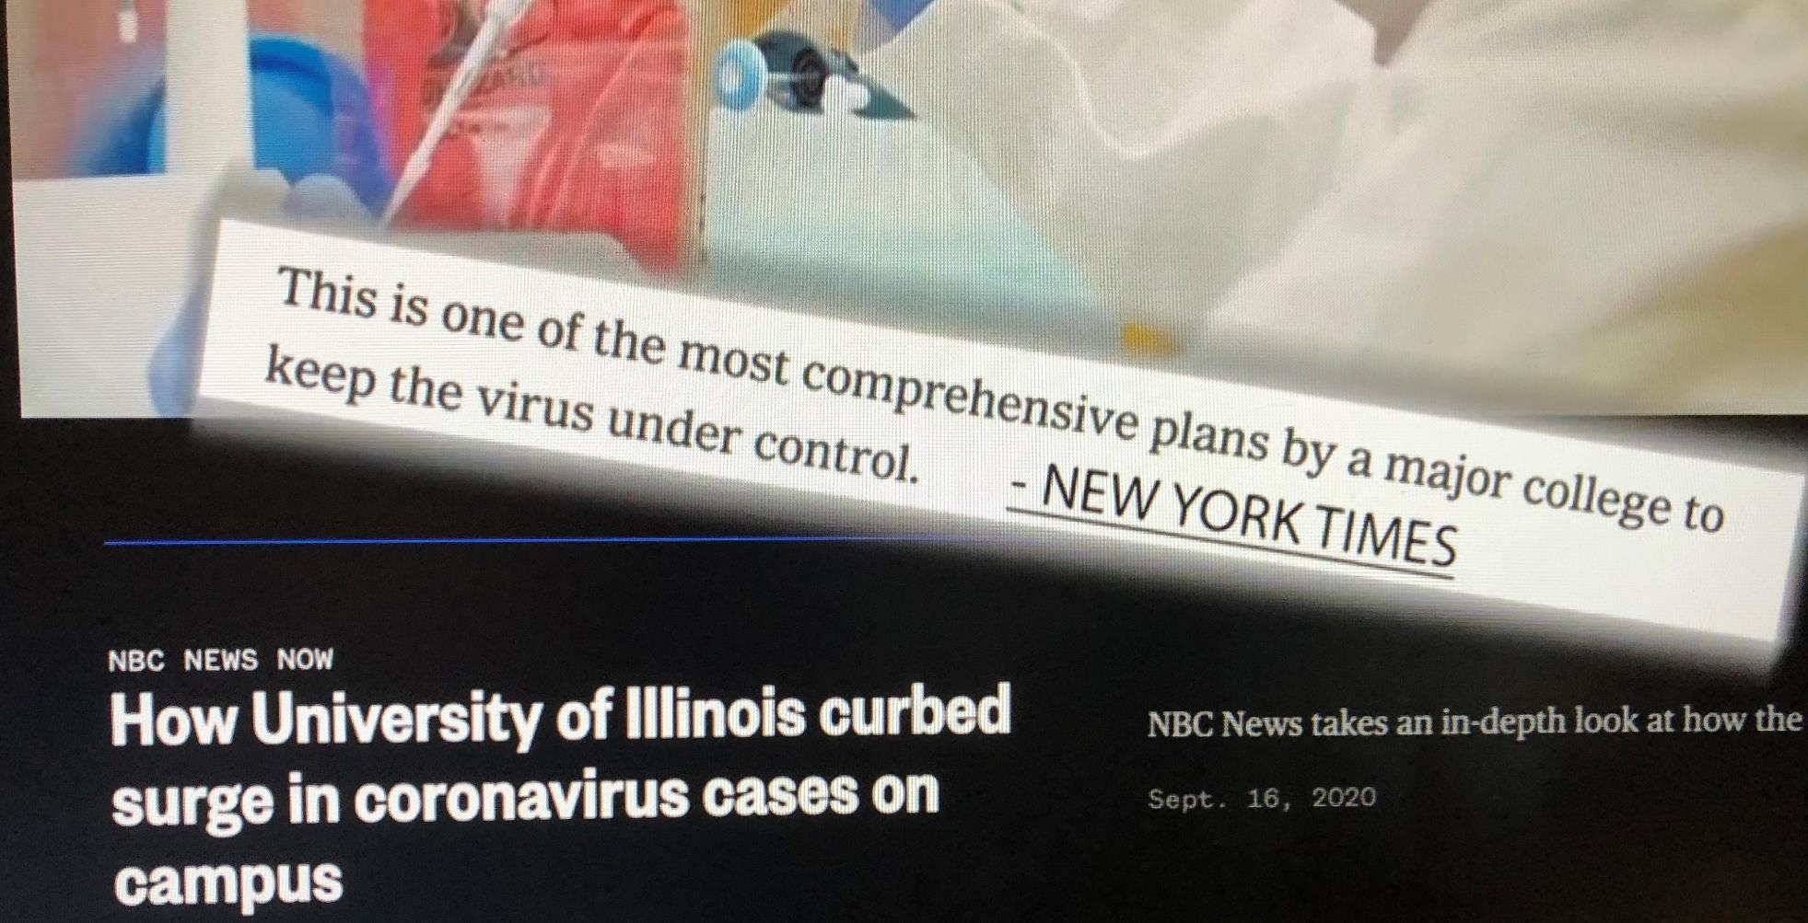
How University of Illinois curbed surge in coronavirus cases on campus – NBC news

Slide 13
Supporting Other Institutions
Supporting Institutions Across the Nation With COVID Testing
State Grant to Support IL Public Universities
State Grant to Support Community Colleges, High Schools
and Communities Sites
City of Chicago Grant to Support High Schools in Chicago

Slide 14
COVID Financial Impact
Fiscal 2020: March to June 2020
Fiscal 2021: July 2020 to March 31, 2021
Refunds
To Students
Unanticipated
Costs
Lost Auxiliary
Revenue
Lost Clinical
Revenue

Slide 15
COVID Financial Impact
(Excluding Hospital)
Fiscal Year | Period | Impact
2020 | March – June 30, 2020 | $140M
2021 | July 1, 2020 – March 31, 2021 | $190M
 | TOTAL to date | $330M

Slide 16
Federal Stimulus Funding
($Million)
Federal Funds | Student Grants | Funds to Offset Costs
CARES Act (FY20) | $33.98 | $33.73
CRRSAA (FY21) | $32.82 | $62.12
Recovery Act (Estimate) | $83.20 | $83.20
TOTAL | $150.00 | $179.05

Slide 17
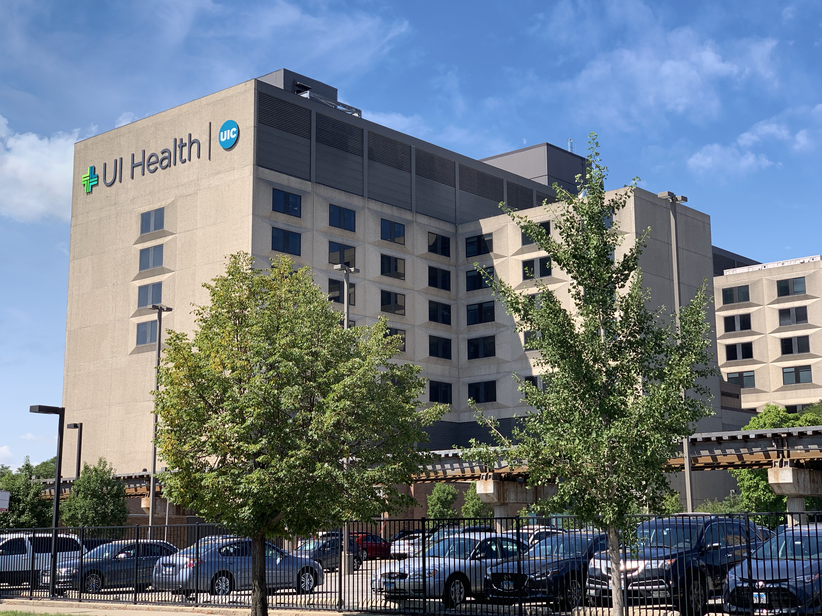
COVID Impact for Hospital
Fiscal Year | Period | Impact
2020 | March – June 30, 2020 | $58M
2021 | July 1, 2020 – February 28, 2021 | $49M
 | TOTAL | $107M

Slide 18
Federal & State Funding for Hospital
Federal Provider Relief Fund (CARES Act)
General Distribution for COVID-related expenses and lost revenue: $10.2 million (FY20)
High Impact Distribution to hospitals with large volume of COVID inpatients: $17.8 million (FY20)
$17.8 million (FY21)
Safety-net Distribution to hospitals who care for vulnerable populations: $43.1 million (FY21)
Illinois HFS Provider Stability Fund
State allocation of CARES Act funds for distribution to Medicaid providers
to help offset COVID-related expenditures
Distribution to Hospital in December 2020: $28.3 million (FY21)
TOTAL Received from Federal and State sources: $117.2 million

Slide 19
Significant Cost Containment Efforts
Postponing Salary Increases
Hiring Slowdown
Capital Spending Slowdown
Voluntary Retirement
Travel and Events
Other Cost Controls

Slide 20
FY2021 Operating Performance
(YTD March 31, 2021)

Slide 21
YTD (Mar 31) Operating Summary
(Excluding Hospital)
 | FY21 | FY20 | FY21-FY20
Revenue | $3,670M | $3,724M | -$54M
Expenses | $3,015M | $2,922M | +$93M

Slide 22
COVID Related Variances
Revenues
Auxiliaries Down $122M
Self-Supporting Down $34M
Tuition Up $24M
Gifts Up $38M
Non-Operating Grants Up $44M
Expenses
Financial Aid up +$61M
Services and Stores up +$26
Travel Related expenses down -$36M

Slide 23
Federal Funds and Prudent Spending Will Help Overcome Challenges
But COVID Impacts are Continuing Continued Vigilance is Required

Slide 24
Thanks to Students, Faculty and Staff Across the System for their Diligent Efforts

