Slide 1
Public education for the public good
Kathryn Clancy, Professor of Anthropology, UIUC
University Senates Conference, 2025-present

Slide 2




The University of Illinois – Leading the state
Illinois Extension
The Institute for Policy and
Civic Engagement
2

Slide 3
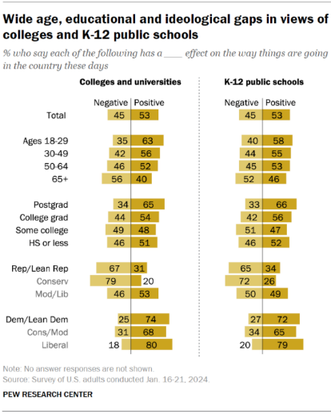
Half of the nation Sees Positive impact
Source for ROI info: https://universitybusiness.com/roi-50-state-university-systems-colleges-rank-degree-return-on-investment/
3

Slide 4
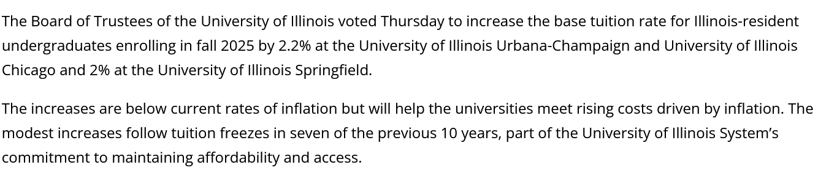
Tuition increase for incoming freshman
4
Quigley (Jan. 23, 2025)

Slide 5
Attention and Short form video
5
https://psycnet.apa.org/fulltext/2026-89350-001.html

Slide 6
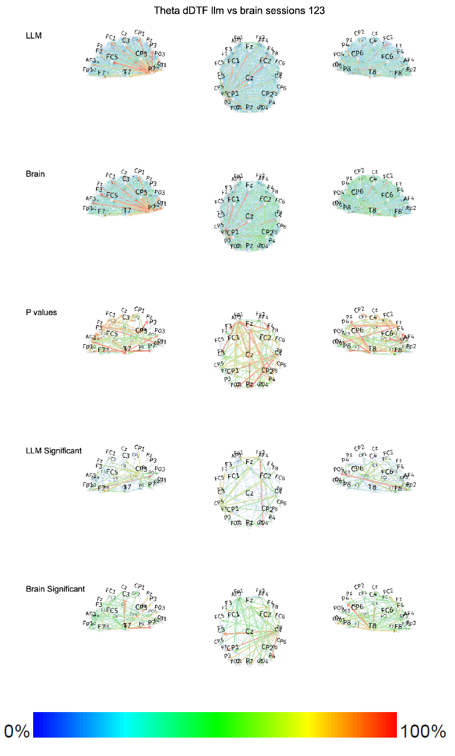
Your brain on chatgpt
6
Your Brain on ChatGPT (arXiv, 2025). https://arxiv.org/abs/2506.08872; (Hau 2025)

Slide 7
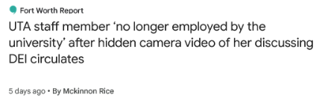
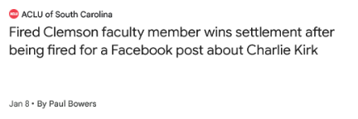
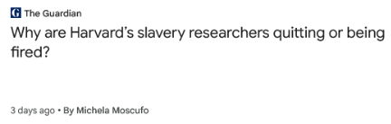
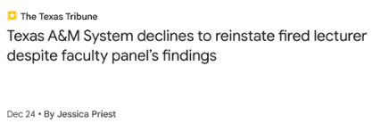
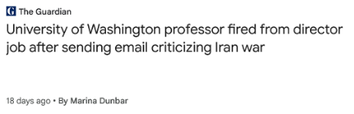
Academic freedom and self-censorship
https://president.yale.edu/committees-programs/presidents-committees/committee-on-trust-in-higher-education
7

Slide 8
How does a world-class public university system like Illinois:
Serve the public?
Respond to modern challenges?
Restore trust?
8

Slide 9
Advancing the public good
Take stock of demographic, economic, political changes
Engage with citizens, stakeholders, students
Be reflexive and responsive to the needs of the people of Illinois
The public good is served by a strong public university system resourced to perform world-changing research and life-changing education.
9

Slide 10
Being accountable to “learning and labor”
How can we achieve conceptual clarity regarding what we mean by “public education for the public good?”
How can we better attend and adapt to the needs of our neighbors?
How might we forge new relationships between our universities and our communities?
How might we spark curiosity, build trust, and create change?
10

Slide 11
Comments and Questions?
Kathryn Clancy
USC Member
Email: kclancy@illinois.edu
Phone: 217-244-1509
Sandra De Groote
USC Chair
Email: sgroote@uic.edu
Phone: 312-413-9494
David Perryn
USC Administration
Email: dperryn@uillinois.edu
Phone: 217-300-7448
11

