Slide 1
University of Illinois Board of Trustees
May 21, 2026

Slide 2
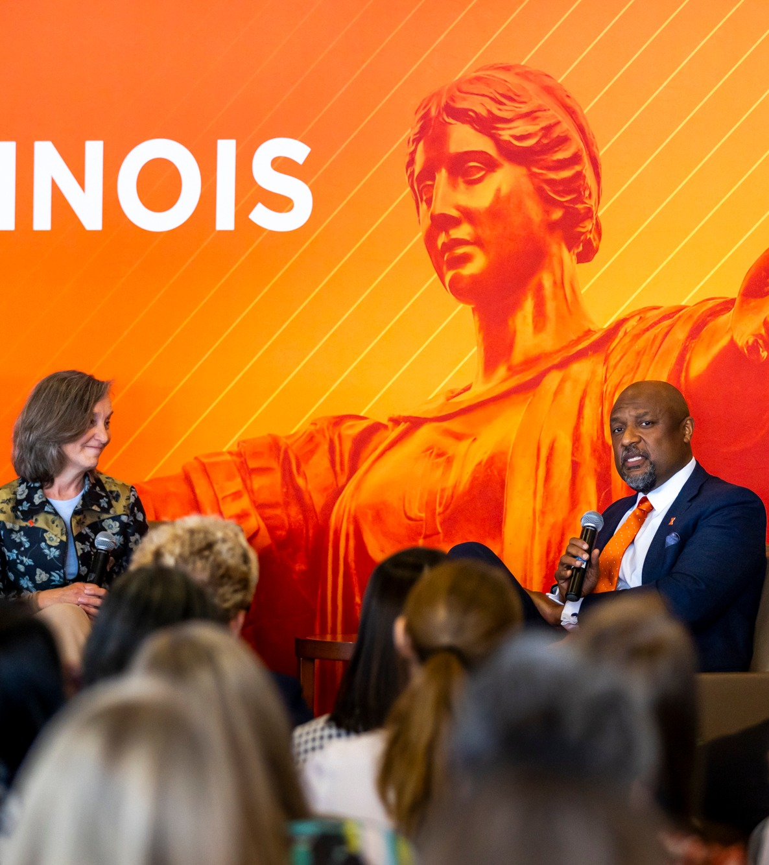
Welcome

Slide 3
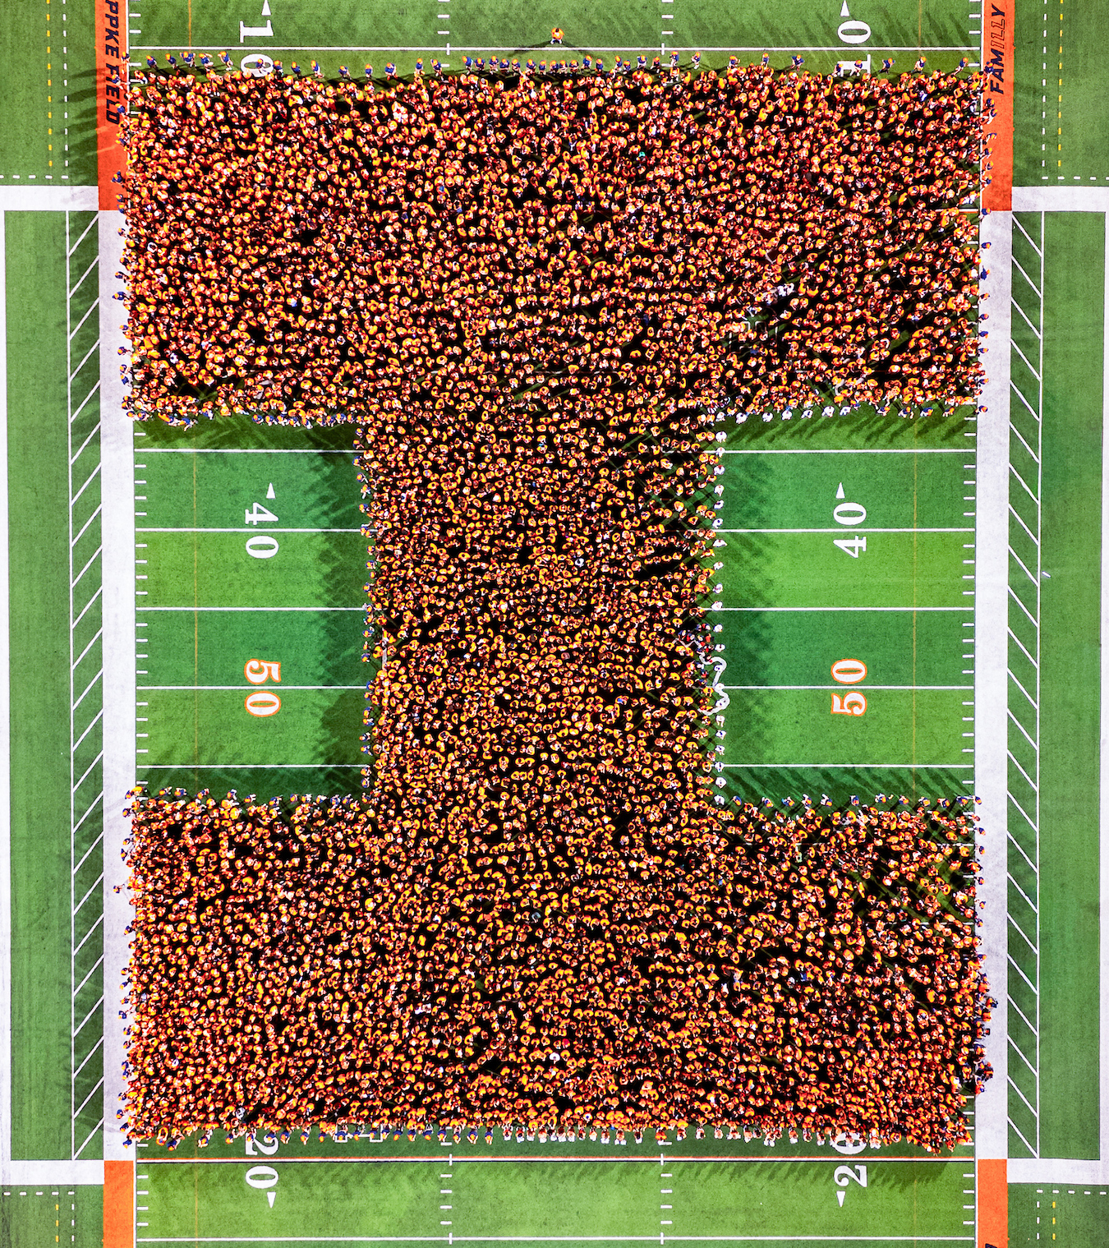
Largest freshman class ever
Largest freshman class in our history
Total enrollment 60,848
6,587 students from the state of Illinois
27,978 undergraduates are from the state of Illinois

Slide 4

Celebration of Diversity
Morrill Engineering Program
  Celebrating 50+ years
Celebration of Diversity breakfast
  Celebrating 40 years
  We must actually listen, as opposed to simply waiting our turn to speak

Slide 5
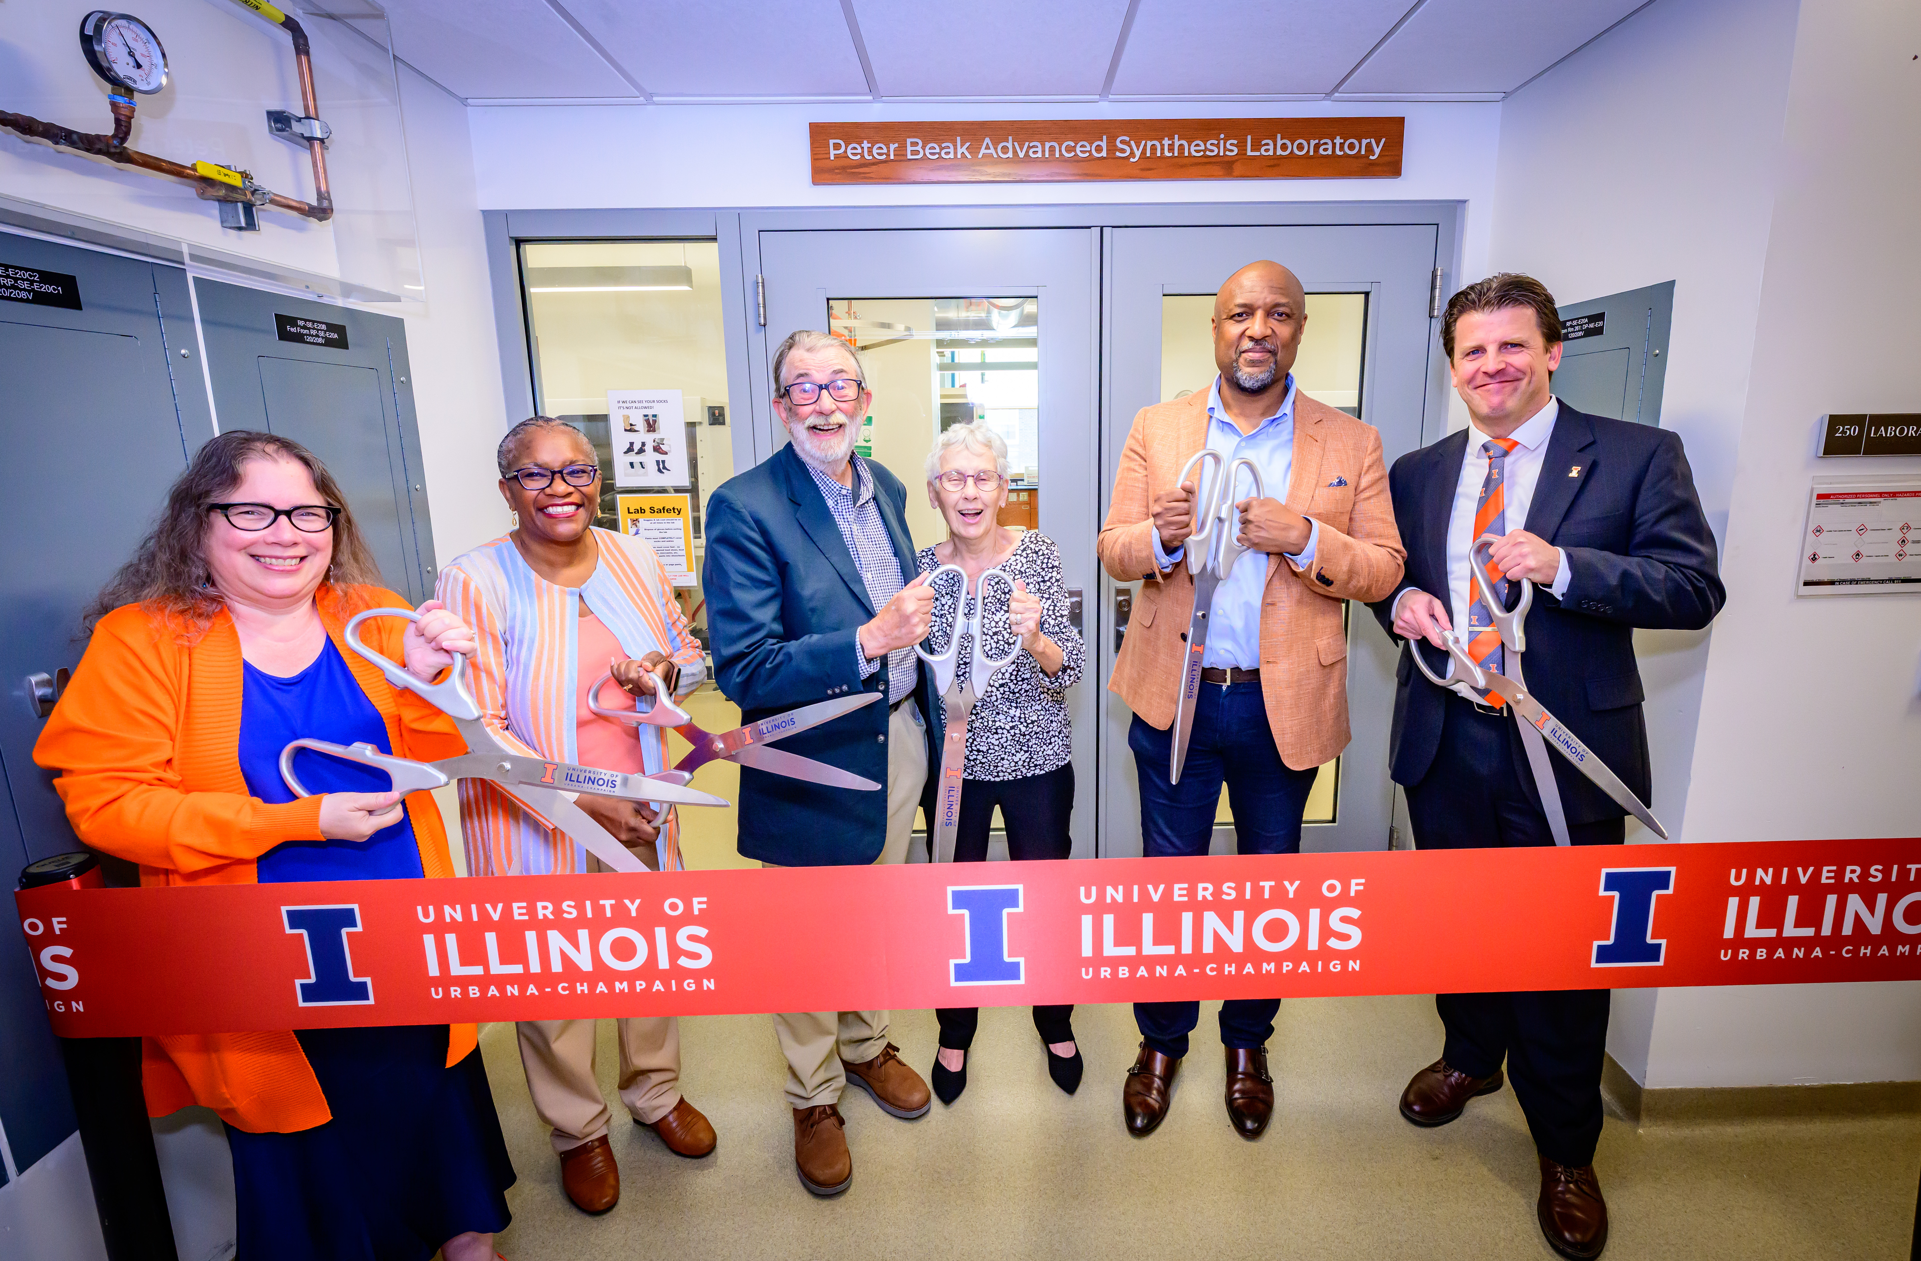
Named laboratories and centers
The Peter Beak Advanced Synthesis Laboratory
The Connie Frank CARE Center
The Landuyt Center for Entrepreneurship
The Ogura-Sato Japan House Annex

Slide 6
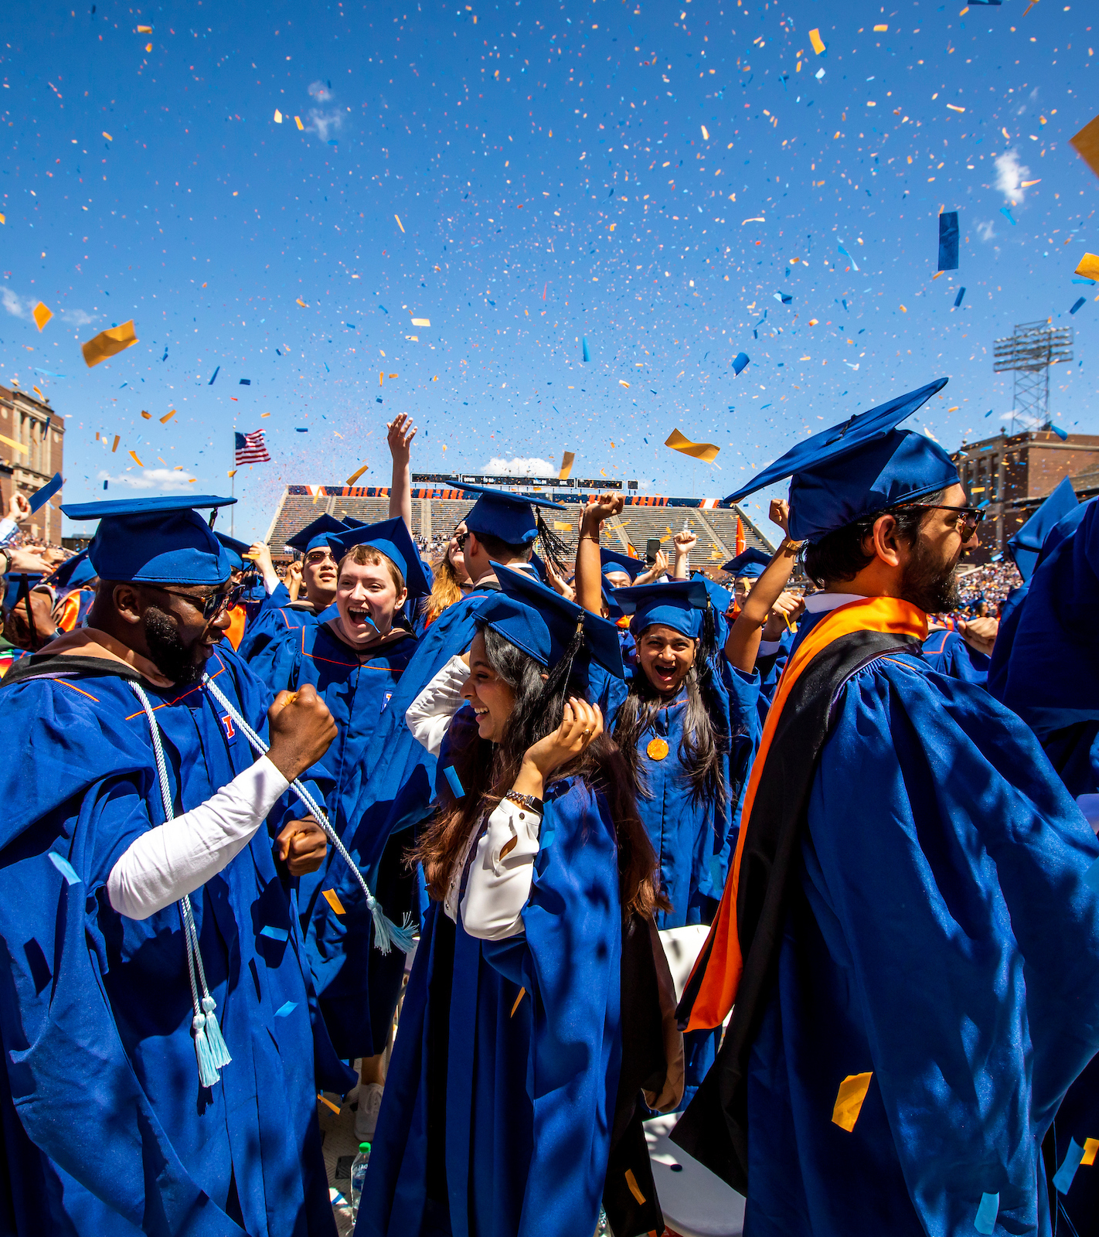
Graduate success
93% of graduates found a job or enrolled in a graduate or volunteer program within six months of graduation
80% of Illinois residents secured their first destination within the state of Illinois
91% of graduates report participating in experiential learning opportunities while at Illinois

Slide 7
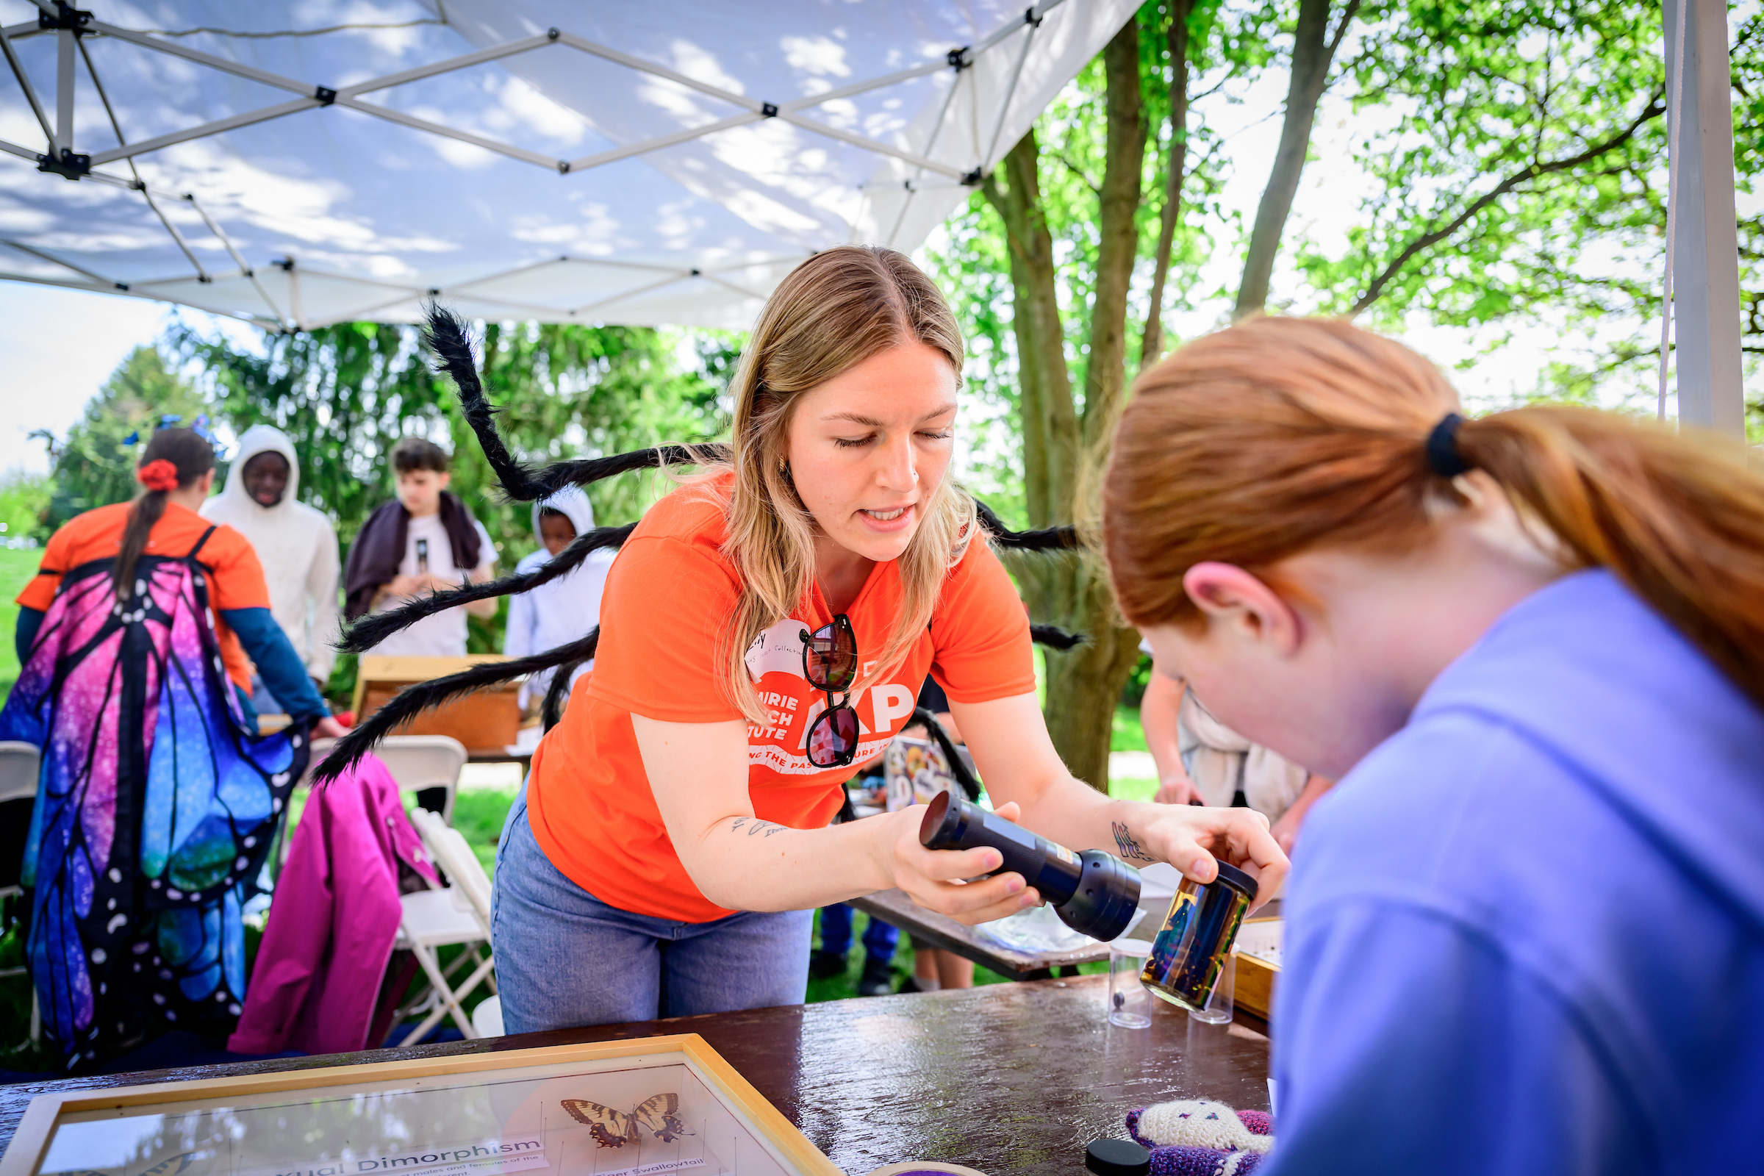


Institutional awards/designations
Illinois received the 2026 Carnegie Community Engagement Classification
Illinois was named one of its five national recipients of the 2026 Senator Paul Simon Award for Campus Internationalization

Slide 8
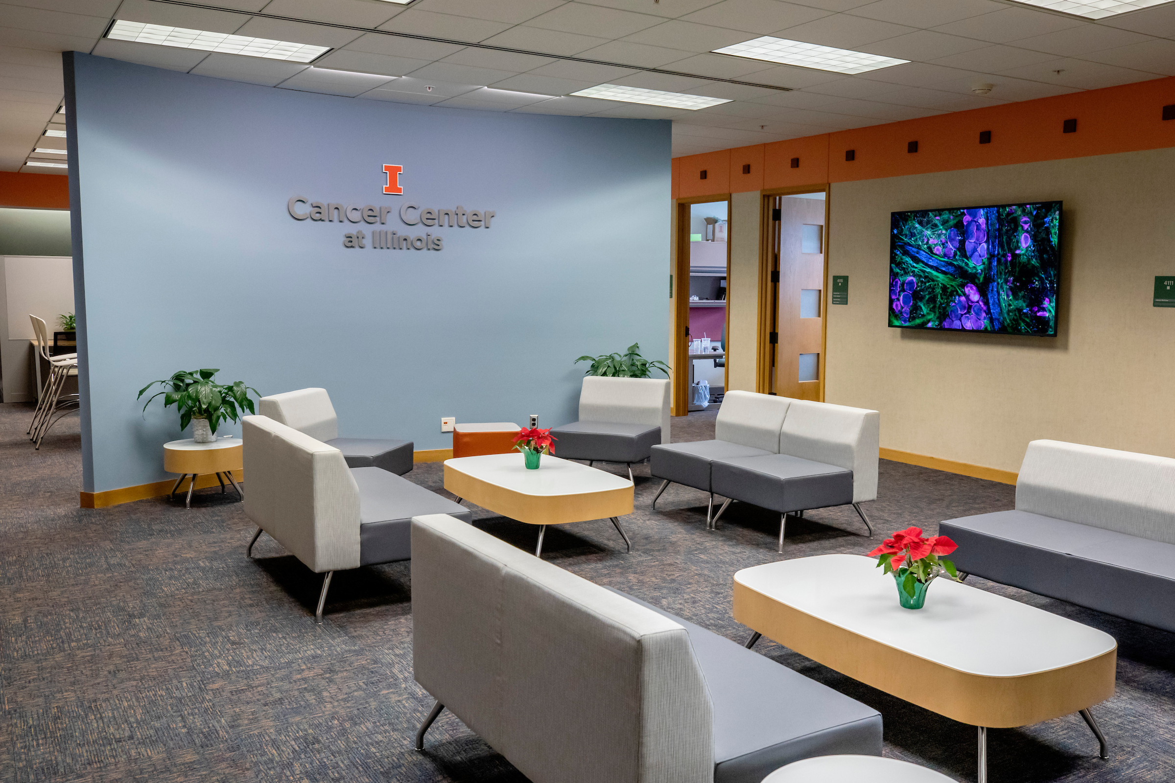
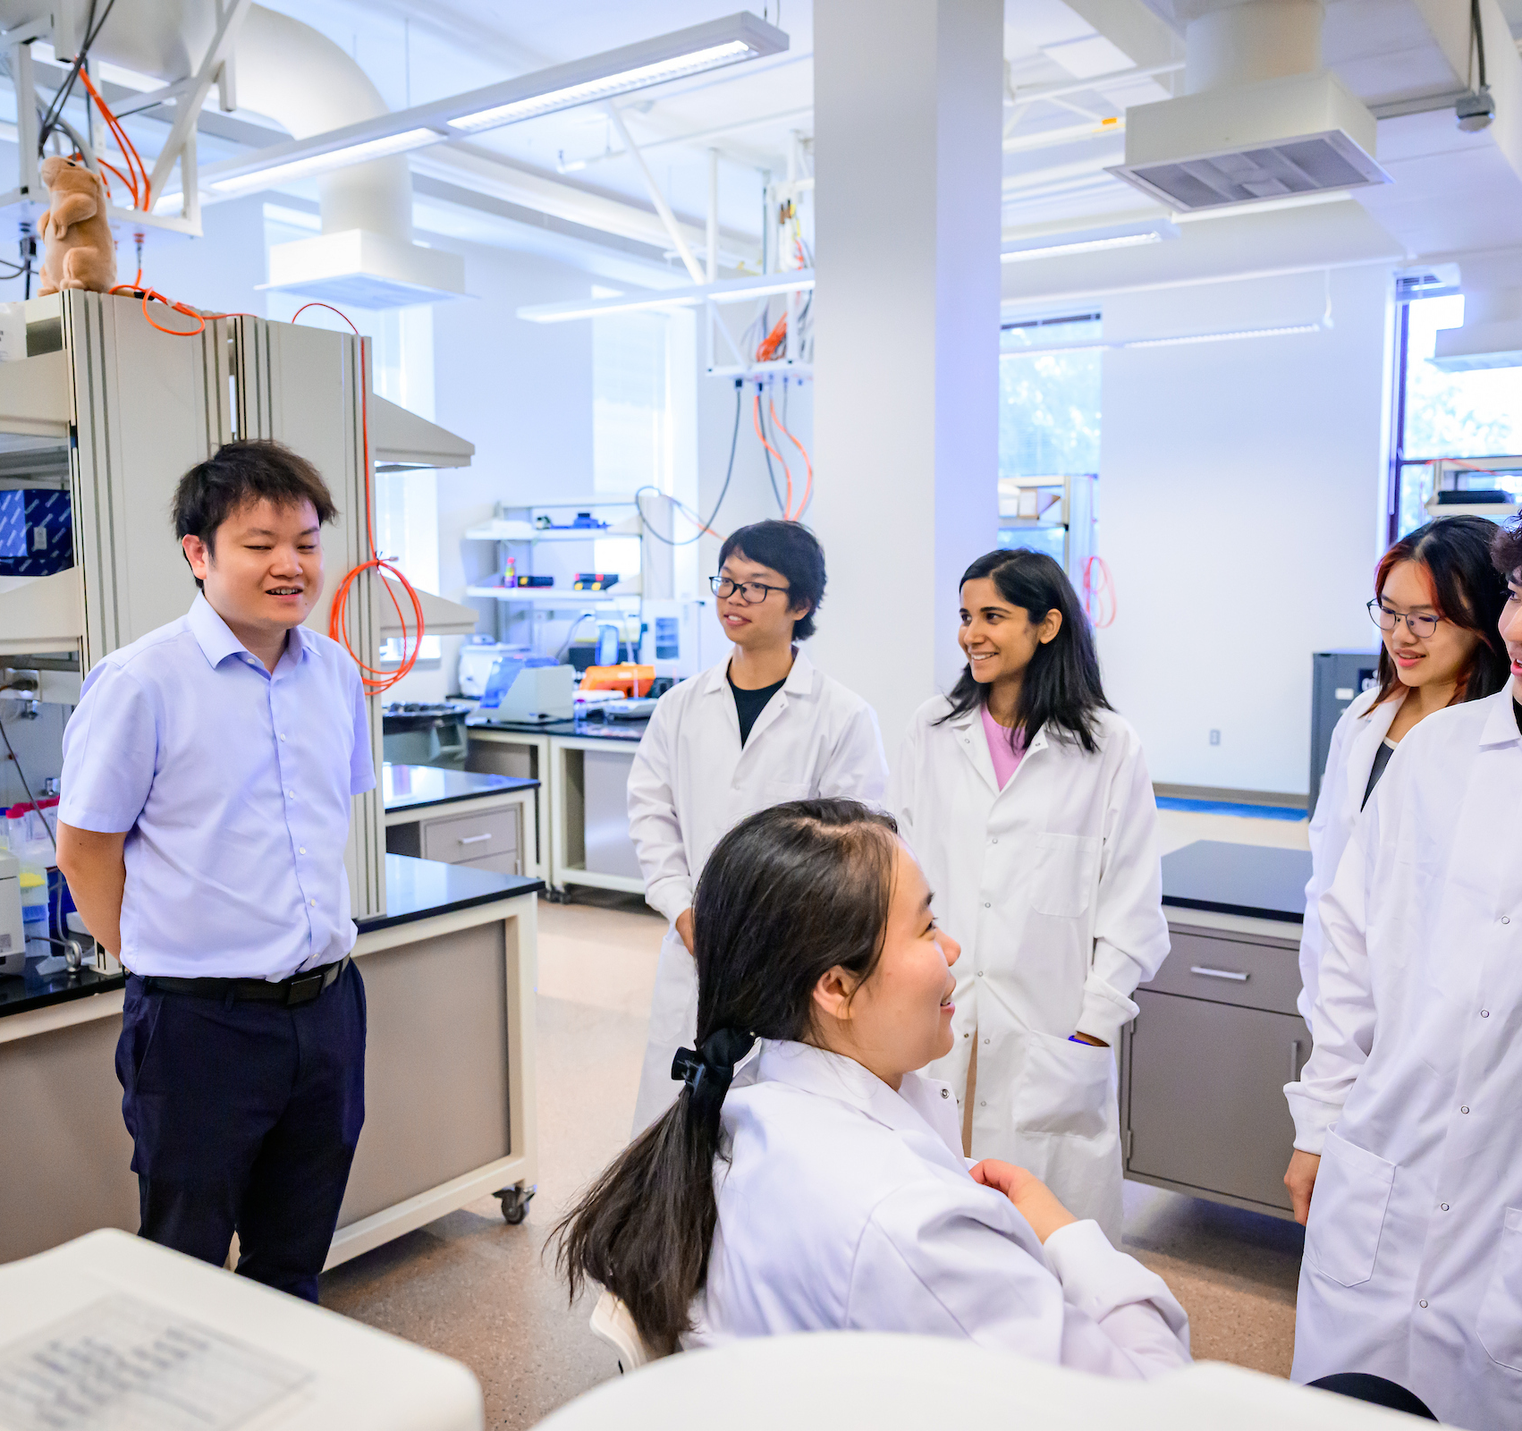
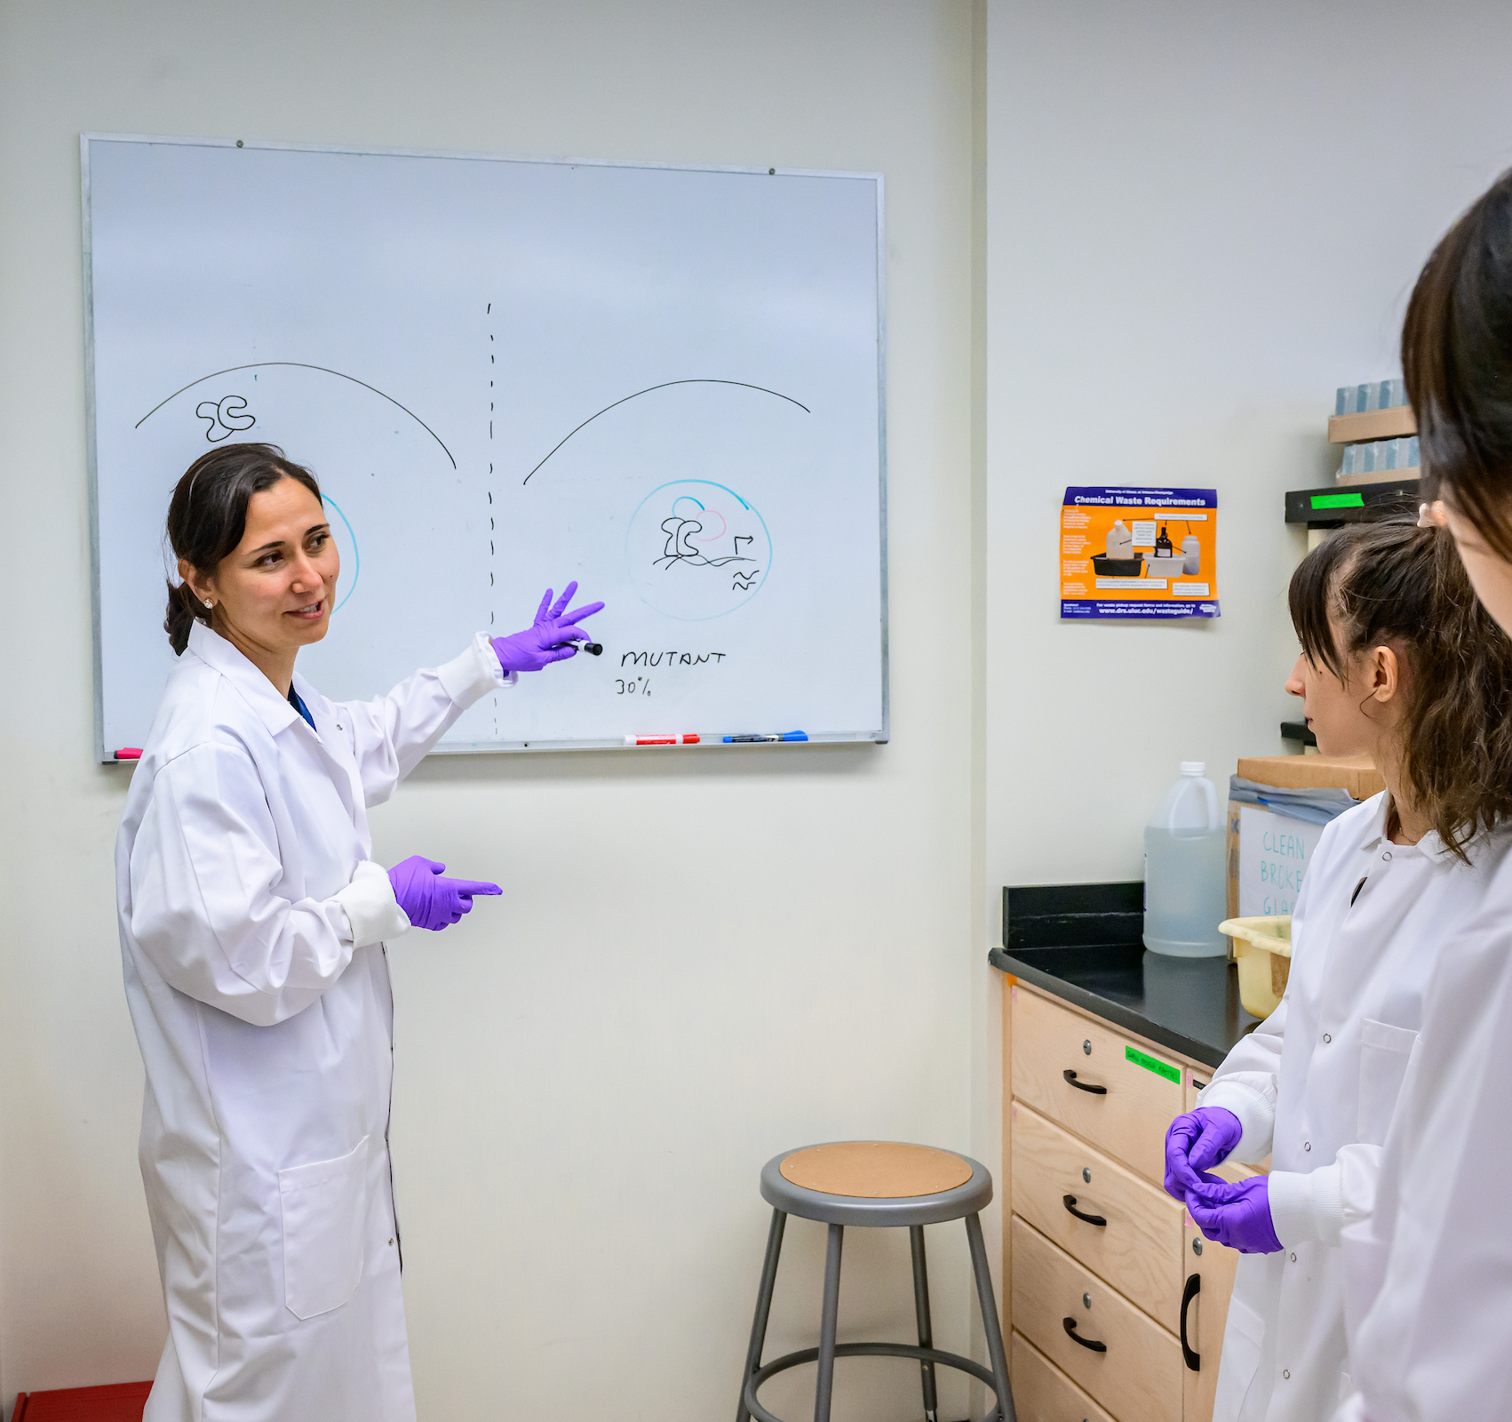
NCI designation for Cancer Center at Illinois
The first new Basic Cancer Center designation in nearly 40 years
The CCIL is only the eighth center recognized as a Basic Cancer Center nationwide, and the only one in Illinois

Slide 9
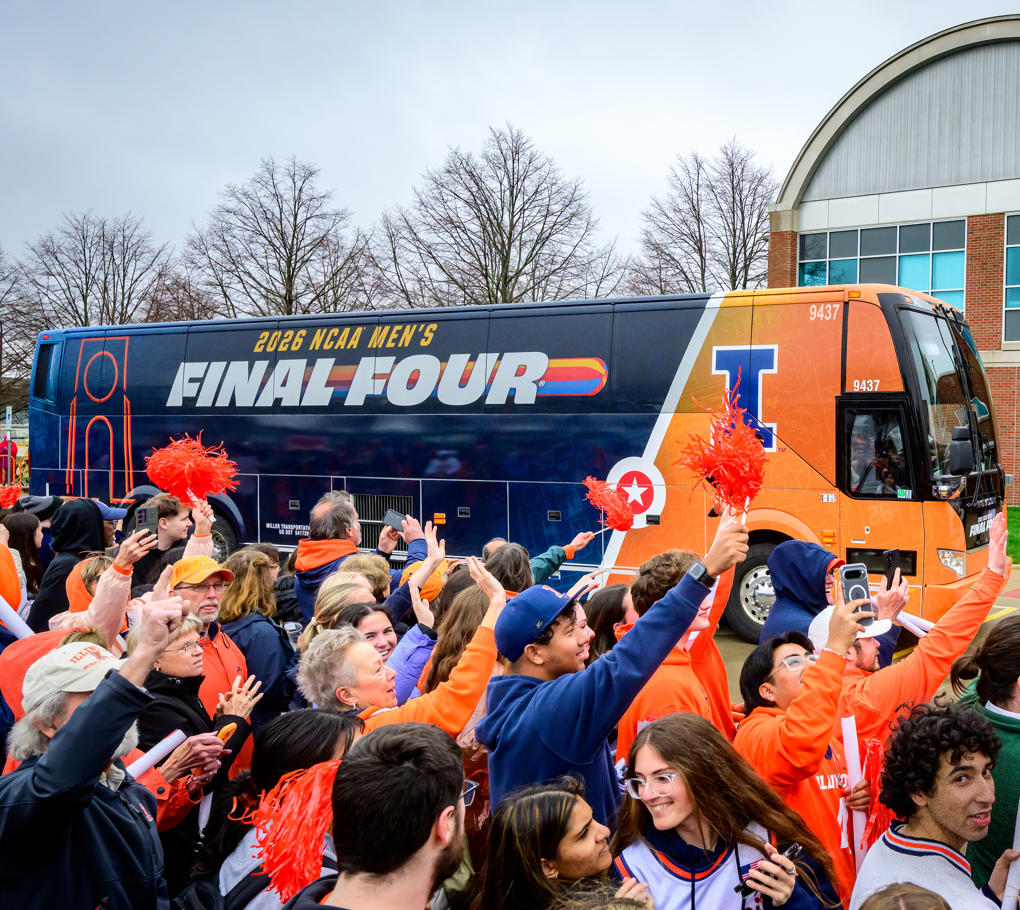
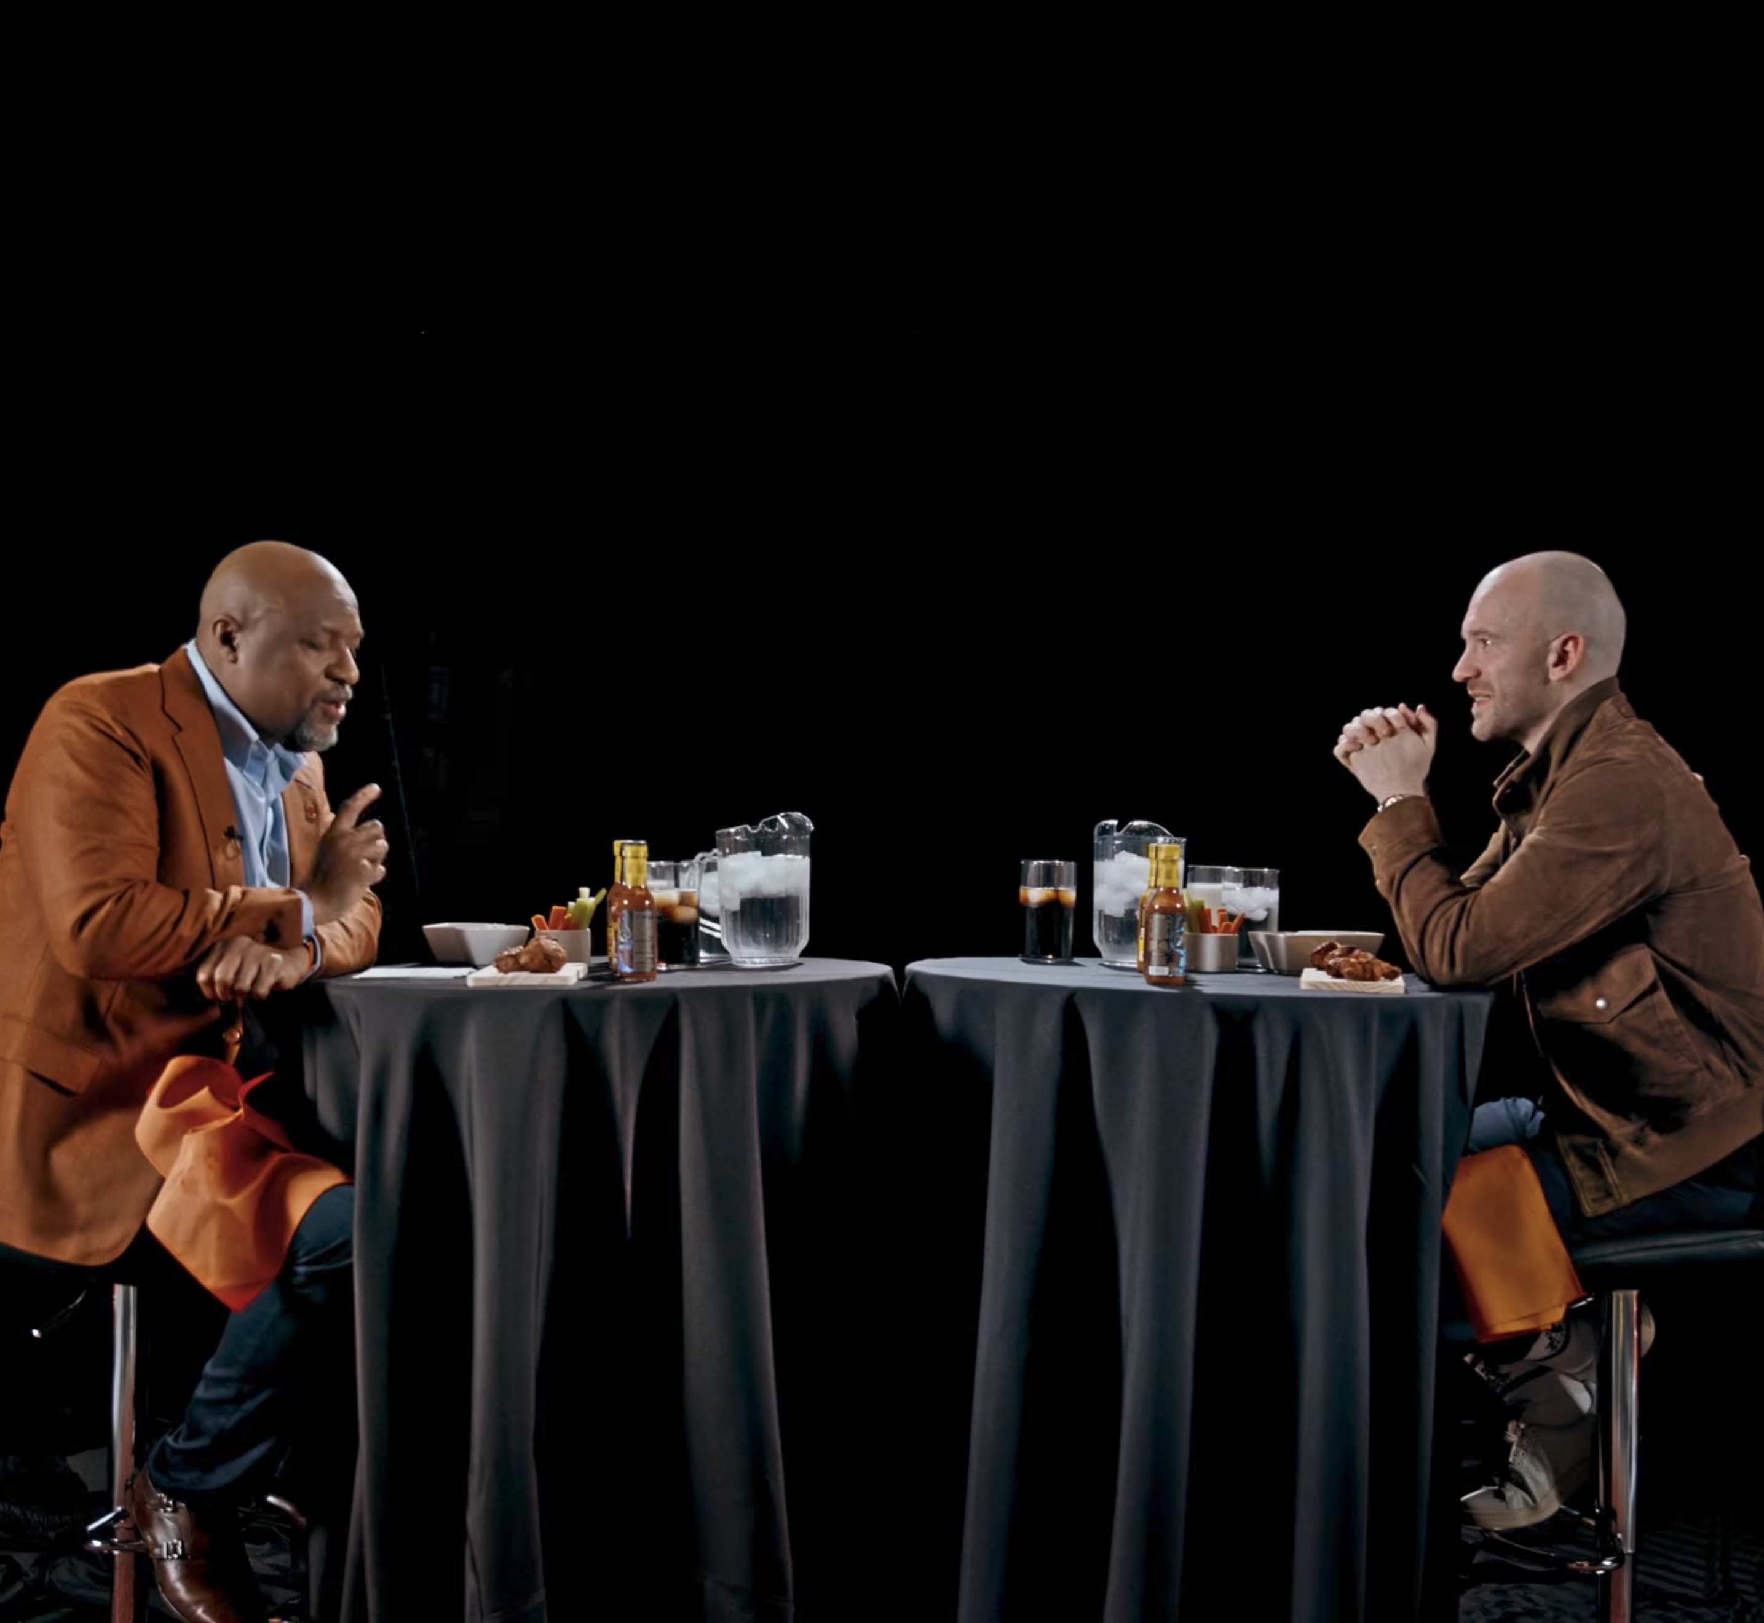
And much, much more

Slide 10
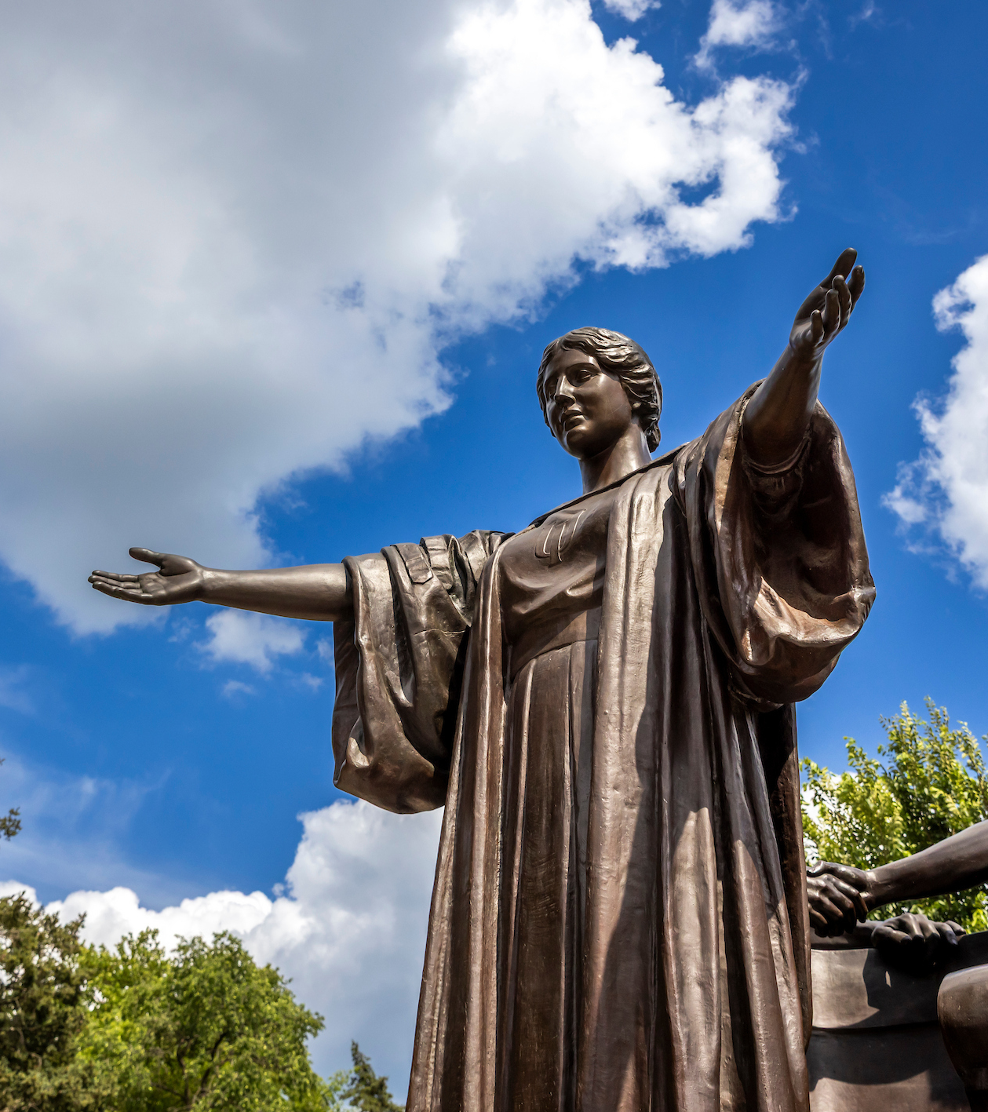
Taking the lead

Slide 11
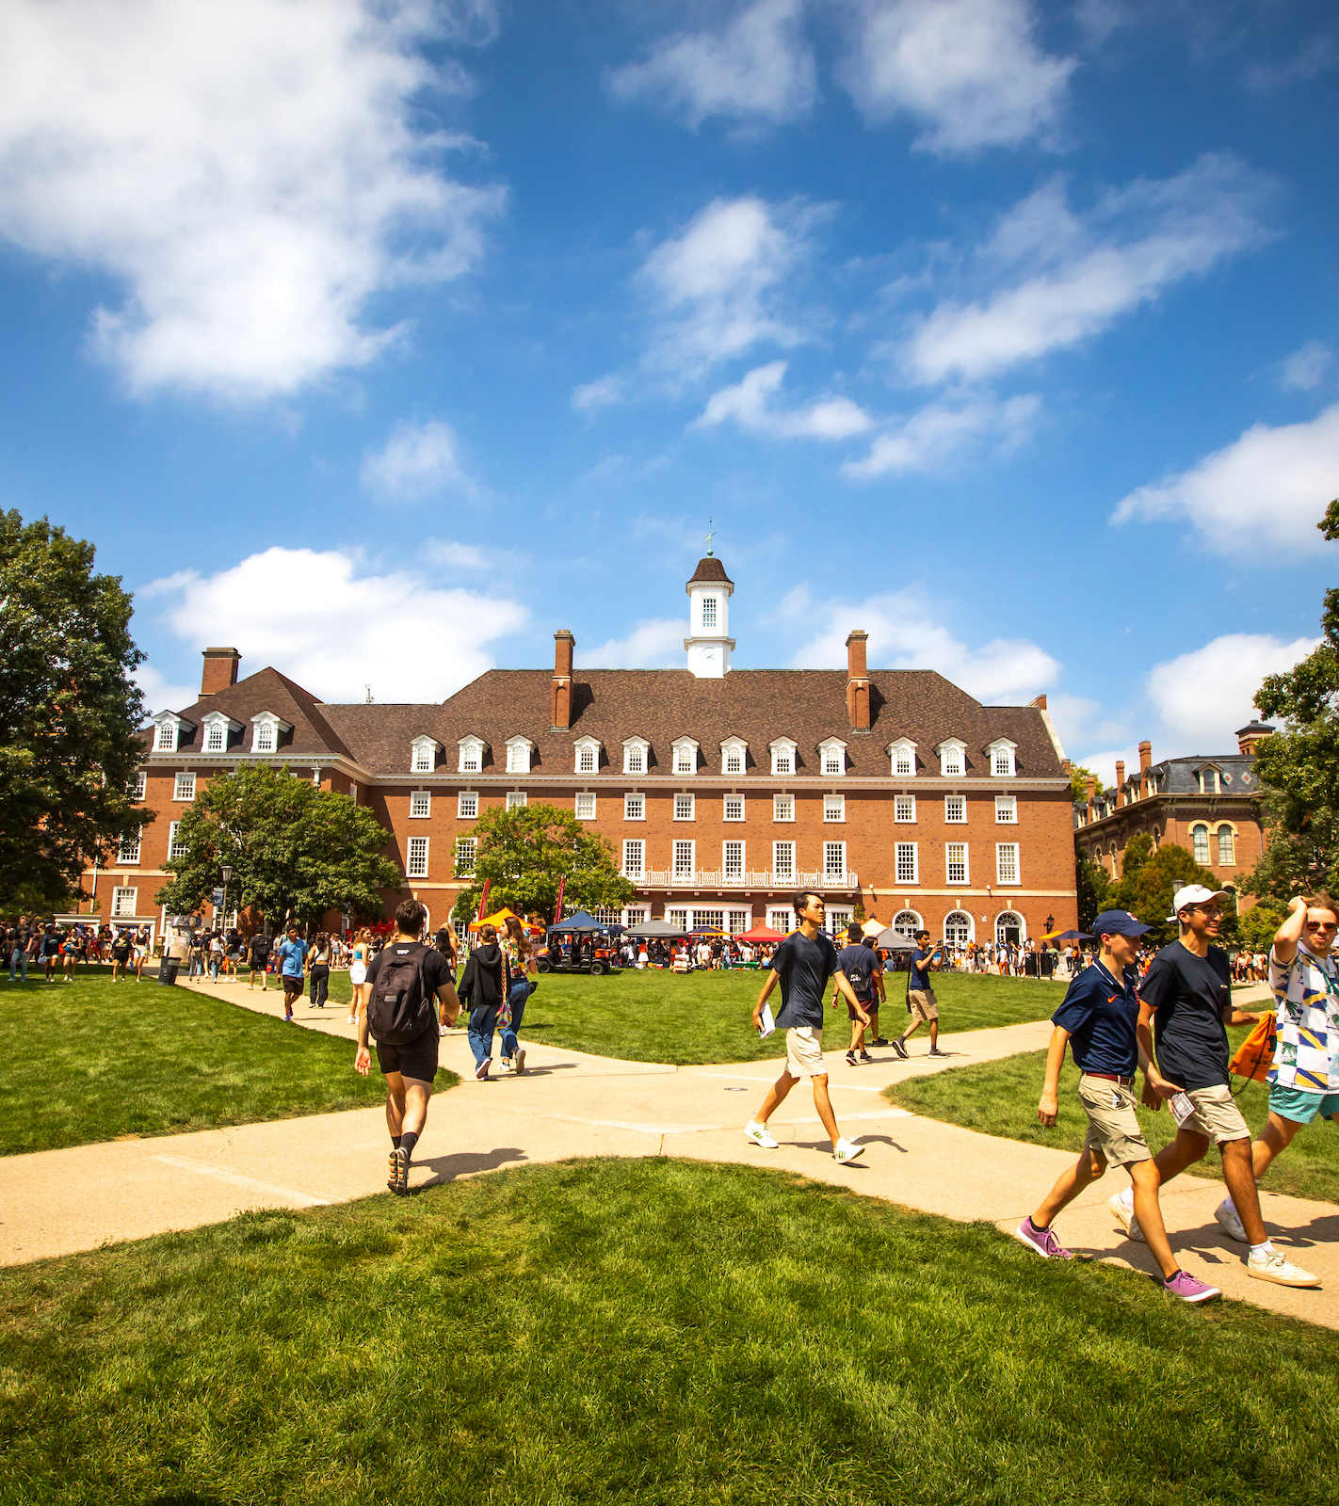
Thank You

