Slide 1
UNIVERSITY SENATES CONFERENCE
Cross-University Faculty Collaboration through the Institute of Government and Public Affairs University of Illinois System | Board of Trustees November 14, 2024
Steven D. Schwinn
USC Member, UIC
Professor of Law and
Associate Dean for Faculty Research and Development
UIC School of Law
schwinn@uic.edu

Slide 2
IGPA: WHAT IS IT?
The People’s Policy Think Tank
Ben Superfine
Senior Director, IGPA
Professor, Educational Policy Studies Department
University of Illinois Chicago
bsuperfi@uic.edu
IGPA includes scholars across disciplines, and across the three universities
IGPA scholars provide objective, non-partisan, and evidence-based research and analysis of public policy issues
IGPA connects our research with public policy and public-policy makers

Slide 3
How IGPA Does it
Faculty collaborations
Policy analyses
Partnerships and ad hoc projects
Funding for promising and relevant faculty research
Events/outreach for media and public

Slide 4
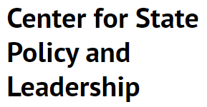
Faculty Collaboration
125+ faculty affiliates from across all three universities and system-level units

Slide 5
FACULTY COLLABORATION: working groups
Working Groups
Equity, Justice, and Human Flourishing
Education, Learning, Child and Family Well-Being
Fiscal and Economic Policy
Substance Use Disorders and Behavioral Health
Science and Technology (starting 2024-25)

Slide 6
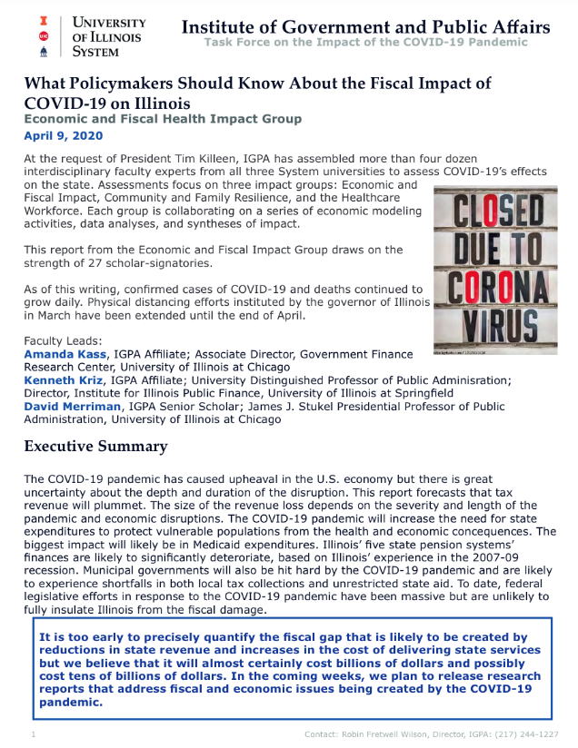
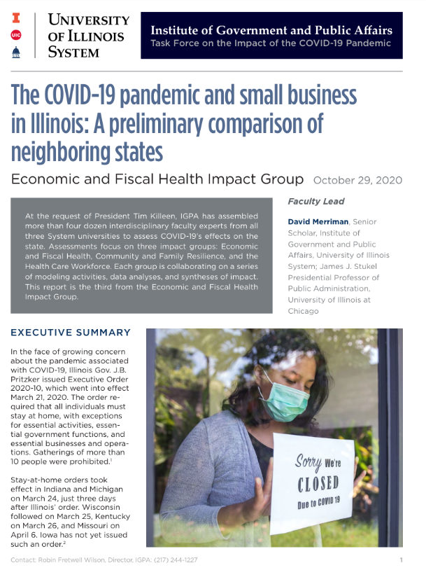
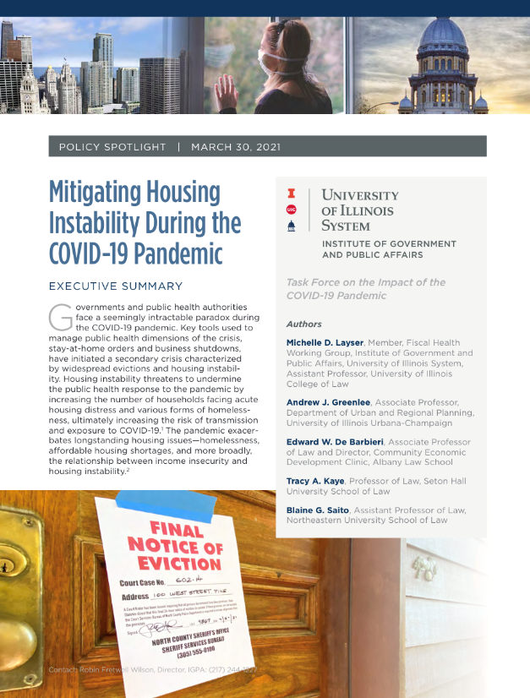
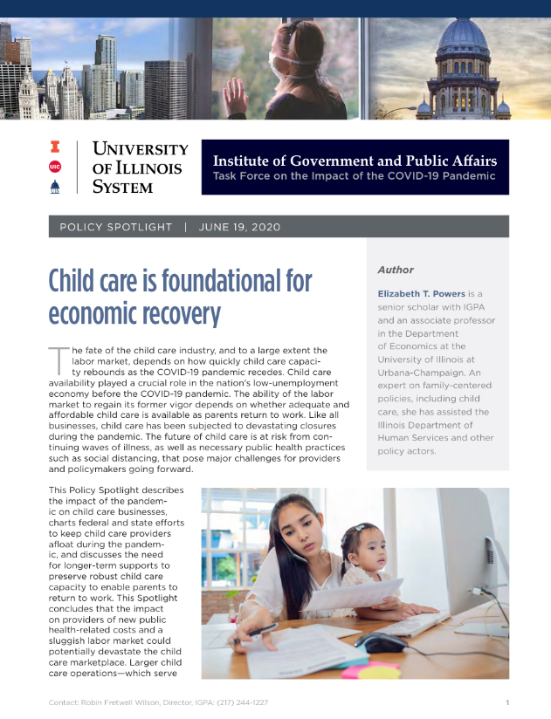
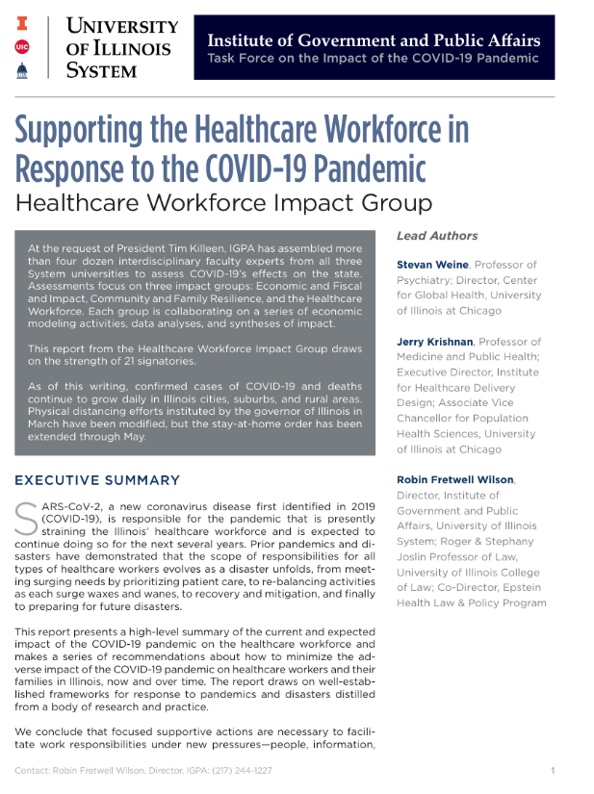
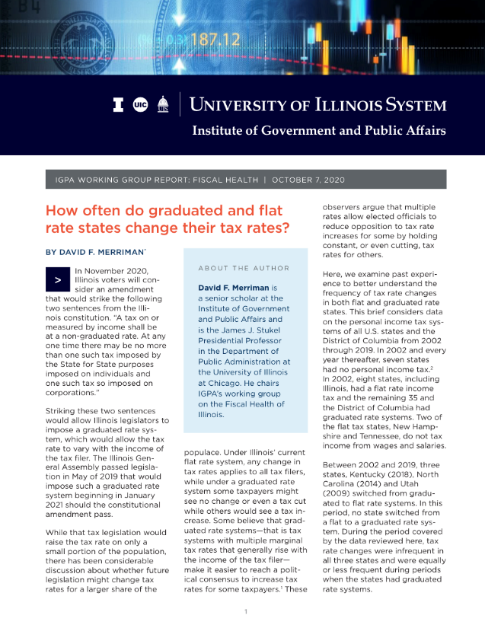
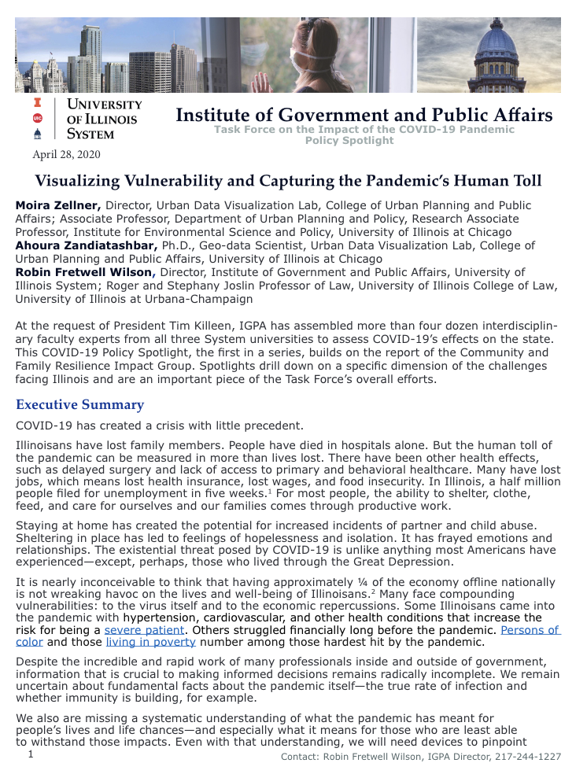
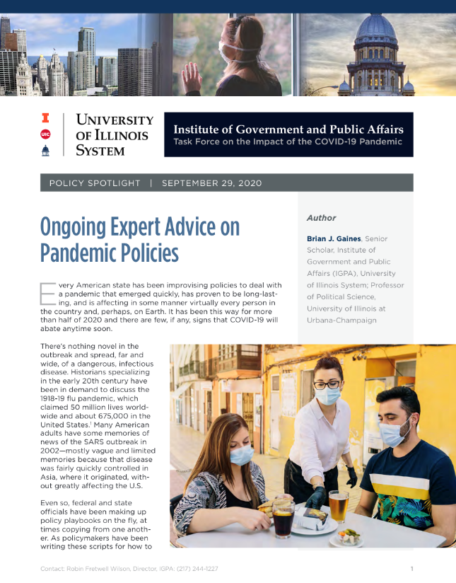
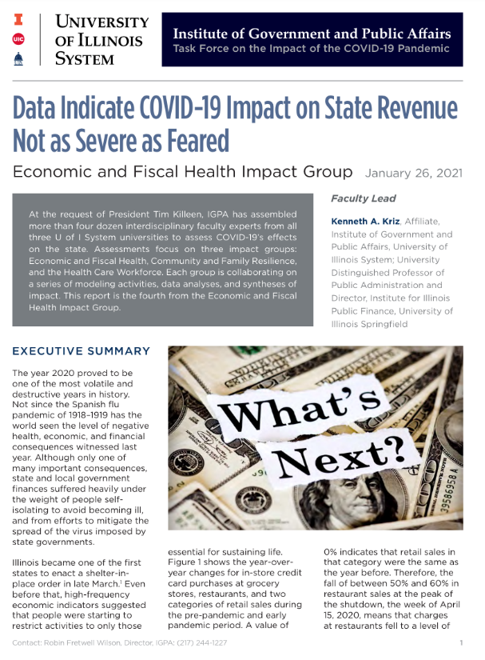
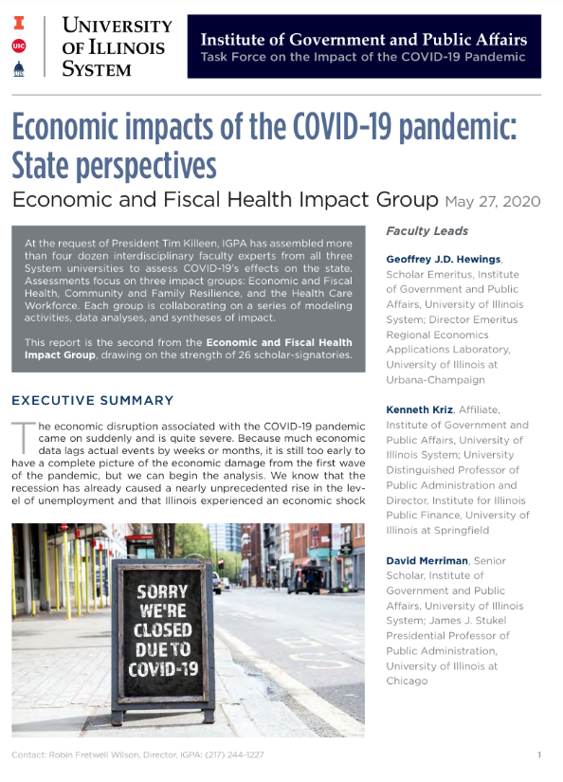
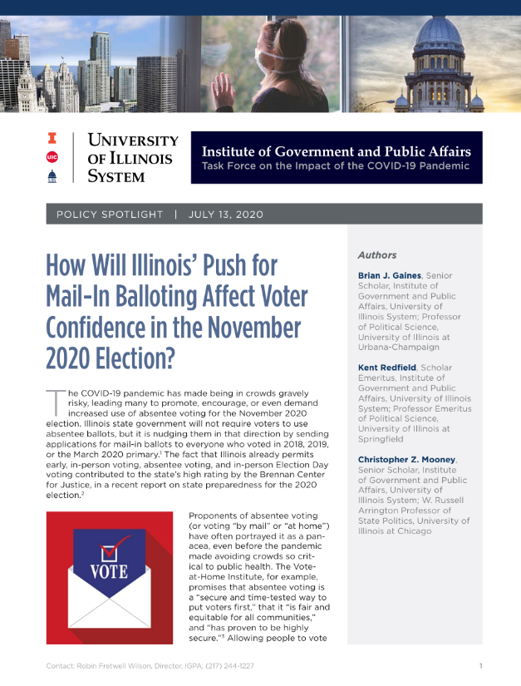
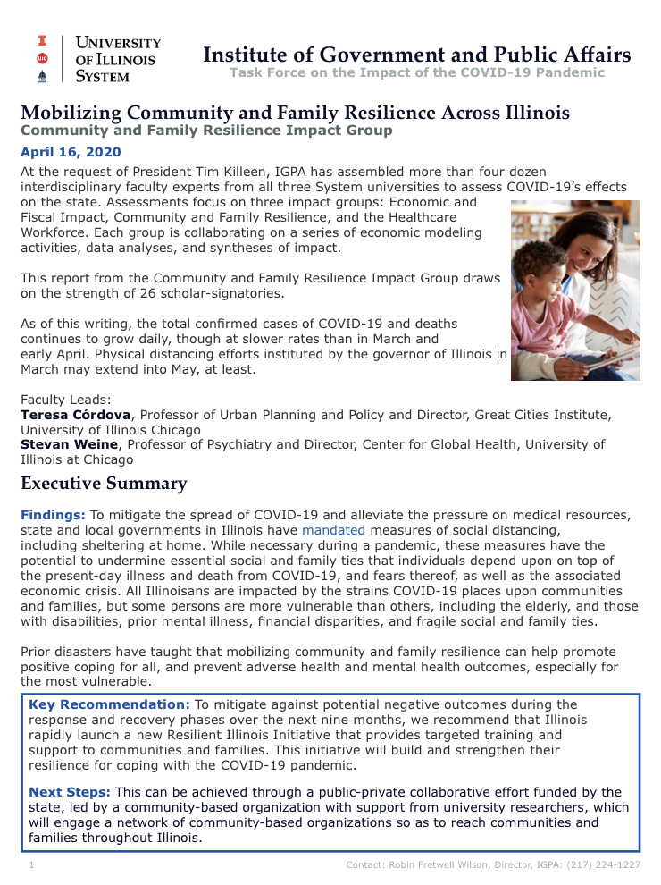
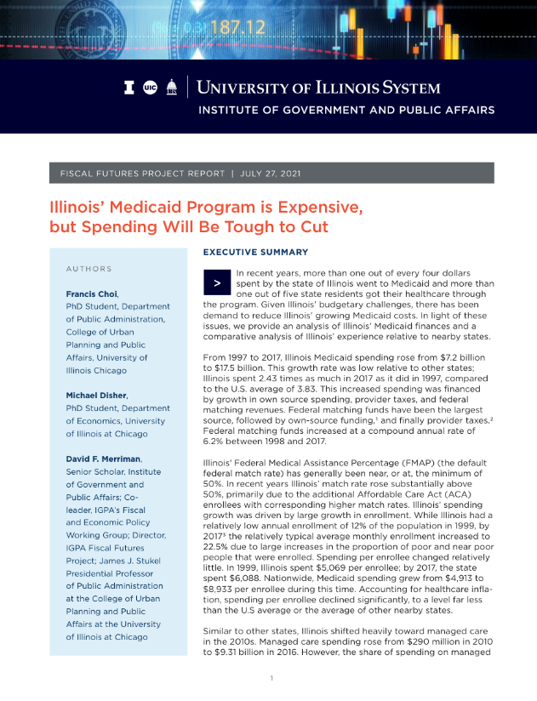
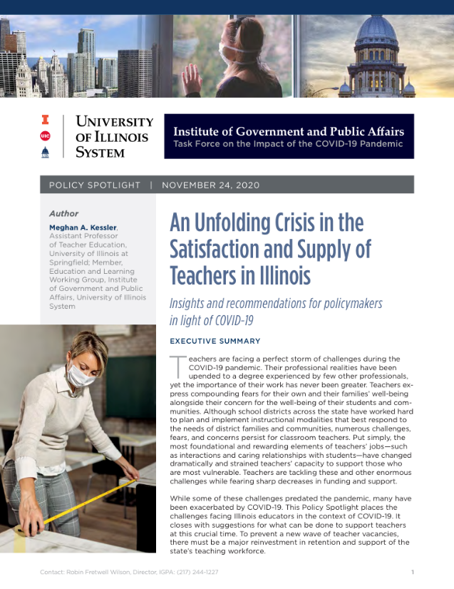
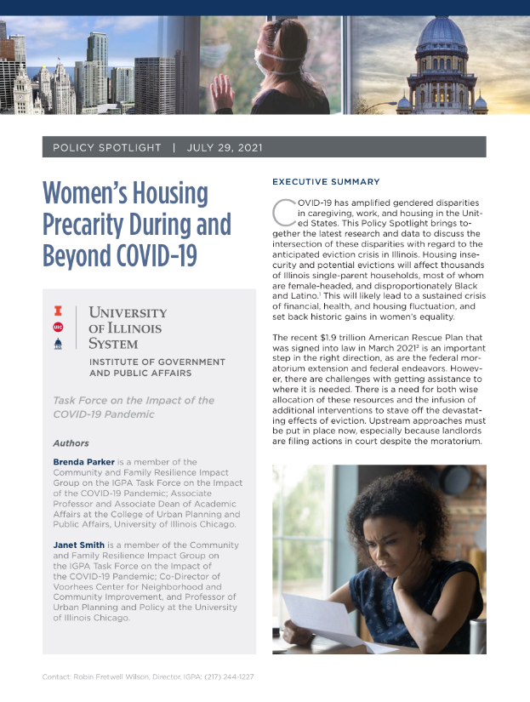
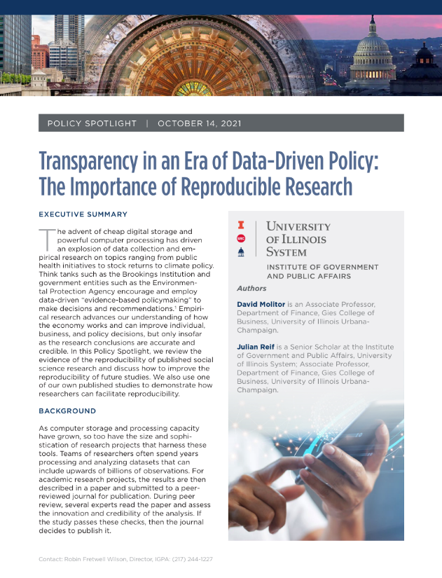
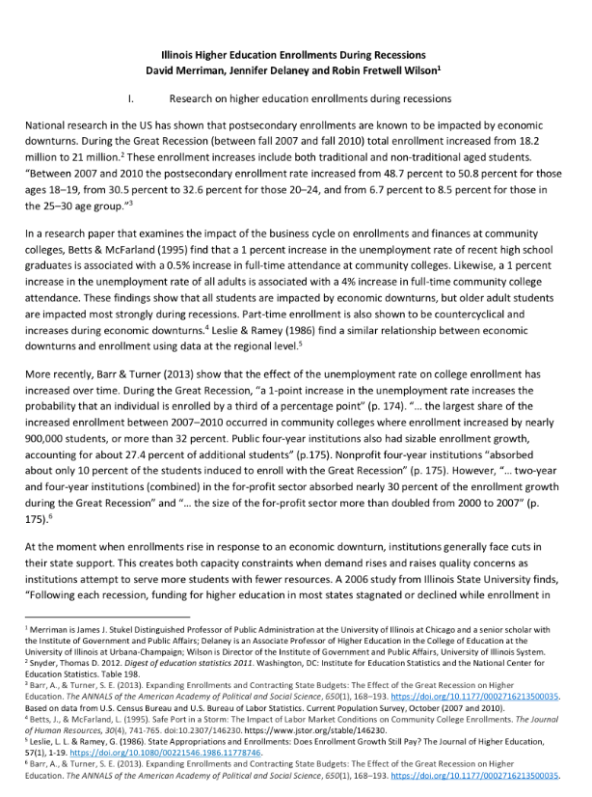
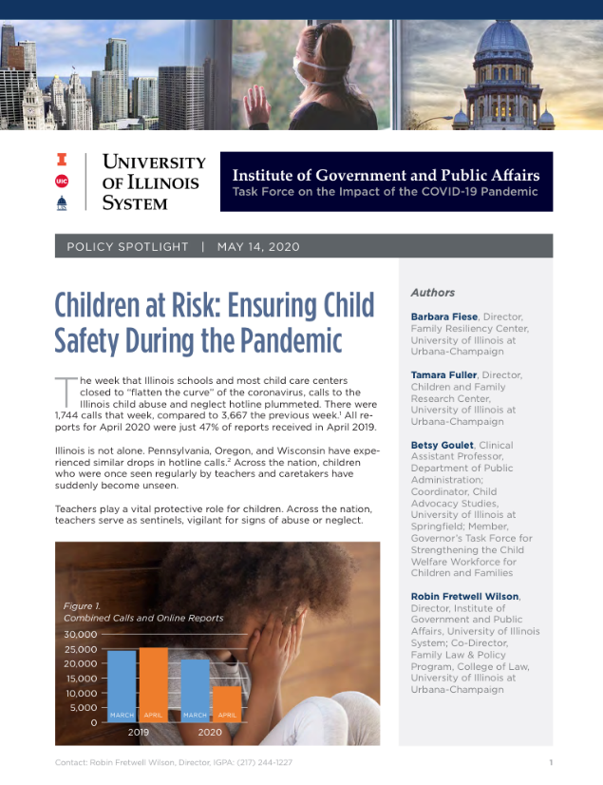
POLICY ANALYSES

Slide 7
PARTNERSHIPS
With government and
non-governmental organizations
On-Demand projects
Responding quickly to immediate policy needs
Funding for research
Resources for scholarly initiatives

Slide 8
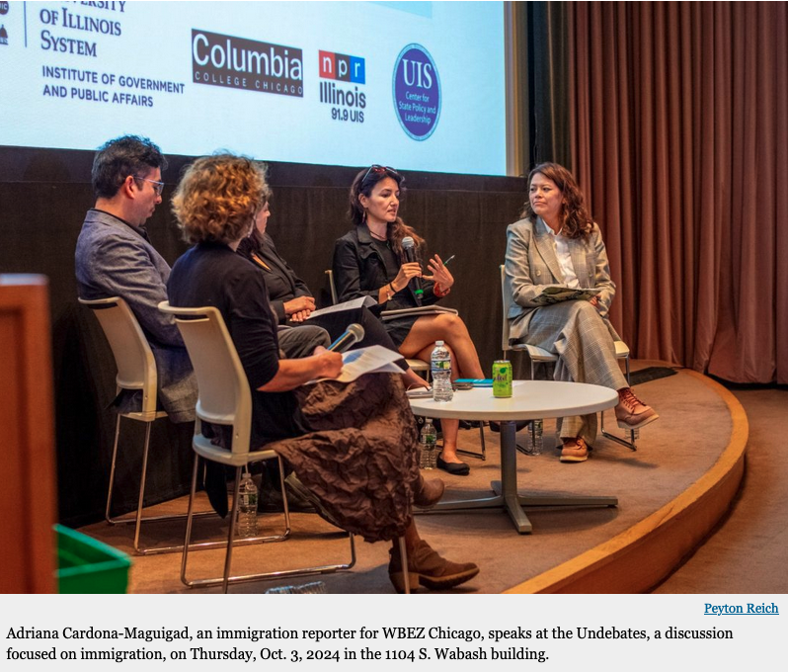
EVENTS
September 11, Undebate 1: Foreign Policy (Urbana)
September 17, Undebate 2: Reproductive Health (Springfield)
October 3, Undebate 3: Immigration (Chicago)

Slide 9
QUESTIONS AND COMMENTS
IGPA Online:
www.igpa.uillinois.edu
Ben Superfine
Senior Director, IGPA
Professor, Educational Policy Studies Department
University of Illinois Chicago
bsuperfi@uic.edu
Steven D. Schwinn
USC Member
Professor of Law and
Associate Dean for Research and Faculty Development
University of Illinois Chicago
schwinn@uic.edu

