Slide 1
Introduction
REMARKS TO THE BOARD OF TRUSTEES
President Tim Killeen
November 14, 2024
Notes:
Thank you, Chairman Edwards
At this time, I would like to introduce our treasurer, LESTER H. MCKEEVER JR., partner at Mitchell-Titus accounting firm in Chicago.
Also:
Chancellor and Vice President ROBERT JONES from Urbana;
Chancellor and Vice President MARIE LYNN MIRANDA from Chicago;
And Chancellor and Vice President JANET GOOCH from Springfield
And the Other University Officers and Staff:
University Counsel SCOTT RICE;
Vice President/Chief Financial Officer and Comptroller PAUL ELLINGER;
Executive Vice President and Vice President for Academic Affairs NICHOLAS JONES;
Vice President of External Relations and Communications ADRIENNE NAZON;
Vice President for Economic Development and Innovation JAY WALSH;
And Secretary of the Board of Trustees and the University JEFFREY STEIN.
Representing the University Senates Conference and the University of Illinois Chicago Senate, Donald Wink, professor of chemistry, University of Illinois Chicago.
Representing the academic professional staff, MINT SIMAGRAI (SIM-a-greye), director of operations for the Office of International Services, University of Illinois Chicago.
Representing the University of Illinois Urbana-Champaign Senate, CHARLES ROSEMAN, associate professor of evolution, ecology, and behavior and associate professor of anthropology, as well as chair of the University of Illinois Urbana-Champaign Senate Committee on Academic Freedom and Tenure.
Sandra De Groote, professor and head of assessment and scholarly communications, chair of the UIC Senate Executive Committee, is also observing today.
Also joining us via the livestream and representing the University of Illinois Springfield Senate, Lynn Fisher, chair of the Department of Sociology and Anthropology, professor of anthropology, and chair of the UIS Senate.

Slide 2

2019-2024 – An Era of Progress
2019-2024
An Era of Progress
Notes:
With today’s meeting, as you know, we will all but bring to a close Chairman Edwards’ leadership of the Board of Trustees.
The six years that will soon end are a period of incredible success across the University of Illinois System, even through an array of challenges – ongoing challenges felt across higher education and others that are, if not unprecedented, certainly distinct.
It’s well worth taking a closer look at where we as a university system were when the chairman was first chosen by his fellow trustees to lead the board in 2019 and where we are today.
The highlights I’m about to share tell a story of growth, resilience, service and excellence that we can be proud of -- across the entire U of I System.

Slide 3
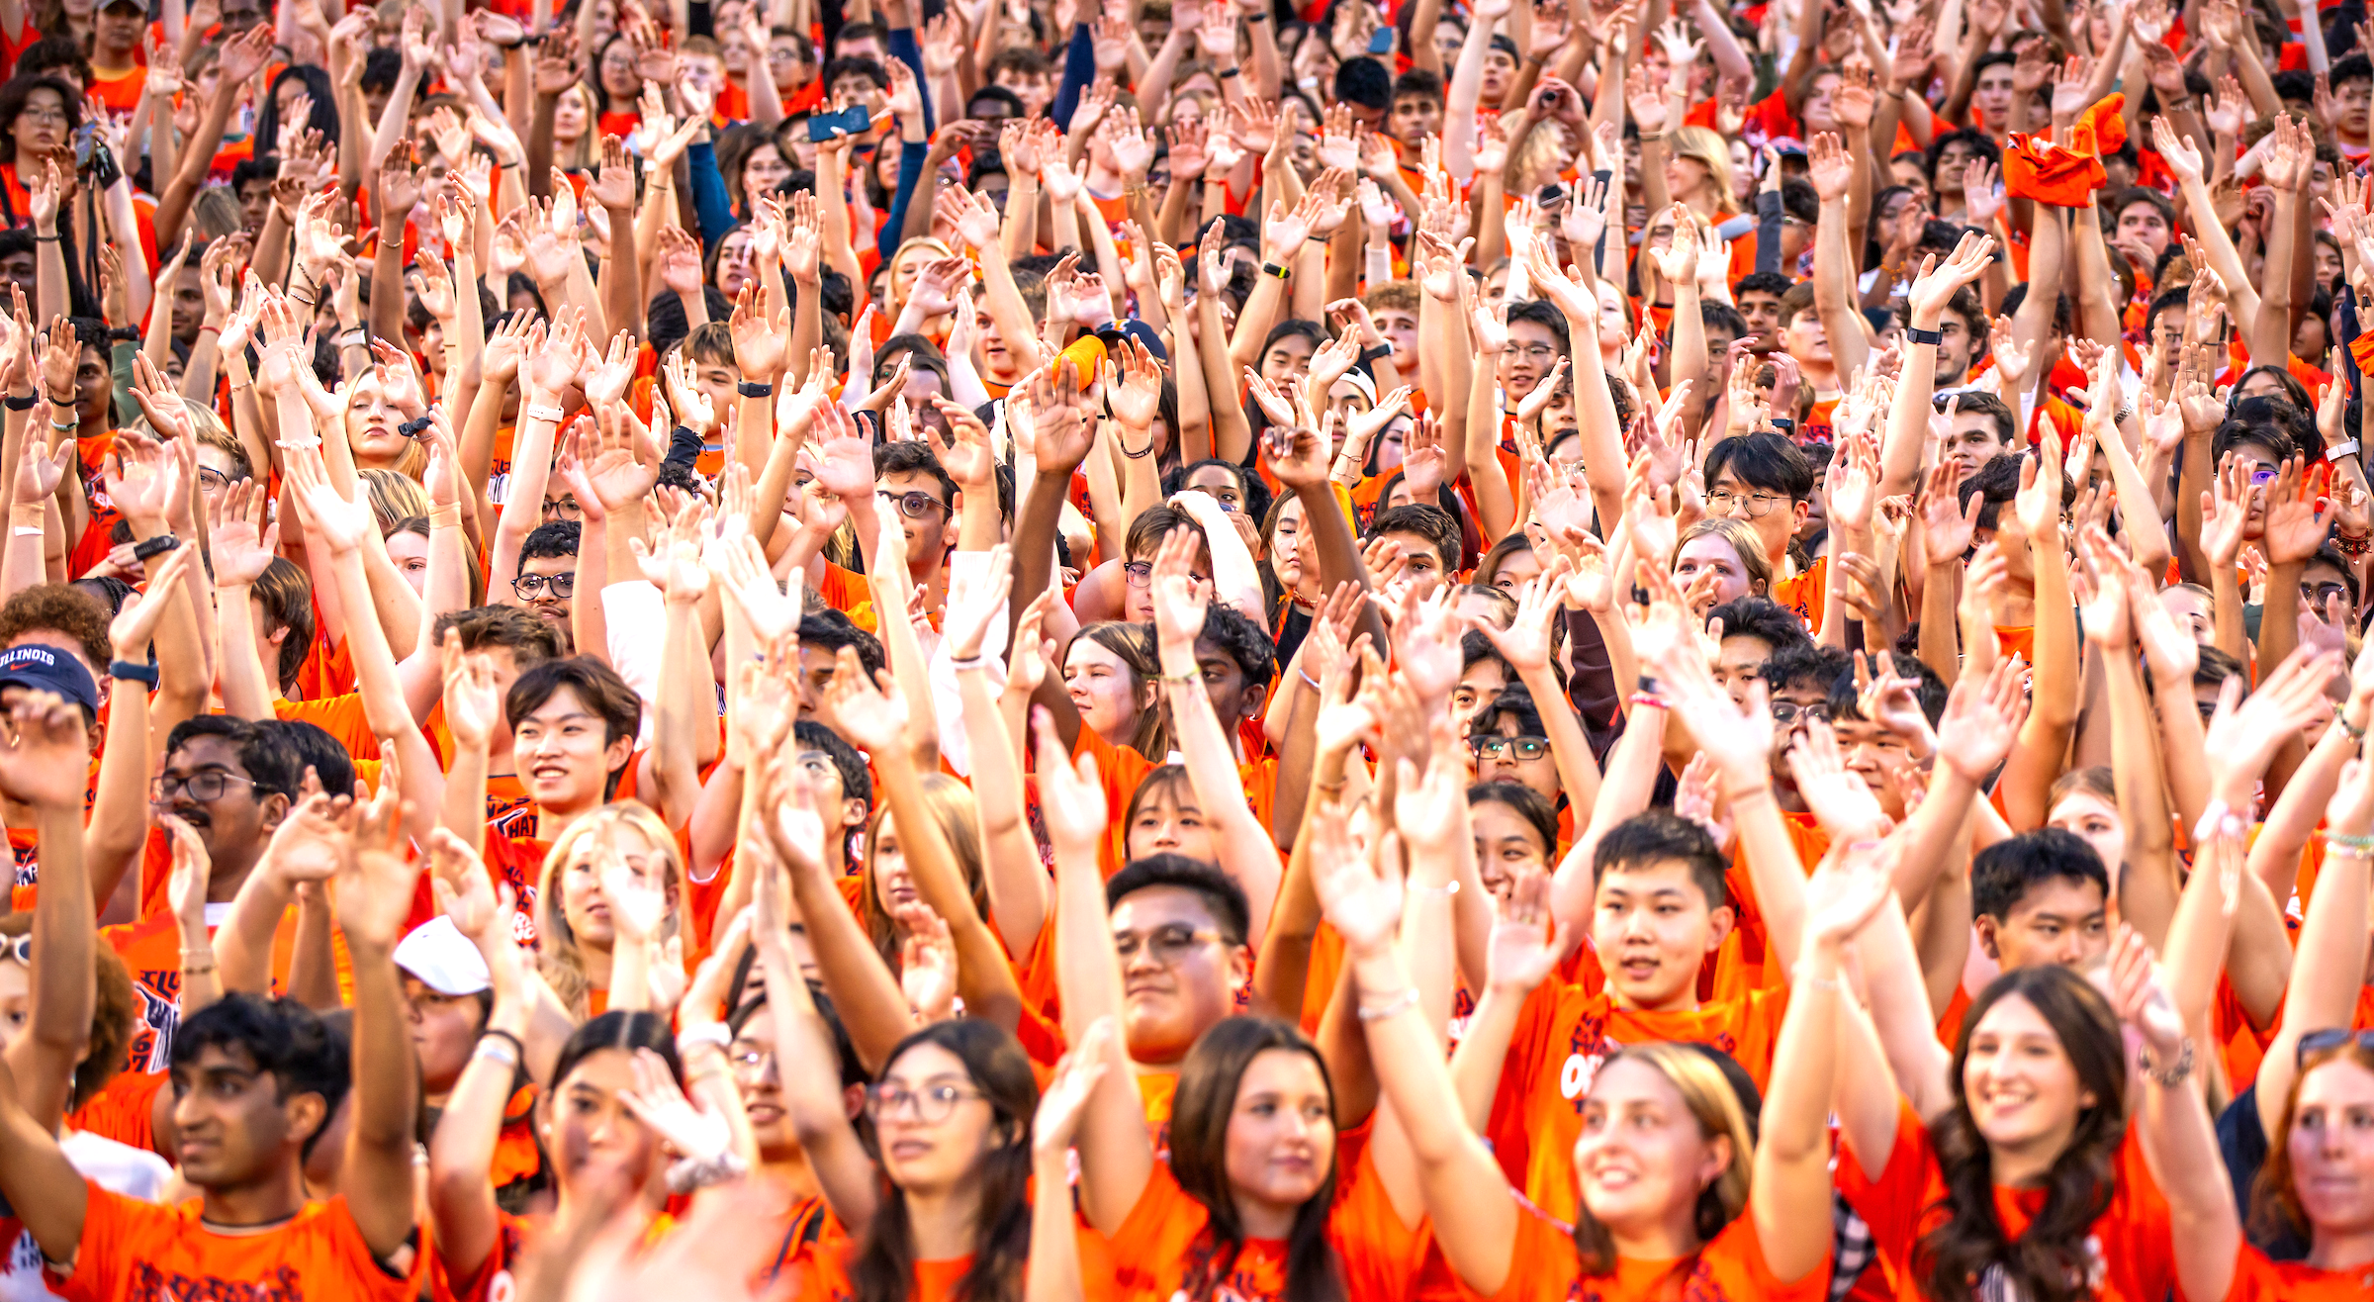
Growing enrollment
Growing Enrollment-Systemwide
Notes:
Enrollment is not the only way to measure growth and success, but it is probably the most fundamental.
And you can see on the slide evidence of what you have heard me say so often: that students and their families continue to vote feet with their feet and choose a U of I education.
And they do so in ever-increasing numbers.
Our enrollment has grown by almost 10 percent since our trustees met in November 2019 – 8,500 students, the equivalent of a regional university to the state’s higher education landscape.
That fall, we enrolled nearly 89,000 students, a new benchmark that drew the praise of even Gov. Pritzker -- an indicator of something that has become increasingly important in our success these past six years: alignment, the strength we enjoy when everyone from elected leaders to our trustees, faculty and staff work together to make certain that the university system is the best it can be.
This is how this engine we oversee fires on all cylinders.
And it means, ultimately, that each of the more than 8,500 additional places made available at our three universities since 2019 is an opportunity for a young student to chart a course for a life lived well.
But it is, of course, not enough to just enroll more students.

Slide 4
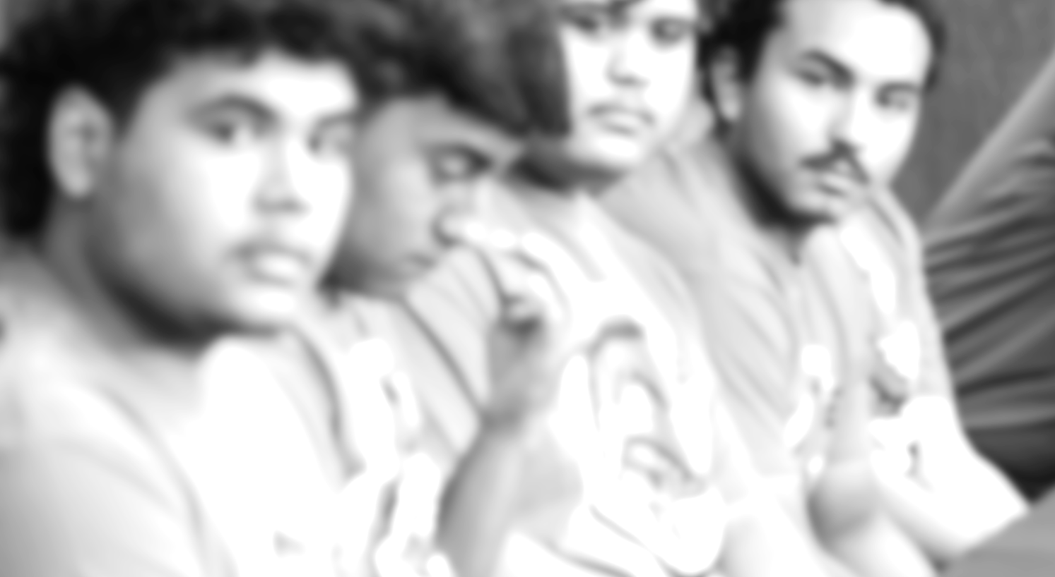
Expanding access for all
Expanding Access For All
Undergraduate enrollment of underrepresented minority students
Notes:
Our commitment to increasing access to the education we offer is central to our mission. And these past six years we have made tangible progress in opening our doors wider to students from a wider range of backgrounds.
This fall, 20,001 undergraduates from underrepresented minority populations are enrolled across the U of I System.
That’s an increase of 2,013 students from the fall of 2019.
Those 20,001 students now account for fully one-third of our undergraduate enrollment.
We also now have just over 17,000 first-generation college students enrolled systemwide, up from about 15,000 in 2019.
I am proud to say we are also building a smoother pathway for transfer students than ever before, as well.
Our enrollment of first-time transfer undergraduate students increased this fall by 4.4%.
And we never forget our commitment to making certain our first commitment is to students from Illinois.
On this we have remained consistent these past six years, enrolling almost 47,000 in 2019 and well over 47,500 this fall. They account for 79 percent of our undergraduate enrollment.

Slide 5
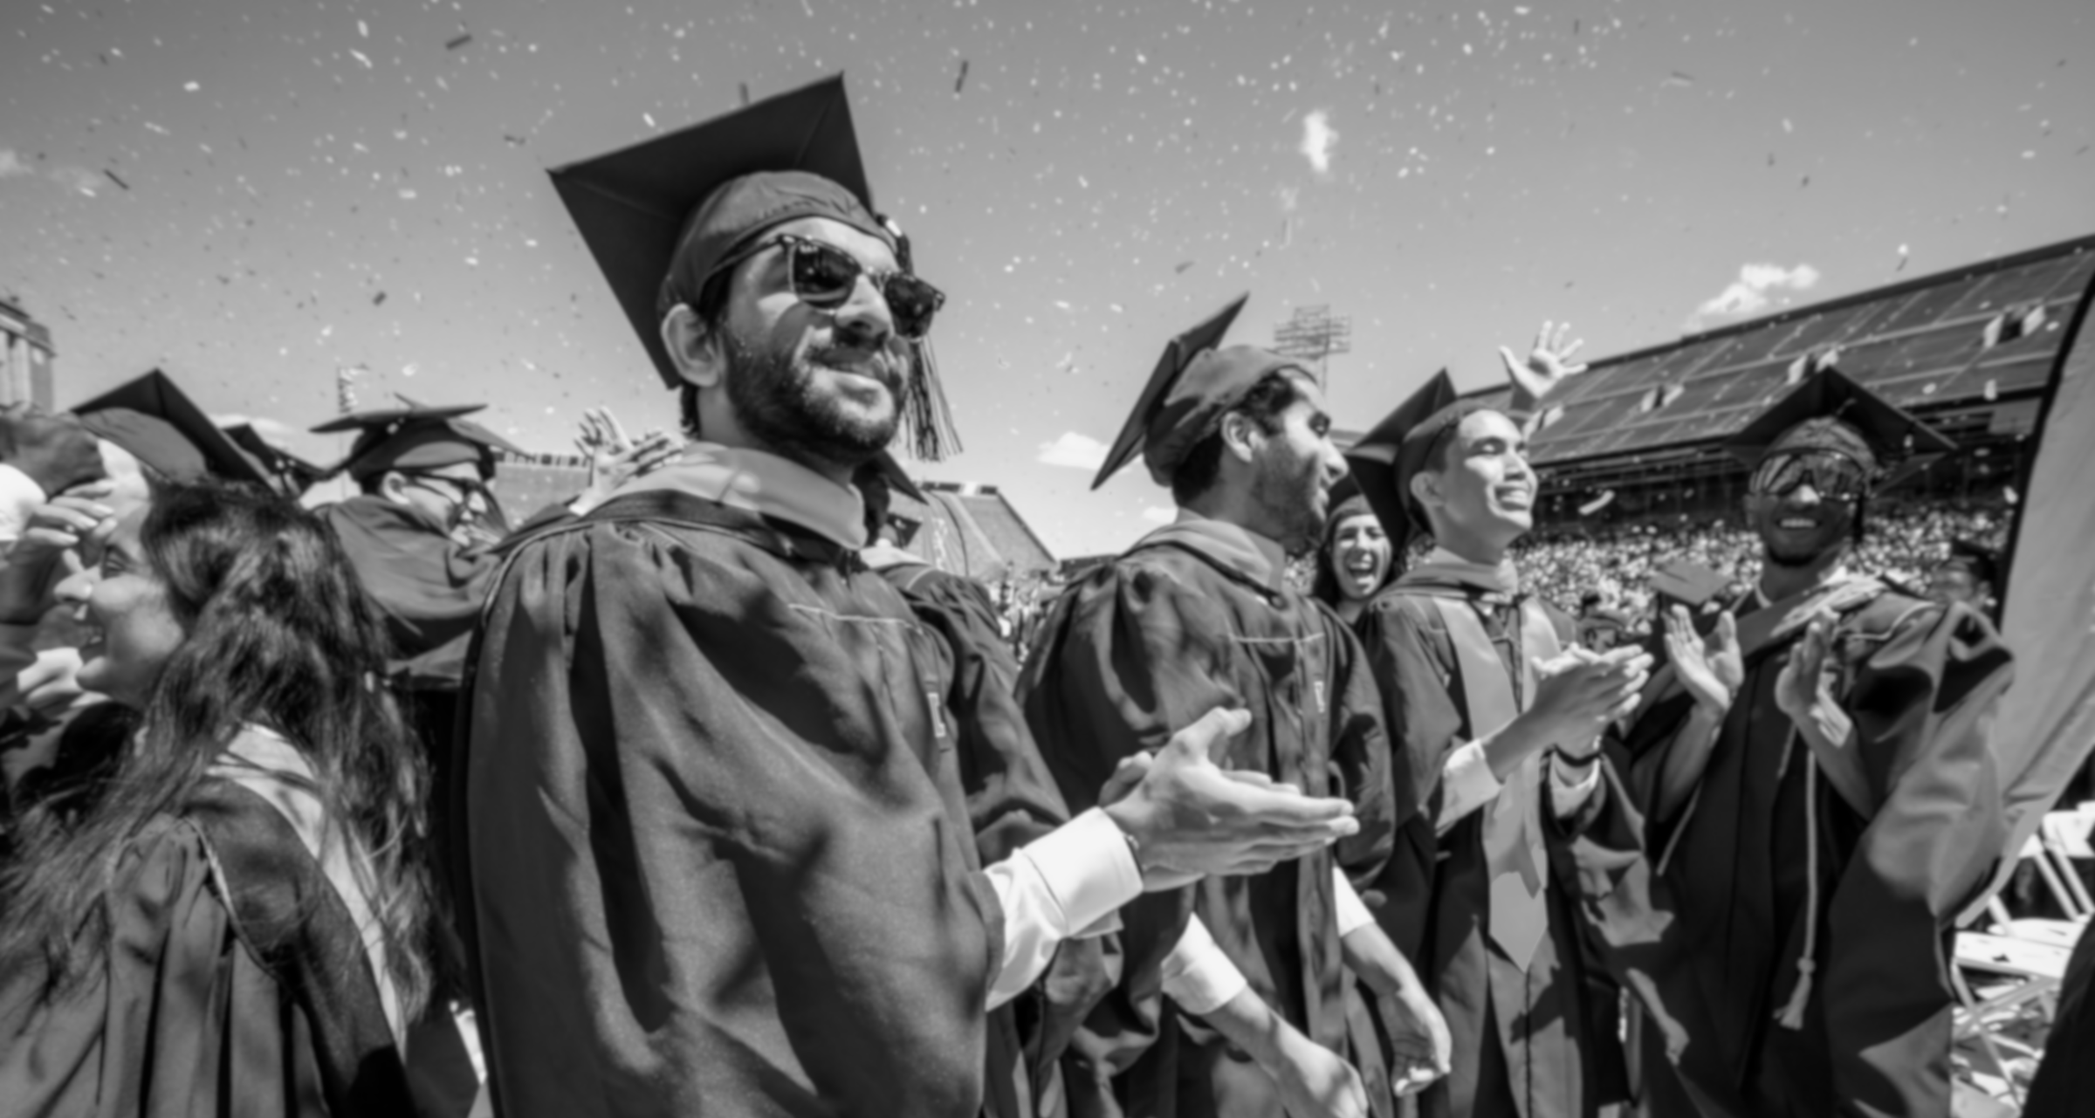
Degrees awarded
Degrees Awarded
22,688
27,041
2018-2019
2023-2024
Notes:
With our growth, we now award more degrees than ever, as well.
And the growth here has been remarkable.
In the 21018-19 academic year, an impressive 22,688 students became brand-new holders of University of Illinois degrees.
Now?
In the academic year we completed over the summer, that ballooned to 27,041 new degrees.
That is just incredible growth and proof of our commitment to improving access – and outcomes.

Slide 6

Black and Hispanic Graduates
Black & Hispanic Graduates
Degrees Awarded to Black and Hispanic Students
2018-2019
2023-2024
Black 1,368
Hispanic 2,551
Black 1,751
Hispanic 3,790
Notes:
If we take a closer look, that broad-based growth in the number of degrees we award is having an impact on populations we have long sought to offer opportunities to.
The number of U of I System degrees award to Black and Hispanic students have increased substantially since 2019 – a 29 percent increase for Black graduates and a 49 percent leap – 49 percent! – for Hispanic graduates.
We have much more work to do here, certainly, but our progress is real and impacting lives.

Slide 7
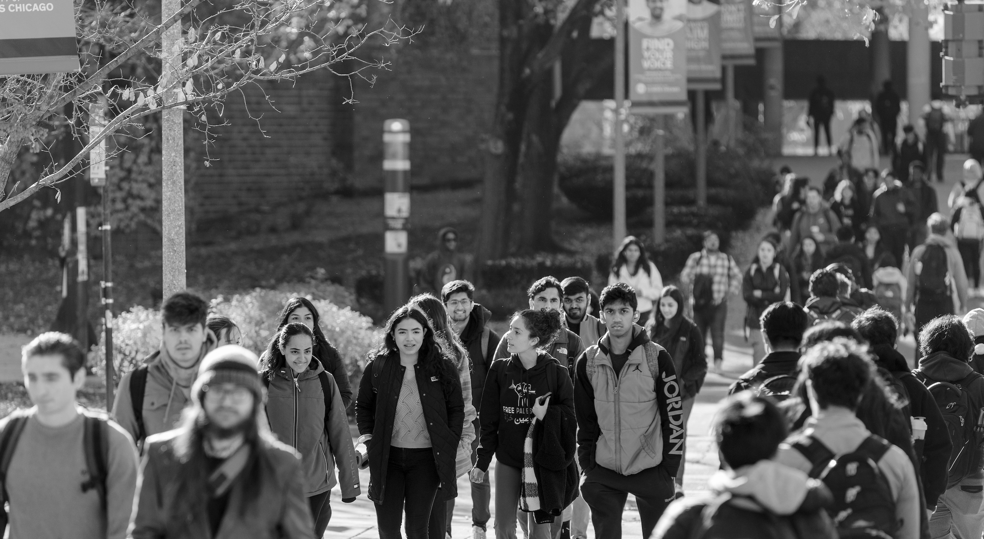
Tuition
{
Tuition
^{FROZEN SEVEN OF THE} ^{PAST 10 YEARS}
Notes:
We improve access by committing to affordability.
This is another area where our alignment with trustees is vital -- and pays off for our students and their families.
First, the board voted to freeze tuition for incoming freshmen from Illinois in seven of the past 10 years.
That includes periods of serious financial pressure, including the pandemic and the inflationary period that it helped fuel.
Those decisions, I’m sure, were not easy. But they were true to our commitment here -- few things we can do have a more positive impact on the working families of Illinois than holding down the cost of a life-changing college education.

Slide 8

Commitment to Affordability
Commitment to Affordability
Financial aid commitment (U of I system funding)
$239 Million
$298 Million
FY2019
FY2024
Increased by +$59 million, or 25%
Notes:
Second, we have drastically increased our investment in financial aid.
And I say investment because there is a return, in the lives of our students and the contributions they’ll make to our state and our country in the years to come.
In 2019, the U of I System provided $239 million in financial aid, on top of state and federal funding.
Last year, we provided $298 million, an increase of 25 percent.
Now, about two-thirds of our resident undergraduates pay less than full tuition and fees and about a third pay no tuition or fees at all.

Slide 9
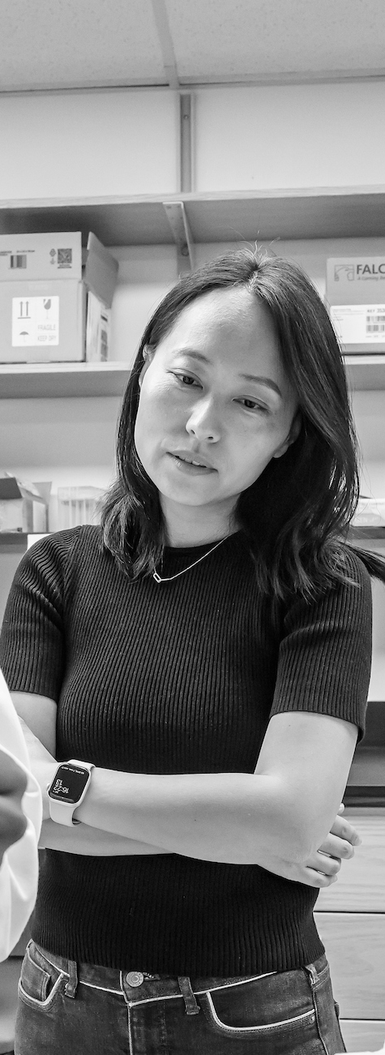
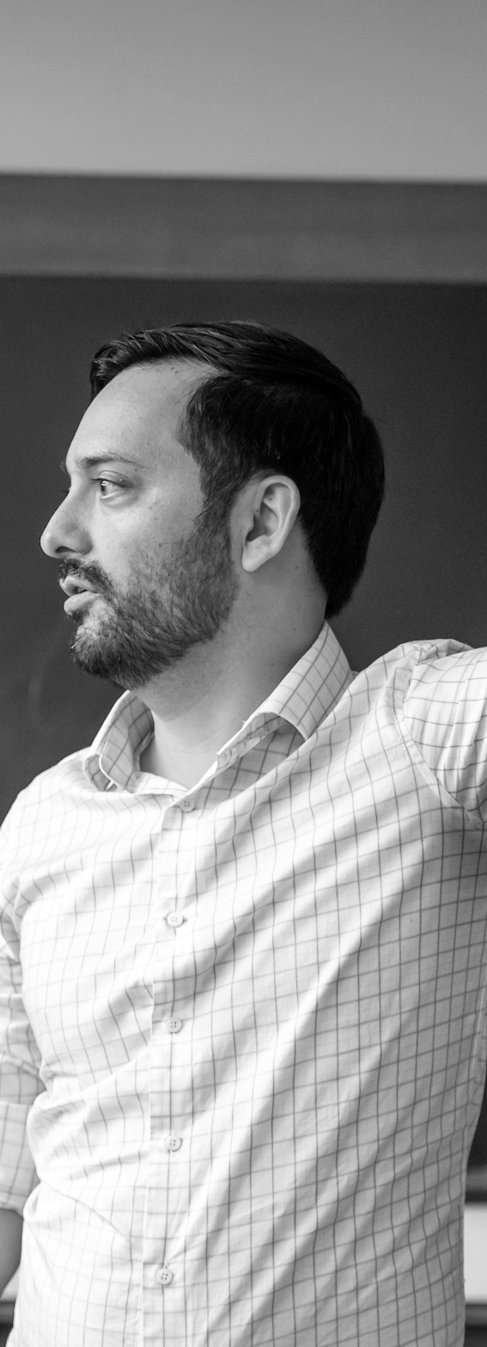
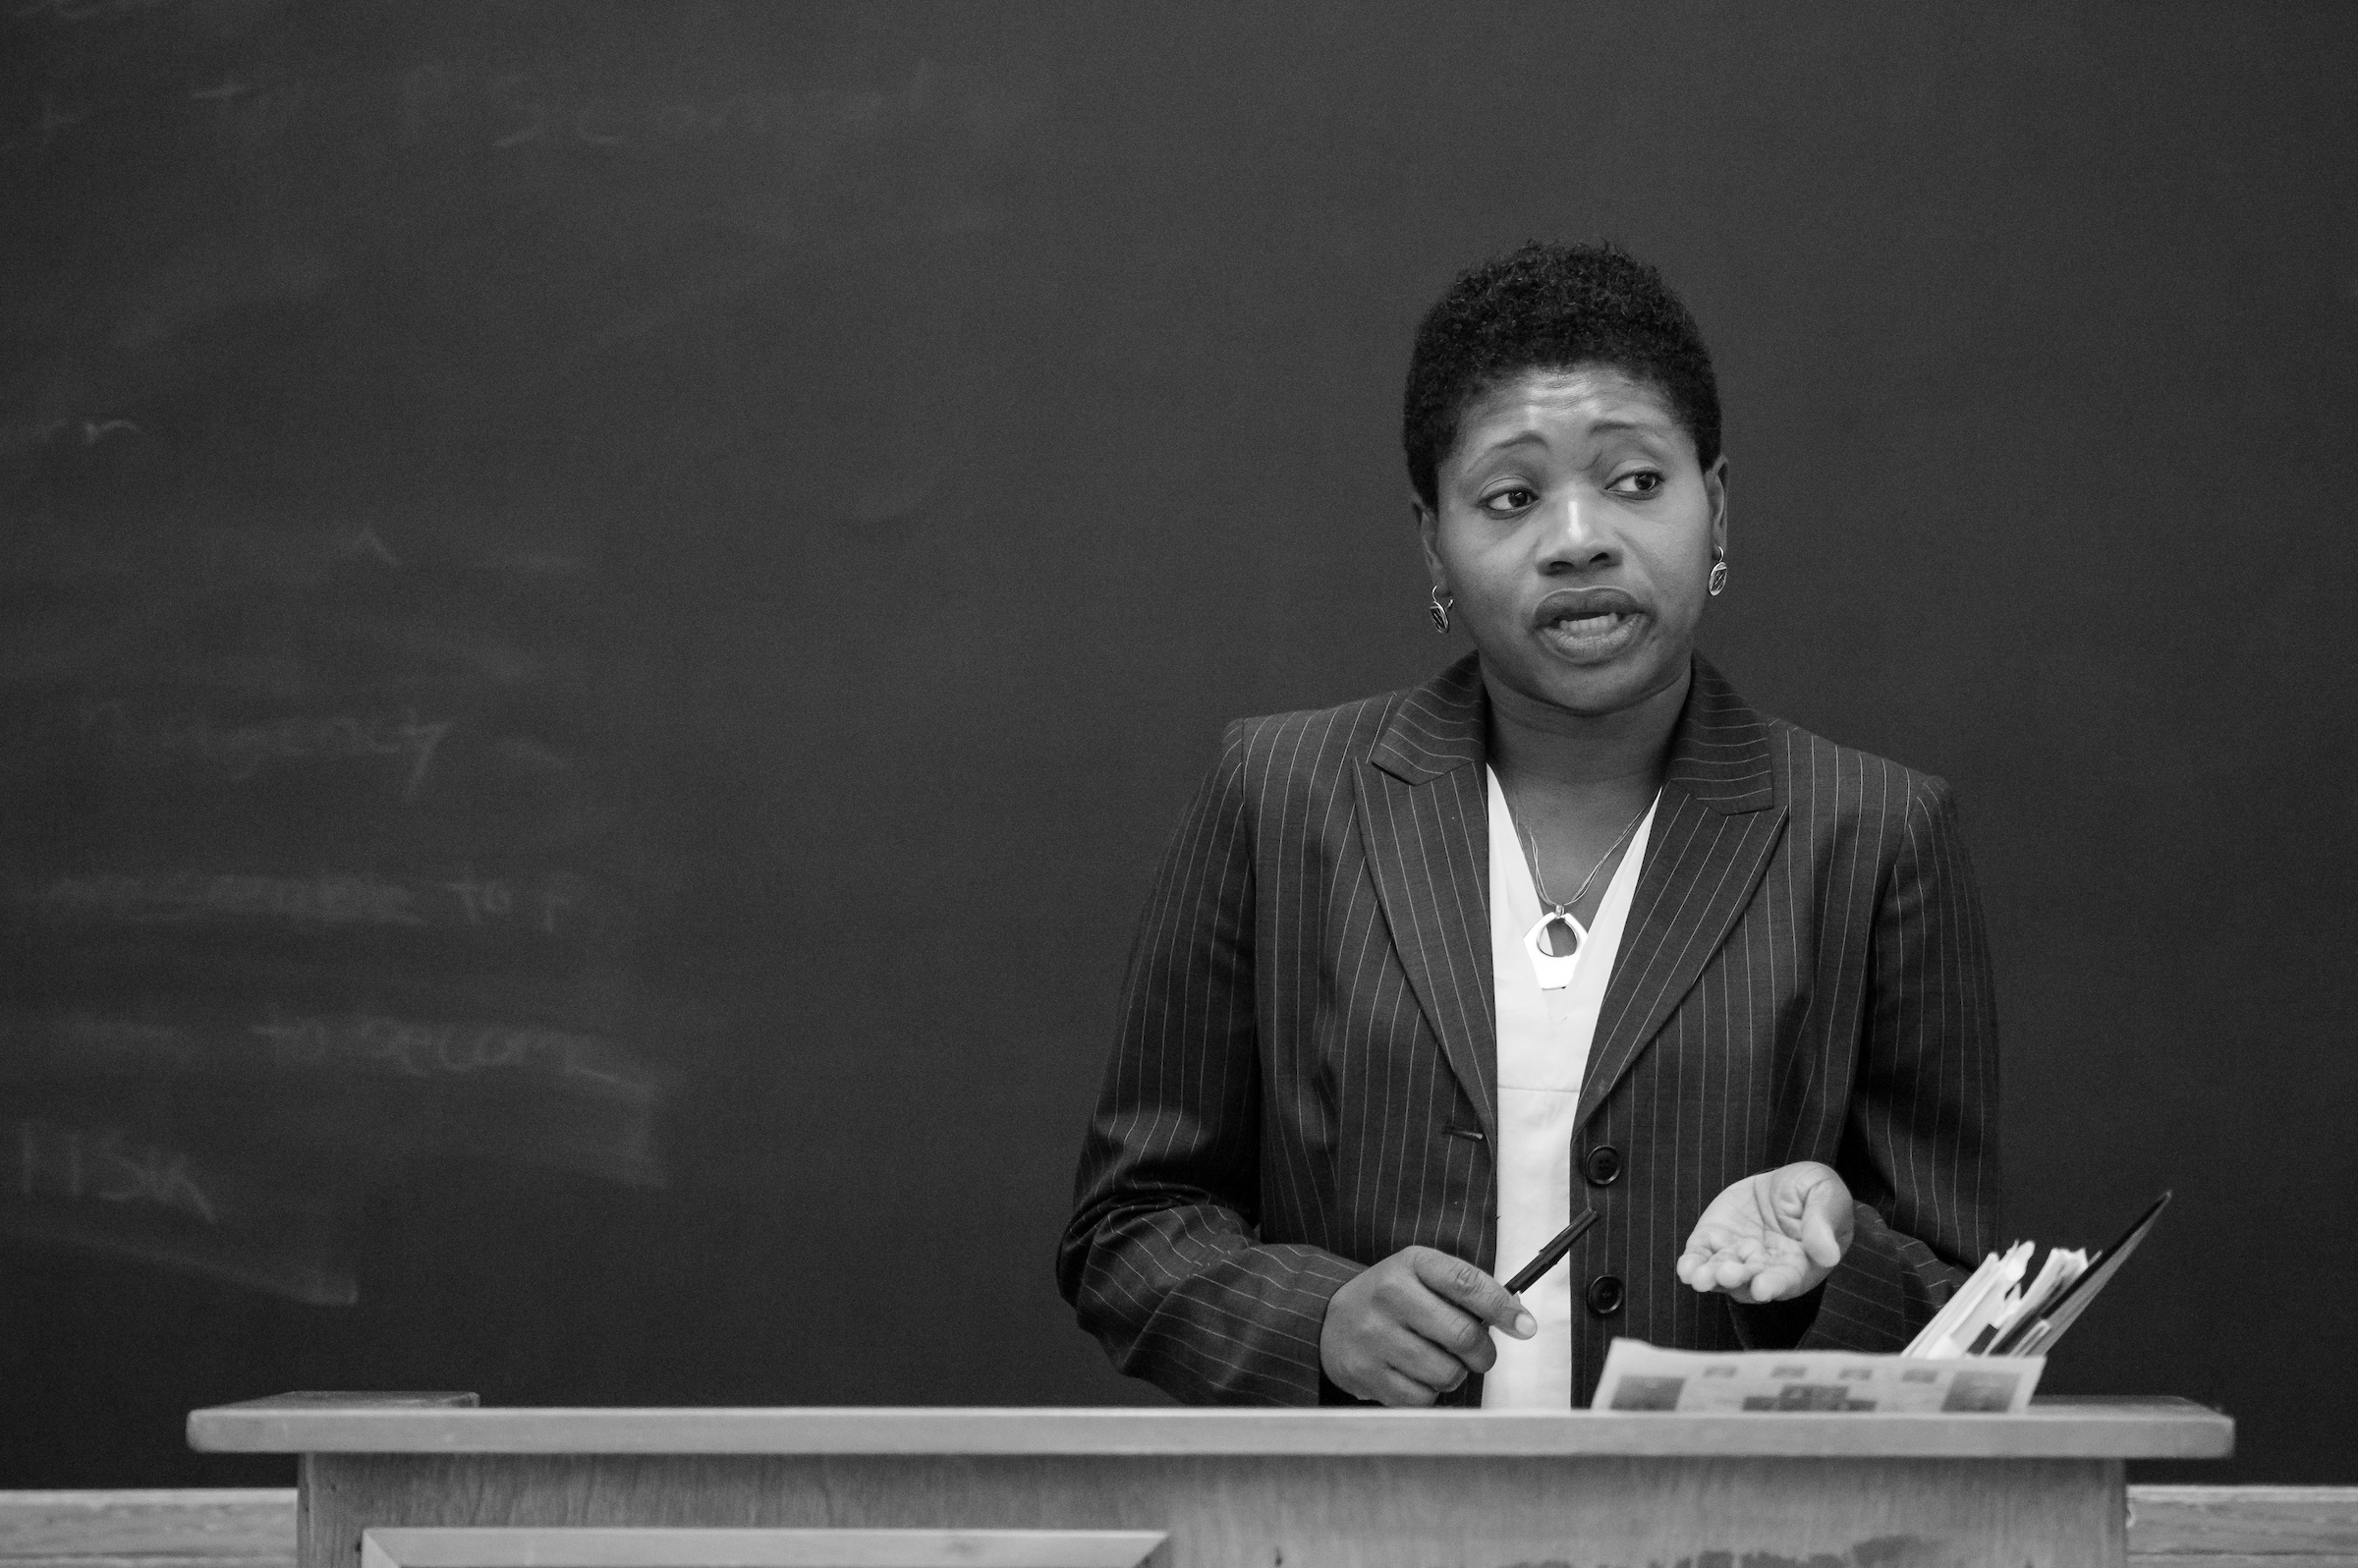
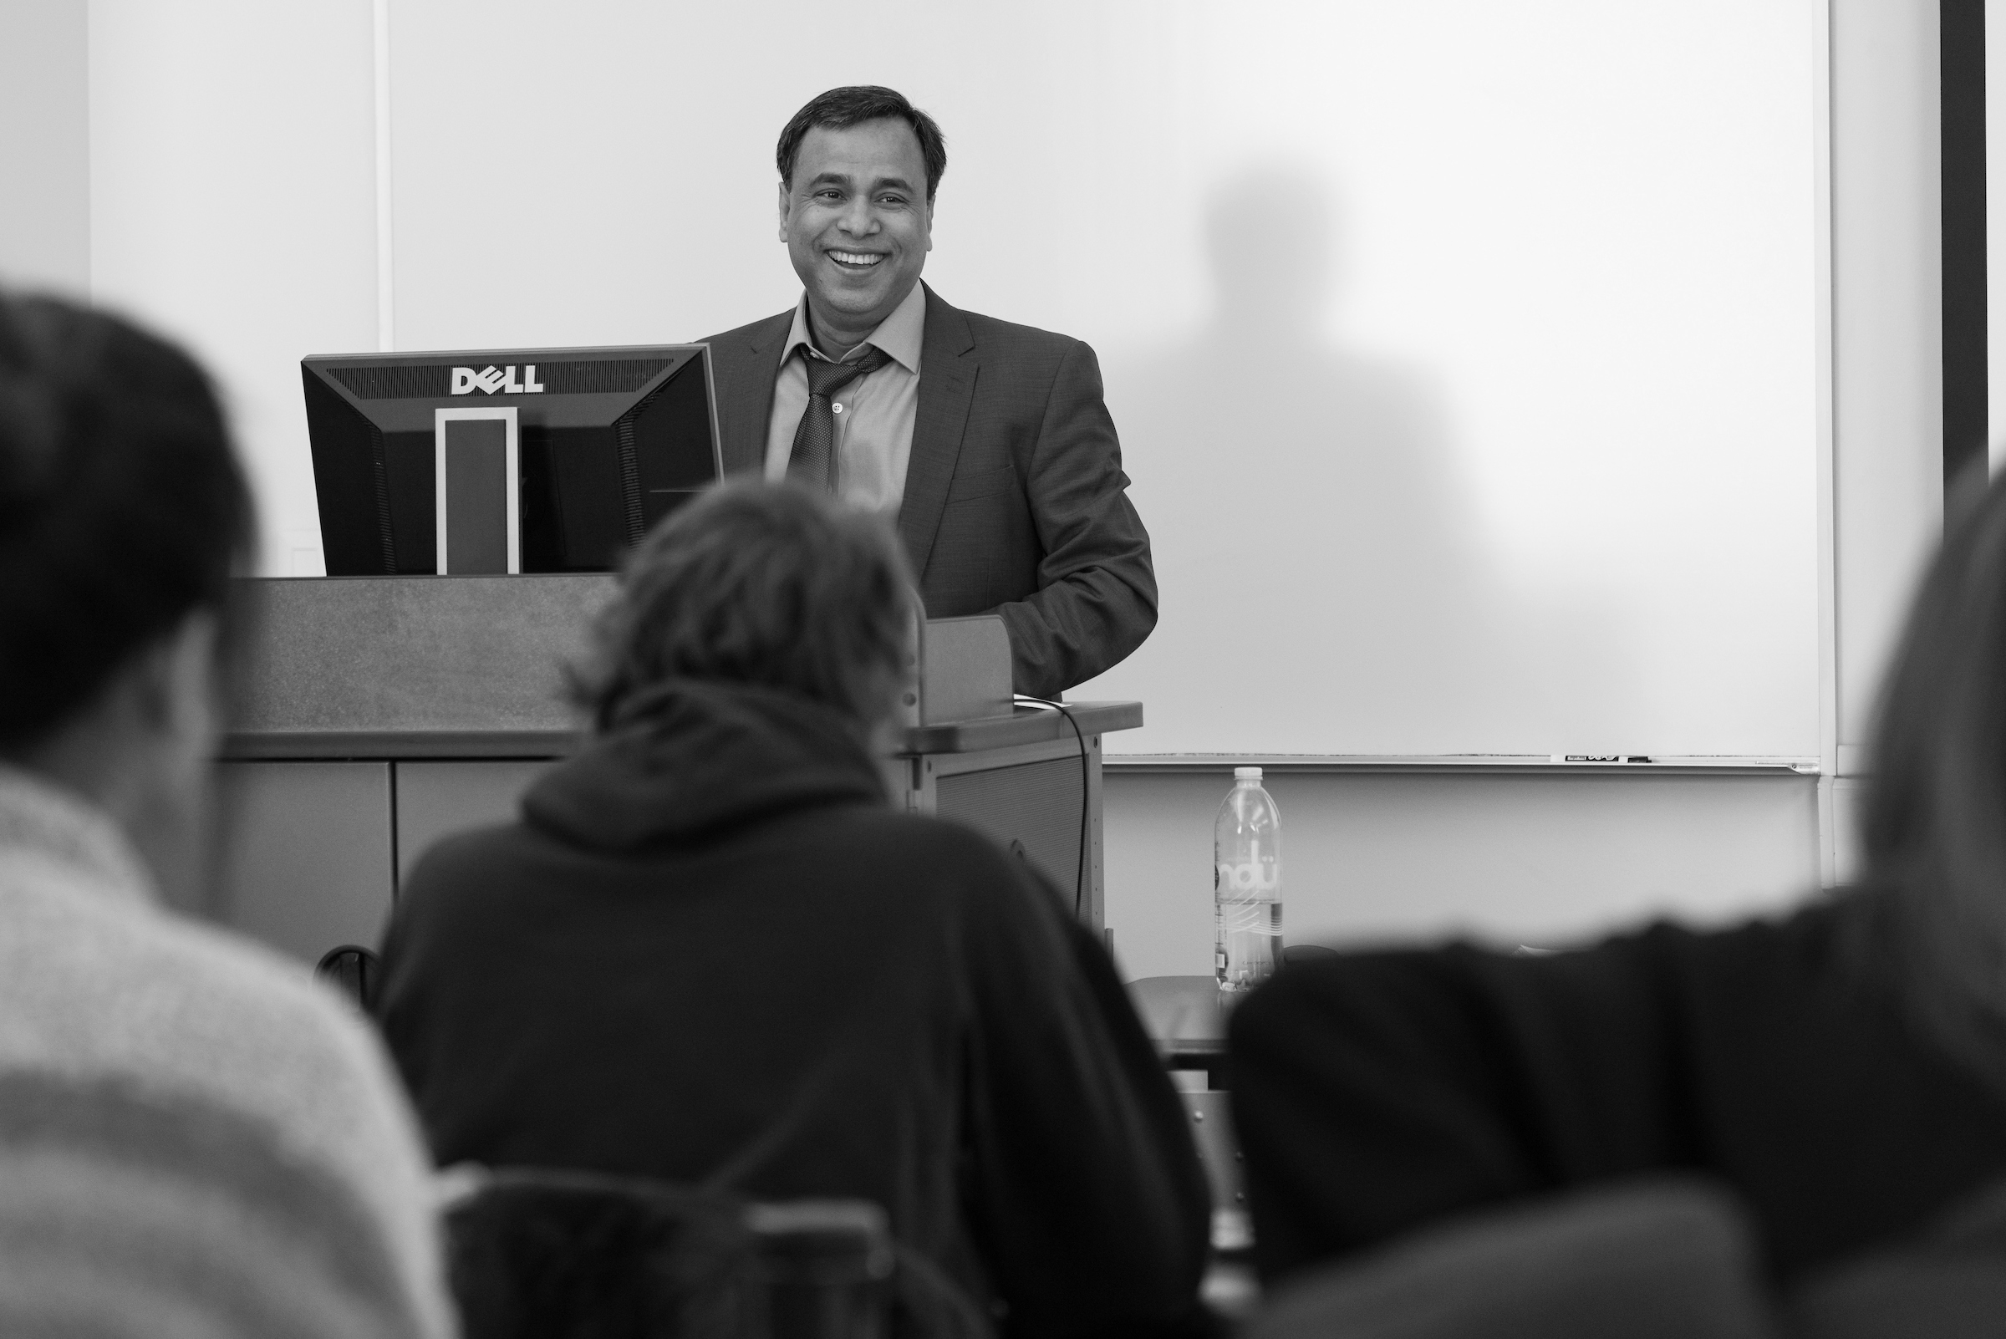
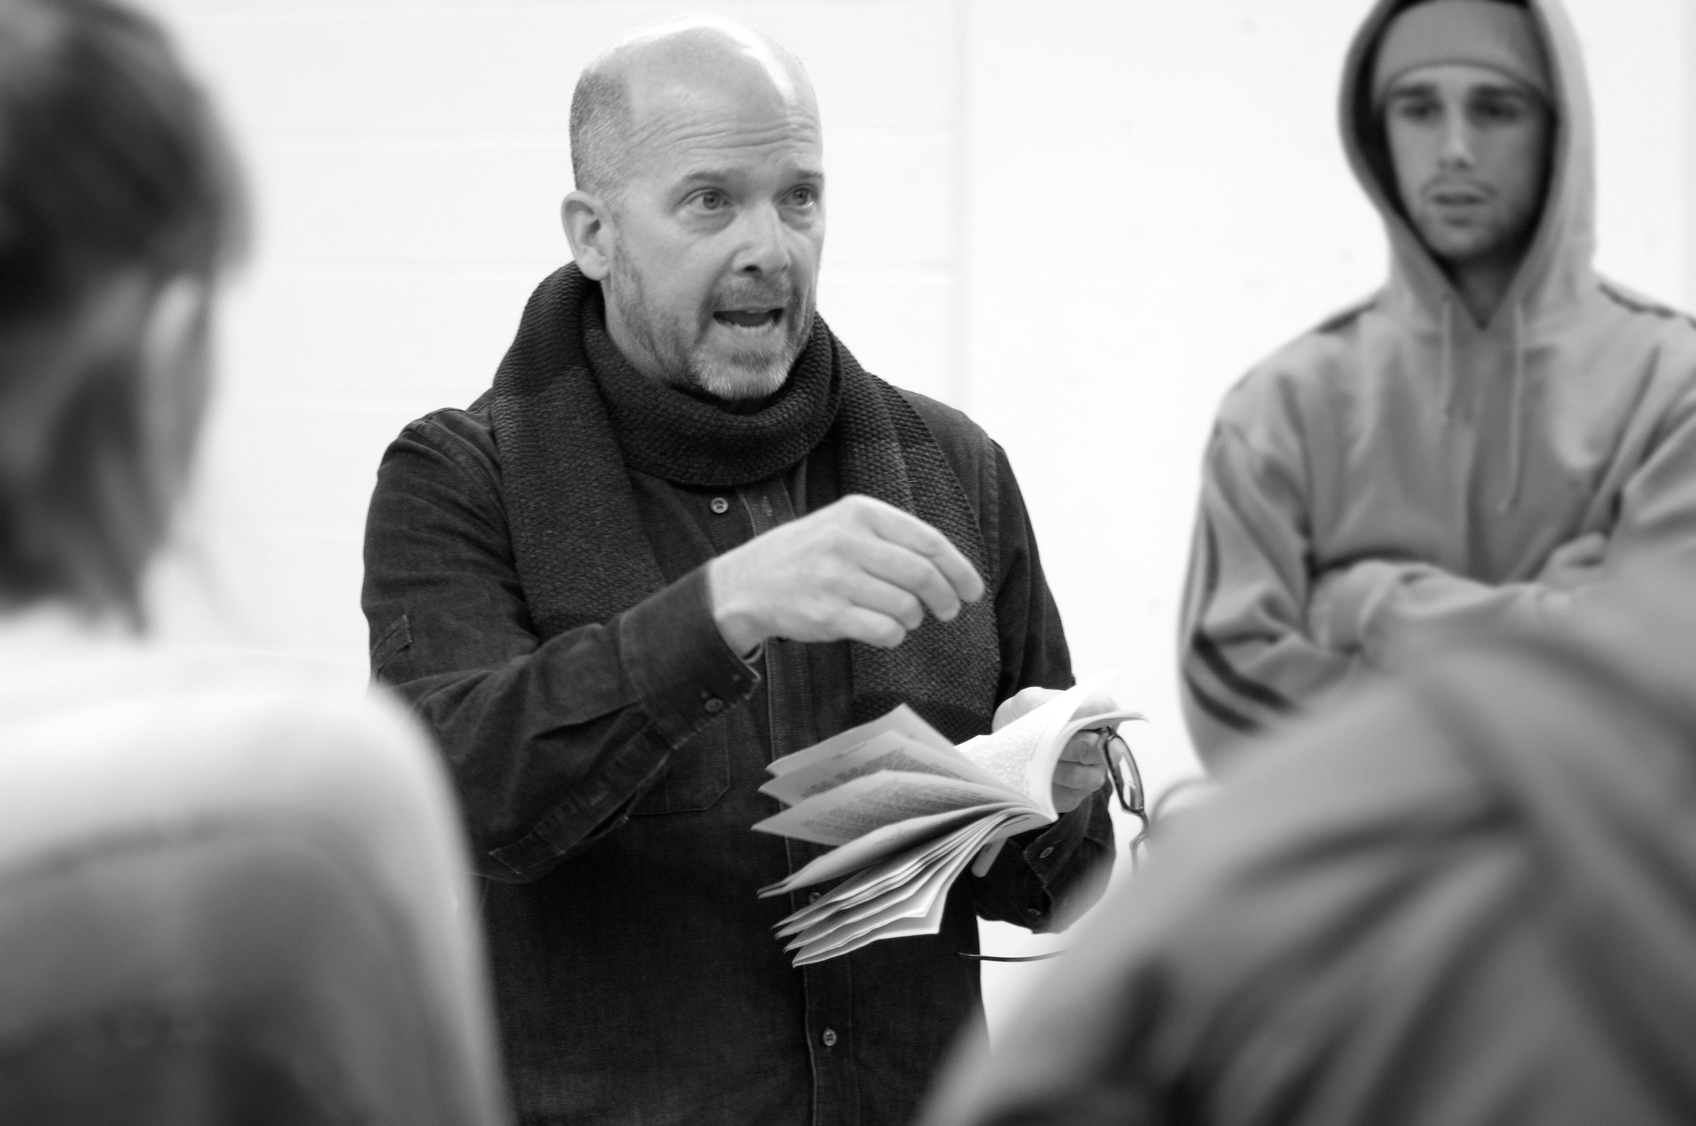
Growing faculty
Growing Faculty
2018-2019 TENURE SYSTEM FACULTY
2024-2025 TENURE SYSTEM FACULTY
3,277
3,540
Total faculty 6,140
Total faculty 7,047
Notes:
Growth, of course, creates the need for more world-class faculty.
And we can say that our universities have become standout destinations for leaders in the full range of academic fields over the past six-plus years.
Like students and families, talented academics are now certainly voting with their feet and choosing Illinois.
Since 2019, we have added 263 tenured faculty positions – 8 percent growth that has pushed us to 3,540 tenured faculty this fall.
And in all, we now top 7,000 total faculty across the U of I System.

Slide 10






Research & Discovery
Research with Impact
AI
Powering Discovery
AGRICULTURE
Focused on Feeding the World
QUANTUM
Next Generation of Computing
HEALTH CARE
New Medicines/ Advanced Understanding
CLIMATE
Meeting Must-Solve Challenges
Notes:
When the University of Illinois System puts its energy into something, amazing things happen.
There is no realm where this is more true than research and discovery – and the people who count on us have never needed our commitment to research and discovery more than right now.
Illinois is rich in research assets, including its four research universities – two of them of course, are our universities here and in Urbana-Champaign.
We’ve revved up our financial commitment to research – we devoted $1.32 billion in FY ’23, a solid increase over the $1.06 billion we spent in 2019.
But that financial supports means little if it doesn’t produce results.
We are a leading player in the new Illinois Quantum & Microelectronics Park, managing this first-of-its-kind park for quantum scale-up and related quantum and advanced microelectronics research and development.
The impact of our investment in research at UIC in Chicago includes more than 3,400 projects last year, everything from the development of new medical treatments and policies for violence prevention and sustainable cities to innovative research on health disparities, urban climate, manufacturing technologies and diversity in STEM education.
In Urbana-Champaign, our research at the Center for Advanced Bioenergy and Bioproducts Innovation is developing efficient ways to grow bioenergy crops, And the iFAB Tech Hub is focused on converts crops like corn and soybeans into a range of high-value chemicals and ingredients through biomanufacturing.
Urbana-Champaign also now leads three NSF-funded AI institutes focused on STEM education, agricultural resilience and sustainability, and molecular discovery and Manufacturing.
We also will host a global gathering on sustainability next summer, the Sustainability Research and Innovation Congress, in Chicago.

Slide 11
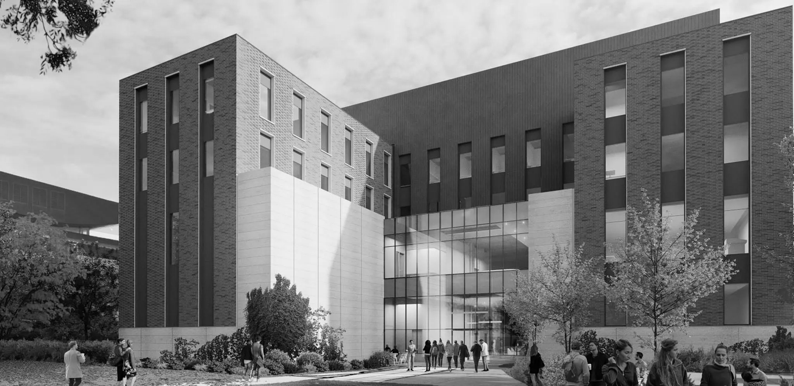
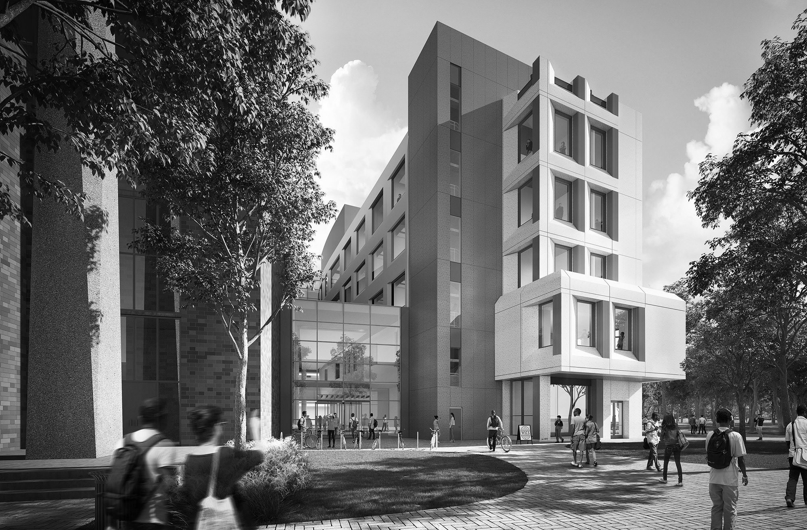
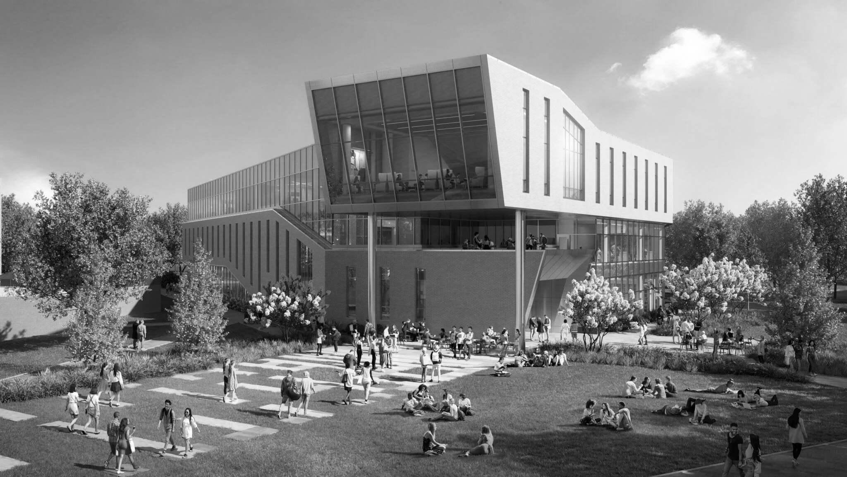
Building for our future
Building For Our Future
UIUC
Siebel Center for Design
Stephen S. Wymer Hall
UIC
Computer Design Research & Learning Center
Bruno & Sallie Pasquinelli Outpatient Surgery Center
UIS
Library Commons
Notes:
The U of I System has devoted $1.36 billion to facilities supporting teaching and research since 2019 and continued investments over the next decade will ensure classroom and research space matches the system’s academic excellence and the needs of the state and our country.
You can see this in the buildings rising and being renovated at our three universities.
In Urbana-Champaign, the Siebel Center for Design, now three years old, is focused on human-centered design – a way of problem-solving that addresses challenges in any field through collaborative thinking.
Just a couple of blocks away, Stephen S. Wymer Hall is nearing completion at the Gies College of Business. This addition, when it’s fully open next year, will be focused on the in-demand future of business education, providing collaboration spaces, traditional and flexible classrooms, an auditorium, informal learning environments, studios and sound stages for online education.
In Chicago the Computer Design Research and Learning Center is moving toward completion. This beautiful new building will educate the next generations of students seeking a place in a wide range of high-demand fields.
Across the UIC campus, the Bruno & Sallie Pasquinelli Outpatient Surgery Center is UI Health's center for same-day surgery and robotic surgical procedures. It’s been open two years and is making a difference in the health of Chicagoans.
And in Springfield, the new Library Commons will be the university’s library and house the Center for Online Learning Research and Service. It will sit on the quad between the Student Union and the Health Sciences Building.

Slide 12
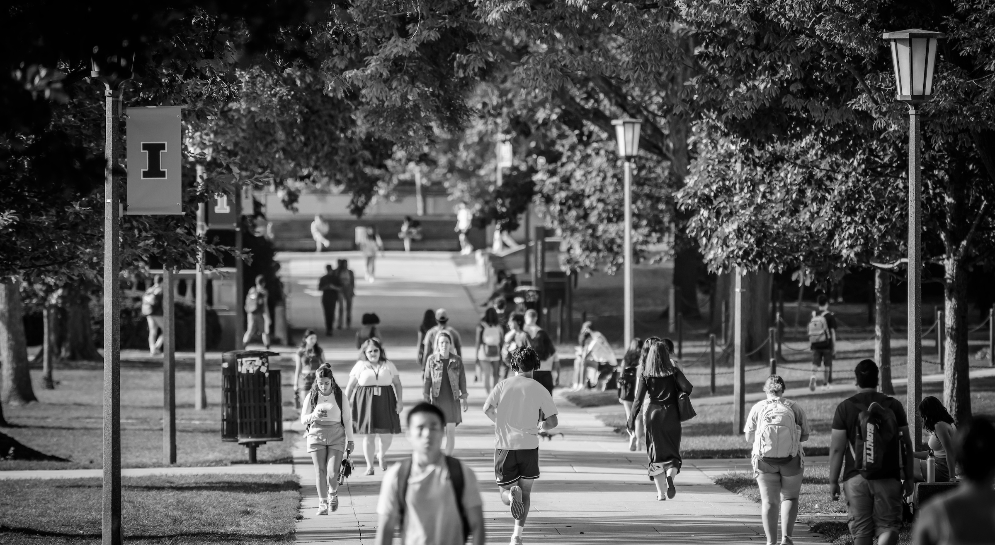
IMPACT
{
Impact
^{DEFINING THE MODERN} ^{LAND-GRANT MISSION}
$19 Billion Total Impact
Supports 164,000 Jobs
80 Percent of Undergraduates From Illinois
Most Graduates Remain in Illinois
Train one in three Illinois physicians, more than 8,000 nurses, one in four social workers
Educating Citizens, Strengthening Society
Notes:
As you can see, the impact of the U of I System is broad.
You can measure it in any number of ways.
We account for $19 billion in impact for the state’s economy – including support for 164,000 jobs, one in every 44 in the state.
Out of the 27,000-plus new degree-holders our universities produce every year, three-quarters remain in Illinois.
They are this state’s next generation of teachers, doctors, nurses, dentists, engineers, bankers, musicians, artists and entrepreneurs – the next layer of the deep foundation upon which we build our economy and our society.
Here in Illinois and beyond, a U of I education provides the fuel for a high percentage of the startups that earn the title unicorns – a valuation of $1 billion or more.
One in every 33 were founded by people who have studied at one of our universities, according to Stanford University research. Only three public universities and a very small handful of private universities have generated more.
Beyond dollars and cents, we impact lives – during the pandemic, we saved them.
The saliva-based test for COVID-19 developed in Urbana-Champaign, the role we played here in Chicago and vaccine development, and the help UIS provided in delivering online education – all of them saved Illinois lives while ensuring that life also went on.
And if you look around the state, you can our Illinois Innovation Network, our Extension Service, our Prairie Research Institute all making Illinois communities stronger, more equitable, more sustainable.

Slide 13

Six Extraordinary Years
{
Six Years of Extraordinary
Notes:
There are many, many other examples I could cite of our strength and momentum over these past six years, our ability to deliver – as Chairman Edwards often says – excellence at scale.
I barely touched on our service during the COVID-19 pandemic, but we should never forget how this university system delivered for its students, faculty and staff and for our whole state during a period when we were tested like never before.
The moment demanded that we deliver, and WE did.
The “We” is important in that last sentence.
We – the board, university leadership, faculty and staff --- did all of this together, in collaboration.
Not in lockstep, mind you, but aligned in shared beliefs about what is possible and our ultimate goal of working on behalf of Illinois.
Someone mentioned last week that, in his role, Chairman Edwards has routinely asked the right questions – penetrating questions that have helped us find focus and direction, that made us better, frankly.
The alignment that makes all of this possible only happens through that kind of leadership and a vision for what we can and should be, what we must be – a force for progress and opportunity in Illinois, for all Illinoisans.
This is grounded, I believe, in something you all share: A personal understanding of what a University of Illinois education can mean in a life … and a love for both the university system and this state.

