Slide 1
FY 2023 BUDGET REQUEST
Presentation to the Board of Trustees
November 2021

Slide 2
U OF I SYSTEM BUDGET REQUEST CONTEXT
Grew enrollment by 16,210 students
since FY 15
(+20.6%)
Enrolled 5,046
more Illinois undergraduates
since FY15
(+11.8%)
Increased financial aid by 88% in 10 years +$122M
Froze undergraduate tuition in six of
last seven years

Slide 3
FY 2023 OPERATING APPROPRIATION REQUEST
FY 2022 state appropriation: $622.0M
FY 2023 incremental request: $61.2M
Total FY 2023 state operating appropriation request: $683.2M
Increase of 9.8% over FY 2022

Slide 4
STATE APPROPRIATIONS – U OF I SYSTEM
FY 2022 Appropriation 18% less than FY 2010 in nominal dollars
FY 2022 Appropriation 36% less than FY 2010 in inflation adjusted dollars
FY 2023 Request still 31% less than FY 2010 in inflation adjusted dollars
Millions
Inflation for FY 2022 and FY 2023 assumed at 2.5%.

Slide 5
OVERALL GOALS OF INCREMENTAL REQUESTS
Keep more Illinois students In the state and support them for success
Enhance academic excellence by recruiting and retaining faculty

Slide 6



REQUESTED FOR FY 2023 OPERATIONS
(Dollars in Thousands)

Slide 7
UNDERGRADUATE FINANCIAL AID
88%, $122M
INCREASE IN U OF I SYSTEM AID OVER
10 YEARS
Other Fed/State
CARES
$279M
Federal, State
and Other
$261M
Institutional
7

Slide 8



FINANCIAL AID & SCHOLARSHIPS
LOWER COSTS FOR RESIDENTS
% Illinois Undergrads Who Pay Less Than Full Tuition & Fees
71%
79%
81%

Slide 9
SUPPORT STUDENT SUCCESS
Funding for:
Expanding student mental health services
Bridge programs

Slide 10
BRIDGE PROGRAMS
Introductory
curriculum
Collaboration and mentoring
Personalized advising
Programming to reduce barriers
to enrollment and persistence
Higher retention, advancement, and academic success

Slide 11
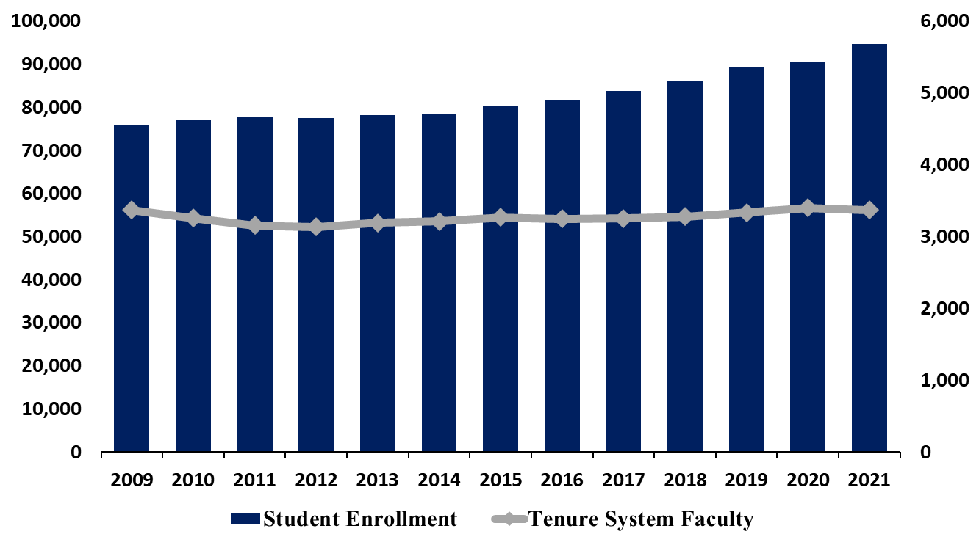
RECRUITING AND RETAINING FACULTY

Slide 12
CAPITAL REQUESTS
Implementing the Long-Term Capital Plan

Slide 13




REQUESTED FOR FY 2023 CAPITAL
INNOVATION &
WORKFORCE DEVELOPMENT
$171.0M
ACADEMIC
LIBRARIES
$240.0M
HOSPITAL &
HEALTH SCIENCES
$60.0M
REPAIR &
RENOVATION
$202.3M
Total state capital appropriation request: $673.3M

Slide 14



REQUESTED FOR FY 2023 CAPITAL
(Dollars in Thousands)

Slide 15

THANK YOU!

