Slide 1

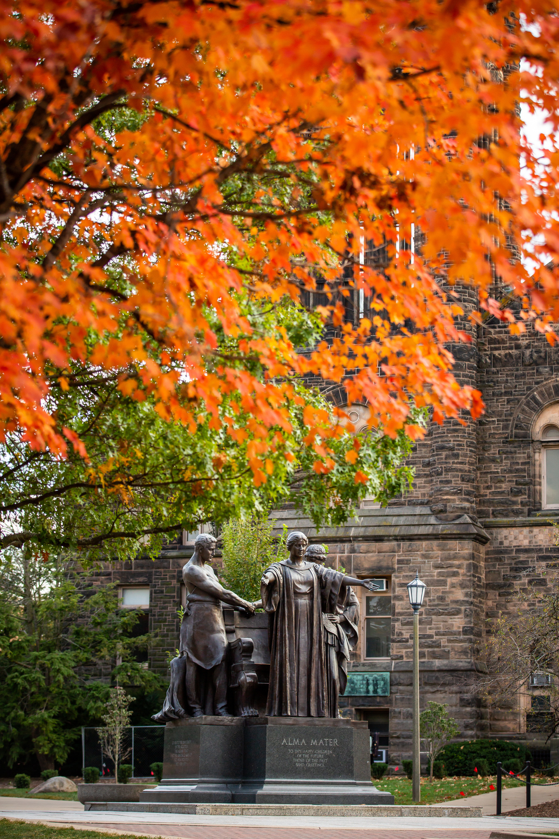
UNIVERSITY OF ILLINOIS ALUMNI ASSOCIATION UPDATE
David Bambrey, President (UIAA)

Slide 2
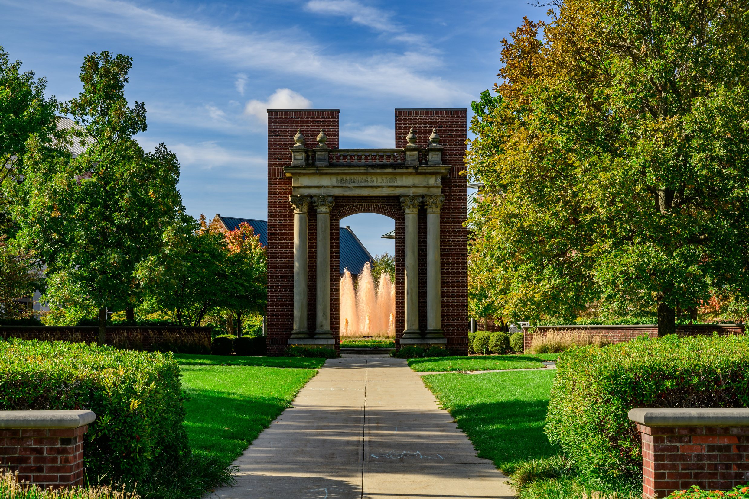


UIAA OVERVIEW

Slide 3

HISTORY & OVERVIEW
  Founded in 1873
  Incorporated as a 501(c)(3) independent, not-for-profit organization with the Internal Revenue Service in 1912.
    Governed by volunteer Board of Directors.
    A University Related Organization (“URO”) of the University of Illinois, similar to the University of Illinois Foundation.
    Maintains annual service agreement with the University of Illinois Urbana-Champaign.
  Currently have 21 employees.
    Functional areas: Communications, Engagement, Finance, HR, Marketing and Business Development.
  Based out of Alice Campbell Alumni Center.

Slide 4
UIAA BOARD OF DIRECTORS
  Governing board of up to 20 Voting Directors
    Currently have 17 Voting Directors: Chair, Vice Chair, Secretary, Immediate Past Chair, + 13 general members
    Also have 6 non-voting Ex Officio Directors
  Activities and procedures governed by bylaws and General Policies & Guidelines
  Standing committees: Audit, Executive, Governance and Board Development, Finance
    Established by bylaws
  Ad Hoc committees: Alumni and Student Engagement, Awards, and Membership
    Established by Chair
  Additional working groups established as needed.

Slide 5
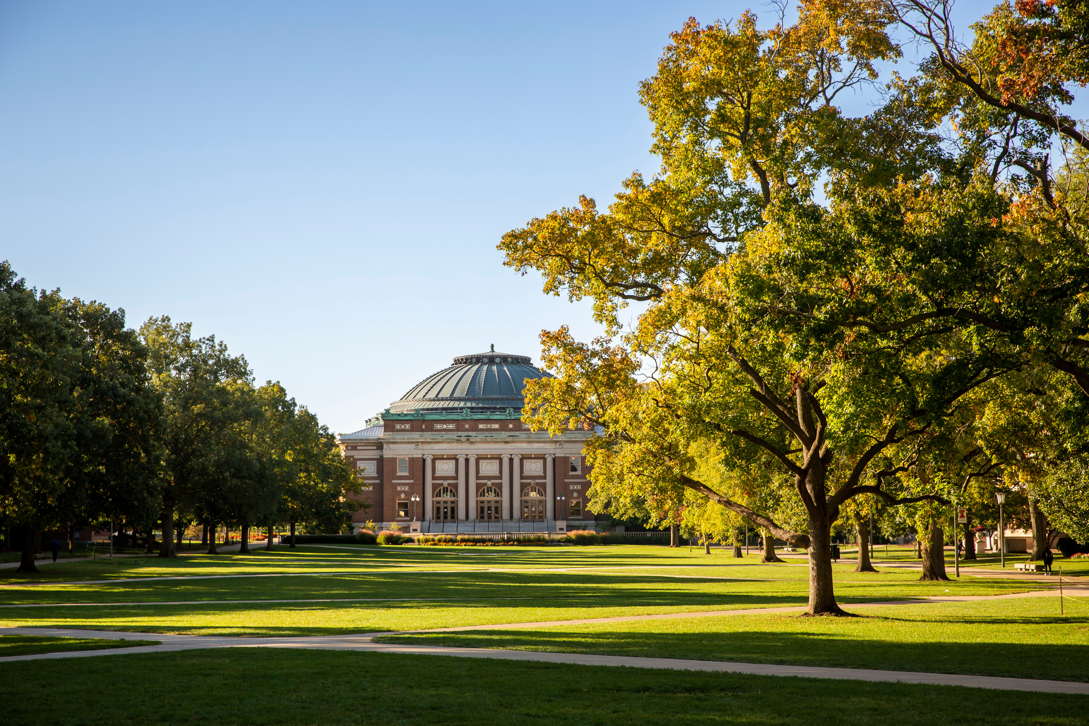
DEFINING ENGAGEMENT

Slide 6




CASE ENGAGEMENT METRICS
Experiential
Communication
Volunteer
Philanthropic

Slide 7
KEY PROGRAMS & SERVICES
Experiential | Volunteer
Clubs Program Speaker Series Homecoming Virtual Book Club Athletic Pregames Explorers Travel Program | IlliniLink Volunteer Boards Classroom Speakers Clubs Program
Communication | Philanthropic
Illinois Alumni Magazine (Print & Digital) Social Media Crowdsourcing Homecoming Theme Engagement Digest E-Newsletter | Annual Membership Life Membership Annual Giving Planned Giving

Slide 8
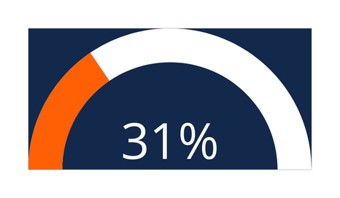

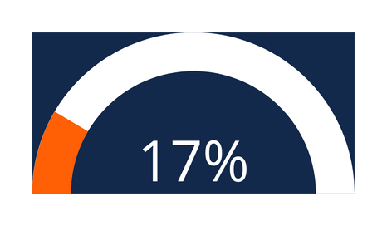
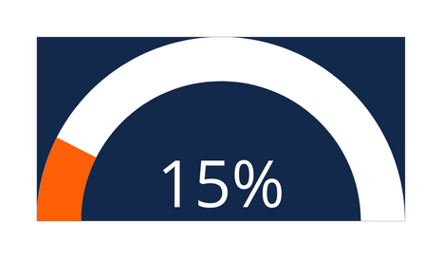
2024 RESULTS
Overall Engagement 160,892 alumni engaged
Illinois | Peers | US/Canada | All Respondents
 |  | 17%

Slide 9
THANK YOU!
QUESTIONS

