Slide 1
UNIVERSITY SENATES CONFERENCE
Presentation to the Board of Trustees
Sandra De Groote, USC Chair
September 18, 2025

Slide 2
University senates conference
Coordinates the work of the three university senates
Provides advice on revisions to Statutes and General Rules
Act as an advisory group to the president and the Board of Trustees (through the President)

Slide 3
USC Full Membership 2025-2026
UIC | UIS | UIUC
Annette Carmichael | Kristi Barnwell | Kate Clancy
Larry Danziger | Lynn Fisher* | Jon Hale
Sandra De Groote* | Hanfu Mi | Linda Herrera
Danilo Erricolo |  | Prasanta Kumar Kalita
Kate Floros |  | Angela Lyons*
Steven Schwinn |  | William Maher
Donald Wink |  | Linda Moorhouse
 |  | Charles Roseman
 |  | Carol Symes
 |  | Joyce Tolliver
7 members | 3 members | 10 members
UIC Senate members: | UIS Senate members: | UIUC Senate members:
*Denotes SEC chair at each university

Slide 4
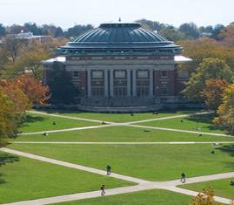
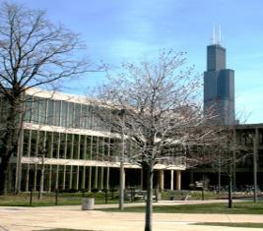
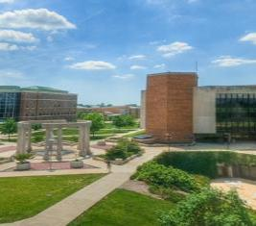
UNIVERSITY SENATES
University of Illinois Statutes establish that:
Each university shall have a senate responsible for legislative decisions related to educational policy, including matters such as admission requirements, degree and certificate criteria, and the academic calendar
Each senate is also empowered to propose amendments to the Statutes, which are submitted through the University Senates Conference to the president and the Board of Trustees
Senates:
Have own bylaws and committee structures (executive committee, budget, educational policy, academic freedom & tenure, external relations, faculty affairs, and more…)
Also, provide feedback and/or approve policies at the university level related to faculty

Slide 5
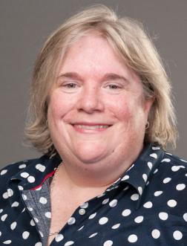
USC EXECUTIVE COMMITTEE 2025-26
Sandra (Sandy) De Groote, Chair (UIC)
Lynn Fisher, Vice Chair (UIS)
Angela Lyons (UIUC)
Hanfu Mi (UIS)
Joyce Tolliver (UIUC)
Donald Wink (UIC)
Consists of two faculty members from each of the three university senates
Sandra (Sandy) De Groote
USC Chair 2025-2026
Notes:
USC has four official committees
our USC Executive Committee members are listed on this page
Two faculty members from each of the three Senates
Consists of two faculty members from each of the three university senates

Slide 6
USC Standing committees
Academic Affairs and Research
Reviews policies related to academic and research issues that cross the campuses; may draft proposed policies or other documents related to academic affairs and research for consideration by USC or other stakeholders; generate advice relevant to system-wide issues
Finance, Budget, and Benefits
Reviews the system administration budget to assist the University Senates Conference in advising the president on system administration budget priorities and policies; promotes the faculty role in overseeing university policies on faculty employment and benefits
Statutes and Governance
Reviews proposed statutes and general rules amendments; ensures proposed changes are reviewed by all three senates; proposes compromise language when senates differ; drafts governance-related documents or amendments

Slide 7

Ongoing Activities
Engagement in Shared Governance
Input on policies and updates shared by the president’s office
Advice on revisions to the Statutes and General Rules
Currently ST-83, 87, 89, 90, 91
USC Retreat Topics (October)
Shared Governance, budget bootcamp, BOT information session

Slide 8
To work for the greater good of the University of Illinois and all of its universities. (USC mission)
As elected representatives of the faculty of the three universities, USC looks forward to working with you all to uphold the mission and values of the University of Illinois.
Sandra De Groote
USC Chair
Email: sgroote@uic.edu Phone: 312.413.9494
David Perryn
USC Administration
Email: dperryn@uillinois.edu
Phone: 217.300.7448
University Senates Conference

