Slide 1
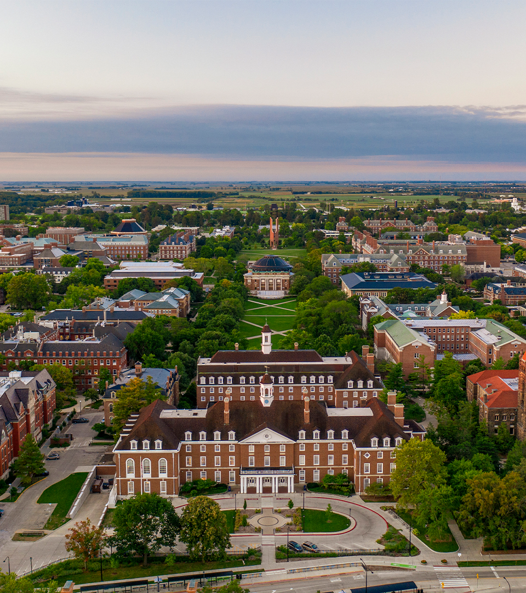
Welcome to Urbana
Notes:
Good morning and welcome to Urbana.
It’s been a busy summer, and I’m confident that our Trustees will already be familiar with many of the things I’ll highlight today. For the benefit of everyone else joining us today, I’d like to take a few minutes to update everyone on some of the notable highlights and challenges over the summer and into the fall semester.

Slide 2
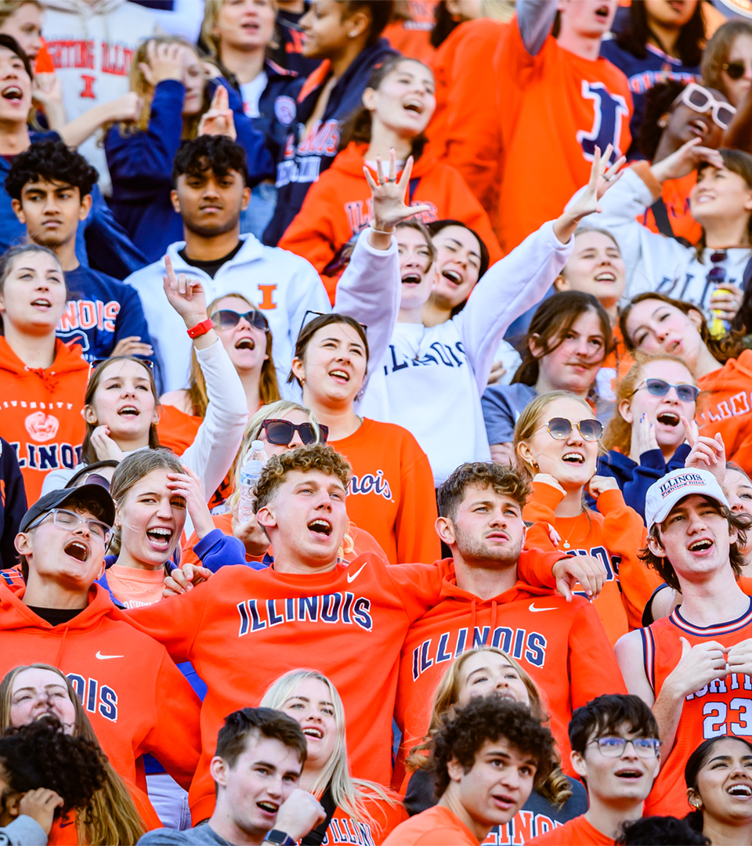
Homecoming
Notes:
Homecoming/Memorial Stadium anniversary
As I’m sure you have seen, our campus is full of activity and our semester is in full swing.
I’m glad some of you could join us for our annual homecoming celebration last weekend. As you know, we were one of the first universities to celebrate homecoming, and we did it this year on the heels of an upset over a top 20 program the previous week.
We’re also celebrating the 100th anniversary of Memorial Stadium, and the Big Ten Network will air our half-hour documentary on the Stadium’s history next month. I’ll share the specific broadcast details as soon as we have them.

Slide 3
Record Enrollment
Notes:
Record Enrollment
After our tenth day of classes last week, we were able to confirm both the largest new class of students in our history and the largest overall student body population this university has ever had. I like to say that a hallmark of our great university is excellence at scale, and I think we are delivering on that statement year after year – with a continued focus on growing our online programs. With this growth, we must continue to enhance our infrastructure, supports and resources to ensure those students succeed on this campus and online. We have an impressive track record of not only enrolling students, but also making it possible for them to make steady progress, graduate in a timely manner and go on to careers or graduate programs. We are committed, now more than ever, to making sure that continues to be our reality.

Slide 4
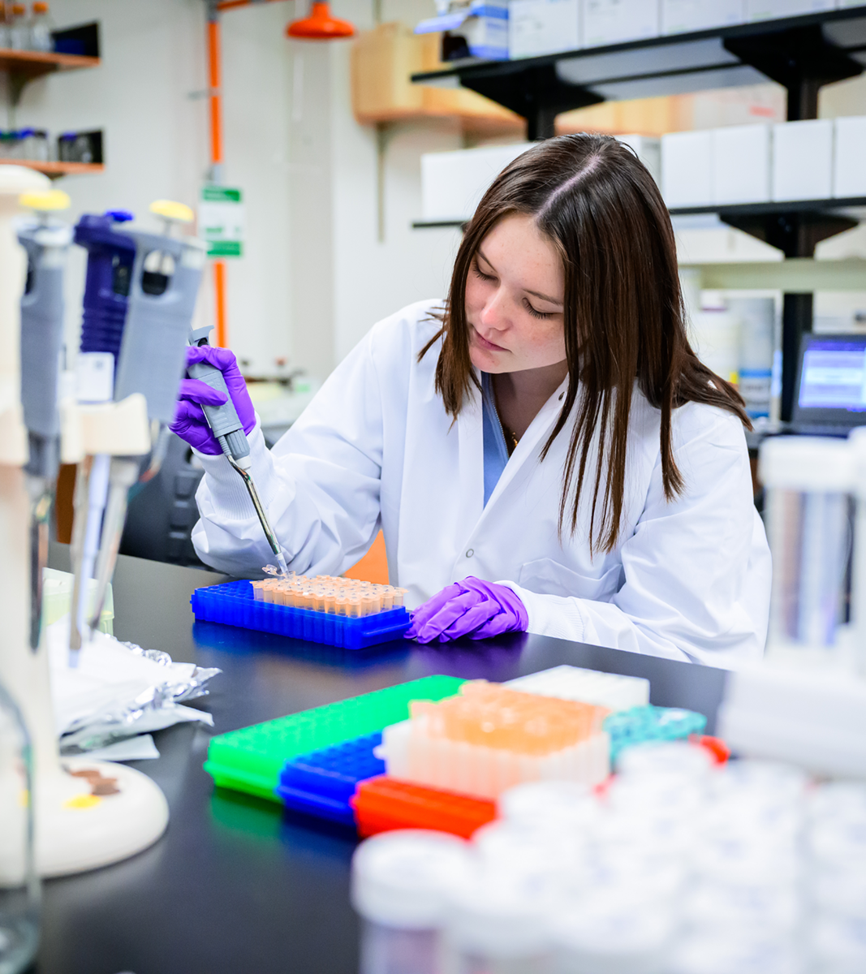
Research and Innovation
Notes:
Research and Innovation
Our research enterprise also continued to drive critical aspects of our nation’s infrastructure for innovation and prosperity. (Melissa will provide these by COB Tuesday.)

Slide 5
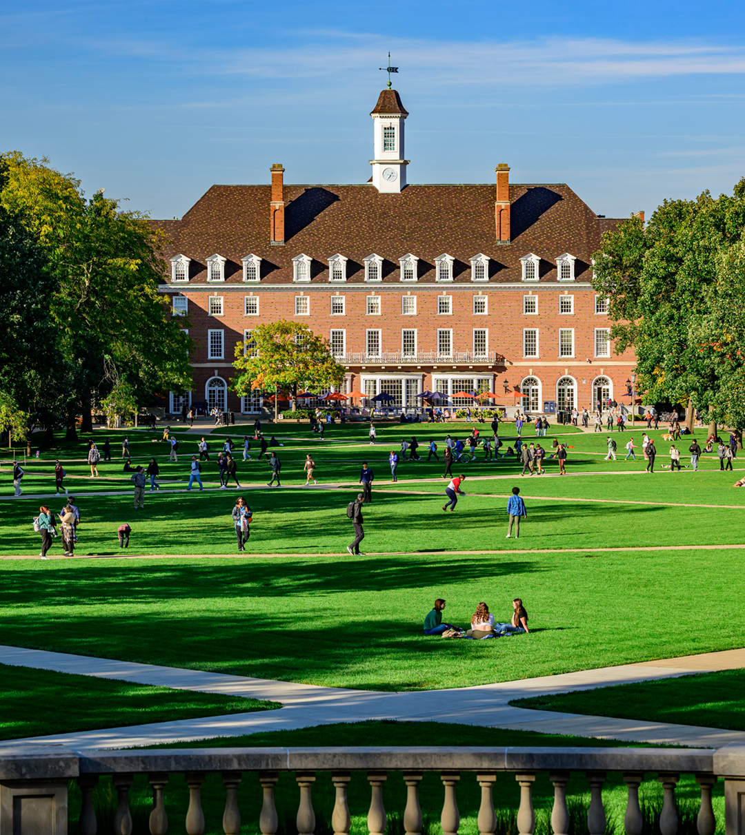
Current Issues
Notes:
OCR resolution
I am pleased to share that the U.S. Department of Education’s Office for Civil Rights has determined that it was appropriate to resolve a complaint about antisemitism through a voluntary resolution agreement in which it makes no finding against the university. The agreement reflects our commitment to enhance our ongoing efforts to provide a safe and supportive educational environment. We are proud to partner with OCR to implement measures that build on our ongoing work – and to take new steps to bring consistency and transparency in addressing discrimination and harassment based on national origin and shared ancestry. Vice Chancellor Sean Garrick has asked Claire Sharples Brooks to serve as Interim Title 6 Coordinator to lead the university’s response to the Title 6 resolution agreement. SEIU strike
The university has been in negotiations with the SEIU which represents food and building service workers. Last month we reached a good-faith agreement with the SEIU Local 73 bargaining team, but the members voted not to accept it. The agreement was consistent with the market, and we were disappointed that they didn’t approve it. The contract expired on Aug. 31, and they submitted their intent to strike on Sunday, Sept. 1. We met with the union’s bargaining team last week to learn more about the disconnect between the membership and their bargaining team. At the same time, we began planning for a possible strike, with the goal of continuing to provide vital services to our students, faculty and staff in the event of a walkout. These workers are valued members of this university, and we hope we can come to an agreement that is fair and that stewards our limited resources.

Slide 6
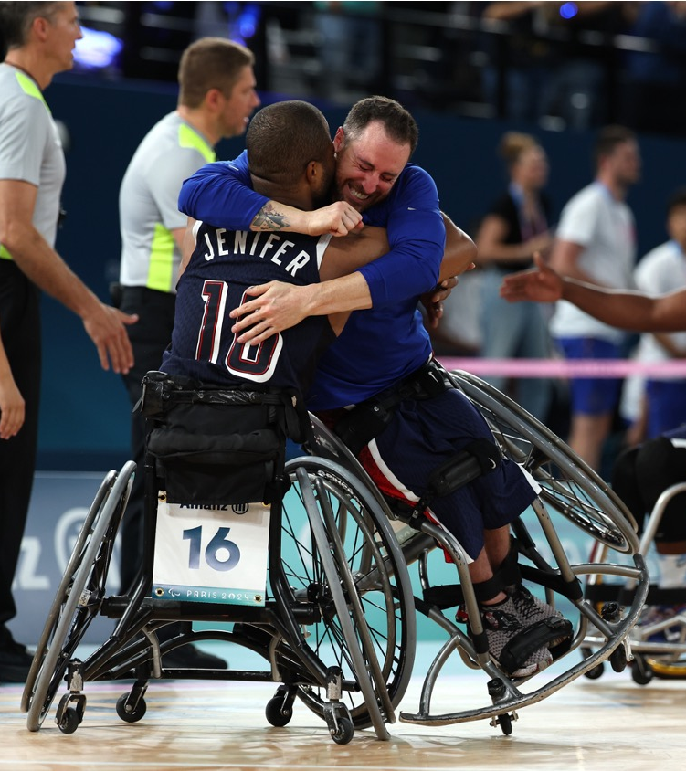
Olympians and Paralympians
Notes:
Olympics/Paralympics
Last week, the Paris 2024 Paralympic Games wrapped up competition, and Illinois was well represented. Head coach of the U. of I. wheelchair track and road racing team Adam Bleakney was there — coaching for Team USA. All nine of the wheelchair racing athletes representing the U.S. have a connection to Illinois —most of them have trained at our facility in the Rehabilitation Education Center, one of eight U.S. Olympic and Paralympic training sites. And I’m happy to say our Illini are taking home some hardware. (NEED DETAILS!!)
Earlier this summer at the Paris 2024 Olympics, Illinois volleyball alum Jordyn Poulter brought home a silver medal for the second-straight Olympics. The Team USA captain posted 25 assists and five digs in the gold medal match. Poulter was also the starting setter for Team USA at the Tokyo Olympics in 2020, helping the program earn its first-ever gold medal.
Deanna Price completed her third-straight Olympic hammer throw final appearance with an 11th-place finish on a throw.
And PGA TOUR professionals and former Fighting Illini Thomas Detry and Adrien Dumont de Chassart (Day Shass-ARE), represented their native Belgium at the games.

Slide 7
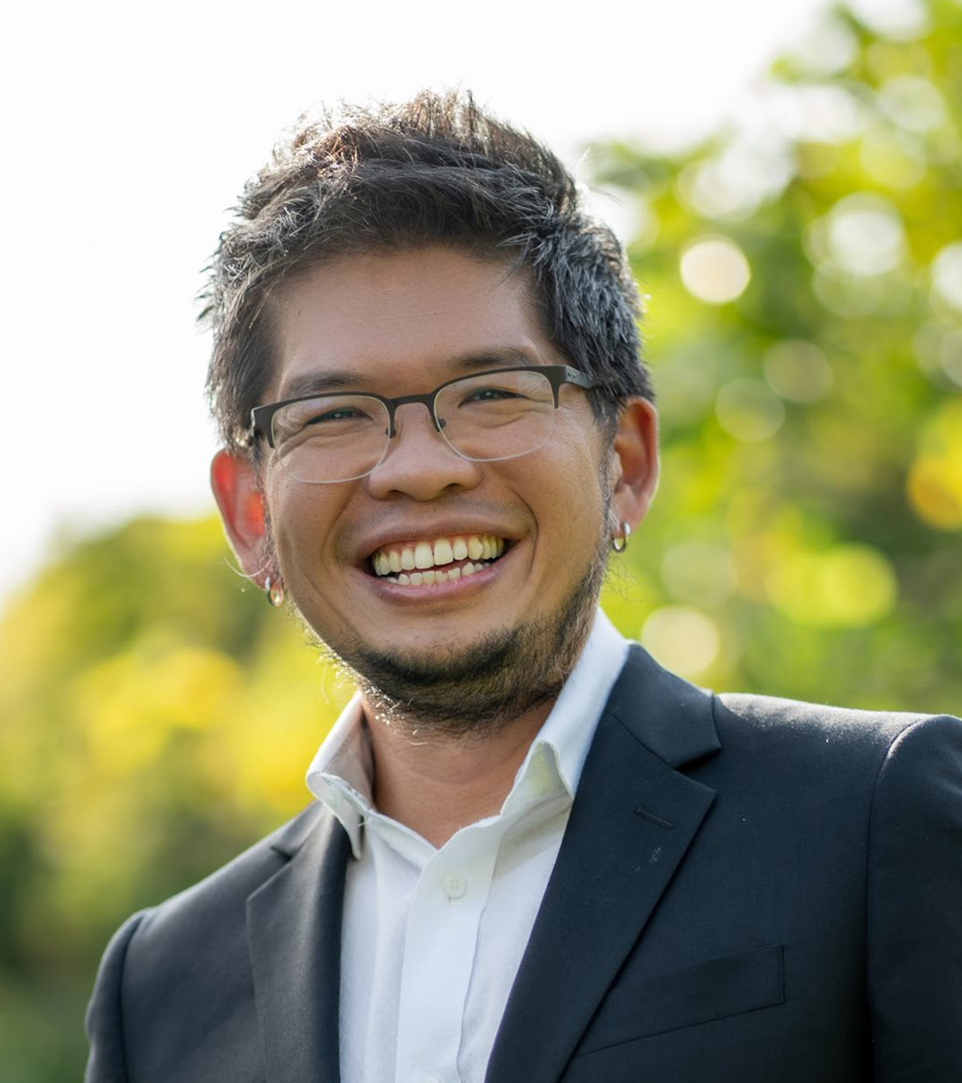
YouTube Founder and Alum on Campus
Notes:
Steve Chen on campus
He wasn’t in the Olympics, but alum and YouTube co-founder Steve Chen certainly helped millions of people around the world share videos about the games. The Grainger College of Engineering had one of their signature “Conversations” events where Steve shared insights from his journey from Illinois student to tech innovator. He offered a firsthand account of the entrepreneurial path that led to YouTube’s creation. Grainger has a video up, and I encourage you to watch it if you have a few minutes. He is a powerful example of how an Illinois education and a big idea can change the world. I’ll ask Jeff and Marla to share the link with you after this meeting.
On that note, I’ll end my comments and let you get on with the important business at hand.
Once again, welcome to Urbana!

