Slide 1
USC: who we are – what we do – what we want
UNIVERSITY SENATES CONFERENCE
What is the USC
Who we are
What we want
Celest Weuve, USC Chair
September 21, 2023

Slide 2
What is the USC?
20 member committee:
3 from UIS
7 from UIC (1 to be seated)
10 from UIUC (1 to be seated)
Each member is elected for a 3-year term by their respective Senate
Individuals usually serve on their respective Senate in addition to the USC – especially the Chairs of the Senate Executive Committees
Focus is on consultation with University of Illinois System officials on topics affecting the system as a whole
USC Executive Committee
2 Senators from each university with Chair and Vice Chair

Slide 3
Who are the Usc members?

Slide 4
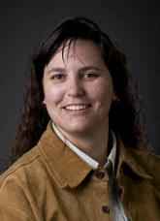
USC chair and Vice-chair
CELEST WEUVE, PHD, ATC, LAT USC Chair
Associate Professor, Athletic Training
Director, School of Health Sciences
Why I love my job:
I get to make the world a better and safer place one student at a time!
JEFFREY ERIC JENKINS
USC Vice-Chair
Professor and Chair of Theatre Studies Director of Graduate Studies in Theatre
Why I love my job:
I appreciate having the opportunity to build bridges between and among global communities as we explore the nature of human experience.

Slide 5
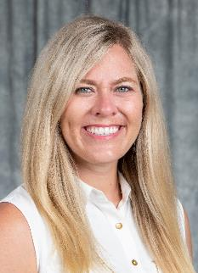
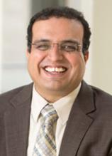
Page 5 USC Members
AMY DUNNING, PHD
Assistant Professor, Mathematics Education
School of Education
Vice-chair of Campus Senate
Why I love my job:
Making a difference in the lives of teachers and students.
SUDEEP SHARMA, PHD
USC Executive Committee
Associate Professor of Management
Department of Management, Marketing, and Operations
Why I love my job:
It gives me the opportunity to do research and teach the topics I am passionate about, such as negotiation and conflict management and the role of personality and emotions in the workplace.

Slide 6
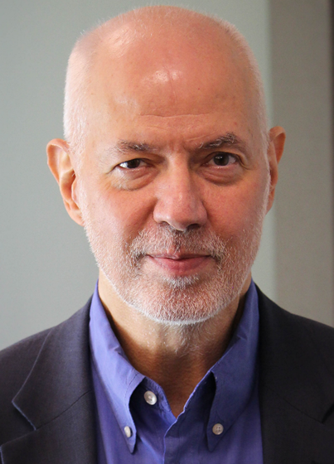
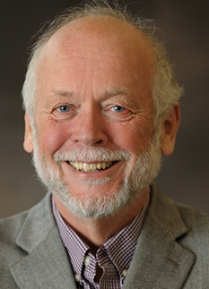
Page 6 USC Members
NICHOLAS C. BURBULES, PHD
USC Executive Committee
Edward William and Jane Marr Gutgsell Professor Department of Education Policy, Organization and Leadership
Why I love my job:
I am always learning. Every class, every project, teaches me something new.
ROY H. CAMPBELL, PHD
Sohaib and Sara Abbasi Professor Emeritus, Computer Department of Computer Science
Why I love my job:
Inspiration of creating and teaching computing innovation that benefits humanity.

Slide 7
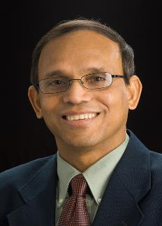
Page 7 USC Members
JOHN DALLESASSE, PHD
Professor, Electrical and Computer Engineering
Associate Dean for Facilities and Capital Planning, Grainger College of Engineering
Why I love my job:
Mentoring graduate students and teaching undergraduates to enable the next generation of progress.
PRASANTA K. KALITA, PHD, FELLOW ASABE, ISAE
Professor, Soil & Water Resources Engineering
Distinguished Teacher Scholar – Agricultural & Biological Engineering
Why I love my job:
I work to solve food insecurity, water insecurity, climate change adaptation and sustainability, and empowering human resources around the world through research and education.

Slide 8
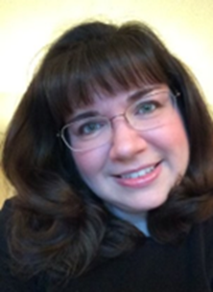
Page 8 USC Members
CAROL LEFF, PHD
Associate Professor Emerita, Political Science
Center for Global Studies and European Union Center
ANGELA LYONS, PHD
Associate Professor, Agricultural and Consumer Economics
Why I love my job: Every day I have the privilege of working with industry, education, and government to design practical, sustainable, and innovative solutions aimed at enhancing economic inclusion and financially empowering families and communities throughout the state, nationally, and around the world!

Slide 9
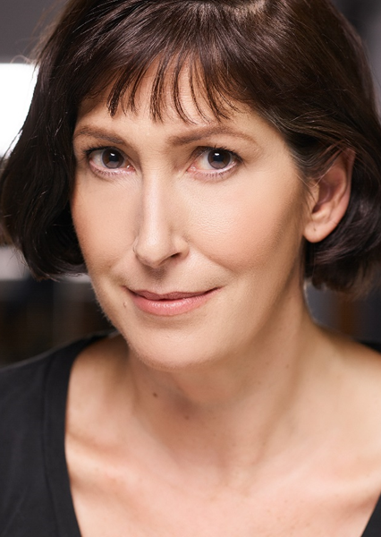
Page 9 USC Members
CAROL SYMES, PHD
Professor, History
Why I love my job:
Every year, I get to go back to school for the first time.
JOYCE TOLLIVER, PHD
Associate Professor and Director
Translation & Interpreting Studies and Spanish & Portuguese
Why I love my job:
Constantly exploring new ideas and helping others to do the same.

Slide 10
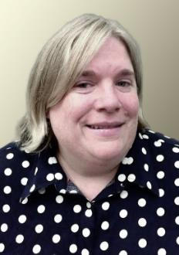
Page 10 USC Members
LARRY H. DANZIGER, PHARMD
UIC Distinguished Professor
Professor of Pharmacy and Medicine
Director of the Infectious Diseases Pharmacotherapy Section, Department of Pharmacy Practice
Executive Director, CADRE
Why I love my job:
I enjoy teaching and research sharing knowledge with other people.
SANDRA DE GROOTE, MLIS, MED, AHIP
USC Executive Committee
Professor, Library and Information Science
Head, Assessment and Scholarly Communications, University Library
Why I love my job:
Connecting people with resources and technology, assisting their success.

Slide 11
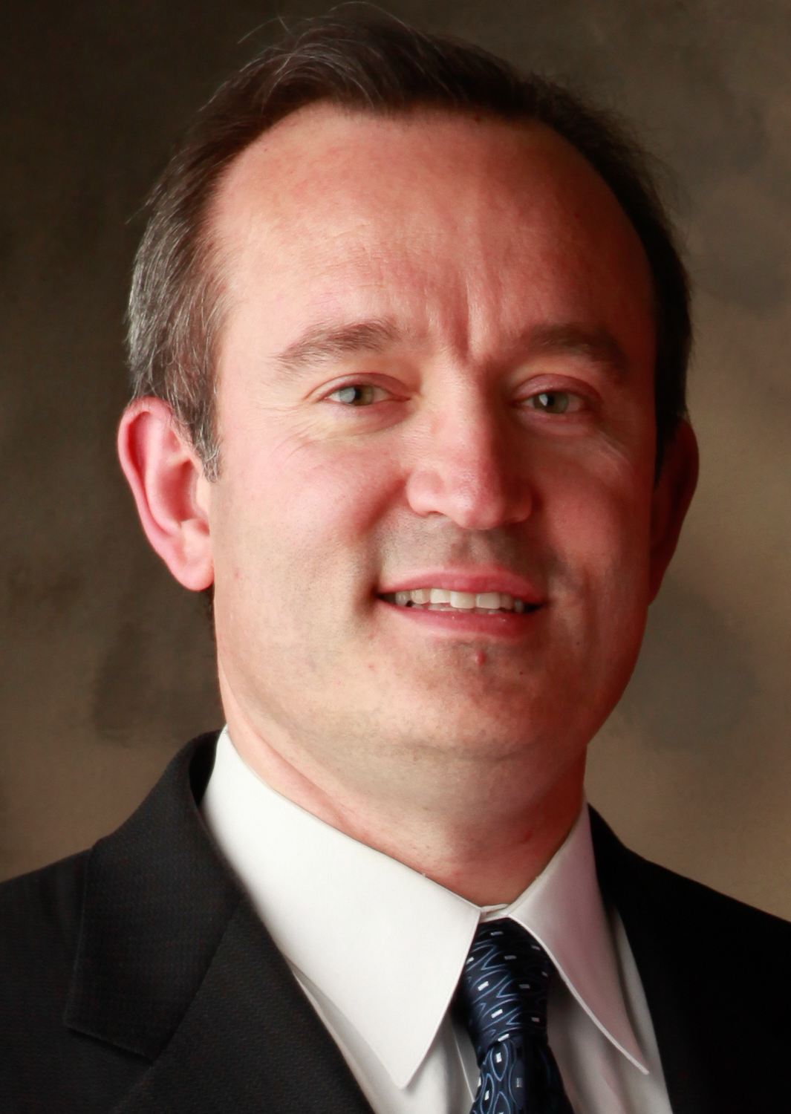
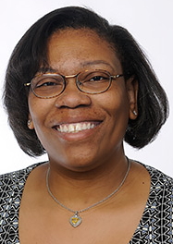
Page 11 USC Members
DANILO ERRICOLO, PHD
Professor, Director of Graduate Studies
Adjunct Professor, Bioengineering
Department of Electrical and Computer Engineering
Director of the Andrew Electromagnetics Laboratory
KEIA HOBBS, MD, FAAFP
Assistant Professor of Clinical Family Medicine
Assistant Dean for Graduate Medical Education Associate Director of Medical Student Education
Why I love my job: I share a passion for teaching and inspiring other learners with the mission of reducing health disparities and caring for underserved populations. (UIC College of Medicine Website)

Slide 12
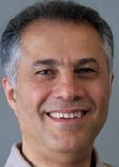
Page 12 USC Members
FARID PEIRAVIAN, PHD
Clinical Assistant Professor
Director, Active Transport and Geomatics Labs
Civil, Materials and Environmental Engineering
DONALD J. WINK, PHD
USC Executive Committee
Professor, Chemistry
Academic Chair, Learning Sciences Research Institute
Why I love my job:
My work has been oriented towards teaching…I’m especially proud to work with our undergraduates — they’re a really cool bunch. (UIC Today: October 22, 2013)

Slide 13
Page 13 USC Members
DAVID PERRYN
USC Administrative Aide
Why I love my job:
I have the opportunity to help achieve meaningful results, working with others nearby or across the state, in support of shared governance and purpose.

Slide 14
What do the Members want?

Slide 15
List of what the USC wants
TOOLS AND RESOURCES
To teach our students
To complete the other aspects of our job
INSTITUTIONAL SUPPORT AND PROTECTION AS WE DO OUR JOB
CONNECTIONS
Students
Colleagues (campus and system)
Community
Board of Trustees

Slide 16
Questions?
Celest Weuve
USC Chair
Email: cweuv2@uis.edu
Phone: 217.206.8414
David Perryn
Administrative Aide
Email: dperryn@uillinois.edu
Phone: 217.300.7448

