Slide 1
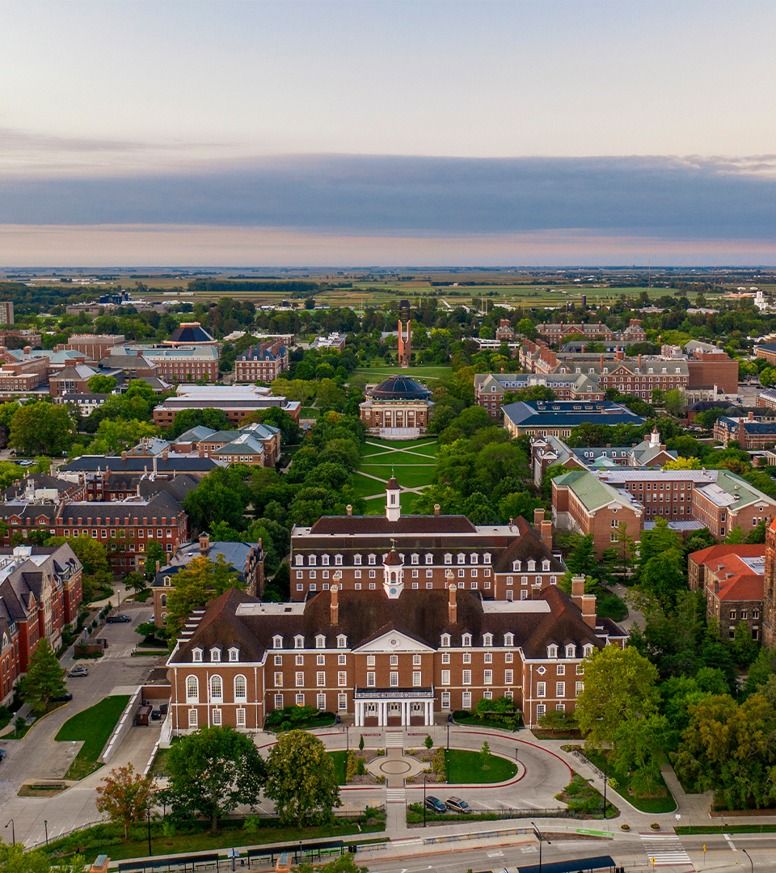
Welcome to Urbana

Slide 2

Our
New Class

Slide 3

Affordable, Accessible, Achievable

Slide 4
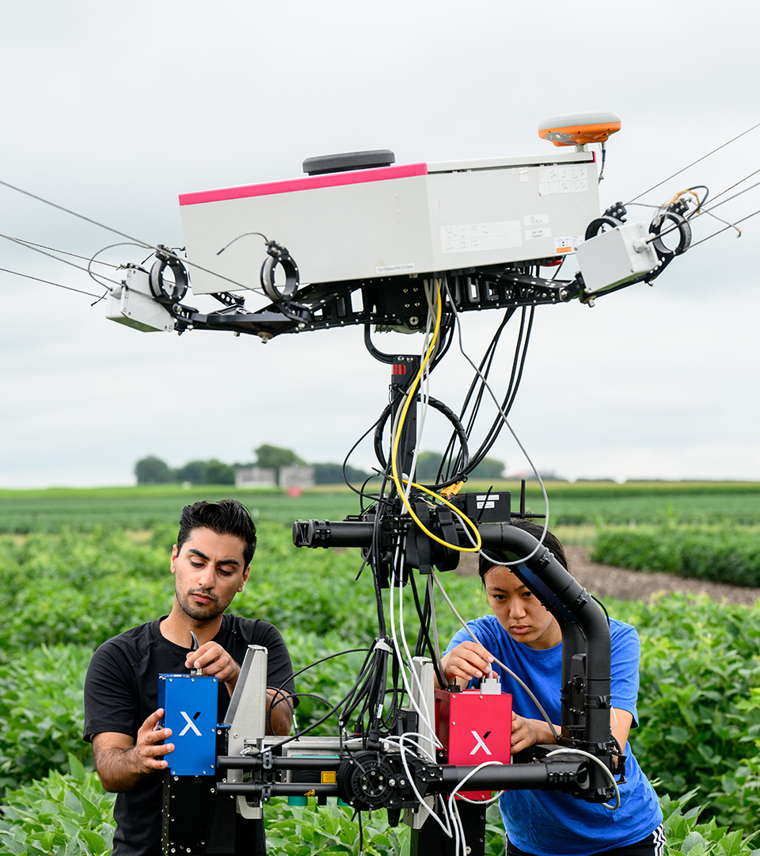
Boldly Driving Discovery and Innovation

Slide 5
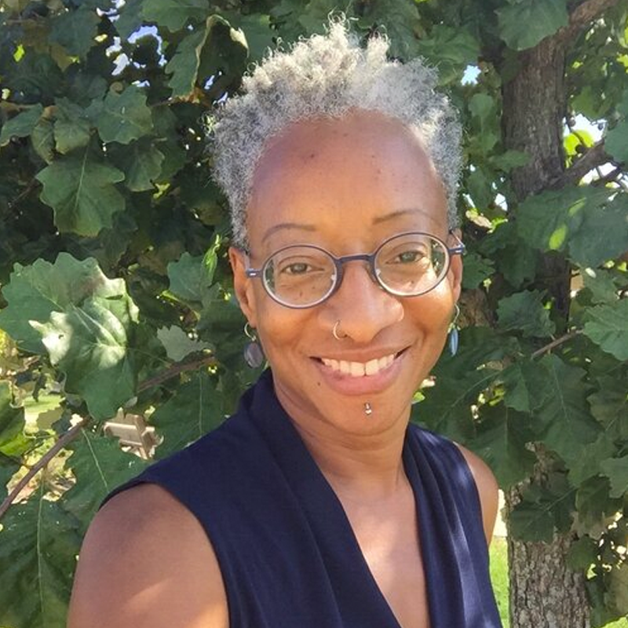
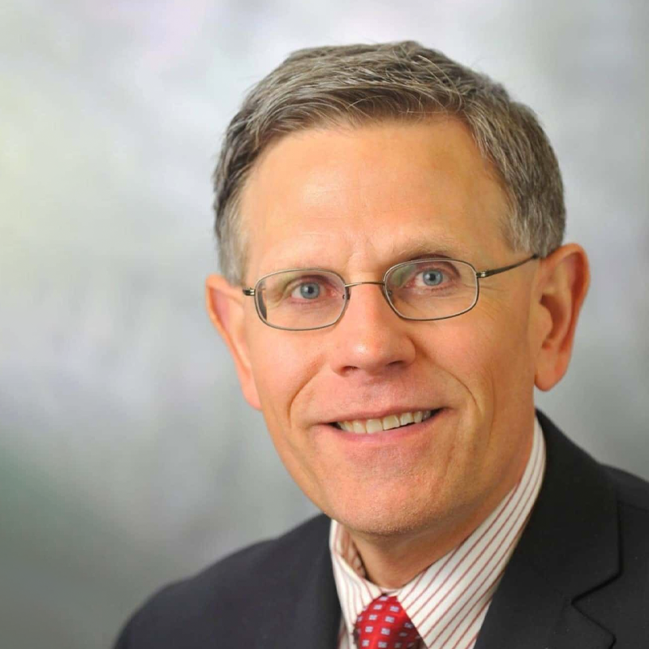
Boldly
Transdisciplinary
Cynthia Oliver
Special Advisor to the Chancellor for Arts Integration
Kelvin Droegemeier
Special Advisor to the Chancellor for Science and Policy

Slide 6
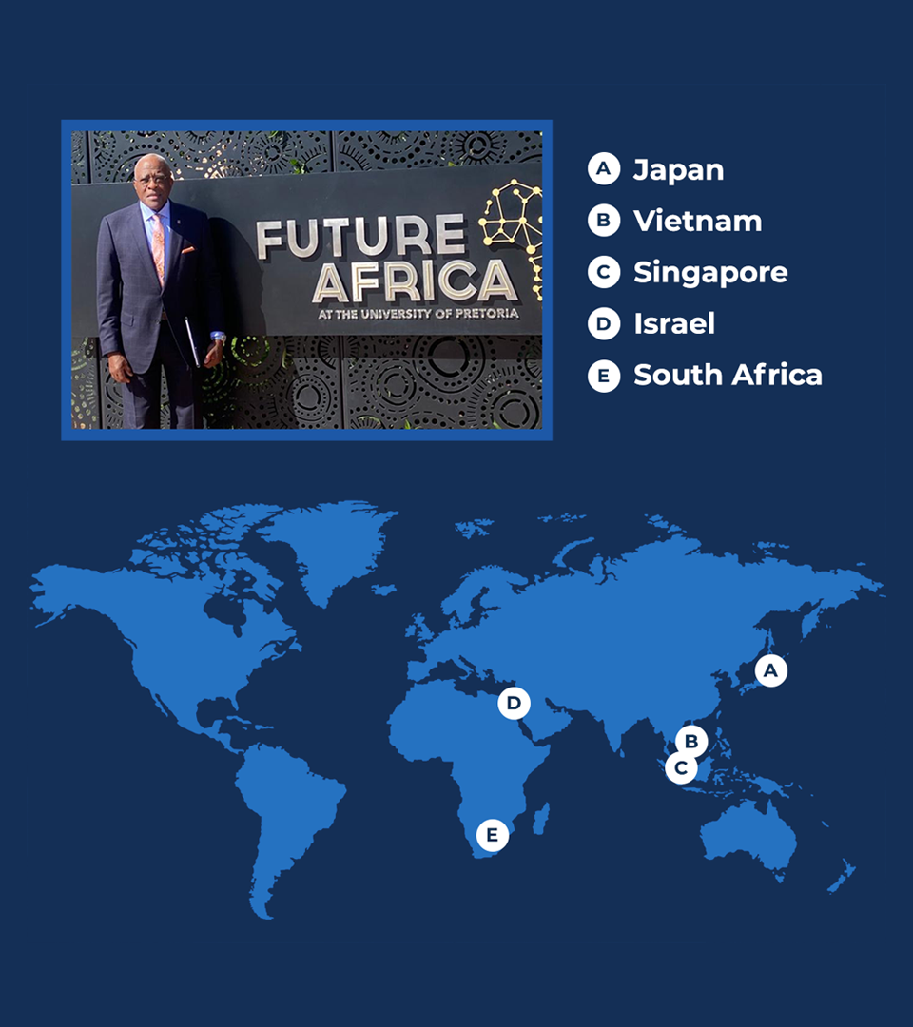
Reconnecting International Partners

Slide 7
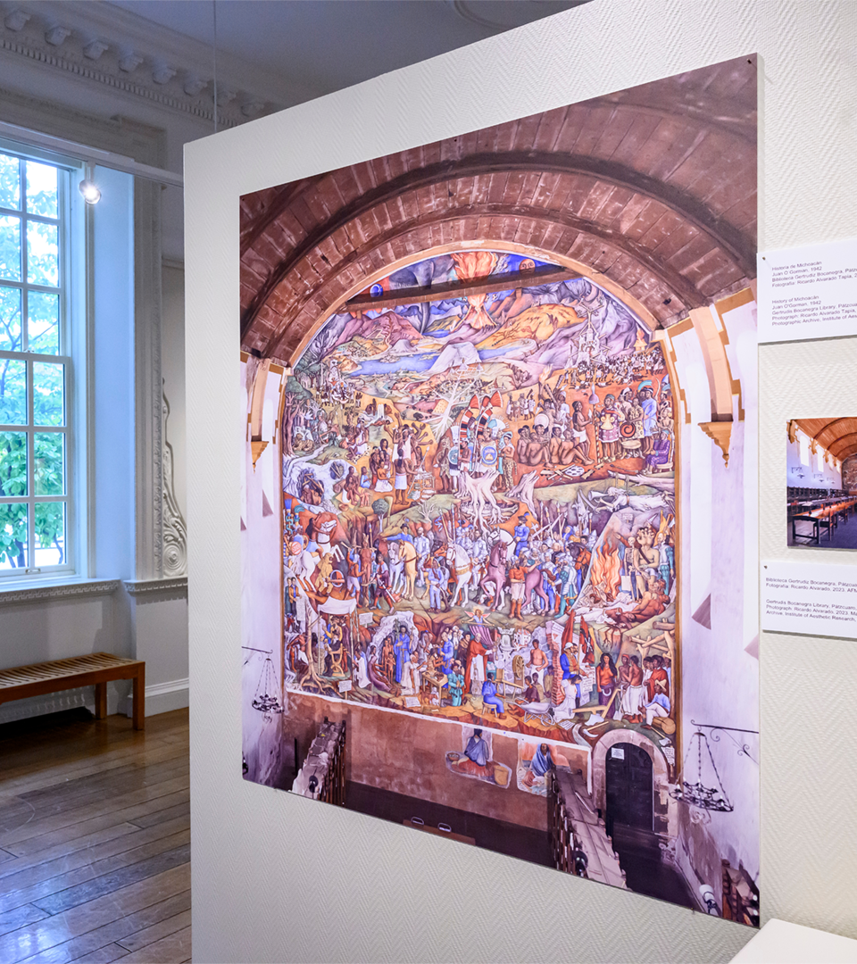
Expanding
Horizons

Slide 8
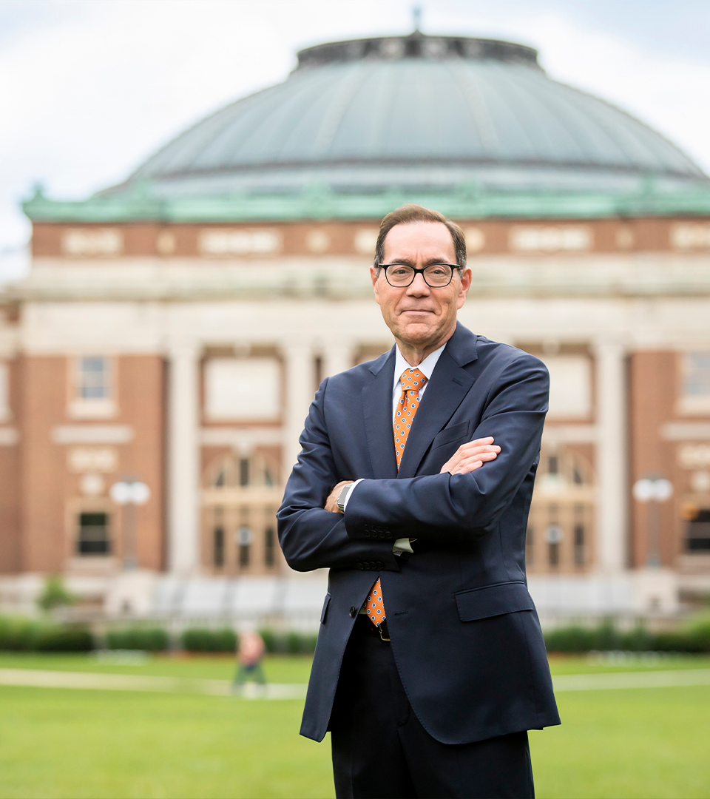
Visionary Leadership
John Coleman
Vice Chancellor for Academic Affairs and Provost

Slide 9

Nationally Recognized Excellence

Slide 10
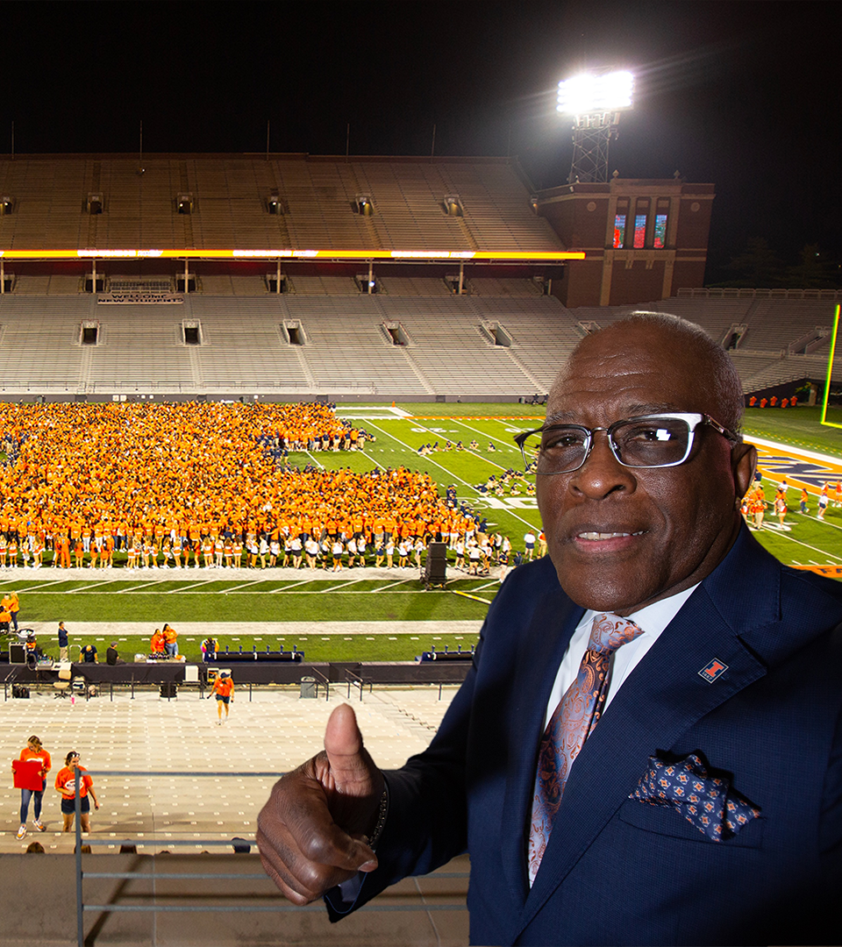
Welcome to Urbana

