Slide 1
REMARKS TO THE BOARD OF TRUSTEES
REMARKS TO THE BOARD OF TRUSTEES
President Tim Killeen
September 21, 2023
Notes:
Thank you, Chairman Edwards
At this time, I would like to introduce our treasurer: LESTER H. MCKEEVER, JR., partner at Mitchell-Titus accounting firm in Chicago.
Also:
Chancellor and Vice President ROBERT JONES from Urbana;
Chancellor and Vice President MARIE LYNN MIRANDA from Chicago;
Chancellor and Vice President JANET GOOCH from Springfield.
And the other university officers and staff:
University Counsel THOMAS BEARROWS;
Vice President/Chief Financial Officer and Comptroller PAUL ELLINGER;
Executive Vice President and Vice President for Academic Affairs NICHOLAS JONES;
Vice President of External Relations and Communications ADRIENNE NAZON;
Vice President for Economic Development and Innovation JAY WALSH;
Secretary of the Board of Trustees and the University JEFFREY STEIN.
Representing the University Senates Conference, CAROL LEFF, associate professor emerita of political science;
Representing the Urbana Senate: DAVID DALPIAZ, teaching associate professor, Department of Computer Science;
Representing the Academic Professional Staff: LISA MERRIFIELD, Illinois Extension Community and Economic Development specialist, Urbana.
Also joining us via the webcast:
Representing the Chicago Senate: BENET DeBERRY-SPENCE, professor, Marketing, College of Business Administration;
Also joining us via the livestream is SANDRA DeGROOTE, professor & head, Assessment & Scholarly Communications, University Library and Chair of the UIC Senate Executive Committee;
Representing the Springfield Senate, (NO REPRESENTATIVE AT THIS TIME).
We are just a few weeks into one of the most exciting and rewarding times of every year on any university campus, with faculty and students in class for the new academic year.
It never fails to amaze me how much power and promise there is in the start of a new year – like a wave of creative energy sweeping across our campuses, kicked off with the turn of the calendar.
There is no feeling, no sense of the great things that are possible, quite like it.
We change the world here – one student, one life, one family, one innovative discovery at a time. And that is multiplied again and again to achieve a scale that has broad impact.

Slide 2
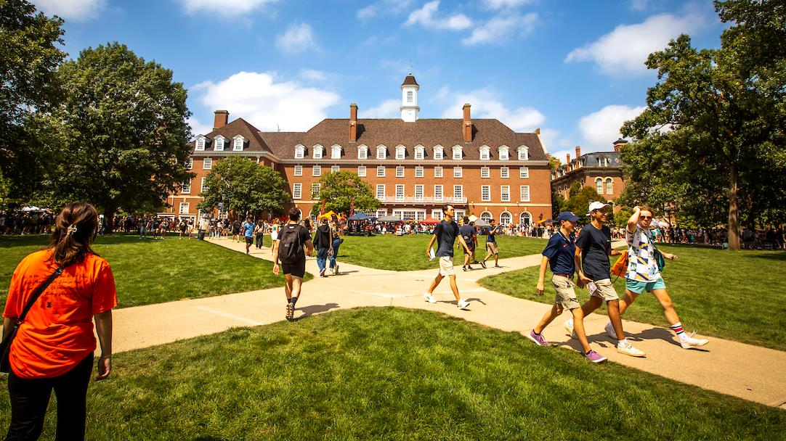
ON THE QUAD
Notes:
There are many, many things I love about being president of this great university system, but high on that list is walking out of my office in Henry Hall and onto the Quad on a busy fall day … crowded with students, sometimes a few with their families … thinking, reading, studying, making new friends … and almost always experiencing pure wonder … and joy.
What a reminder this is of the core mission here, seeing all that promise and possibility, whether it’s on the Quad here in Urbana, on the renovated East Campus Quad in Chicago or at the new Student Union in Springfield.
I would like to take a minute before I continue, to visualize what that looks like at our universities. These wonderful photos are from the beginning of the academic year here in Urbana-Champaign, in Chicago and in Springfield.

Slide 3

START OF FALL VIDEO
Notes:
That’s just incredible, isn’t it? For me, it never, ever gets old.
We are making good on our promise to provide those students with a world-class education, the kind that paves the way to life-changing opportunities and the tools with which to be fully engaged citizens of our state and our country.

Slide 4

University of Illinois system new records
NEW RECORDS
13,231
60,031
FRESHMAN ENROLLMENT
UNDERGRADUATE ENROLLMENT
Notes:
The proof is right out there, at our universities, right now.
Across the system this fall, we have more new freshmen than ever before – 13,231 in all.
We also have record-high undergraduate enrollment – 60,013 students, and almost 80 percent of them from Illinois.
I’ve talked about it before, but it matters so much to Illinois that we operate at this scale, that we provide these students a great education and the kinds of economic and social opportunities that will keep them here.
Our graduates – in engineering, business, medicine, the sciences, history, law, art, music and so many more disciplines – are key ingredients in the recipe for the sustainable economy and equitable society our state and the world need for the decades ahead.
We have also been working to build better pathways for transfer students from Illinois’ community colleges, and that work is beginning to pay off.
Here in Urbana, for instance, transfer enrollment increased by 5 percent this fall.
Our overall enrollment dropped by about 100 students from last year’s record 94,861.
That slight decrease was driven by a record number of graduate students completing their degrees – students whose academic progress kicked into high gear after a slowdown during the pandemic.
Chancellor Jones will talk a bit more about Urbana-Champaign’s enrollment, including some impressive successes in key areas.
But let me drill down a bit for you in Chicago and Springfield and offer their chancellors an opportunity to comment, as well.

Slide 5

University of Illinois Chicago statistics
4,647
46%
FRESHMAN ENROLLMENT
FIRST-GENERATION STUDENTS
Notes:
Like the system as a whole, UIC and Chancellor Miranda welcomed the largest incoming freshman class in UIC history, 4,647 students, almost 10 percent more than a year ago.
Forty-six percent are the first in their families to attend college.
African-American and Black enrollment among that incoming freshman class is up 27.9 percent.
That is an incredible jump.
And more than 40 percent of the incoming freshmen at UIC, a federally designated Hispanic-serving institution, are Hispanic.
Chancellor Miranda, can you tell us more about why this success matters to UIC, not to mention to Chicago and our state?

Slide 6

University of Illinois SPRINGFIELD statistics
11%
19%
ENROLLMENT GAIN
ONLINE ENROLLMENT GROWTH
Notes:
In Springfield, overall enrollment grew 11 percent over last fall, including a 5 percent gain in first-time freshmen to 258 students.
UIS also has impressively grown its graduate enrollment – it’s up by a remarkable 28 percent this fall to 2,319.
I’d also add that Chancellor Gooch and her faculty and staff deserve our praise for a major increase in online enrollment, an area that is already a real strength for UIS.
Online enrollment grew by 19 percent this fall -- with a total cohort of just over 1,900 students from 45 states and 74 countries working toward their UIS degrees.
This is a second straight year of healthy growth at UIS, Chancellor Gooch. Can you tell us more about how important this is?

Slide 7
OUTCOMES
OUTCOMES
77%
+70%
GRADUATION RATE
STAY IN ILLINOIS
Notes:
Enrolling these tens of thousands of students, of course, is an undeniable success. I am incredibly proud of all of those who work in admissions and elsewhere across our universities who made this happen.
But we don’t measure our success only at the opening bell every fall. Outcomes matter, and the U of I System is performing for students and families there, too.
Systemwide, our graduation rate is 77 percent – that’s 13 percent better than the national average for four-year public colleges and universities.
And, just as important, well over 70 percent of our graduates stay in Illinois. They represent our future – the doctors, nurses, engineers, business leaders, entrepreneurs, educators, public servants and engaged citizens of a thriving state.

Slide 8
Thank you
Thank you
Notes:
Our bottom line: Students and their families continue to vote with their feet -- and I’d add with our growing online presence, their laptops and their phones -- in favor of a U of I System education.
Thank you.

